Slide 1
Innovation Through Simulation: Inspiring the Next Generation of Workers.
OIC of Wilson Presents

Slide 2
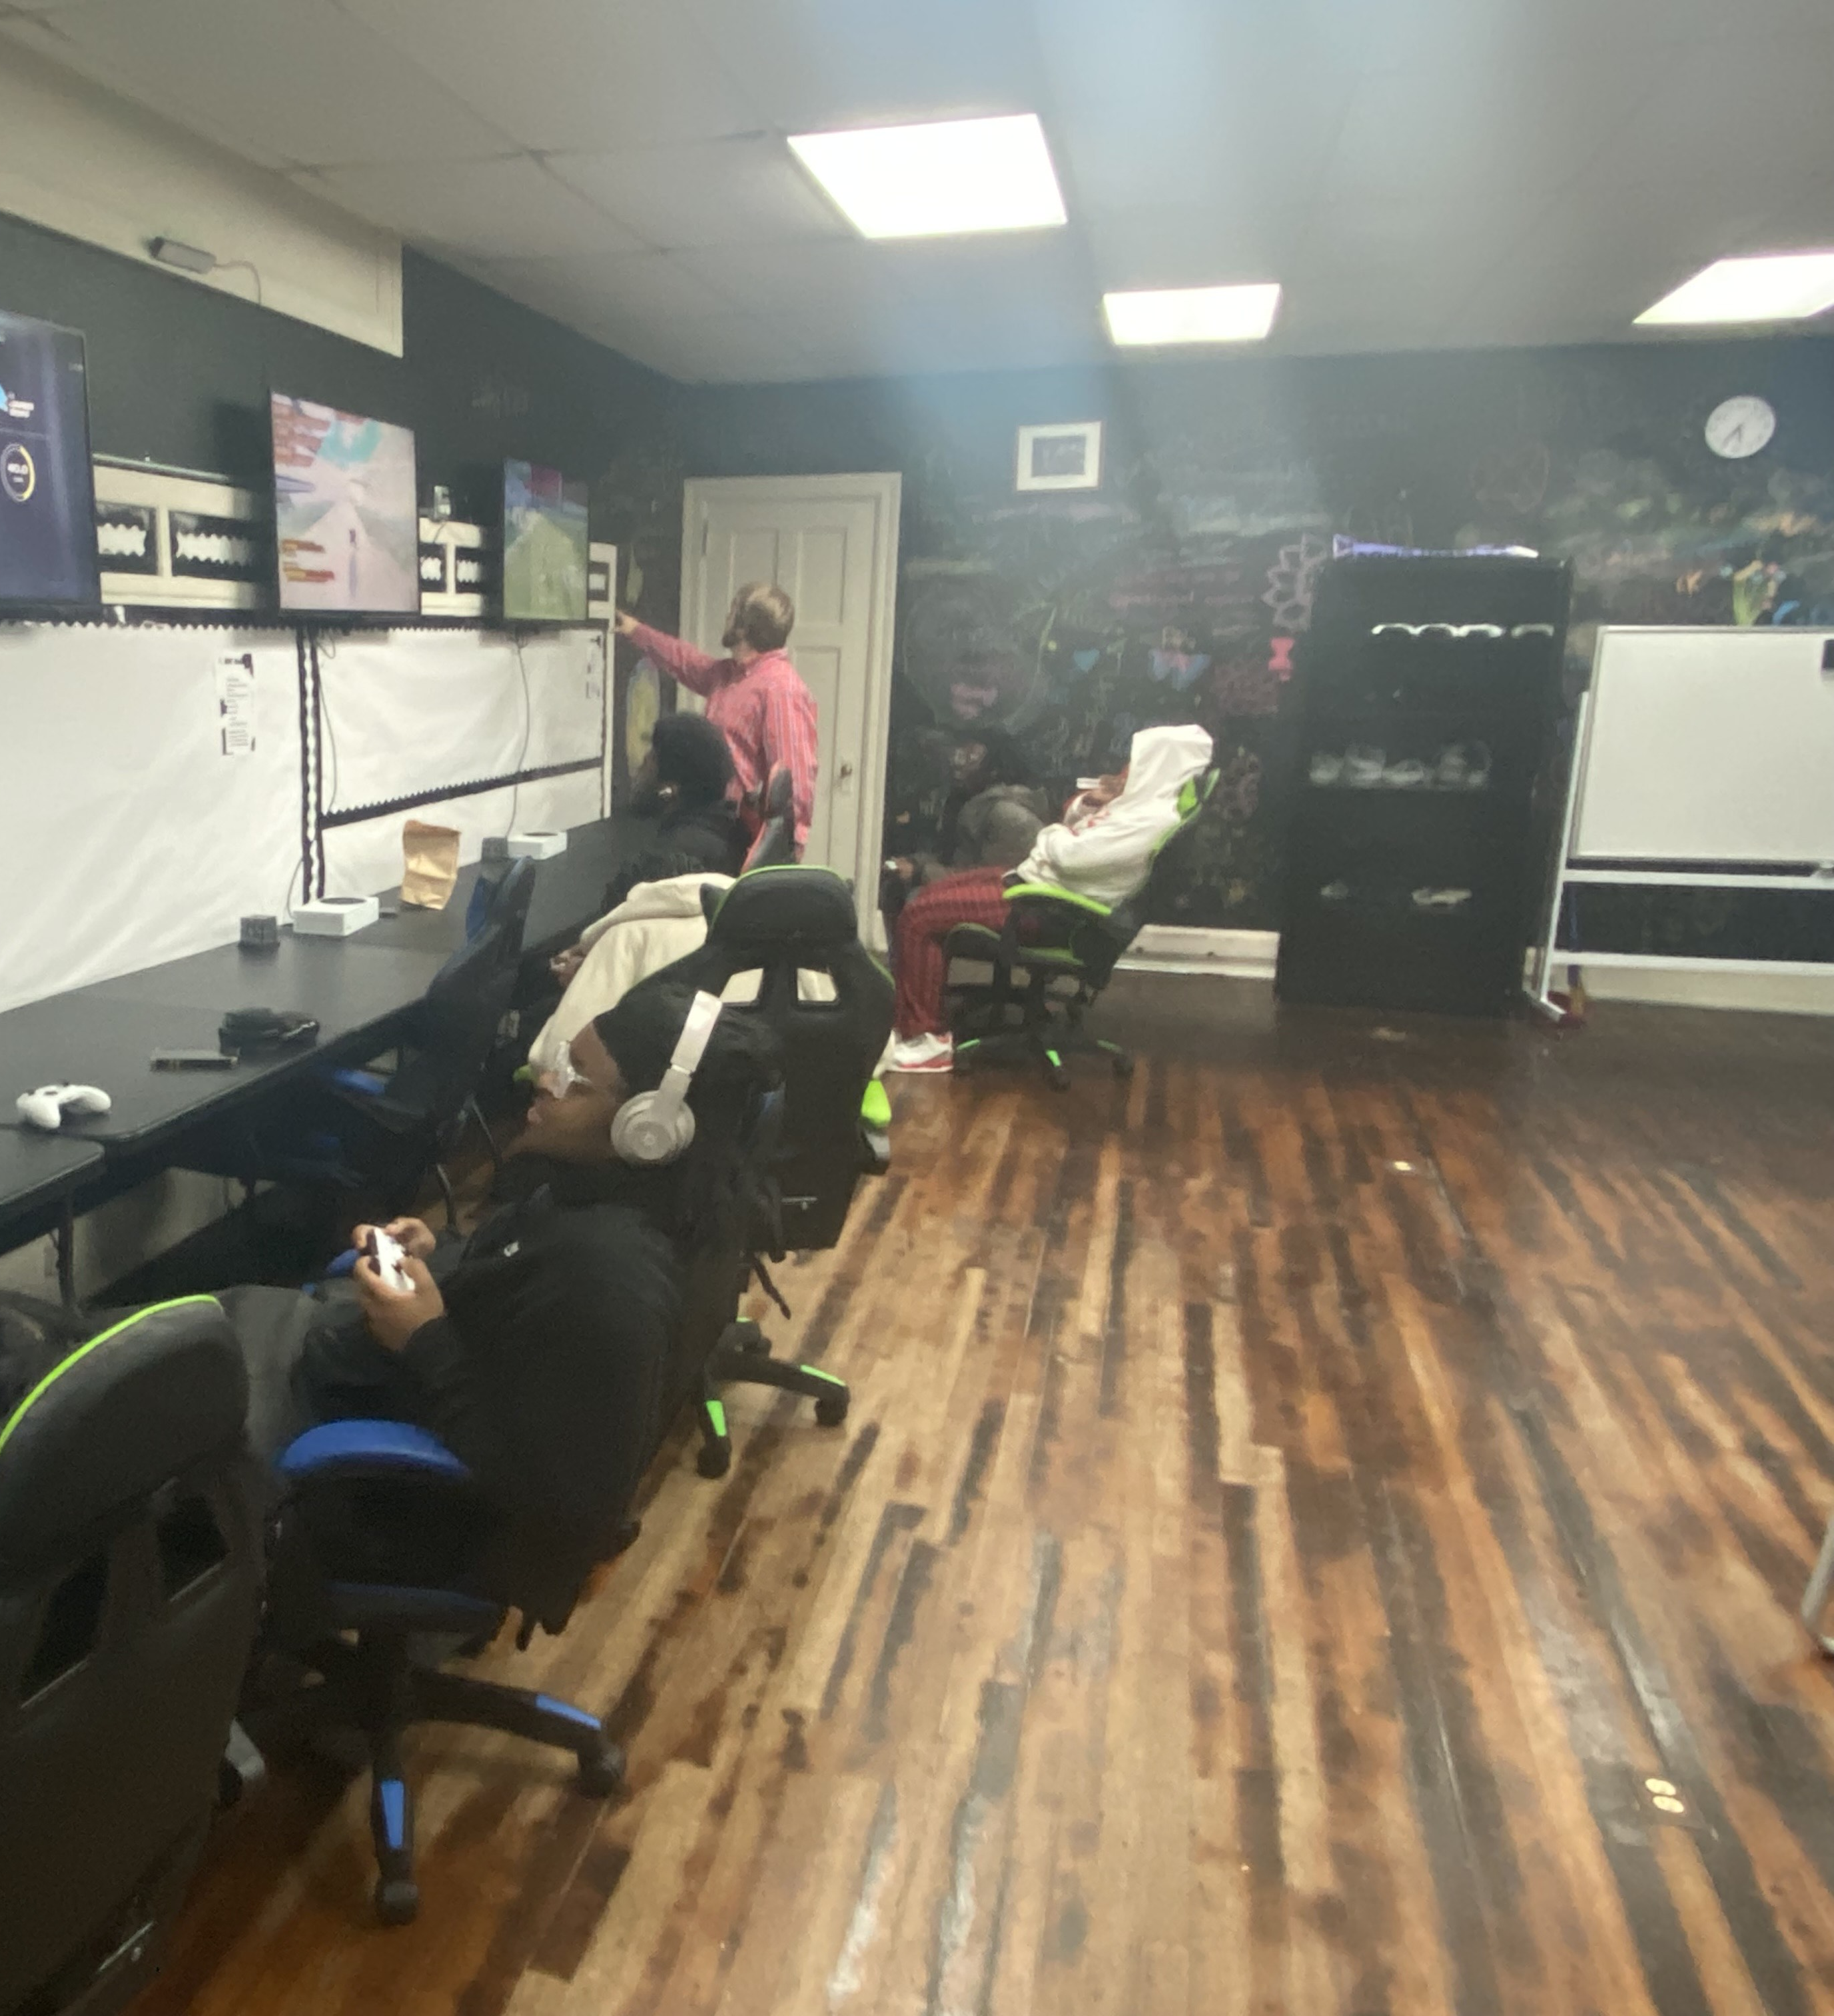
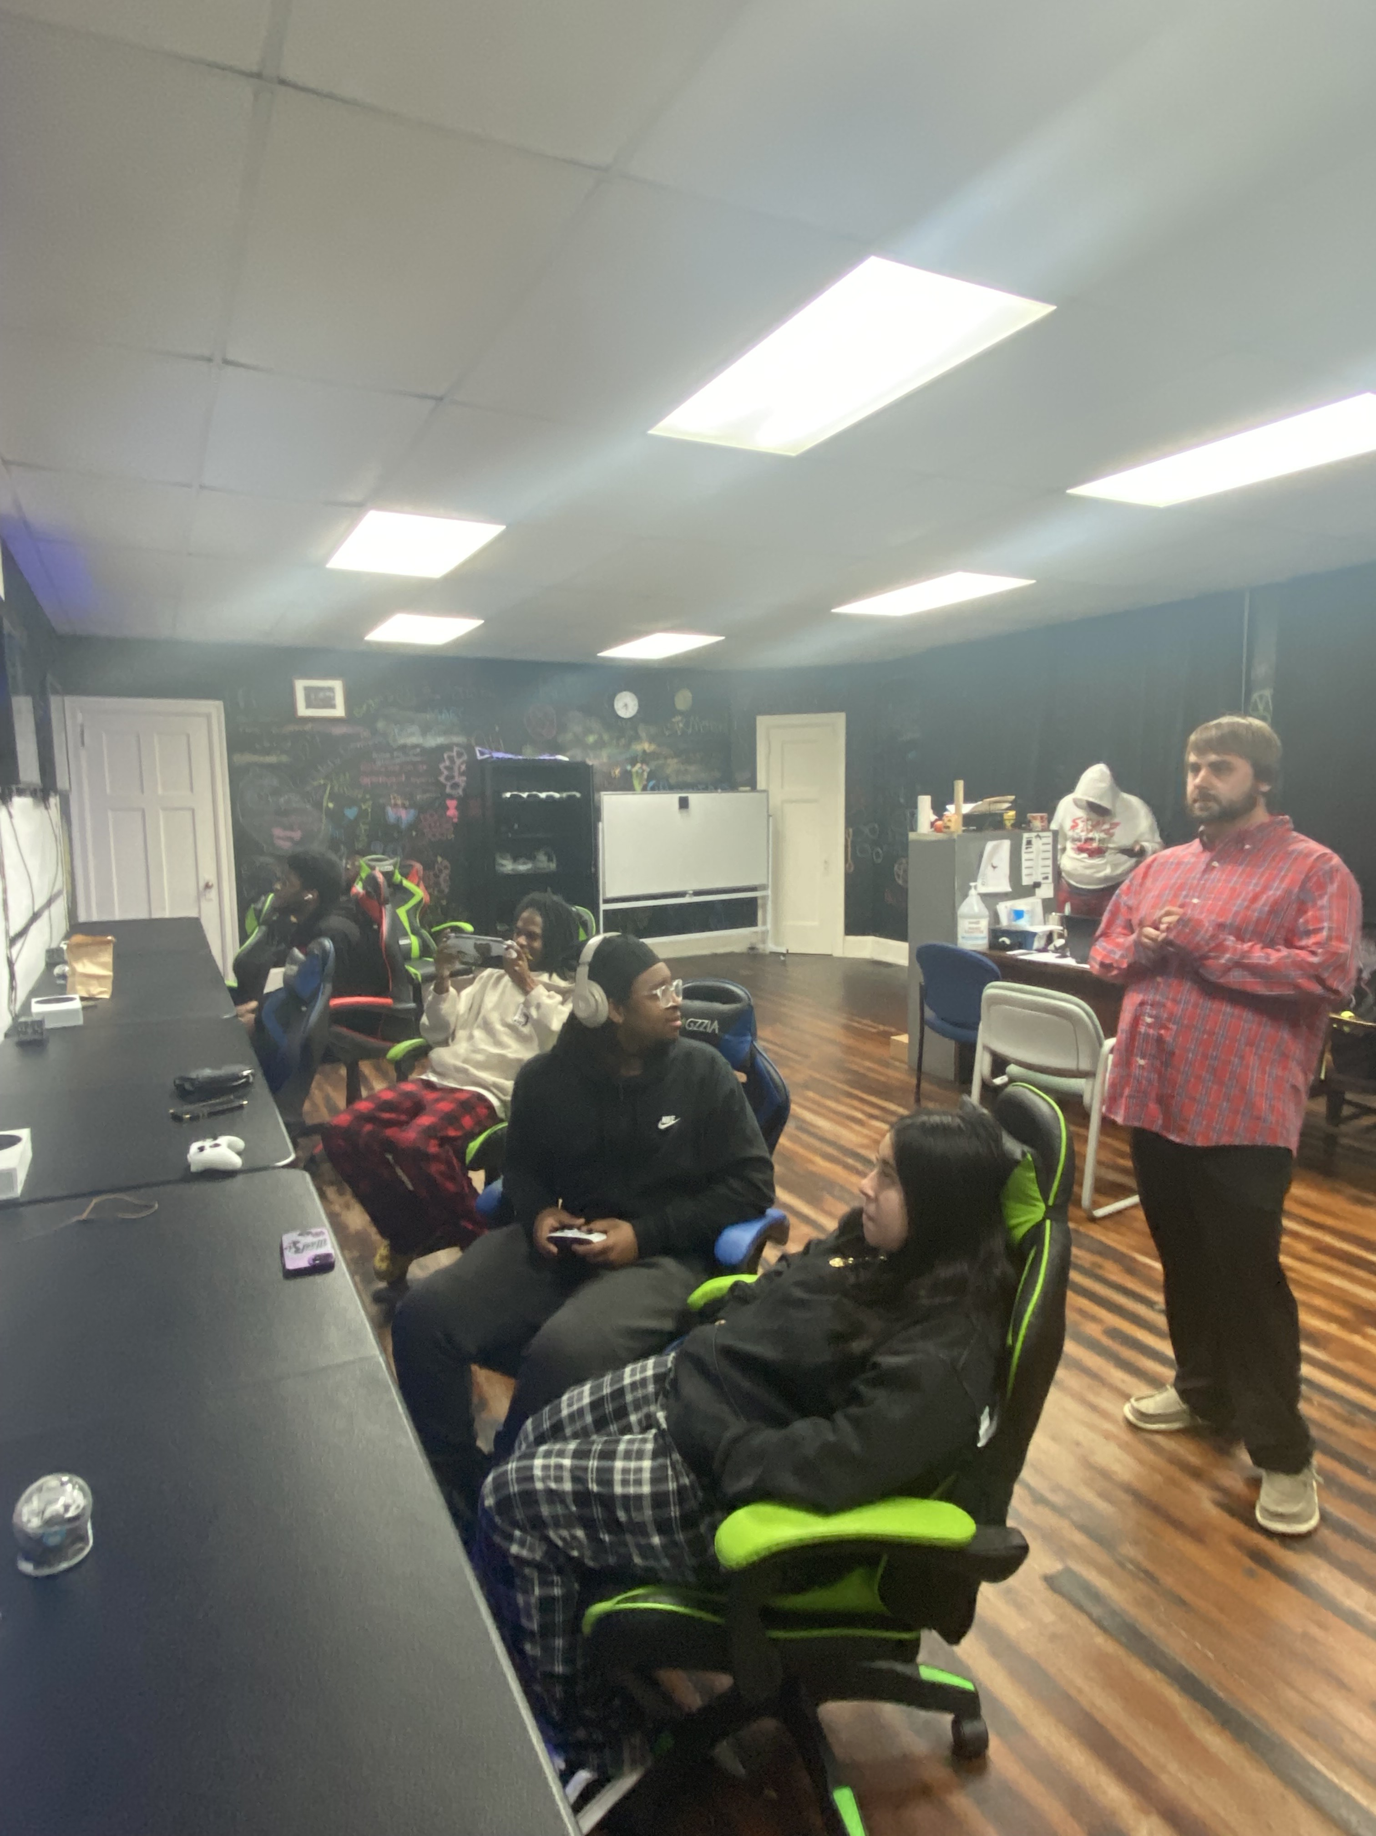
LEARNING DOES NOT HAVE BE BORING!!!! Interactive learning coupled with repetition, helps the skills stick to the participant like glue.
Together, we can empower the NextGen of employees to succeed in the modern workplace.

Slide 3
Gaming as a learning instrument?!
Gaming promotes problem solving, strategic planning, and the ability to adapt and innovate on the fly. With time winding down, we need to focus and execute.
What better way to learn then practice what you need to do through simulation? A hands-on approach is the fastest way to pick up the necessary reps to get you conditioned and in-shape for the employer . By use of simulation through VR or console, you build confidence, valuable skills, and gain an understanding of the profession and the responsibilities that come with it.

Slide 4
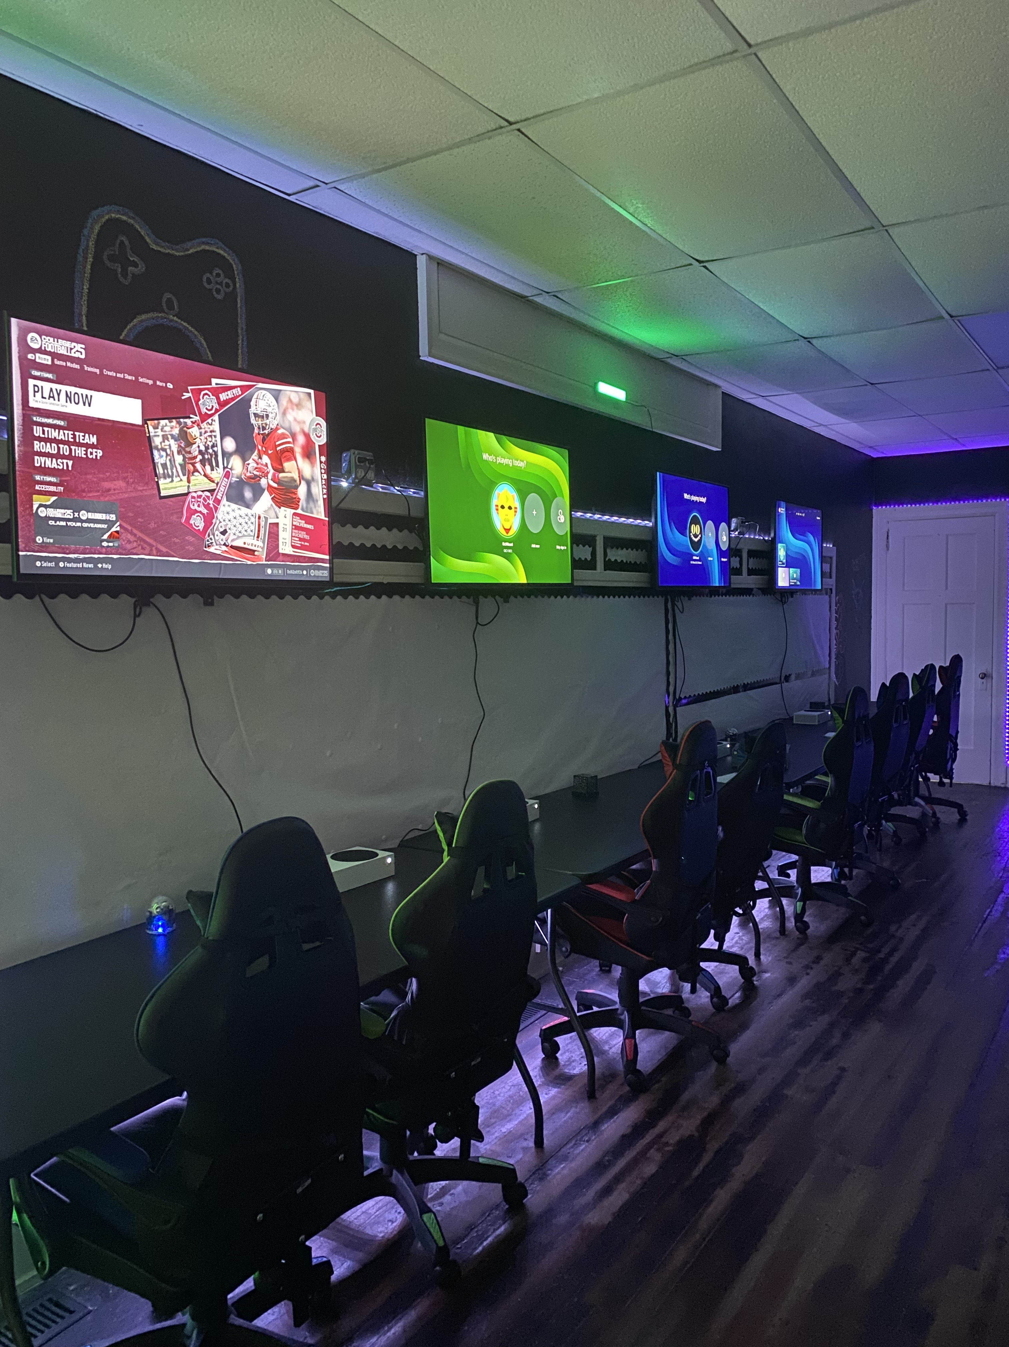
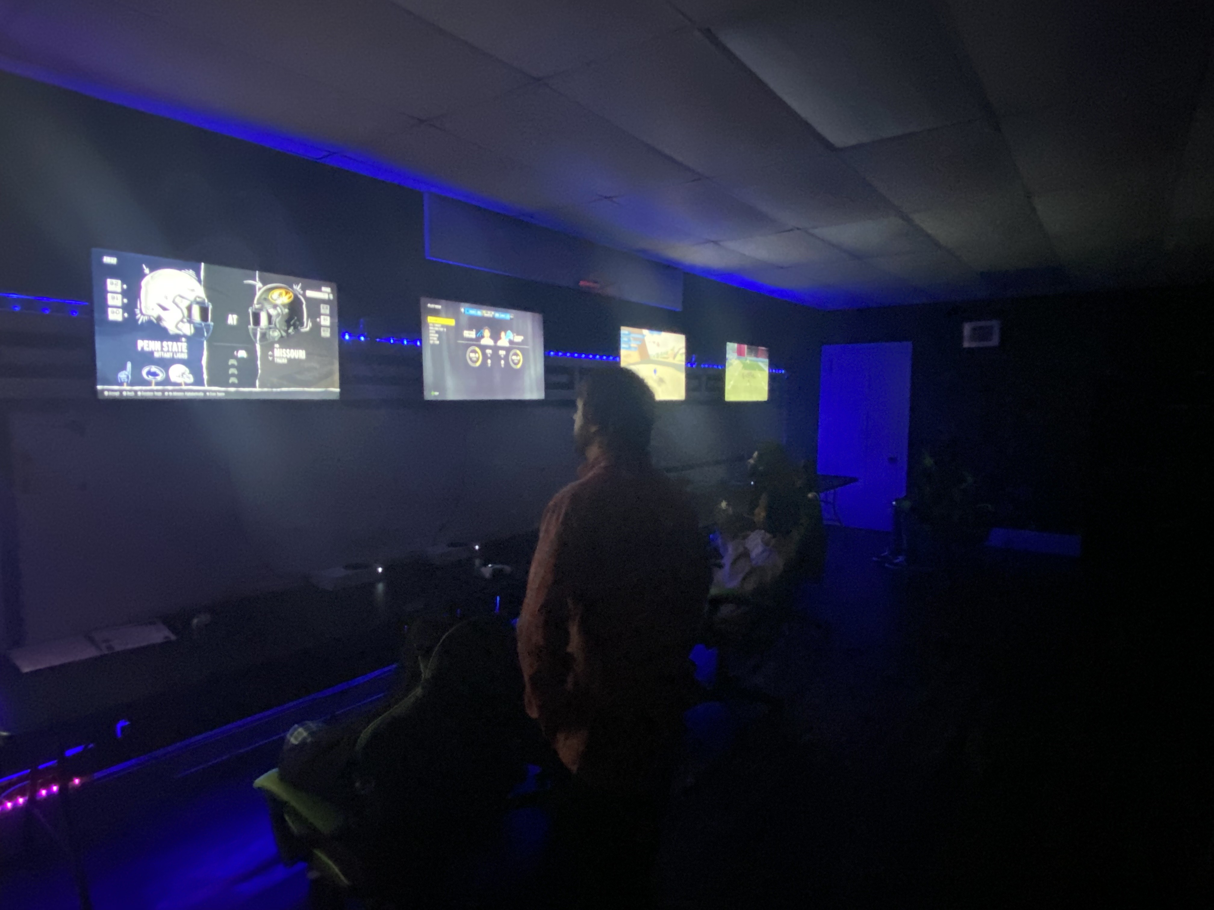
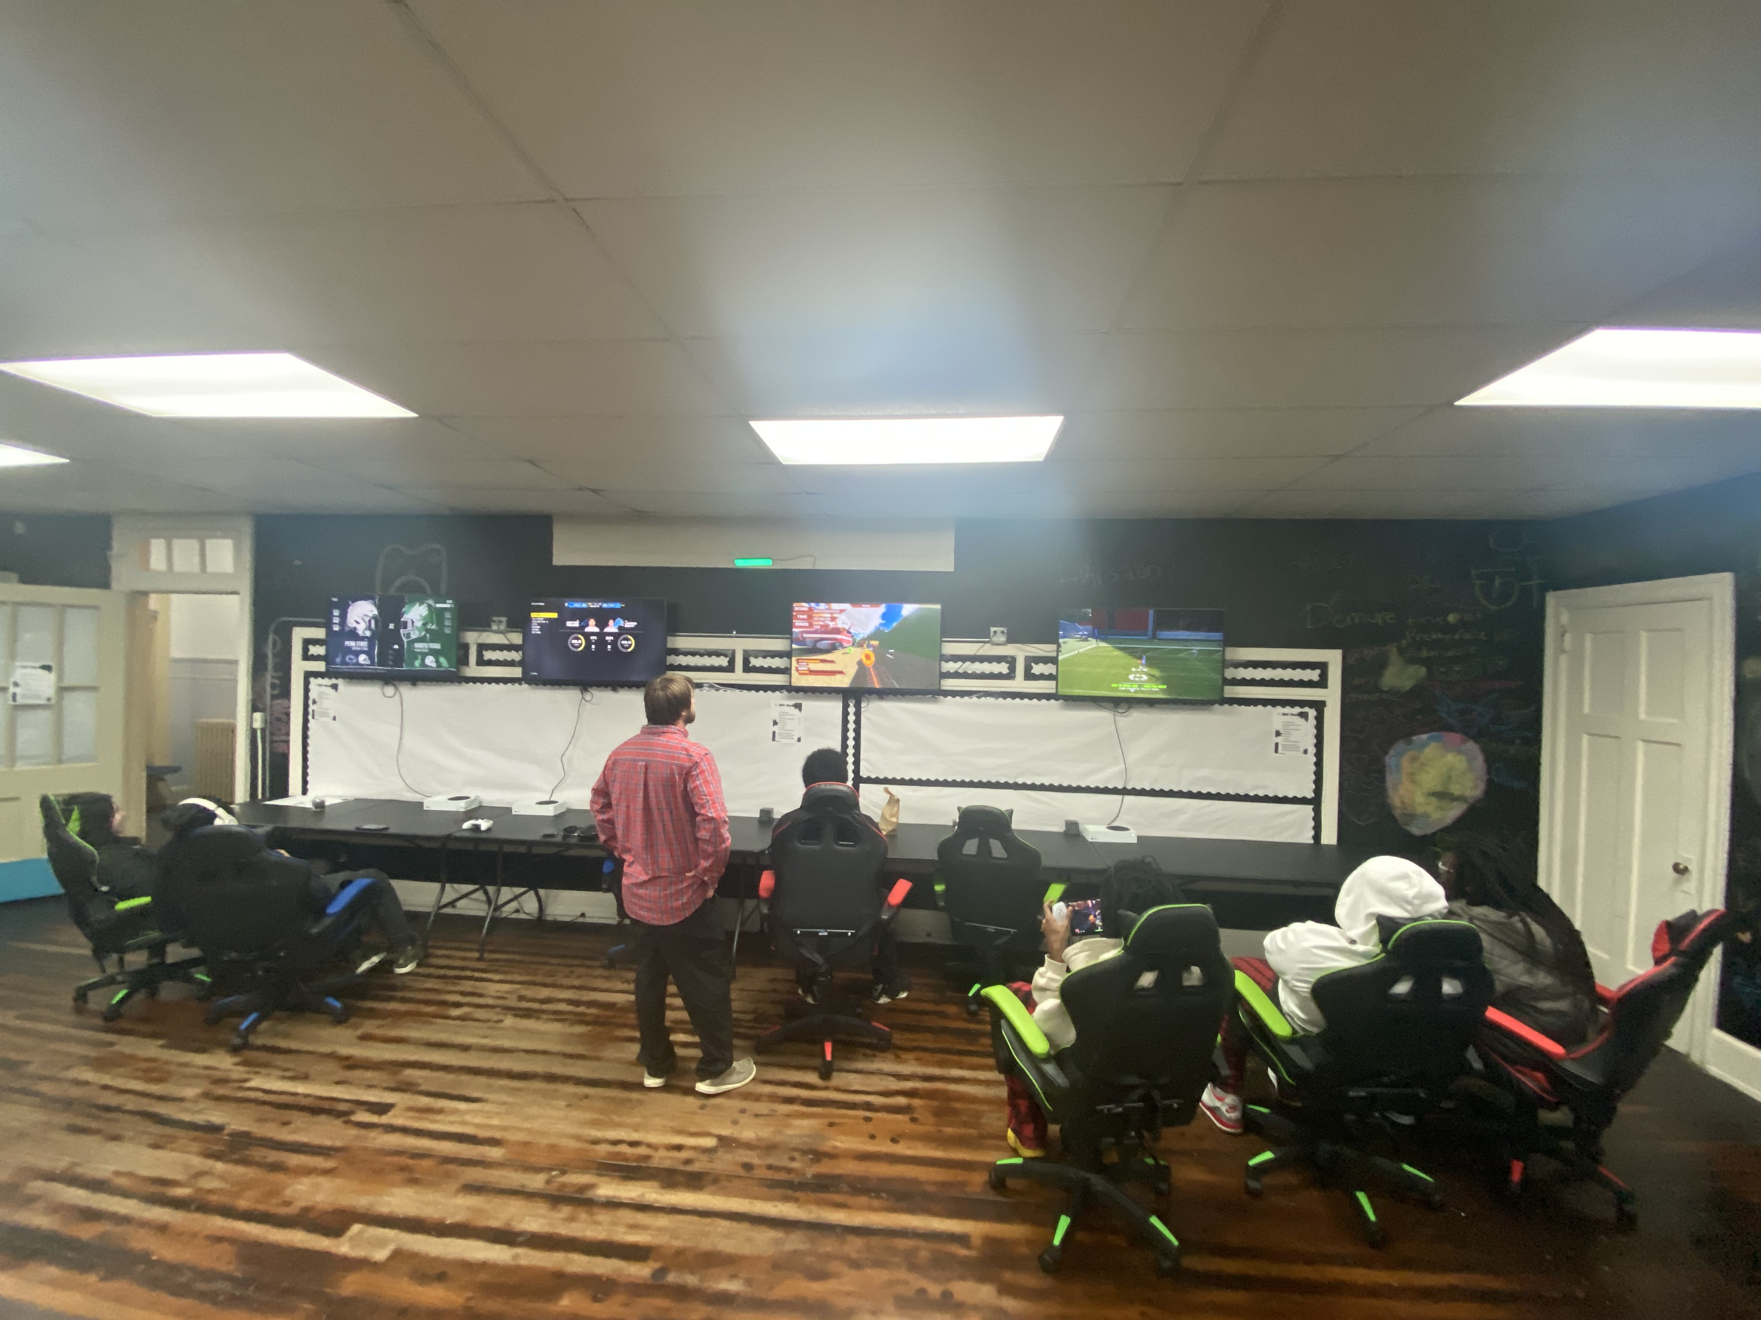
Helping People Help Themselves

Slide 5
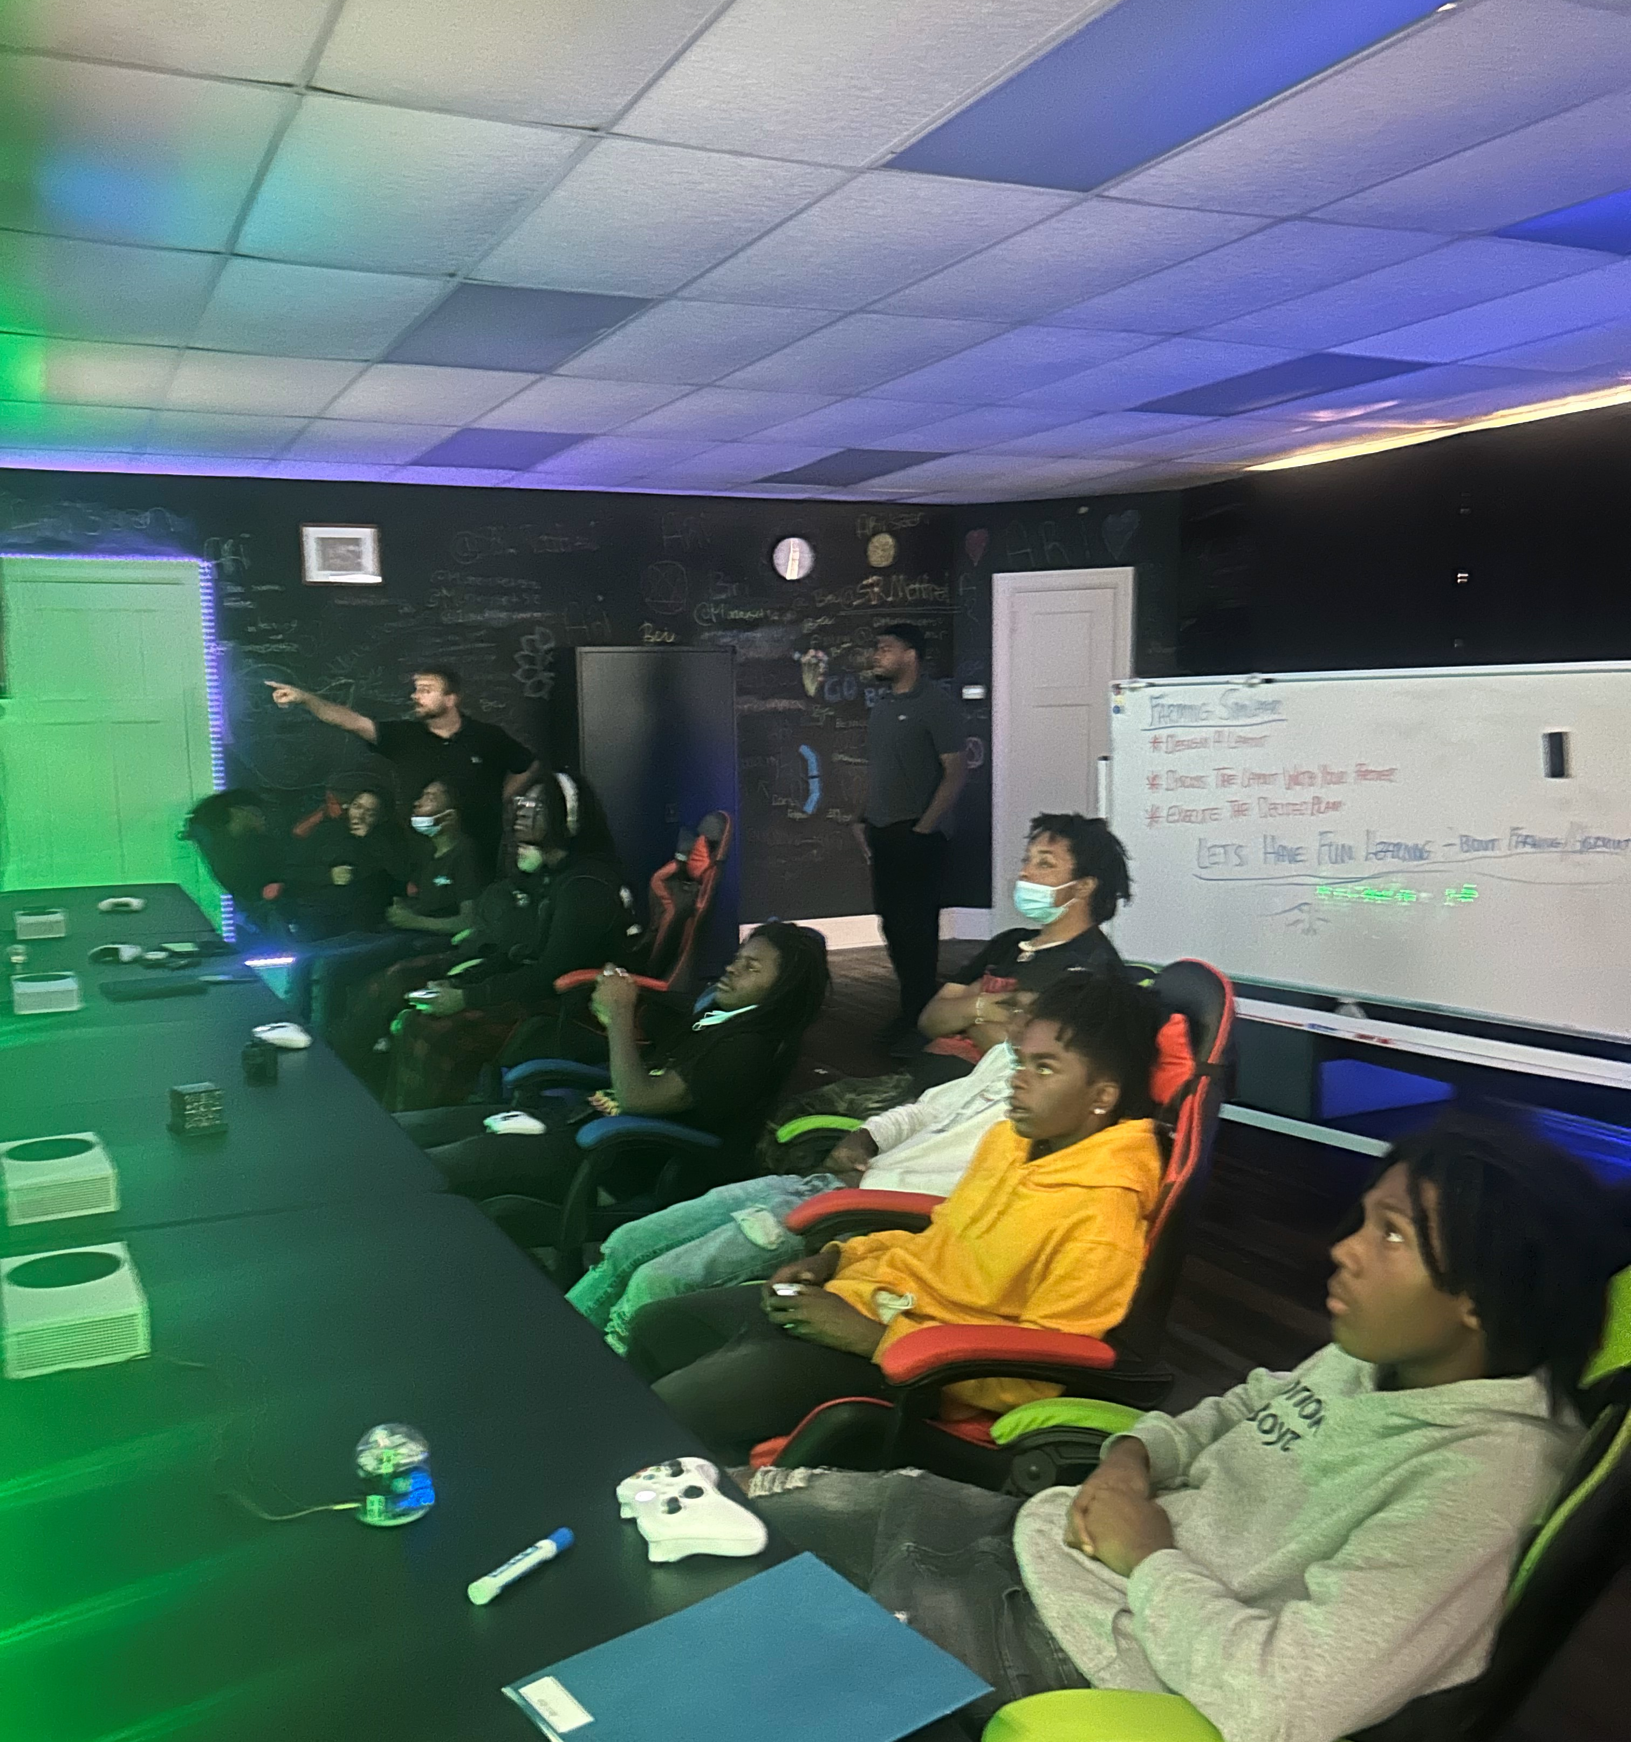
Innovation and Simulation
Through simulation, inexperienced workers get introduced to a job/career and get to practice the responsibilities/tasks of the position.
Simulation builds confidence in the young professional. Everyone is nervous on their first day and through repetition those jitters may be quelled through the practice you gain through VR or console simulation.
Let’s have fun and learn at the same time. Through simulated employment we get to relax our way into developing customer service skills, situational awareness, time management, and task accomplishment through gaming and other simulations.
Accomplishing goals and feats help inspire that inner desire for success. We’re all competitive n some way. Gaming brings out the competition in all of us.
Everyone loves to play games and interact with their peers. It helps increase the efficiency of the education if the student is having fun while doing it.

Slide 6
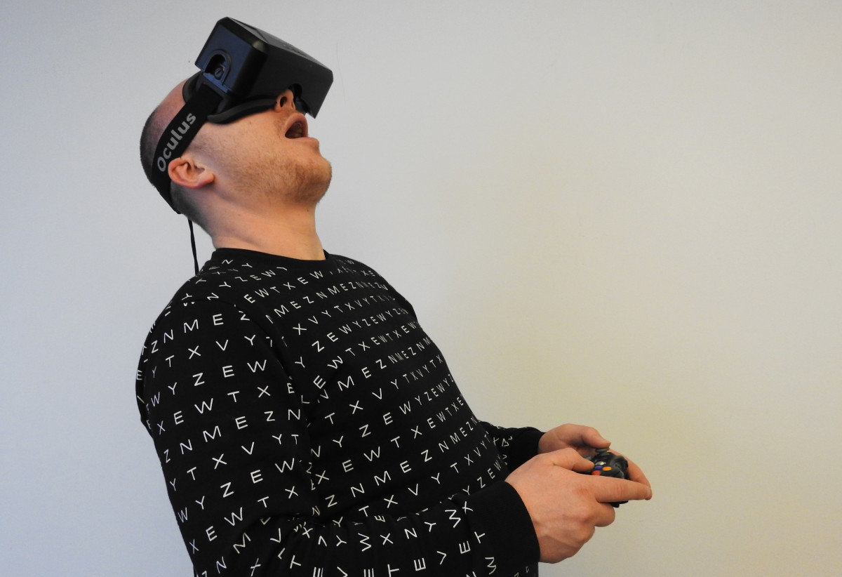
Position based training
Creating a culture of Success
As simulations become more popular, employers and WIOA affiliates should embrace it as a training tool that puts them in charge of creating the type of employee they need.
In some jobs such as automation, manufacturing, and warehouse labor, this tool can be used to give individuals on the job training, while minimizing risk and liability.
Simulations increase knowledge retention by providing a fun and interactive environment to learn and repeat tasks, developing the needed muscle memory and repetitions.
Through simulation technology, employers and WIOA affiliates get to see directly where the employee's strength and weaknesses lie. That way targeted training can help make the participant more of an asset to the employer.
Through simulation technology you create a happier work environment without having to have the higher rate of turnover for participants that did not like the worksite or the career path.
Simulation decreases the time to train an employee, therefore it becomes more cost efficient to do so. With the bonus of immediate feedback, this makes the pros far outweigh the cons.

Slide 7
At the OIC of Wilson, we put the Fun in fundamentals.

Slide 8
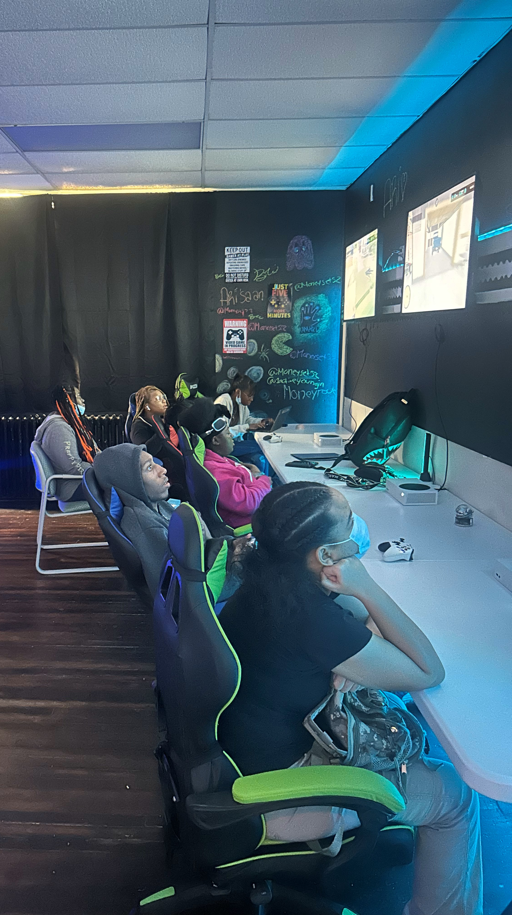
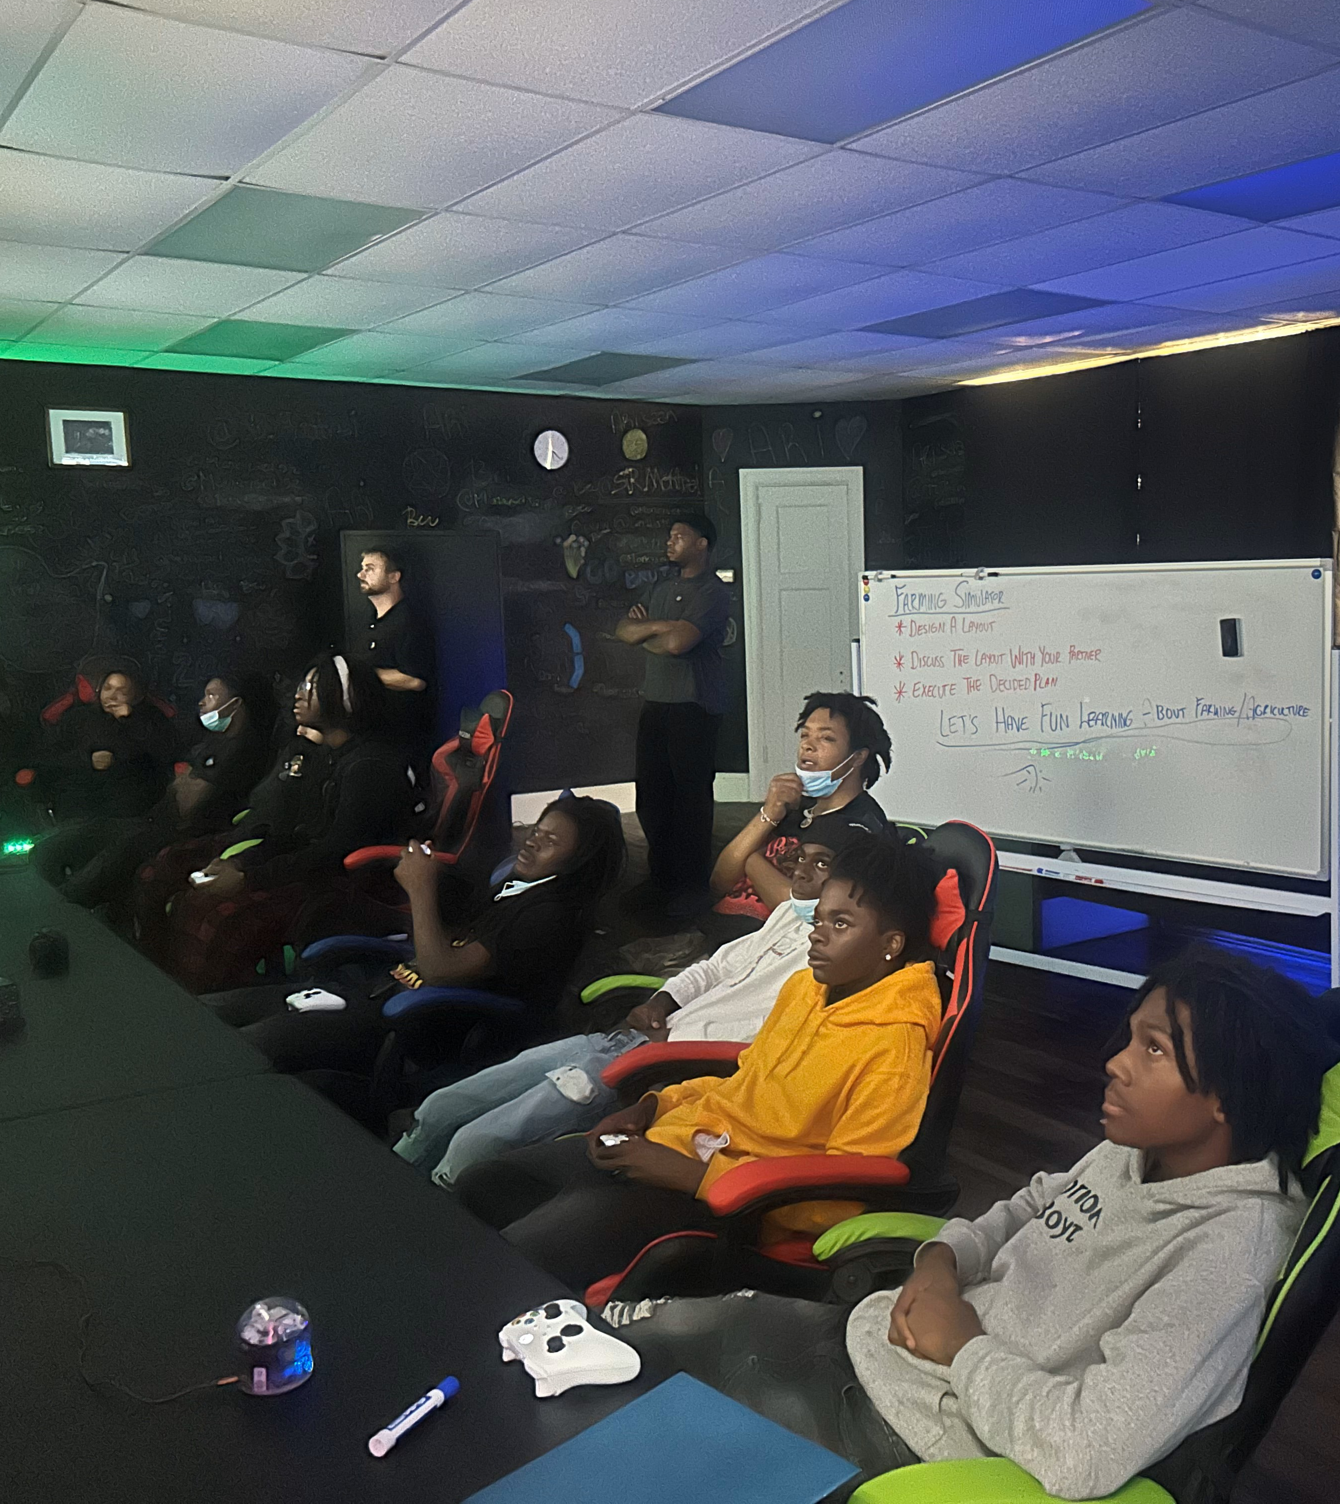
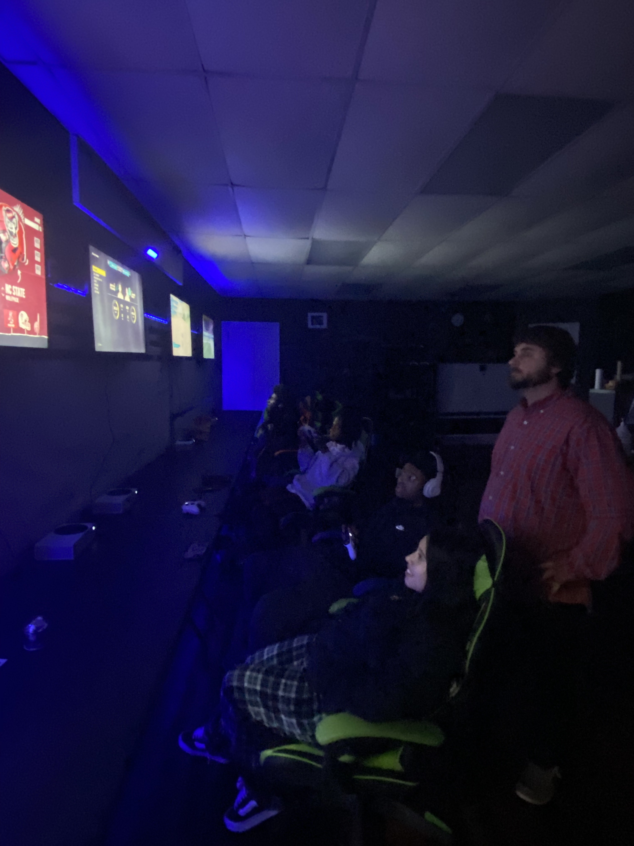
If You Love What You Do, Then You Will Never Work A Day In Your Life.

Slide 9
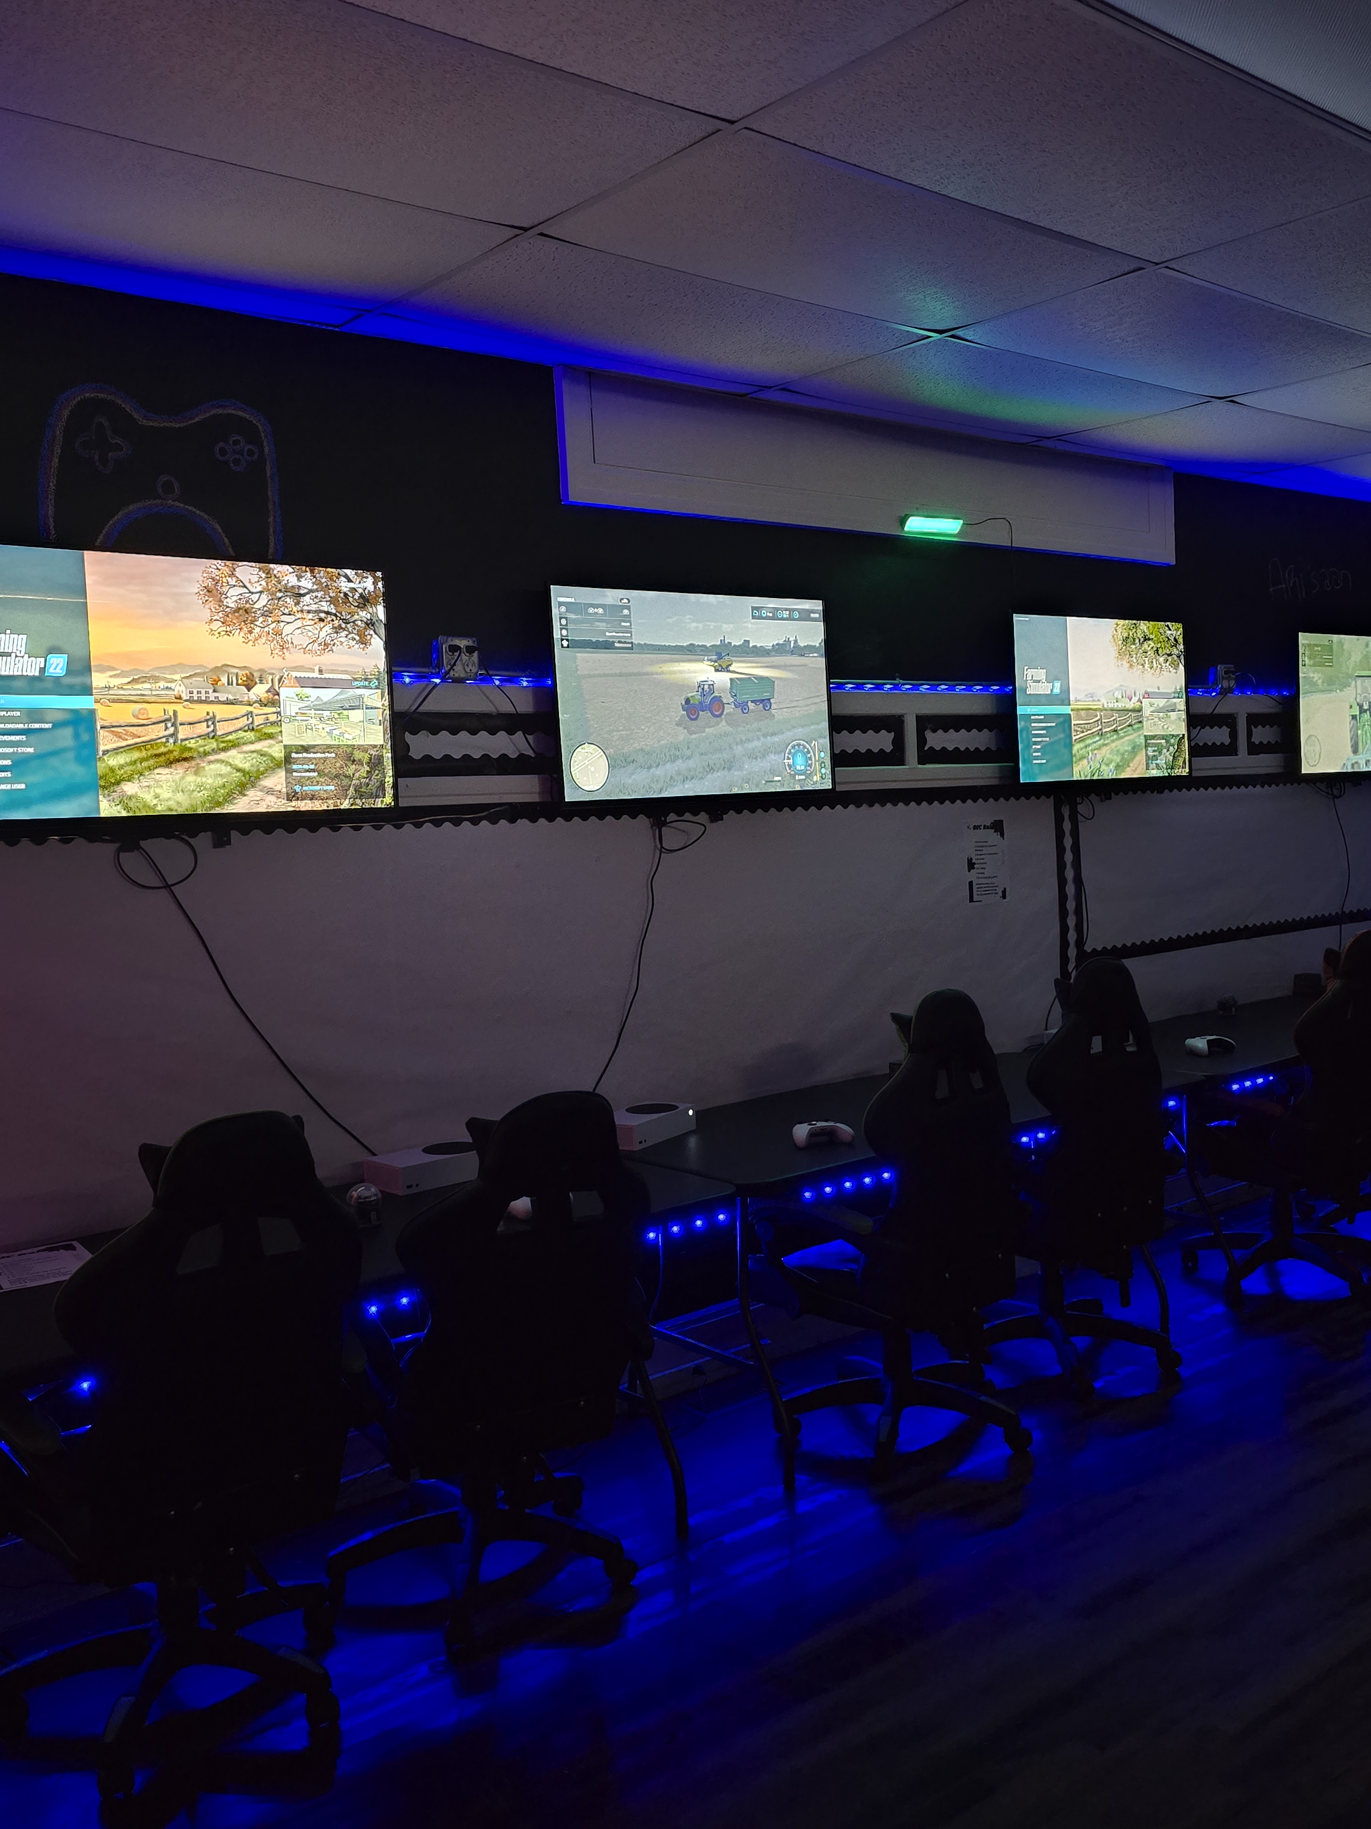
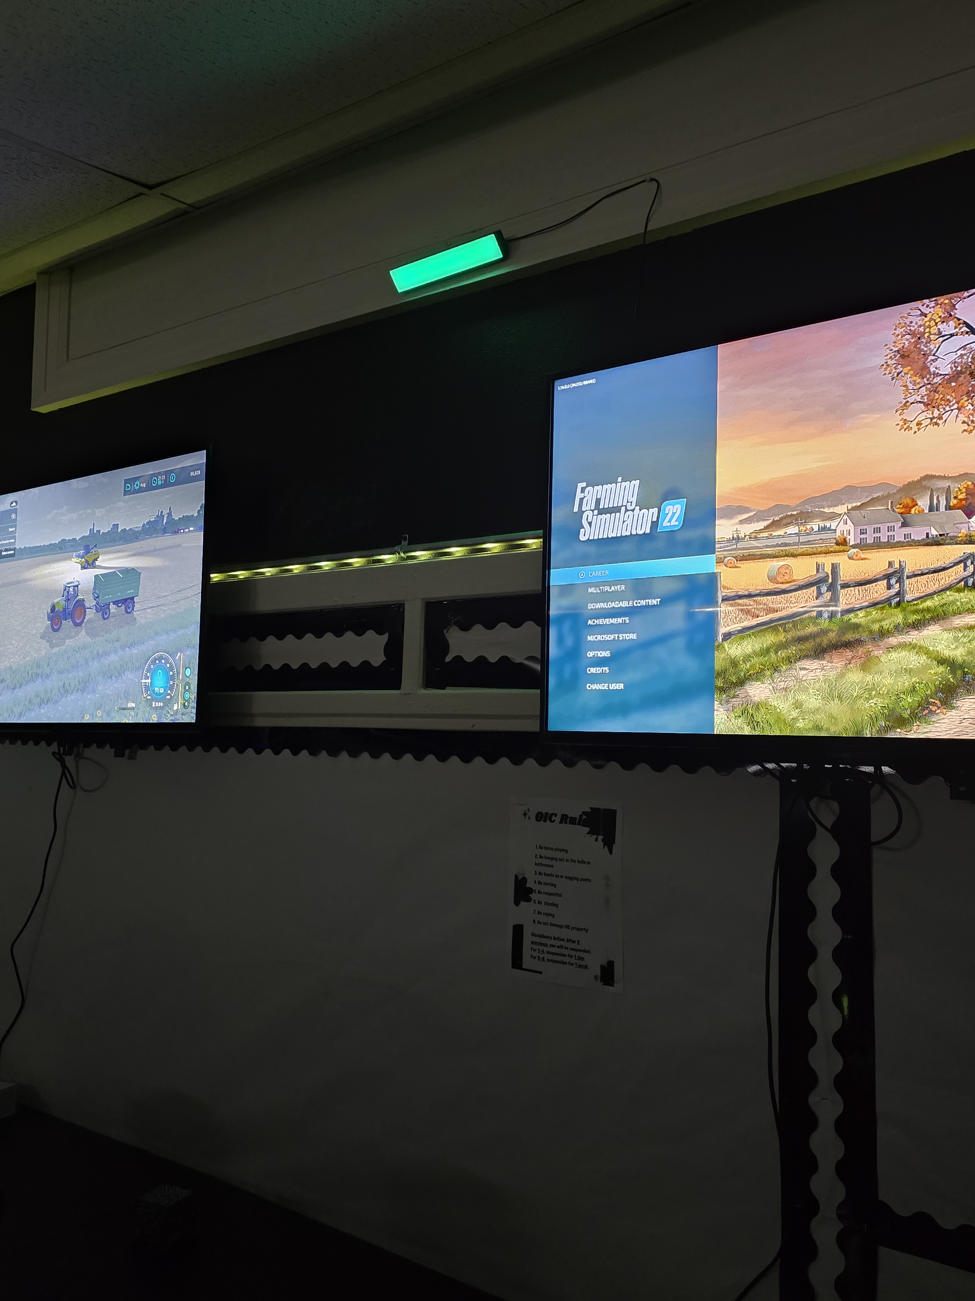
Final Thoughts
Using gaming for workforce development and soft skill training offers an innovative and engaging way to prepare the next generation for today’s workplace. This approach makes learning fun and effective, boosts critical thinking, problem solving, and teamwork skills. By adopting these new and innovative strategies, we inspire young individuals to excel in a rapidly changing world. At the OIC of Wilson, we are Helping People Help Themselves.

