Slide 1
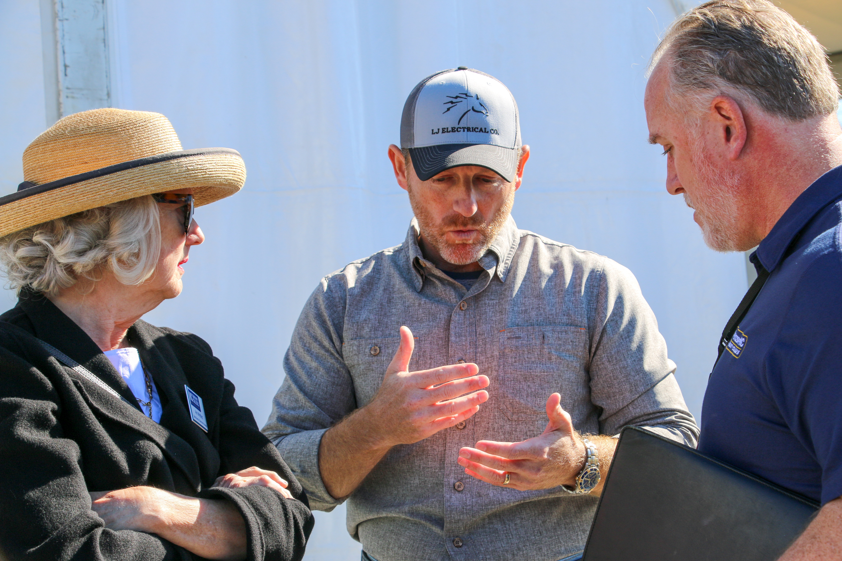
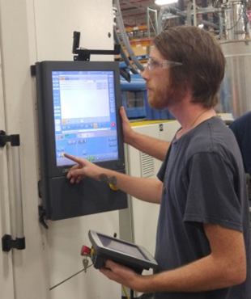
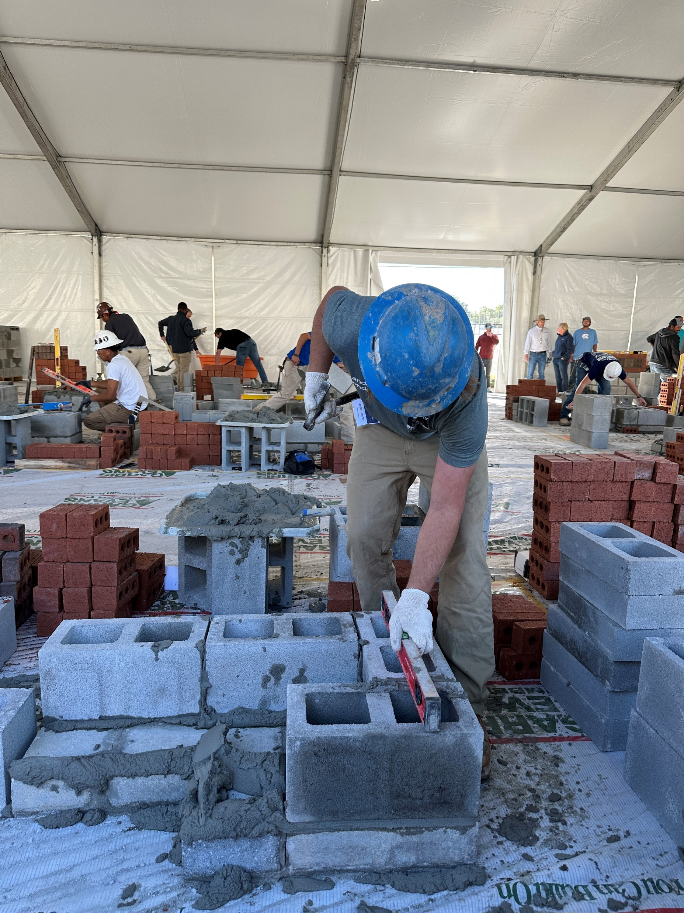
A SKILL BASED WORKFORCE DEVELOPMENT STRATEGY
Earn While You Learn
Work under the careful supervision and guidance of experts in the field.
Your Future is Calling
Gain valuable skills and knowledge to build a lifelong career.

Slide 2
ApprenticeshipNC - Who We Are and What We Do
Recognized by the Office of Apprenticeship to act on behalf of the U.S. Department of Labor, ApprenticeshipNC is the State Apprenticeship Agency authorized to register apprenticeship programs tailored to meet employers’ needs
Purpose: The purpose of ApprenticeshipNC is to empower employers to achieve their goals through a highly skilled workforce. By doing this, we build thriving communities where everyone has the opportunity to contribute and prosper.
Vision: Our vision is that North Carolina leads the nation in a skilled workforce, driven by a robust apprenticeship system that equips individuals for success.
Mission: Our mission is to help employers use Registered Apprenticeship to build and retain an adaptable, skilled, and efficient workforce that meets their current and future needs.

Slide 3
What do you know about Registered Apprenticeships? (RAPs)
Do you know what a RAP is? Have you ever thought about them prior to today?
Do you normally speak with customers / businesses / partners about RAPs?
Do you have any mechanisms in place to address RAPs?
How would you find information about RAPs?
Notes:
Ask questions – get verbal answers and take notes on butcher board
End it by going into exercise
Break up group into teams
Rules: use their flowchart to add stickies on where they would insert comments or steps to integrate RAPs into their customer engagement
Review results by team – use skit to see if it works by getting others to critique / ask questions (give lots of candy)

Slide 4
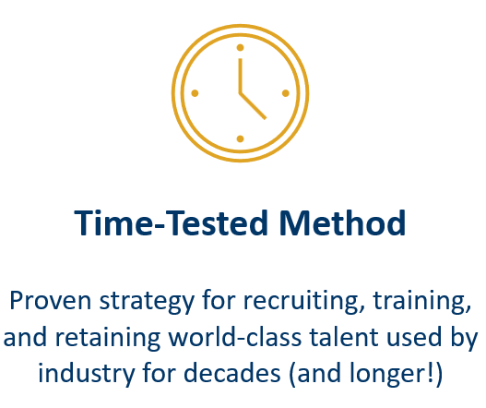
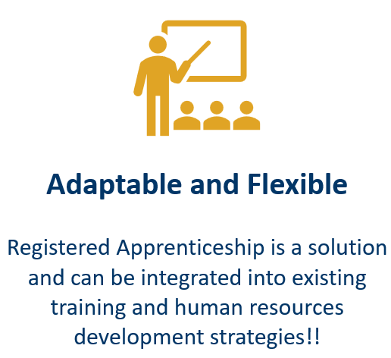
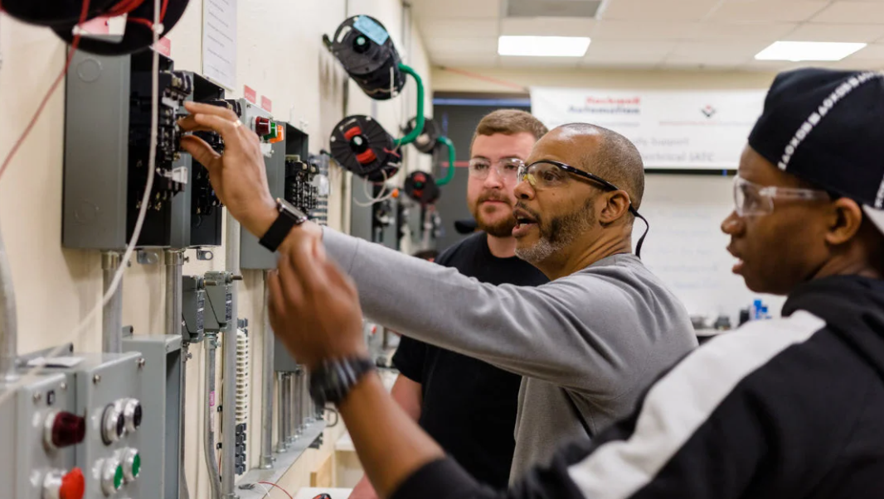
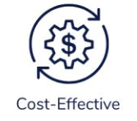
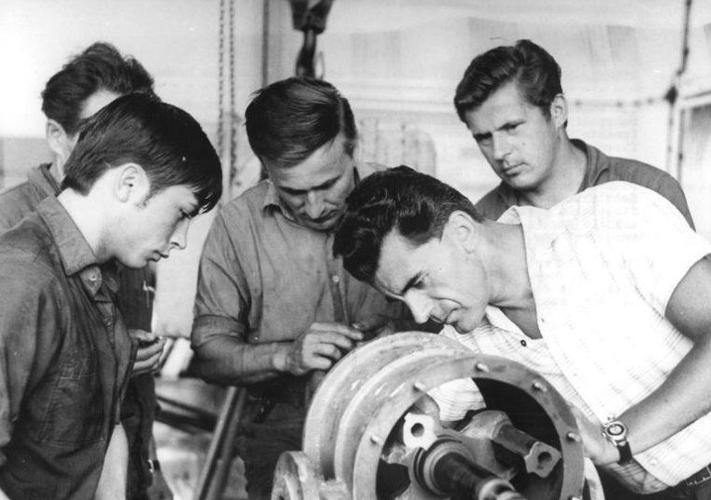
Why Registered Apprenticeships?
Notes:
Ask questions – get verbal answers and take notes on butcher board
End it by going into exercise
Break up group into teams
Rules: use their flowchart to add stickies on where they would insert comments or steps to integrate RAPs into their customer engagement
Review results by team – use skit to see if it works by getting others to critique / ask questions (give lots of candy)

Slide 5
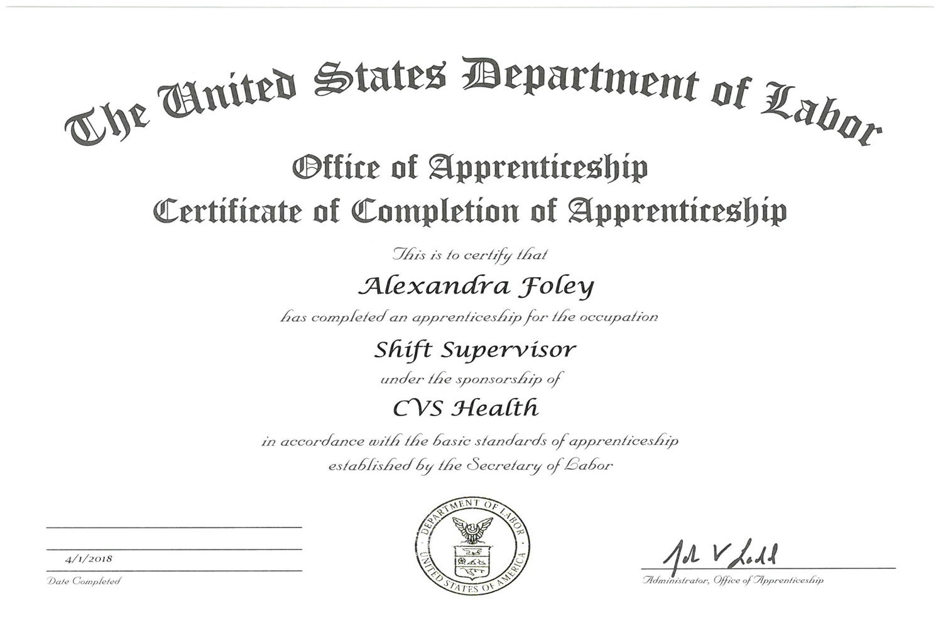
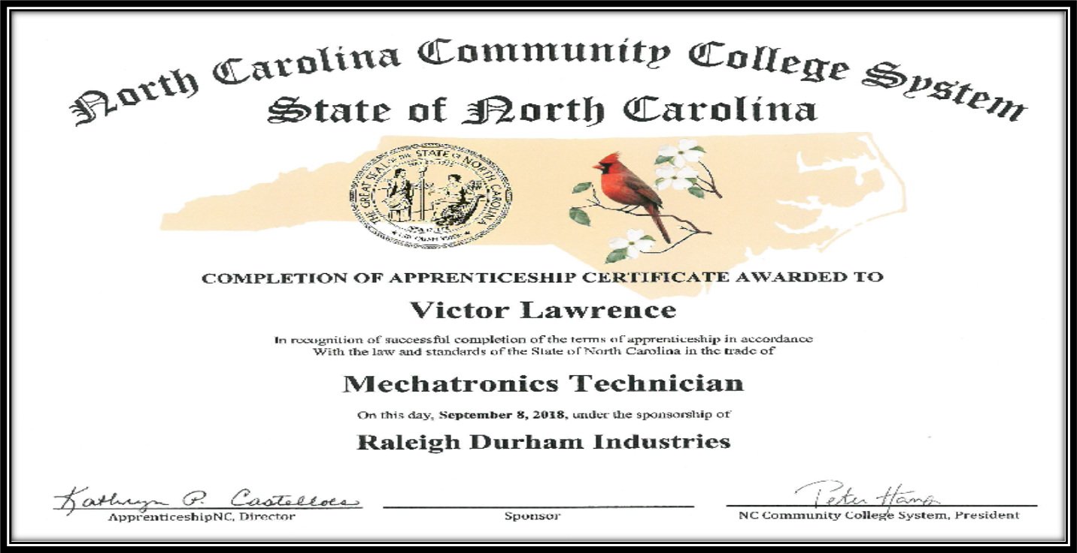
Registered Apprenticeship Components
On the Job
Learning
Supplemental
Education
Paid
Job

Slide 6
The Youth Apprenticeship Model
Can be registered apprenticeship or pre-apprenticeship (RPA)
RPA is similar to an RAP but with more flexibility
Better fit for youth, especially high schoolers
Minimum age 16
Financial benefit for high school youth…

Slide 7
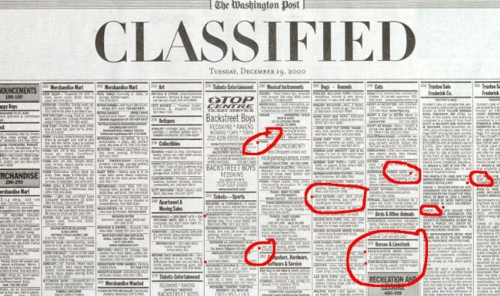
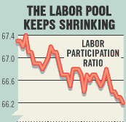
The why for business
Employers' supersize their talent pool!
How do they attract talent today?
Do they know your local talent pool?
Apprenticeship

Slide 8
The why for Workforce / NCWorks
Registered Apprenticeship Provisions in WIOA
Registered Apprenticeship on Eligible Training Provider List – Section 122(a)(2)(B) and (3)
Registered Apprenticeship as recognized post-secondary credential – Section 3(52)
Registered Apprenticeship on State Workforce Board – Section 101(b)(1)(C)(ii)(II)
Registered Apprenticeship on Local Workforce Board – Section 107(b)(2)(B)(ii)
Pre-apprenticeship as Youth program service – Section 129(c)(2)(C)(ii)
Registered Apprenticeship as career pathway for Job Corps – Section 141(1)(A)(ii) and Section 148(a)(2)(B)

Slide 9
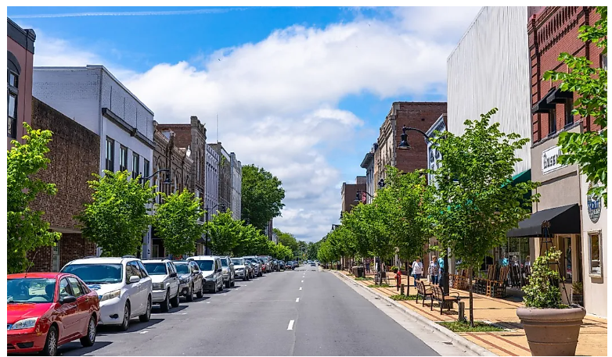
Benefits for Workforce Development Boards
Help meet performance measures
Participant Performance Measures
Employer Performance Measures
Provides job seekers with immediate employment and ability to learn job skills
Median earnings $$
Employer penetration rate
Increases employment opportunities for underrepresented populations
# employed / retained metrics
# establishments receiving services
Pct. $$ expended in training
Incumbent worker training services
Addresses the specific workforce needs of employers in your local community
Measurable skills gains
Workforce recruitment assistance
Credential attainment
Strategic planning / economic dev activities
Promotes economic growth
Employer information and support services

Slide 10
How do we take advantage of this information?
Would the customers we serve benefit from RAPs?
Shouldn’t case managers have some knowledge about RAPs?
How can WIOA help eligible participants?

Slide 11
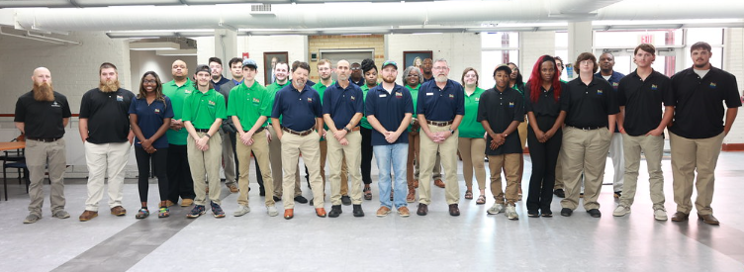
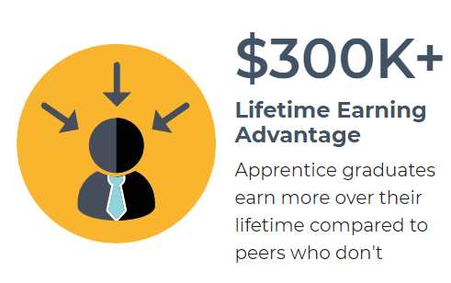
Win – Win for all!
Job seekers with minimal skills gain immediate employment
Business gets the talent they need
Completion rate of those entering a program is 70% - 80%
Retention rate of completers 90% five years post program
$10,000 / year or more higher wages than non-apprentice in field

Slide 12
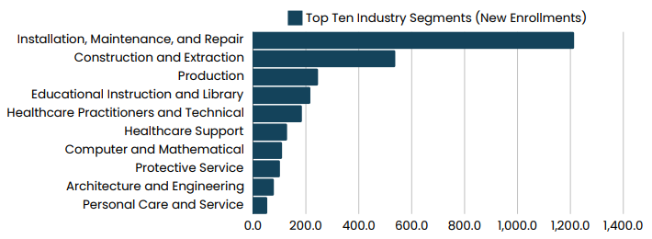
Apprenticeship programs by industry 2024

Slide 13
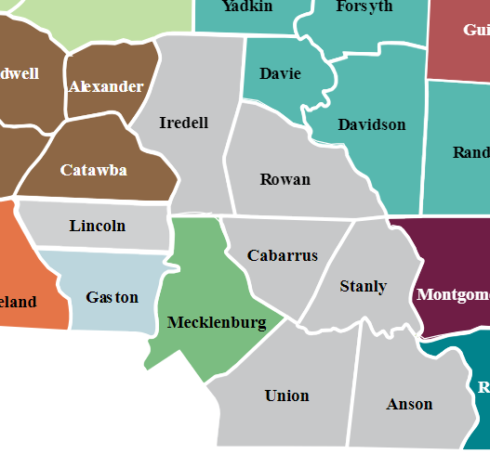
What’s happening in your area…
Centralina Region
95 registered programs
17 pre-apprenticeships
78 apprenticeships
87 employers
68 occupations

Slide 14
Questions for you?
What do you think about all of this?
Do you think RAPs can be valuable to your customers?
Are your case managers being trained on RAPs?
Do case managers know where RAP opportunities are in their region?
Do staff know their local ApprenticeshipNC consultant?
Are staff purposefully discussing how to screen incoming participants and employers for RAP opportunities?

Slide 15
How ApprenticeshipNC can help you
Provide staff a basic understanding of registered apprenticeships?
Schedule periodic training on RAPs and other news?
Quick links to information / news?
Visibility of RAPs in your region?
Quick link to public site detailing RAP information?
Awareness of local ApprenticeshipNC staff? (consultant map / contact info)
Something else?

Slide 16
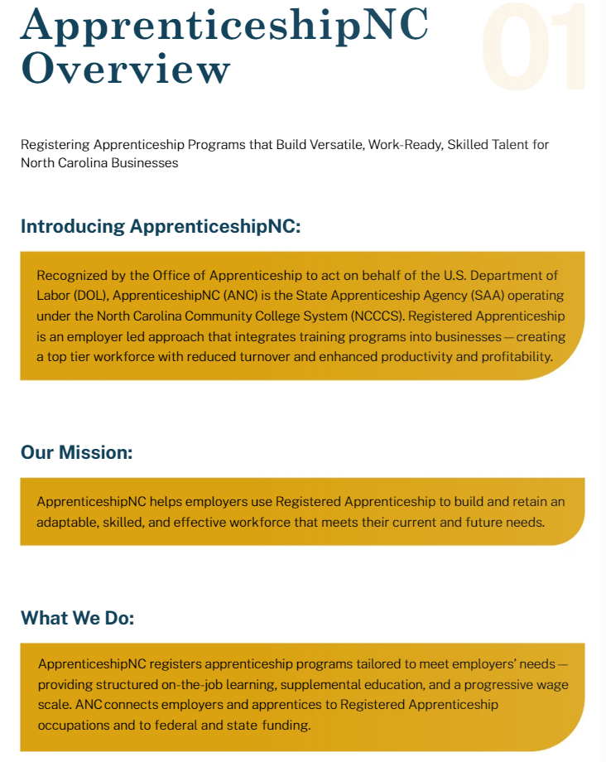
Quick tools for information and valuable news
The what, the why and the how:
Toolkit
Information
Newsletters
Much more….
Notes:
Two approaches – US DOL registered or State Registered​

Slide 17
Visibility of RAPs by county – Program locator
Find what is happening in your area!
Sponsor and Employer List 08.16.24 (flippingbook.com)
Notes:
Two approaches – US DOL registered or State Registered​

Slide 18
Dr. Chris Harrington
State Director
Future County Realignment timing Q1 2025
Office Admin & Support
Cyndy Hummel
Jen Vogelsberg
Dee Simmons
Dale Yarborough
Regional Supervisor
Alleghany
Warren
Currituck
Ashe
Surry
Stokes
Rockingham
Caswell
Person
Vance
Northampton
Gates
Camden
Watauga
Wilkes
Granville
Halifax
Hertford
Pasquotank
Part Time / Temp
Julie Carpenter
Debi McKeown
Antwan Pippen
Training, Systems, Assessment
Yadkin
Perquimans
Avery
Forsyth
Guilford
Orange
Franklin
Bertie
Chowan
Mitchell
Caldwell
Alamance
Durham
Nash
Madison
Yancey
Alexander
Davie
Edgecombe
Tyrrell
Grants
Elizabeth Orion
Mark Roberts
Patty Moyer
Burke
Iredell
Davidson
Martin
Washington
Dare
McDowell
Catawba
Rowan
Randolph
Chatham
Wake
Wilson
Haywood
Buncombe
Johnston
Pitt
Beaufort
Swain
Rutherford
Lincoln
Lee
Greene
Hyde
Marketing
Amy Davis-Moore
Margaret Spainhour
Graham
Jackson
Cleveland
Cabarrus
Stanly
Harnett
Wayne
Henderson
Mecklenburg
Montgomery
Moore
Polk
Gaston
Lenoir
Craven
Cherokee
Macon
Transylvania
Pamlico
Clay
Union
Anson
Richmond
Hoke
Cumberland
Sampson
Jones
SOP Project
Part Time / Temp
James Yarley
Duplin
Scotland
Onslow
Carteret
Robeson
Bladen
Liaison Consultants
Pender
Jill Hendrix
58 Community Colleges
Columbus
New Hanover
Scott Panagrosso
20 Workforce Development Boards
115 Public School Systems
Brunswick
Charlie Milling
Workforce – 241,361 (5.1%)
Wanda Ramos- McPherson
Workforce – 287,115 (6.0%)
Reggie Baker
Workforce – 217,586 (4.6%)
Cassandra Royal
Workforce – 296,445 (6.2%) incl Ft. Liberty
Cindy Messer
Workforce – 210,729 (4.4%)
Sylvia Jones
Workforce – 390,550 (8.2%)
Tony McKnight
Workforce – 312,217 (6.5%)
New 4
Workforce – 259,034 (5.4%)
Shelby McClain
Workforce – 217,565 (4.6%)
Jeremy Moore
Workforce – 390,550 (8.2%)
Ashley Dyson
Workforce – 366,661 (7.7%)
Preston Baker
Workforce – 301,806 (6.3%)
Linda Robinson,
Workforce – 298,498 (6.3%)
New 2
Workforce – 248,983 (5.2%)
Caleb Gilley
Workforce – 366,661 (7.7%)
Danny Boykin
Workforce – 362,038 (7.6%)

Slide 19
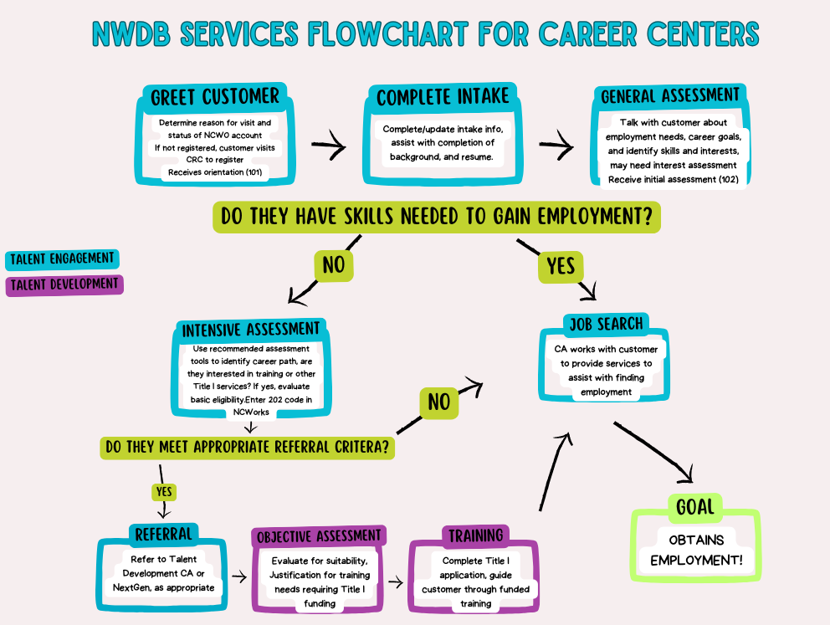
How to integrate RAPs into your work
Let’s answer the following
Review your career center flow chart
Where should RAPs be considered?
What tools / resources will you need to help?
List out things you feel would be helpful.
How would you discuss RAPs with a potential customer?
What would you say to a business?

Slide 20
It’s time for a hands-on exercise!

Slide 21
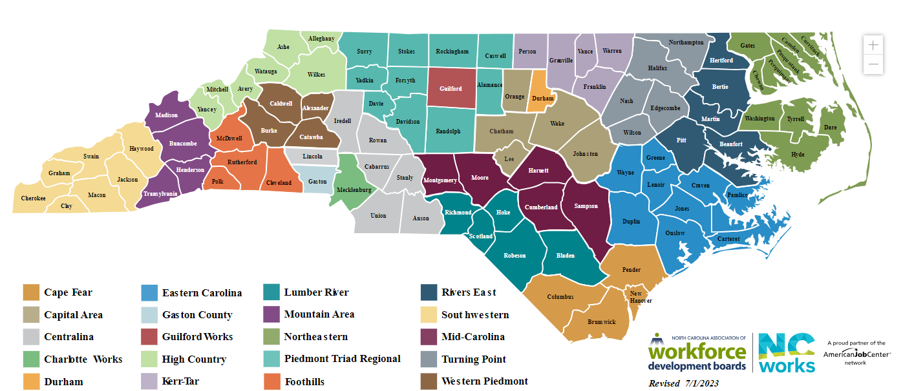
What’s happening in your area…
Find your region
Look up your programs
Apprenticeship?
pre-apprenticeship?
Employers?
Unique occupations?

Slide 22
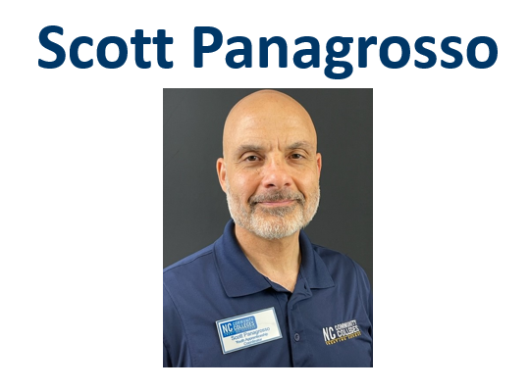
Connect with ApprenticeshipNC
panagrossos@nccommunitycolleges.edu
QUESTIONS?

