Slide 1
focusing on
counties
ENHANCING LABOR MARKET INFORMATION ACCESSIBILITY FOR JOBSEEKERS IN EASTERN NC
MARTIN
PITT
BEAUFORT

Slide 2
LABOR MARKET INFORMATION (LMI)
includes data on employment trends, wages, industries, and skills demands which empowers jobseekers to make informed career choices.

Slide 3
BARRIER
BARRIER
BARRIER
BARRIER
LIMITED DIGITAL ACCESS & DIGITAL LITERACY
INSUFFICIENT LOCALIZED DATA FOR SPECIFIC COUNTIES
LACK OF AWARENESS ABOUT EXISTING RESOURCES
COMPLEX, TECHNICAL PRESENTATION OF DATA
STRATEGY
STRATEGY
STRATEGY
STRATEGY
Digital accessibility improvements
Localized data customization
Community awareness campaigns
Simplified presentation of LMI

Slide 5
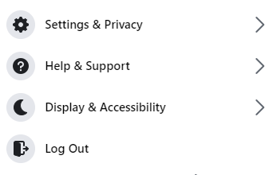
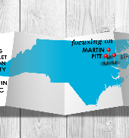
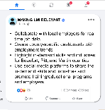
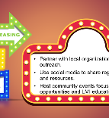
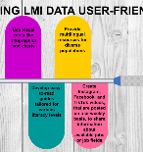
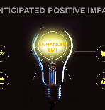
3
LMI
…
MAKING LMI RELEVANT
15 hrs
Collaborate with local employers for real time job data
Create county-specific dashboards with employment trends
Highlight in-demand skills and industries for Beaufort, Pitt, and Martin counties
Use social media platforms to share the in-demand skills and industries and promote training/educational programs and employers
Friend Requests
See All
Confirm
Delete
Report Topics
Confirm
Delete
Making LMI Relevant
Contacts
Increasing LMI Awareness
Making Data User-Friendly
Anticipated Positive Impact

Slide 6
INCREASING
LMI
Partner with local organizations for outreach.
Use social media to share regular updates and resources.
Host community events focused on career opportunities and LMI education.
AWARENESS

Slide 7
MAKING LMI DATA USER-FRIENDLY
Use visual tools like infographics and charts
Provide multilingual resources for diverse populations
Develop easy-to-read guides tailored for various literacy levels
Create Instagram, Facebook, and TikTok videos, that are posted on a bi-weekly basis, to share information about available jobs or job fields

Slide 8
ANTICIPATED POSITIVE IMPACT
ENHANCED
LMI
Improved job matching rates
Strengthened local economies
Increased collaboration among community organizations
Better career planning for jobseekers

Slide 9

Together, we can bridge the gap and empower jobseekers in Eastern NC.


