Slide 1
EVERYDAY HEROES
CAREER EXPERTS THAT SHOW UP AND MAKE THE WORLD RUN

Slide 2
Team Partners
James Cappelletti
Lorrie Fleming
Ginny Lewis
Teresa Lucas
Oprah Blackmon
Cynthia Bynum-Parker

Slide 3
“”
The Everyday Heroes are the ones showing up to great careers everyday that keep the world going.
Our Everyday Heroes Not only show up to their careers but show up to reach our students.

Slide 4
Everyday Heroes
They know how to utilize their resources to help students in crisis.
They go the extra mile to make sure no one is left behind. Ordinary people doing extraordinary things. So you can reach your goals.

Slide 5
Most difficult things.
Who or What it is ?
One of the most difficult things when trying to get new people and experiences for students is knowing where to find the new things.
That is where the Hero Spreadsheet comes in .
Availability?
Will my request overwhelm?
Hero Spreadsheet

Slide 6
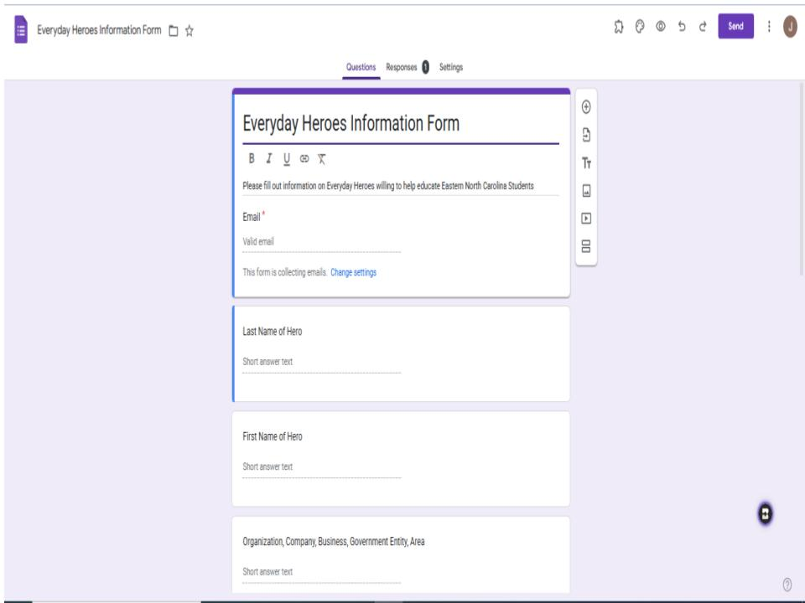
Organizers with access to the spreadsheet will fill out a basic Google Form.
Everyday Heroes Form
https://forms.gle/U7S4GwW5bTnqX4U89

Slide 7
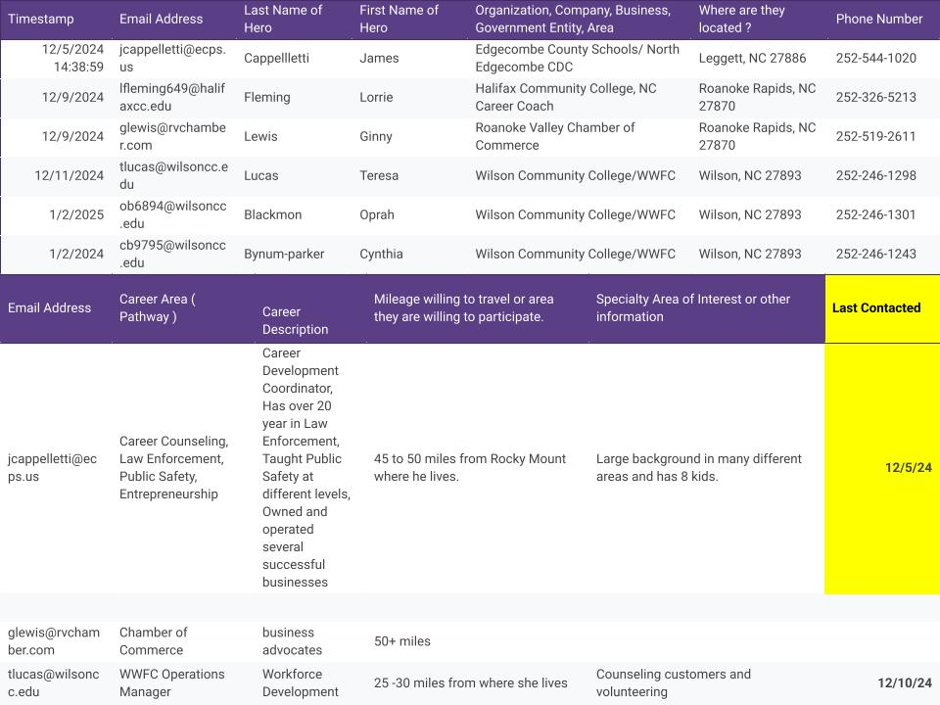
Everyday Heroes Spreadsheet
Spreadsheet will have all the basic groundwork information needed to help find opportunities.
Name, Number, Email, Location, Distance willing to travel, Career Area, and other information including a last contacted date.

Slide 8
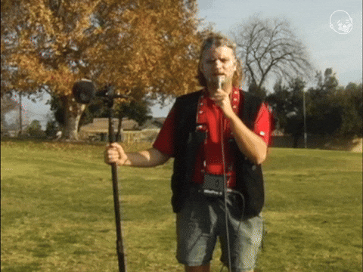
What Now?
Now anyone that has been given access can add information and opportunities.
They can view spreadsheet
Invite guests
Update last contacted
Add new Opportunities

