Slide 1






Presented by
Brandi Bragg
Workforce Connector

Slide 2



WHAT IS ARTIFICIAL INTELLIGENCE (AI)?
  AI simulates human thinking to solve problems and complete tasks.
  Examples of AI in everyday life:
    Virtual assistants (e.g., Siri, Alexa).
    Predictive text in emails.
    Netflix recommendations.

Slide 3

AI BENEFITS
WHY USE AI IN WORKFORCE DEVELOPMENT
TIME-SAVING
CREATIVITY
  AI can:
    Save time on repetitive tasks.
    Spark creativity with fresh ideas.
    Help Youth Career Advisors support participants effectively.
WORKFORCE
SUPPORT

Slide 4
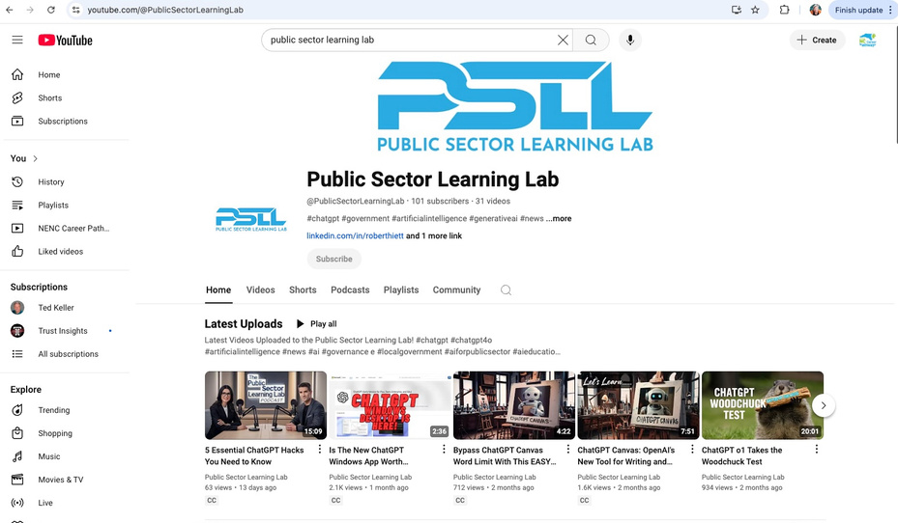
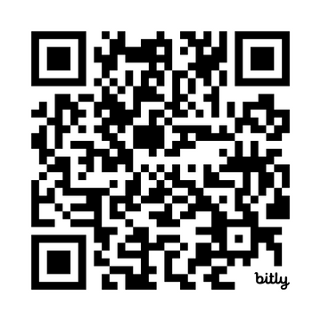
DISCOVER REAL-WORLD APPLICATIONS
Explore practical examples of AI in workforce and public sector initiatives through the Public Sector Learning Lab.
  AI tools are used to:
    Improve recruitment and retention strategies.
    Enhance professional development.
    Support innovative approaches in public sector programs.
Public Sector Learning Lab on YouTube

Slide 5



AI ETHICS AND CONSIDERATIONS
  AI is a tool, not a replacement for human judgment.
  Always review and verify results.
  Avoid inputting sensitive or personal data.
  Be transparent about AI use in your professional work.

Slide 6
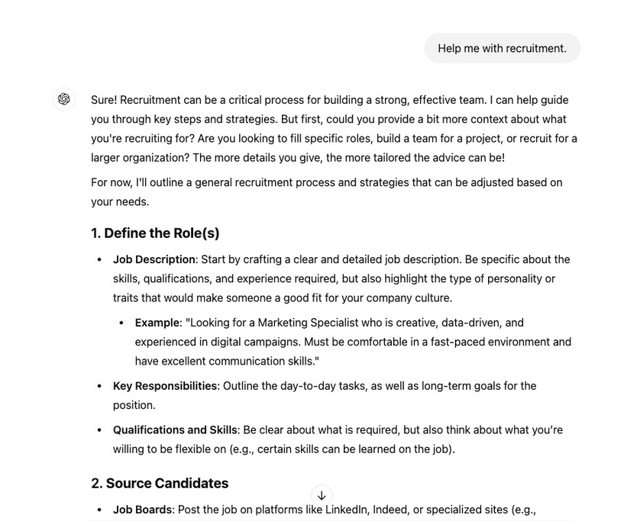
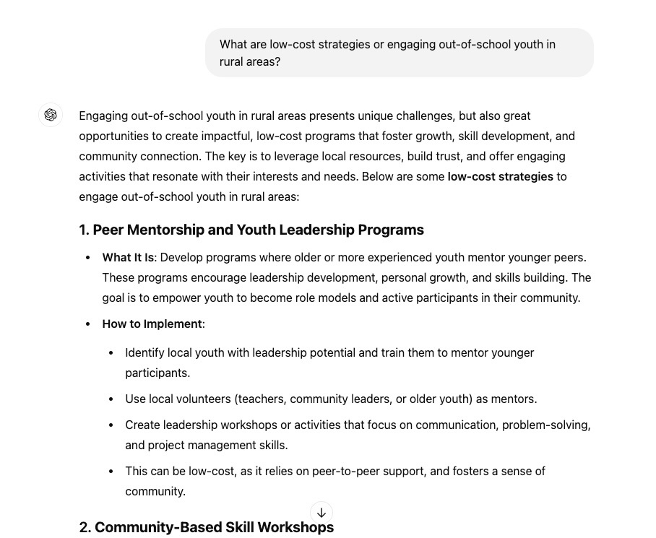
HOW TO USE AI EFFECTIVELY
  Be specific in your requests. Example:
    Instead of "Help me with recruitment," ask, "What are low-cost strategies for engaging out-of-school youth in rural areas?"
  Refine the outputs to fit your needs.
  Use AI as a starting point, not the final draft.

Slide 7


LET’S SEE AI IN ACTION
  What we’ll demo:
    Drafting a quick outreach email.
    Brainstorming retention strategies.

Slide 8

AI IN ACTION: RECRUITMENT BRAINSTORMING ACTIVITY
Scenario:
  "You’re tasked with recruiting 10 new participants aged 16-24 into your WIOA program within the next 3 months. Use AI to brainstorm creative and practical strategies."
Prompts to Try:
  "What are some creative ways to recruit out-of-school youth in rural areas using local partnerships?"
  "How can we use social media to engage 16-24-year-olds for career development programs?"
  "Suggest low-cost strategies for connecting with disengaged youth through community events.”
  "What kind of incentives would attract youth to attend an open house for our program?"
  "How can I use influencers or peer leaders to promote the program to 16-24-year-olds?"

Slide 9
CONCLUSION & QUESTIONS

Slide 10

BUILDING ON CAREER PLANNING AND EMPLOYABILITY SKILLS
Presented by
Brandi Bragg
Workforce Connector

Slide 11

QUESTIONS FROM YESTERDAY
    Let’s take 5 minutes to address any quick questions or reflections from Day 1.

Slide 12

CAREER PLANNING AND EMPLOYABILITY SKILLS
  Today’s focus:
    Using AI to enhance Career Planning.
    Brainstorming ways to integrate Employability Skills into activities.
  Examples of what we’ll explore:
    Creative ways to use NCCareers.org.
    Activities that teach teamwork, communication, or leadership.

Slide 13

AI IN ACTION: USING AI FOR RECRUITMENT AND SKILL BUILDING
Scenario:
  "You want to design a workshop for youth aged 16-24 that integrates career planning tools like NCCareers.org with employability skill-building activities."
Prompt to Demo:
  "I work with youth aged 16-24 in a WIOA program. Can you suggest creative ways to integrate career planning tools like NCCareers.org into hands-on workshops that also teach employability skills such as communication, teamwork, or leadership? Focus on low-cost activities suitable for small groups."

Slide 14



TIPS FOR CRAFTING EFFECTIVE PROMPTS
  Be Specific: Define your audience, tools, and goals.
    Example: Instead of "Help with career planning," ask, "Suggest ways to use NCCareers.org to teach career exploration."
  Iterate for Clarity: Adjust your prompt if the response isn’t helpful.
  Verify Outputs: Use AI ideas as a starting point, not the final plan.
  Keep It Ethical: Avoid sharing sensitive information.

Slide 15

GROUP ACTIVITY:
YOUR TURN TO EXPLORE
Scenario:
  "Your team is designing a program activity that combines:
    Career planning tools (e.g., NCCareers.org).
    Employability skill-building (e.g., teamwork, communication, leadership).”
Prompts to Try:
  Career Planning:
    "What are some creative ways to use NCCareers.org in career exploration activities for youth?"
    "How can we use local career fairs to help participants identify pathways?"
  Employability Skills:
    "What activities can build teamwork and communication skills?"
    "How can we integrate leadership skill-building into group activities?"
  Combined:
    "How can we create a workshop that combines career planning tools with hands-on teamwork activities?"
Goal:
Use AI to brainstorm at least one actionable idea.

Slide 16
QUICK REMINDERS
  Keep your prompts specific.
  Adjust and refine if needed.
  Use AI suggestions as a starting point.
  Respect privacy—no sensitive information!

Slide 17



EXPLORING FOLLOW-UP SERVICES,
COUNSELING, AND EDUCATION
  Today’s session focuses on three key areas:"
    Follow-up services: Keeping participants engaged post-program.
    Comprehensive counseling: Addressing career and personal challenges.
    Contextualized education: Making learning relevant and practical.

Slide 18
YOUR TASK: AI BRAINSTORMING
FOLLOW-UP SERVICES PROMPTS | COMPREHENSIVE COUNSELING PROMPTS | CONTEXTUALIZED EDUCATION PROMPTS
"How can we create personalized follow-up plans for youth participants?" | "How can we address both career and personal challenges for youth participants?" | "What practical ways can we teach soft skills through real-world scenarios?"
"What strategies can keep participants engaged post-program?" | "What activities or resources support mental health and life skills?" | "How can we align training with participants’ career goals?"

Slide 19

EXPANDING YOUR
PARTICIPANT’S STORY
  Use AI to brainstorm how to enhance your participant’s journey with retention strategies and additional WIOA elements.
Prompts to Try:
  "What retention strategies can we use to keep youth participants engaged in long-term programs?"
  "How can we integrate mentorship or peer support to improve retention outcomes?"
  "What activities can make apprenticeships more appealing and accessible for youth?"
  "Suggest ways to include leadership development or supportive services into our participant’s program journey."
  "What follow-up services can help ensure participants stay on track after program completion?"

Slide 20
FILLING IN THE GAPS
Use AI to explore remaining areas for your participant’s story.
FOLLOW-UP SERVICES PROMPTS | COMPREHENSIVE COUNSELING PROMPTS | FINANCIAL LITERACY AND ENTREPRENEURSHIP PROMPTS | REFLECTION PROMPTS
"What follow-up activities can help participants stay on track after program completion?" | "What counseling services can help youth participants overcome personal and professional challenges?" | "What are some fun, interactive ways to teach financial literacy to youth participants?" | "Based on your participant’s journey, how did the 14 WIOA elements contribute to their success?"
"How can we measure the success of our follow-up services?" | "How can we integrate mental health resources into our program offerings?" | "How can entrepreneurial training prepare participants for self-employment opportunities?" | "What lessons can you take from your participant’s story to apply in your own work?"

Slide 21
CONCLUSION & QUESTIONS

