Slide 1
Collaborative Approaches Promises, Challenges, and Staying the Course
February 10, 2025
Abigail Holdsclaw, ncIMPACT Initiative

Slide 2
Agenda: Today’s Roadmap
ncIMPACT and Carolina Across 100 (CX100) Background
Promise of Collaborative Approaches
Challenges of Collaborative Approaches
Discussion: Staying the Course

Slide 3
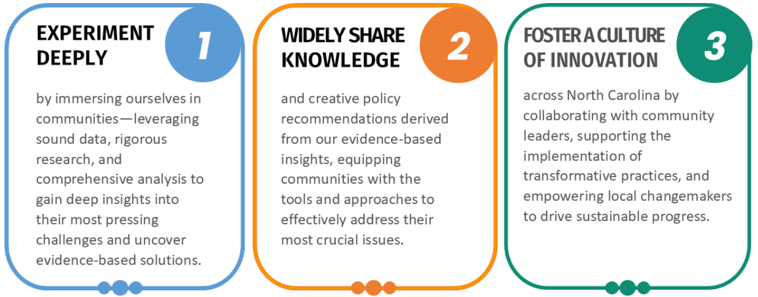
ncIMPACT Initiative

Slide 4
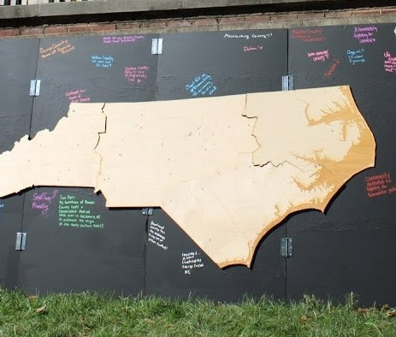
Carolina Across 100
5-year pan-university initiative to partner with communities in each of North Carolina’s 100 counties
Charged and supported by the UNC-Chapel Hill Office of the Chancellor, coordinated by ncIMPACT Initiative and led by the Carolina Engagement Council
Embodies this public university’s mission to “enhance the quality of life for all people in the State”
Builds and supports cross-sector collaborations in communities
Addresses challenges created or exacerbated by COVID-19
The University for North Carolina as well as the University of North Carolina

Slide 5
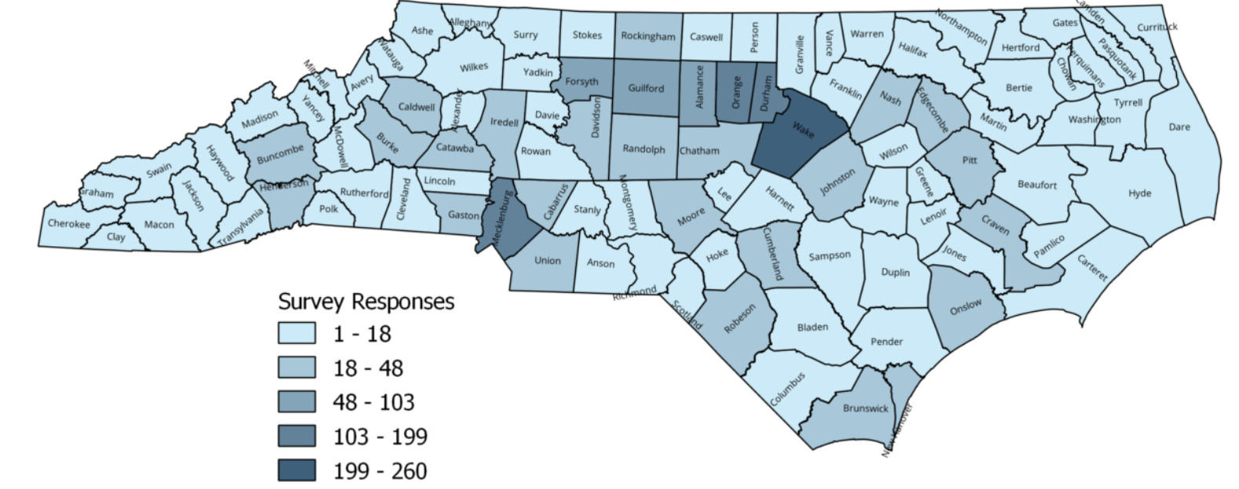
Deep Listening
2,866 completed surveys representing:
all 100 counties
all 16 Council of Government regions
all 8 prosperity zones
all 3 economic tiers
85+ individual interviews representing:
66 counties
all 16 Council of Government regions
all 8 prosperity zones
all 3 economic tiers

Slide 6
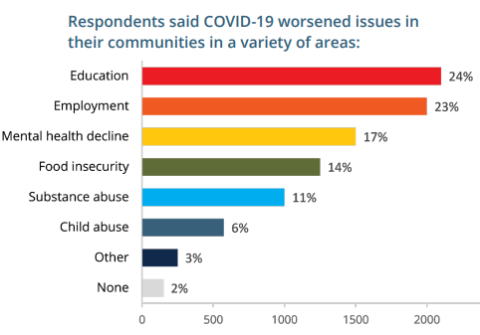
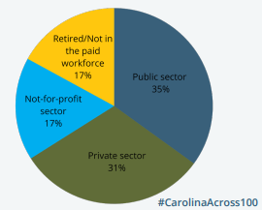
Deep Listening

Slide 7
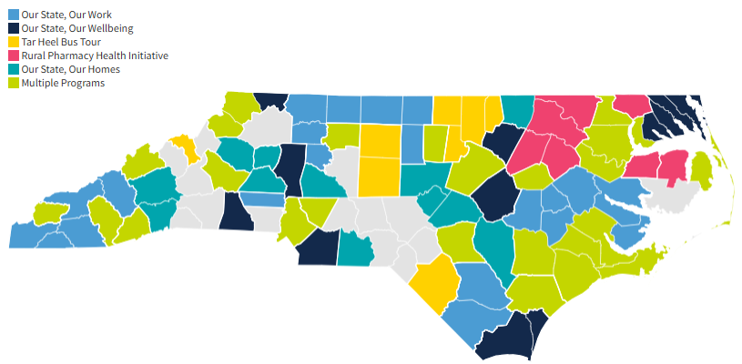
CX100’s Reach

Slide 8
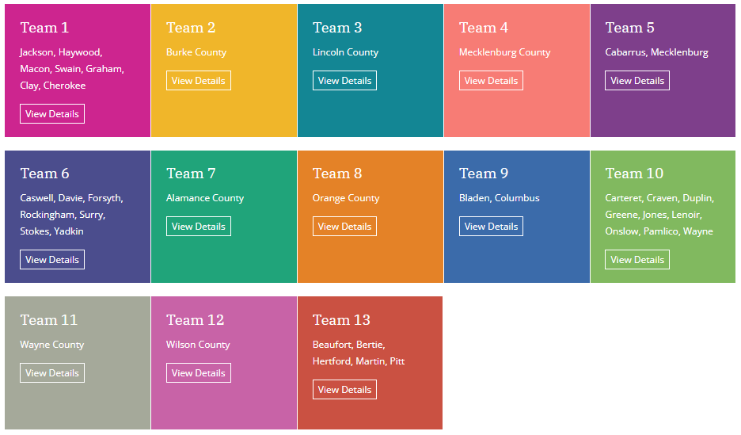
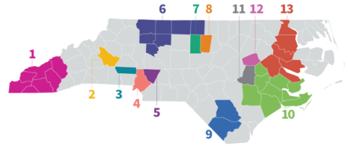
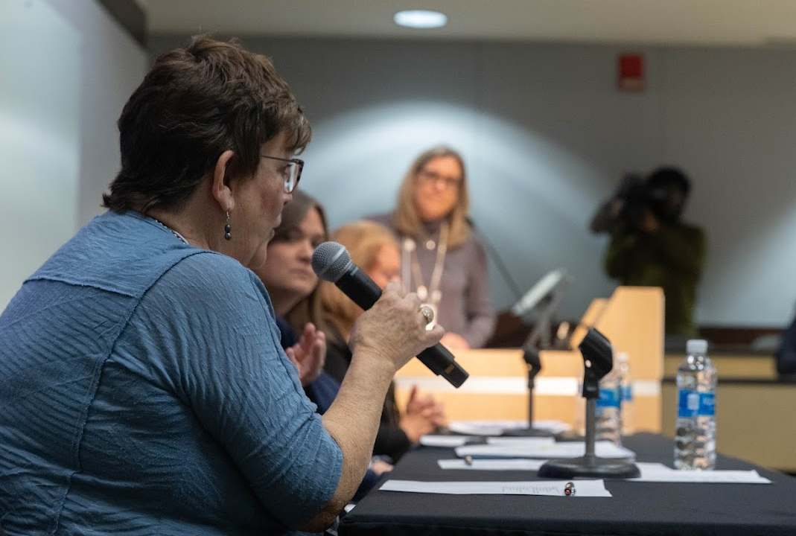
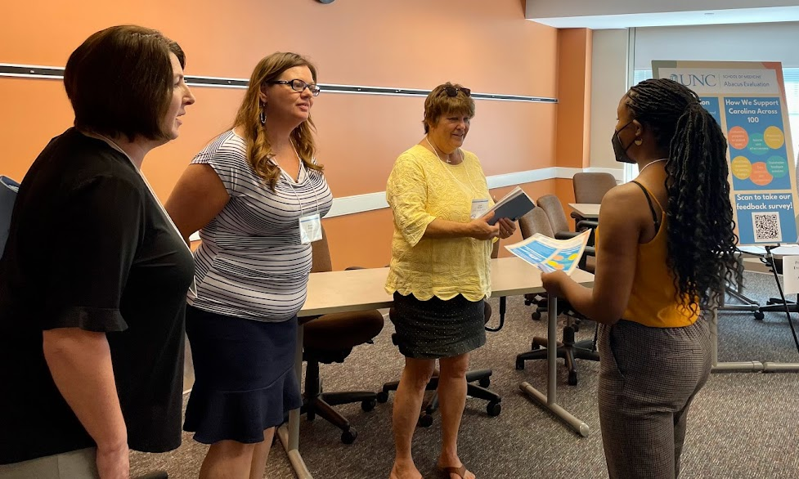
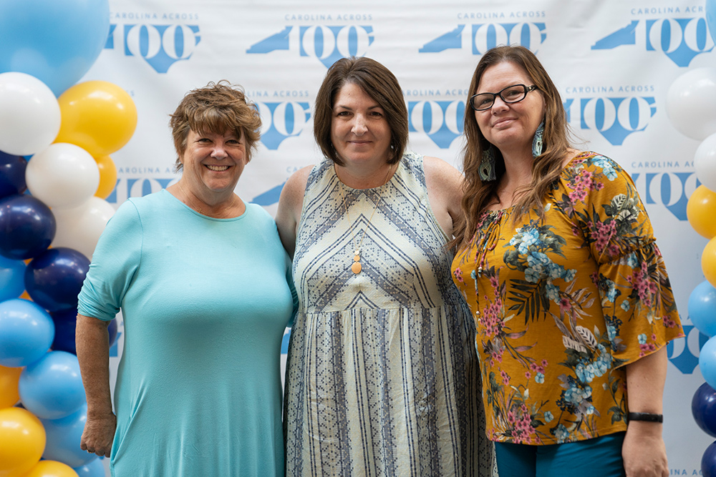
“Our State, Our Work”

Slide 9
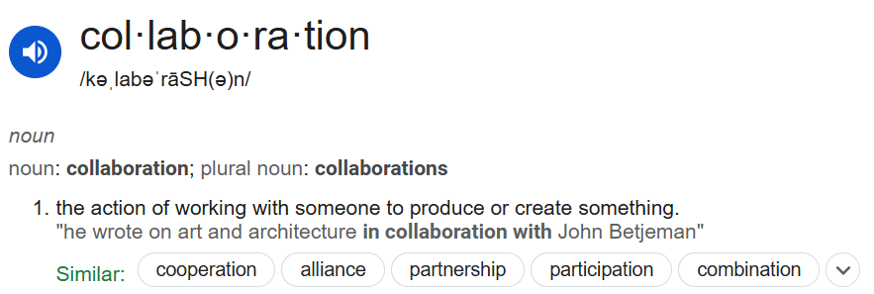
Collaboration

Slide 10
“Our State, Our Work”
Over 14,500 Opportunity Youth served
More than 33,000 career services
More than 2,600 educational services
More than $97,000 in financial support provided

Slide 11
“Our State, Our Wellbeing”
Over 1,600 mental health services delivered
More than 660 trainings and events
More than 19,000 training attendees
More than 5,000 gun locks distributed

Slide 12
Your Projects
Supportive entry into the workforce for ALL students in your region
Improved financial outcomes for students and their families
Workforce participation and support for people with disabilities
Improved awareness of educational and career readiness resources and supports
Greater awareness and connectedness of community leaders
… for a more resilient, connected, thriving region

Slide 13
Challenge #1: Keeping in Mind the “Why”
Differences
Organizational and personal Capacity
Organizational Goals/Strategic Plans
Reporting Needs
Sectoral focus
Motivations

Slide 14
Challenge #1: Keeping in Mind the “Why”

Slide 15
Challenge #1: Keeping in Mind the “Why”
Differences
Organizational and personal Capacity
Organizational Goals/Strategic Plans
Reporting Needs
Sectoral focus
Motivations
United in common goal for a successful project

Slide 16
Challenge #2: Building Trust and Accountability
Trust
This work involves difficult decision-making and hard conversations
How will you build trust?

Slide 17
Challenge #2: Building Trust and Accountability
Trust
This work involves difficult decision-making and hard conversations
How will you build trust?
Accountability
You have personal and professional responsibilities outside of these projects
How will you ensure steady progress?

Slide 18
Challenge #3: Being Ready to Pivot
Subject to change…
Processes
Organizational/Personal Capacity
Team Makeup
Needs of your project

Slide 19
Challenge #3: Being Ready to Pivot
Subject to change…
Processes
Organizational/Personal Capacity
Team Makeup
Needs of your project
Be flexible to accomplish your goals despite changes

Slide 20
Let’s talk!

Slide 21
How will you keep your ultimate goals in mind when things get hard?
How will you build trust?
What can you do to ensure accountability?
How will you assess the impact of your work?
What will you do to prepare for “pivot moments?”
What are you most excited about?
What about today has inspired you?

Slide 22
Thank You!
carolinaacross100.unc.edu | ncimpact.sog.unc.edu
aholdsclaw@sog.unc.edu
#CarolinaAcross100

