Slide 1
7 Steps to Get Hired
February 11, 2025
Notes:
Abigail (<1min)

Slide 2
Today's Game Plan
Background: Our State, Our Work and the ncIMPACT-NCCCS Partnership
What is this Course?
Partnership & Implementation
Notes:
7 Steps to Get Hired: The Keys to Building Your Future is a no-cost,
interactive, self-paced course comprised of seven modules designed to
help learners understand and practice highly-desired job skills while
building their resumes and boosting their job-seeking confidence. The
course is hosted by the Virtual Learning Community and was designed
through a partnership between NCCCS, Carolina Across 100, the ncIMPACT
Initiative, and UNC School of Government Instructional Design team with
funding from the Golden LEAF Foundation.
This course is intended to help remove the roadblocks that keep young
adults from connecting with living wage jobs or the educational
opportunities they might need to take their next career steps.

Slide 3
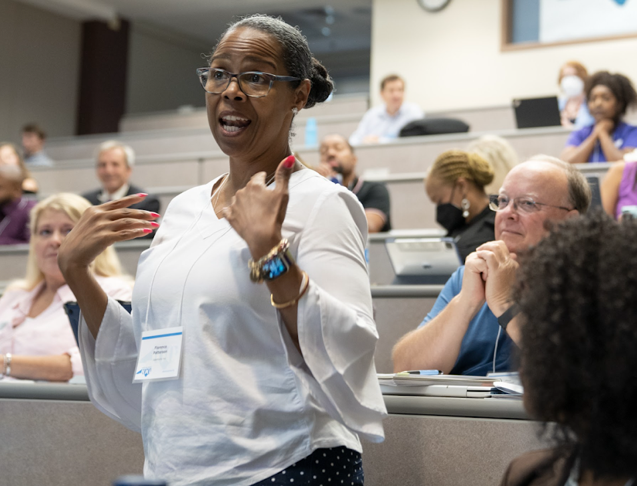
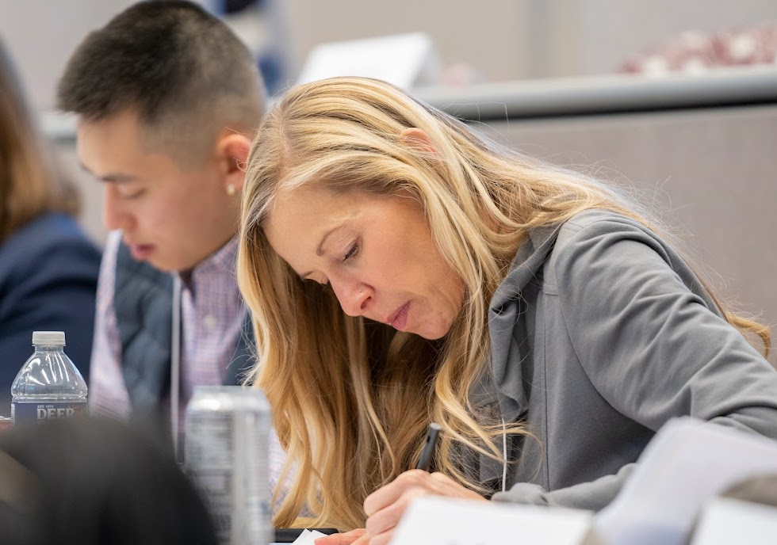
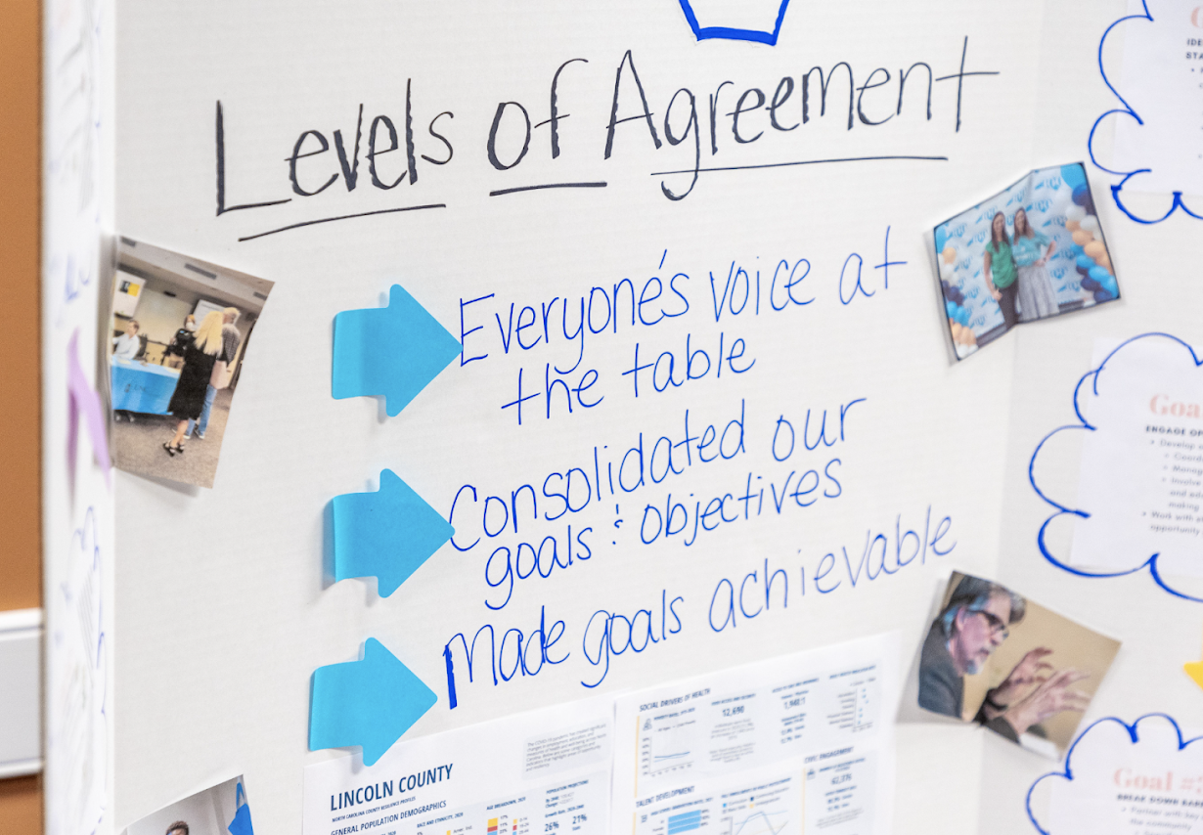
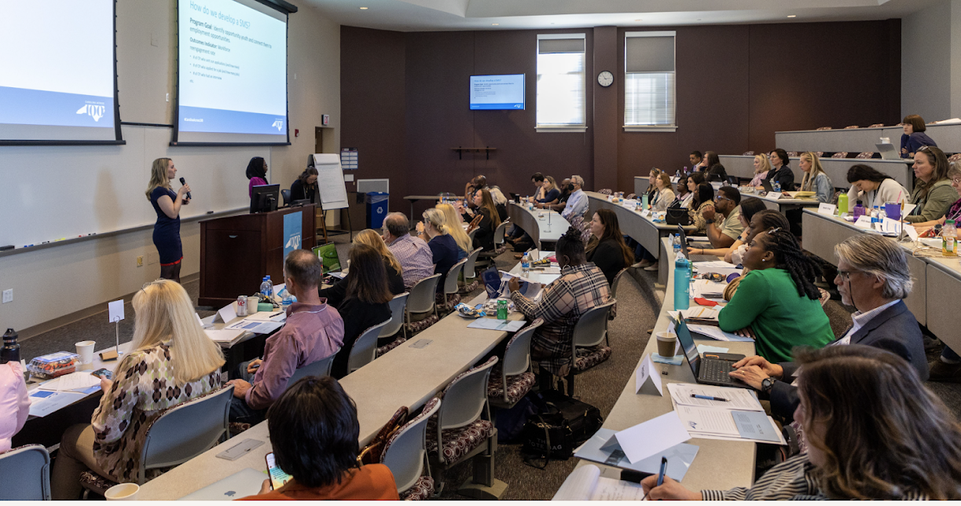
"Our State, Our Work"
Notes:
"Our State, Our Work" is the first program of Carolina Across 100, an initiative at UNC-CH led by ncIMPACT for the University to respond to challenges created or exacerbated by the COVID19 pandemic. This first program of work was focused on "Opportunity Youth," young adults 16-24-years-old who are not in school and not working. 13 teams covering 37 counties, made up of business, civic, education, nonprofit, faith-based, and government partners, participated in this 18-month deep engagement. They learned from one another, campus and external experts, and participated in activities such as strategic planning and asset mapping to amplify their local impact.
This project was active from June 2022-December 2023. However, this employability course is a direct response to the concerns and advice raised by these local experts.

Slide 4
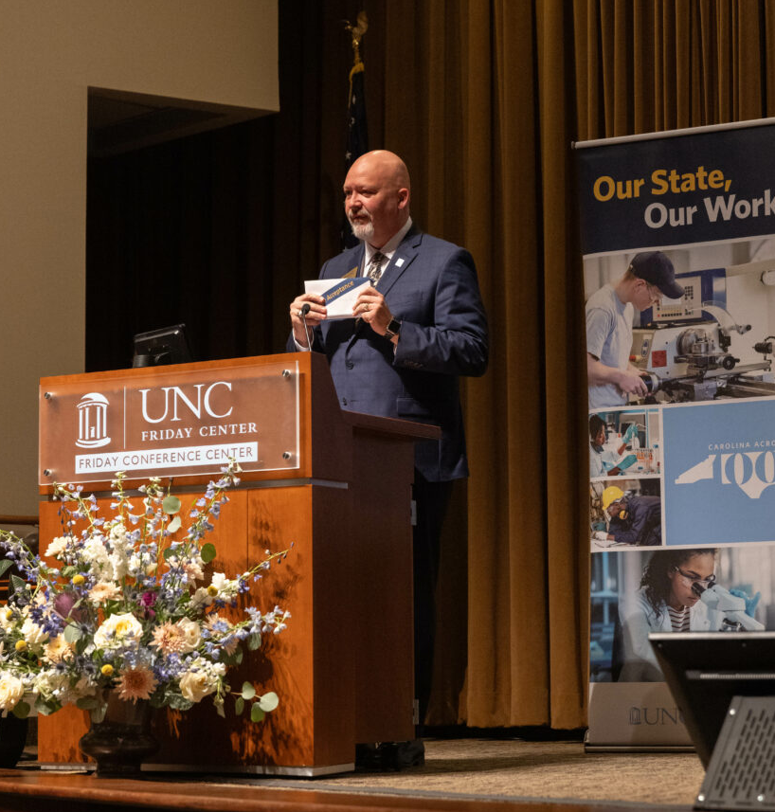
ncIMPACT - NCCCS Partnership
Notes:
In helping the Carolina Across 100 (CX100) team respond to the OSOW teams’ requests for information about existing programming, NCCCS representative, Barbara Boyce, attended in-person learning forums to present about the available programs and services, as well as practical tips for helping young adults access these services and programs.
NCCCS further demonstrated their commitment to reengaging Opportunity Youth when President Jeff Cox providing early acceptance certifications to Opportunity Youth at the event “Stories Brought to Life: a Statewide Summit on Opportunity Youth” in November as the active program period concluded. Recognizing that this population of young adults faces significant barriers to reentry, these letters allowed Opportunity Youth to bypass application processes and costs associated with application to a NCCCS institution. These letters served as a testament to the confidence that the NCCCS has in these young people to contribute to the NCCCS and the state in meaningful ways.

Slide 5
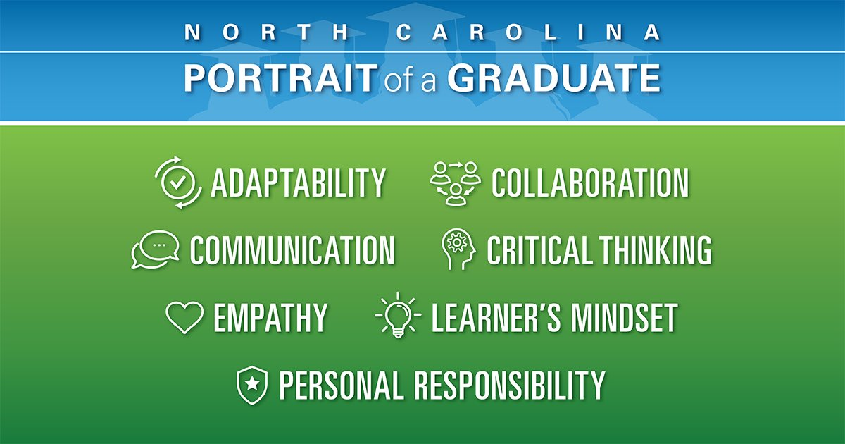
About this course Integrating the Content
NCCCS 2018 work
NCDPI Portrait of a Graduate
“Where are the Workers” Focus Groups
Feedback from OSOW participants
Feedback from NCCCS partners
Partnership with HRD instructors to update curriculum
Course that responds to employability needs of NC Opportunity Youth
Notes:
The content of the course was informed by the NC Community College System’s 2018 __________, as well as NCDPI’s “Portrait of a Graduate” report (**special shoutout to Kristie VanAuken, especially! ☺). The works laid out what durable skills are important and would help improve employability prospects for NC young adults.
We also used data from the following sources:
Feedback from the participants in the “Our State, Our Work” program that Abigail previously mentioned, who work with Opportunity Youth and other young adults in their communities
Focus groups called “where are the workers” conducted with faculty from the Kenan-Flagler Business School with Opportunity Youth, service providers, and employers
Feedback form NCCCS partners about previous curriculum strengths and places for updates
Through or work and data collection, is became obvious that young workers felt disconnected from the skills employers actually wanted in the workplace. Employers noted that the workplace is changing, and they need workers who are adaptable to meet those demands. There was a disconnect between both groups. Thus, we want to connect young people who are ready to fill the roles employers need in the workplace.
So, we went to The Golden LEAF Foundation they agreed with our direction and generously agreed to fund the development of this virtual employability course.

Slide 6
What’s different about this course?
Accessibility: available any time across all 100 counties
Notes:
We hope to provide young workers (namely Opportunity Youth) with opportunities to practice key employability skills that employers told us are needed in the modern workplace.
In our work with the Our State, Our Work we learned that some of our infrastructure was not as strong as we thought. You all told us we needed to cultivate a system that would help young adults find living wage jobs in their communities.
Here are a few of the items that make this particular course different than what we have had in the past.
Built for learners ages 16-24 (who may or not be attending a community college).

Slide 7
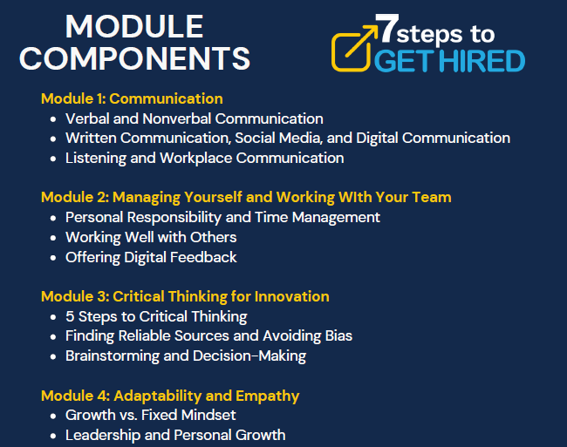

Slide 9
Course Content
Explore (Learn)
Dive In (Practice & Apply)
Walk the Path (Do & Reflect)
Web Link: Module 2: Managing Yourself and Working with Your Team: Demo - Employability Course - ncIMPACT
Learning Objectives
Activities
Key terms
Videos
Interactive scenarios
Reflections
Quizzes
Self-assessments

Slide 10
Notes:
Show sample video and scenario
Activity with group to dive in more

Slide 11
Partner Support
Notes:
Learners will be connected with local workforce development career specialists in their area who offer support for learners and who help make connections with employers who are hiring. We are especially grateful to have the partnership of NCWorks!

Slide 12
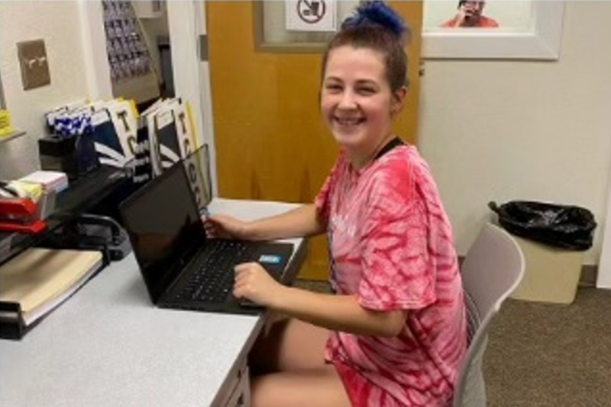
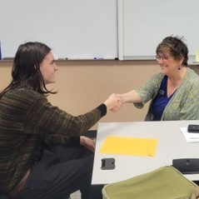
7 Steps Course and NCCCS
Ongoing course access through NCCCS Virtual Learning Center (VLC)
Modules/content for CC instructors to weave into current courses
Exploration by CC Human Resource Development (HRD) Advisory Board

Slide 13
Questions for you
What need(s) do you see this meeting?
What are your “next steps” – how do you see yourself fitting into this work?
Notes:
Mention the importance of partnerships here

