Slide 1
Your Online Resource for Careers in your Area and more…

Slide 2
What Labor & Economic Analysis Division Does
Labor Market Data Production
Data Collection & Production (incl. Unemployment Rates)
Industry Establishments & Jobs
Economic & Policy Analysis
Employment Projections
Star Jobs
Publications & Websites
Online & Print Publications
Big Data Analysis & Research
Big Data Analysis
Program Evaluation
Common Follow-up System (NCTOWER.com)
LMI Tools & Publications
Economic Development Reports (e.g. County Tier Designations)
Data Access Tools (D4.Nccommerce.com, NCcareers.org)
Occupational Employment & Wages
Dashboards (Analytics.NCcommerce.com)

Slide 3
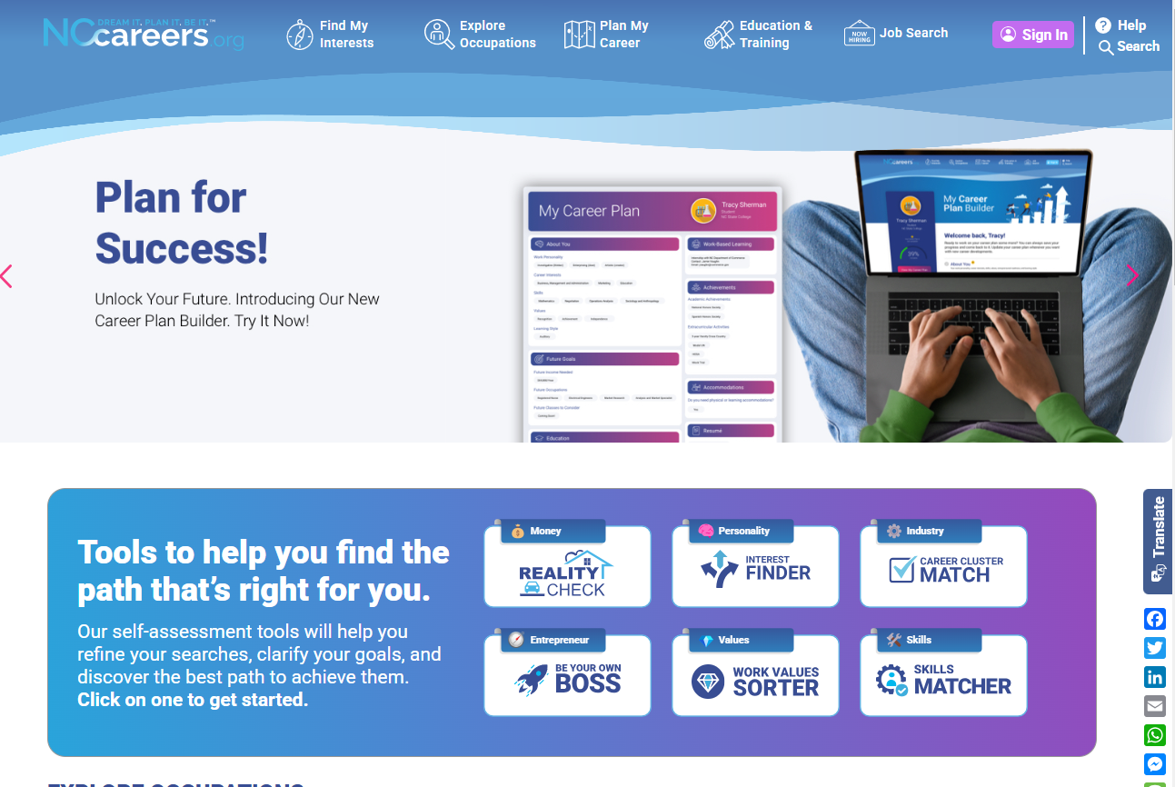

Slide 4
Who is NCcareers?
Governance Partners
Advisory Partners

Slide 5
Career Exploring and Planning
… a series of steps to help clarify and determine short- and long-term career goals.

Slide 6
Find My Interests
Explore Occupations
Plan My Career
Education & Training
Job Search

Slide 7
Find My Interests
Learn about yourself and focus on the occupations that most meet your needs, interests and wants.

Slide 8
Can Help you Address
Financial Literacy
Lifestyle Reality Check
Budget Reality Check
Understand Salary Needs to Live a Certain Lifestyle
Understand a Lifestyle Based on a Salary

Slide 9
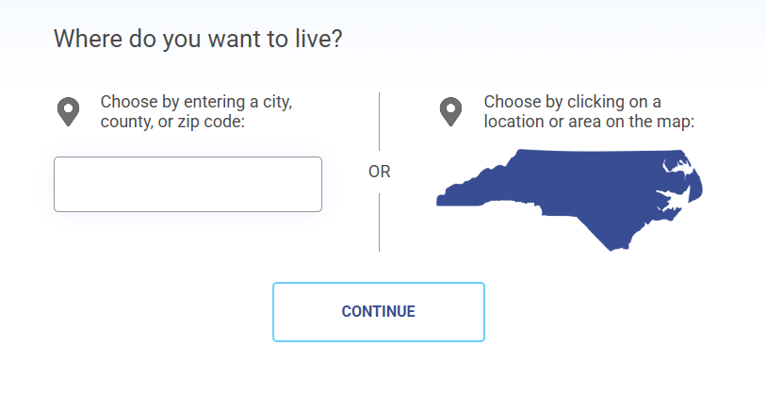
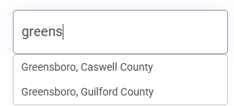
Lifestyle Reality Check

Slide 10
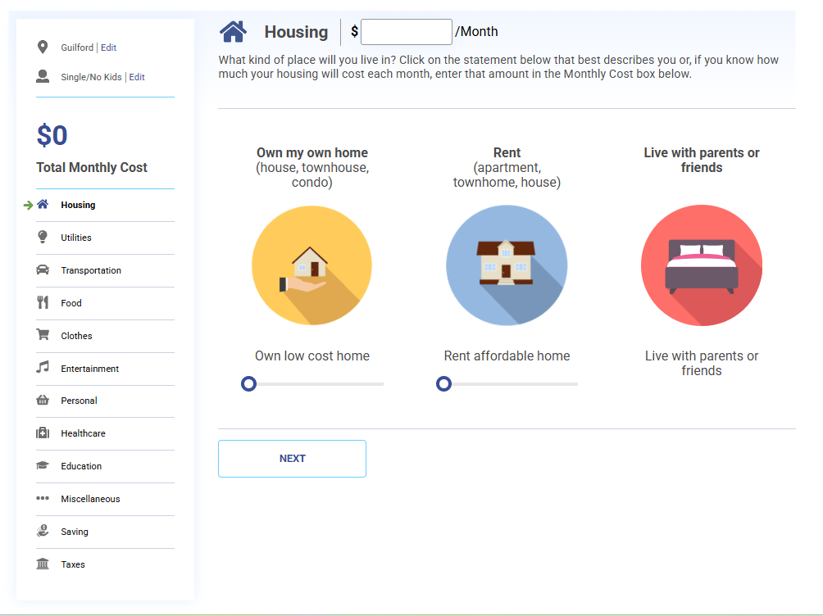
Lifestyle Reality Check

Slide 11
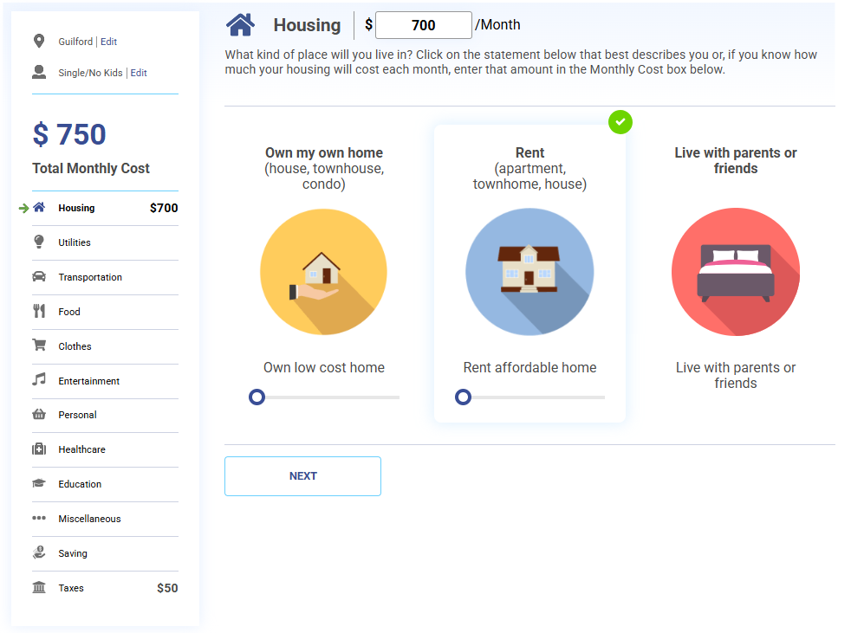
Lifestyle Reality Check

Slide 12
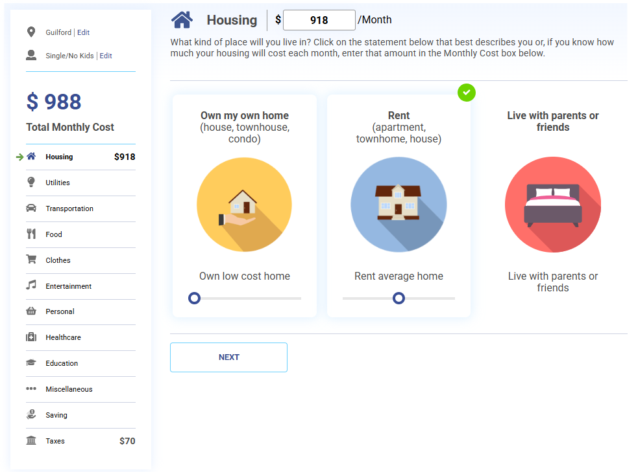
Lifestyle Reality Check

Slide 13
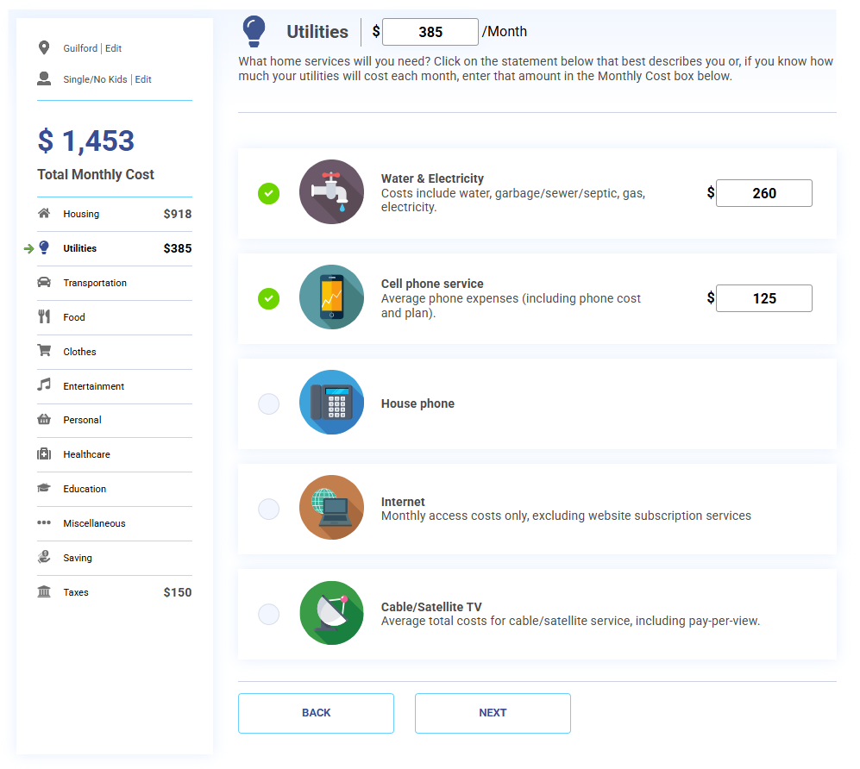
Lifestyle Reality Check

Slide 14
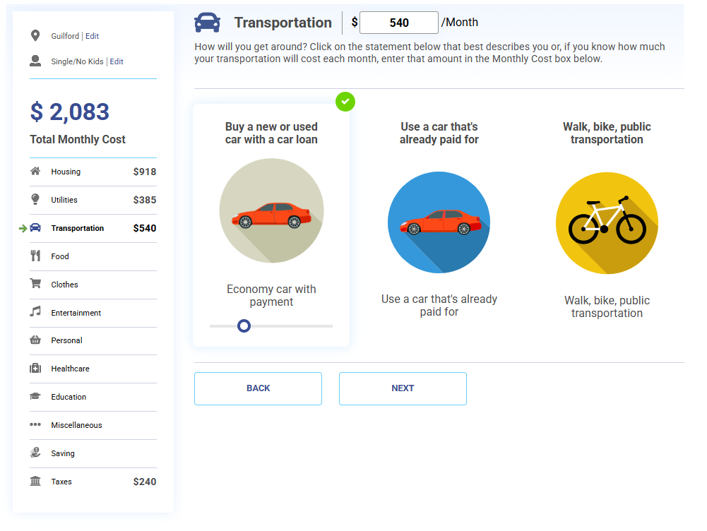
Lifestyle Reality Check

Slide 15
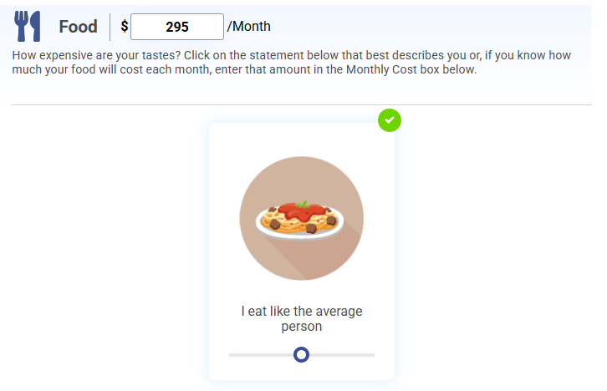
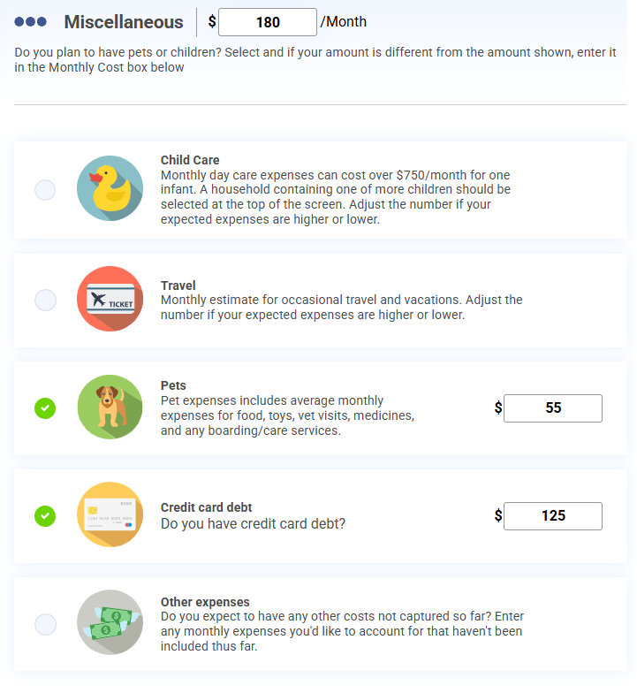
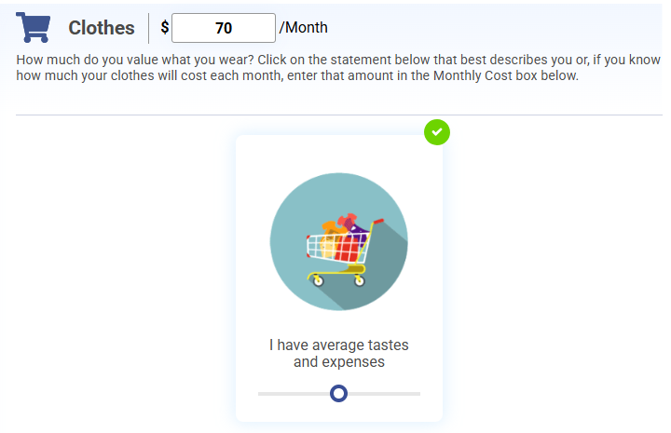
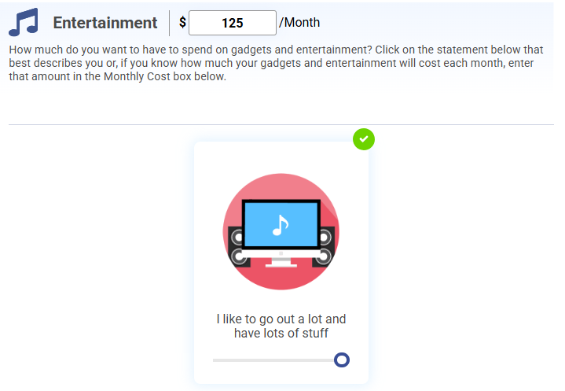
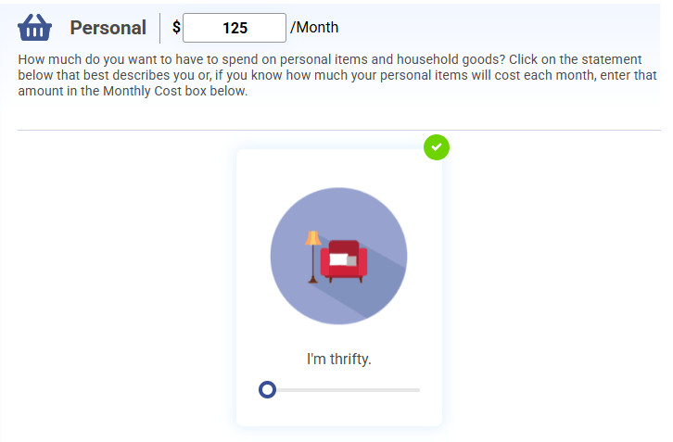
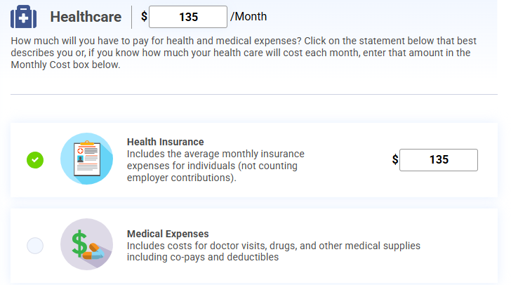
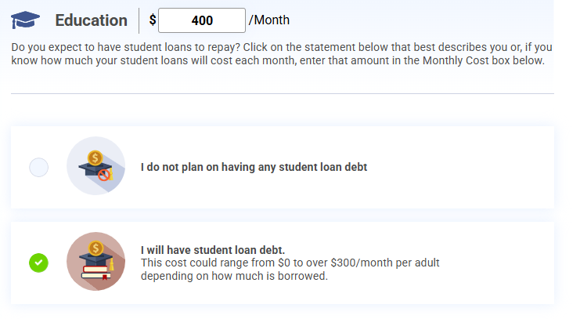
Lifestyle Reality Check

Slide 16
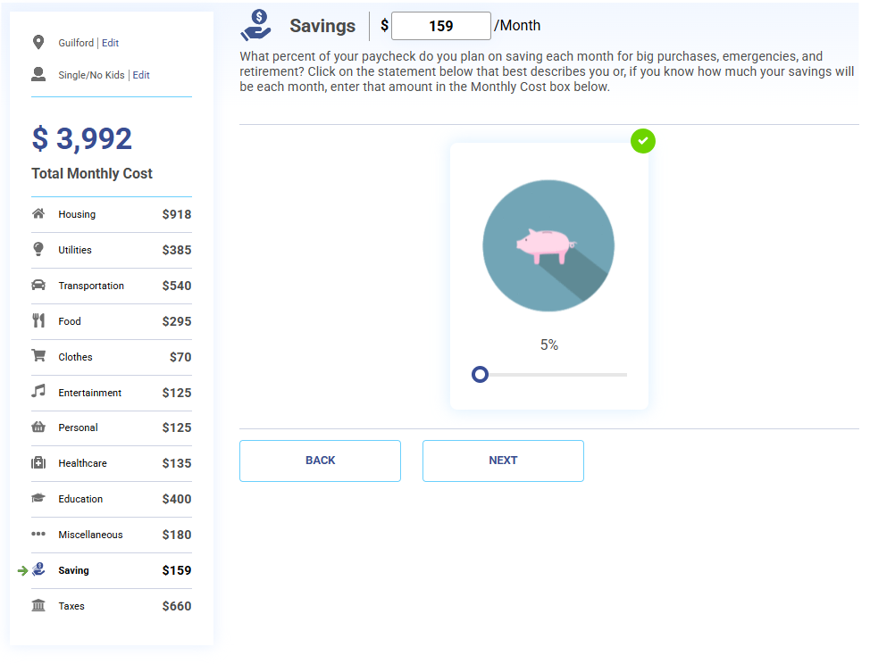
Lifestyle Reality Check

Slide 17
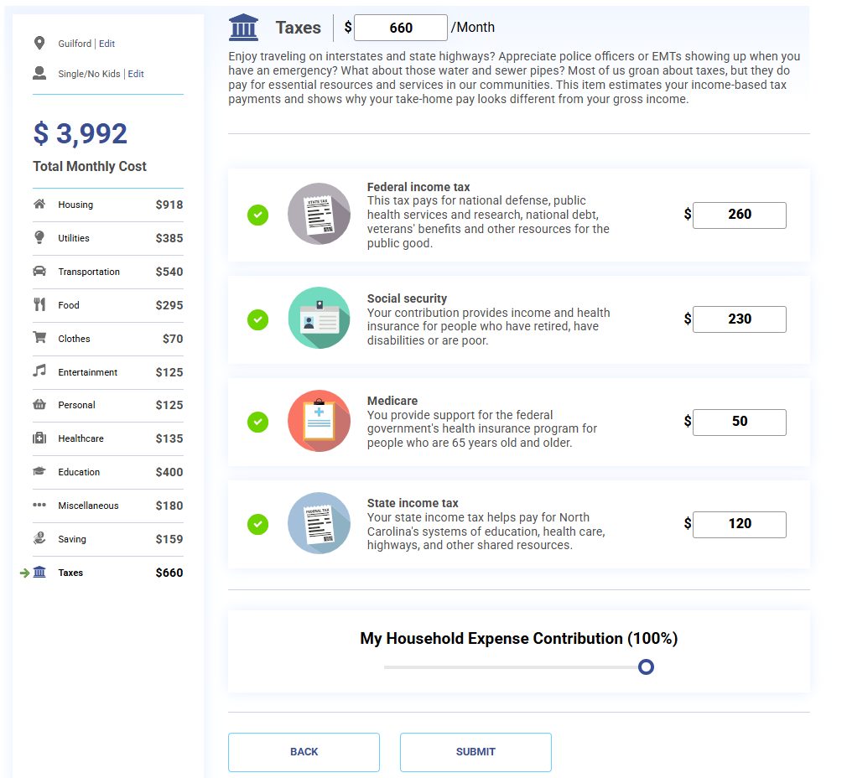
Lifestyle Reality Check

Slide 18
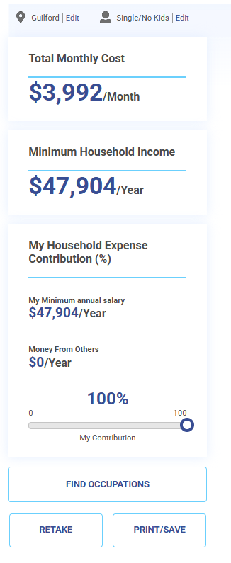
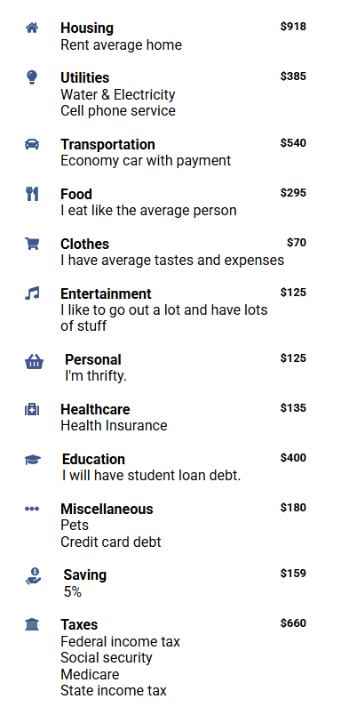
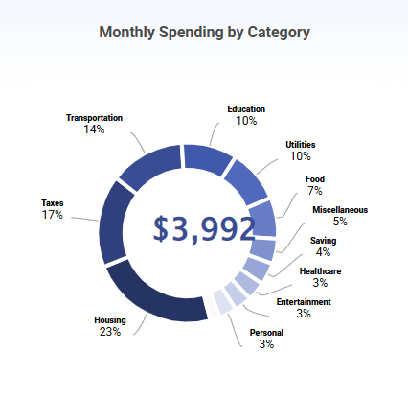
Lifestyle Reality Check

Slide 19
Budget Reality Check

Slide 20
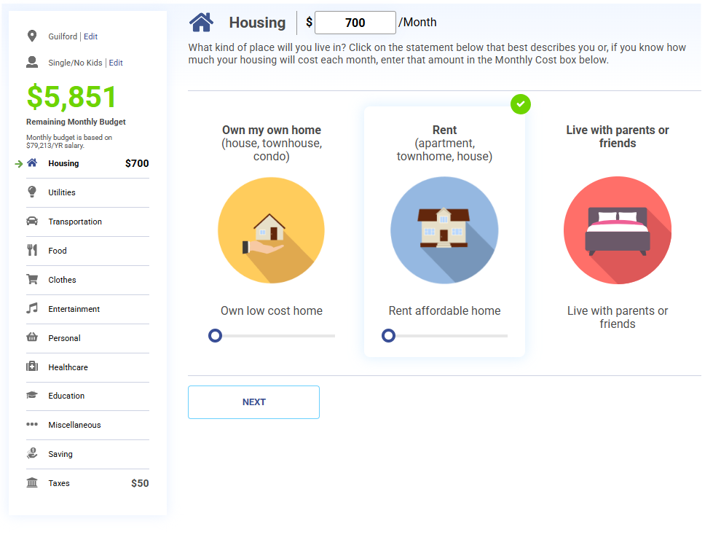
Budget Reality Check

Slide 21
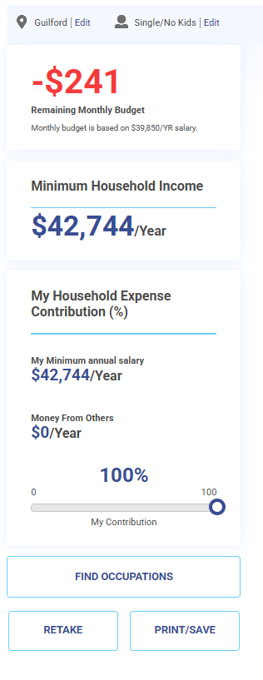
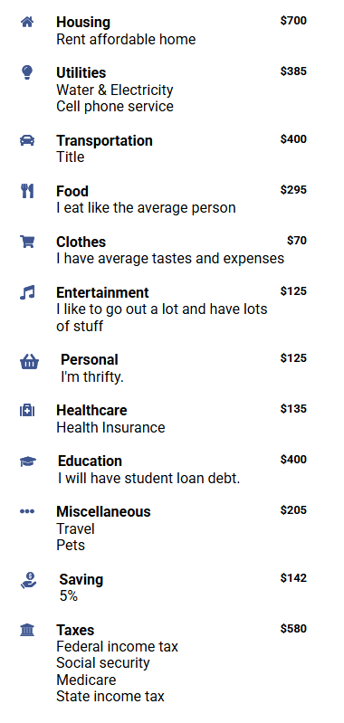
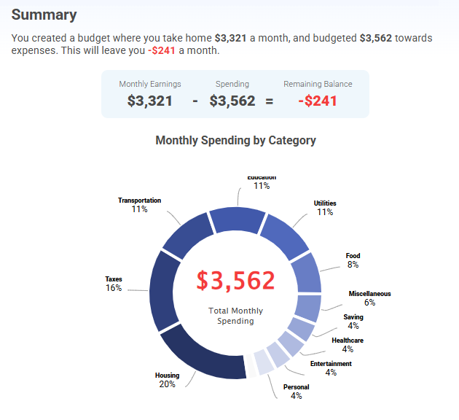
Budget Reality Check

Slide 22
Can Help you Address and Identify
Entrepreneurial Skills to Develop
Are you ready to be an entrepreneur?

Slide 23
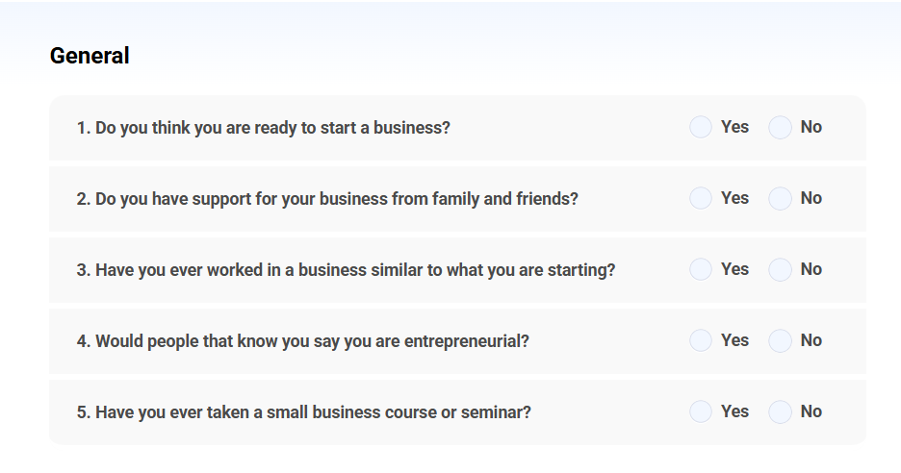
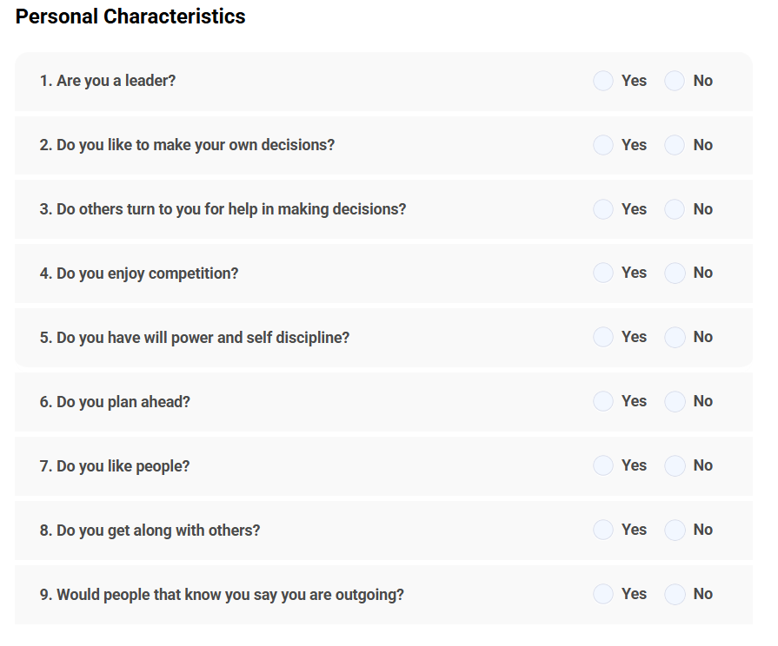
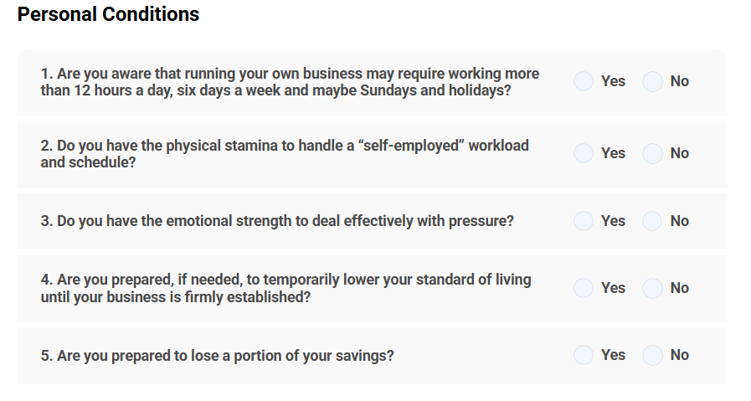
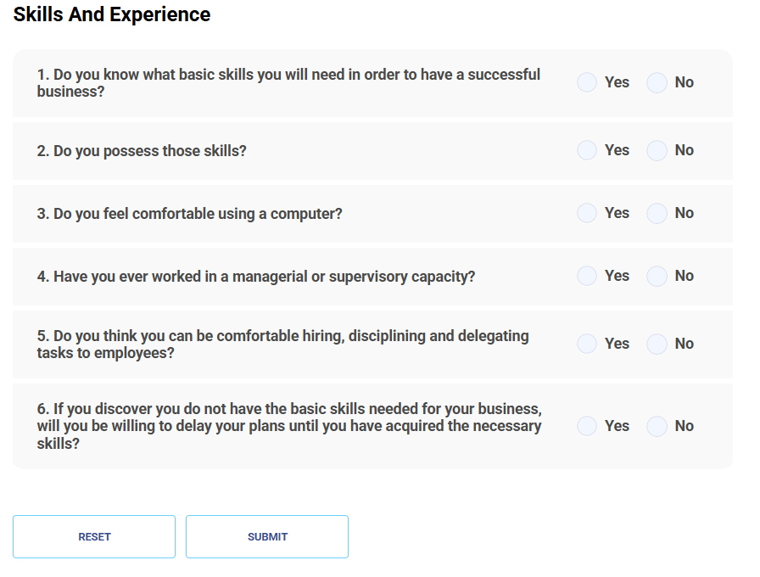

Slide 24
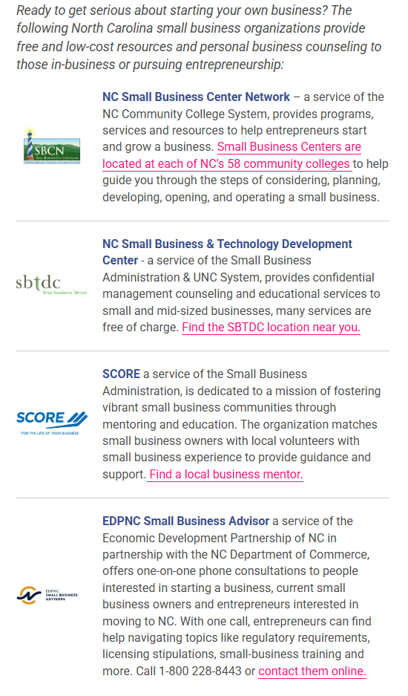
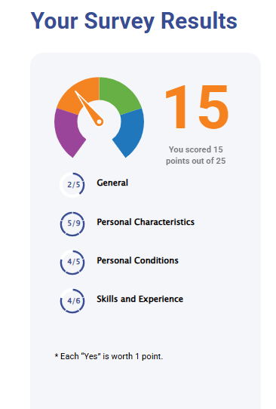
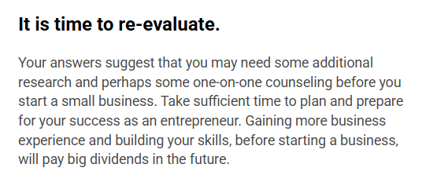

Slide 25
Other tools to find your interests…

Slide 26
Access the Labor Market Information necessary to help participants
Explore Occupations
Find the information you need on more than 800 occupations.

Slide 27
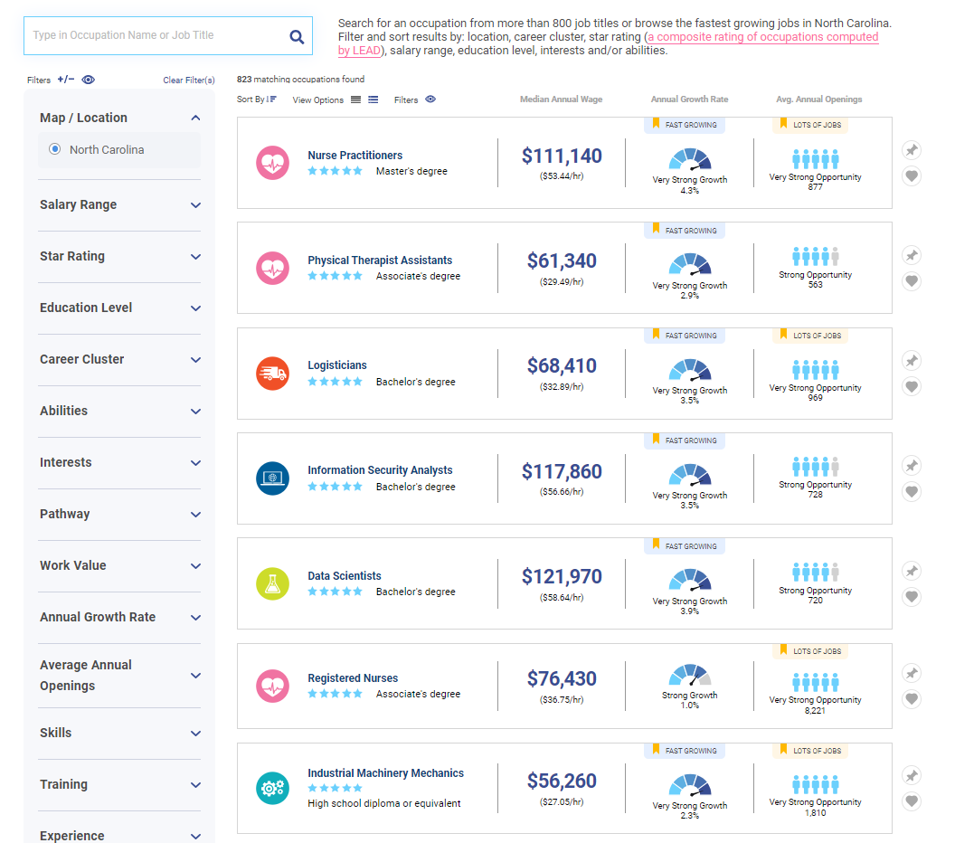
Explore Occupations Table
823 Occupations
Multiple Filters
Geography
Wages
Star Rating
Education
Career Clusters
and more…

Slide 28
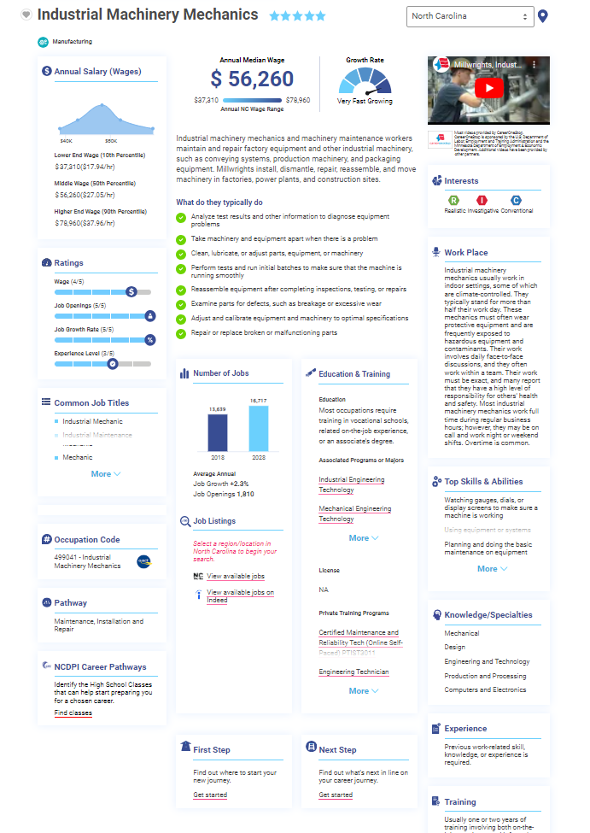
Occupation Profile Page
All data in one place
Links to additional information
Can mark as a favorite or print
Can change geography

Slide 29
Why is Geography important?
Understand what is going on in your area!
Economies are regional:
Wages
Demand
Growth

Slide 30
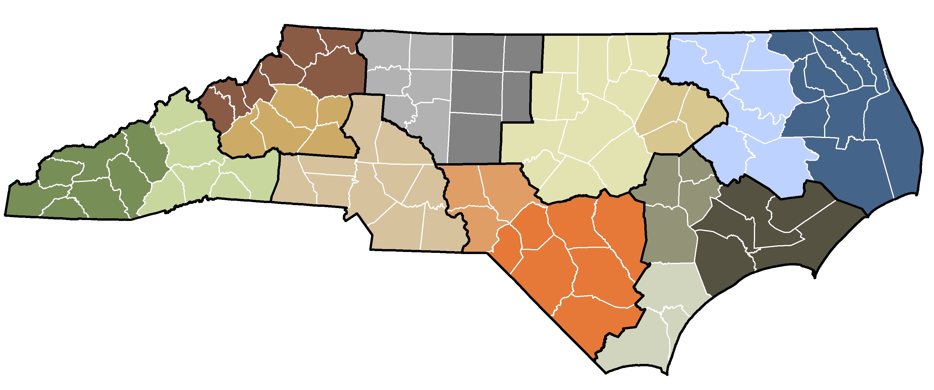
Elizabeth
City
Boone-
Wilkesboro
Winston-Salem
Raleigh-
Durham
Greenville
Waynesville-
Franklin
Greensboro
Rocky Mount-
Wilson
Hickory
Charlotte
Pinehurst-
Rockingham
Goldsboro-
Kinston
Asheville
Fayetteville-
Lumberton
Jacksonville-
New Bern
Wilmington

Slide 31
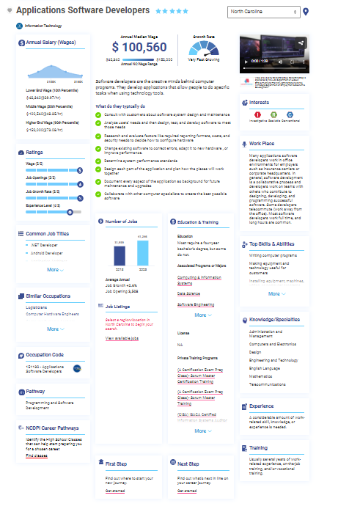
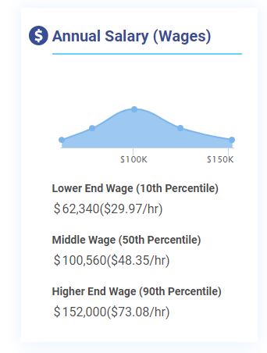
How much does it pay?

Slide 32
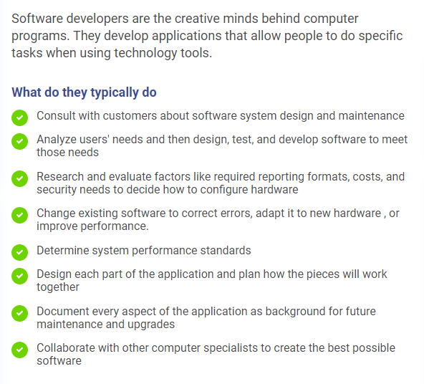
What does this occupation do?

Slide 33
Is this a good long-term prospect?
Occupations to plan for

Slide 34
Average
Wage
Growth
Rate
# of Job
Openings

Slide 35
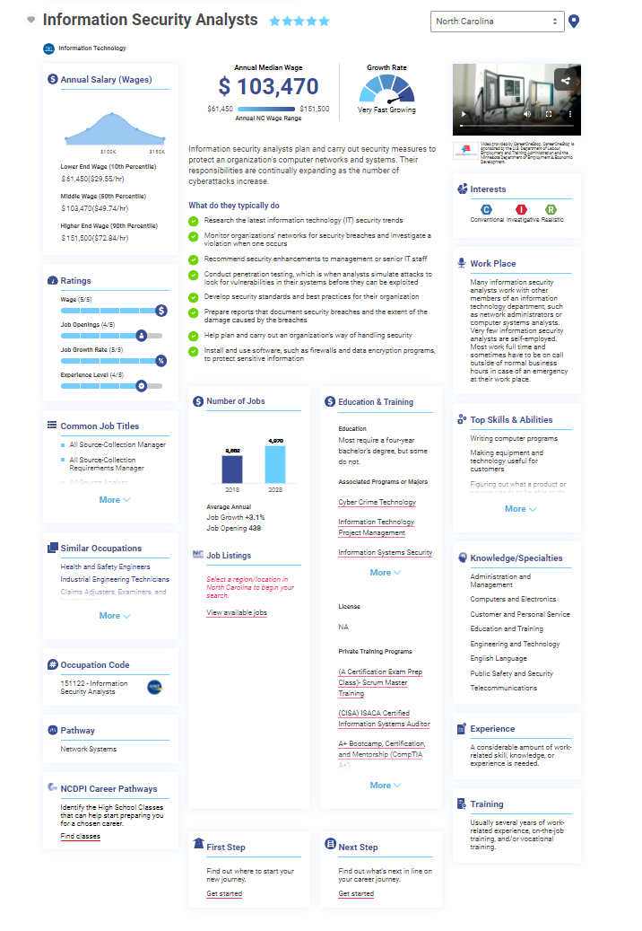
What education do I need?
Where can I get it?

Slide 36
How can an individual use it for Career Exploration?

Slide 37
Judy
Age: 21 years old
Situation: Judy has been working off an on in retail since she graduated from HS. She wants a steady career and thinks she would like to work in health care. She is most interested in working as a Dental Hygienist. She has been told that there is a high demand for Dental Hygienists but not much else. She has also been told that he should pursue a 4-year degree but is concerned about debt and is interested in working while pursuing higher education. How can Judy use NCcareers.org to help plan for the future?

Slide 38
“What is Judy interested in?”

Slide 39
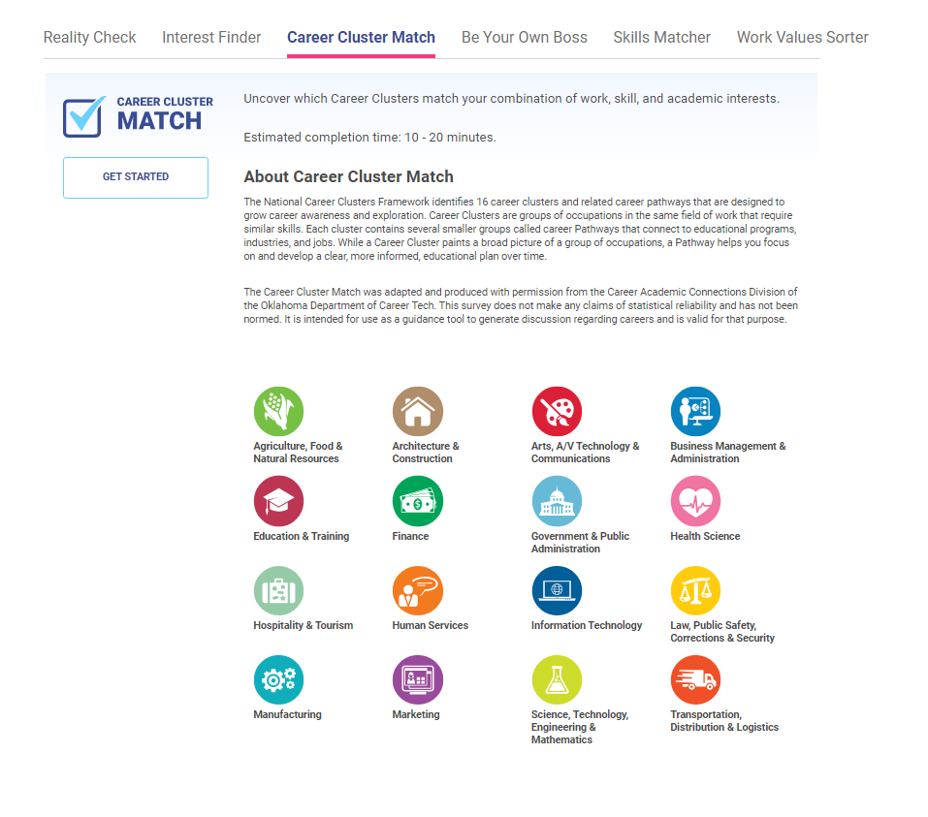
Identify favorite Career Clusters

Slide 40
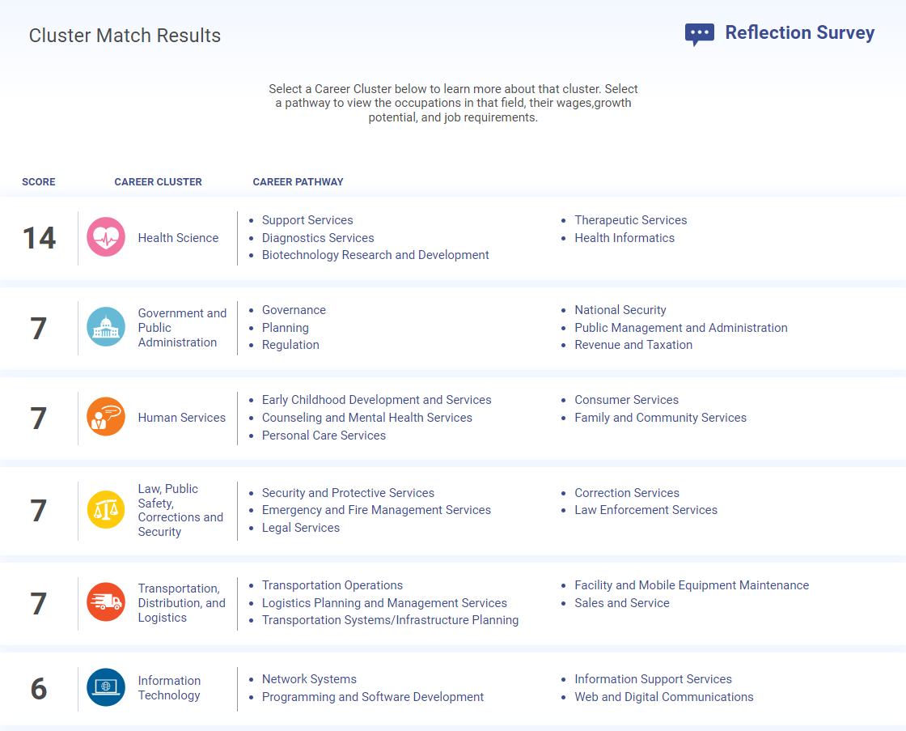

Slide 41
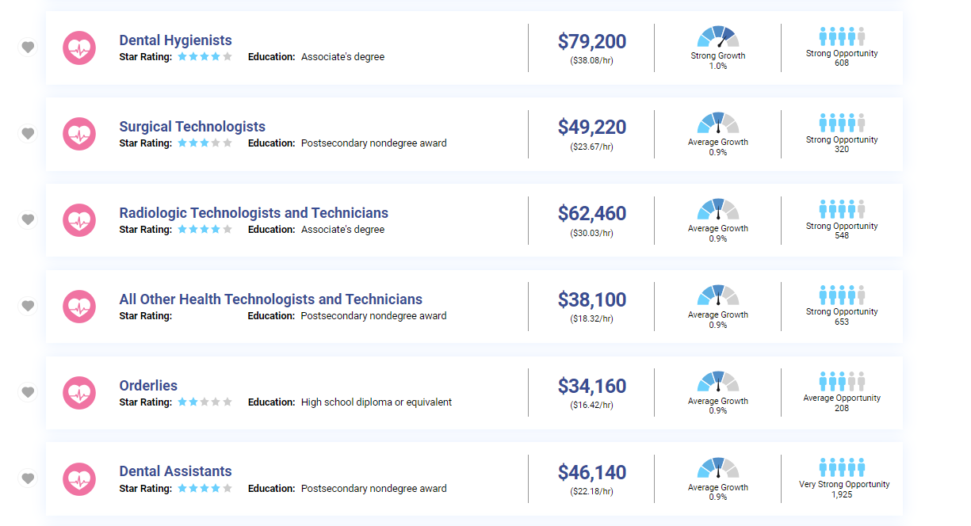

Slide 42
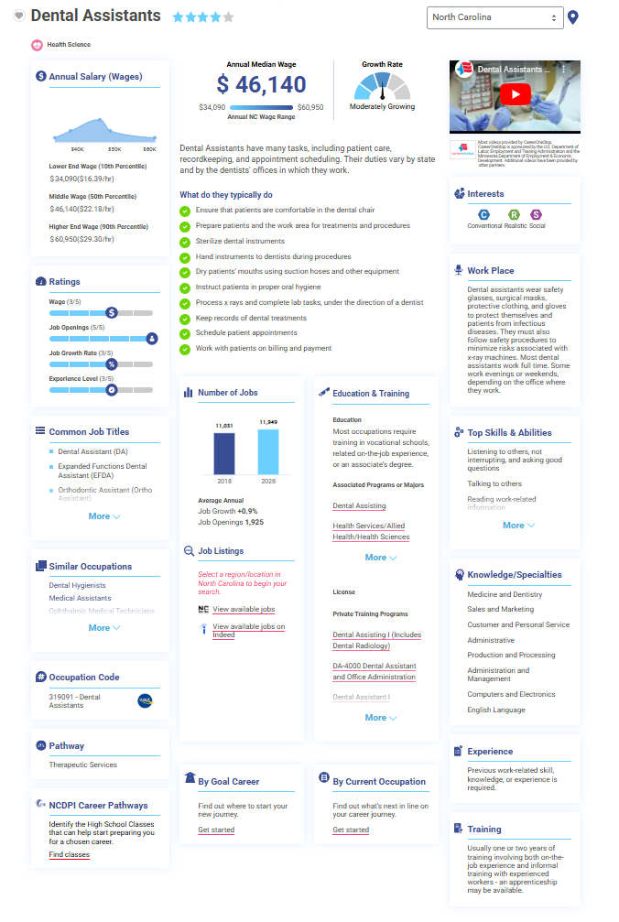
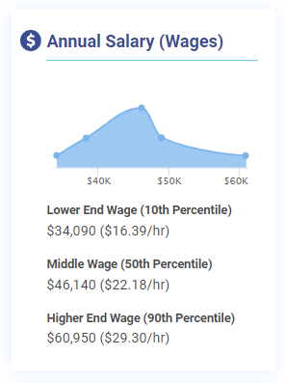
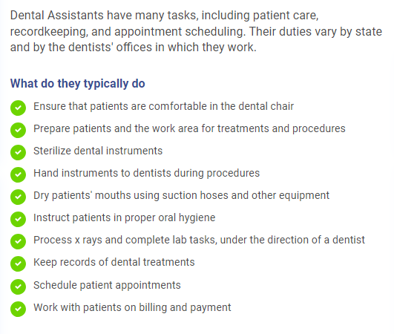
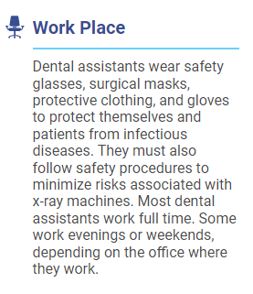
Learn about the Occupation

Slide 43
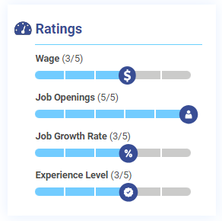
Good opportunity?

Slide 44
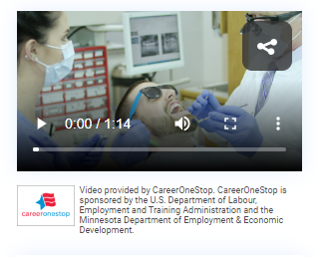
Learn more quickly…

Slide 45
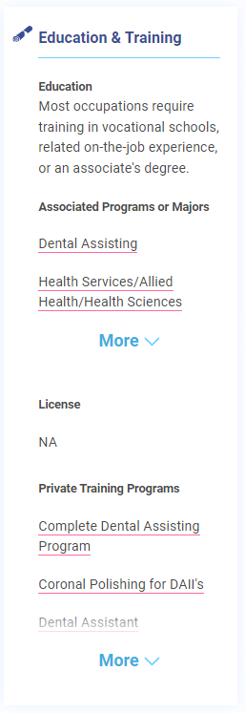
Where to get training?

Slide 46
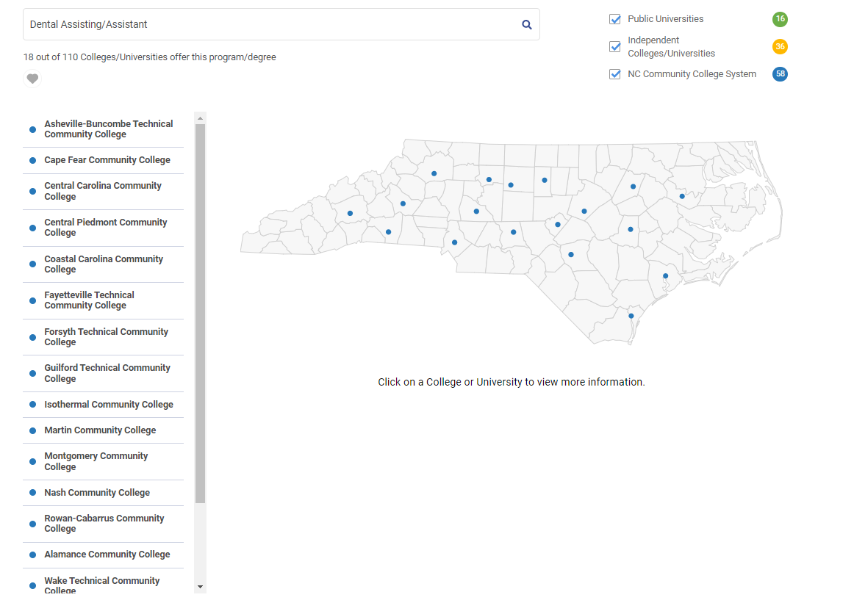
For detailed info on the school:

Slide 47
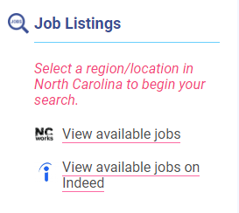
Who is hiring?

Slide 48
Does it lead to a Dental Hygienist?

Slide 51
To view Occupation Profile

Slide 53
Create a free account
Not required for access!

Slide 54
Account Creation
Use current CFNC, NCWorks or NCEdCloud credentials
Not required for access!
Free for all users
Save
Assessment Results
Career Development Plans
Favorite Occupations and more!

Slide 55
Did you say something about Career Development Plans?

Slide 58
Why is it important to have a CDP?
Opportunity to better display and share
NC Regional Data
NC Higher Education
Ease of Portability
Across Districts
Past High School
Ability to update as needed
Focus on Goals
Find my Interests
Explore Occupations
Plan My Career
Education & Training

Slide 59
Jamie Vaughn
Sr. Analyst for Market Intelligence
Jamie.Vaughn@commerce.nc.gov
@CareersInNC
@LEADNC
Facebook.com/NCcareers.org

