Slide 1
Martin Community College EQUINE SCIENCE
DIRECTOR
TAMMIE THURSTON
INSTRUCTOR
LAWSON WALSTON
FACILITY MANAGER
MARY DALCOURT

Slide 2
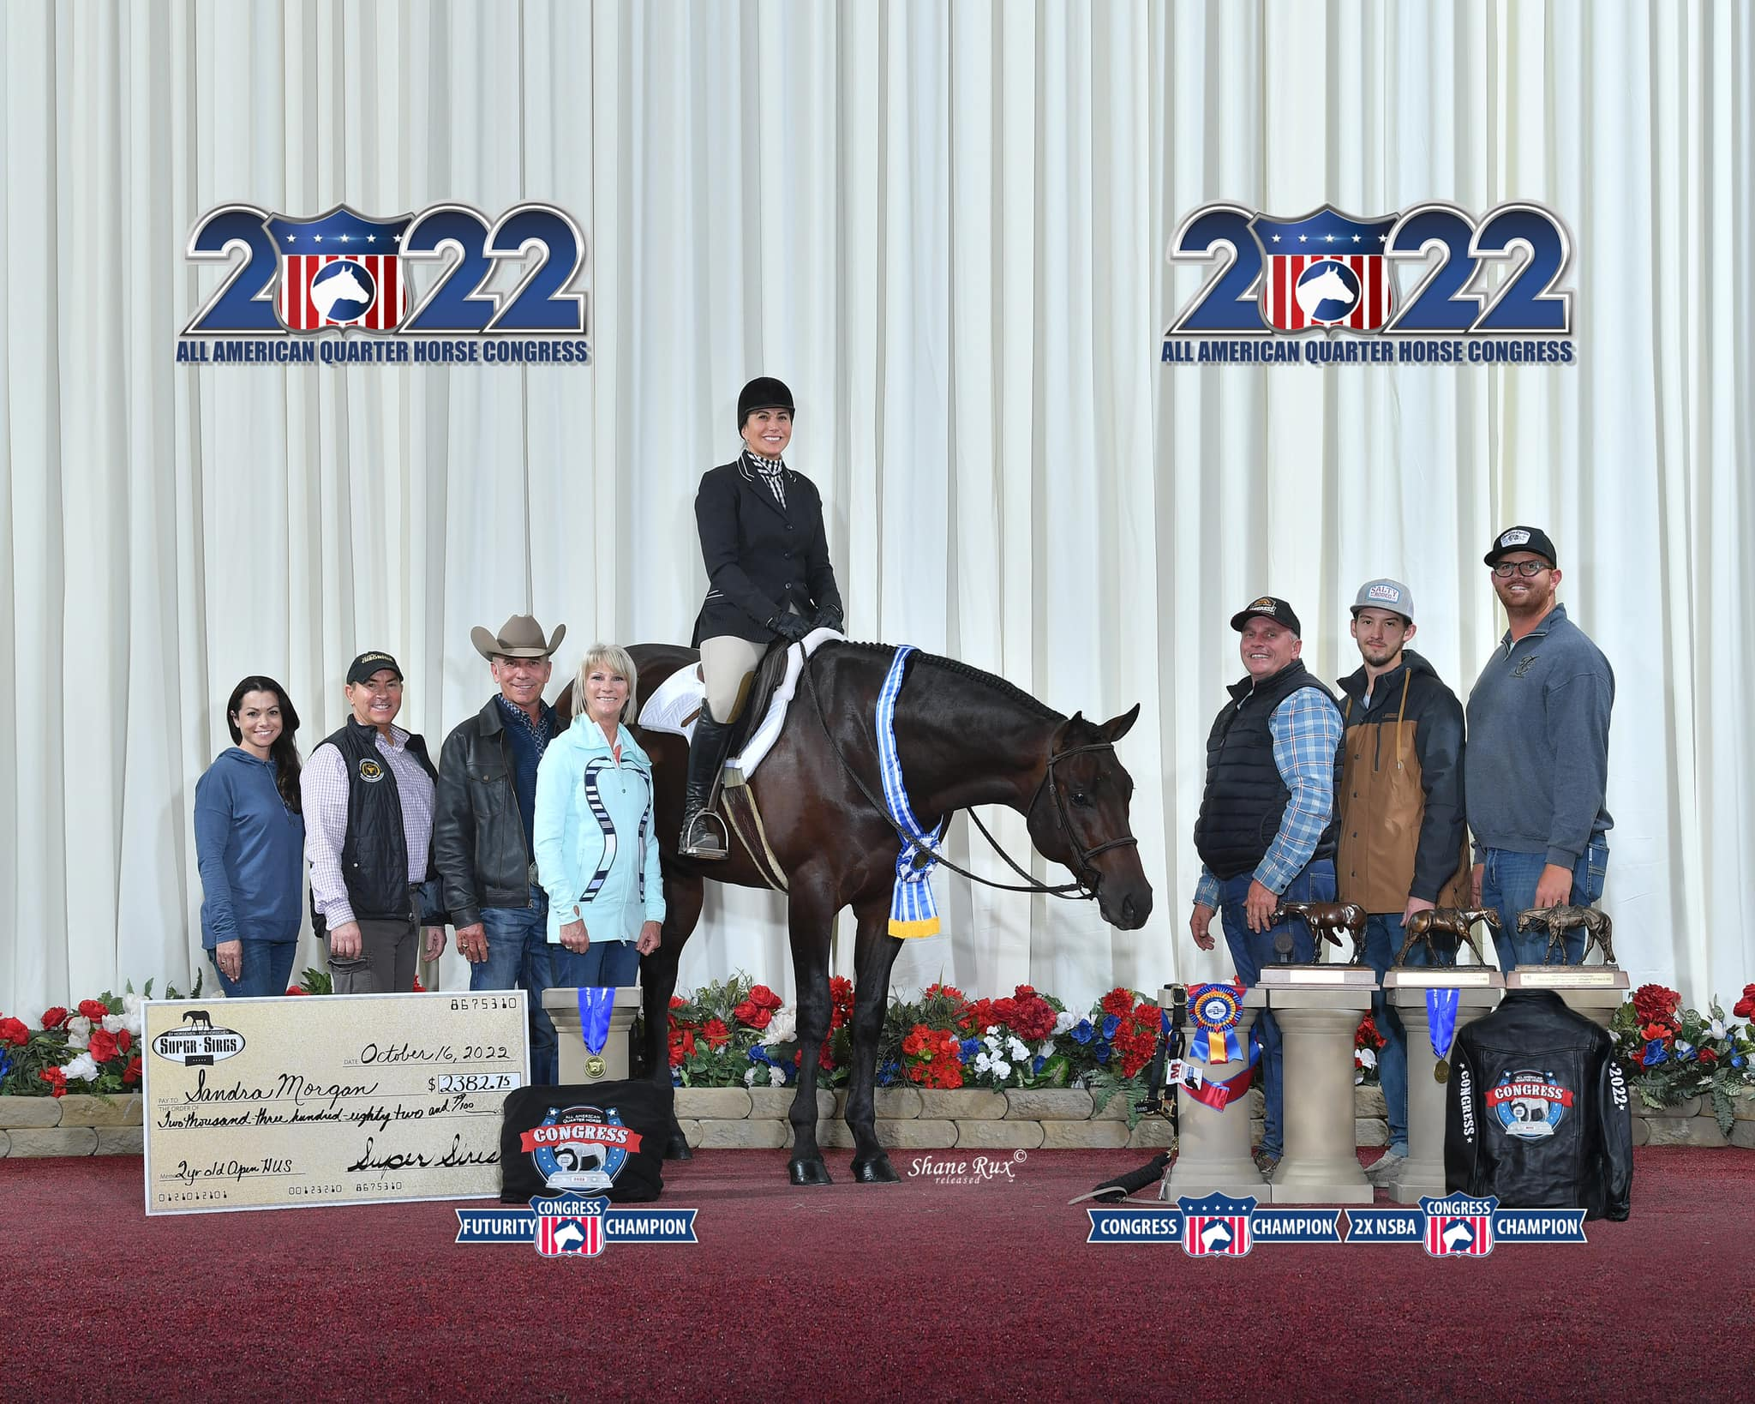
Tami Thurston Martin CC Equine Director Graduate University of Findlay
“This is my chance to give back to the equine community that’s given so much to me”

Slide 3
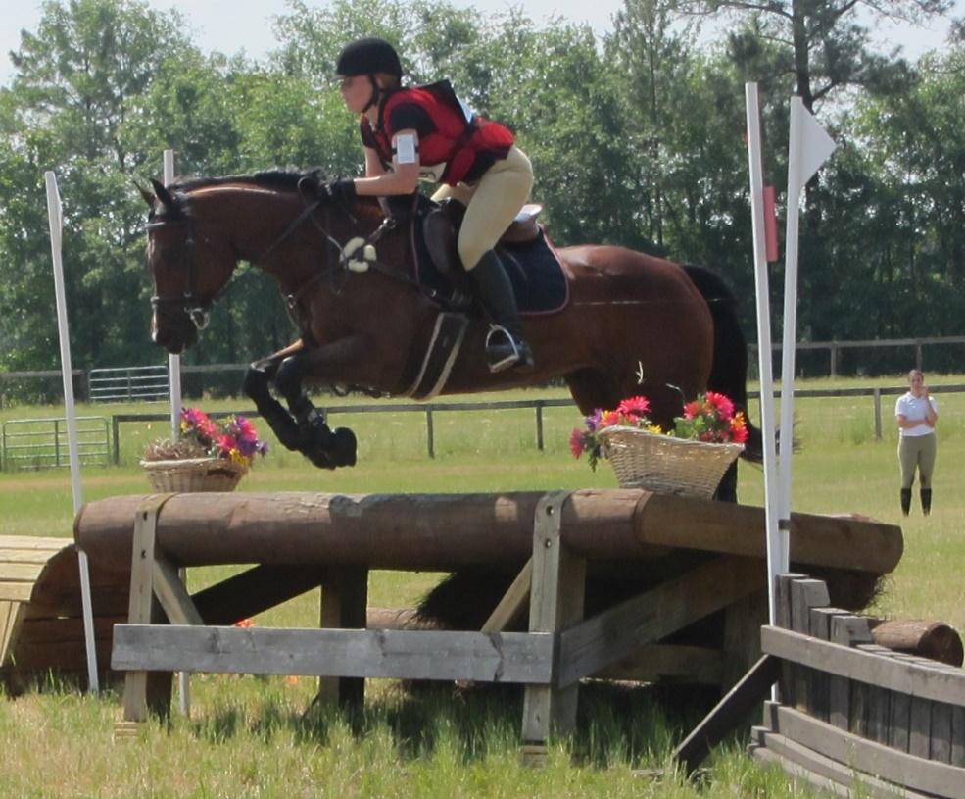
Mary Dalcourt Facilities Manager Open show/Eventing Coach MCC graduate 2009
“It’s so important as an equine professional to be well-rounded. Everyone loves the riding and the horses, not everyone loves it enough to want to learn the ins and outs of everything that comes along with it.”

Slide 4
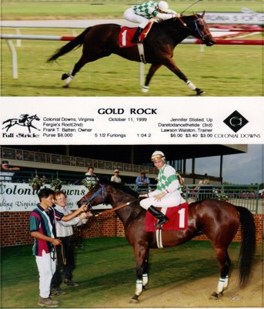
Lawson Walston MCC Instructor of Equine Business and Equine training NCSU Graduate
"My Mission is to provide a valuable resource to the students and horseman while offering priceless opportunities for learning and growth "

Slide 5
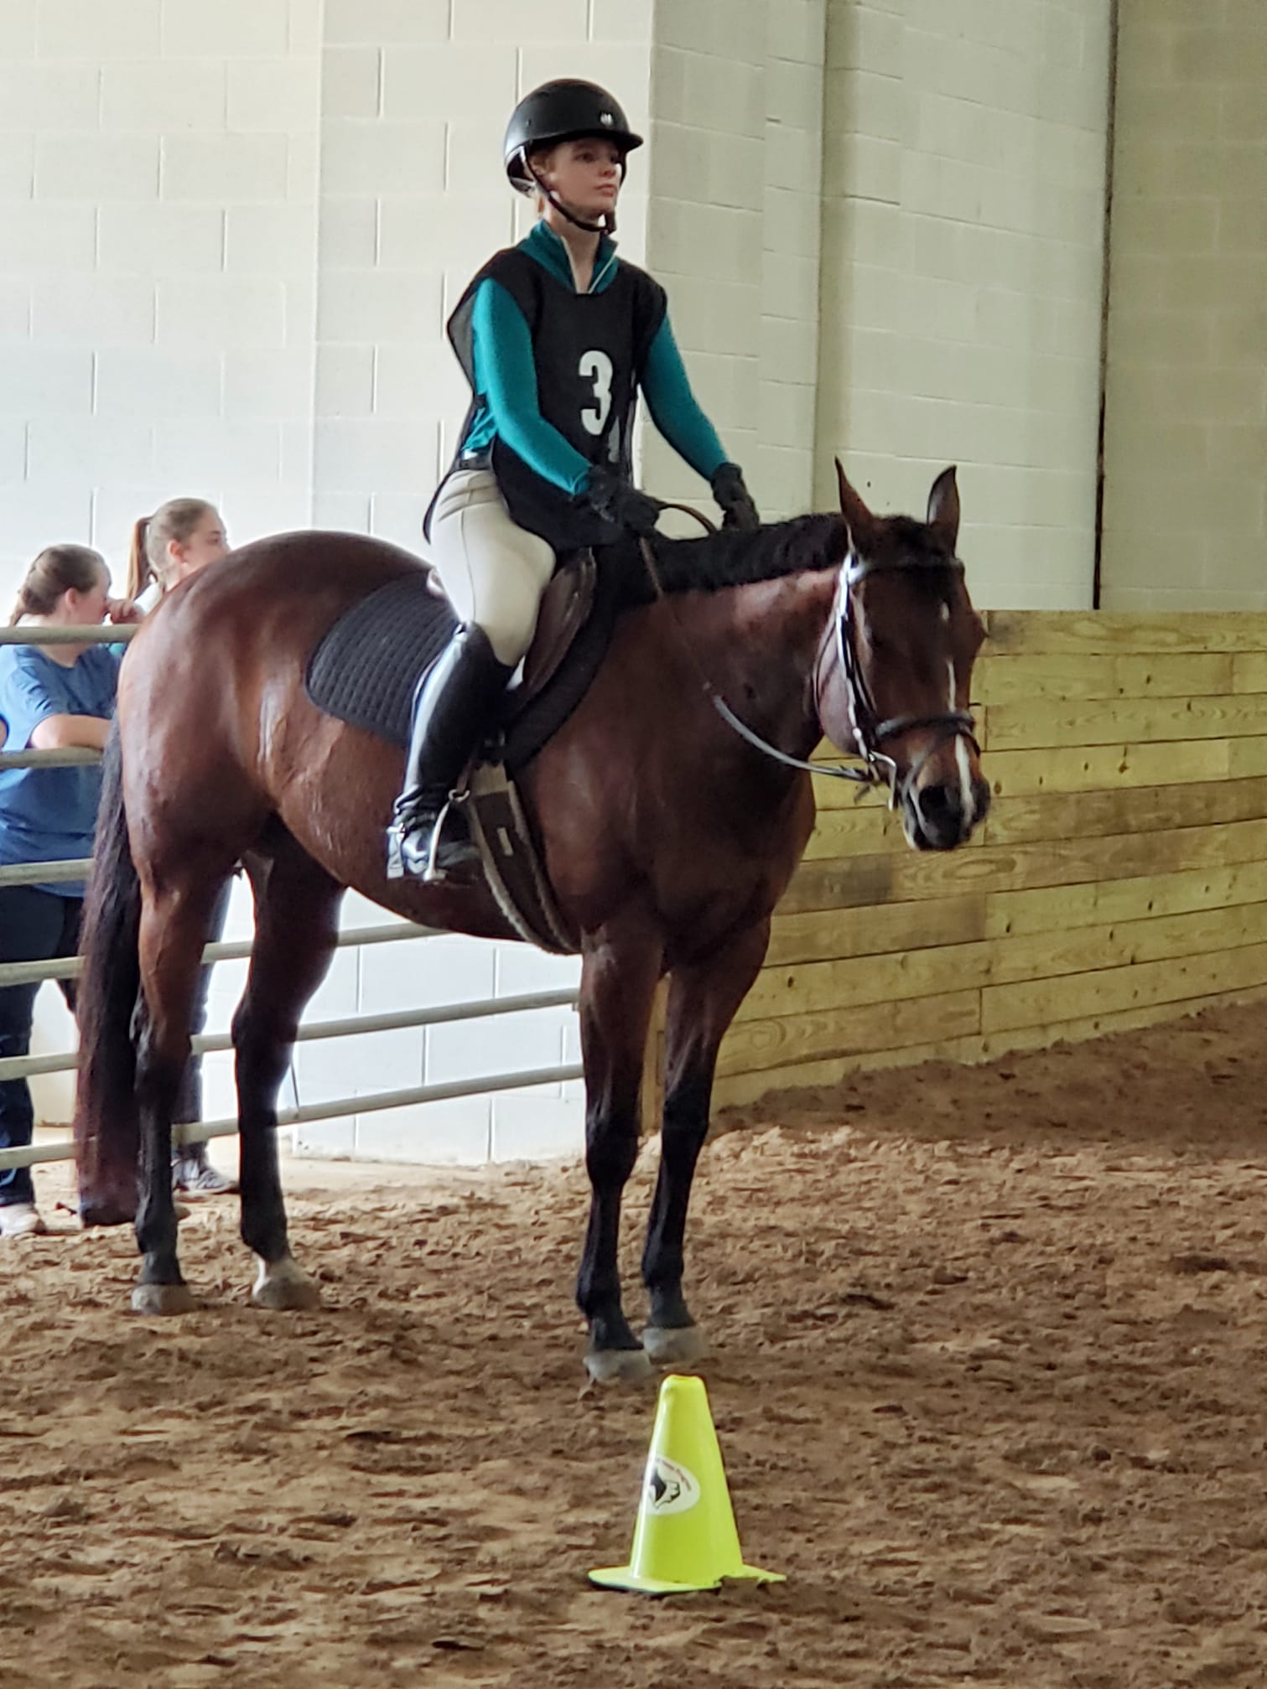
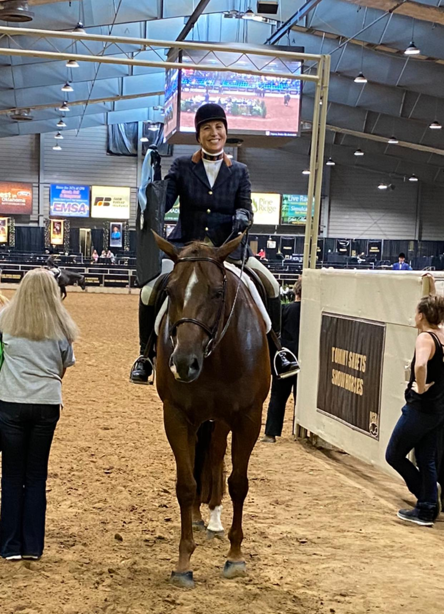
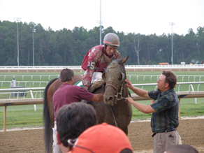
MCC instructors have diverse
experiences in a wide range of disciplines.
Cl

Slide 6
The Equine Technology curriculum is designed to prepare students for positions within the horse industry. The curriculum is management oriented, preparing graduates for the widest range of available equine jobs; areas of specialization may be pursued during a summer internship and co-op program.
MCC offers curriculum and instruction in...
Horse Science
Equine Evaluation
Farm Management and Business Practices
Equine Software
Equine Law
Equine Anatomy and Physiology
Equine Nutrition
Equine Riding Instruction
Natural Horsemanship Groundwork / Showmanship
Colt Starting
Stock Horse Disciplines:
Western Pleasure
Hunter Under Saddle
Equitation / Horsemanship

Slide 7
Programs of Study
Equine Training, A.A.S. Degree
Focuses on training, groundwork, and showing
More “hands on” and time spent at the Equine Facility
Equine Business, A.A.S. Degree
Focuses on management
More time spent in a classroom setting
Equine Training and Business Diploma/Highschool
Completion in three semesters
Equine Science Certificate
Completion in two semesters

Slide 8
Freshmen Equine Classes *does not include General Education courses
First Semester
Second Semester
Horse Science I
Equine Evaluation I
Horsemanship I
Equine Anatomy & Physiology
Horse Science II
Equine Evaluation II
Horsemanship II
Equine Nutrition
Sophomore Equine Classes
Horse Farm Management I
Horse Training I
Equine Business Law
Horse Farm Management II
Horse Training II
Equine Reproduction & Genetics
Basic Colt Training
Principles of Riding Instruction

Slide 9
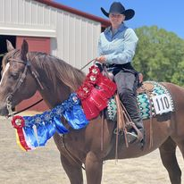
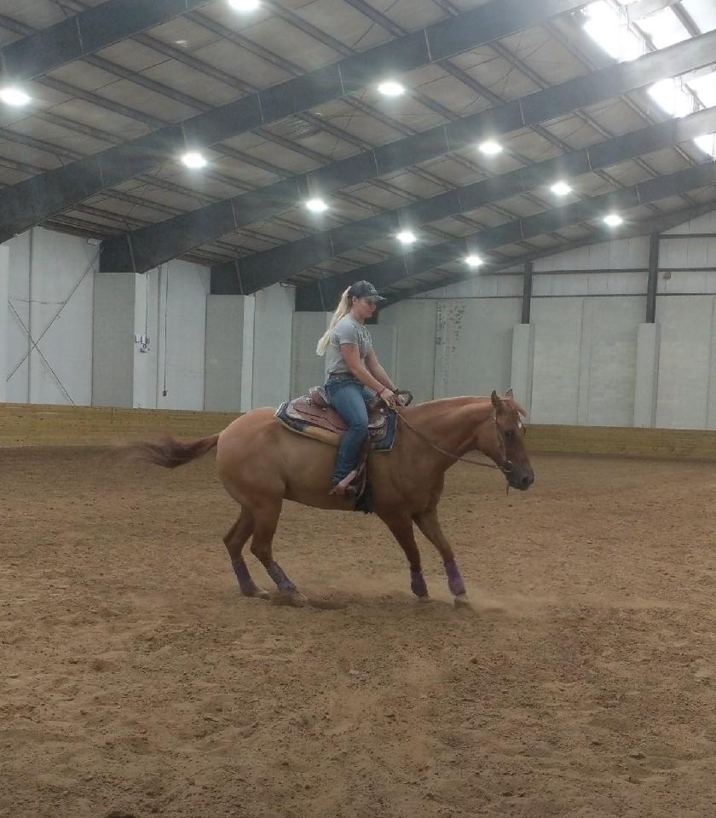
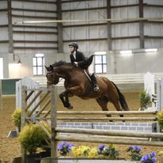
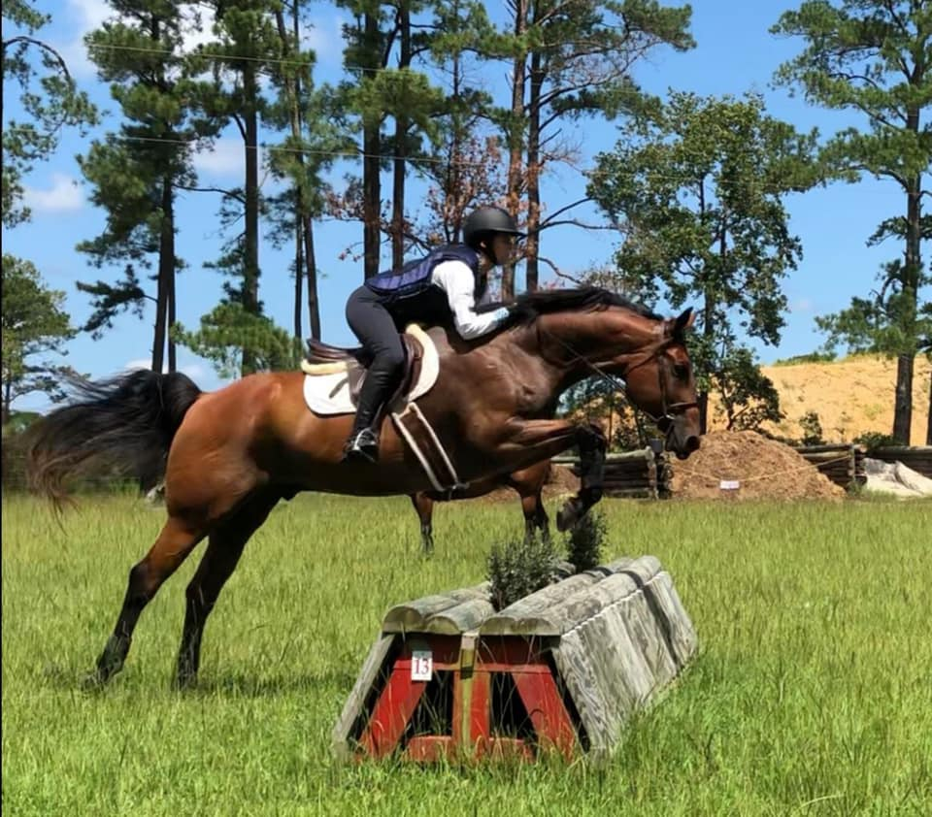
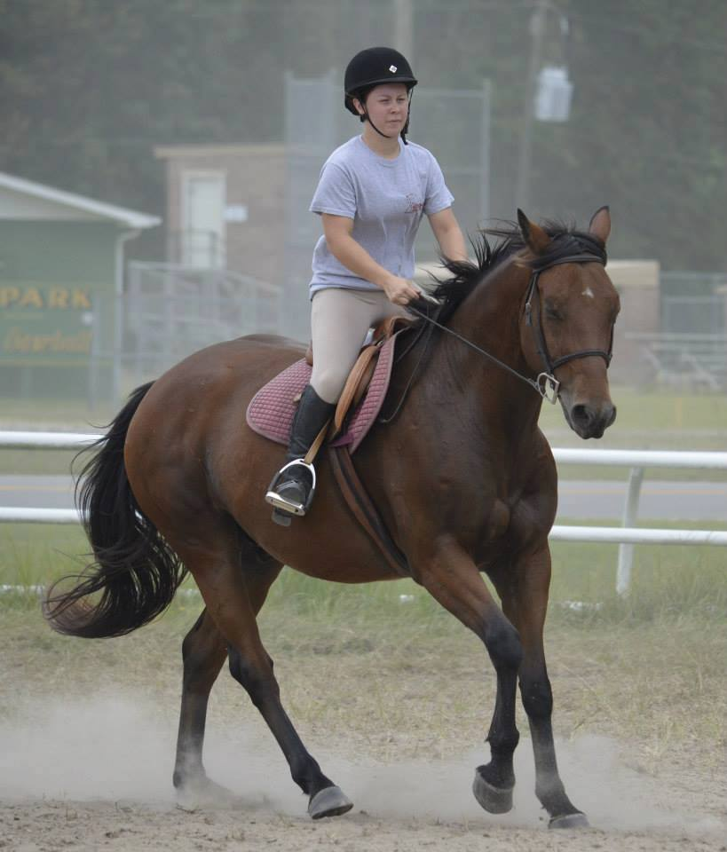
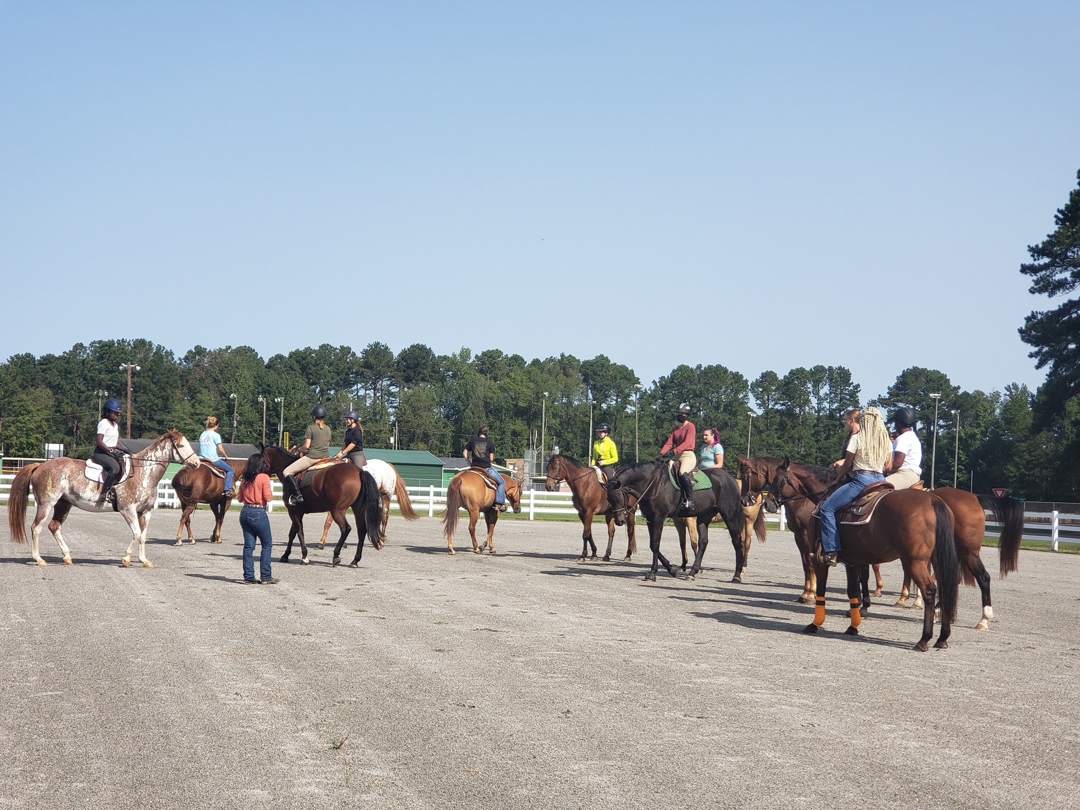
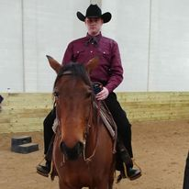
The MCC herd ranges from 40-45 horses on average to be used in during the various classes. Students are paired with horses based upon ability and interests.
LOOK MCC Foundation HSA, Region 5
Horse of the Year

Slide 10
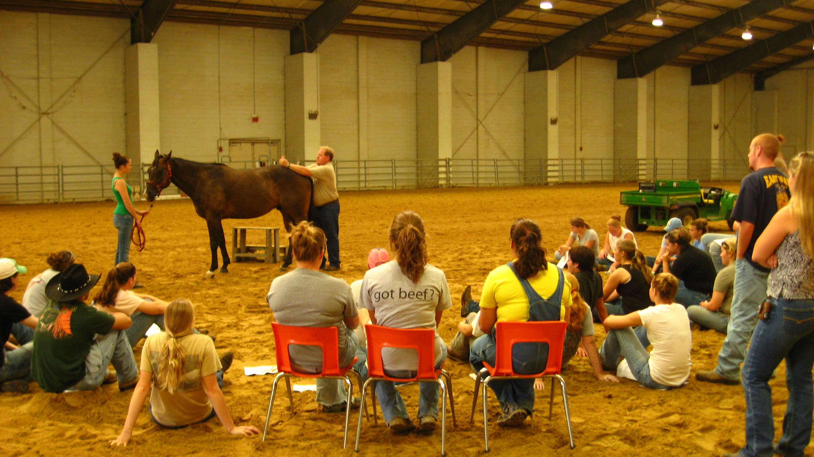
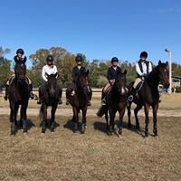
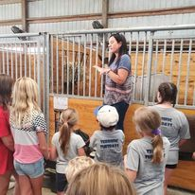
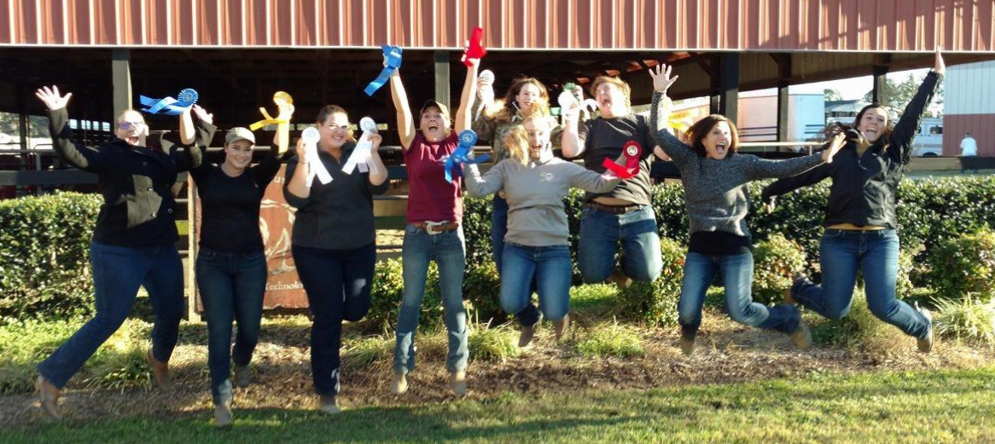
What’s Happening…

Slide 11
Facility Renovations/Upgrades
Total renovation of Barns A and B and Indoor Arena
New stalls, fans, big fans, concrete, and lights
Kick wall and cleanup of indoor arena
Future Projects
Complete renovation of Barn C
Renovation of all Pasture and Paddocks
Lime, fertilize, plant grass
Shelters

Slide 12
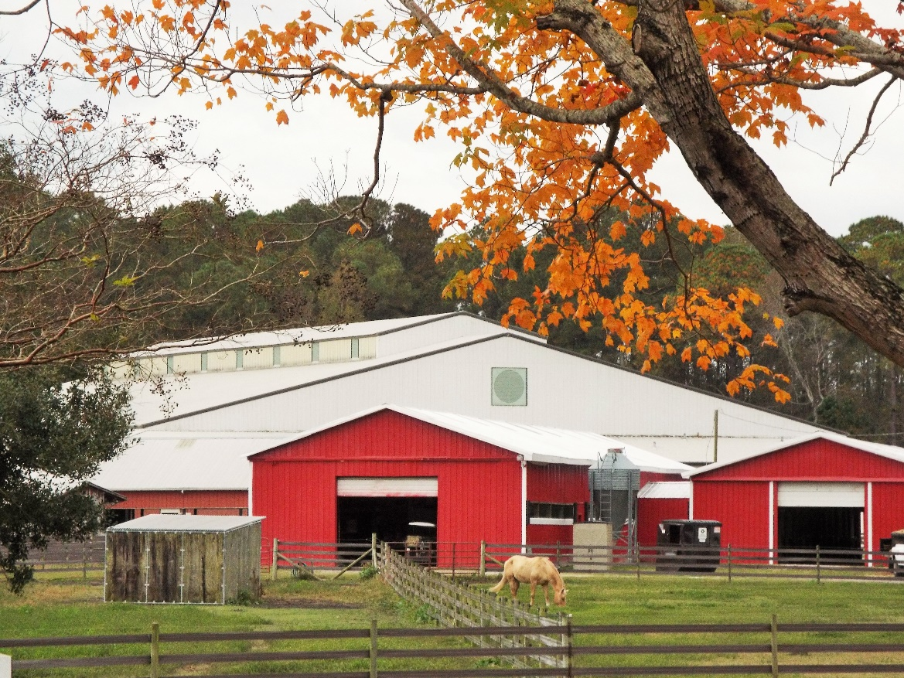
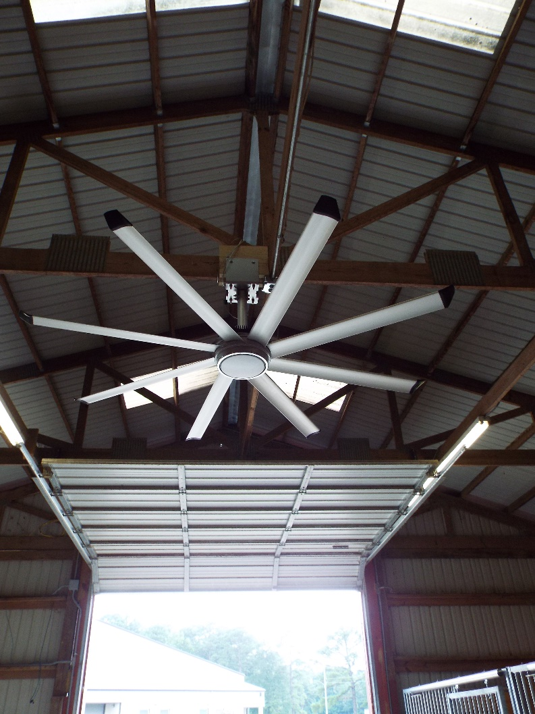
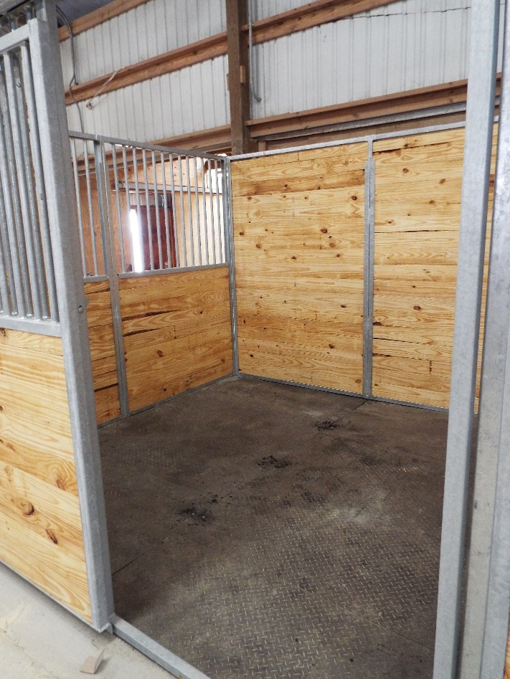
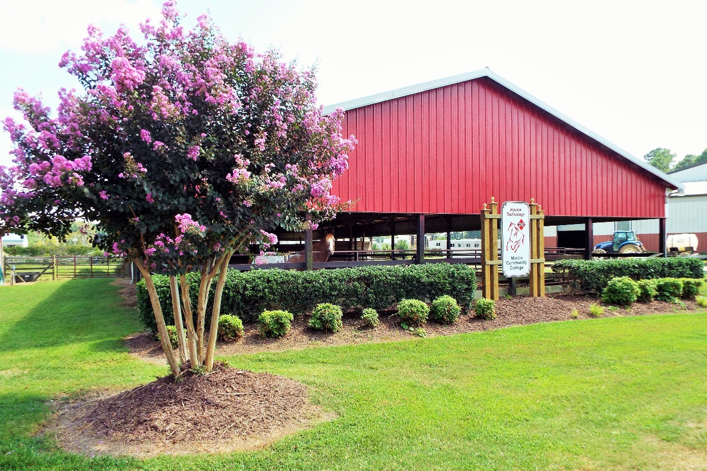
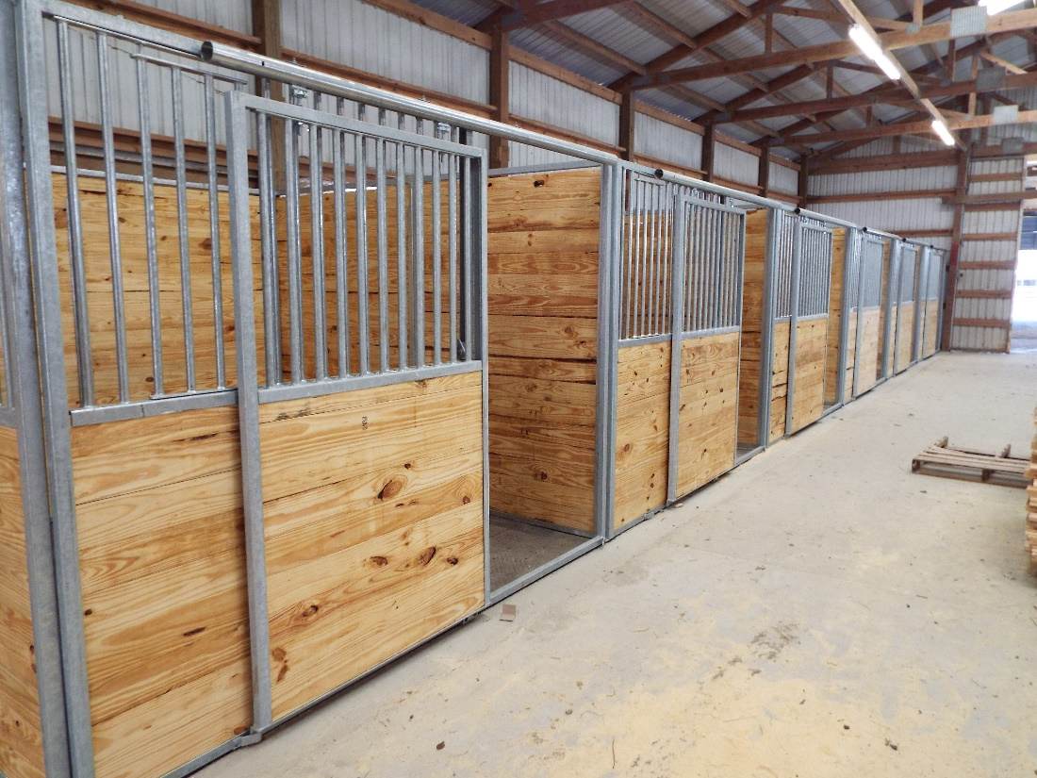

Slide 13
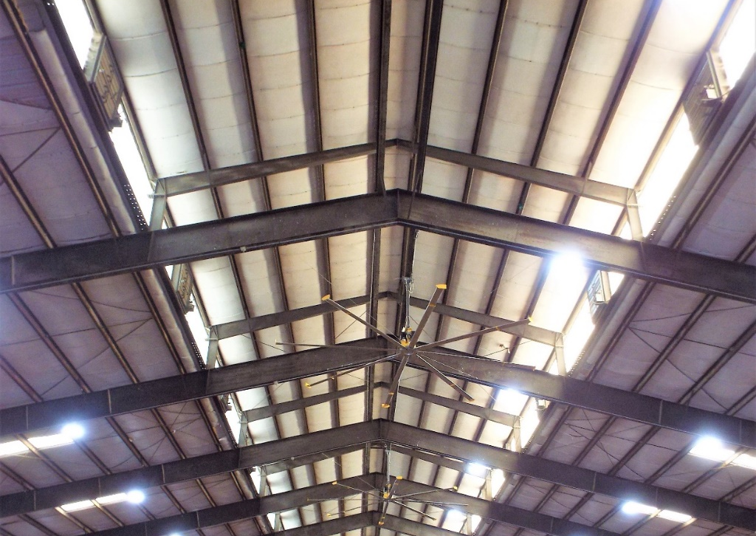
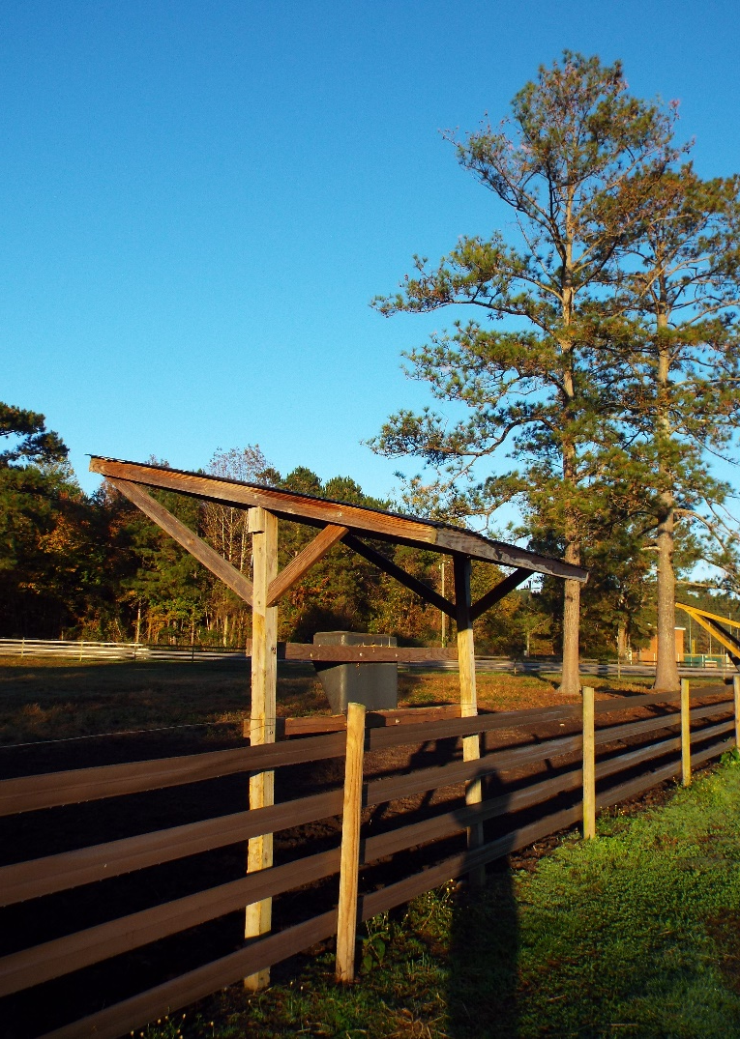
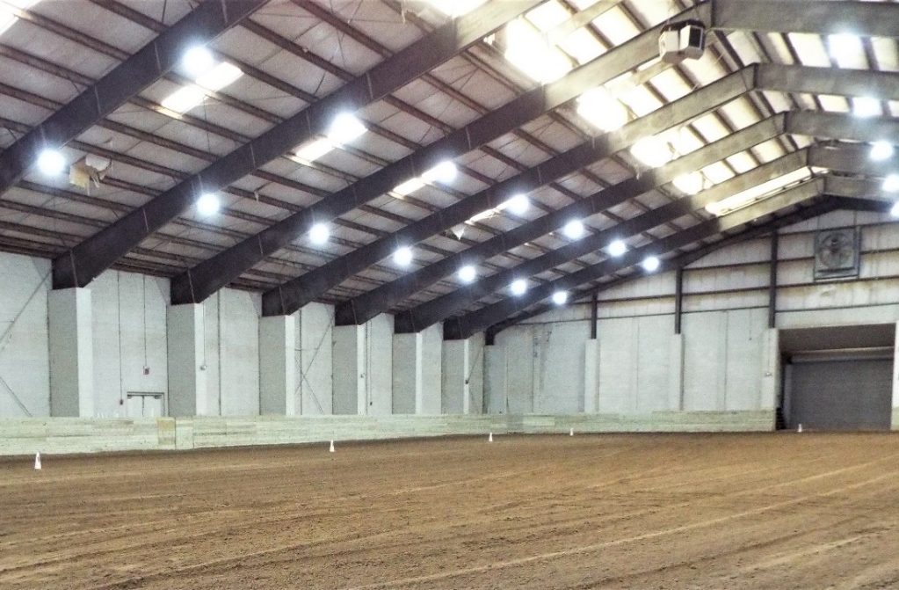

Slide 15
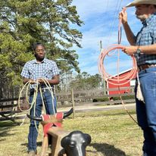
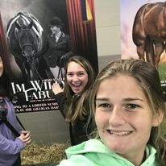
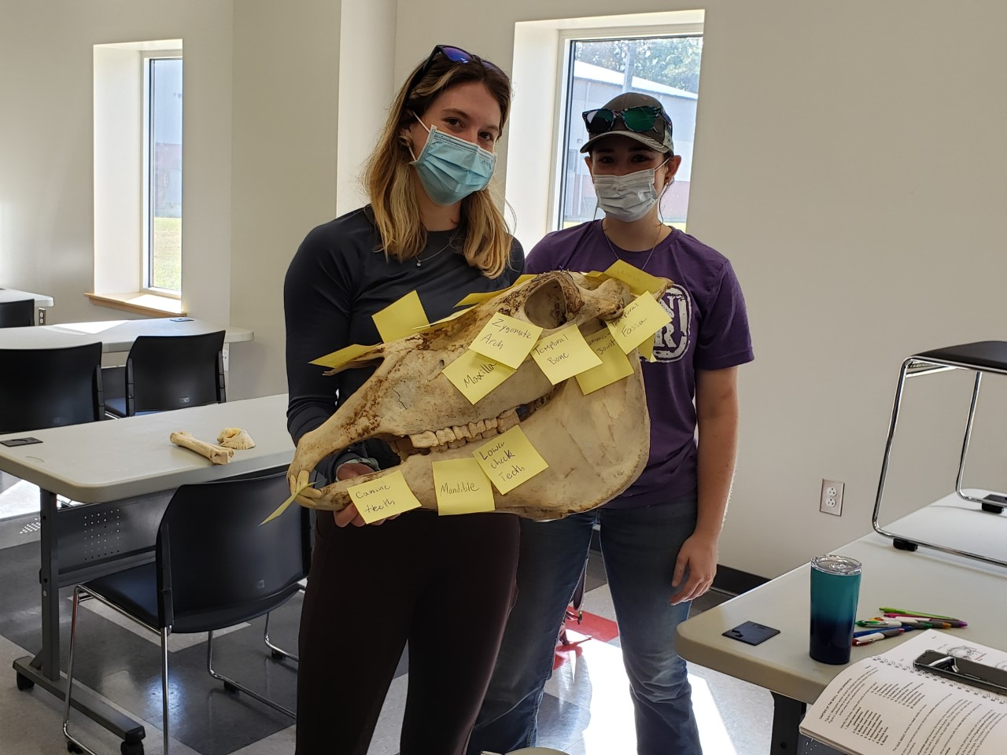
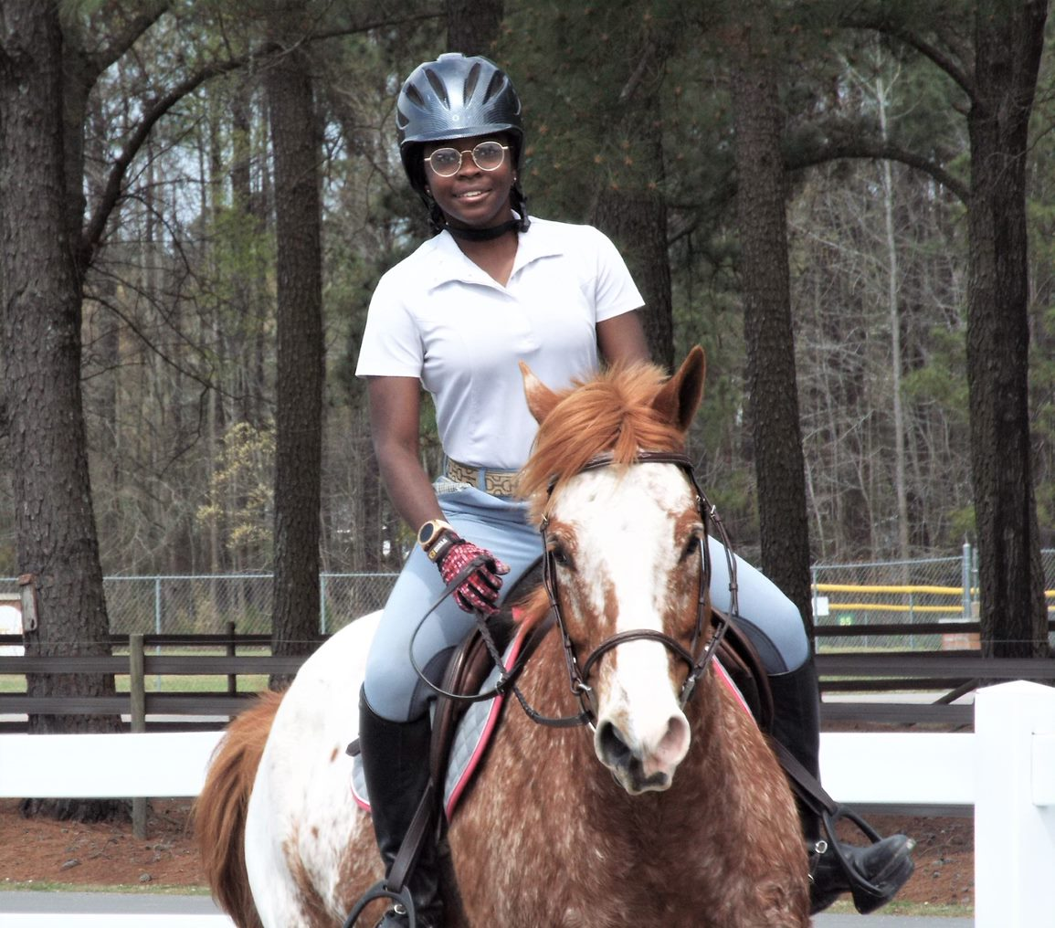
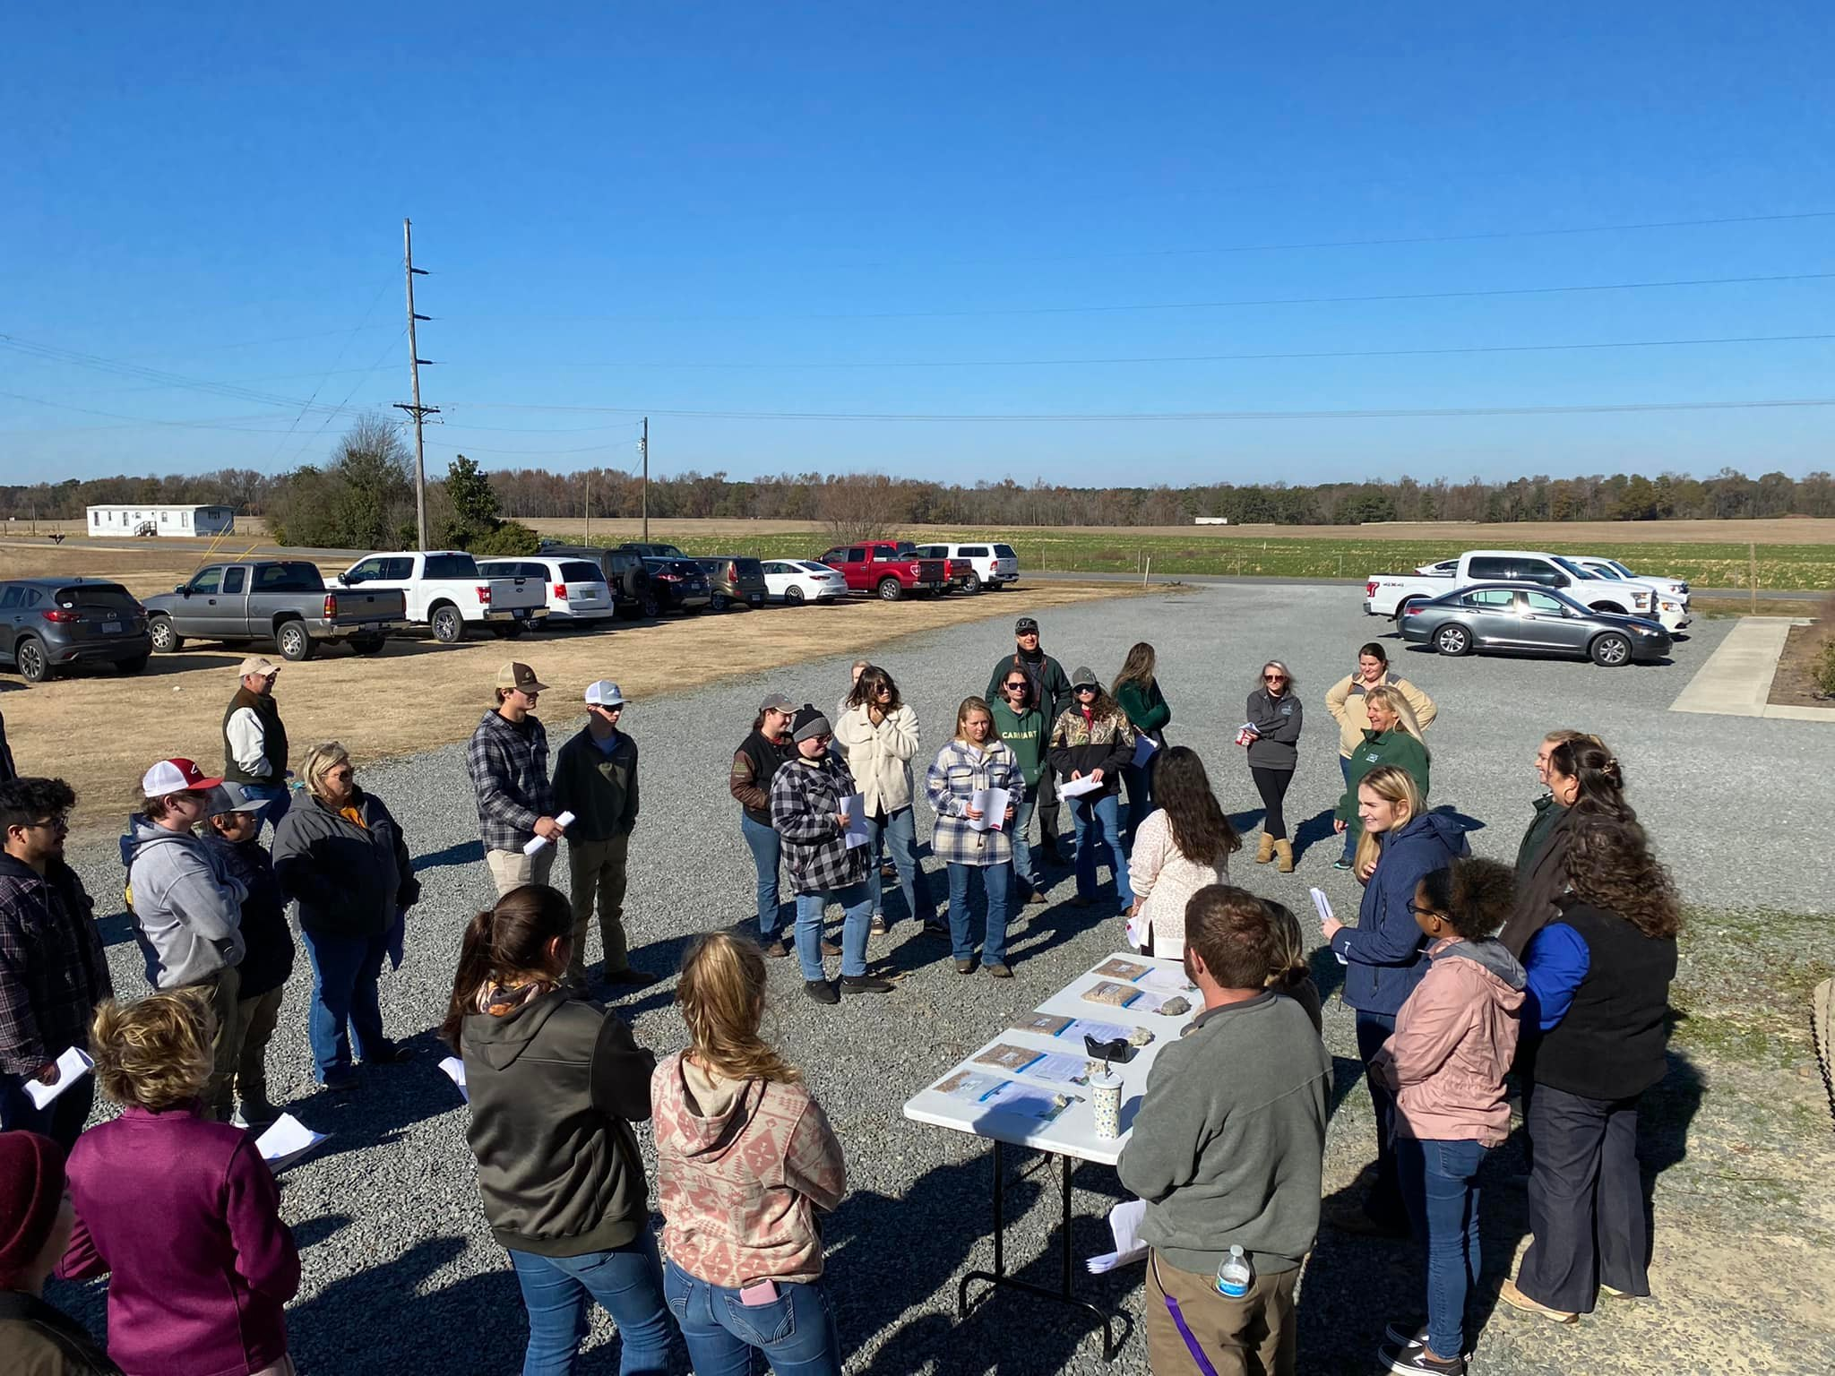
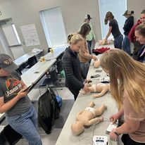
For every hour spent sitting in lecture, you have 2 hours worth of “hands-on” learning

Slide 16
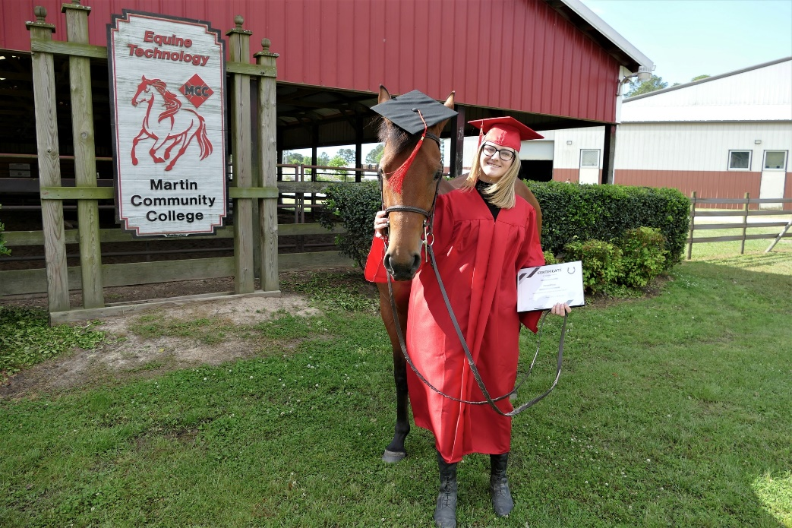
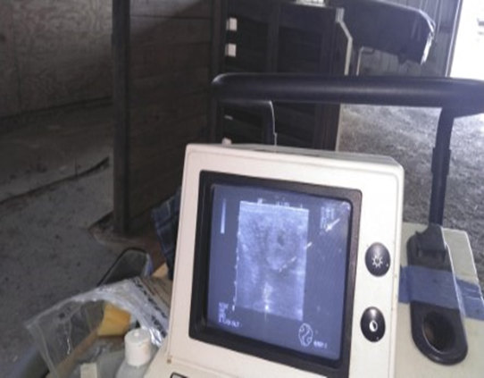
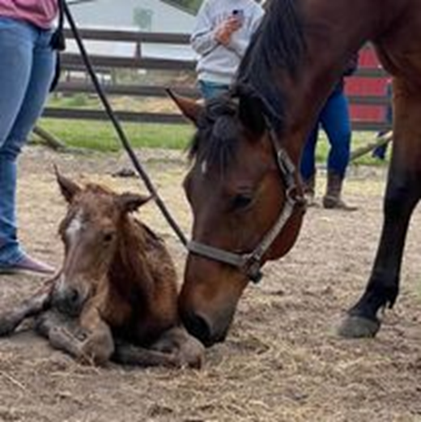
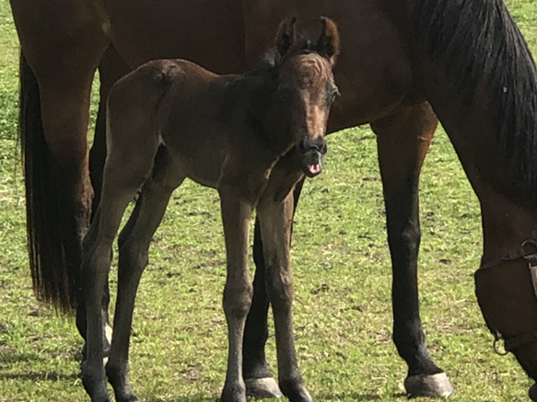
Reproduction and Colt Starting
.

Slide 17
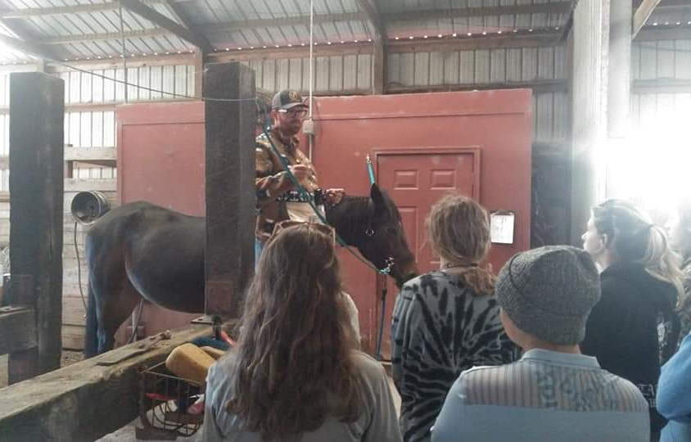
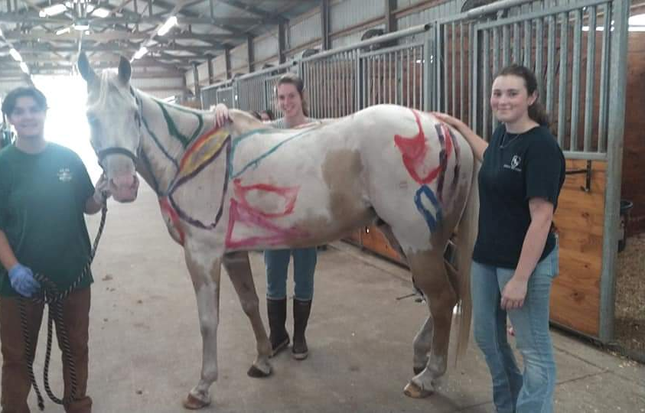
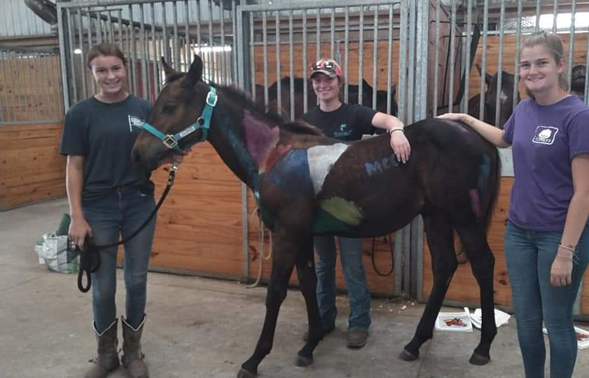
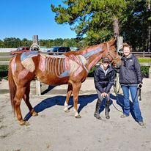
Horse Science and Anatomy Class

Slide 18
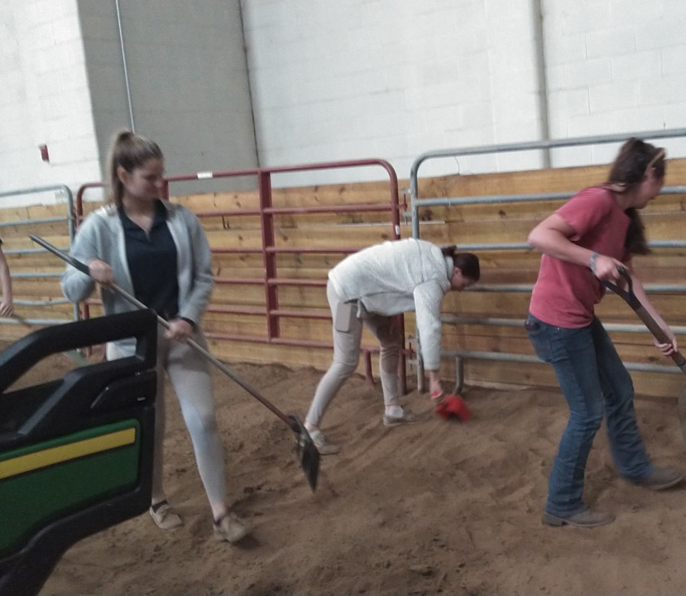
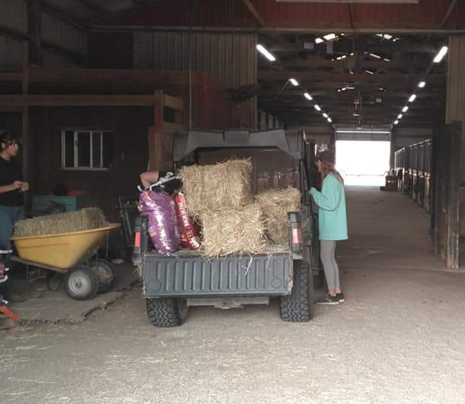
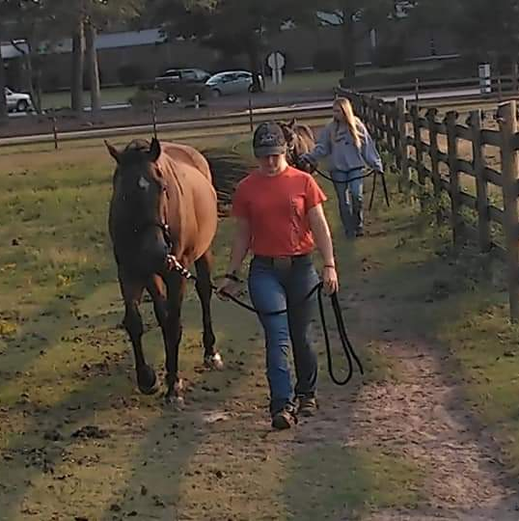
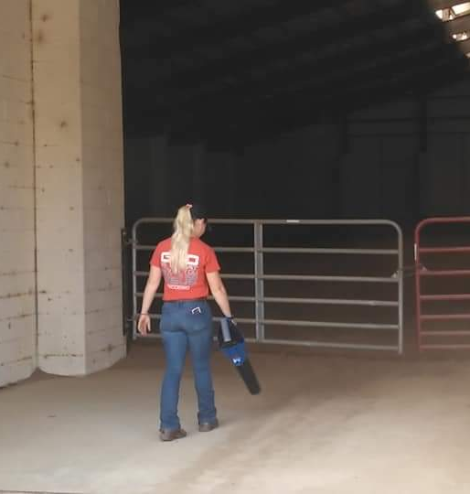
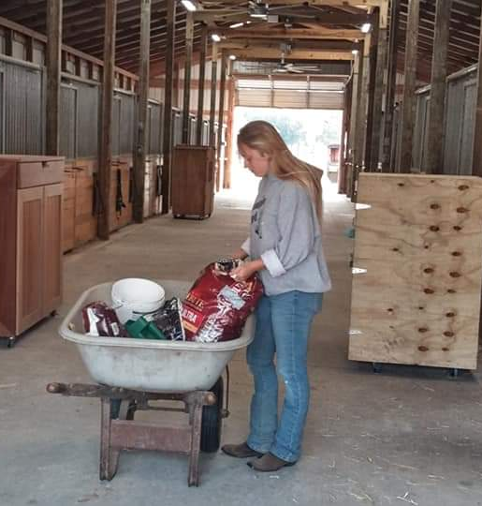
Students are given the opportunity to experience everything needed to run a successful equine facility.

Slide 19
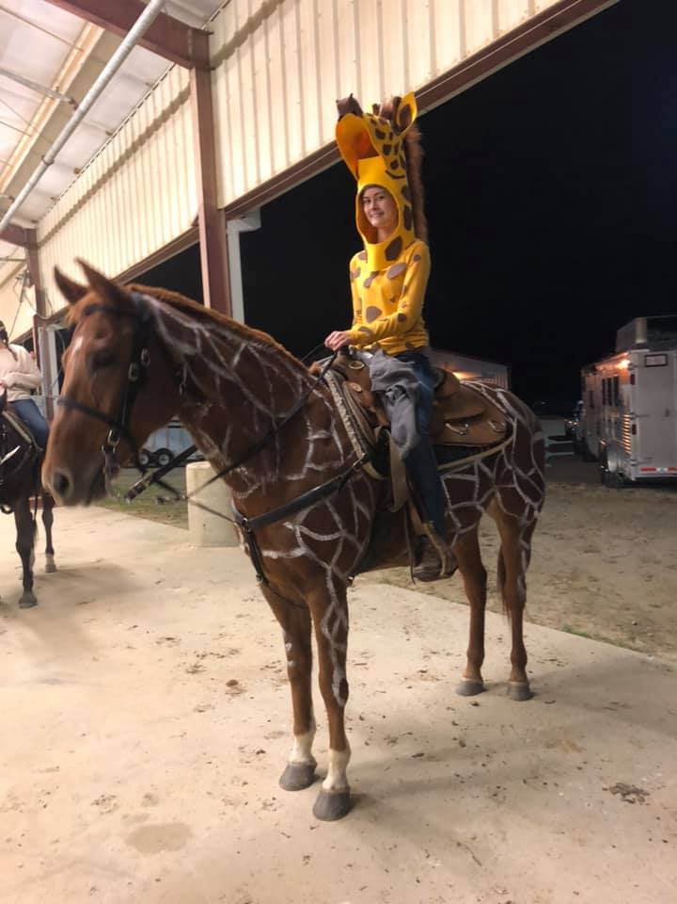
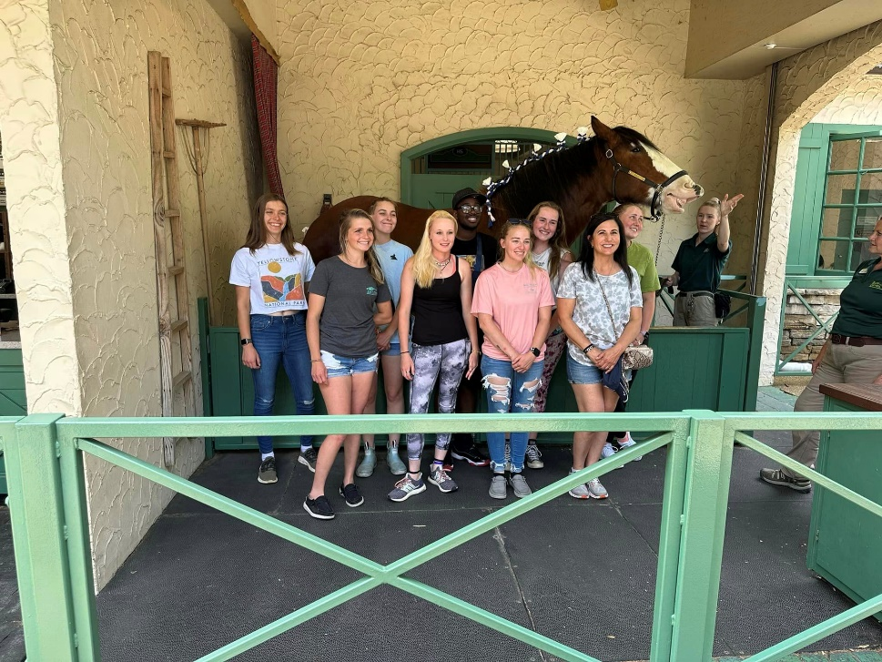
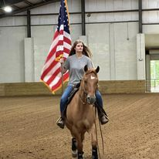
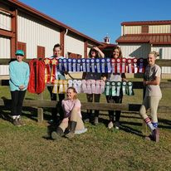
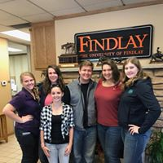
Extracurricular Events

Slide 20
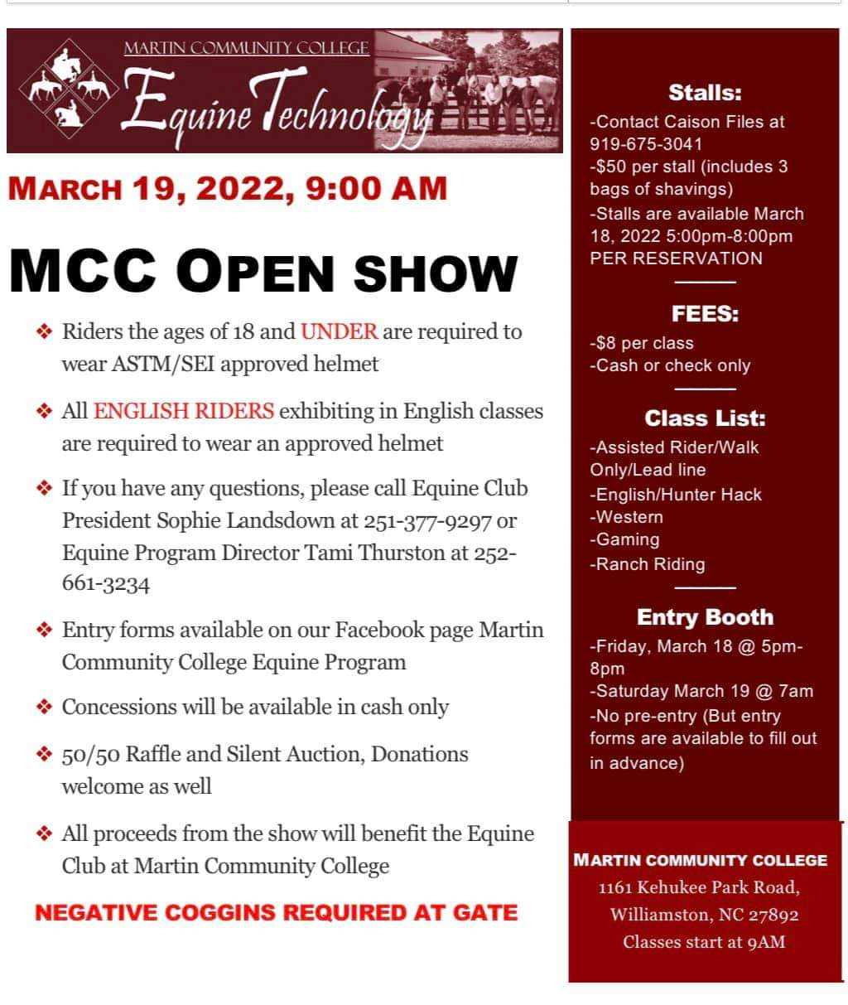

Slide 21
Faith Thompson:
Program Award Winner AND Martin Community College Distinguished Graduate Award Winner
A.A.S. Equine Technology Graduates Equine Science

