Slide 1


Agriscience/Biotechnology career Pathways
Quarterly Meeting
June 11, 2024
Powered by Northeastern, Rivers East and Turning Point Workforce Development Boards

Slide 2
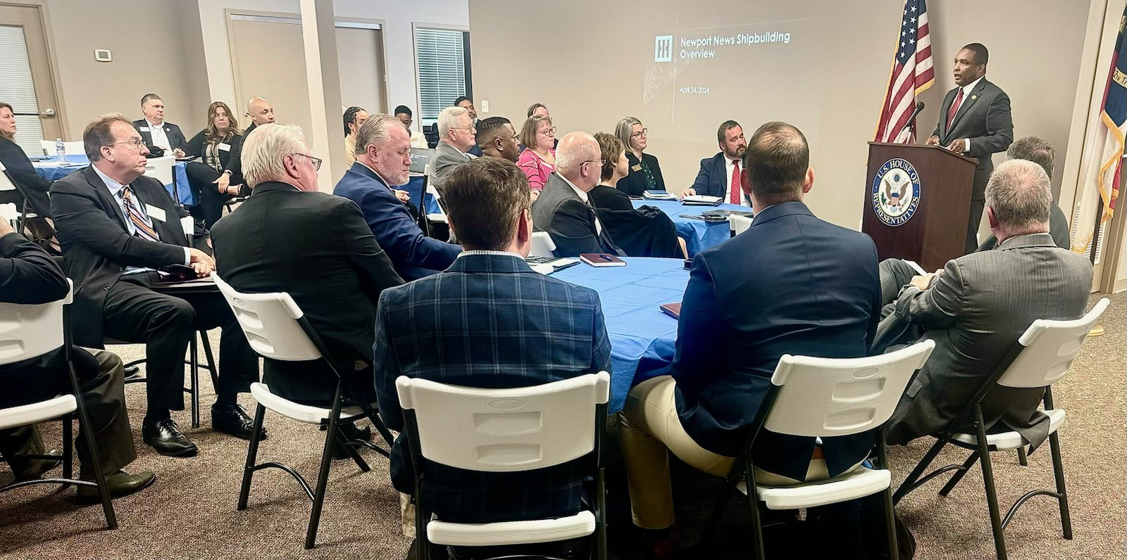
https://dondavis.house.gov/media/press-releases/congressman-don-davis-hosts-shipyard-event-connects-students-good-paying-jobs

Slide 3
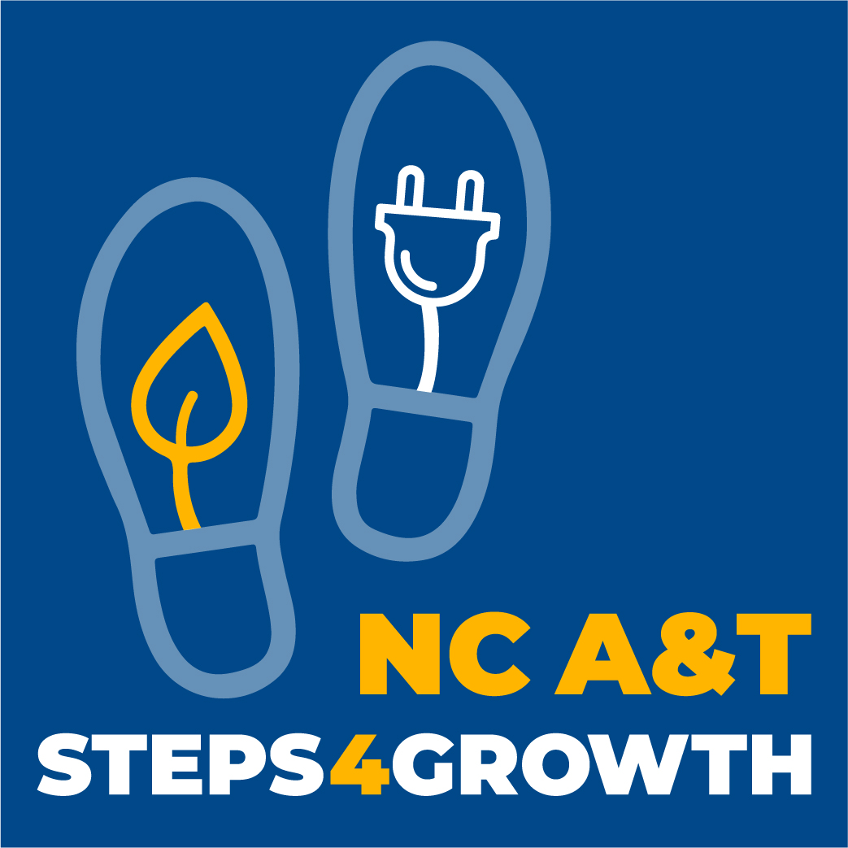




Slide 4


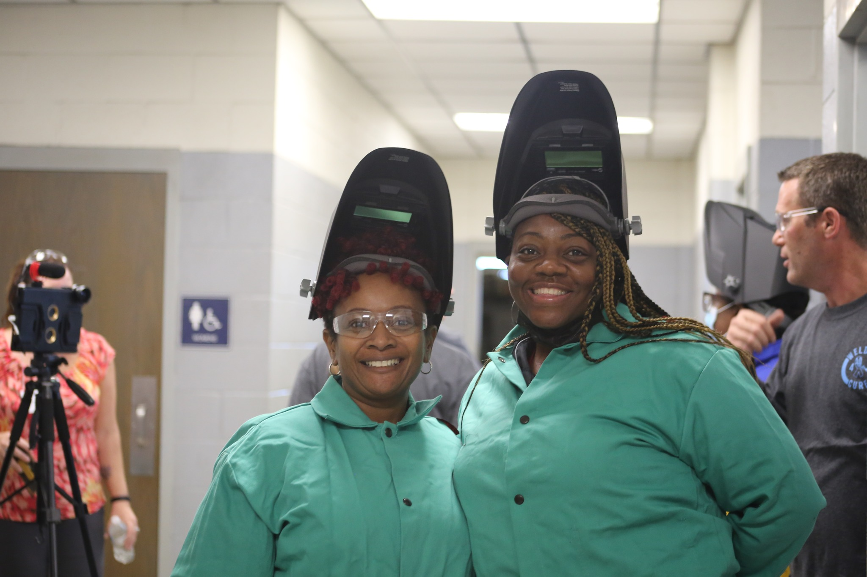
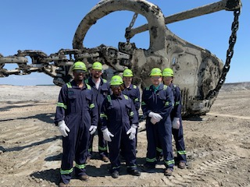
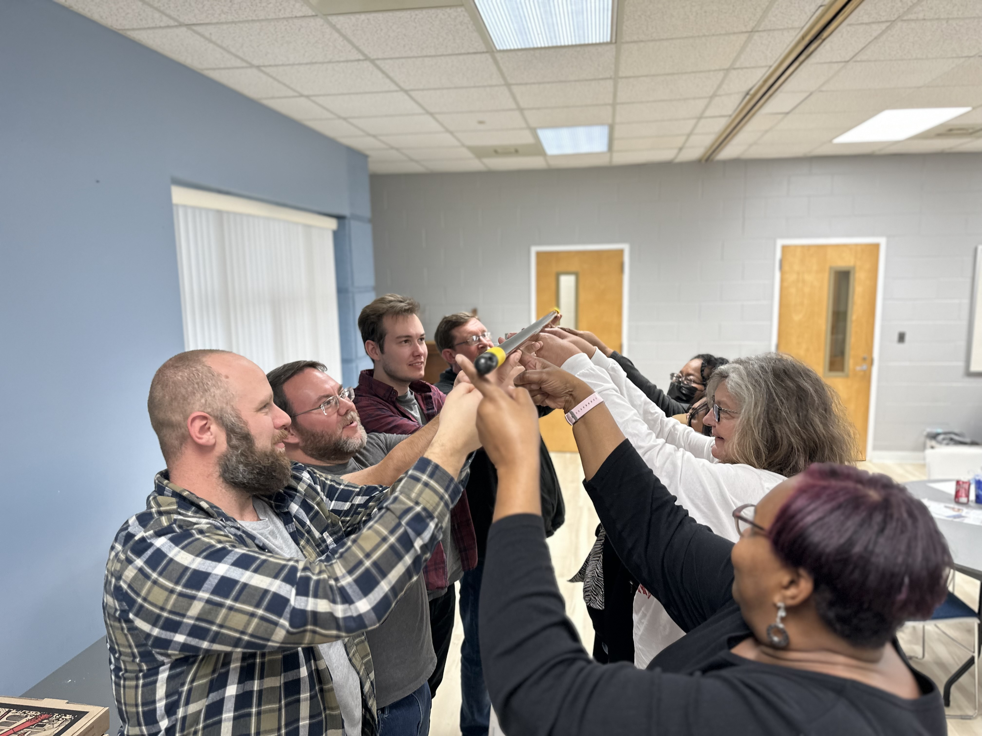







Slide 5
Partner Survey 2024

Slide 6
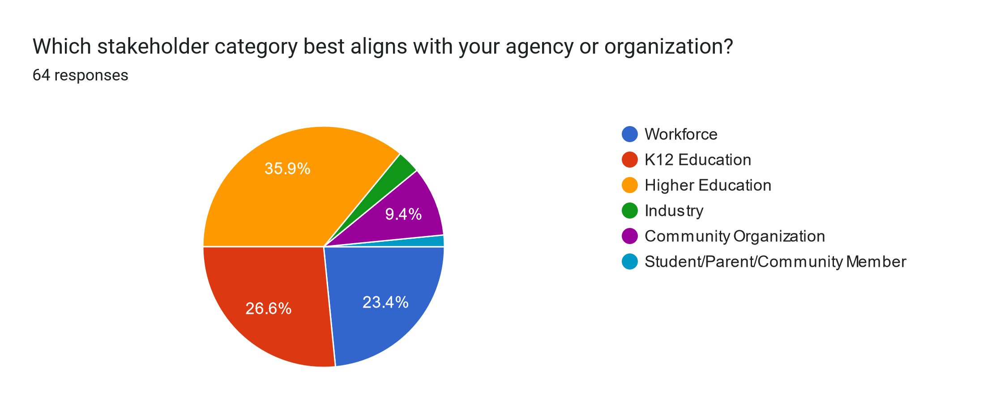

Slide 7
Only about ¼ of respondents had not attended a quarterly meeting in the past year
More than 70% of respondents open to 2 guidance retreats instead of quarterly meetings
BUT there were a lot of comments about still wanting the updates somehow

Slide 8
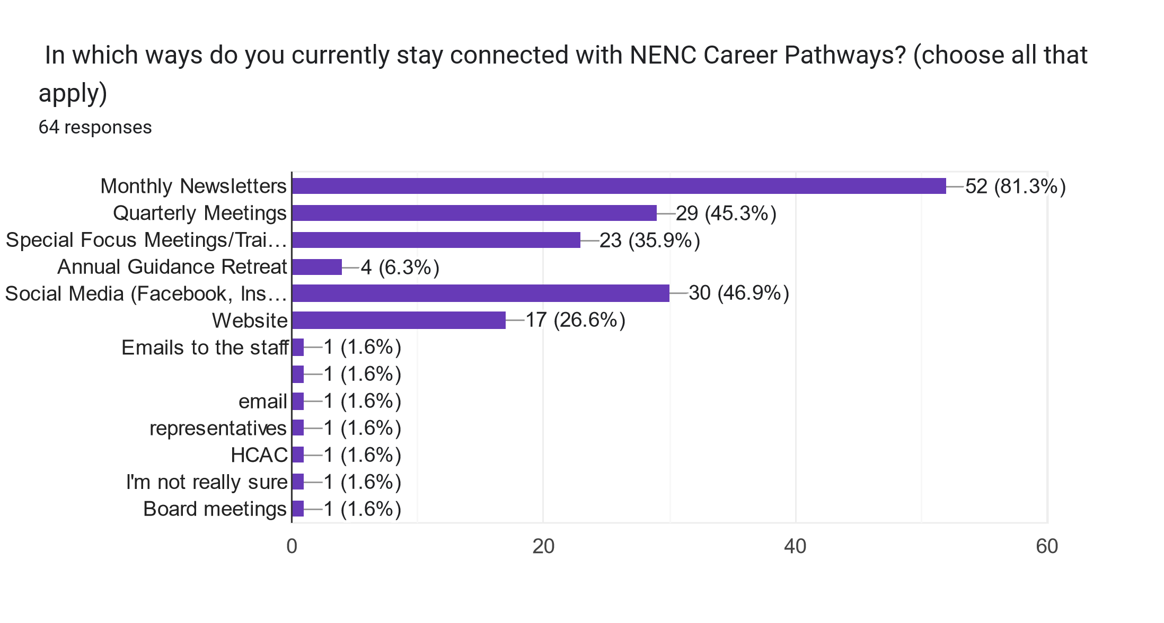

Slide 9

What challenges do you face in engaging with employers for workforce development?
Lack of interest
Insufficient Resources to build connections
Misalignment of skills and employer needs
Communication barriers

Slide 10

"Hospitality and Tourism" (32 mentions).
"Aviation/Aerial Systems" is the second most mentioned sector (11 mentions).
"Cybersecurity" is the third most mentioned sector (9 mentions).
Other sectors include Construction, Green Economy/Clean Energy, Maritime/Blue Economy, Artificial Intelligence, Manufacturing, and Healthcare.

Slide 11
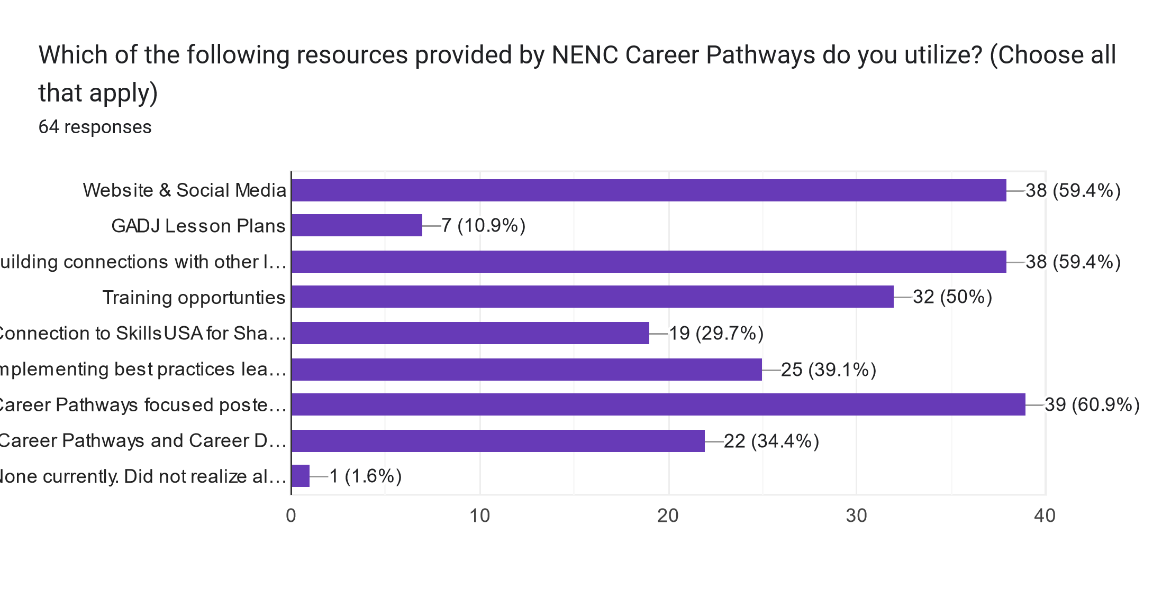

Slide 12
Contact information for local employers:
Specifically for those willing to be speakers or offer field trips to middle/high school groups. Difficulty in
finding appropriate contacts from websites was mentioned.
Data warehouse or repository:
A centralized repository of all connections in the area and their expertise.
Additional printed materials:
To distribute at career fairs and to the general public.
Retreats:
For team building and strategic planning.
More access to VR headsets:
Also, staffing to support the needs of career education units in courses as guest presenters.
9-14 pathway development assistance:
Including someone dedicated to working with colleges on ETPL documentation and someone to connect
with the Perkins Grant Manager.
Regular roundtable discussions and information gathering with employers:
Assistance in developing integrated education training programs for collaboration with workforce/NCWorks,
community colleges, and employers.
Industry and community college collaboration:
Ensuring that educational efforts align with industry needs.
Links to other partners and resources:
Facilitating better networking and resource sharing.
List of resources:
A comprehensive list of available resources and opportunities.
Handouts:
To provide quick reference materials and information.
What is Needed?

Slide 13
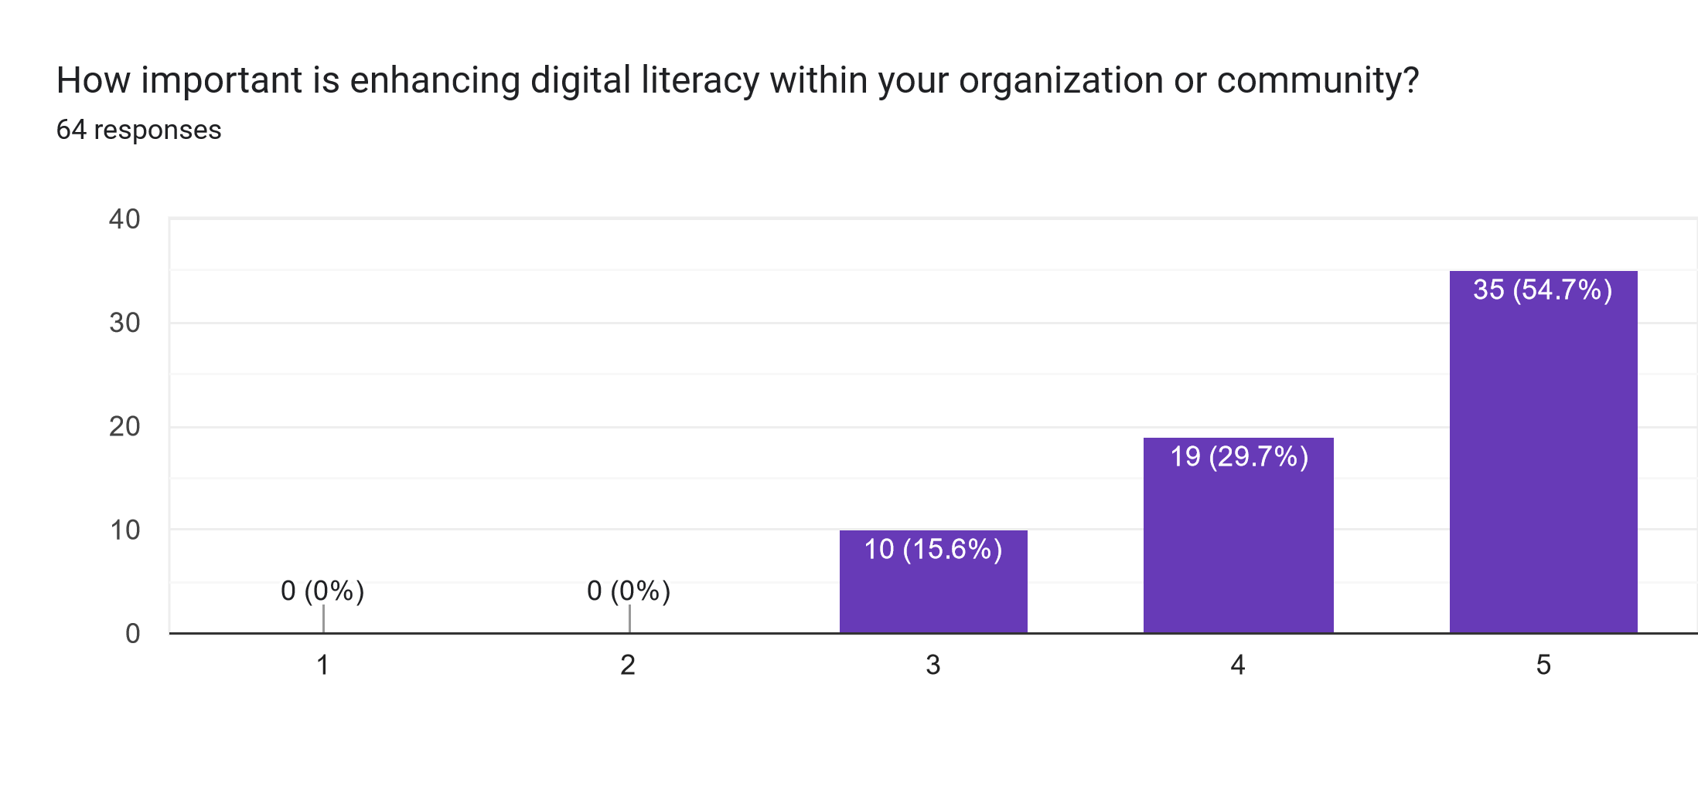
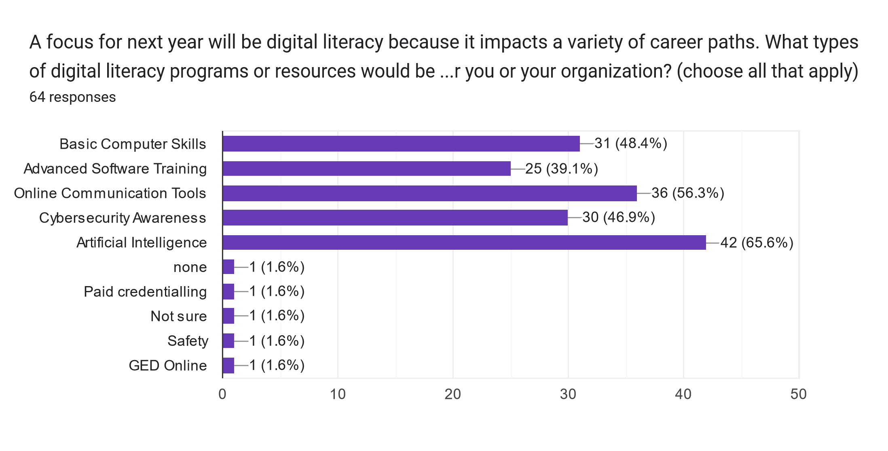
Digital Literacy

Slide 14
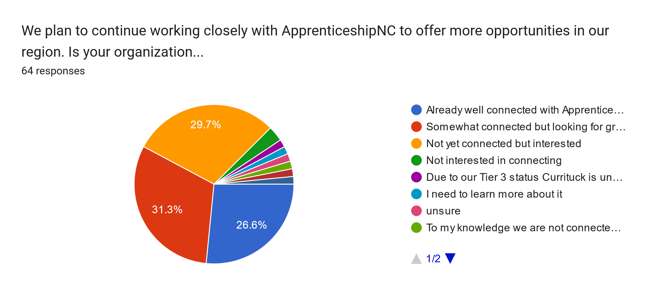

Slide 15

What can
We spotlight?
Internship Programs
Staff Recognition
Programs and Success Stories
Student Involvement
Events and Collaborations
Promotions and Awards
Professional Development
Mission and Vision
Career Development and Apprenticeships
This Photo by Unknown Author is licensed under CC BY-NC

Slide 16
What can we do to better support your future career pathways needs?
"Reentry and veterans continue to be a major focus - how do career pathways fit with these groups - provide examples - highlight successes!
“It would be nice to receive updates about any emerging careers or industries that maybe haven't had a lot of job openings in our area in the past but are becoming more in-demand."
"Virtual Webinars."
"Promote training and development, Mentorship programs, Train managers, Identify and encourage unique skills, promote cross-functional projects, provide networking opportunities."
"Continued professional development, career fairs and publications in the field."
"I would like specific examples on how I can incorporate career pathways into 'lessons' for my participants."

Slide 17


COMING
SOON

Slide 18
Agriscience/
Biotechnology Career Pathway

Slide 19
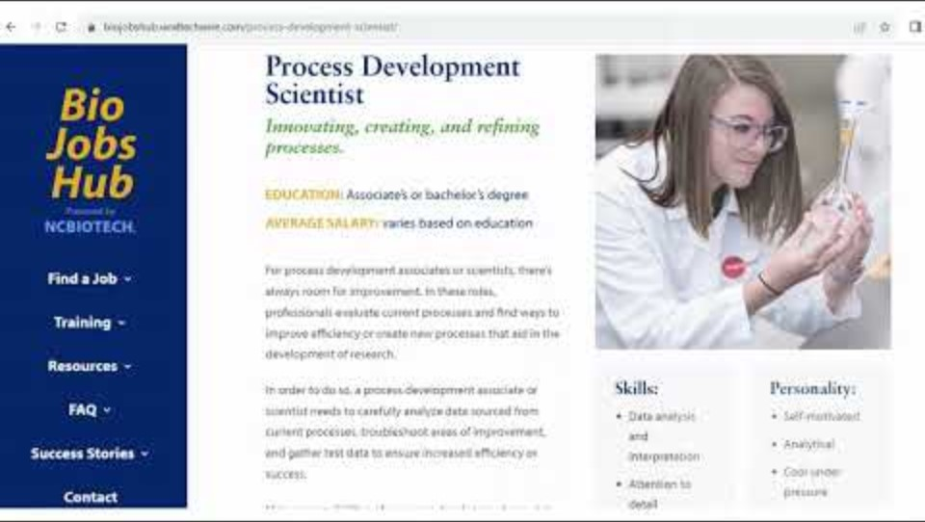

Slide 20
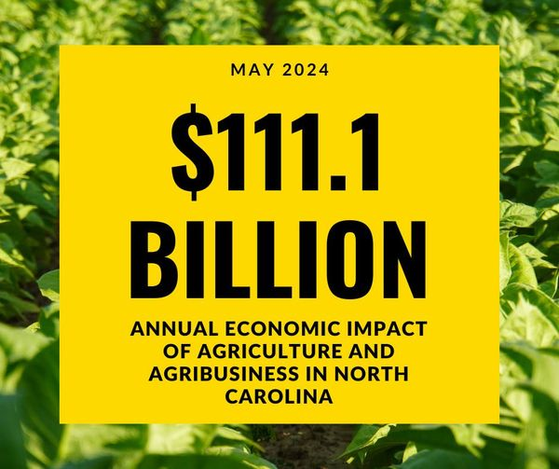

Slide 21
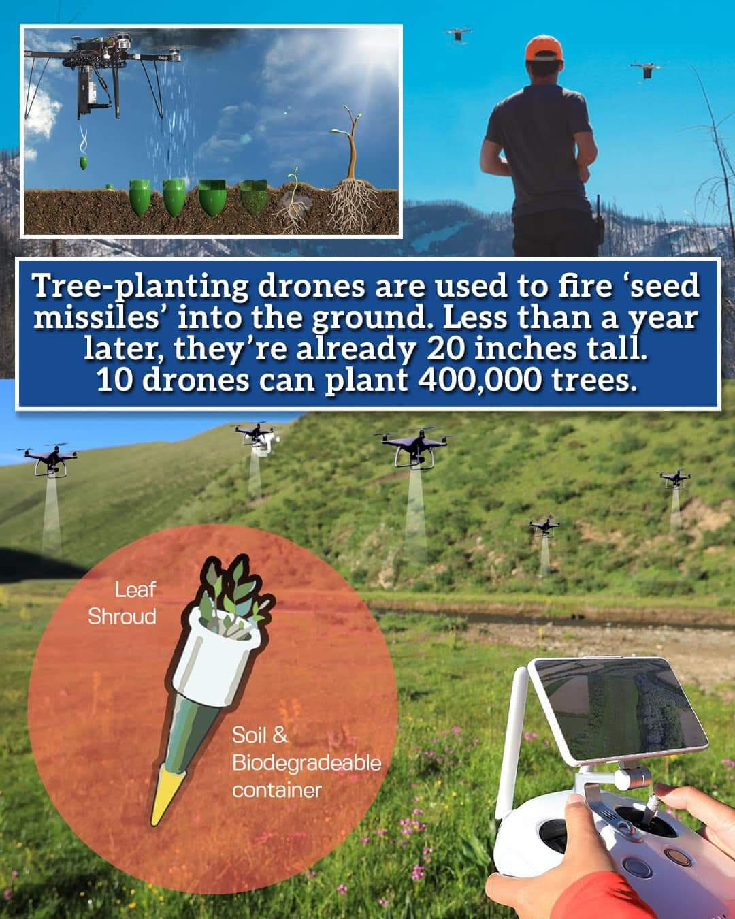

Slide 22
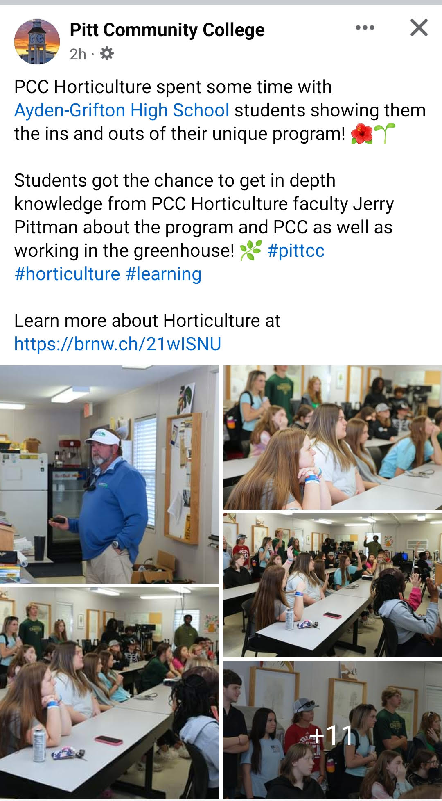
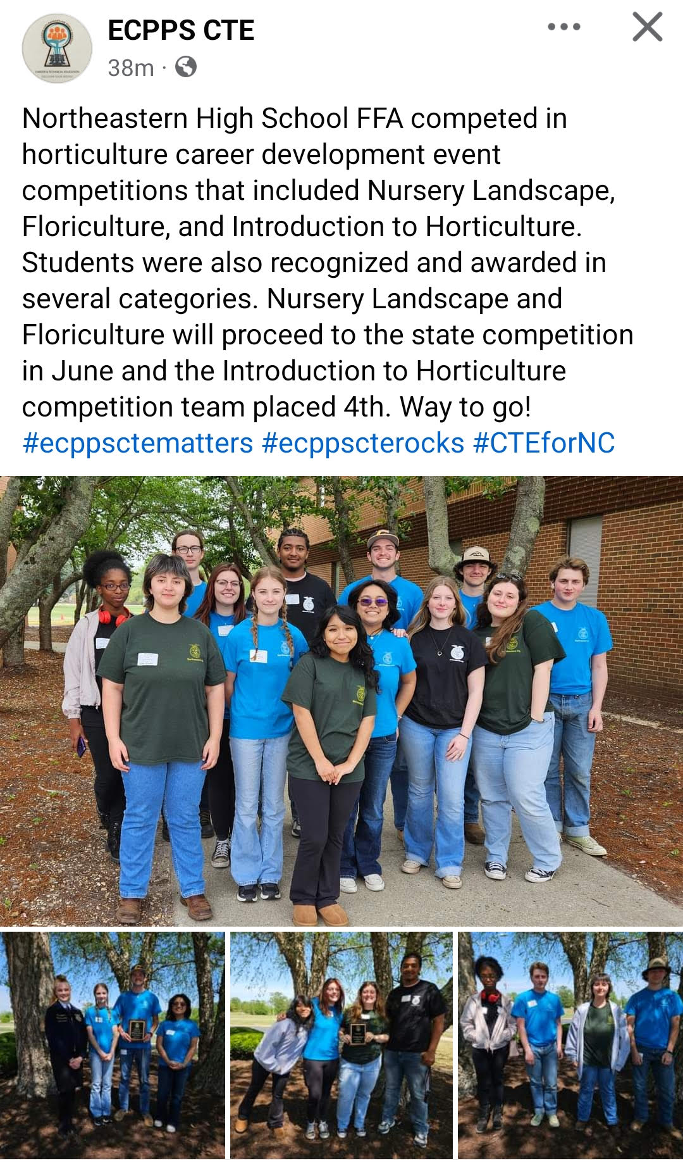

Slide 23
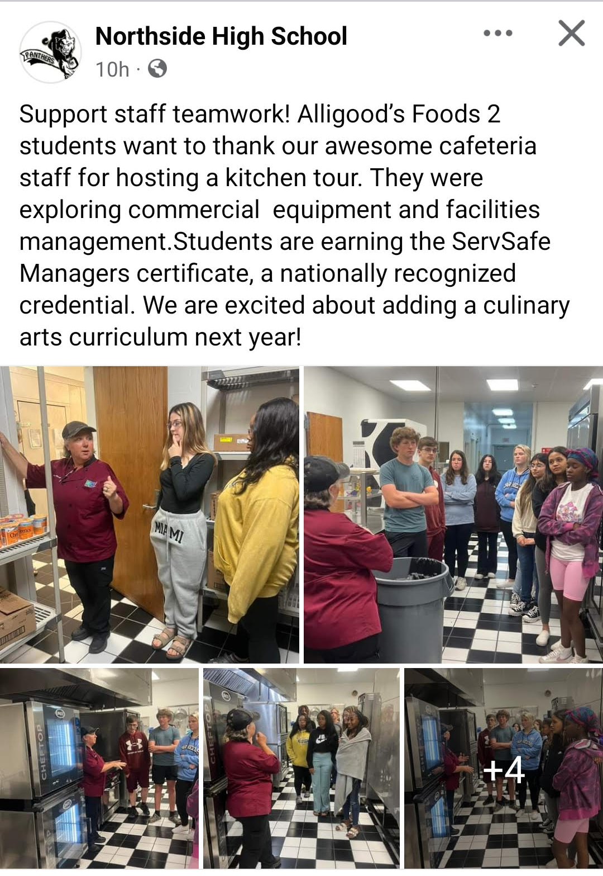
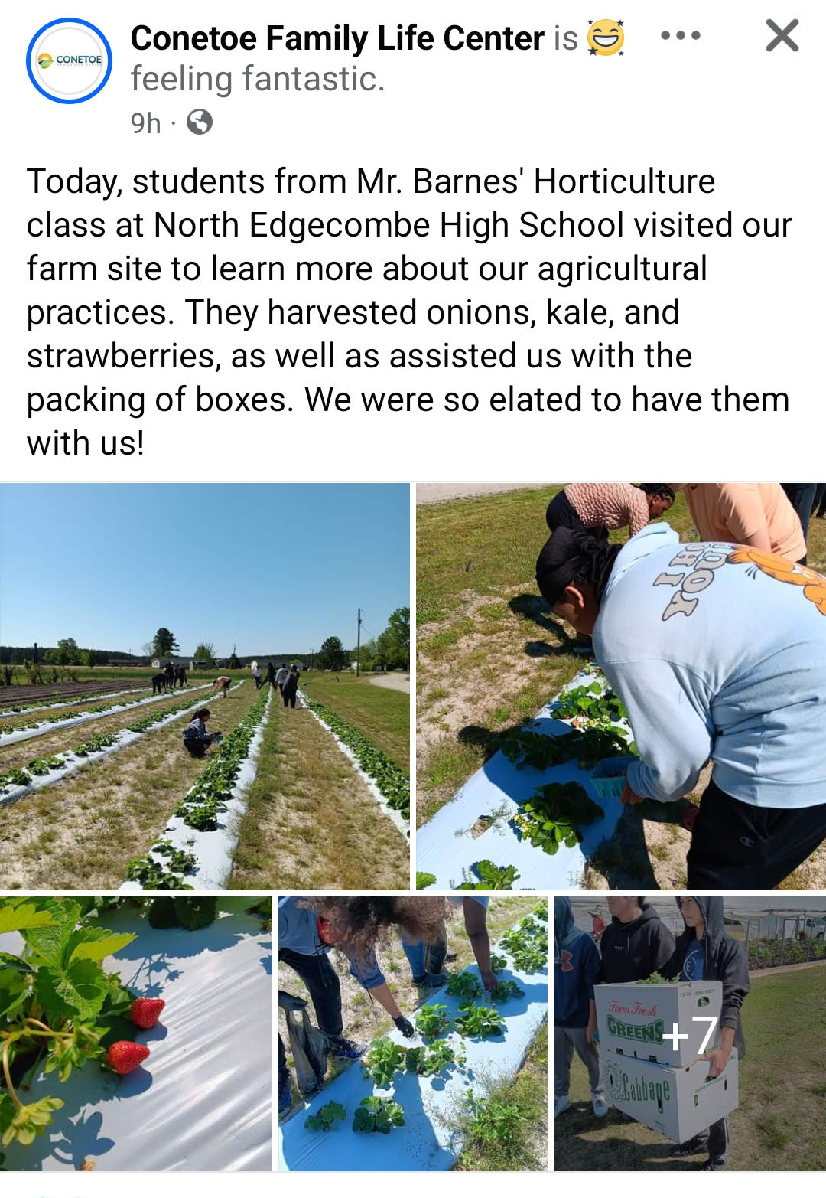

Slide 24
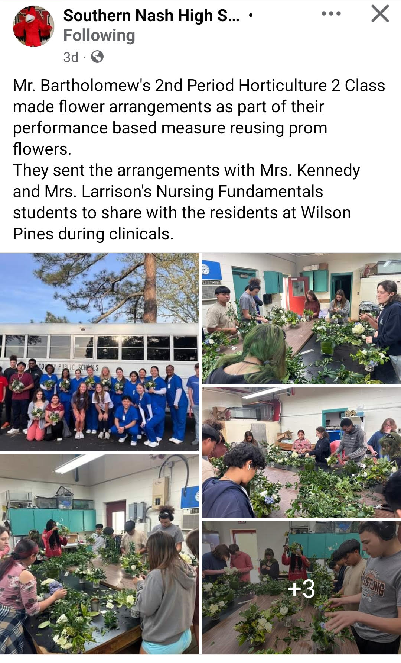
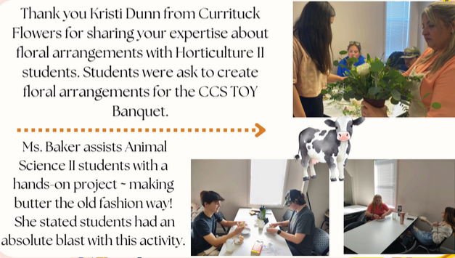

Slide 25
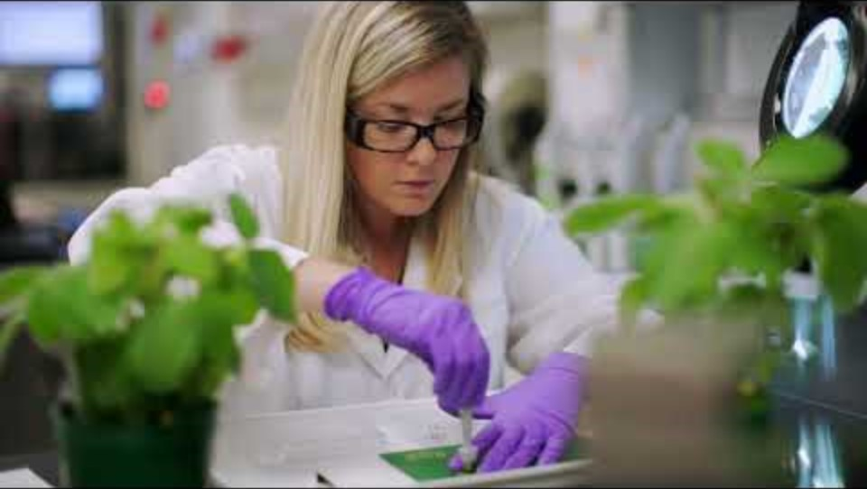

Slide 26
Tyler Bennett
NC Commerce –
Agricultural Employmet

Slide 27
Dr. Tabitha Miller
President
Martin Community College

Slide 28


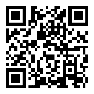
Let’s Stay In Touch
Facebook: https://www.facebook.com/nencpathways/
Instagram: https://www.instagram.com/nenccareerpathways/
Twitter: https://twitter.com/NENCPathways
LinkedIn: https://www.linkedin.com/company/nenc-career-pathways/
Sign up for our monthly newsletter: https://lp.constantcontactpages.com/su/OAWODhw/nenc
Connect with Brandi: brandi.bragg@nencpathways.org
Career Pathways TOOLKIT
Coming Soon – Stay Tuned!

