Slide 1
Business Administration
Cynthia King

Slide 2
Pathways
Career Pathway
Transfer Pathway
Certificates for High School Students
Bus. Admin. Cert.
Marketing Cert.
Management/Supervision Cert.
Additional Certificates
Accounting Cert.
Entrepreneurship Cert.
Human Resource Mgmt. Cert.

Slide 3
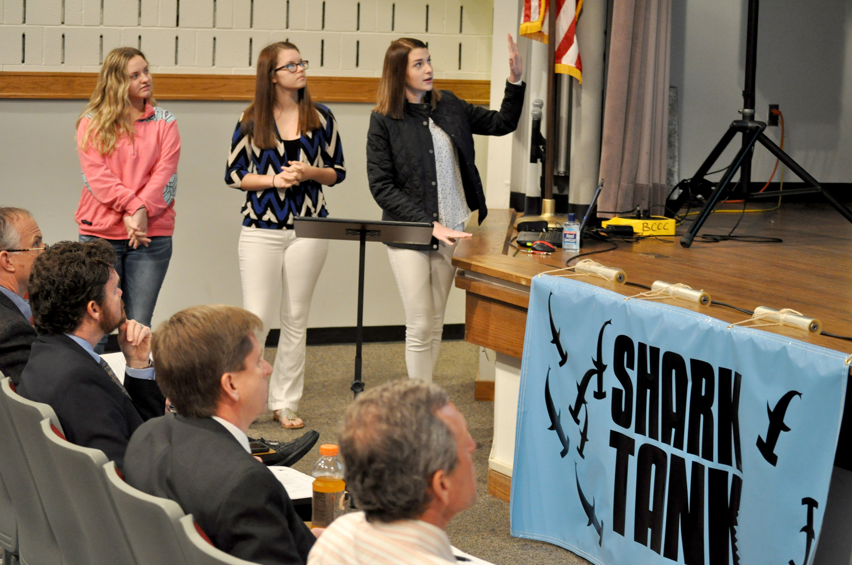
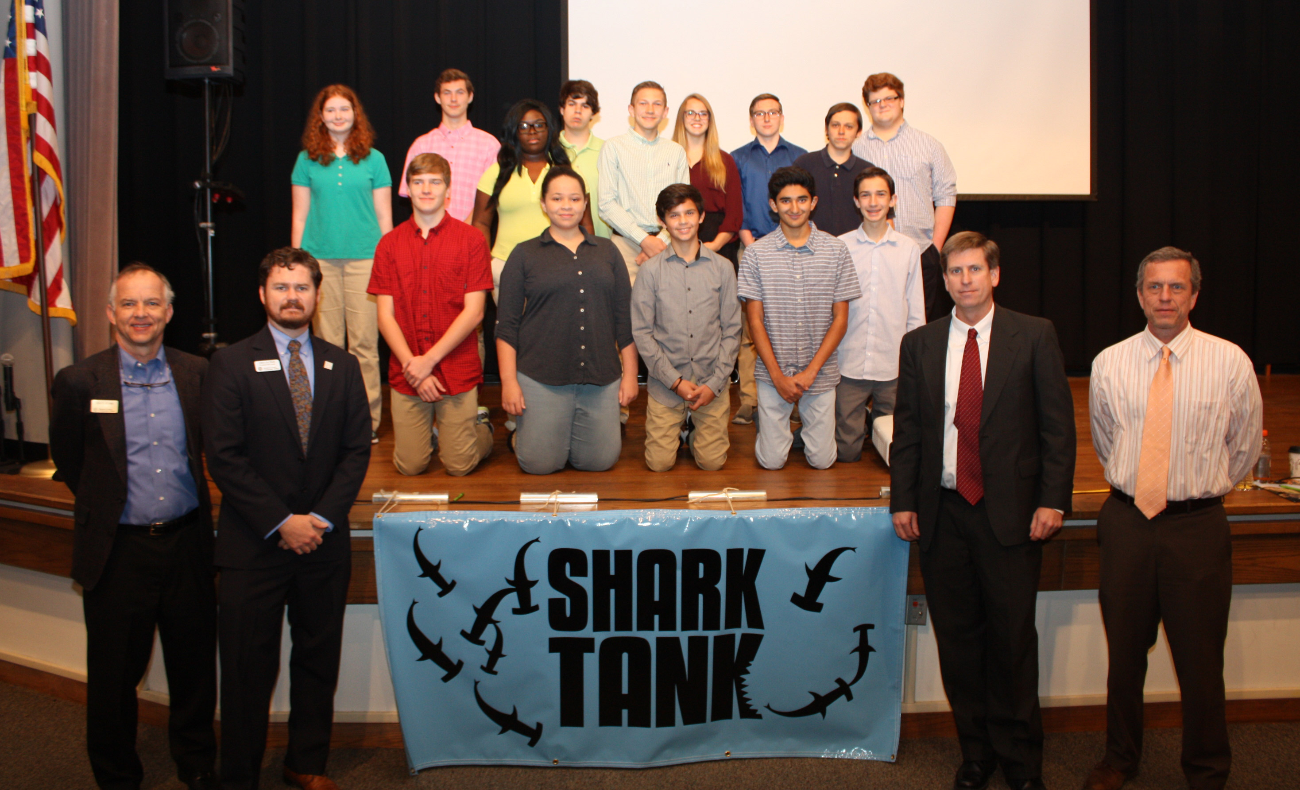
BUS 110 Introduction to Business
Shark Tank

Slide 4
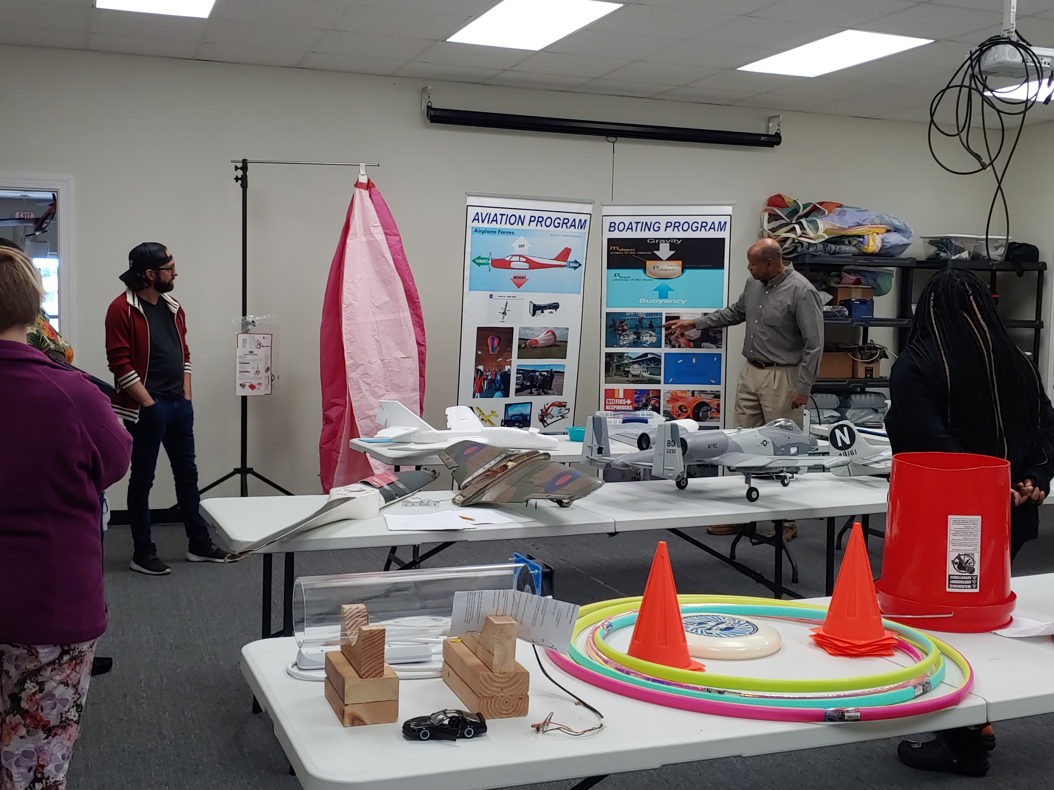
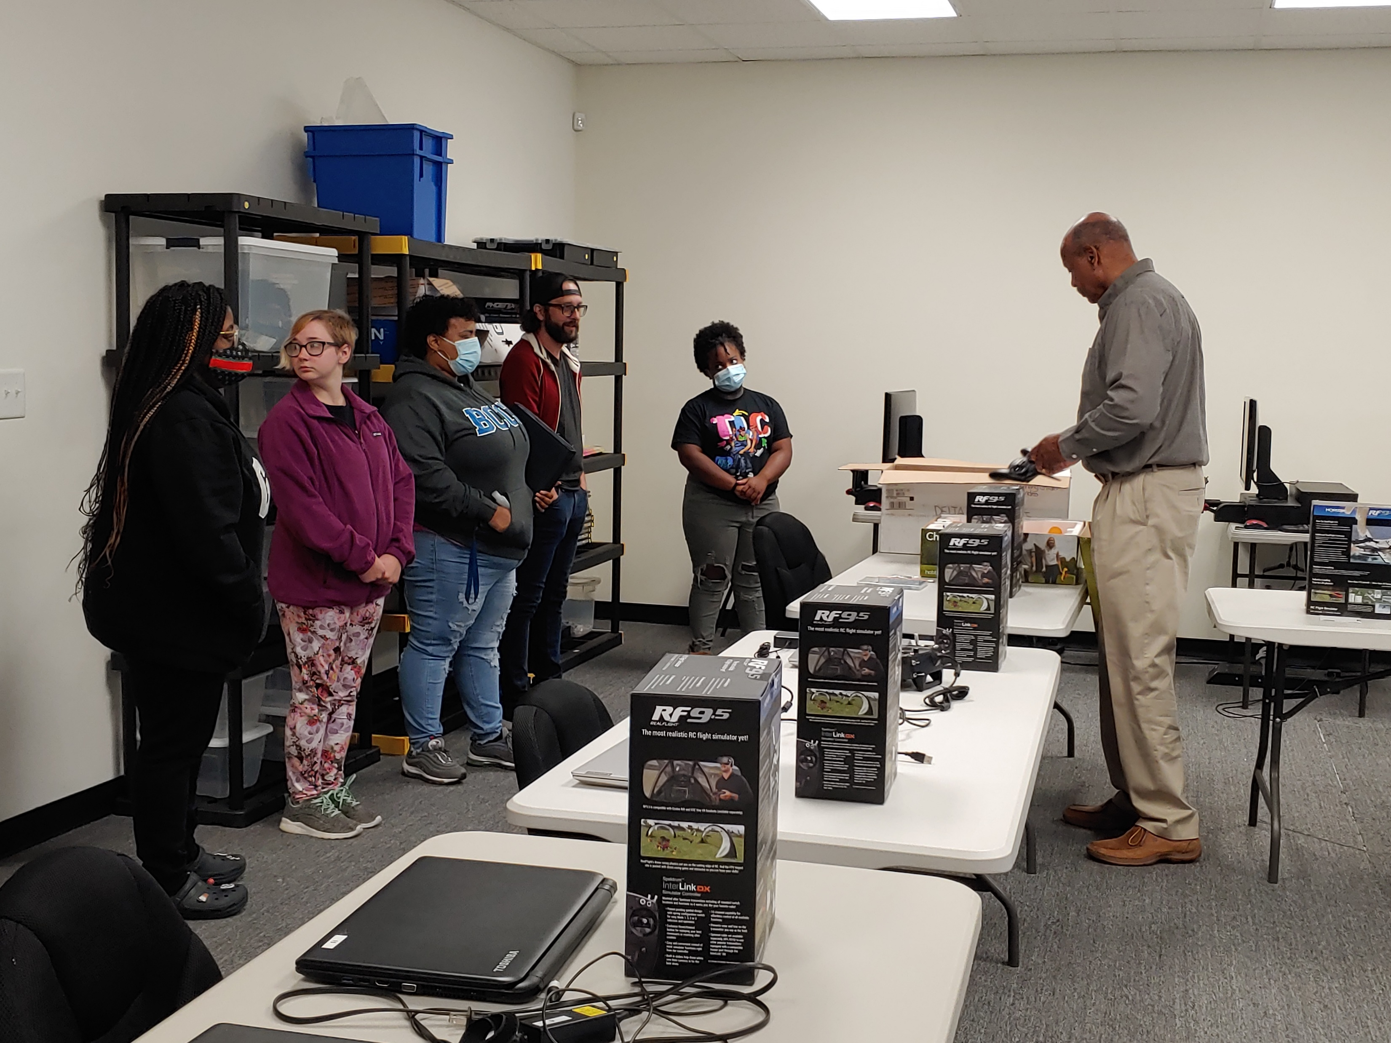
MKT 220 Advertising & Sales Promotion
IBX STEM Project: Social media marketing Plan

Slide 5
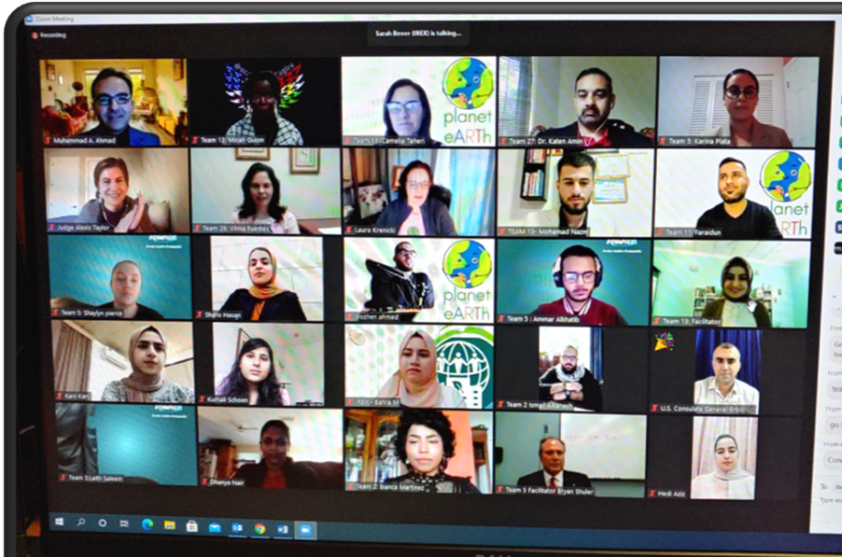
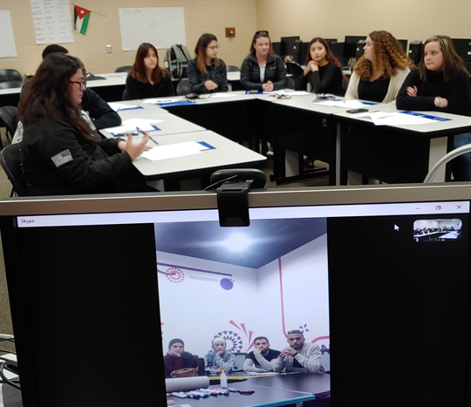
Notes:
Business Concepts:
Sustainability
Triple bottom line
Cross-cultural collaboration
Human-centered design thinking
Empathy
Mind-mapping
Problem-solving
Brainstorming
Prototyping
Giving a business pitch

Slide 6
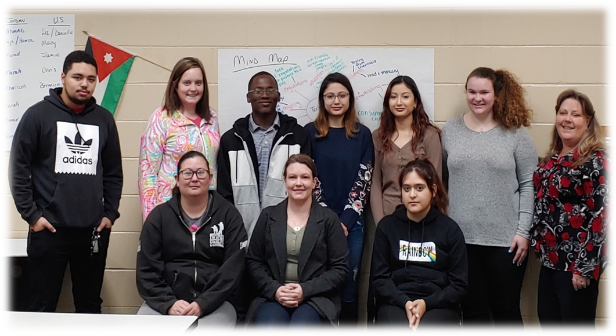
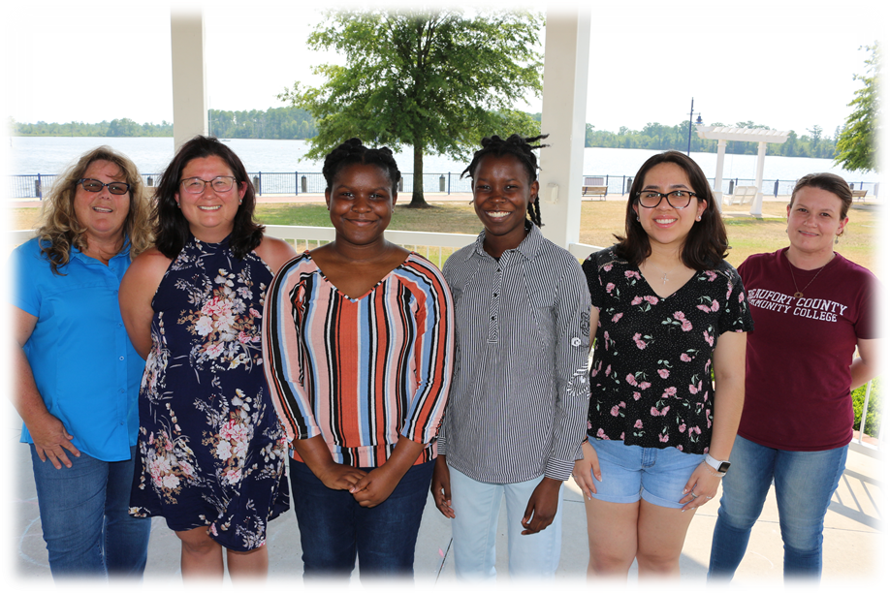
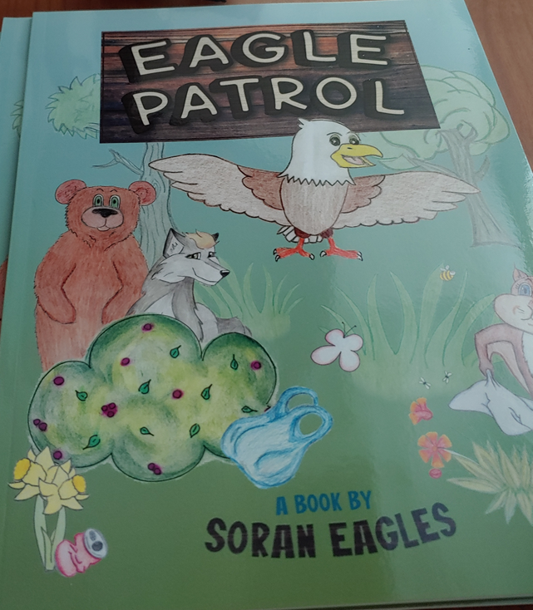
Team JoSeagulls
Pitch: SEA Gas Detection System
Placed 2nd Spring 2020
Team Soran Eagles
Pitch Eagle Patrol
Placed 1st Fall 2020

Slide 7
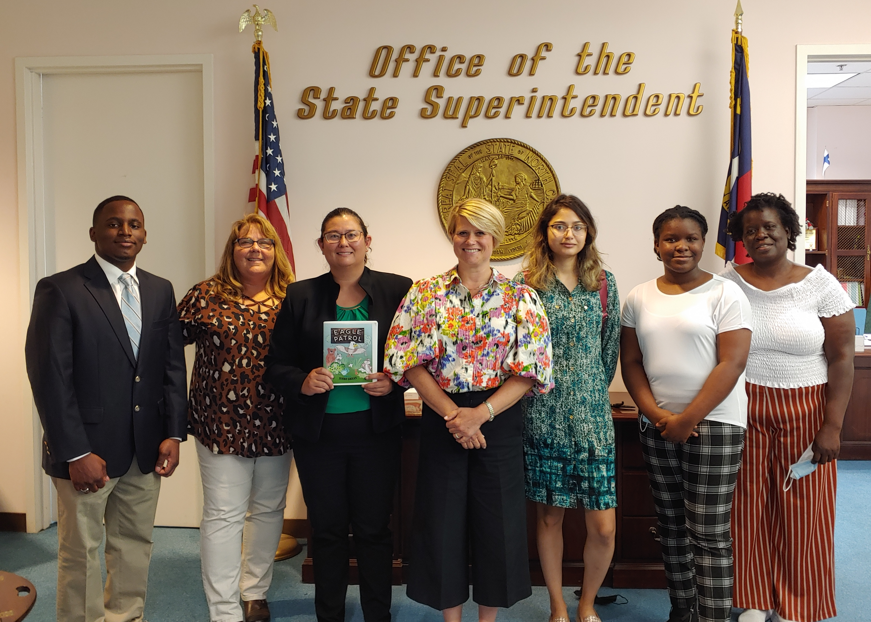
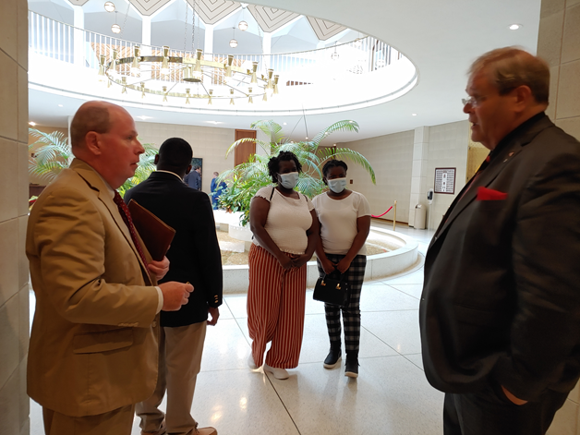
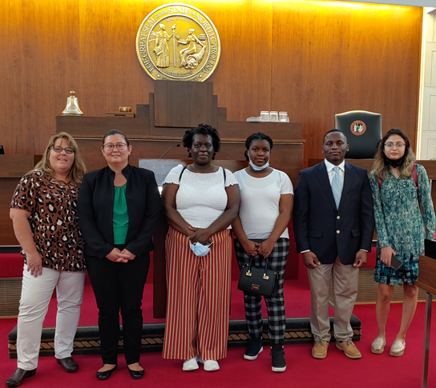
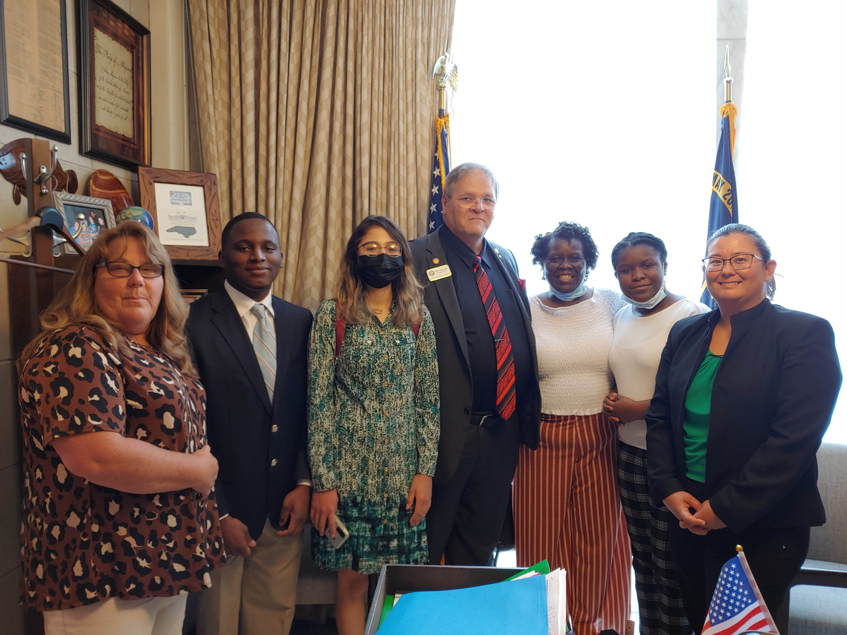
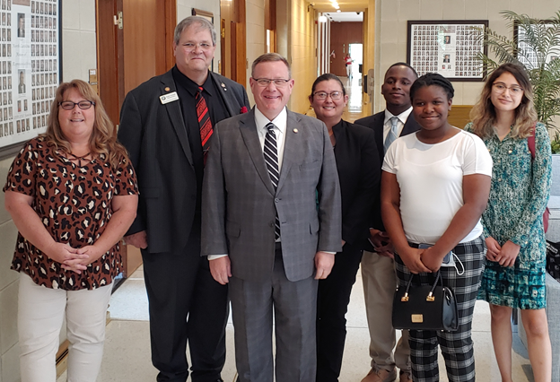
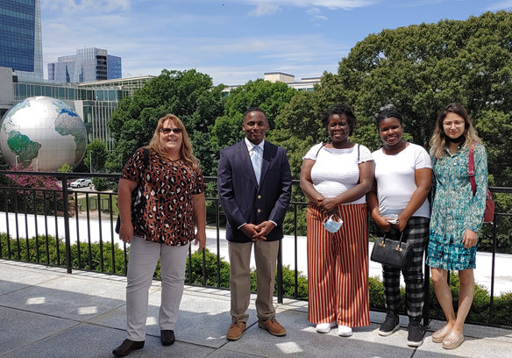
BCCC Teams honored at NC House

Slide 8
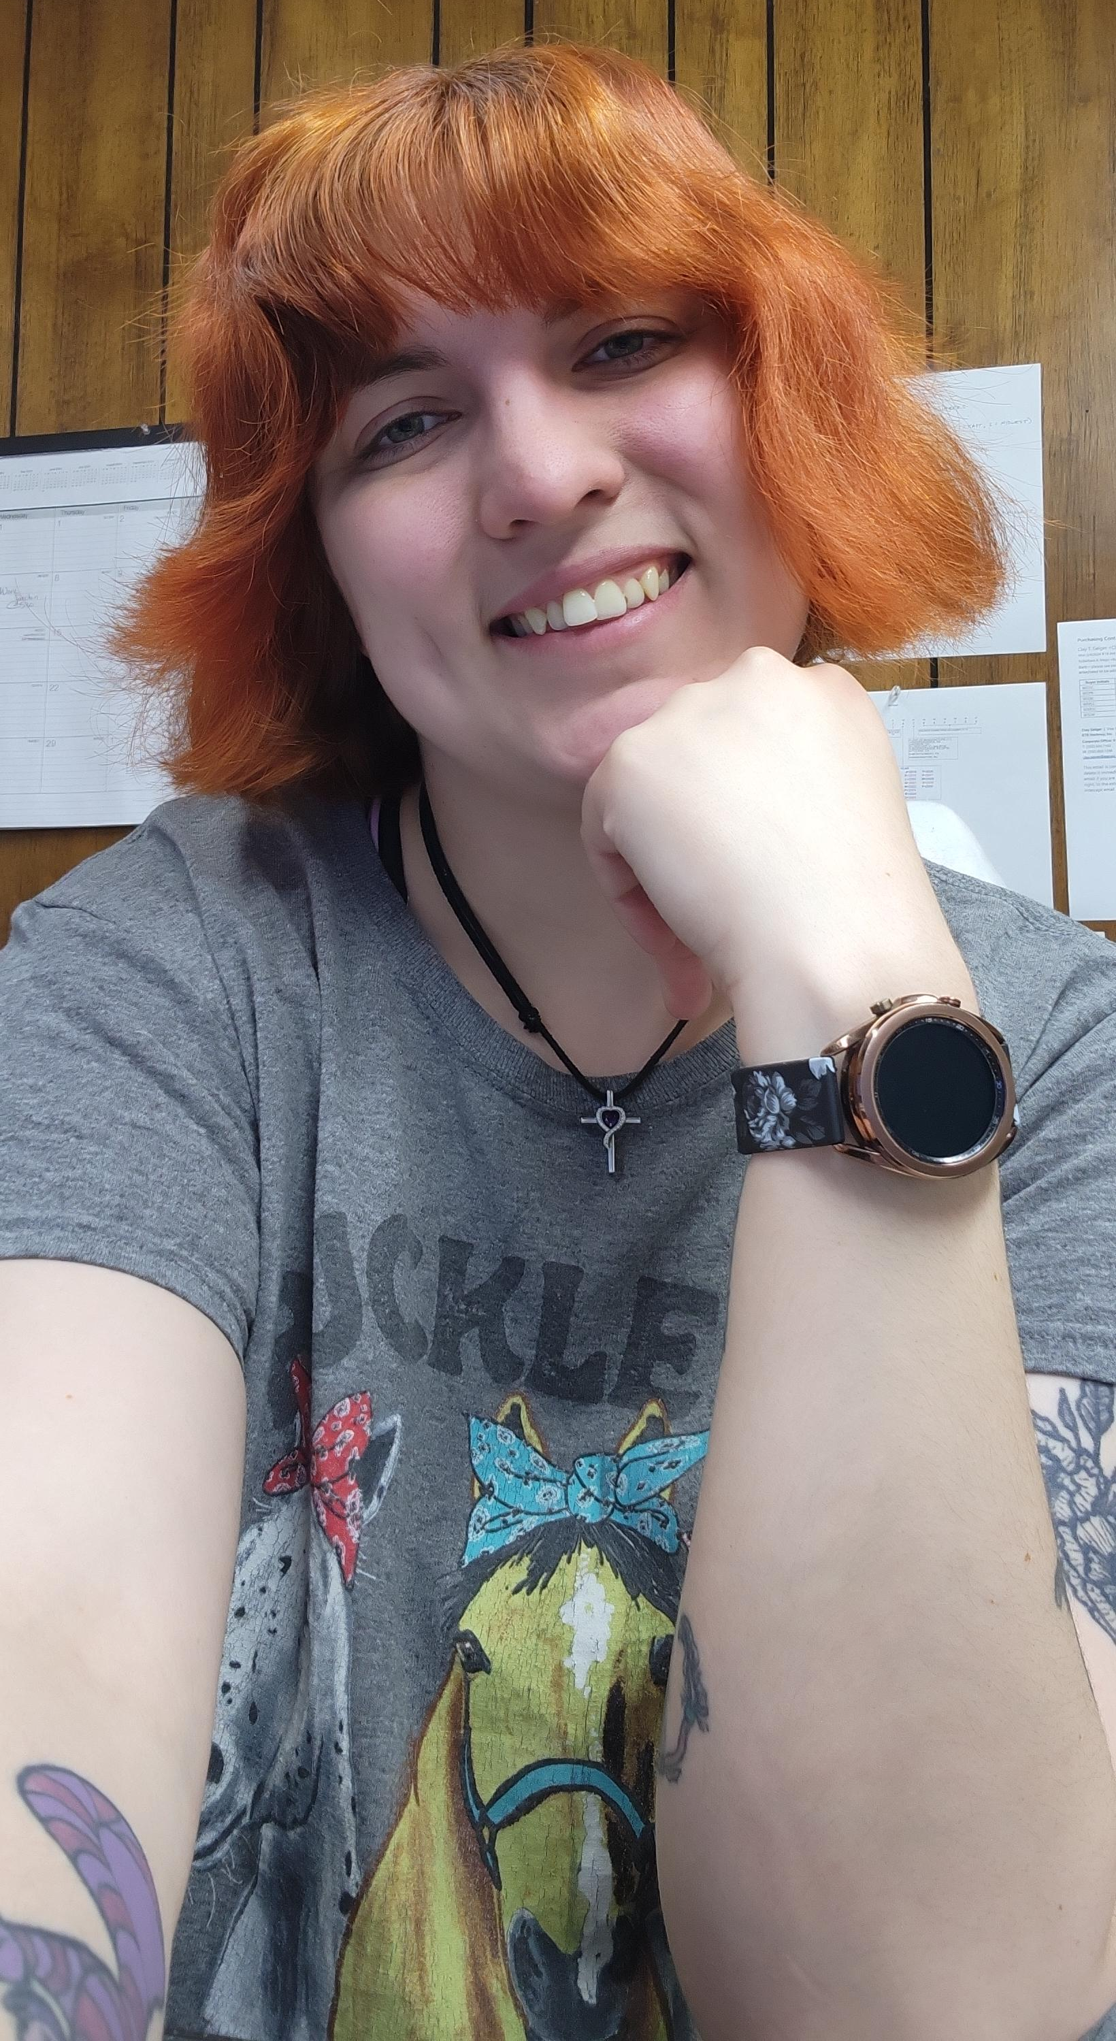
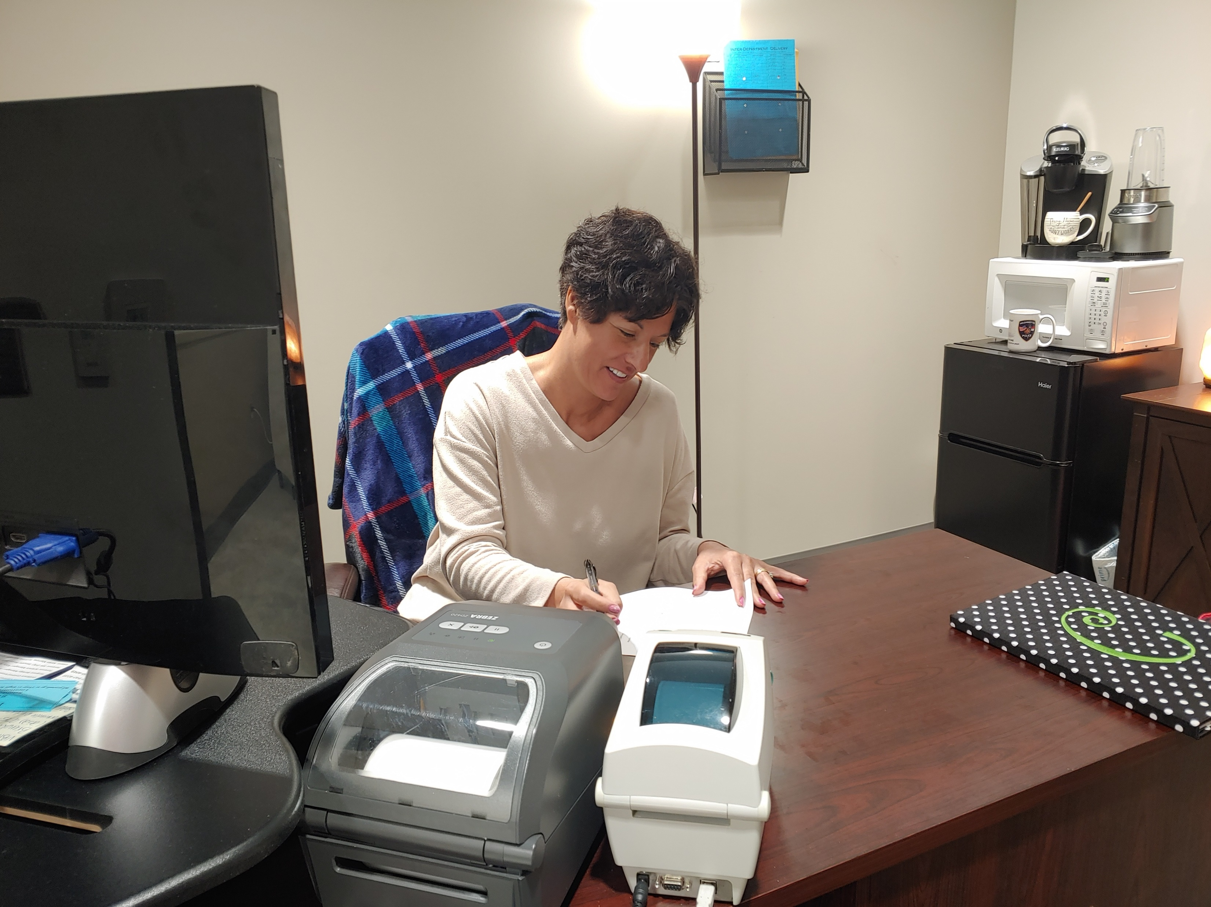
Work-Based learning
Washington Police Dept.
King Chicken
State Employees Credit Union
Flatlands Insurance Group
Hackney

Slide 9
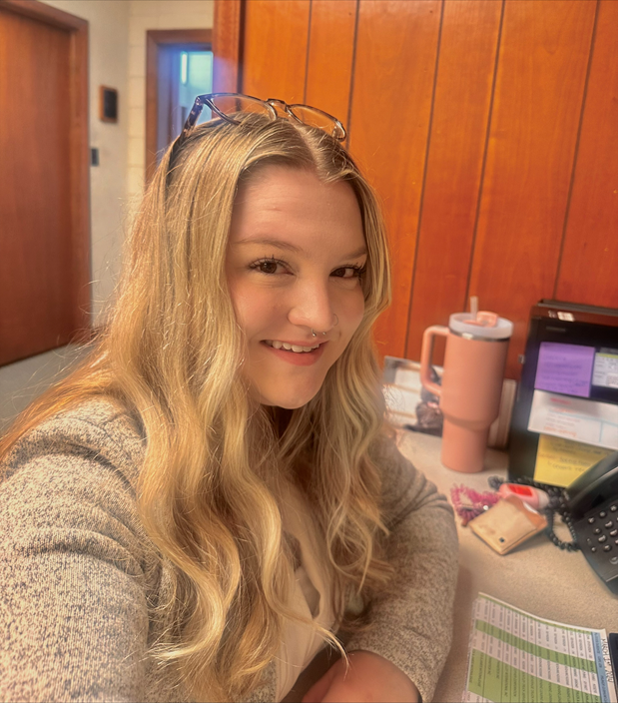
WBL collaboration Success Story
Mitchell Lance
VP, Hackney Sales and Marketing

