Slide 1
Business – Marketing, Finance
Information Technology
Transportation & Logistics

Slide 2
CAREER PATHWAYS
an integrated collection of regional and local programs and services connecting youth and adults to the workforce through education and training for highly skilled, sustainable careers in high demand industries.
Notes:
Career Pathways is a phrase used by a variety of organizations and agencies and is defined at least slightly differently by each of them. This is the definition we agreed upon in the NE.

Slide 3
SHARED VOCABULARY
CAREER FOCUSED
CAREER DEVELOPMENT
PARTNERSHIPS
RESOURCES

Slide 4
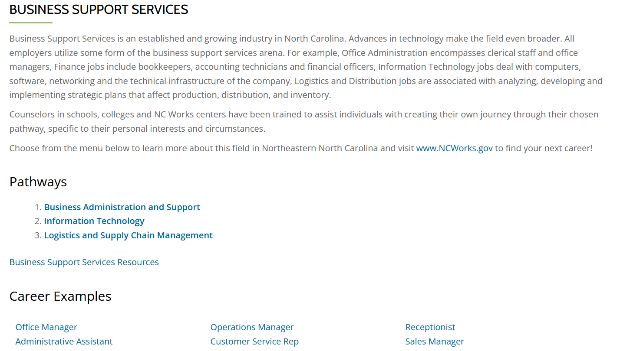
www.nencpathways.org

Slide 5
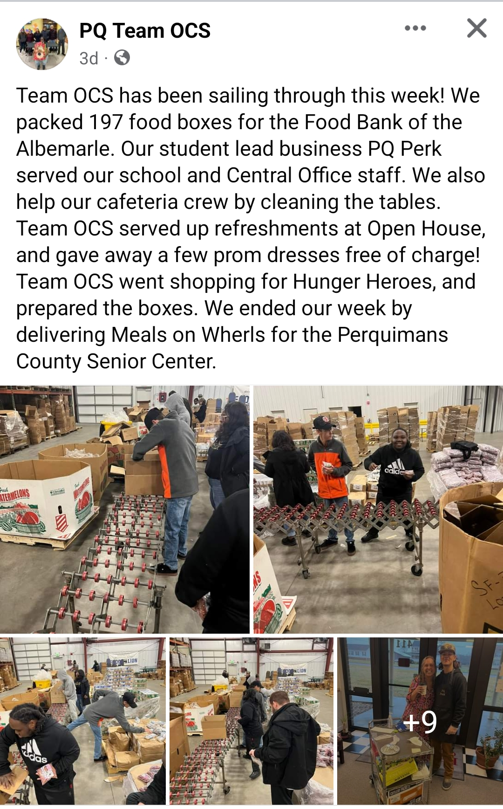

Slide 6
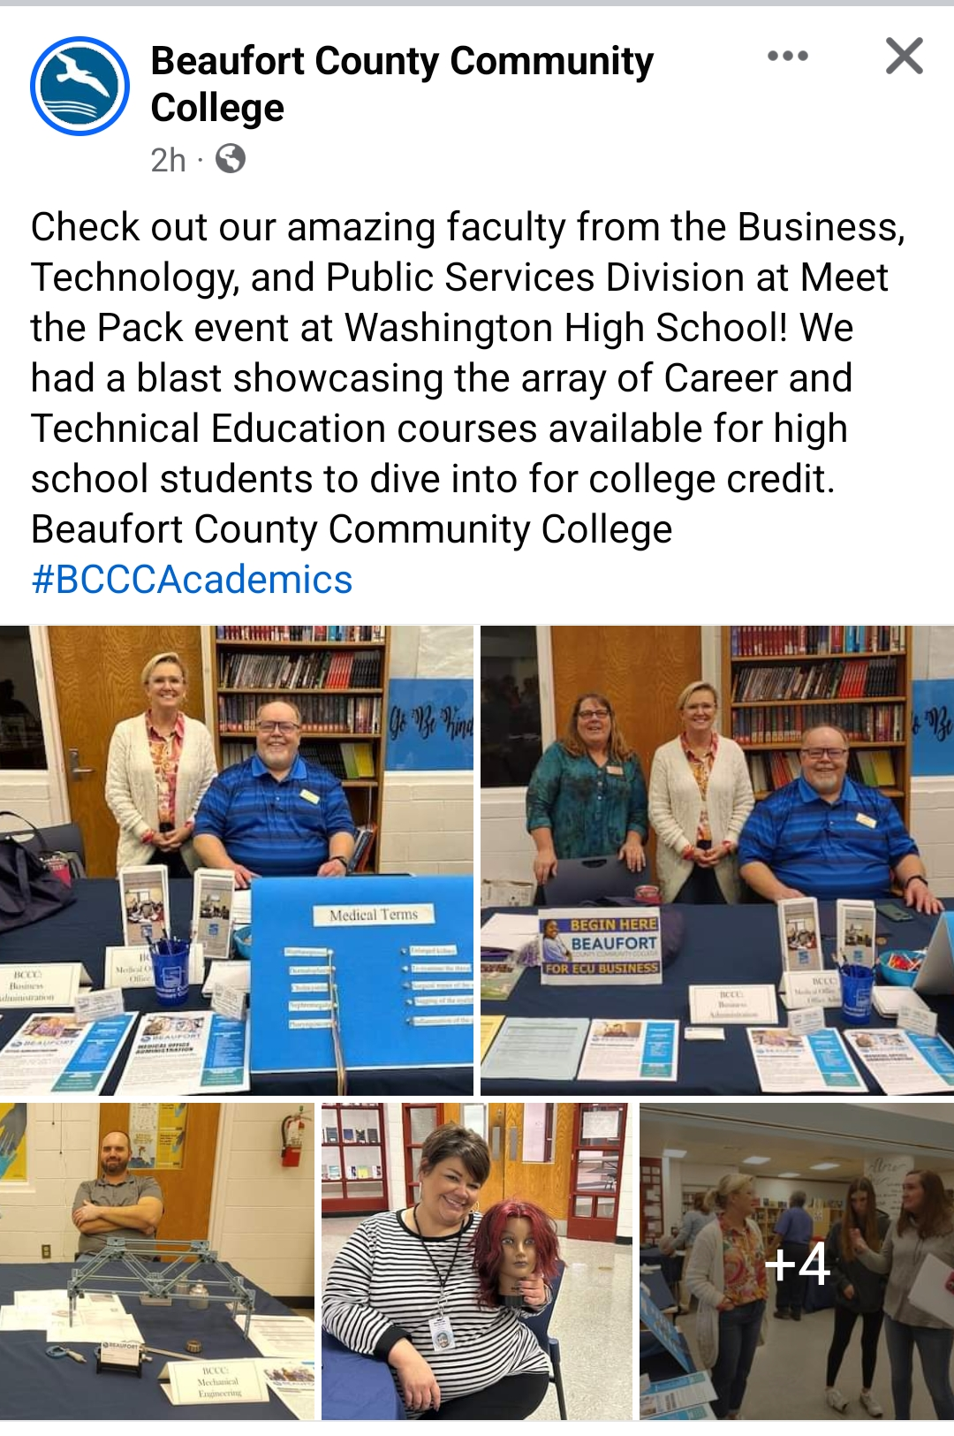
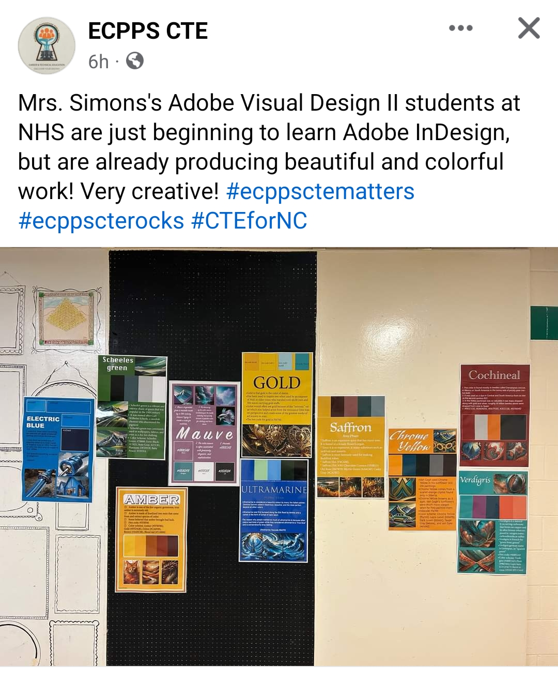

Slide 7
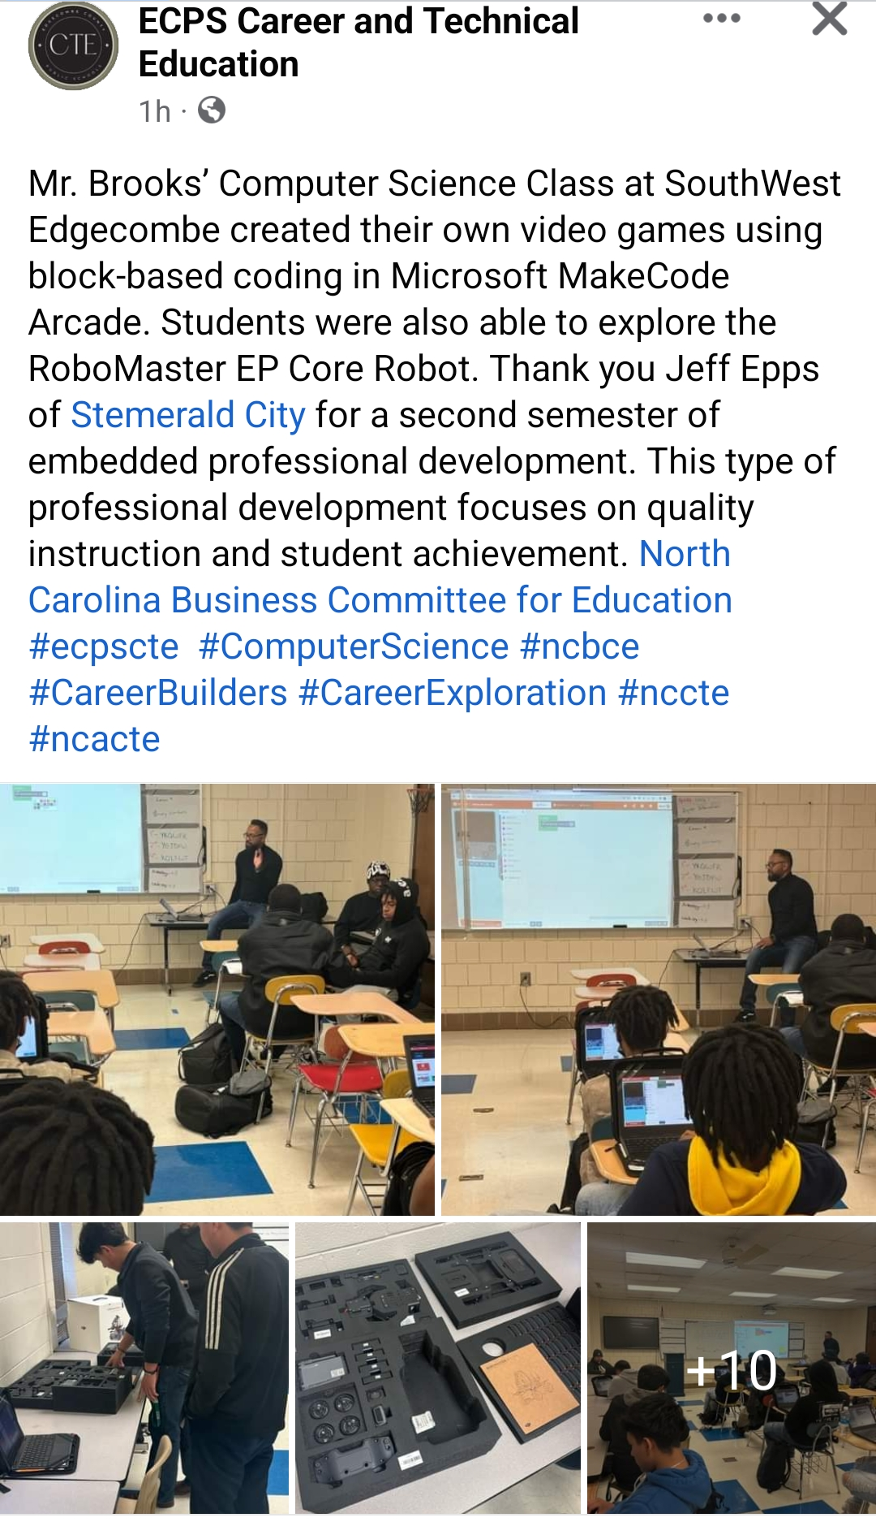

Slide 9
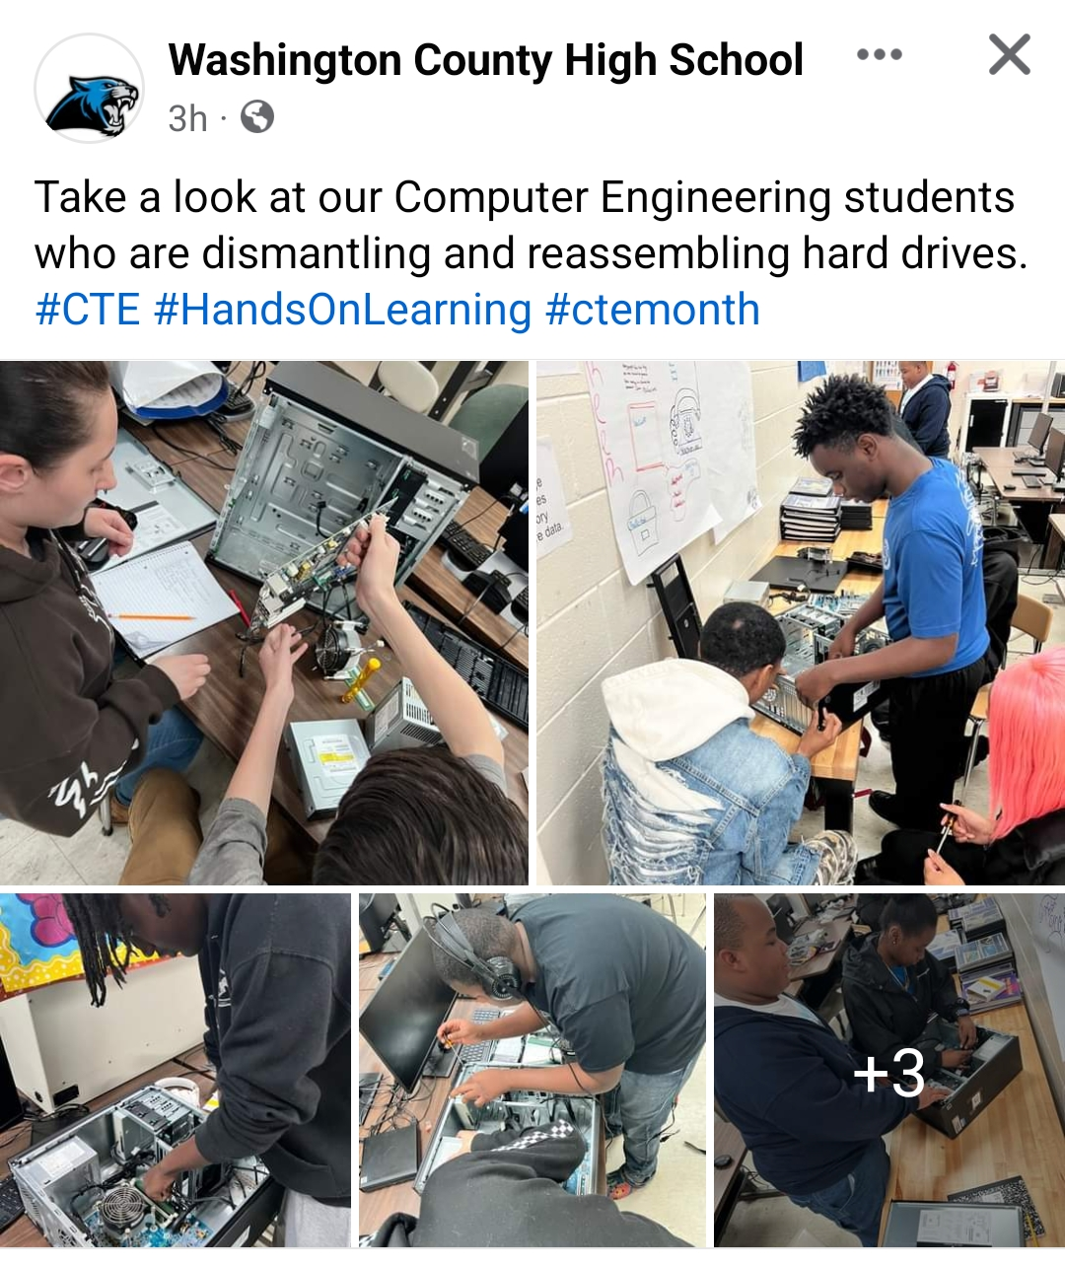

Slide 10
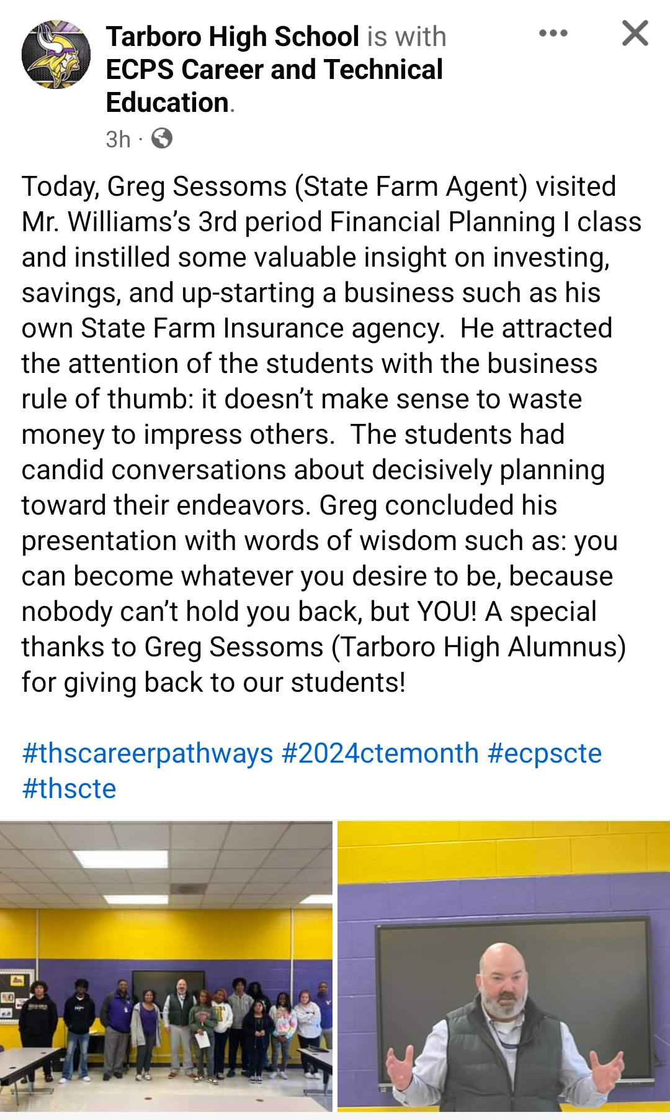

Slide 11
Business Support Services Career Path
Computer Programmers make around $85,000/yr in our region
NCVR helped more than 5000 people in NC during 2018
Computer Support Specialists earn around $50,000/yr in our region
Specialized programs that allow students to practice what they are learning help inspire interest in careers
BS in Computer Science
This Photo by Unknown Author is licensed under CC BY-SA
Life Happens
Associates in Information Technology
CISCO Networking Certification
Hour of Code
App Lab

Slide 13
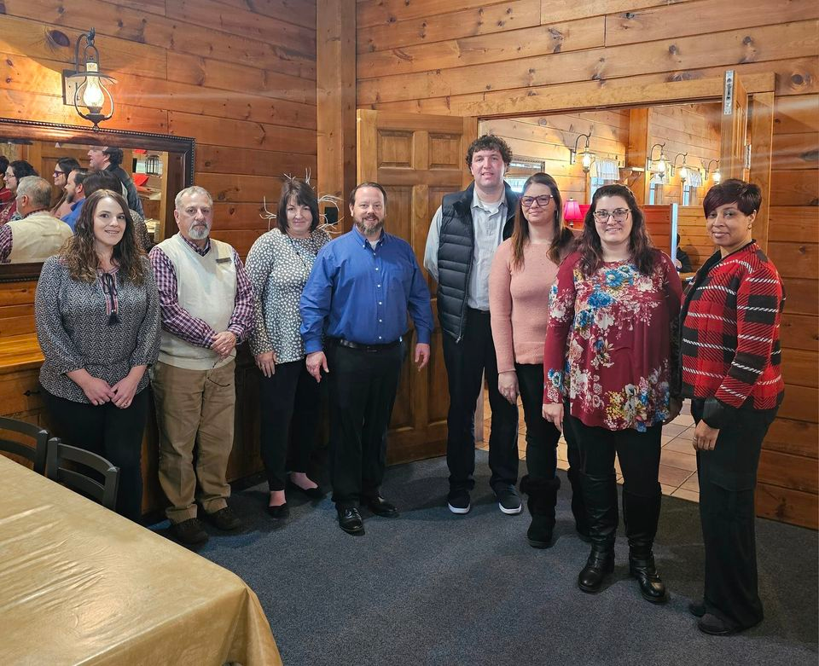
This Photo by Unknown Author is licensed under CC BY-NC-ND
Workforce Board Directors and Business Services Representatives meet with ApprenticeshipNC
February 2024

Slide 14
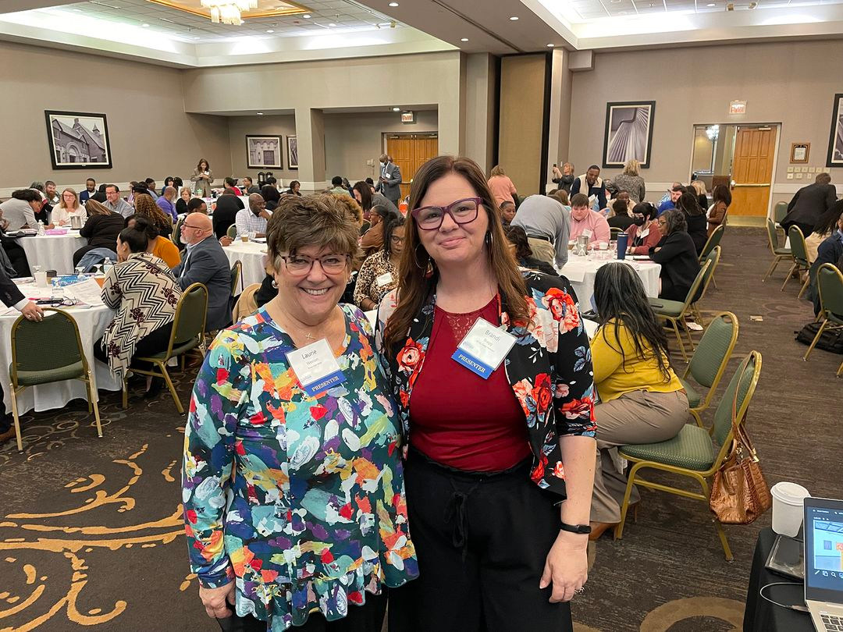
NC YOUTH FORUM 2024
Greensboro, NC
Outreach & Engagement

Slide 15
This Photo by Unknown Author is licensed under CC BY-NC-ND
Maritime Grant
NWDB + COA + HRWC
www.wavesofopportunitync.com

Slide 16
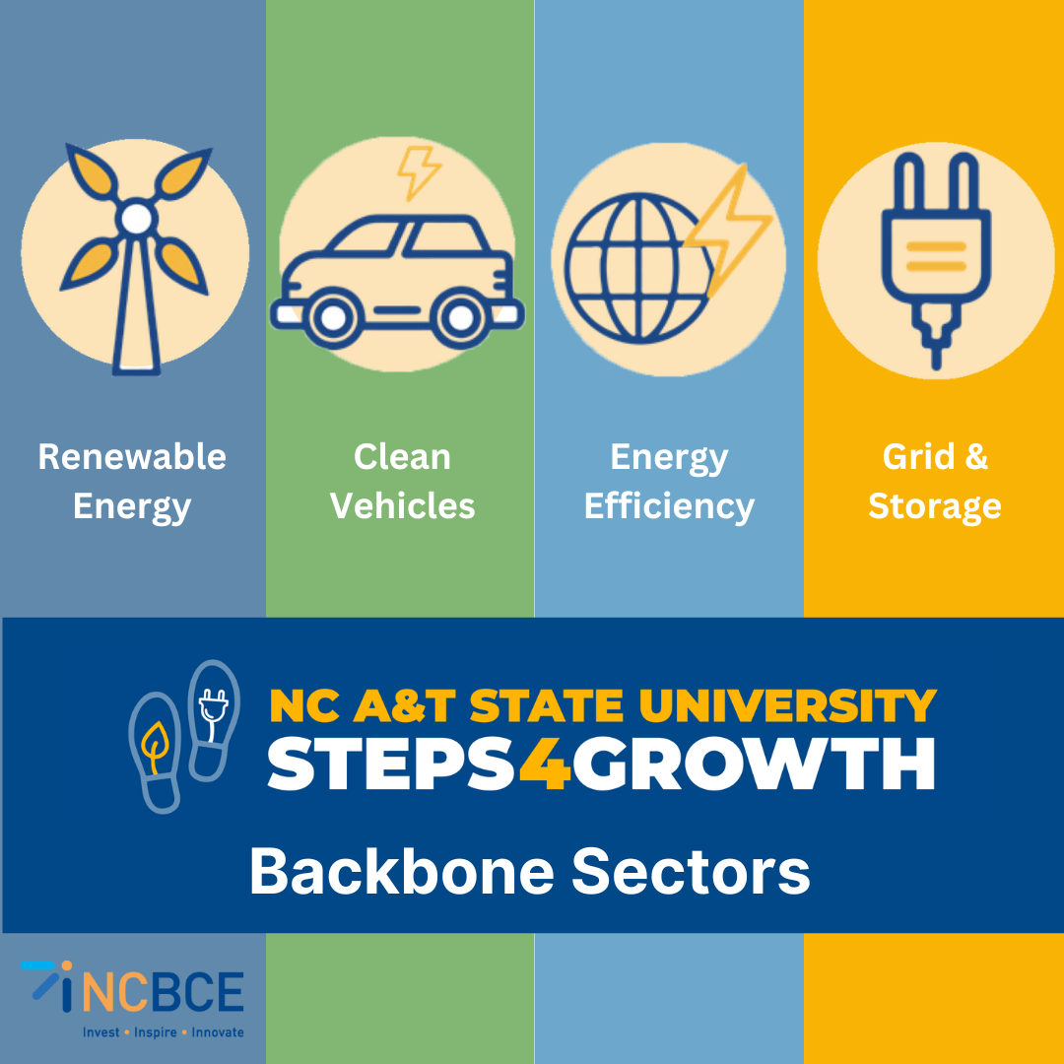
This Photo by Unknown Author is licensed under CC BY-NC-ND

Slide 17
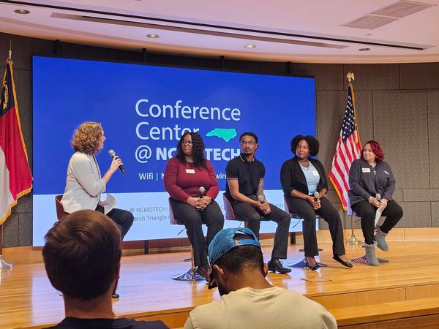
Rocky Mount native Rhonda Thorne, KBI Biopharma.

Slide 18
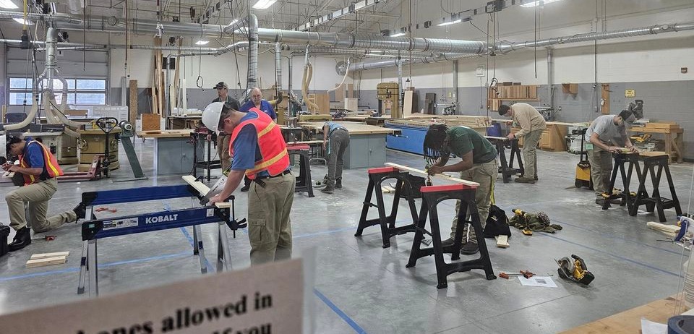
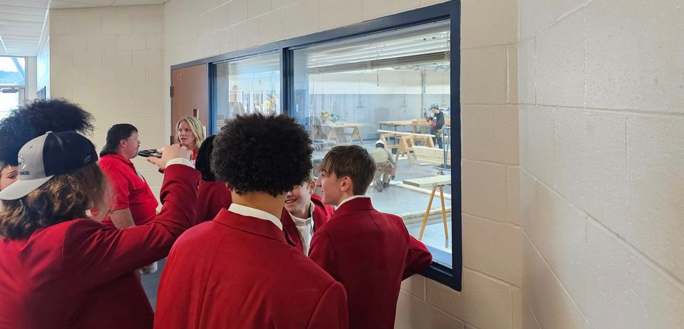
Regional Competition
March 8, 2024
Pitt Community College

