Slide 1
Regional Engagement Model

Slide 2
STEM East Network
A regional network to serve schools, communities, and employers
Initiative of NC East Alliance (regional economic development)
Non-profit providing pK-14 STEM education support
Serves ECU/ECU Health 29 county footprint
Regional STEM Educational Consortium
29 K-12 school districts (paid membership)
10 Community Colleges (paid membership)
Membership funds used for programming only

Slide 3
Notes:
Patrick Lead
Reminder STEM East has expanded 29 counties 31 school districts. Mirrors the service area of our 2 largest regional partners, Vidant and ECU.
Bruce (if Patrick asks)

Slide 4
STEM East Regional Engagement Model
Develop a regional operation to serve schools, communities, and employers
We propose four integrated practice areas:
STEM Schools of Distinction
Industry in Schools Clusters
Advanced Technological Education
Regional Career and Job Fairs

Slide 5
STEM East Regional Engagement Model
Develop a regional operation to serve schools, communities, and employers
Industry in Schools Clusters
Immerse teachers and teacher teams into regional career clusters to align standards-based instruction with authentic student opportunities.
Industry cluster theory and education innovation clusters inform approach.
Place-based professional development fosters regional awareness and builds relationships.
Specialized three-person “cluster” teams lead a regional teacher network.

Slide 6
Industry
Clusters
Community
Colleges
Instructional
Design

Slide 7
Summer 2023
(Pilots)

Slide 8
Lisa Lassiter, MSW, LCSW
Director
Workforce Development
ECU Health
Nancy Turner
Program Coordinator
ECU Health
Donna V. Neal
Dean, Health Sciences Division
Pitt Community College

Slide 9
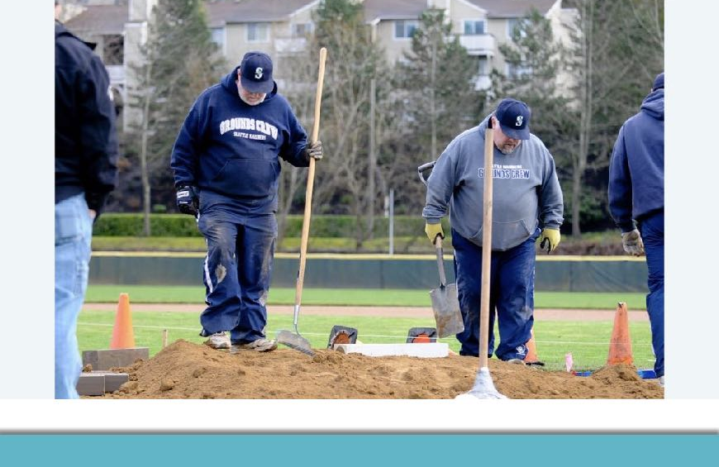
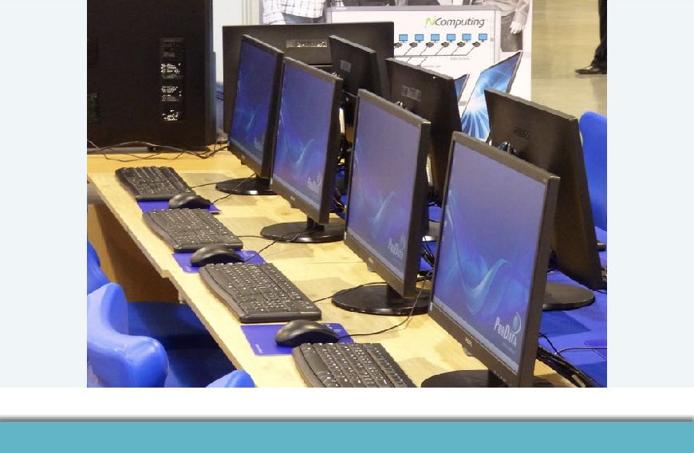
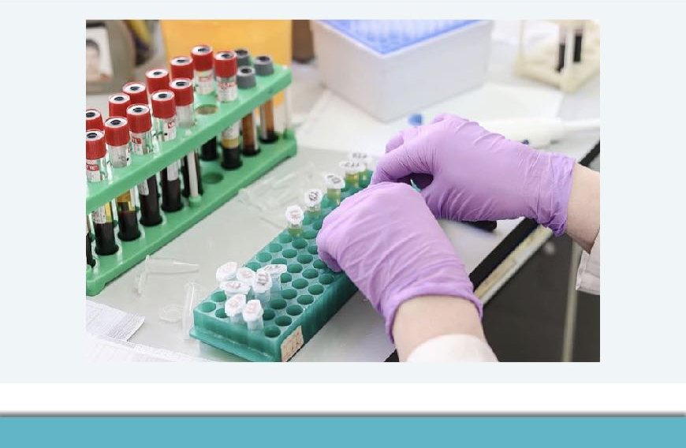

Slide 10
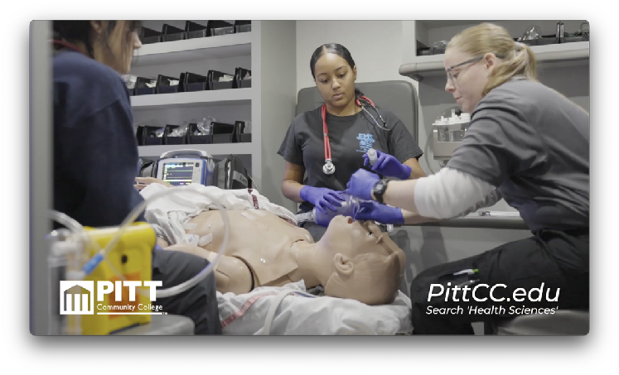
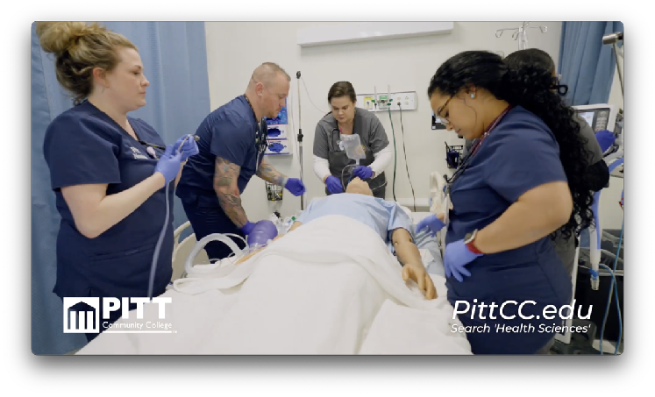
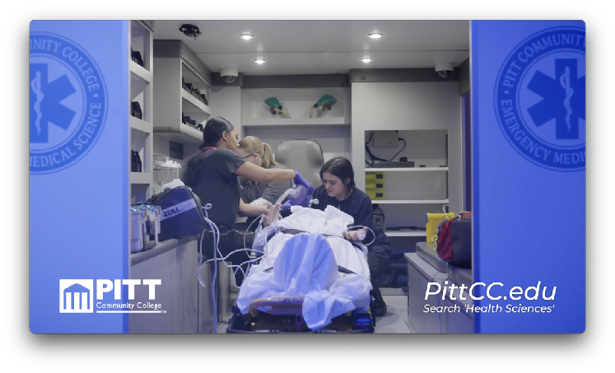

Slide 11
Industry in School
Aviation
Science
Smart
Agriculture
Health
Science
Instructional Leadership Network
Blue
Economy
Green
Energy
Advanced
Manufacturing
Education
Training
Instructional
Design

Slide 12
Bruce Middleton
Executive Director
STEM East
middleton@nceast.org
Jen Annetta
Program Director
STEM East
annetta@nceast.org

