Slide 1
Powered by Northeastern, Rivers East and Turning Point Workforce Development Boards

Slide 2
CAREER PATHWAYS
an integrated collection of regional and local programs and services connecting youth and adults to the workforce through education and training for highly skilled, sustainable careers in high demand industries.
Notes:
Career Pathways is a phrase used by a variety of organizations and agencies and is defined at least slightly differently by each of them. This is the definition we agreed upon in the NE.

Slide 3
SHARED VOCABULARY
CAREER FOCUSED
CAREER DEVELOPMENT
PARTNERSHIPS
RESOURCES

Slide 4
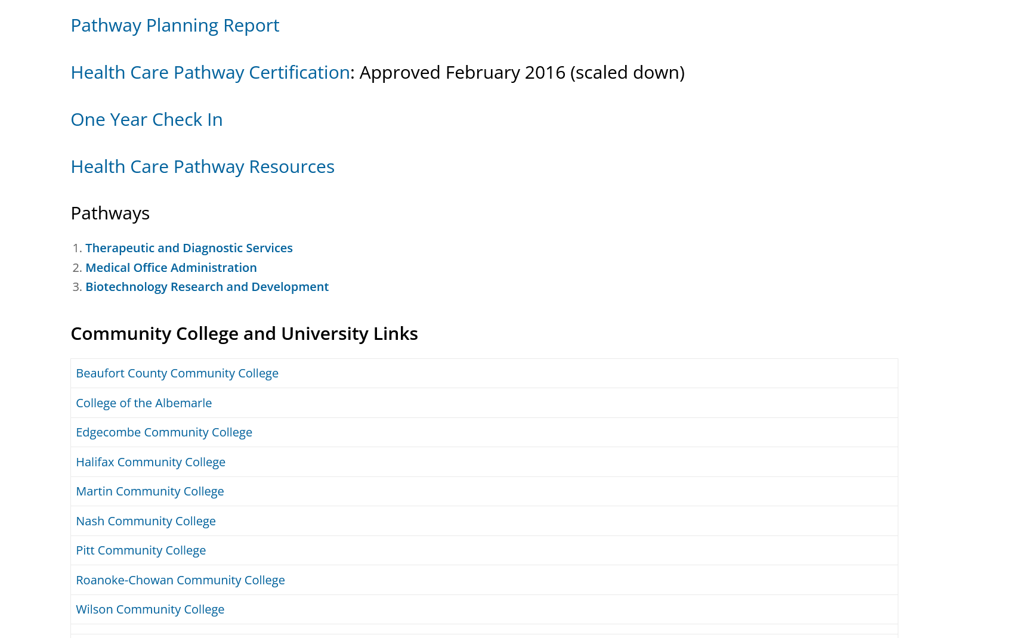

Slide 5
Partnership Updates
Skills USA Endorsement
Grants – Maritime, STEPS4GROWTH, NCBiotech
Rivers East Academy
*Pathway Reviews
*Toolkit Update
Posters
Quarterly Meetings
NCWorks Partners Conference, Synergy, Carolina Across 100, NC Youth Forum, CTE Advisory/Planning
This Photo by Unknown Author is licensed under CC BY-NC

Slide 6
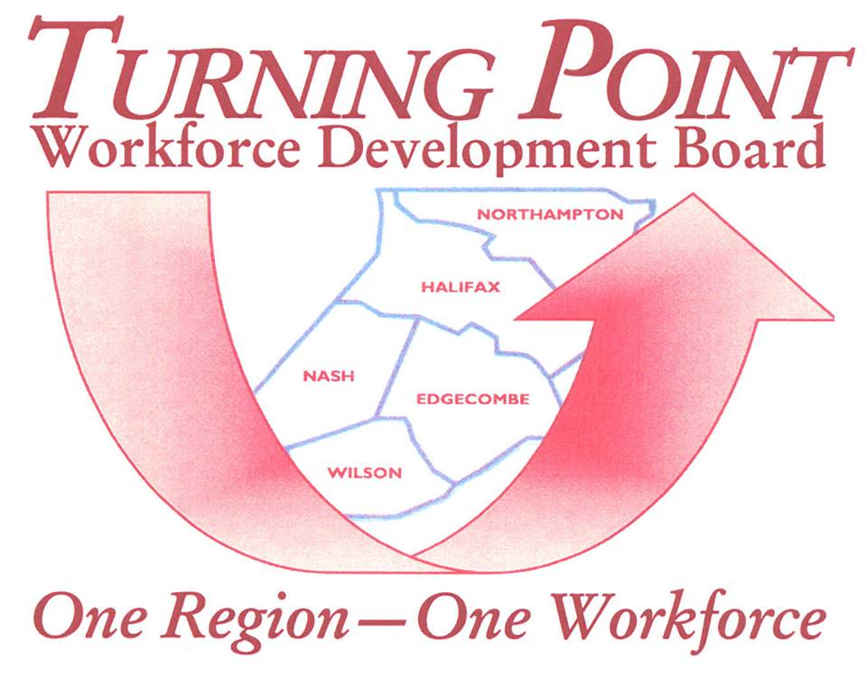
HEALTH CARE ADVANCEMENT COLLABORATIVE (HCAC)

Slide 7
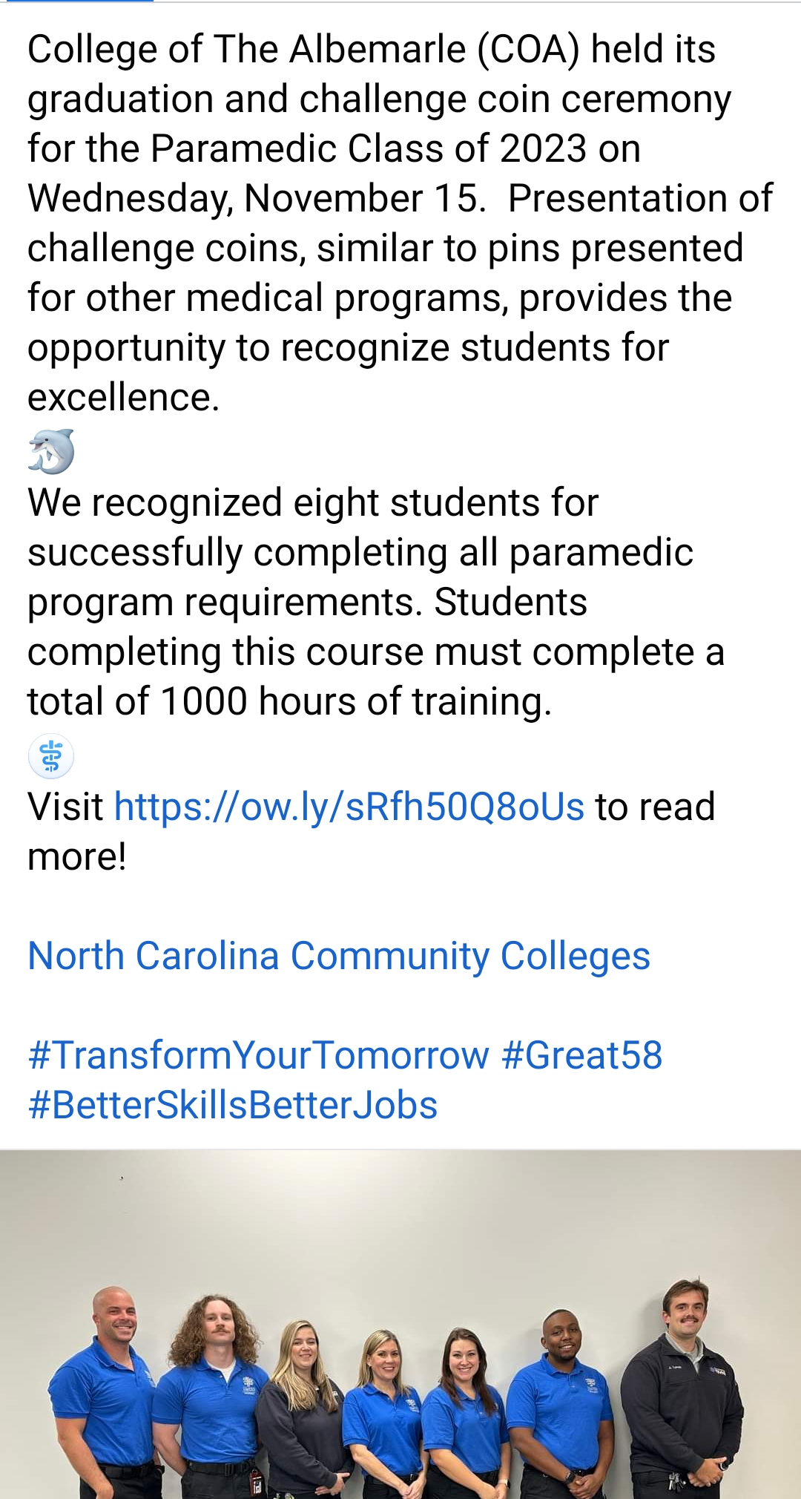
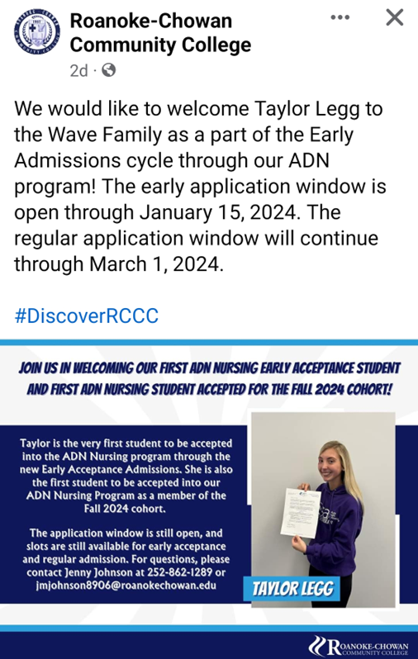
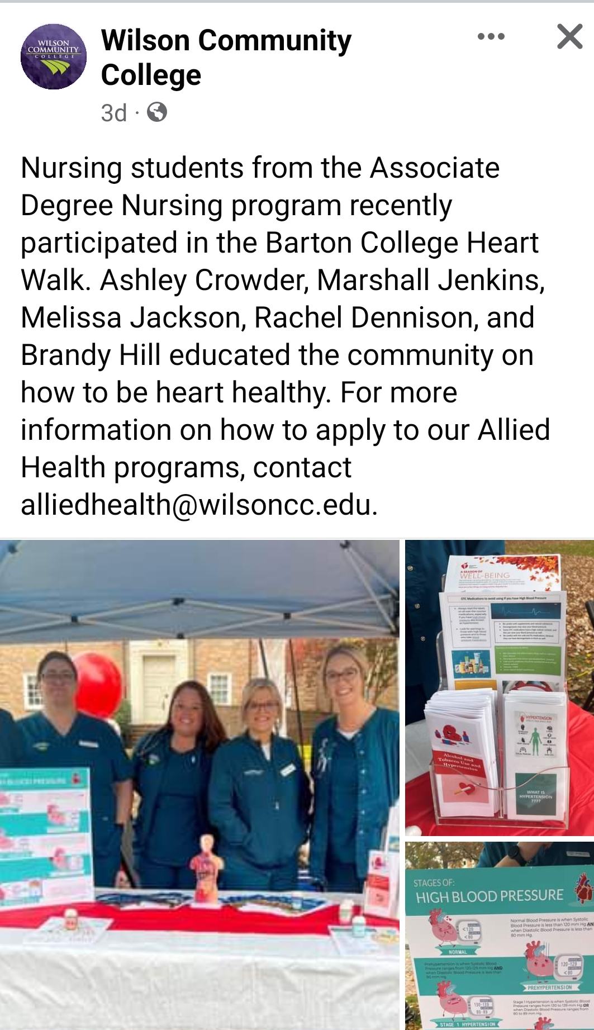

Slide 8
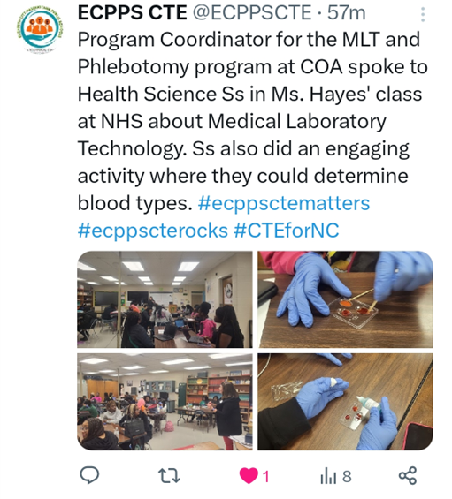
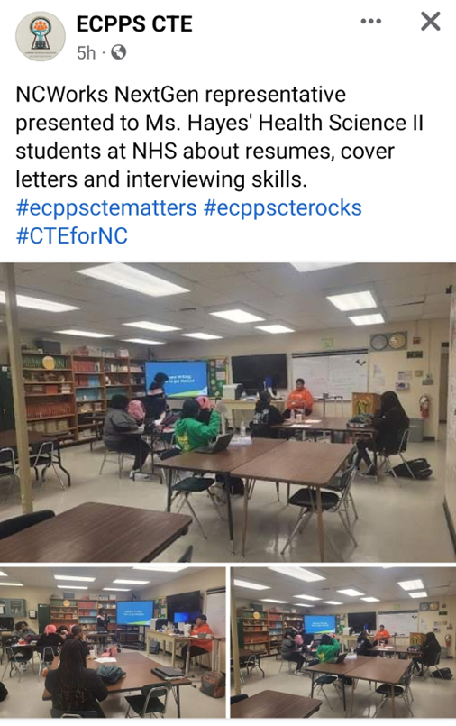

Slide 9
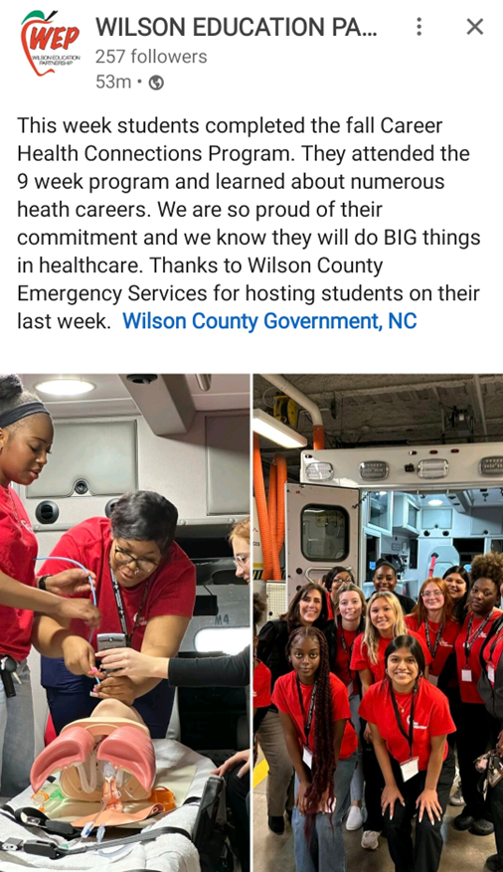
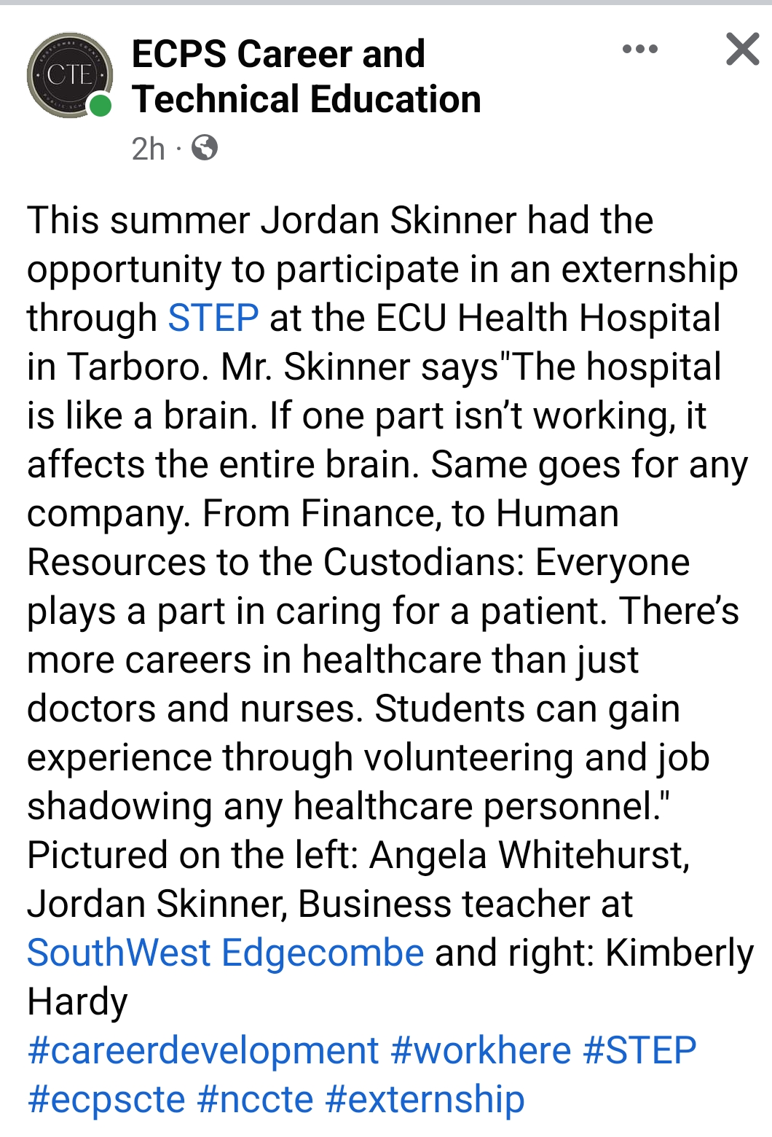

Slide 11
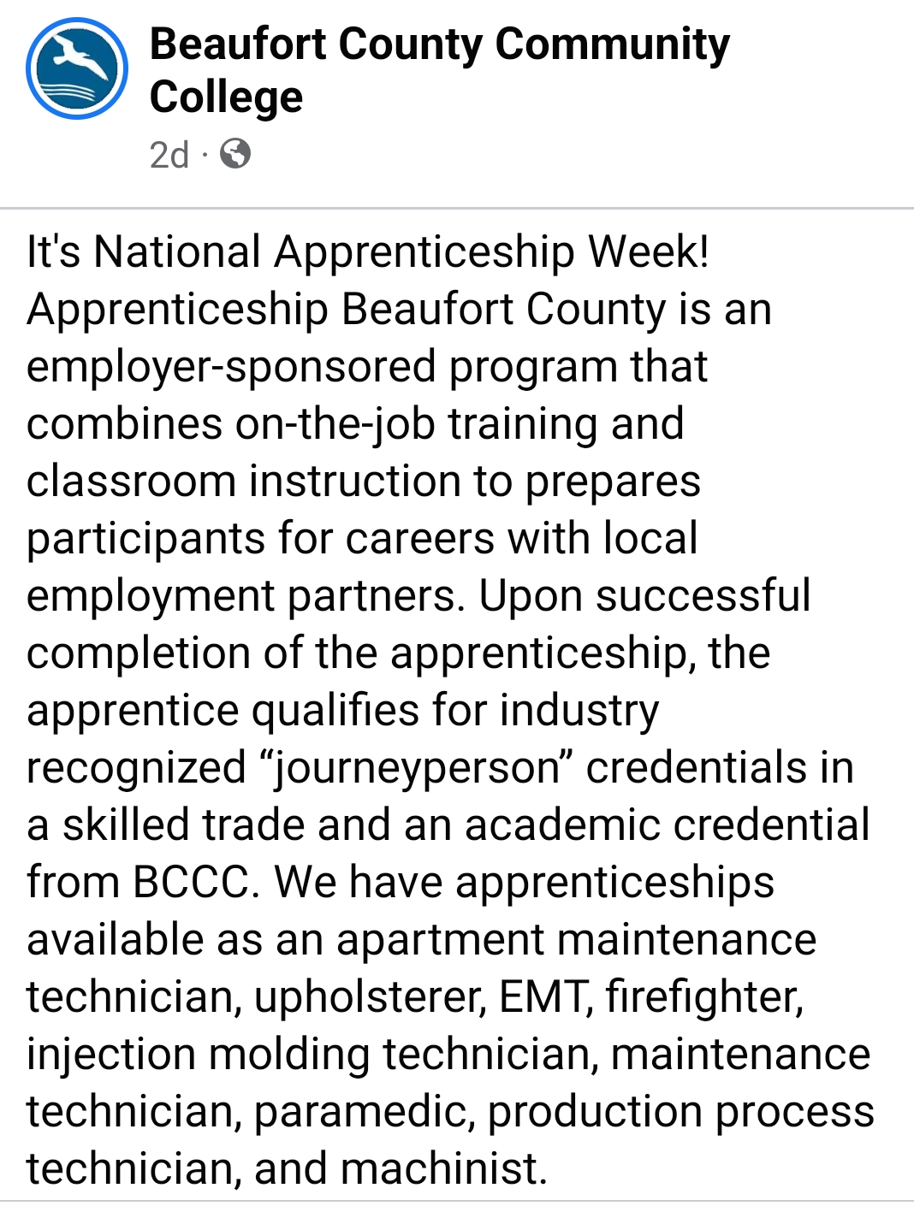
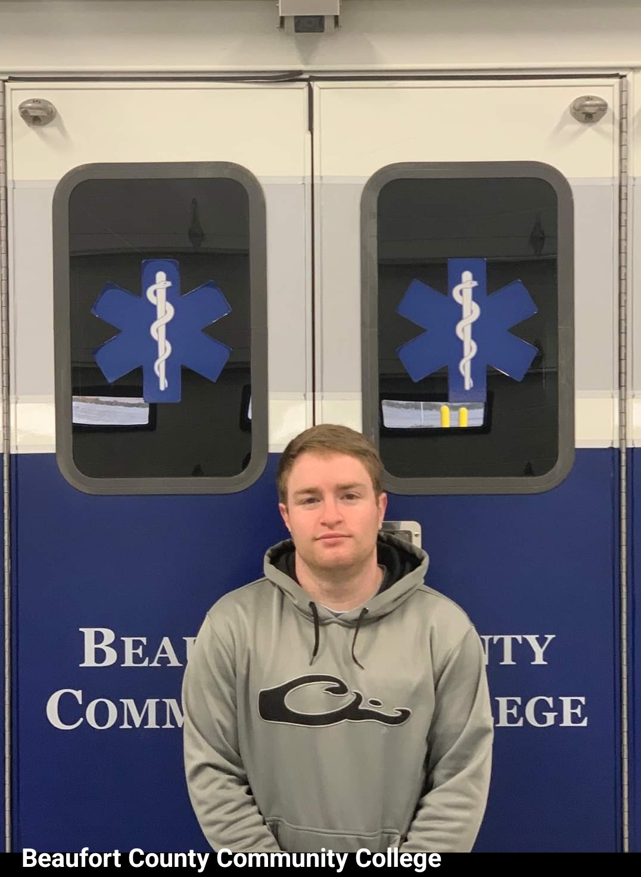

Slide 12
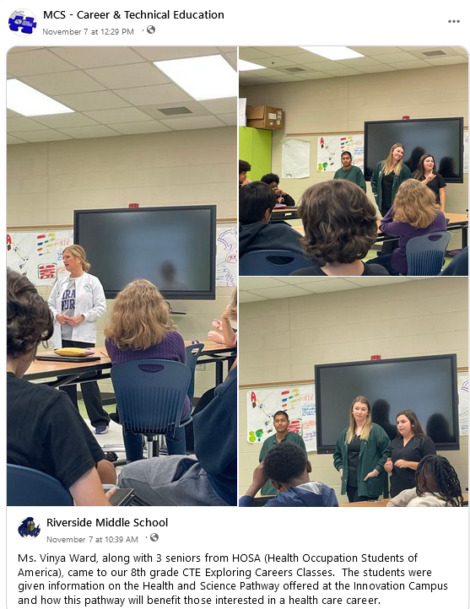
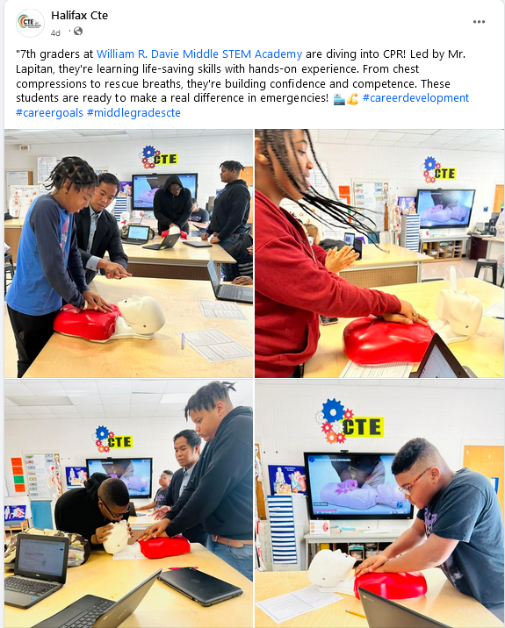

Slide 14
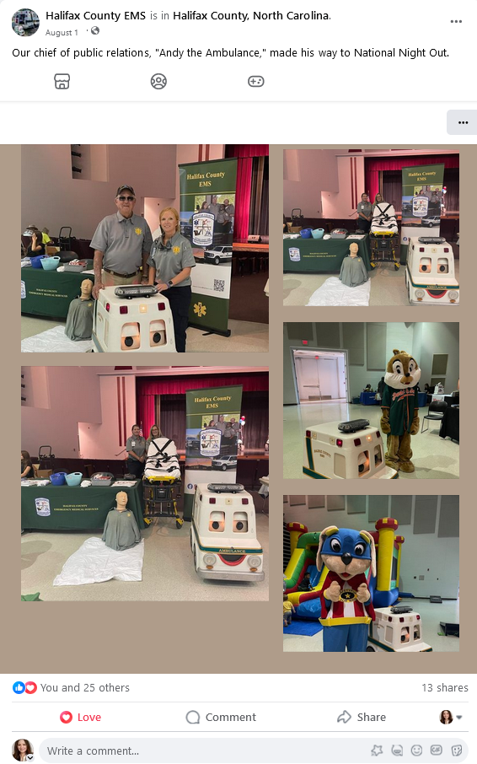

Slide 15
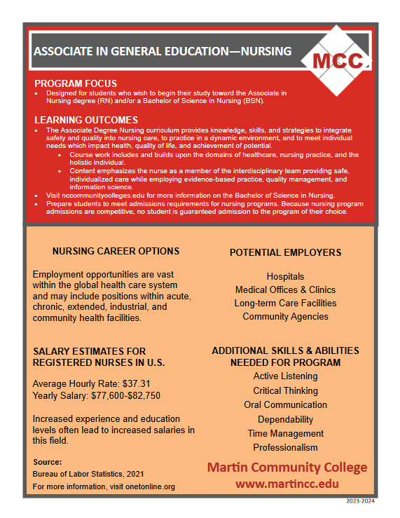
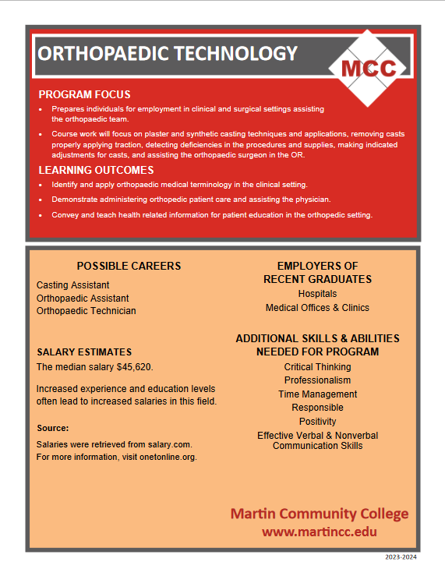

Slide 16
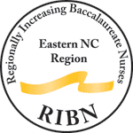
Health Care Career Path
FNP’s earn between $96,000 and $135,000/yr
RN’s salary usually maxes out around $100,000/yr
RN’s starting pay can be around $60,000
CNA’s in NENC generally earn between $10-$15/hr
DNP
Graduation
Family Nurse Practitioner in Eastern NC
ENC RIBN
Completes Bachelor’s Degree
Medication Aide
Completes Associates’ Degree
High School
Completed Certificate
CNA I Certification
APRN RURAL Scholars Program

Slide 17
NENC Career Pathways proudly endorses the SkillsUSA Employability Framework to encourage a SHARED VOCABULARY and CAREER READINESS among partners and those we serve!
Ignite – page 46 “Ready, Set, Draw” – Adaptability/Flexibility

