Slide 1
8th Annual career guidance retreat CAREER PATHWAYS EXPERIENCE 2023
This Photo by Unknown Author is licensed under CC BY-NC
MUSIC
Sponsored by: Northeastern, Rivers East & Turning Point Workforce Boards

Slide 2
CAREER PATHWAYS
an integrated collection of regional and local programs and services connecting youth and adults to the workforce through education and training for highly skilled, sustainable careers in high demand industries.
Notes:
Career Pathways is a phrase used by a variety of organizations and agencies and is defined at least slightly differently by each of them. This is the definition we agreed upon in the NE.

Slide 3
www.nencpathways.org

Slide 4
Advanced Manufacturing Career Path
This career pays around $80,000/yr in our region
Manufacturers employ 10% of the workforce in NC
This field pays around $25/hr in our region
Pre-apprenticeship connects school-based learning with the workplace to integrate core and technical instruction
Electrical Engineer
Hired by Local Company
Uses employability and technical skills
Community College
Completes Electrical Engineering Technology Degree
Full Time + Benefits + Apprenticeship
Pre-apprenticeship
Local Manufacturer
High School
CTE Concentration in STEM

Slide 5
SHARED VOCABULARY
CAREER FOCUSED
CAREER DEVELOPMENT
PARTNERSHIPS
RESOURCES

Slide 6
In the five sections of the shield, draw a picture in response to one of these five questions:
What do you do at work?
How do you like to spend your spare time?
What is something you think you are very good at?
What is something you think your colleagues don't know about you?
What is one of your personal values?
TIMER
MUSIC

Slide 7
10 minutes ~ complete Coat of Arms, artistic ability doesn’t matter
Exchange Coat of Arms with someone at your table.
Spend 3 minutes interpreting the Coat of Arms. Owner should not provide hints unless interpreter is LOST.
Switch so that other participant now interprets (3 minutes)
Now take 2 minutes each to introduce the person whose Coat of Arms you interpreted to the table.

Slide 8
Stackable Credentials
Employability Skills
Career Pathways
Career Ladder
Work-Based Learning
Transferable Skills
Labor Market Information (LMI)
Secondary Education
Post-Secondary Education
Community College
University
Associate Degree
Bachelor’s degree
Graduate degree
Certificate
Credential
Diploma
Internship
Apprenticeship
On-the-Job Training (OJT)
Job Shadowing
Suitability
Notes:
Importance of Shared Vocabulary

Slide 9
TIMER
MUSIC

Slide 10
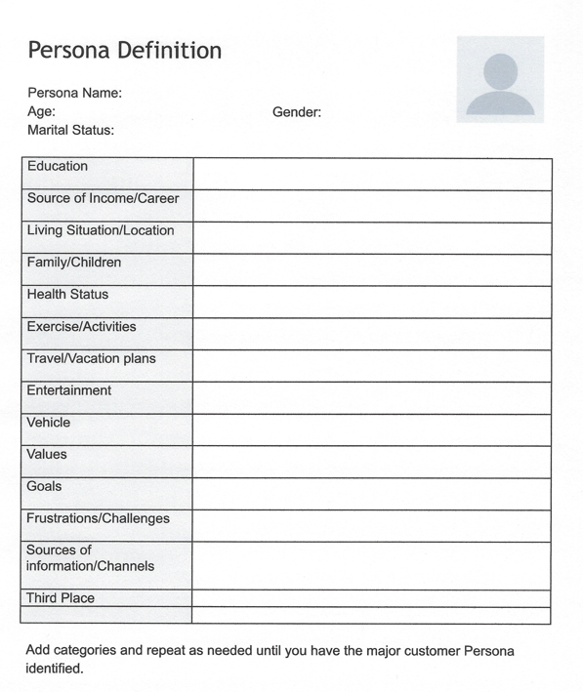
Notes:
Persona workshop

Slide 11
What kind of barriers
might people
face when thinking
about their career goals?
Notes:
barriers

Slide 12
Work on Resources
Networking
TIMER
MUSIC

Slide 13
NENC CAREER PATHWAYS PARTNERSHIP IS PROUD TO ENDORSE SKILLSUSA EMPLOYABILITY FRAMEWORK TO PROMOTE A SHARED VOCABULARY AND WITH AN EMPHASIS ON CAREER READINESS
Notes:
SkillsUSA activity

Slide 14
This Photo by Unknown Author is licensed under CC BY-SA

Slide 15
SHARED VOCABULARY
CAREER FOCUSED
CAREER DEVELOPMENT
PARTNERSHIPS
RESOURCES

Slide 16
LABOR
MARKET
INFORMATION
www.nccareers.org

Slide 17
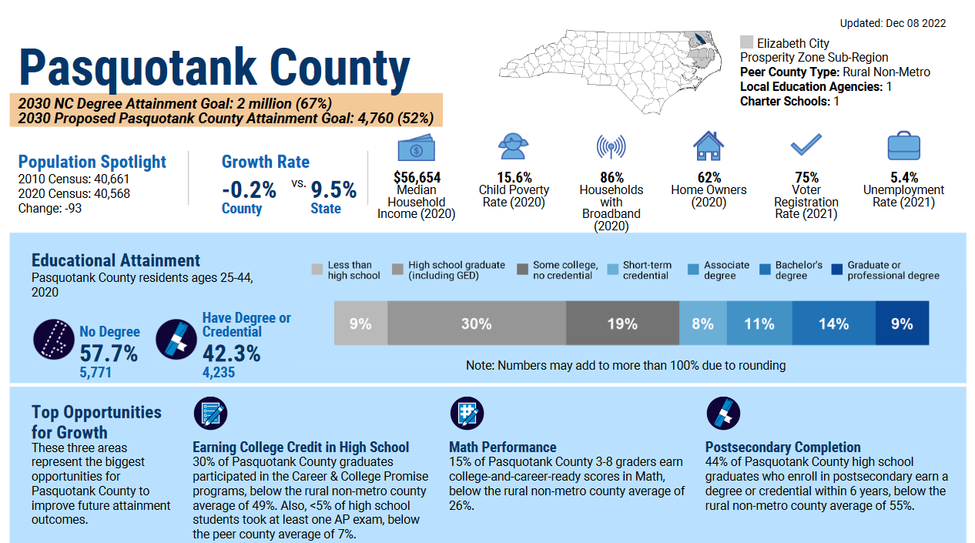
https://dashboard.myfuturenc.org/

Slide 18
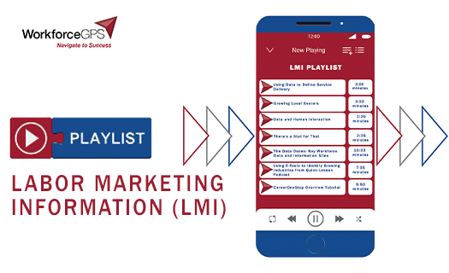
Contact your local
Workforce Development Board
Notes:
Other ways to understand LMI, which can help you focus on high-demand career fields in your area, is to complete some training.

Slide 19
an integrated collection of regional and local programs and services connecting youth and adults to the workforce through education and training for highly skilled, sustainable careers in high demand industries.
CAREER
PATHWAYS
This Photo by Unknown Author is licensed under CC BY-NC-ND

Slide 20
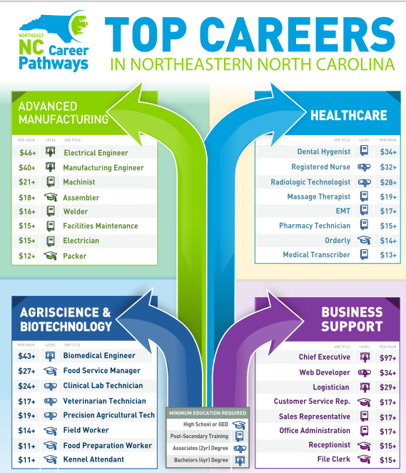

Slide 21
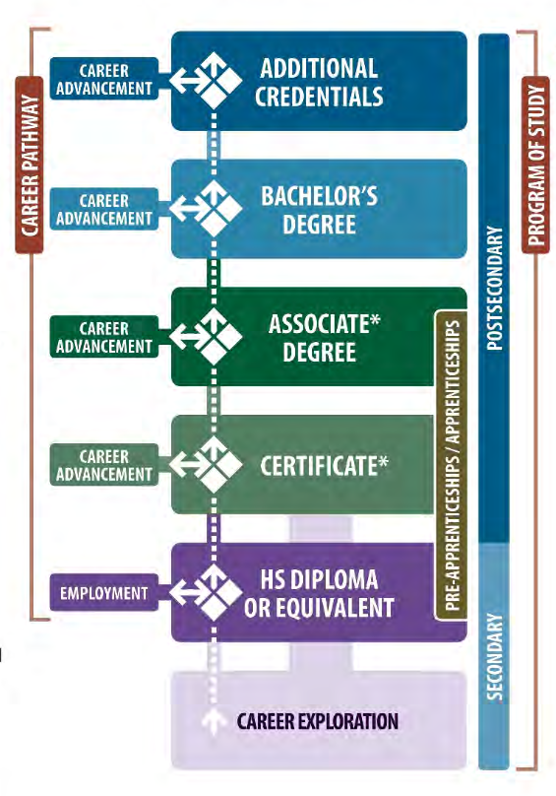
STACKABLE
CREDENTIALS
part of a sequence of credentials that can be accumulated over time to build up an individuals’ qualifications
CTE Certificate
Notes:
https://www.google.com/url?sa=i&url=https%3A%2F%2Fdenisempls.org%2F2019%2F04%2F05%2Fstackable-credentials%2F&psig=AOvVaw39Ujwbxe_SE0EqTsQ7jg95&ust=1692197729789000&source=images&cd=vfe&opi=89978449&ved=0CBEQjhxqFwoTCKCrxff13oADFQAAAAAdAAAAABAE

Slide 22
RESOURCE: Turning Point WDB YouTube Channel https://www.youtube.com/channel/UCk1FK8v9NENeWcsp_BceRlQ

Slide 23
SUITABILITY

Slide 24
THINGS TO CONSIDER
Interests
Skills
Values
Work Environment
Company Culture
Your goals vs Company goals
Work-Life Balance
Salary & Benefits
Co-Workers (longevity, wage transparency, etc.)
Opportunities for growth

Slide 25
Agriscience Career Path
Opportunities are endless…
Assistance is often free, many resources available
Vet Techs in NC make around $35,000/yr
Nonfarm animal caretakers make about $24,000/yr
Small Business Owner
Entrepreneurship
Opens mobile grooming business
Community College
Attends events and takes classes, gets a mentor
Animal Lover
Completes Vet Tech Program
High School
Works for local animal shelter
CTE Concentration in Agriculture
Notes:
Where was LMI used, or where could it be used in this scenario?
How does this example connect to career pathways?
How is this an example of utilizing stackable credentials?
How was suitability determined in this situation?
What resources did John use? What other resources could have been utilized?

Slide 26
TIMER
MUSIC

Slide 27
How did you find success
for your person?
SHOW & TELL US ABOUT YOUR PERSON IN 5 (OR 6) SENTENCES
Who are they?
What barriers did they face?
What resources did you find to help them?
What career path did they choose & why?
What was the plan that helped them find success?
BONUS QUESTION: Anything you didn’t share already that is important for the group

Slide 28
SHARED VOCABULARY
CAREER FOCUSED
CAREER DEVELOPMENT
PARTNERSHIPS
RESOURCES

Slide 29
Event Planning Team
Annette Barnes (NWDB)
Brandi Bragg (NENC CP)
Duna Long (TPWDB)
Laurie Weston (REWDB)
Notes:
PCC
WDBs
Annette, Duna, Laurie

Slide 30
Please share your thoughts!
Thank you for your participation!

