Slide 2
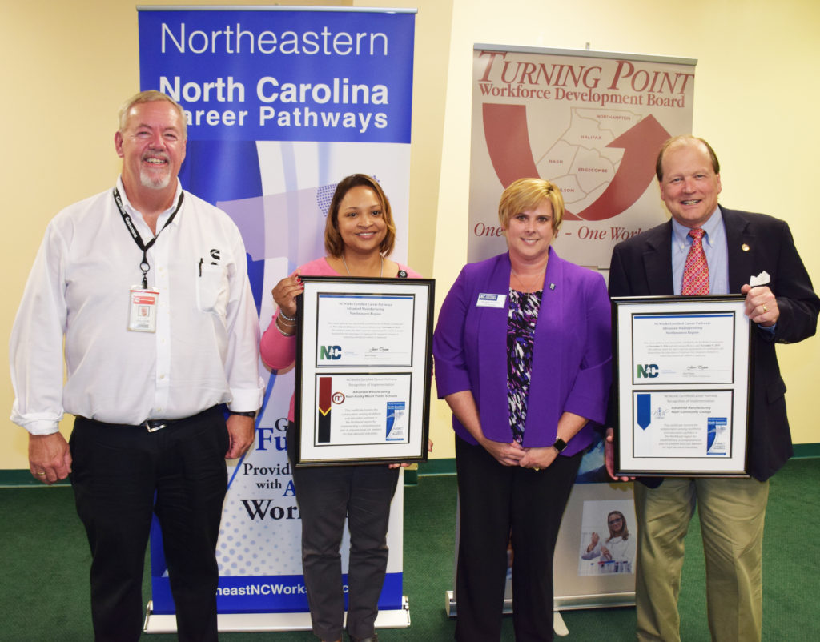

Slide 3
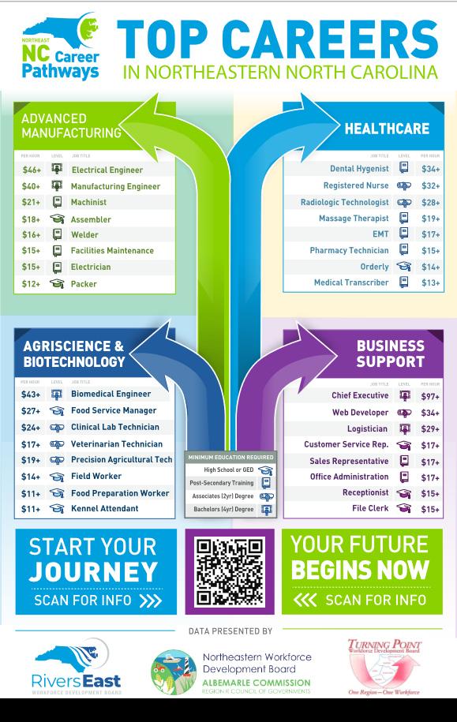
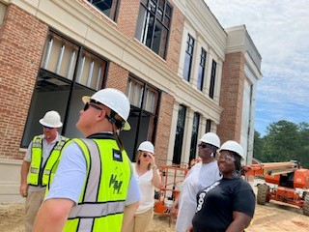
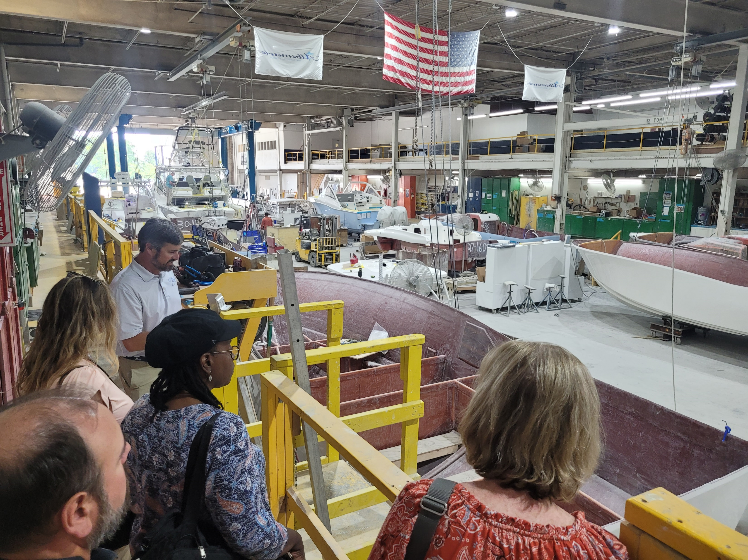
2023-24 Updates
Interactive Poster
Quarterly Meeting Dates
Partner Training Opportunities
Updated Digital Toolkit*
Continued Connection with EDA Grants (Clean Energy, Maritime, Biotechnology)
Rivers East Academy/Made in…
Annual Guidance Retreat (9-18-23)
Advanced Manufacturing Day – Friday October 6

Slide 4
CAREER PATHWAYS
an integrated collection of regional and local programs and services connecting youth and adults to the workforce through education and training for highly skilled, sustainable careers in high demand industries.
Notes:
Career Pathways is a phrase used by a variety of organizations and agencies and is defined at least slightly differently by each of them. This is the definition we agreed upon in the NE.

Slide 5
SHARED VOCABULARY
CAREER FOCUSED
CAREER DEVELOPMENT
PARTNERSHIPS
RESOURCES

Slide 6
www.nencpathways.org

Slide 8
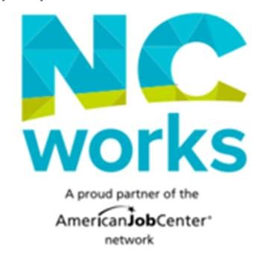
Advanced Manufacturing Career Path
This career pays around $80,000/yr in our region
Manufacturers employ 10% of the workforce in NC
This field pays around $25/hr in our region
Pre-apprenticeship connects school-based learning with the workplace to integrate core and technical instruction
Electrical Engineer
Hired by Local Company
Uses employability and technical skills
Community College
Completes Electrical Engineering Technology Degree
Full Time + Benefits + Apprenticeship
Pre-apprenticeship
Local Manufacturer
High School
CTE Concentration in STEM

Slide 9
NENC Career Pathways proudly endorses the SkillsUSA Employability Framework to encourage a SHARED VOCABULARY among partners and those we serve!

Slide 10
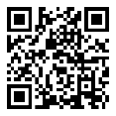
Let’s Stay In Touch
Facebook: https://www.facebook.com/nencpathways/
Instagram: https://www.instagram.com/nenccareerpathways/
Twitter: https://twitter.com/NENCPathways
LinkedIn: https://www.linkedin.com/company/nenc-career-pathways/
Sign up for our monthly newsletter: https://lp.constantcontactpages.com/su/OAWODhw/nenc
Connect with Brandi: brandi.bragg@nencpathways.org

