Slide 1
North Carolina:
A Global Life Sciences Leader
June, 2023
ncbiotech.org

Slide 2
Mission – We create North Carolina’s competitive advantage in the life sciences, engaging partners, maximizing opportunities, and delivering solutions to accelerate innovation, investment, and job creation.
Notes:
PRESENTATION DIVIDER SLIDE
Editable: Headline

Slide 3
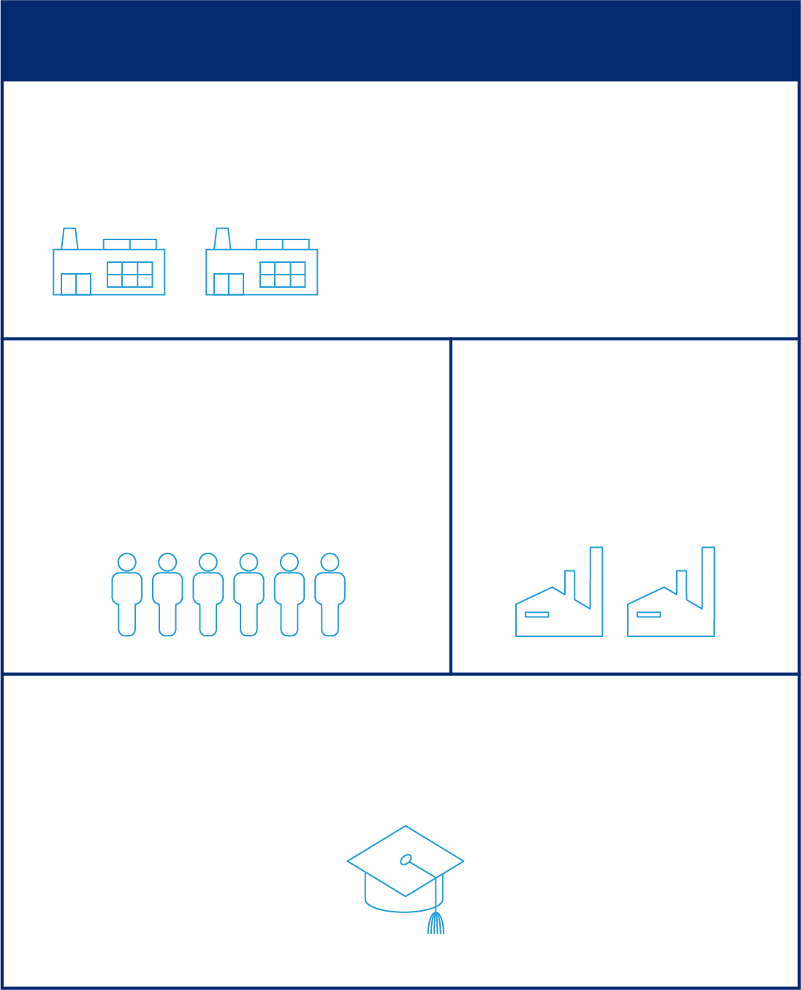
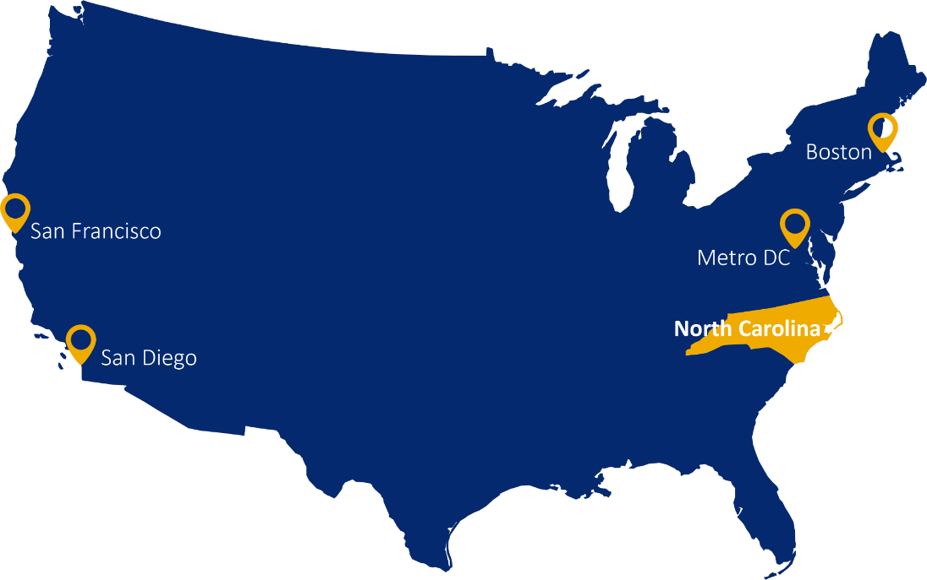
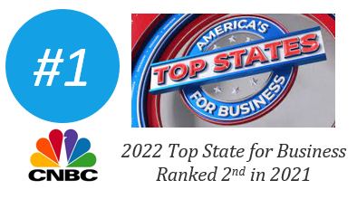
North Carolina’s Life Sciences Community
810
companies, including
140+
Production & Manufacturing
75,000+
2,500
workforce
support companies
degrees awarded (2020-2021)
5,200+
4,600+
Biological and
Biomedical Science
Engineering

Slide 4
NC Life Sciences Industry by the Numbers
Research & Development
Production & Manufacturing
Contract Research & Testing
Other

Slide 5
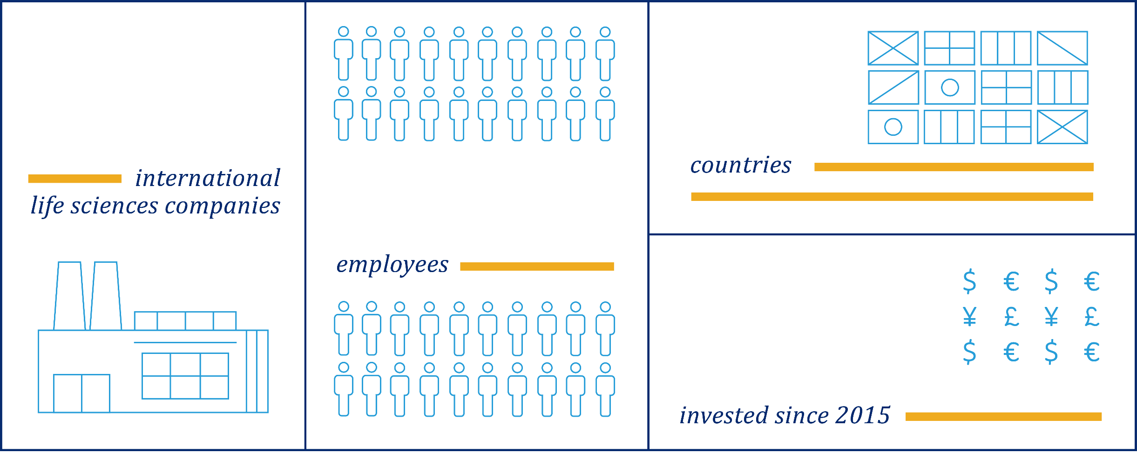
International Life Science Company Presence in NC
96
23
16,000
$5.5B
Source: 2022 | NCBiotech Life Science Intelligence, NCBiotech Company Directory

Slide 6
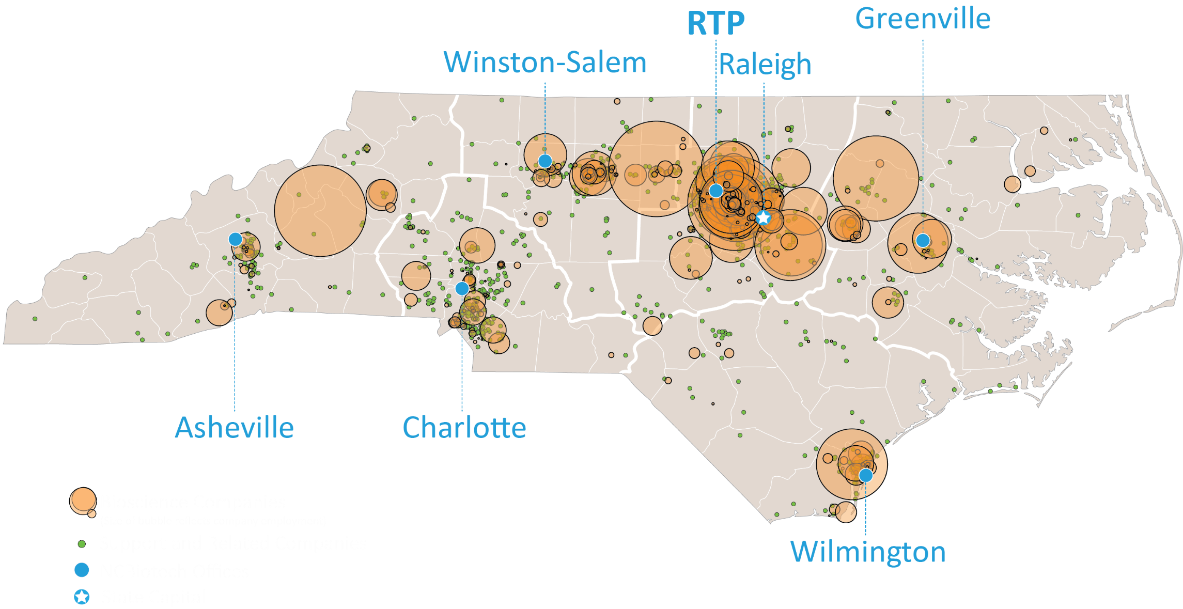
Statewide Life Sciences Strengths
Credit: 2022 | NCBiotech Life Science Intelligence

Slide 7
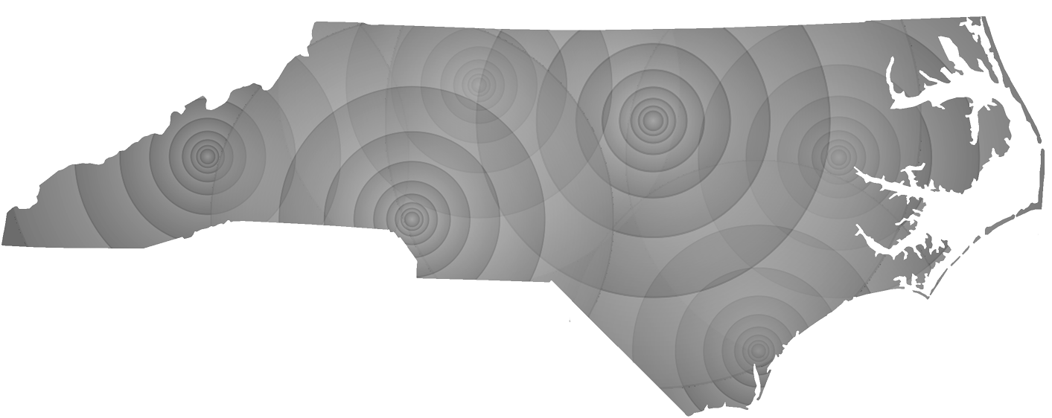
Statewide Operations Sectors Vary by Region
Piedmont-Triad Office
Regenerative Medicine
Medical Devices
Nanobiotechnology
Pharma Bio-Processing
and Manufacturing
Agricultural Biotechnology
RTP Office
Pharma Bio-Processing
and Manufacturing
Agricultural Biotechnology
Medical Devices
R&D
Eastern Office
Pharma Bio-Processing
and Manufacturing,
Agricultural Biotechnology
Marine Biotechnology
Western Office
Natural Products,
Agricultural Biotechnology,
Fermentation Technologies,
Medical Devices,
Pharma Bio-Processing and Manufacturing
Greater Charlotte Office
Medical Devices
Nanobiotechnology
Bioinformatics
Biomedical Engineering
NC Research Campus
Southeastern Office
Marine Biotechnology
Biofuels / Biorenewables
Agricultural Biotechnology
Clinical Research
Notes:
PRESENTATION CHART, TABLE, MAP, AND ARTWORK SLIDE
(artwork example)

Slide 8



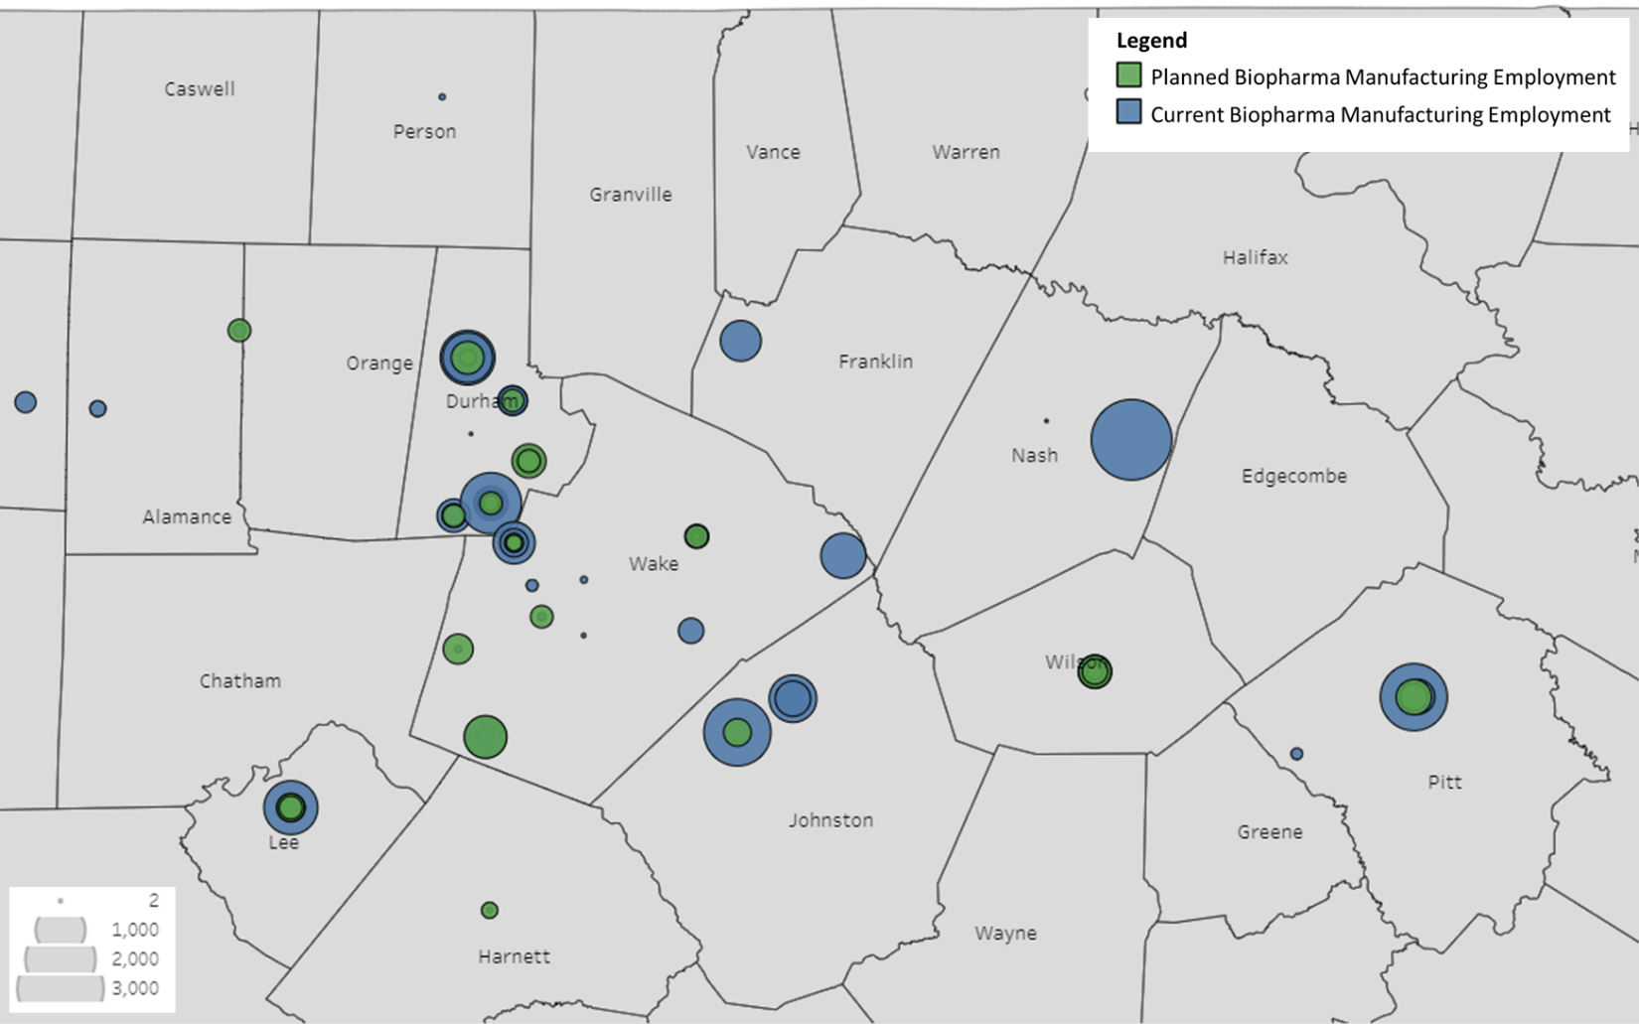









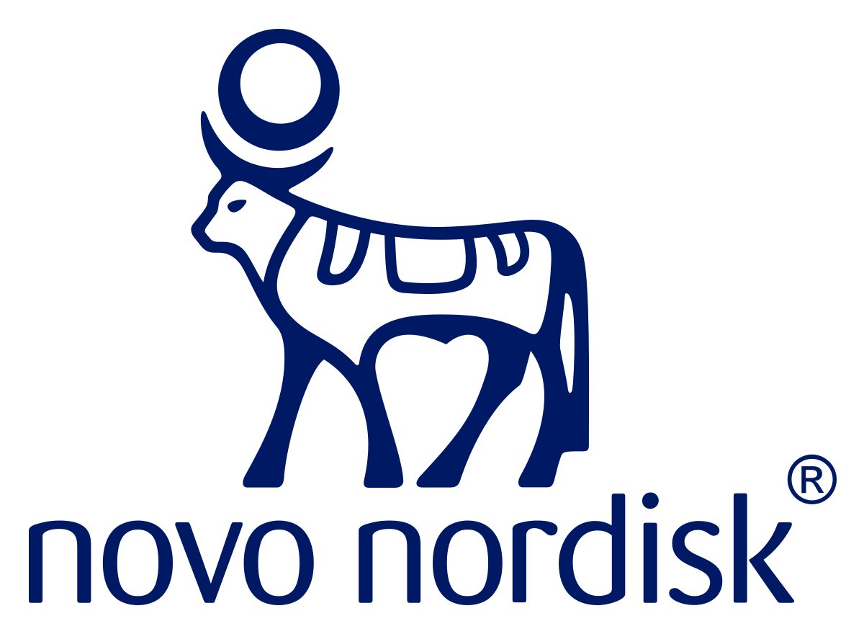





NC Life Science Announcements since 2020
Leading Life Sciences Employers in NC
94
Company
Announcements
12,600+
Announced Jobs
64%
Life Science
Manufacturing

Slide 9













Statewide Life Sciences Growth
January 2023
RTP (Durham County)
100 new jobs
$450M investment
June 2022
Monroe (Union County)
227 new jobs
$46.7M investment
November 2021
Mebane (Orange County)
200 new jobs
$192.5M investment
December 2022
RTP (Durham County)
201 new jobs
$40M investment
February 2022
Mooresville (Iredell County)
394 new jobs
$177M investment
October 2021
Durham (Durham County)
200 new jobs
$125.4M investment
December 2022
Wilson (Wilson County)
100 new jobs
$123M investment
January 2022
Concord (Cabarrus County)
589 new jobs
$939M investment
September 2021
Greenville (Pitt County)
290 new jobs
$154M investment
November 2022
RTP (Wake County)
100 new jobs
$188M investment
January 2022
RTP (Wake County)
145 new jobs
August 2021
RTP (Durham County)
200 new jobs
August 2022
Wilson (Wilson County)
251 new jobs
$11M investment
December 2021
Morrisville (Wake County)
250 new jobs
$1.5M investment
August 2021
Holly Springs (Wake County)
355 new jobs
$550M investment

Slide 10








Biologics and Pharmaceutical Manufacturing Growth in NC
January 2023
RTP (Durham County)
100 new jobs
$450M investment
October 2021
Durham (Durham County)
200 new jobs
$125.4M investment
March 2021
Holly Springs (Wake County)
725 new jobs
$2B investment
December 2022
Wilson (Wilson County)
100 new jobs
$123M investment
September 2021
Greenville (Pitt County)
290 new jobs
$154M investment
March 2021
RTP (Durham County)
90 new jobs
$200M investment
November 2022
RTP (Wake County)
100 new jobs
$188M investment
August 2021
Holly Springs (Wake County)
355 new jobs
$550M investment
December 2020
Durham (Durham County)
201 new jobs
$75M investment
January 2022
Concord (Cabarrus County)
589 new jobs
$939M investment
May 2021
Durham (Durham County)
200 new jobs
$157M investment
December 2020
Greenville (Pitt County)
500 new jobs
$500M investment
January 2022
RTP (Wake County)
145 new jobs
April 2021
Sanford (Lee County)
325 new jobs
$213M investment
December 2020
Durham (Durham County)
200 new jobs
$150M investment

Slide 11


Biopharma Manufacturing Career Pathways: Positions and Salaries*
Eastern North Carolina companies produce vaccines and treatments for diabetes, cancer, and more.
Education Level Career opportunities and starting annual base salaries | Research & Development Develop new processes and solve problems to improve systems | Manufacturing Operate and troubleshoot advanced equipment to manufacture drugs | Quality Assurance & Quality Control Ensure products and processes are safe and meet required standards | Facilities & Operations Keep systems and equipment running smoothly
Certificate or Apprenticeship | Limited career opportunities See reverse for training resources | Technician (Manufacturing, Process, Production) Operator (Packaging & Filling, Machine, Chemical Equipment) Cleanroom Associate $31k–$58k | Limited career opportunities See reverse for training resources | Technician (Facilities, HVAC & Refrigeration, Maintenance) Industrial Machinery Mechanic HVAC & Refrigeration Specialist Warehouse Associate $31k–$55k
Associate Degree | Lab Technician $37k–$58k | Technician (Manufacturing, Engineering) Operator (Packaging & Filling, Machine, Chemical Equipment) $36k–$68k | Quality Inspector QC Analyst QC Technician $31k–$80k | Technician (Calibration, Engineering) Maintenance Scheduler HVAC & Refrigeration Engineering Specialist $45k–$75k
Bachelor's Degree | Associate (Research, Process Development) Scientist (Process Development, Biological, Chemist) Engineer (Manufacturing, Process, Chemical) $55k–$106k | Technician (Manufacturing, Engineering) Manufacturing Associate $40k–$92k | Technician Analyst Associate Engineer (Production Compliance, Quality Validation) $55k–$104k | Engineer (Validation, Automation, Instrumentation, Facilities, Maintenance) Validation Specialist Accounting Supply Chain Management Marketing $55k–$115k
Advanced Degree and/or Experience | Senior Scientist (Process Development, Biological, Chemist) Manager $80k–$135k | Manager (Industrial Production, Manufacturing, Warehouse) Production Supervisor $75k–$143k | QA/QC Director Quality Engineering Manager $76k–$190k *Salary i | Manager (Maintenance, Building & Site Services) Director (Engineering, Facilities) $75k–$190k nformation provided by private industry 10/2022

Slide 12
















Biopharma Manufacturing Career Pathways: Training Resources
Eastern North Carolina companies produce vaccines and treatments for diabetes, cancer, and more.
High School Programs
Certificates and Continuing Education Programs
Community College Programs: Associate Degree
University Programs: Bachelor's/Master's Degree
+
Discover the Plasma
BioWork
AAS – Bioprocess Technology
Advanced Biomanufacturing Training (ABT) Program
Eastern Region Pharma Center at East Carolina University
+
K12 Manufacturing Prep Program
Biomanufacturing Bootcamp
Aseptic Processing
Biomanufacturing Training and Education Center at NC State University
Career Technical Education
Additional course offerings
AAS – Biotechnology
Health Sciences and Engineering
Pharmaceutical Services Network
AAS – Biotechnology
Biomanufacturing Research Institute and Technology Enterprise at NC Central University
Health Science, Engineering and Technology
BioWork
AAS – Biotechnology
Health Science and STEM
21-164_LSED 4/17/2023
BioWork
Health Sciences and STEM

Slide 13
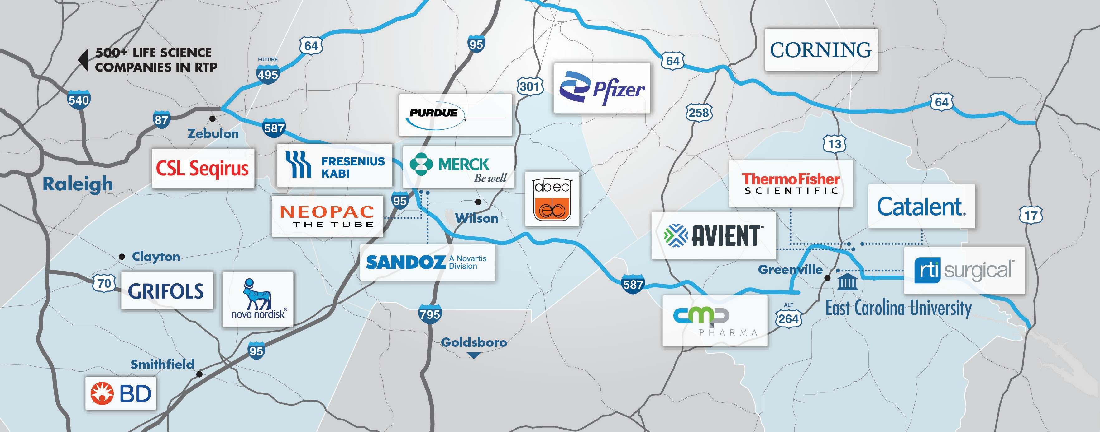
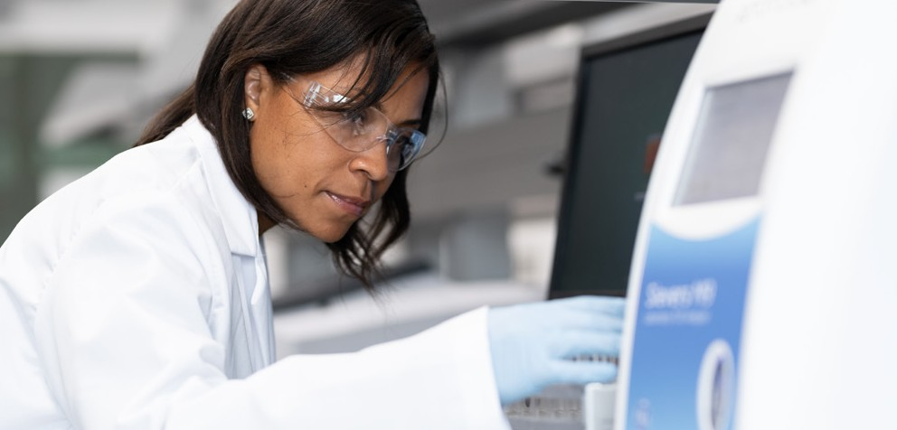
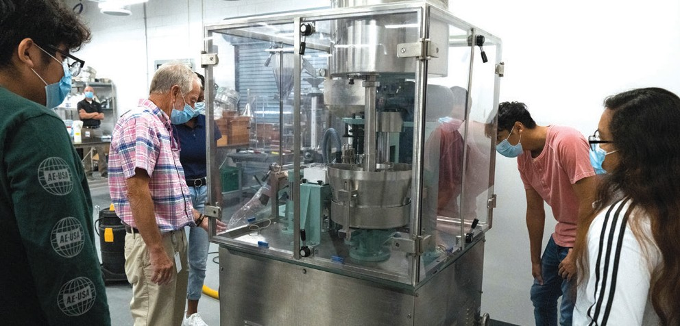
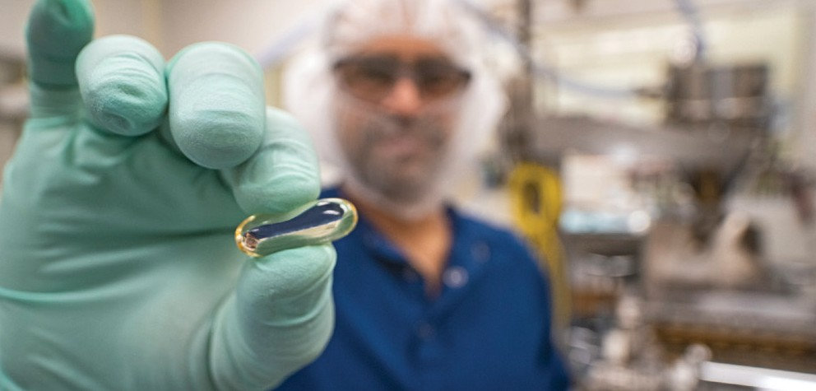
Biopharma Manufacturing Career Pathways: Employers
Eastern North Carolina companies produce vaccines and treatments for diabetes, cancer, and more.
Mayne Pharma/ Rob Taylor
Pitt County/Igoe Creative
Thermo Fisher Scientific, Pharma Services
21-164_LSED 4/17/2023
Powered by
Great companies, great careers improving global health. To learn more, visit | ncbiotech.org/biopharma-crescent-pathway

Slide 14
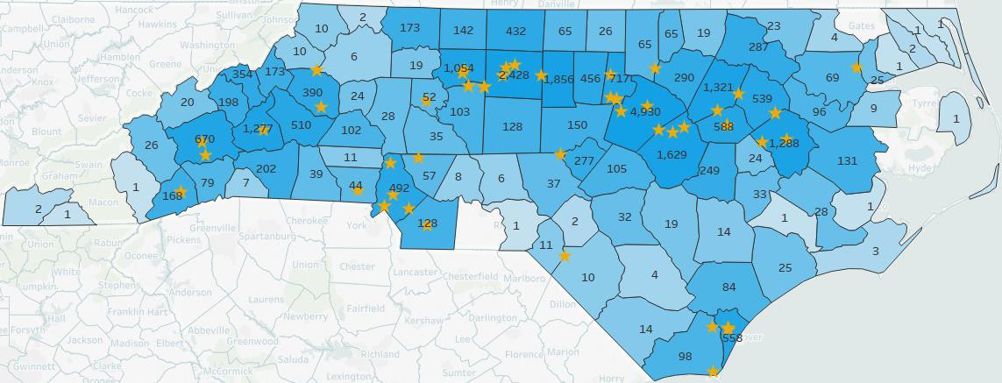
NCBiotech Commuting Study 2018
Representing Life Science Employment in North Carolina, by employees' counties of residence
There are more than 63,000 employees at 700+ life science companies across North Carolina.
This study show the home counties of employees at 58 sites:
West
Adhezion Biomedical (Hudson)
Avadim Technologies (Asheville)
Baxter (Marion)
Exela Pharma Sciences (Lenoir)
Gaia Herbs (Brevard)
Genova Diagnostics (Asheville)
PharmAgra Labs (Brevard)
Stallergenes Greer (Lenoir)
Piedmont Triad
AccuMED Technologies (Mocksville)
Carolina Liquid Chemistries (Greensboro)
Cook Medical (Winston-Salem)
EN-CAS Analytical Labs (Winston-Salem)
Herbalife (Winston-Salem)
High Point Clinical Trials Center (High Point)
KeraNetics (Winston-Salem)
LabCorp (Burlington)
Piedmont Animal Health (Greensboro)
Procter & Gamble (Browns Summit)
SightLife Surgical (Winston-Salem)
Syngenta Crop Protection (Greensboro)
Thermo Fisher Scientific (High Point)
vTv Therapeutics (High Point)
Triangle
Biogen (RTP)
Grifols (Clayton)
GSK (RTP)
GSK (Zebulon)
Mayne Pharma (Raleigh)
Medicago (Durham)
Novo Nordisk (Clayton)
Novozymes (Franklinton)
Novozymes BioAg (RTP)
Pfizer (Sanford)
Purdue Pharma Manufacturing (Durham)
Syngenta Crop Protection (RTP)
East
Avoca (Merry Hill)
CMP Pharma (Farmville)
Fresenius Kabi (Wilson)
Mayne Pharma (Greenville)
Microbac Laboratories (Wilson)
Pfizer (Rocky Mount)
Purdue Pharmaceuticals (Wilson)
RTI Surgical (Greenville)
Sandoz (Wilson)
Thermo Fisher Scientific (Greenville)
Greater Charlotte
Carolinas HealthCare System Division of Therapeutic Research & Development (Charlotte)
CEM Corp. (Matthews)
Chemring Detection Systems (Charlotte)
David H. Murdock Research Institute (Kannapolis)
Glenmark Pharmaceuticals (Monroe)
LANXESS Solutions (Gastonia)
Meridian Laboratory Corp. (Charlotte)
Microban International (Huntersville)
Southeast
Alcami (Wilmington)
Amyris (Leland)
Cygnus Technologies (Southport)
Huvepharma (Maxton)
Novella Clinical (Wilmington)
Quality Chemical Laboratories (Wilmin
Complied by the North Carolina Biotechnology Center, April 2018

Slide 15
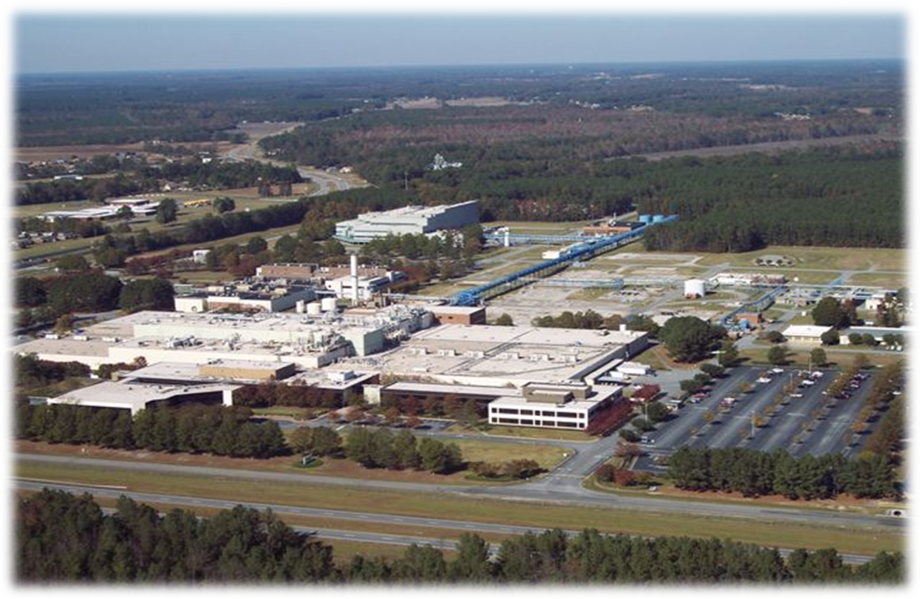
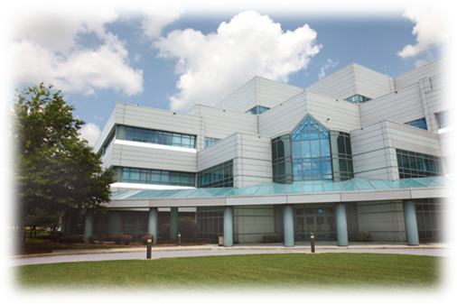
Bio – Pharma Manufacturing / Processing
Thermo Fisher Scientific, Greenville

Slide 16
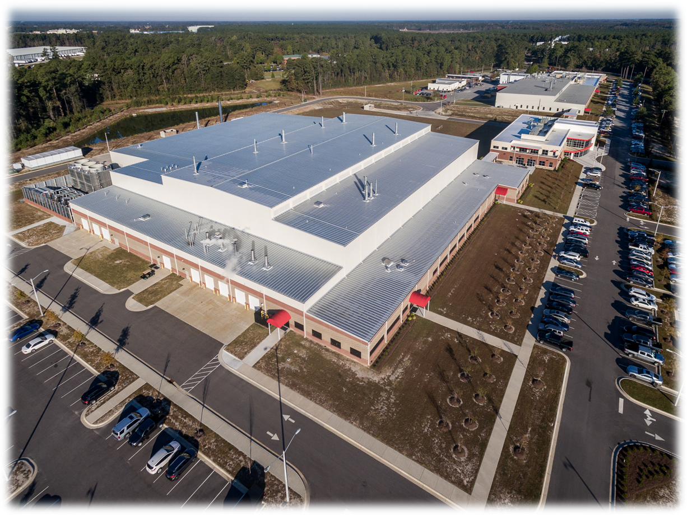
Bio – Pharma Manufacturing / Processing
Catalent Pharmaceuticals, Greenville

Slide 17



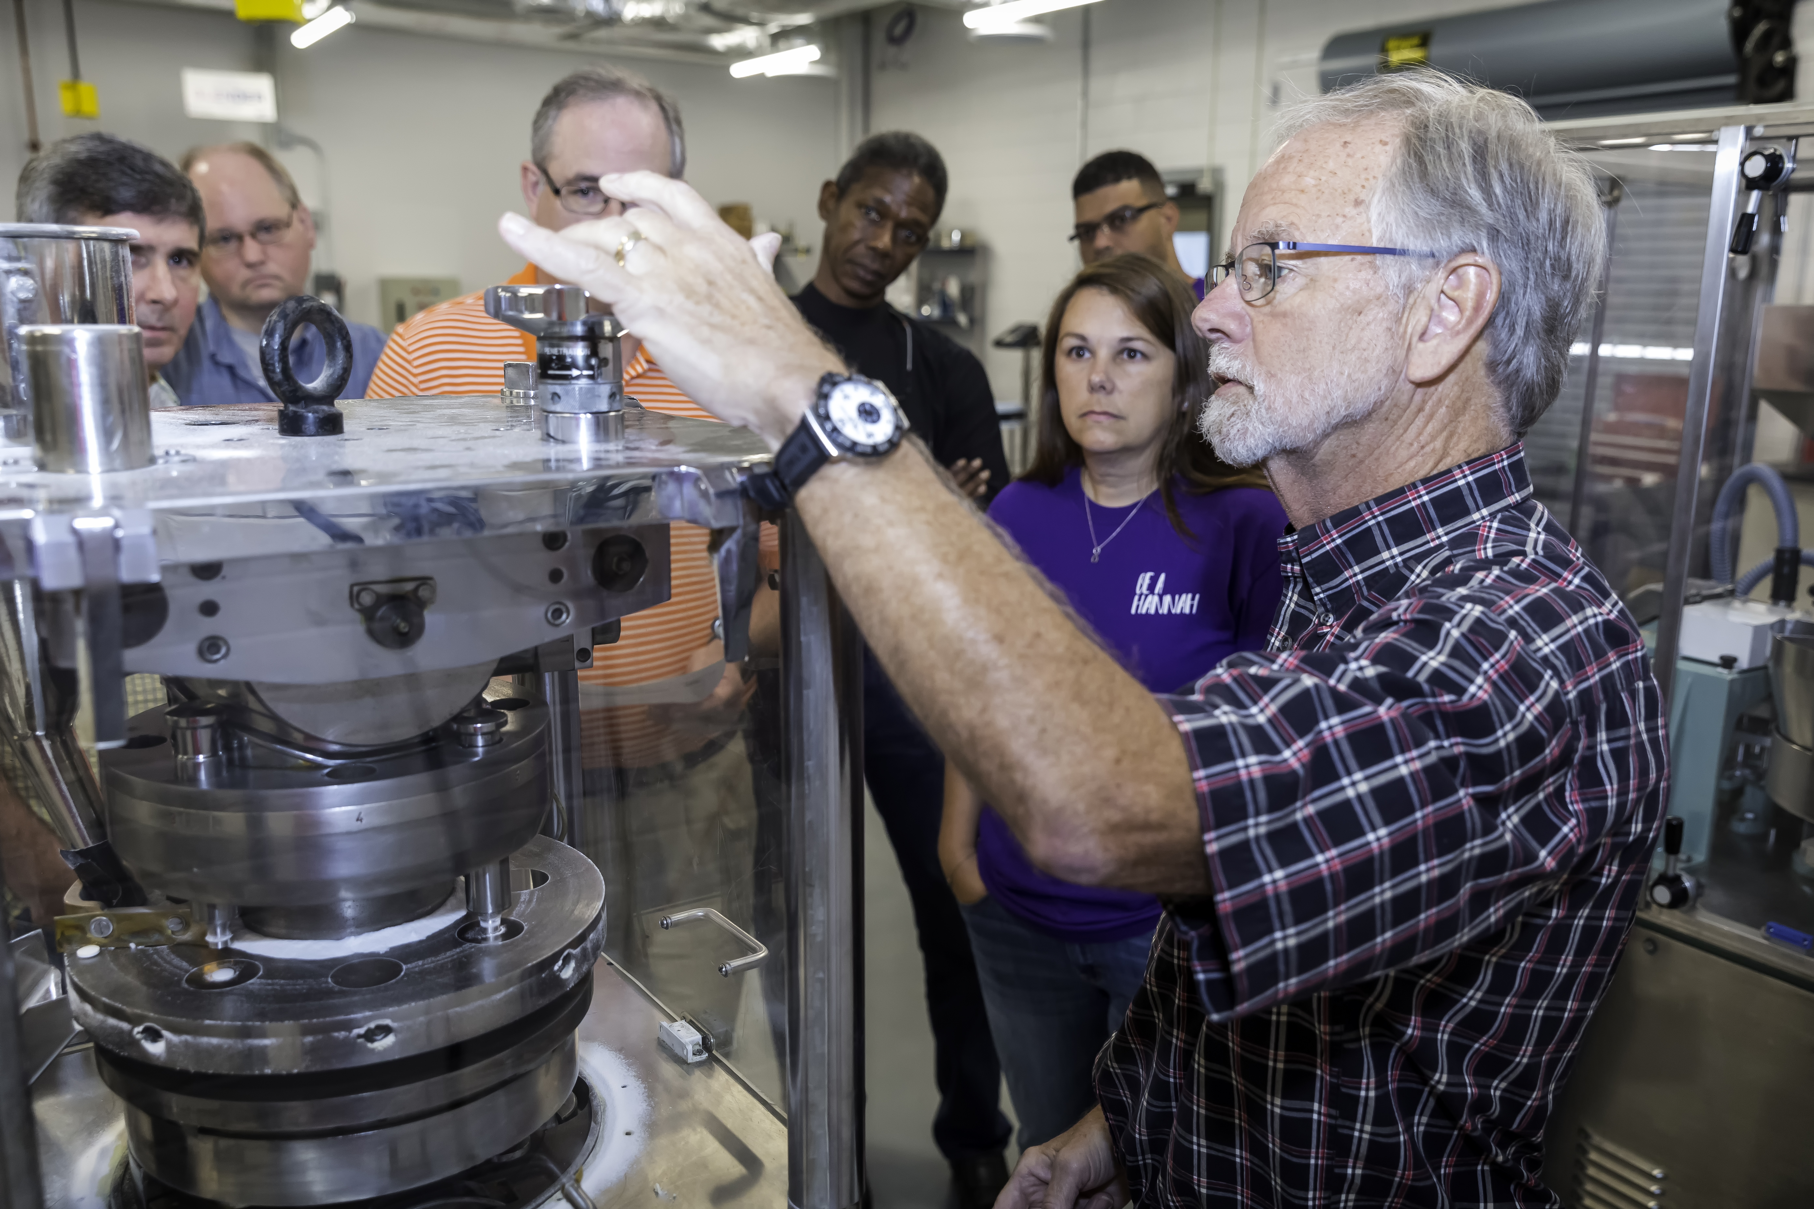
Collaboration between
and
Providing a continuum of pharmaceutical education and laboratory-based training:
  Oral solid dose manufacturing program
  Aseptic Gowning Techniques
  Overview of Working in a Regulated Industry
  GMP/GLP courses
  Custom courses
  Analytical services
  Lab services
Credit: PSN

Slide 18
The Eastern Region Pharma Center (ERPC), established by a $1.9M grant from the Golden LEAF Foundation, is a facilitator for workforce development in biomanufacturing. East Carolina University is the hub of the ERPC within the BioPharma Crescent connecting ECU, five community colleges, and over a dozen pharma companies in eastern North Carolina. The ERPC is committed to:
Increasing pharma awareness and workforce preparedness of rural counties’ young talent in eastern North Carolina
Increasing the numbers, opportunities, capabilities, and productivity of associate and bachelor’s degree graduates
Increasing ECU’s readiness to re-skill, up-skill, and new-skill incumbent employees of our pharma manufacturers

Slide 19
The Life Sciences and Biotechnology building at East Carolina University houses a 4,500-square-foot biomanufacturing laboratory training facility for the Eastern Region Pharma Center (ERPC) featuring:
Separate teaching labs for upstream biomanufacturing and downstream biomanufacturing
Laboratory cyberinfrastructure for implementation of virtual and distance training, Pharma 4.0 technologies, and cybersecurity training
An innovation and industry collaboration lab for implementing new training modules and technologies
A high bay space to hold a pilot scale production teaching lab featuring continuous manufacturing and single-use technologies

Slide 20
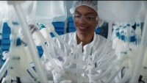
Why NC?
NCBiotech – Why North Carolina?

Slide 21
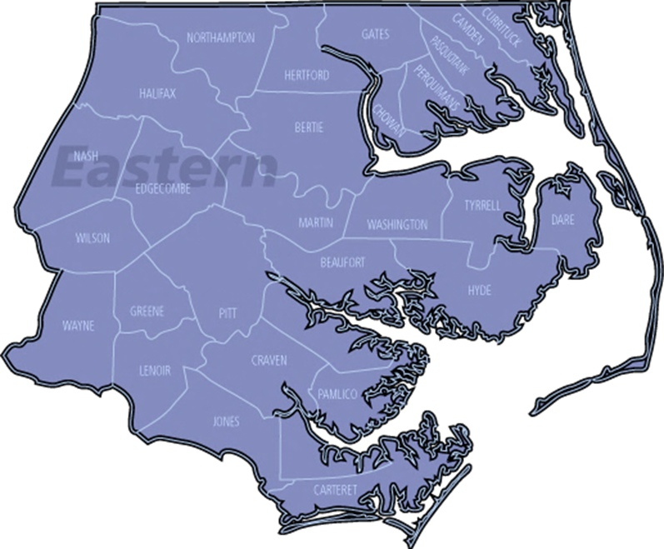

NC Biotechnology Center
Eastern Region
Mark Phillips, VP, Statewide Operations
Executive Director, Eastern Region
mark_phillips@ncbiotech.org
Thomasyne Jefferson, Program Manager
thomasyne_jefferson@ncbiotech.org
Monica Lassiter, K12 Manufacturing
Prep Coordinator
monica_lassiter@ncbiotech.org
Eastern Region Office
209 E. 5th Street
Greenville, NC 27858

Slide 22
Mark Phillips
Vice President, Statewide Operations
Executive Director, Eastern Region Office
mark_phillips@ncbiotech.org

