Slide 1
Quarterly Meeting Agriscience/Biotechnology
Pitt Community College
June 14, 2023
This Photo by Unknown Author is licensed under CC BY-NC-ND

Slide 2
Save the Date
Quarterly Meetings
Partner Trainings
Annual Guidance Retreat
Traitify - ends in August – use NCCareers.org
Toolkit Update
Interactive Posters
Special Projects
Maritime grant – with Hampton Roads
Clean Energy – STEPS4GROWTH
Rivers East Advanced Manufacturing Academy
Apprenticeships
This Photo by Unknown Author is licensed under CC BY-NC
Notes:
Training dates
Quarterly Meeting dates
S4G update
Maritime update
REA update
Toolkit update
Traitify
Annual guidance

Slide 3
RECENTLY APPROVED APPRENTICESHIPS

Slide 4
Career Pathways
are an integrated collection of regional and local programs and services connecting youth and adults to the workforce through education and training for highly skilled, sustainable careers in high demand industries.
Shared Vocabulary
Career Focused
Career Development
Partnerships
Resources

Slide 5
NC Agriculture Commissioner Steve Troxler said for the first time ever the impact of the industry topped $100 billion, reaching a new record of $103.2 billion.
That’s up from $92.9 billion last year.
Troxler said agriculture remains the state’s number one industry, employing about 1/5 of the state’s workforce.
https://www.wbtv.com/2023/05/19/new-record-agriculture-economic-impact-hits-1032-billion/

Slide 6
Biotechnology is an industry covering pathways in pharmaceutical manufacturing and genetic crop engineering.
This was the tie that paired Biotechnology with Agriscience for our region’s pathway.
To that point, we have seen growth in both pathways in Northeastern NC. According to data from EMSI, biotechnology careers are projected to grow an average of 10% through 2029 and are already 60% above similar careers nationally.

Slide 7
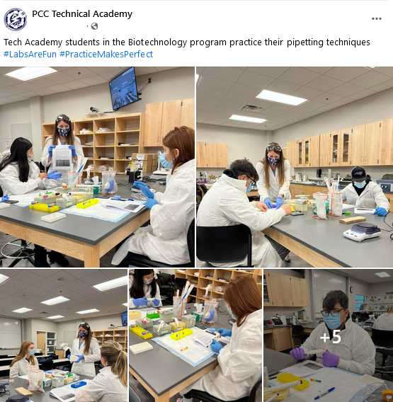
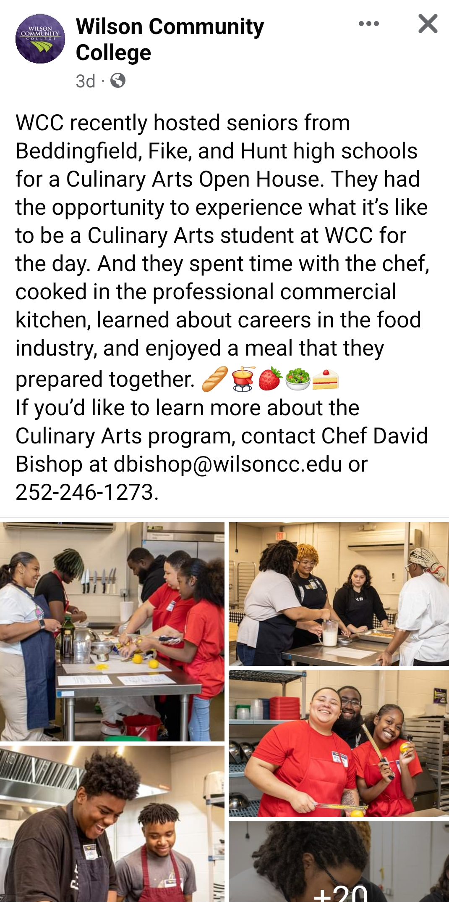
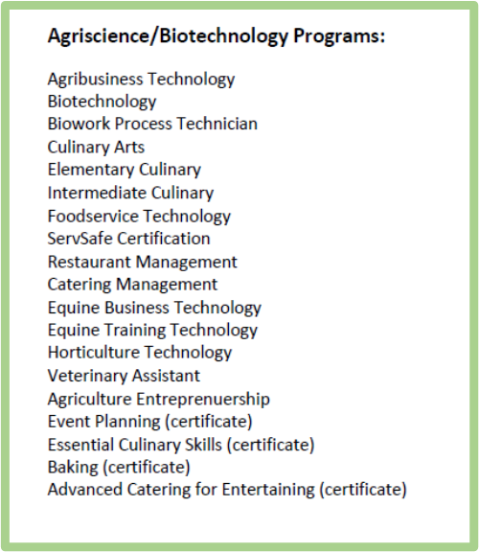
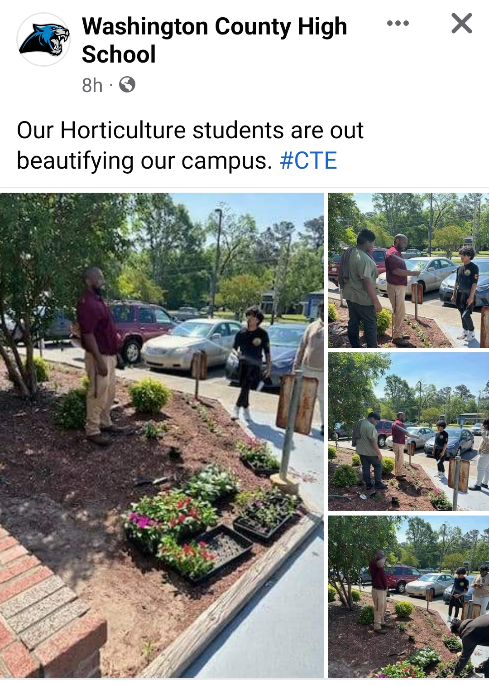

Slide 8
Agriscience Career Path
Opportunities are endless…
Assistance is often free, many resources available
Vet Techs in NC make around $35,000/yr
Nonfarm animal caretakers make about $24,000/yr
Small Business Owner
Entrepreneurship
Opens mobile grooming business
Community College
Attends events and takes classes, gets a mentor
Animal Lover
Completes Vet Tech Program
High School
Works for local animal shelter
CTE Concentration in Agriculture

