Slide 1
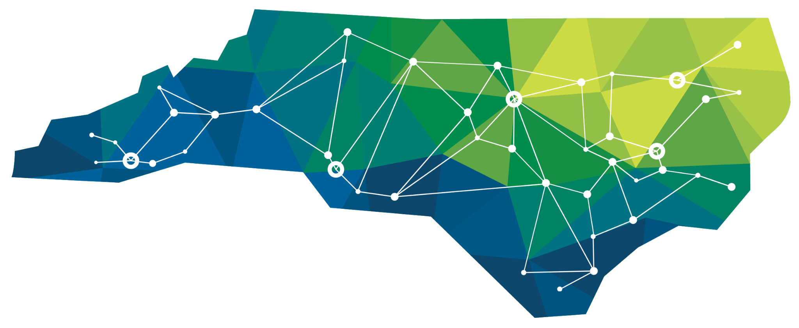
myFutureNC and the Attainment Imperative
NE Pathways - Business Support Services Meeting
Northeast Region:
March 29, 2023

Slide 2
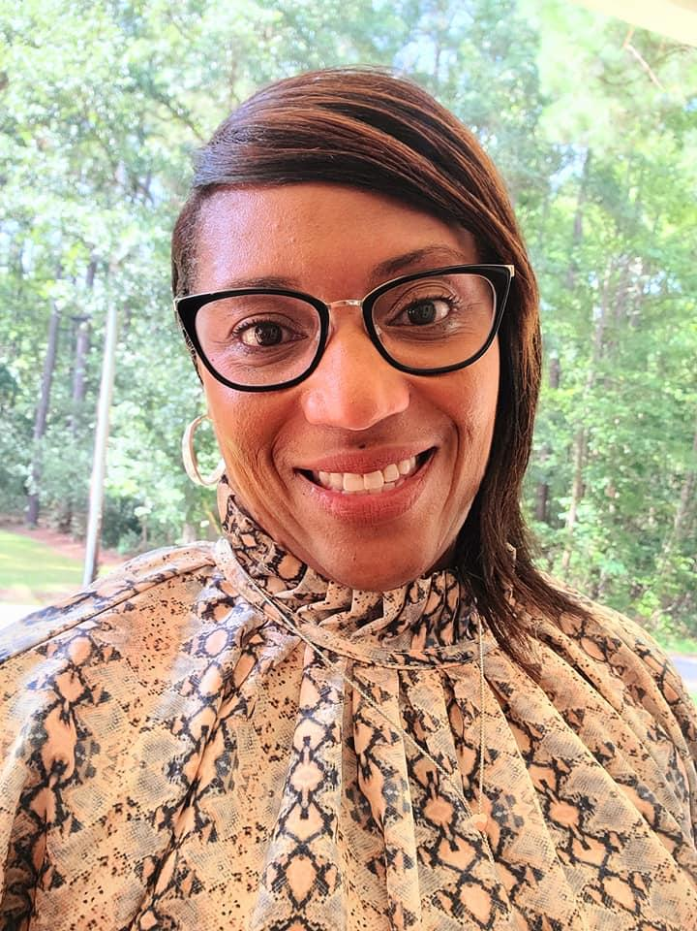
Dr. Angie Jenkins
myFutureNC | Regional Impact Manager
Northeast Prosperity Zone
Notes:
Slide with photo, title, and name for each presenter

Slide 3
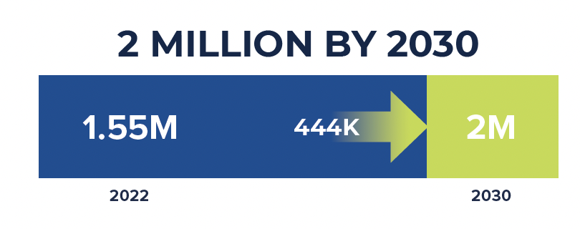
OUR GOAL - HOUSE BILL 664
To ensure North Carolina remains economically competitive now and into the future, we must meet the state’s educational attainment goal – to have 2 million North Carolinians aged 25-44 hold an industry-valued credential or postsecondary degree by 2030.
NC State of Educational Attainment RECAP

Slide 4
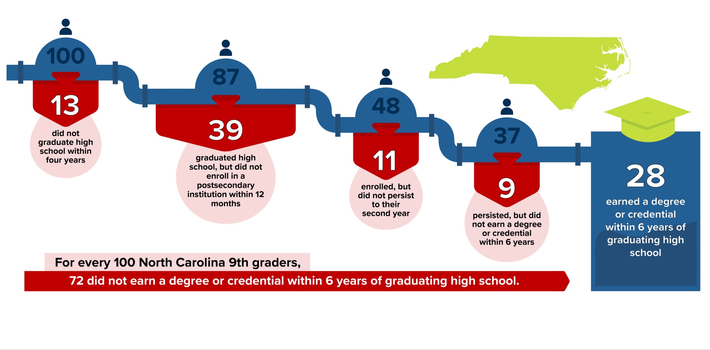
LEAKY PIPELINE
Student Video: Leaky Pipeline

Slide 5
North Carolina’s Great Dilemma

Slide 6
How are we addressing this within the Northeast Region?

Slide 7
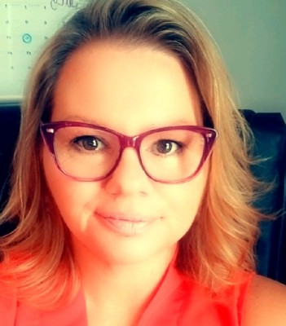
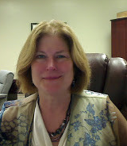
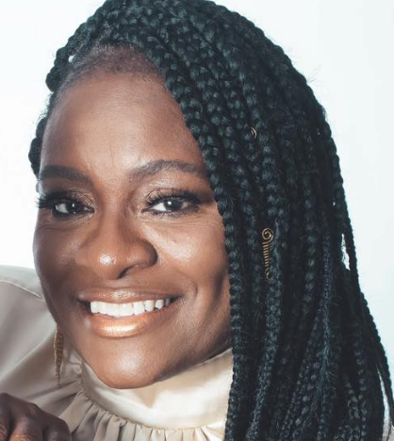
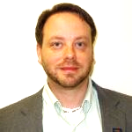
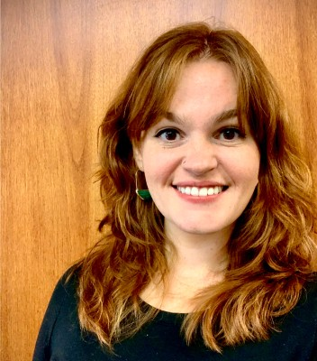
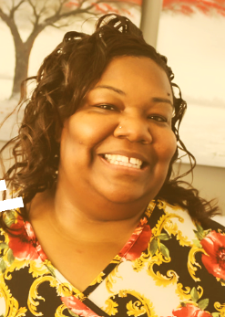
Project Manager
Serving Pasquotank, Tyrrell, and Washington Counties
Dr. Evonne Carter
Vice President
College of the Albemarle
,
Angie Wills
Business Officer
Elizabeth City State University
Brandi Bragg
Career Pathways Facilitator
NENC Career Pathways
LEAC Grant Oversight
David Whitmer
Director
Northeastern Workforce Development Board
Rachel Clipson
Youth Services
Program Manager
Northeastern Workforce Development Board
Tamara Wroughton
Director of Career & Technical Education
Washington County Schools
,
Chanta Pickard
Regional Centers Coordinator
Beaufort Community College
Dr. Gary Brown
Vice Chancellor
of Student Affairs
Elizabeth City State University
Local Educational Attainment Collaborative
Notes:
Flag this map to updated in future presentations . . .

Slide 8
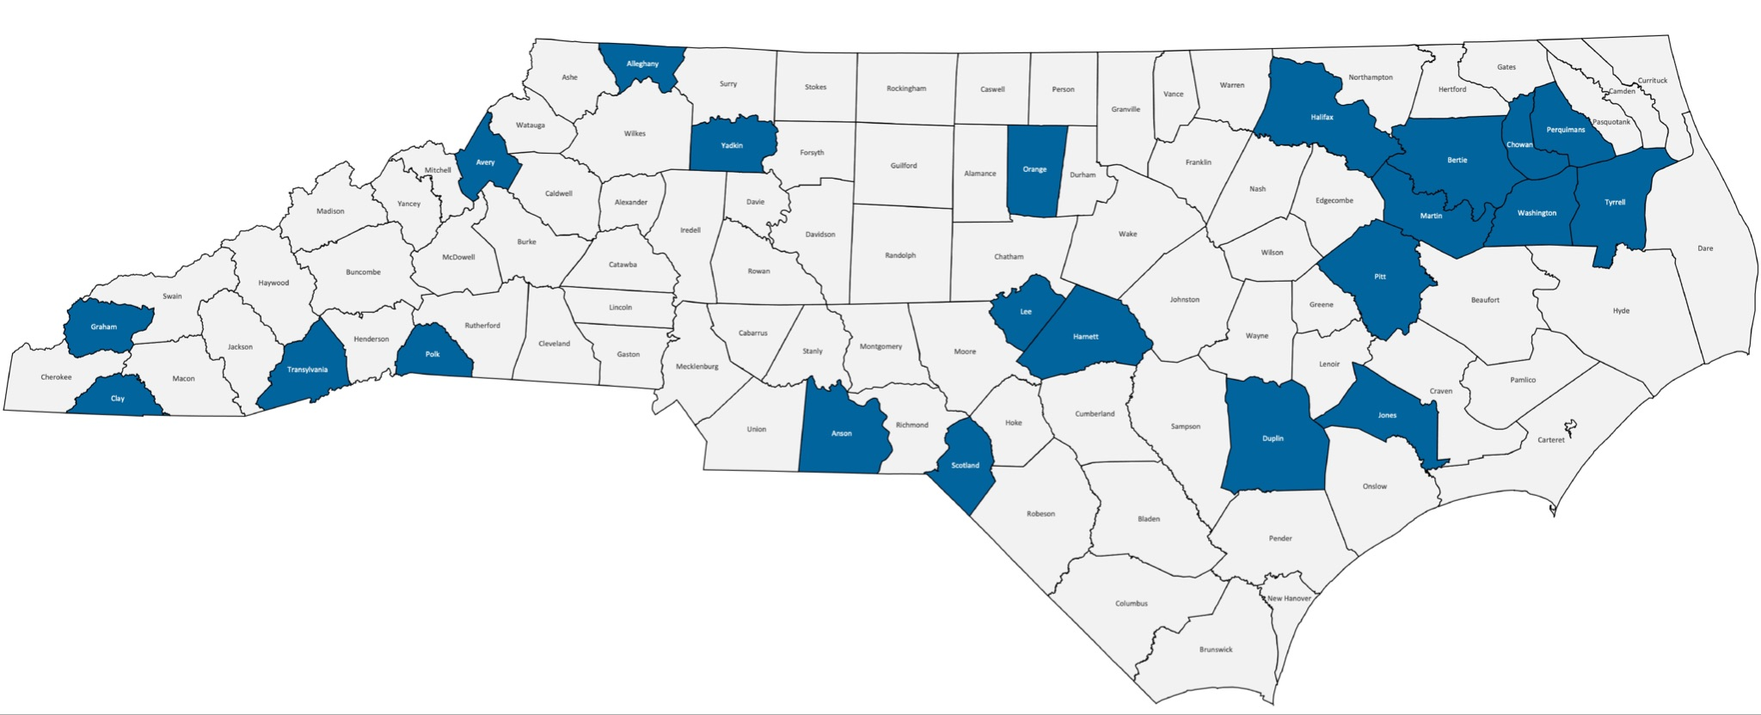
WHAT ARE WE DOING TO INCREASE FAFSA COMPLETIONS IN 2023?
SPRING 2023 FAFSA PILOTS
Pilot Participants: 19% of the school districts in NC
Goal: Increase FAFSA completions and share federal, state, and local financial aid resources to increase attainment
FAFSA taskforce with financial aid and college access state leaders
Data analysis and identifying promising practices and strategies

Slide 9
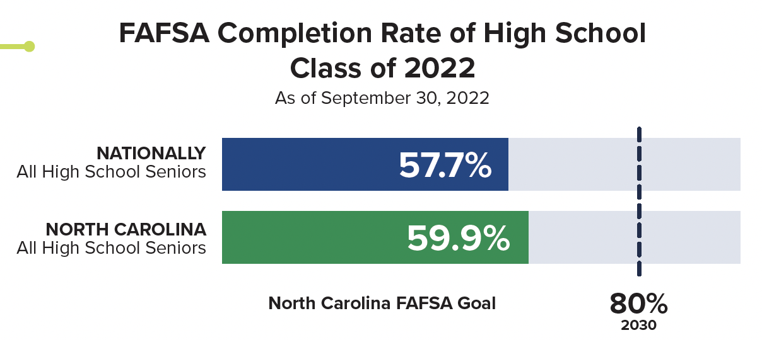
FAFSA - WHERE DOES NC RANK?
NC increased from 27th to 15th nationally in 2022.
65%
2023

Slide 10
WHY FAFSA MATTERS TO 2 MILLION BY 2030
FAFSA completion required for Federal Pell & state need-based grants and some scholarships.
88% of high school seniors who complete a FAFSA attend college, compared to 49% of students who do not.
NC leaves over $100 million in Federal unclaimed dollars on the table each year.
To meet the 2030 FAFSA Goal: 24,000 FAFSA additional completions needed each year.
WEB LINK
qrco.de/NCFAFSA

Slide 11
WHAT ARE WE DOING TO INCREASE FAFSA COMPLETIONS IN 2023?
FINANCIAL AID SUMMIT June 20-21, 2023 - Wake Tech
Presented by NCSEAA, GEAR UP, and myFutureNC for 250 financial aid professionals from state organizations and K12 school districts
Cross-sector representation; Celebrate pilot successes; Share solutions and innovative outreach; Set the stage for transformation

Slide 12
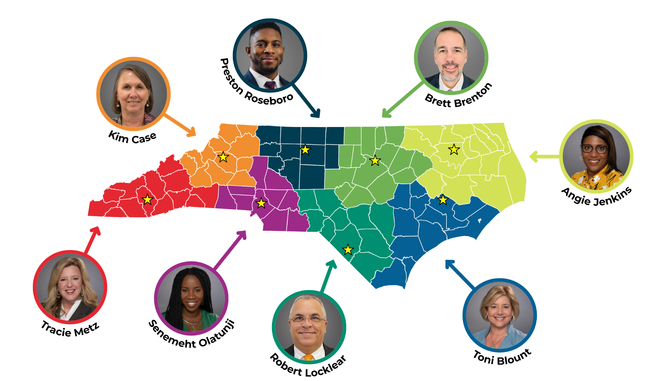
QUESTIONS & ANSWERS
FOR MORE INFORMATION:
Dr. Angie Jenkins (Northeast)
angie@myfuturenc.org
Preston Roseboro (Piedmont Triad)
preston@myfuturenc.org
Brett Brenton (North Central)
brett@myfuturenc.org
Dr. Kim H. Case (Northwest)
kim@myfuturenc.org
Dr. Robert Locklear (Sandhills)
robert@myfuturenc.org
Senemeht Olatunji (Southwest)
senemeht@myfuturenc.org
Toni Blount (Southeast)
toni@myfuturenc.org
Dr. Tracie J. Metz (Western)
tracie@myfuturenc.org
Notes:
Give time to review, any aha’s?

