Slide 1
BUSINESS SUPPORT SERVICES
NENC CAREER PATHWAYS QUARTERLY MEETING
MARCH 29, 2023

Slide 2
Partner Survey 2023
44 Responses (good mix of K12, higher ed and workforce with a sprinkling of employers & community partners)
Most have attended recent meetings, those who didn’t mostly due to scheduling conflict
Nearly all who attended found the meetings valuable
Top 3 ways for connections: Monthly Newsletter, Website & Quarterly Meetings
Most understand Career Pathways and how to implement
Top 3 Most used tools/resources: Posters/Flyers, Building Connections, Website/Social Media
SUGGESTIONS
Local meetings
Keep information in front of those working with students/jobseekers
More no-cost training opportunities
Specific plans to address: college students, barriers, approved certifications
More time for presentations at meetings

Slide 3
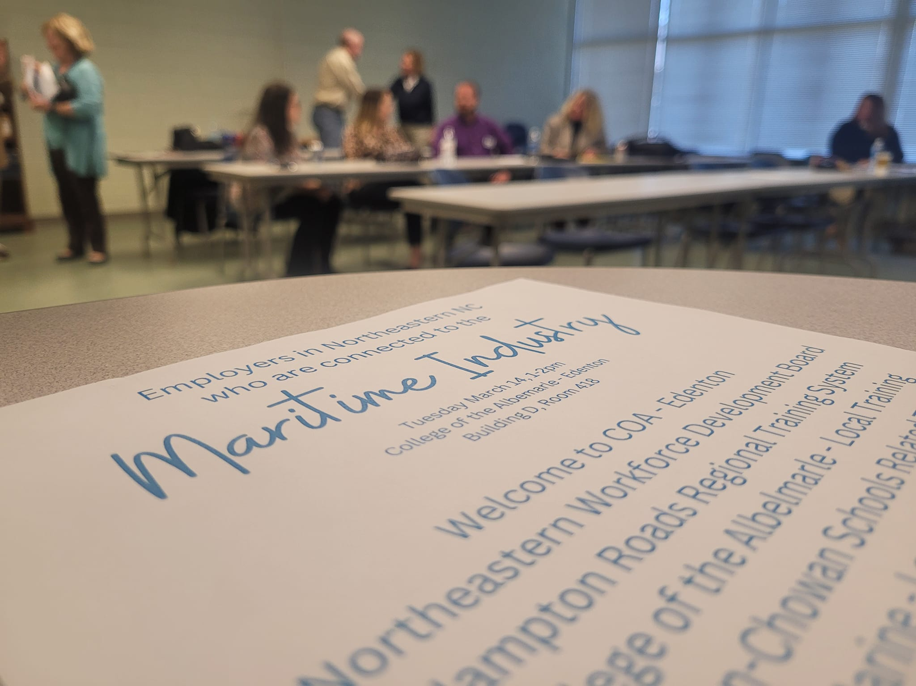
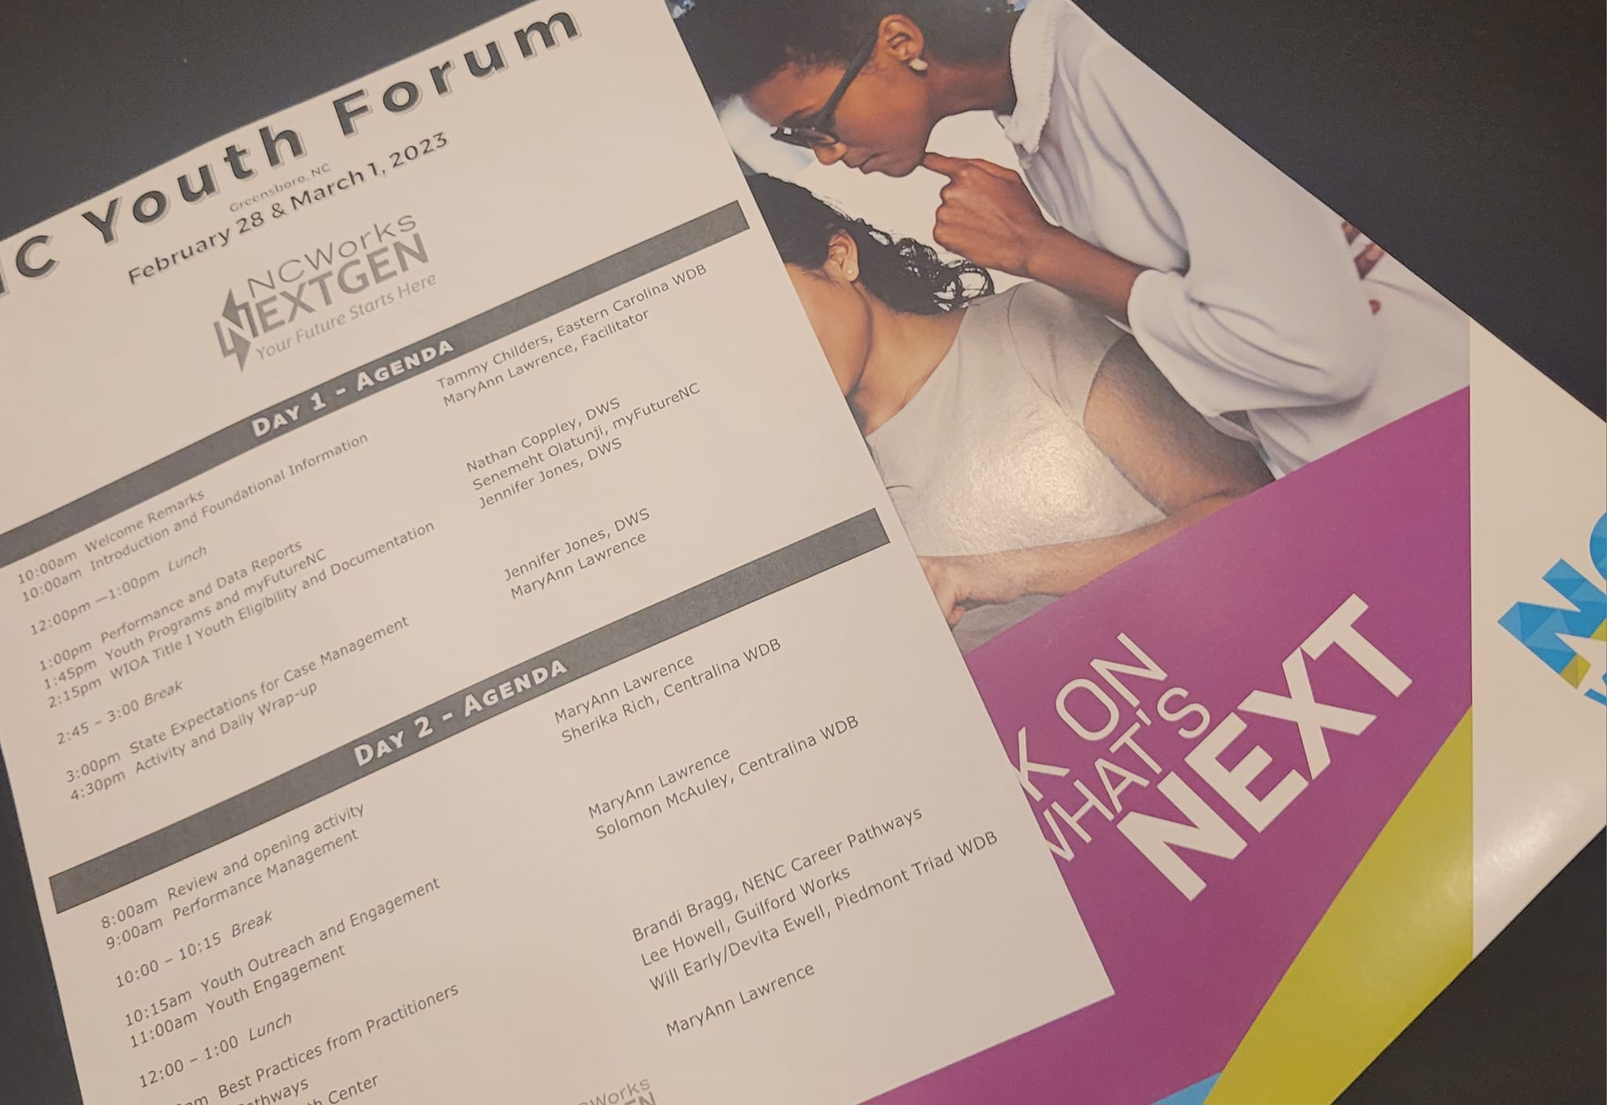
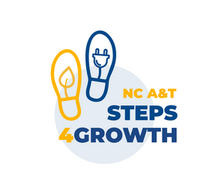
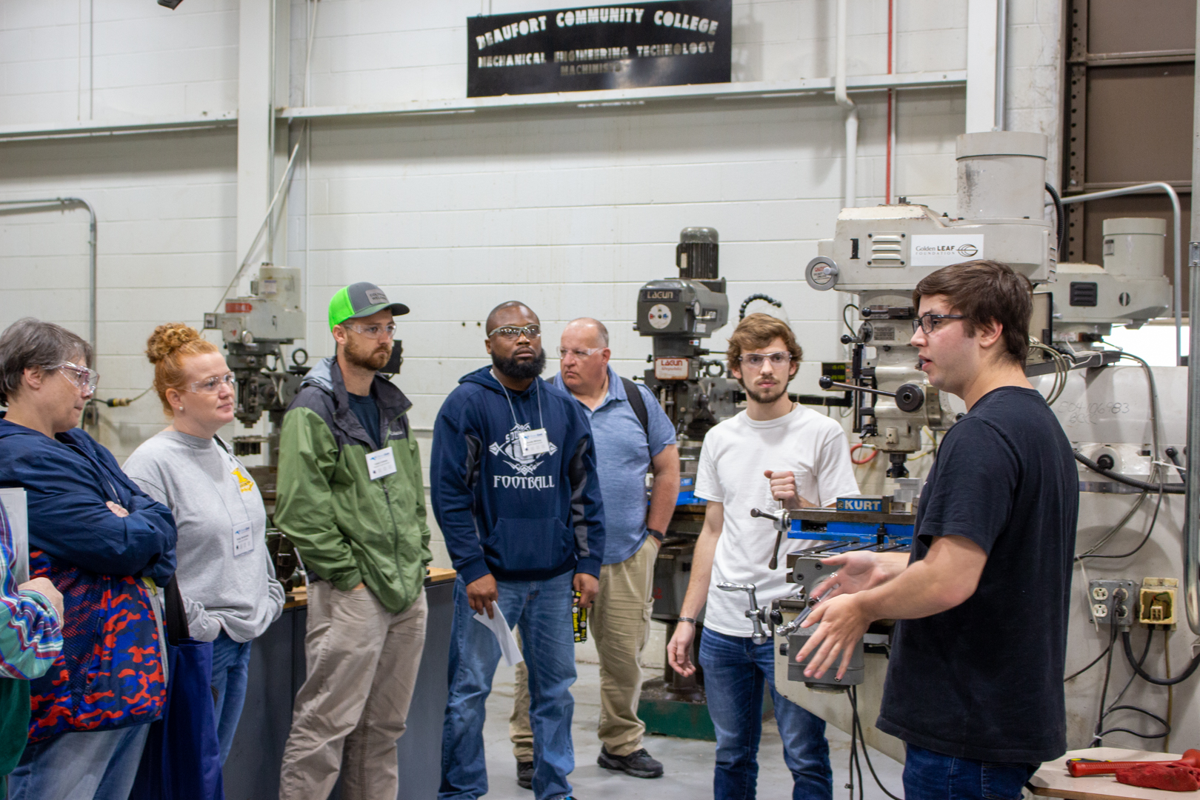
Partnership Updates
HCAC
NC/VA Regional Training System
Rivers East Academy

Slide 4
Upcoming Events
Next Quarterly Meeting focused on Agriscience/Biotechnology
June 14, 2023 10am-11:30am* Pitt Community College
8th Annual Career Guidance Retreat - Career Pathways Experience - for those who work directly with students and/or job seekers – May 2023

