Slide 1

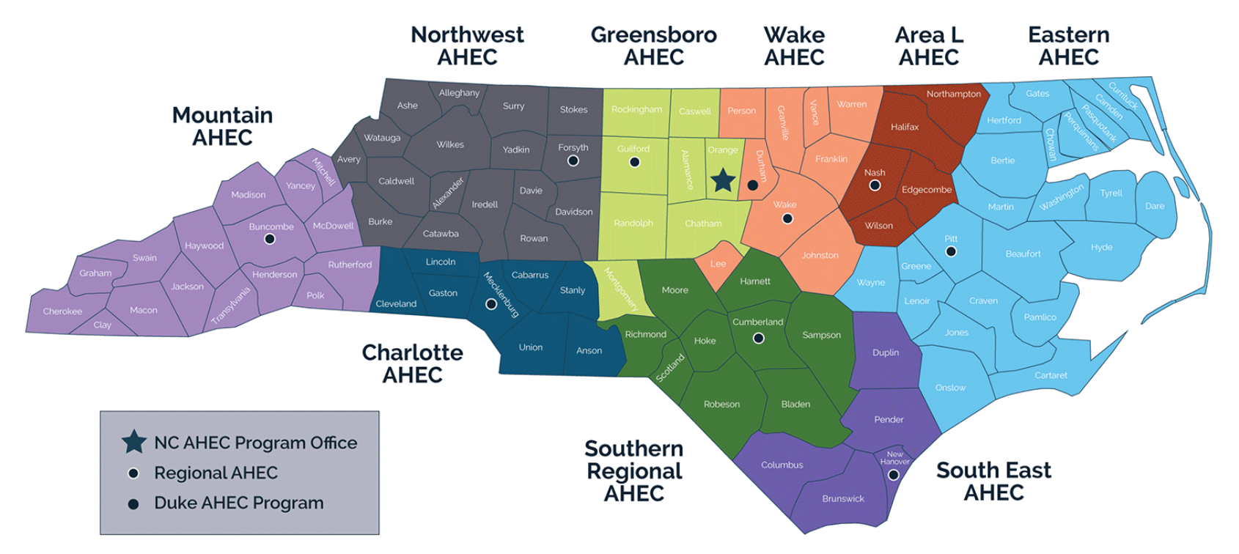
Mission Statement: The NC AHEC Program provides and supports educational activities and services with a focus on primary care in rural communities and those with less access to resources to recruit, train, and retain the workforce needed to create a healthy North Carolina.

Slide 2
Pathway Programs
AHEC Scholars Program- LINK
Health Career Starter Kit- Virtual Summer Program
Pre-Scholars Institute- Statewide Virtual Summer Program
Youth Health Service Corps

Slide 3
Pathway Advisory
Next Meeting:
  Friday, February 17th
  11:30AM-12:30PM
  Virtual

Slide 4

Questions

