Slide 1
Turning Point Workforce Development Board Health Care Collaborative
Health Care Advancement Collaborative

Slide 2
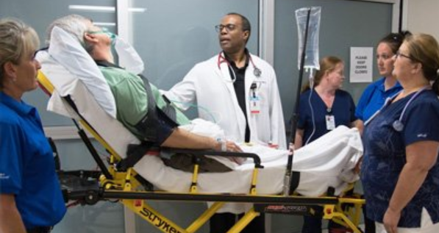
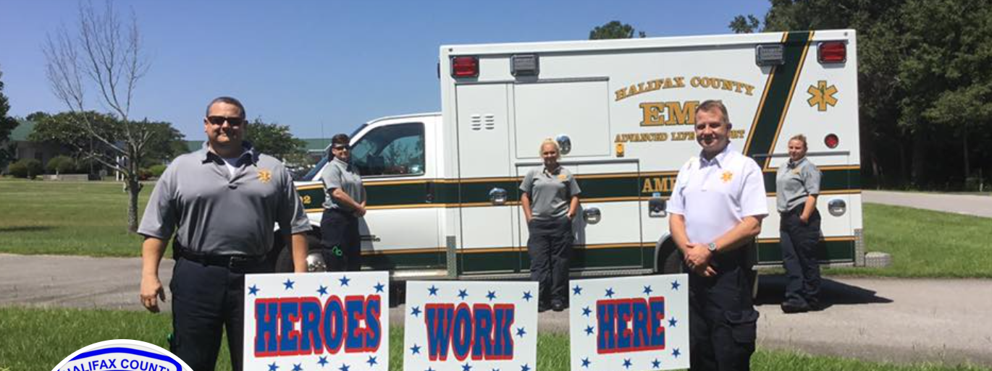
Started in 2021
Made up of health care employers representing a cross-section of industry
designed to foster greater collaboration and strengthen the competitiveness of the health care sector
in the greater Halifax and Nash County region.

Slide 3
Some of the members….

Slide 4
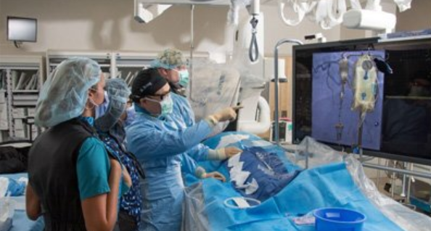
What we are working on
Staffing Pipeline
Burnout/DEI
Workshops,
resources,
upcoming podcasts
Steering Committee
Leadership &
Direction
Outline of Expectation

Slide 5
Brandi Bragg, Workforce Connector Duna Long, Special Projects/Outreach Coordinator

