Slide 1
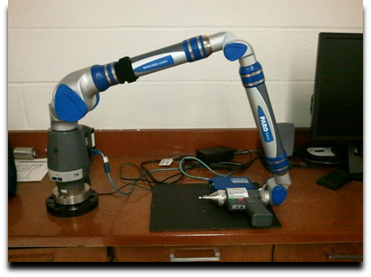
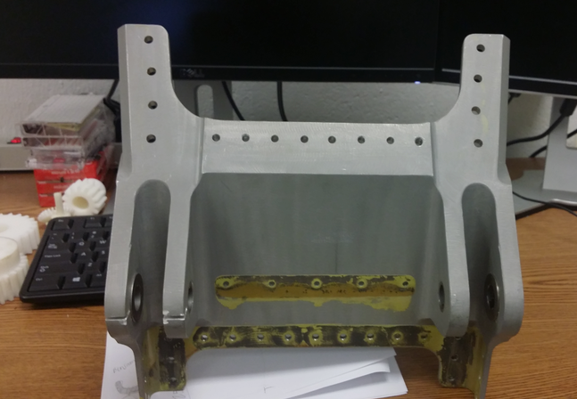
Integrating Reverse engineering, 3d Printing, and CNC for Advanced Manufacturing processes
Elizabeth City State University

Slide 2
Course objectives
Generate a G and M codes needed to operate CNC machine
Utilize the FARO arm and the Geomagic Design X software
Use 3D printing for prototyping the part
Complete stress analysis

Slide 3
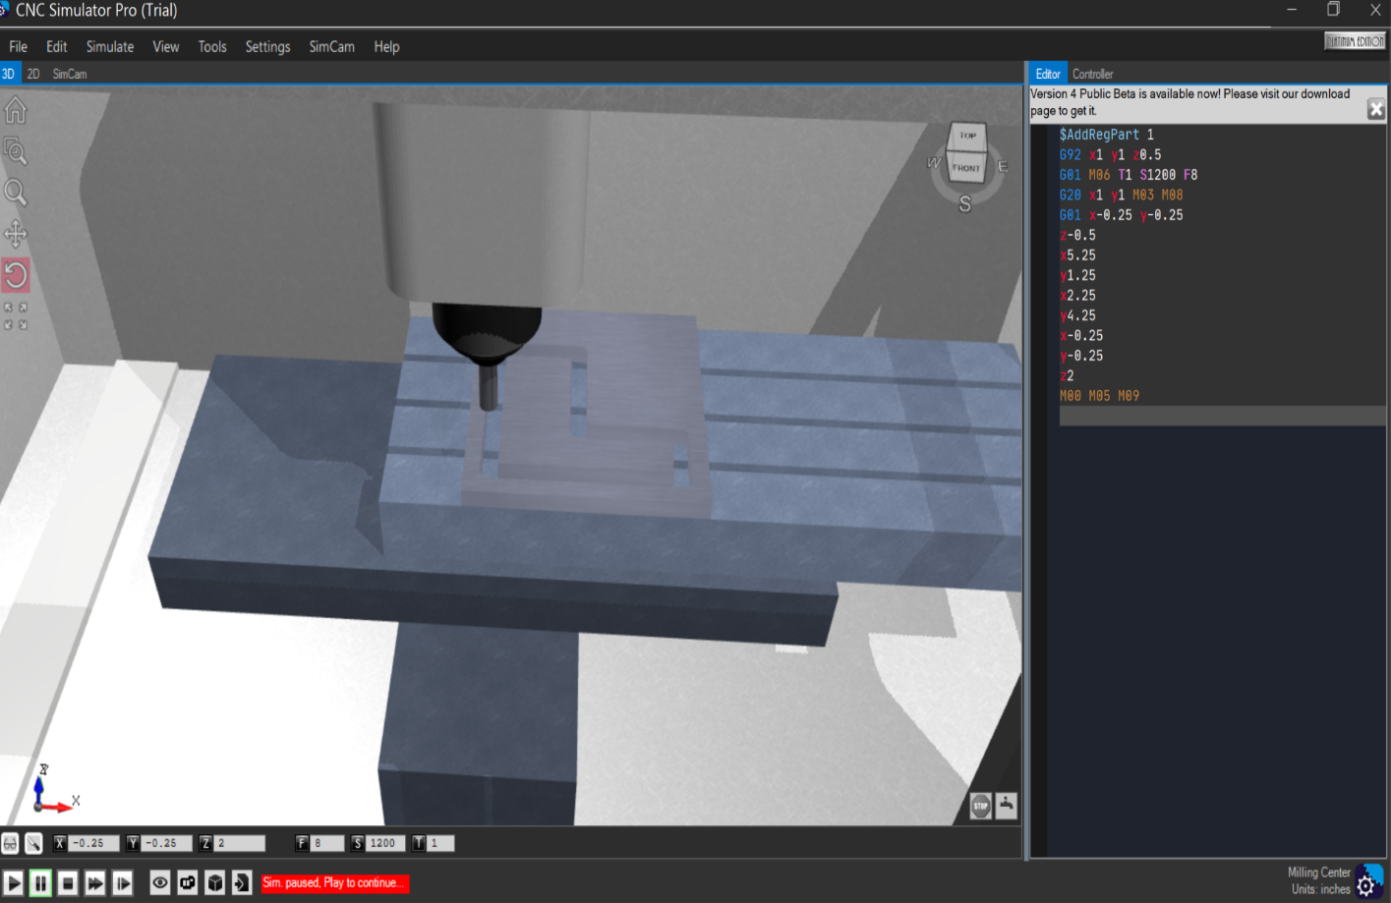
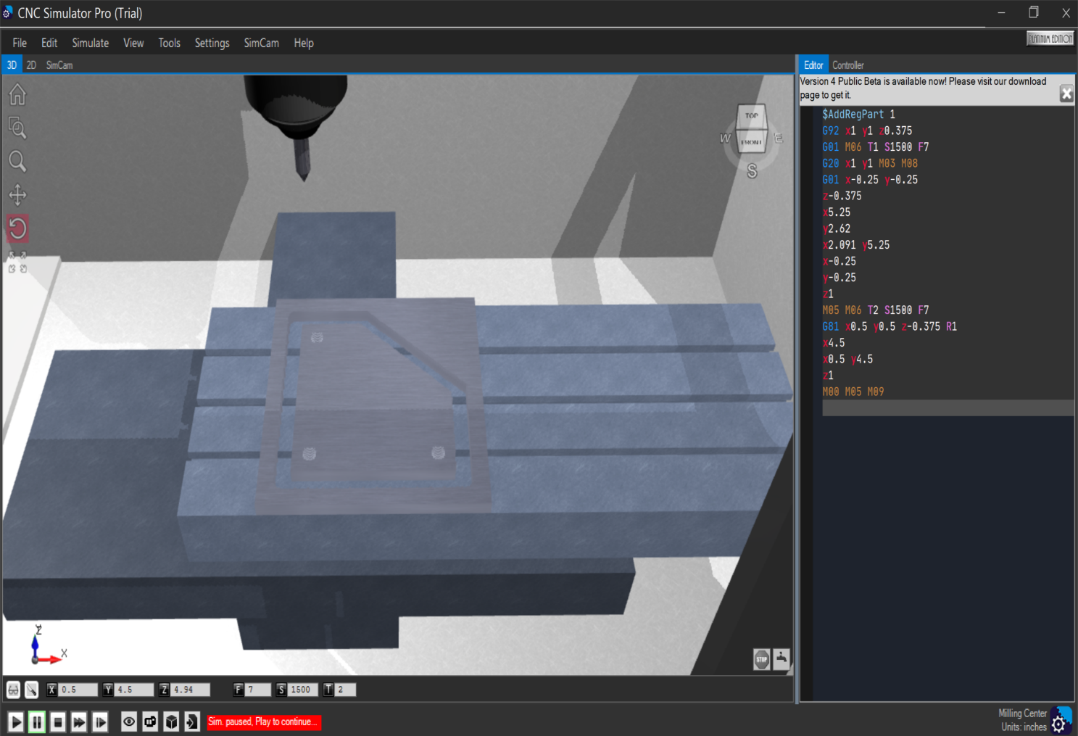
Introducing Advanced Manufacturing in CAD/CAM course-Using simulation pro software

Slide 4
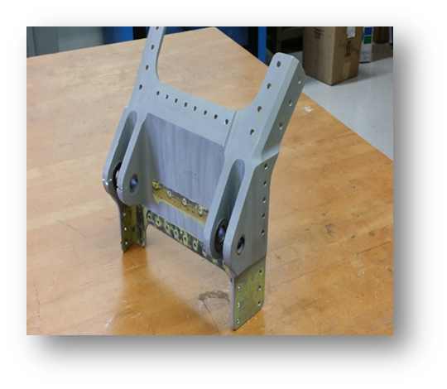
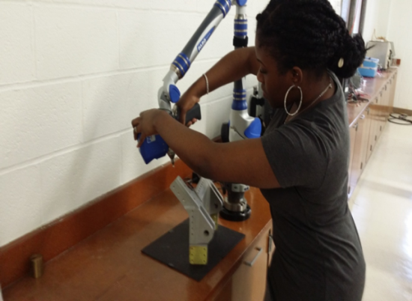
Reverse Engineering technique Process of scanning
Using the FaroArm, and Geomagic software to scan and transform geometry of a part of airplane wing into a useful three-dimensional (3D) computer model platform
Scanning the top part of the object as shown.

Slide 5
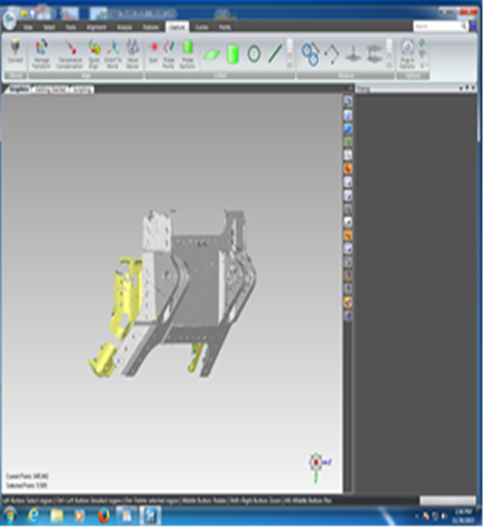
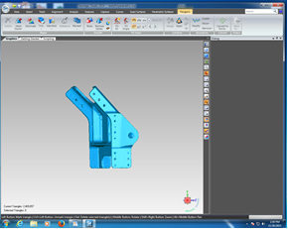
Point clouds of front section. The yellow indicates the software is in process of converting points to computer model.
Side and back of the part after finishing scanning and merging all pieces of the part together to create one solid piece.

Slide 6
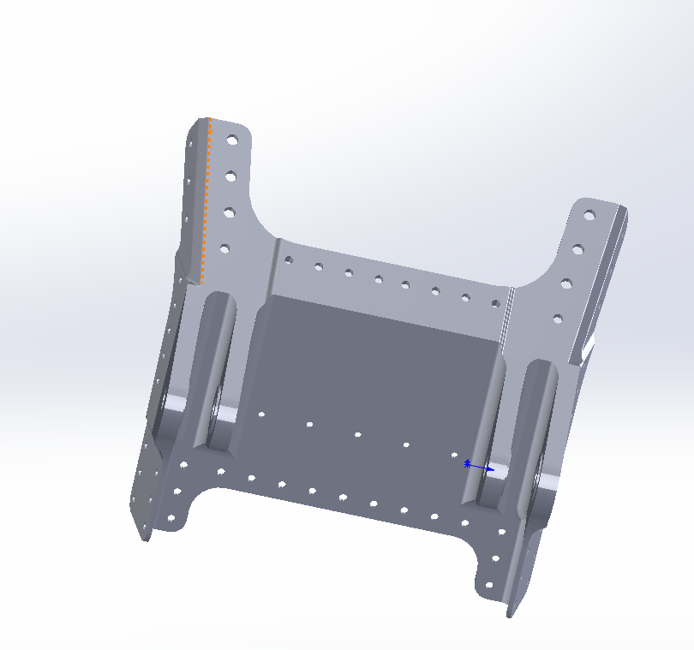
Converting from computer model to CAD model

Slide 7
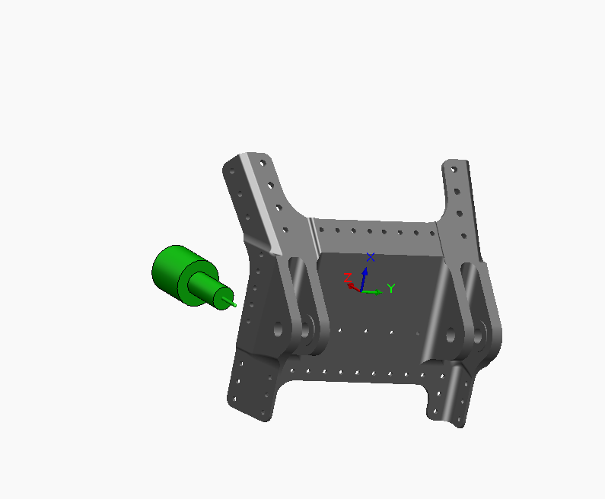
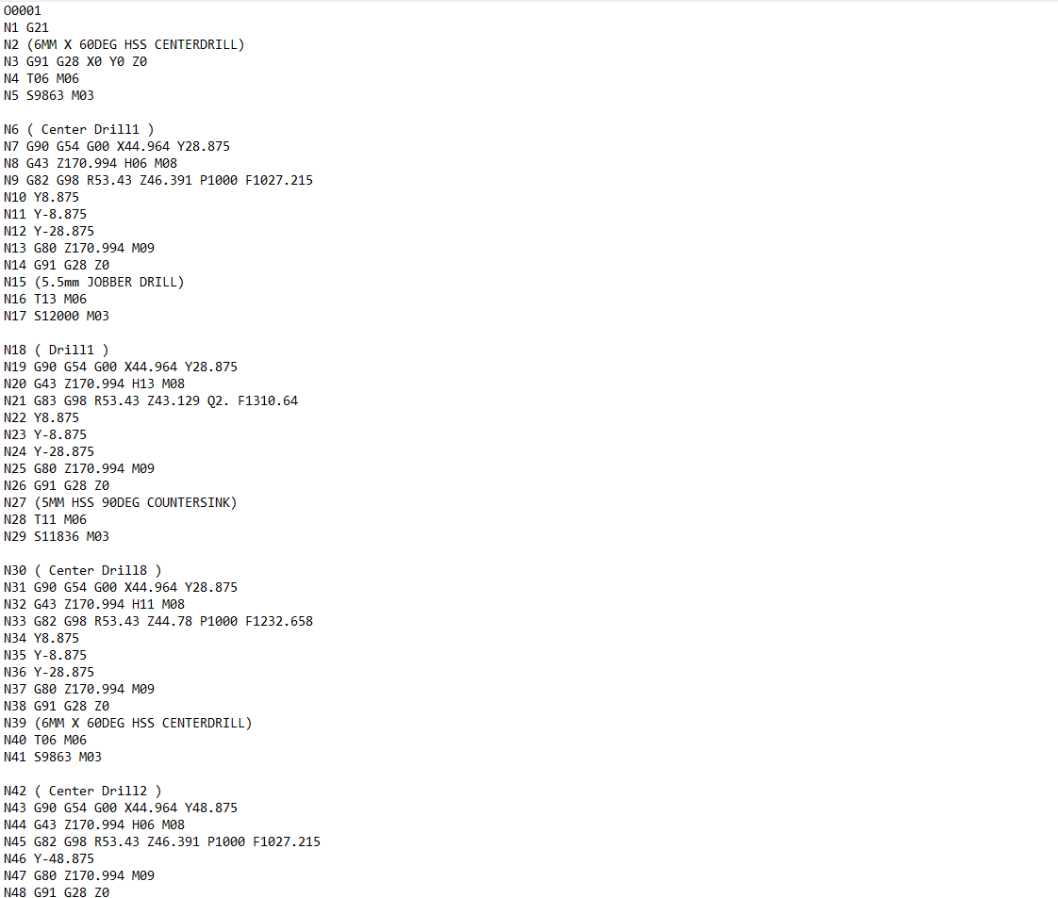
Generating G and M codes for CNC Machine using SolidWorks software-camworks tool

Slide 8
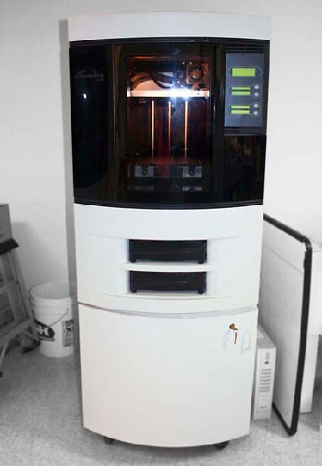
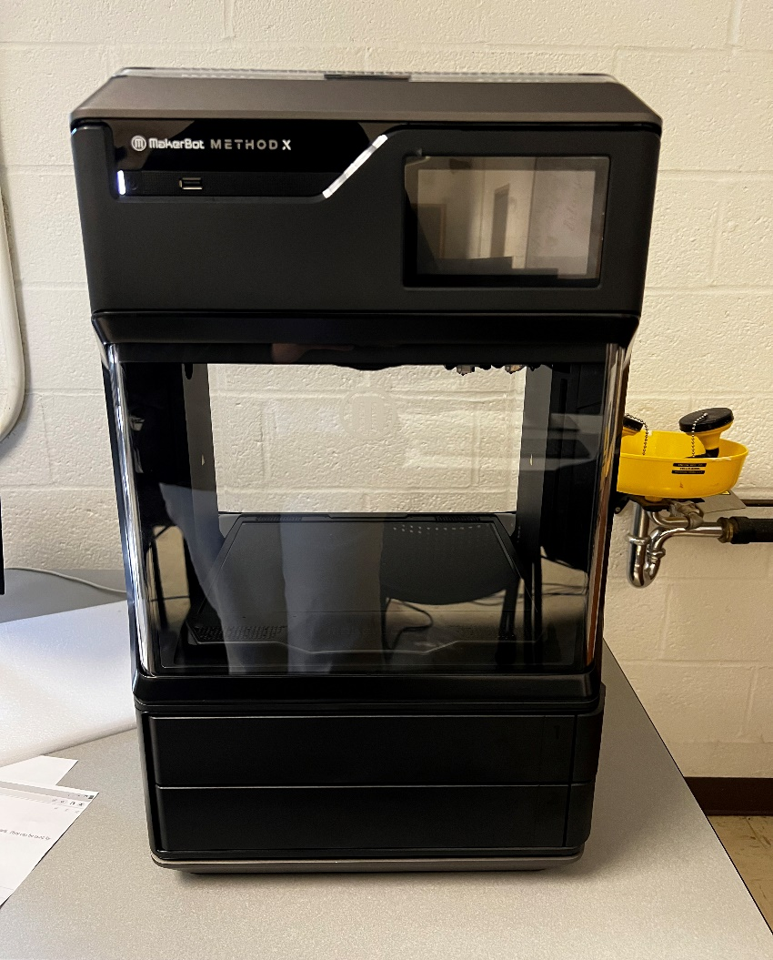
3d printing
MakerBot Method X
The Dimension F-370 3D printer

Slide 9
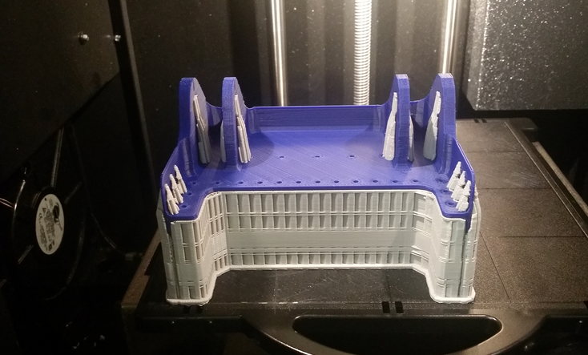
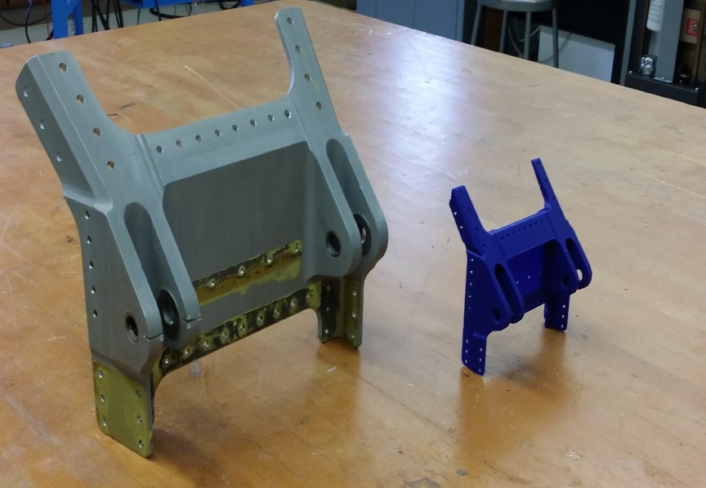
Printing the part
The process began by creating cross-sections of material layer by layer until the 3D model is complete
Because the original part was so big, the prototype was scaled down 50%

Slide 10
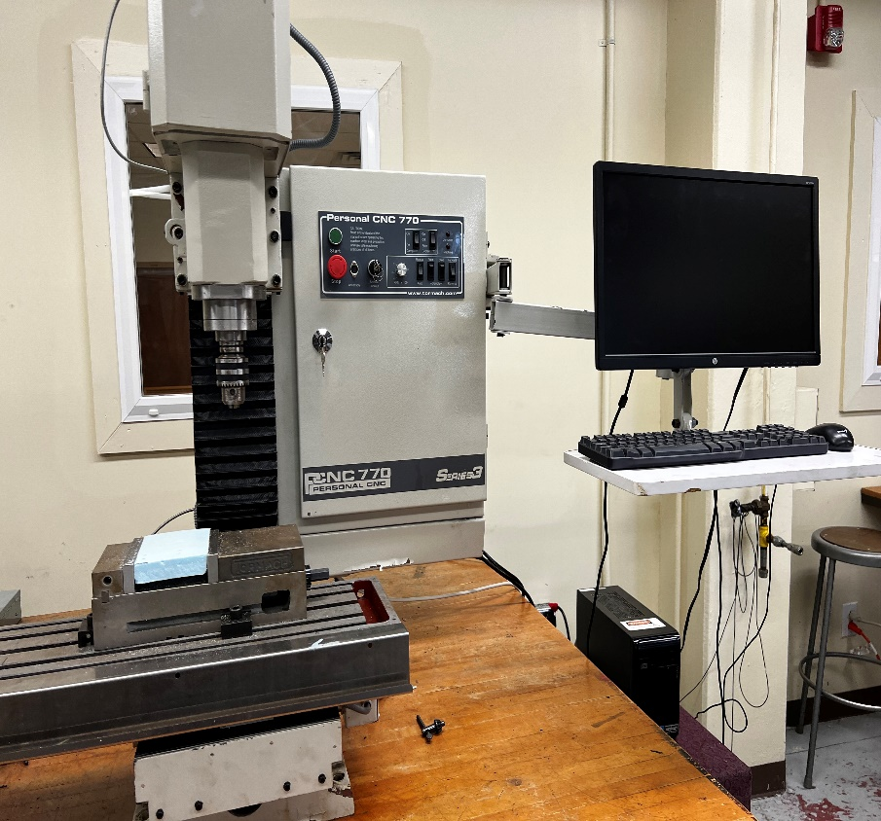
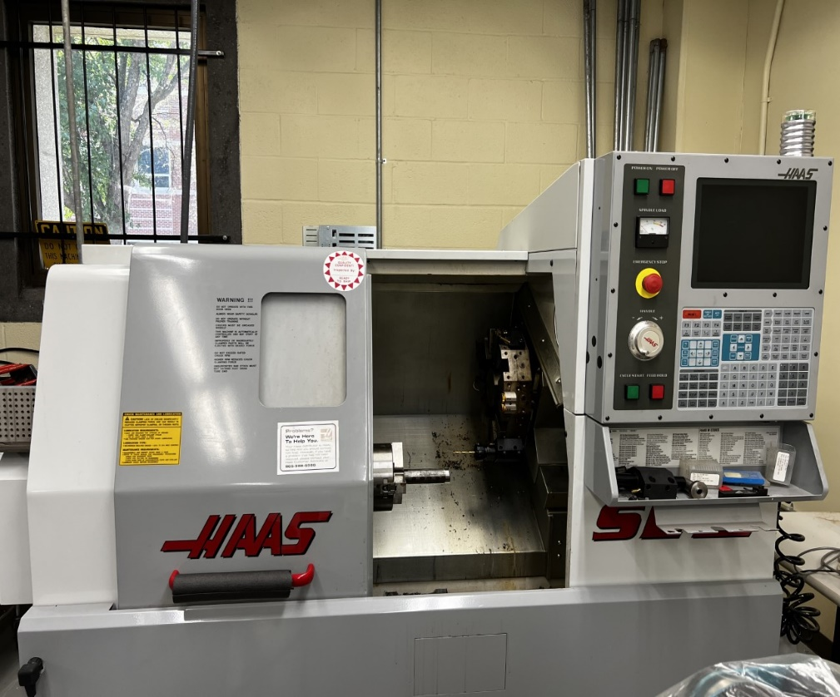
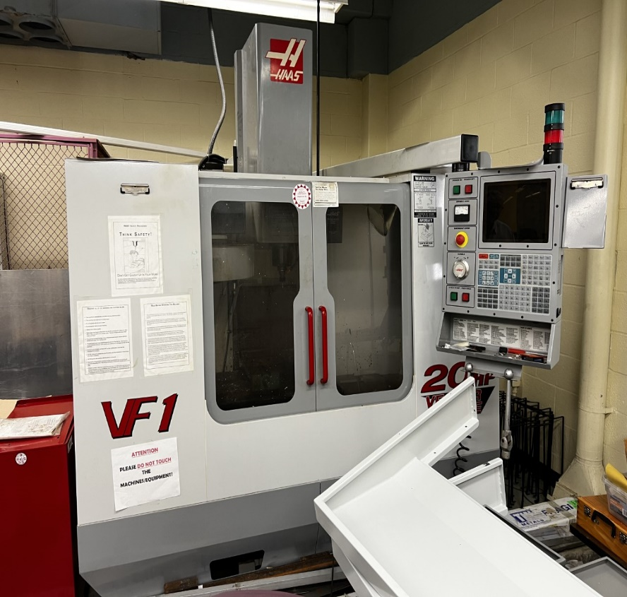
CNC machine In Department

Slide 11
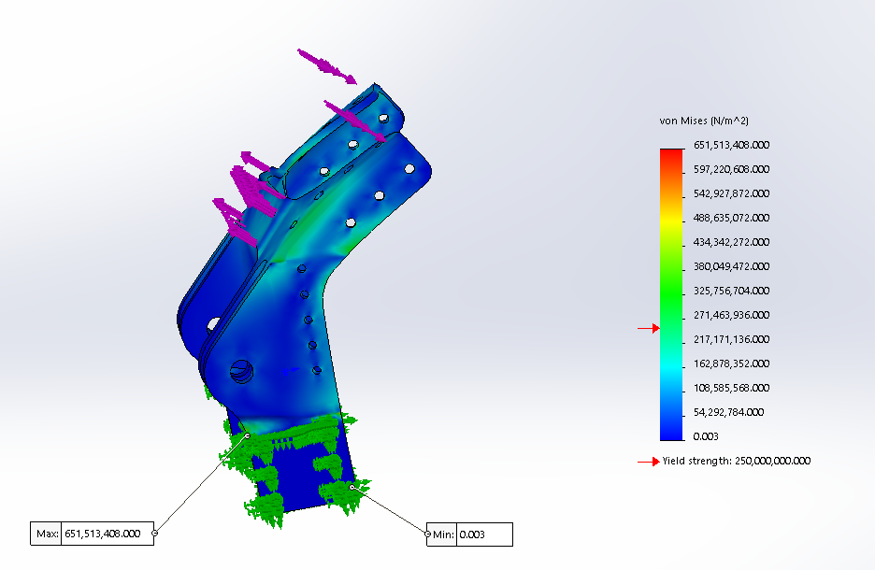
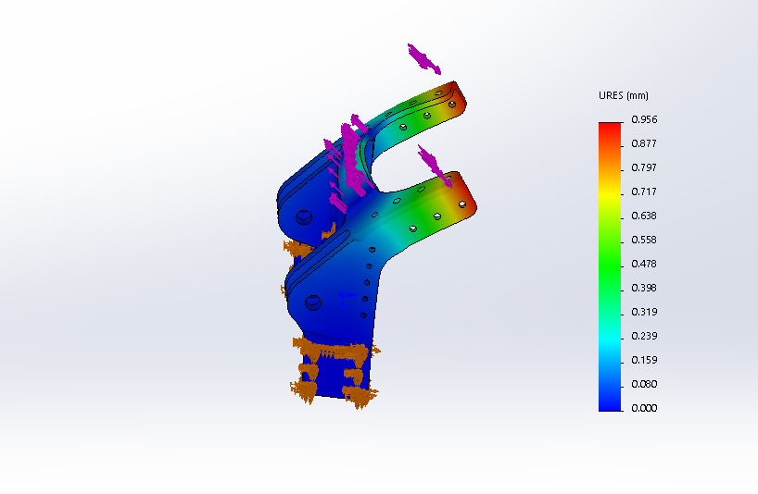
Stress analysis using solidworks simulation tool
Von Mises Stress Displacement in Model during Static Analysis

Slide 12
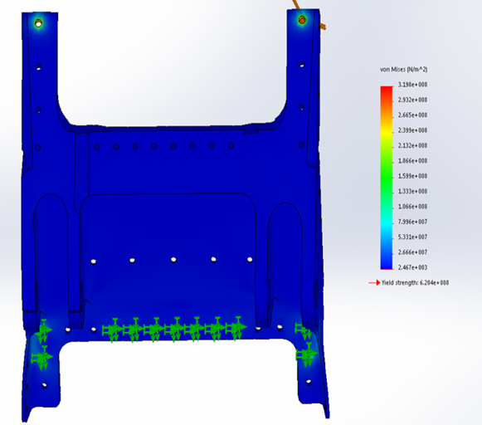
Von Mises STRESS ANALYSIS
Using the Von Mises method
Checking whether the part will withstand a given Load condition.
The 3000lbs force is applied.

Slide 13
question

