Slide 1
REGIONAL FOCUS ON ADVANCED MANUFACTURING
NENC CAREER PATHWAYS PRESENTS

Slide 2
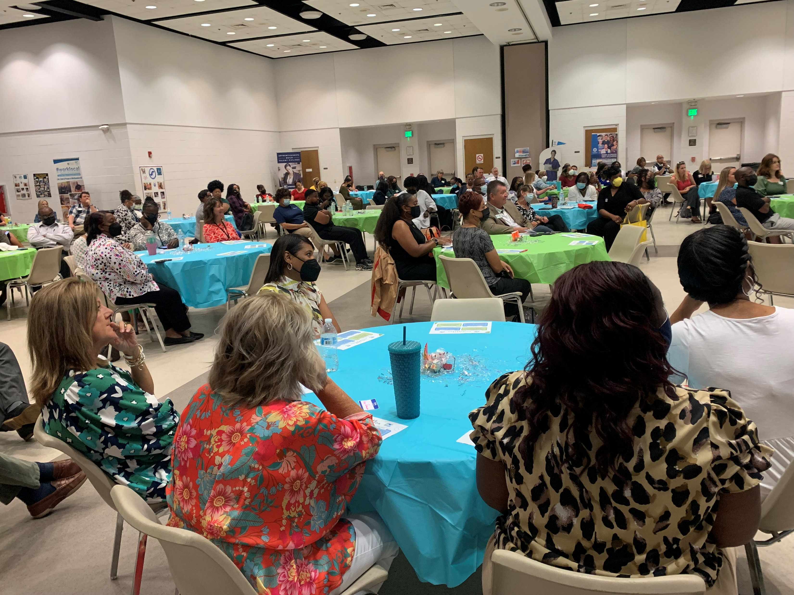
10th Anniversary Celebration

Slide 3
Quarterly Meetings
Health Care @ College of the Albemarle – TBD
Business Support Services – TBD (March)
Agriscience/Biotechnology – TBD (June)

Slide 4
Partnership Updates
Traitify
Posters
Good Jobs Challenge – STEPs4GROWTH
Good Jobs Challenge -- Hampton Roads Workforce Training System for Good Jobs
Build Back Better – NCBiotech: Accelerate NC – Community Colleges
Employer Engagement – HCAC, Rivers East Academy
Local Implementation
Pathway Reviews
This Photo by Unknown Author is licensed under CC BY-NC-ND

Slide 5
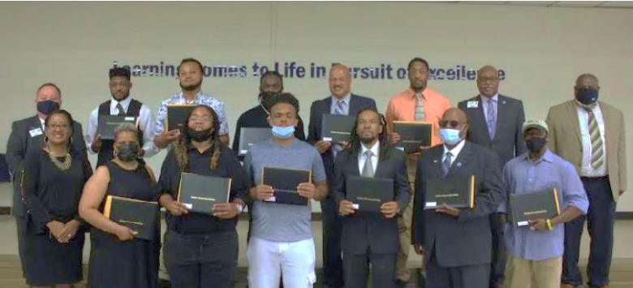
Story of Success – Calvin Barber

Slide 6
Facebook: https://www.facebook.com/nencpathways/
Instagram: https://www.instagram.com/nenccareerpathways/
Twitter: https://twitter.com/NENCPathways
LinkedIn: https://www.linkedin.com/company/nenc-career-pathways/

