Slide 1
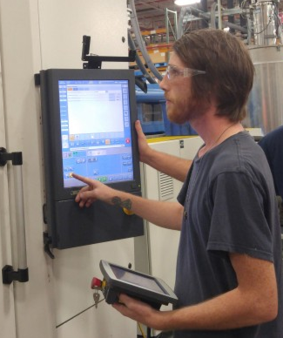
ApprenticeshipNC: A Talent Driven Training Strategy

Slide 2
Why Consider a Registered Apprenticeship?
Build a Competitive Workforce
Employers Facing Complex Workforce Challenges in Competitive Domestic and Global Markets
Time-Tested Model
Proven Strategy for Recruiting, Training and Retaining World-Class Talent Used by Industry for Decades (and longer!)
Adaptable and Flexible
Registered Apprenticeship is a Solution and Can Be Integrated into existing Training and Human Resources Development Strategies!!!

Slide 3
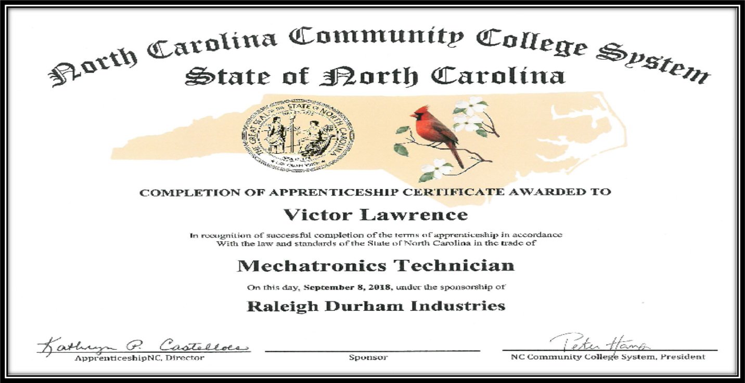
Core Components of an Apprenticeship Program
It all starts with engaged employers!
Nationally recognized occupational credential

Slide 4
Structured On-The-Job Learning (OJL)
What your apprentice will do on the job
Industry / Employers design to their specifications
provided with sample template to help
Credit awarded for previous training received

Slide 5
Job Related Education/Instruction
Providers
Community Colleges
Vocational and/or Technical Schools
Industry Associations
Labor Non-Union and Union Organizations
In-House or Sponsor
Job Related Education/Instruction Delivery Methods
Classroom
Correspondence
Electronic Media/Online
Credentials
Certification
Diploma
Degree
National Journeyworker
Minimum of 144 Contact Hours Per Year (No Maximum)
Notes:
Tiffany

Slide 6
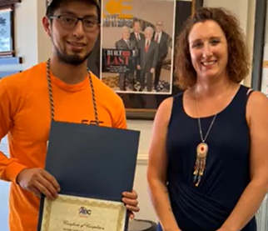
Progressive Wages for Skill Attainment
At least one progressive wage increase
Apprentice graduates to full journey worker wage
Federal minimum $7.25 or 50% of journey worker wage

Slide 7
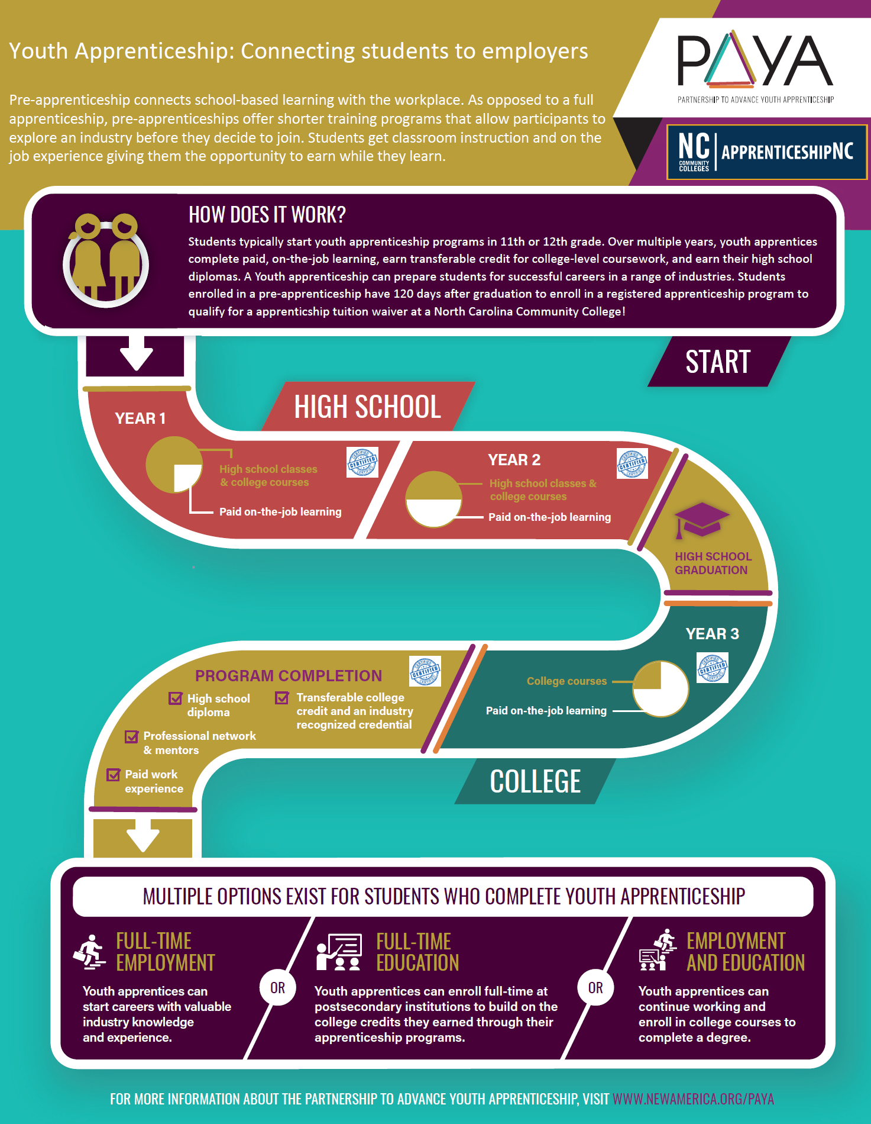
The Youth Apprenticeship Model
A youth apprenticeship (YA) pathway can begin in High School
YA in NC happens two ways
Student can start with Pre-Apprenticeship and lead to Apprenticeship after graduation
Or the apprenticeship can also start in HS (based on employer's needs)
What’s included in the Pre-Apprenticeship?
Related Instruction or
On the Job Learning or
Both!
When is the Pre-Apprenticeship? Minimum Age 16
During school
After school
During summers
Sometimes both or all 3
You must have an apprenticeship

Slide 8
Benefits for the Employer
For Business
Brings new talent into the workplace
Apprentices schooled in employer’s protocols, regulations, practices and equipment
Reduces recruitment cost by creating a sustainable talent pipeline
Hand-pick talent to train and retain
Notes:
Self-explanatory

Slide 9
General Assembly Funds for Apprenticeship Expansion Session Law 2021-180 Section 6.14
$12 million to promote apprenticeships
Eligibility criteria
Apprentices aged 16 – 25 years of age
Tier 1 and 2 counties
Small businesses (500 or less employees)
Incentive for employer
$2,000 reimbursement for training costs of each new apprentice
$2,500 reimbursement per year (two year maximum) for tuition, books and fees*
Max 50% wage reimbursement for up to $15/hour (non high school) and $14/hour (high school) for first 2000 hours / one year

Slide 10
Registered Apprenticeship: Your Next Steps
Contact your Apprenticeship consultant
Employer and team build the program
Launch Program together!
Employer outlines needs to consultant
Program reviewed and approved

Slide 11
Scott Panagrosso Apprenticeship Coordinator Northeast and Southeast Prosperity Zones (including Nash and Edgecombe Counties) panagrossos@nccommunitycolleges.edu 984-365-0577

