Slide 1
Connecting Career and Technical Education (CTE) High School Programs to Business and Industry
Pam Taylor
NCDPI
Northeast Regional Coordinator

Slide 2
CTE Resources
NCDPI – CTE
2022-2023 NC CTE Course Management System (ncsu.edu)

Slide 3
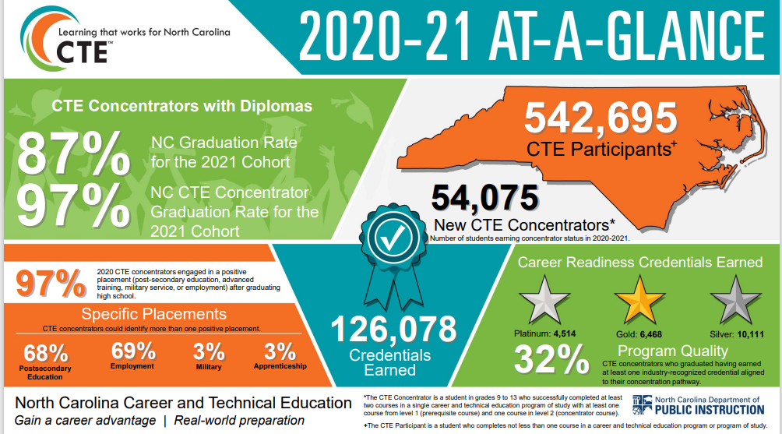

Slide 4
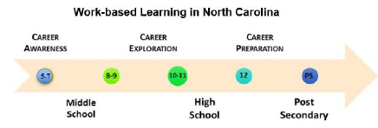
Work-based Learning in NC
Learning ABOUT Work
Learning THROUGH Work
Learning FOR Work

Slide 5

Career Preparation
Apprenticeship/Pre-apprenticeship
Cooperative Education
Internship
Entrepreneurial Experiences
School Based Experiences
Service Learning
Advanced Studies
Work-Study

Slide 6
Career Preparation
Apprenticeship/Pre-Apprenticeship
  a system of skilled occupational training that combines practice work experience with related academic and technical instruction. Partnership among business, industry, education, government, parents, and youth apprentices.
  Youth16-24 years of age.
  Credit earned in college courses taken during high school through certified CCP pathways can be applied toward community college degree.

Slide 7

Elements of Work-based Learning
Alignment of classroom and workplace learning
Application of academic, technical, and employability skills in a work setting
Support from classroom or workplace mentors

Slide 8
Why is Work-Based Learning Important
Makes learning relevant for students by connecting the curriculum to the worksite — increases students’ technical and employability skills.
Keeps education current — assists with the skills gap.
Connects students with community professionals — assists students in developing a career network.
Offers firsthand opportunities for students to learn about unfamiliar career options — increases knowledge about high-skill, high-wage and in demand careers.
Provides realistic experiences to assist students in making informed decisions about education options to help meet their career goals — helps save students money and deter unnecessary college loans.
Grows economic opportunities by creating local jobs and building community cooperation.

Slide 9
High Quality Work-based Learning
A sequence of experiences that begins with awareness and moves on to exploration and hands-on preparation.
Clearly defined learning objectives related to classroom curricula.
Alignment with students’ career interests.
Alignment with content standards and industry/occupational standards.
Exposure to a wide range of industries and occupations.
Collaboration between employers and educators, with clearly defined roles for each.
Activities with a range of levels of intensity and duration.
Intentional student preparation and opportunities for reflection.

Slide 10
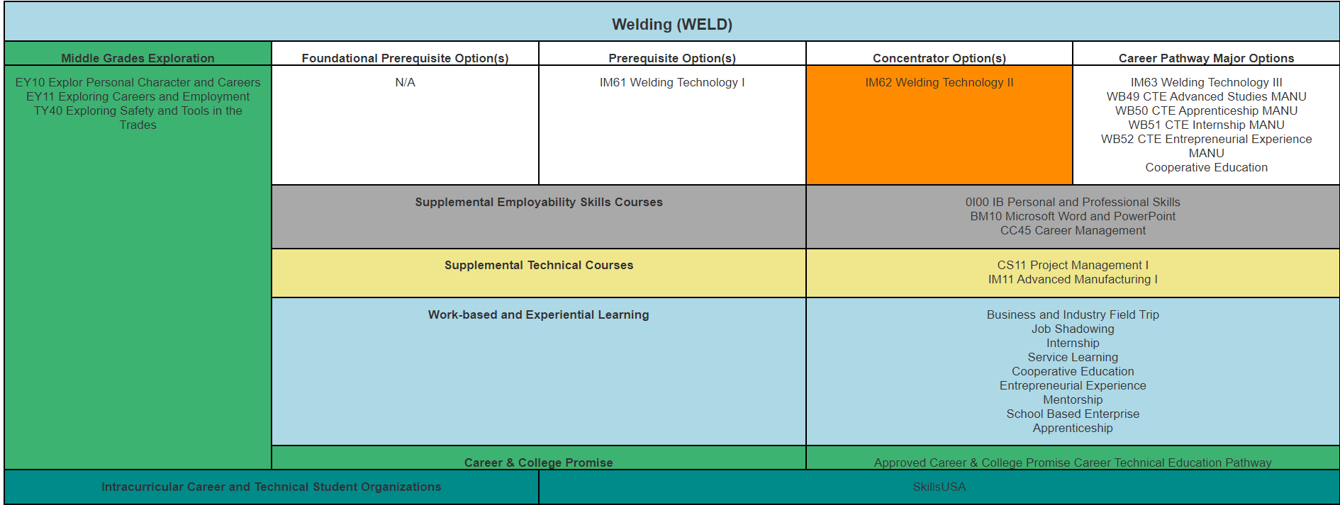
Work-based Learning in Pathways

Slide 11
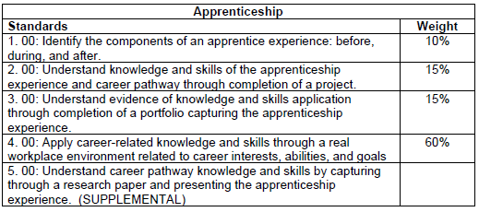
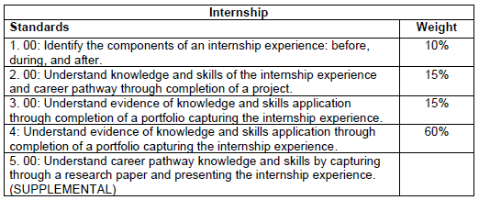
Work-based Learning Courses
Rigorous
Relevant
Based on state and national content standards
Engages technology to teach today’s generation of students
Helps to prepare students for high-skill, high-wage, or in-demand occupational opportunities.

Slide 12
Benefits for Students
Apply classroom learning (both academic and technical) in real-world setting.
Establish a clear connection between school and work.
Assess future employees’ interests, aptitudes, and abilities while allow students to learn about the career possibilities.
Improve post-graduation employment opportunities.
Develop and practice positive work-related habits and attitudes including the ability to think critically, solve problems, work in teams, and resolve issues.
Assess and understand the expectations of the workplace.
Establish professional contacts for future employment.
Expand and refine technical skills.
Participate in authentic, job-related tasks.
Increase motivation and appreciation for staying in school.
Develop awareness of postsecondary education opportunities and their connection to their intended career choices.

Slide 13
Benefits for Employers
Access a pool of skilled and motivated pool of future employees.
Improve employee retention.
Reduce training and recruitment costs.
Develop opportunities for a current workforce.
Develop new projects with student assistance.
Involve employers in the curriculum development process.
Provide opportunities for community service for students.

Slide 14
Benefits for the Community
Create an environment of collaboration and cooperation among the school, the employers, and the community.
Encourage respect, tolerance, and understanding among different groups.
Contribute to building a more productive local economy.
Foster confidence in the school system as practical and beneficial results are observed.

Slide 15
What starts here…. changes everything!

Slide 16
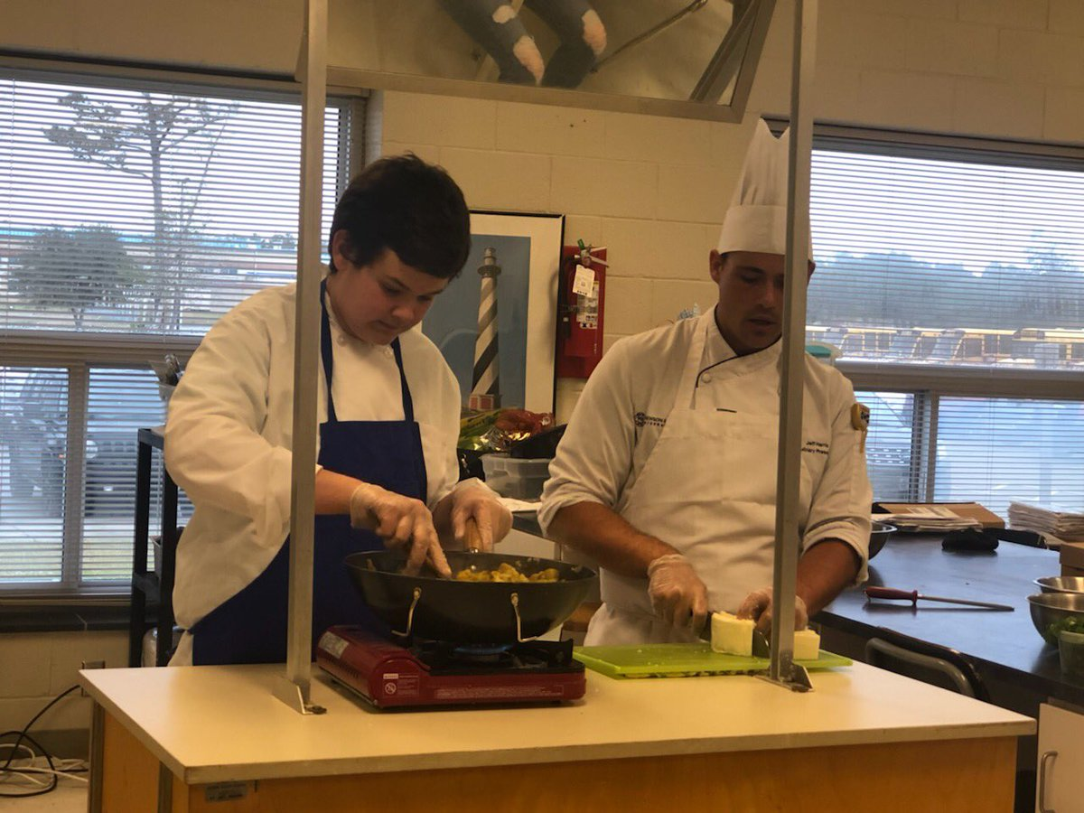

Slide 17
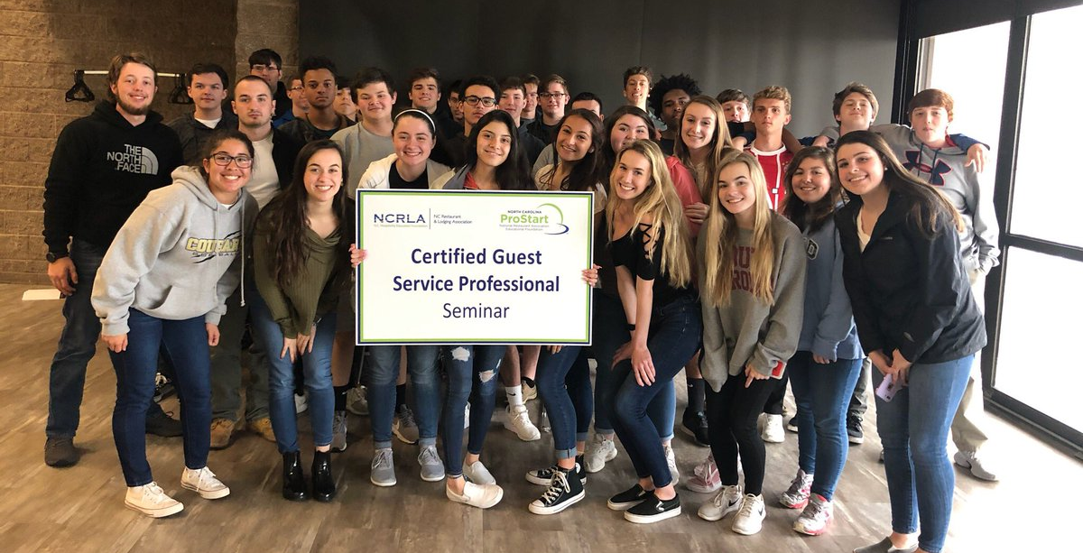

Slide 18


Slide 19
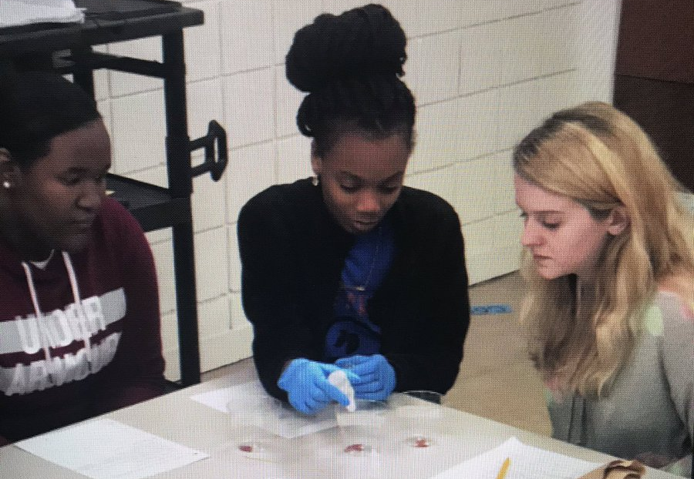

Slide 20
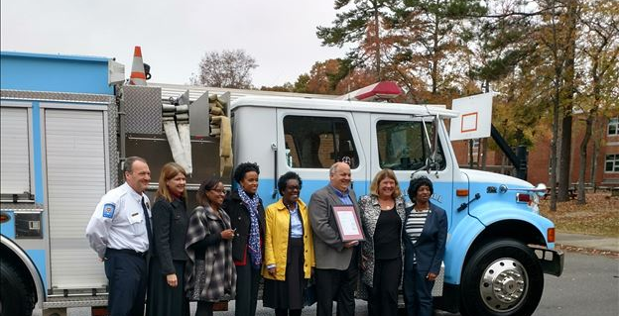

Slide 21
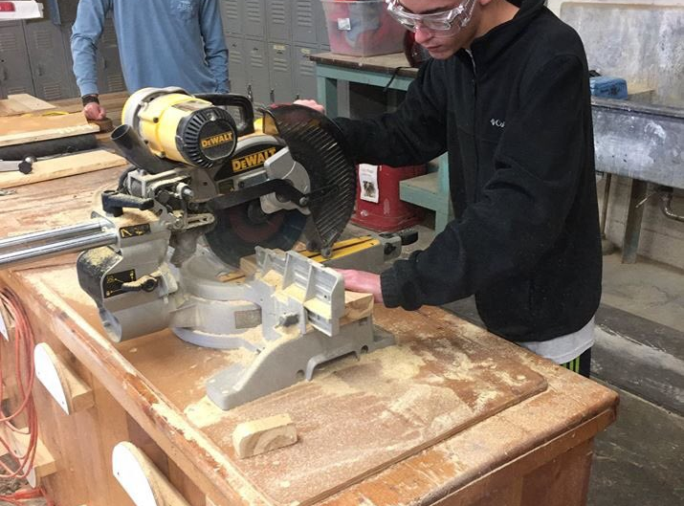

Slide 22
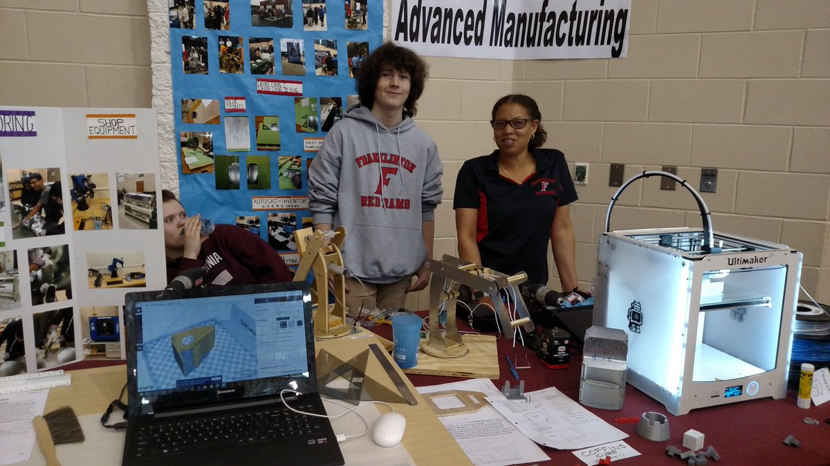

Slide 23
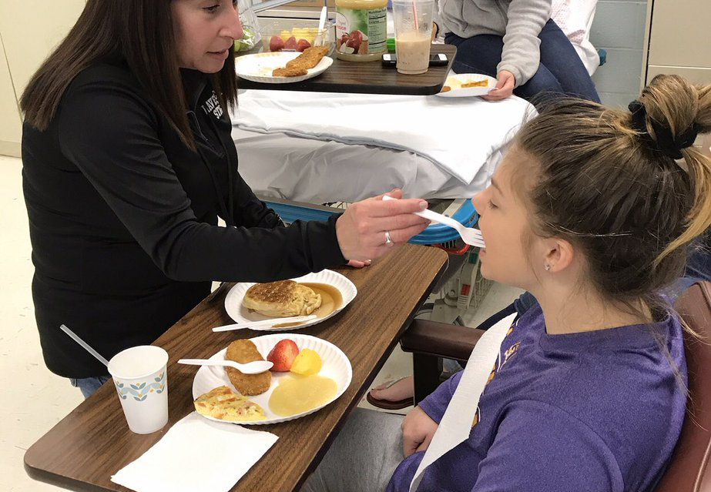

Slide 24


Slide 25


Slide 26


Slide 27
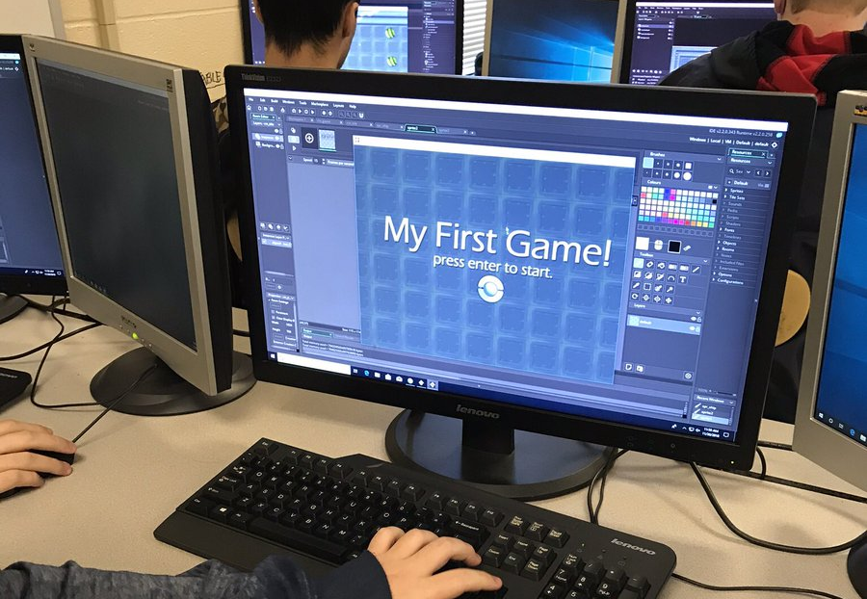

Slide 28
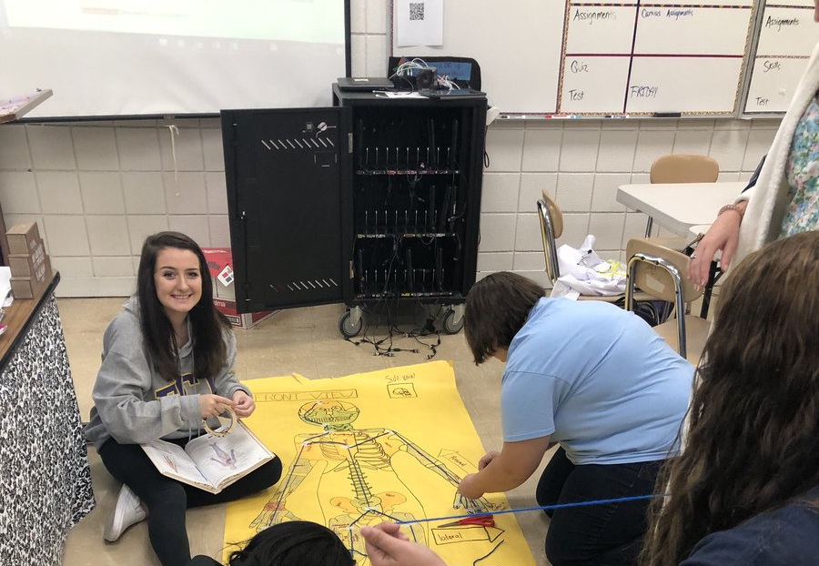

Slide 29
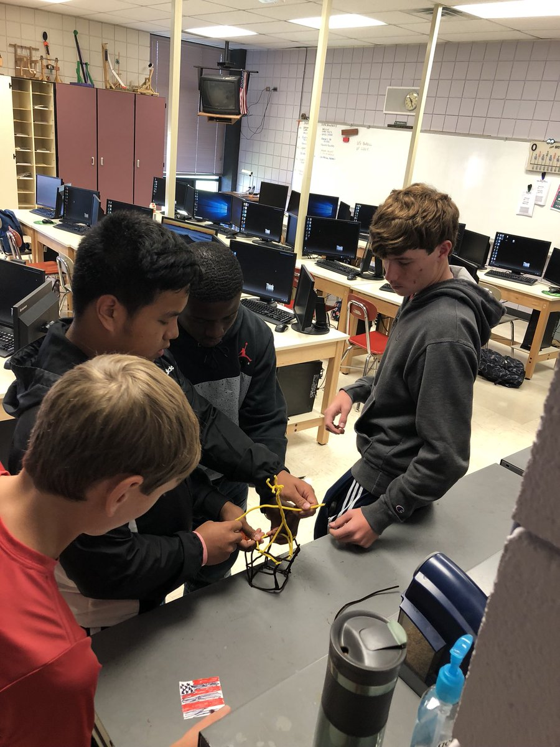

Slide 30
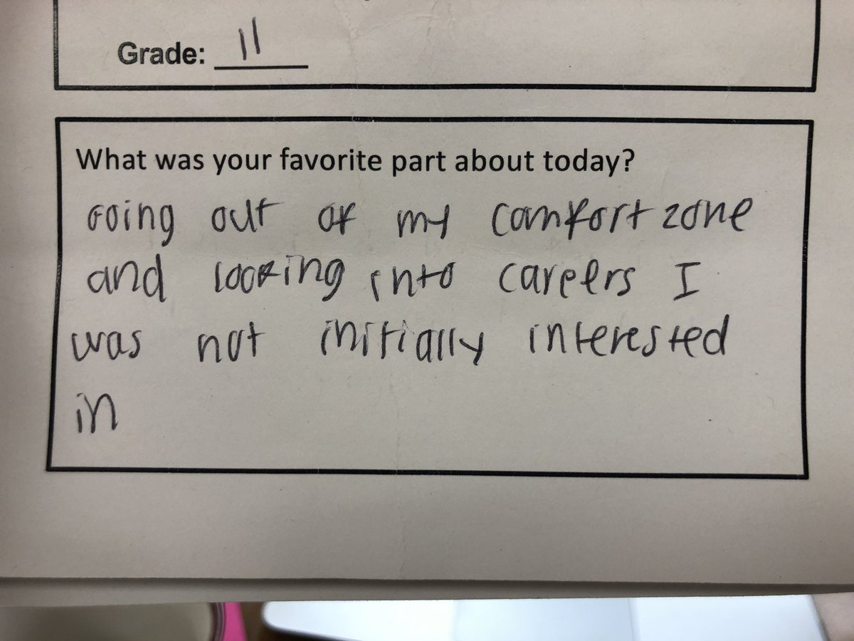

Slide 31
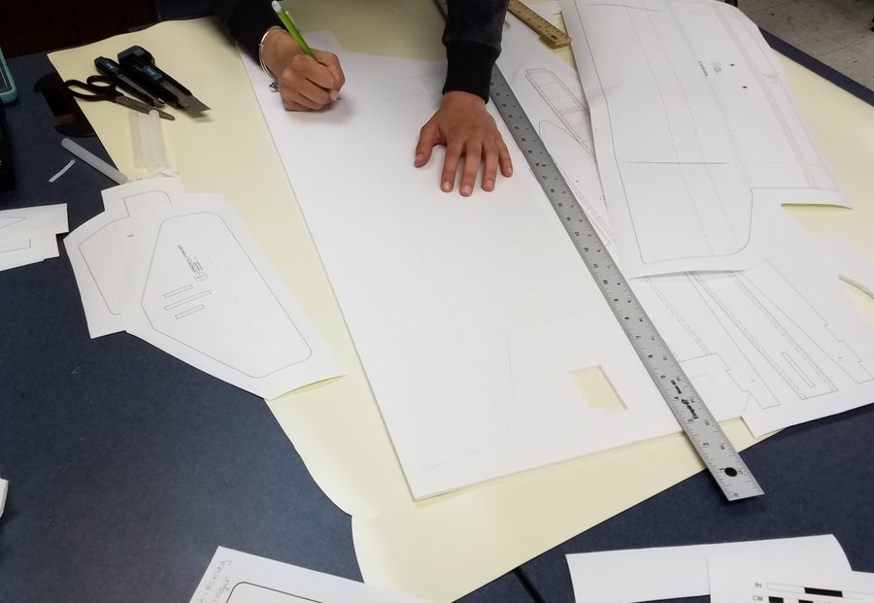

Slide 32


Slide 33
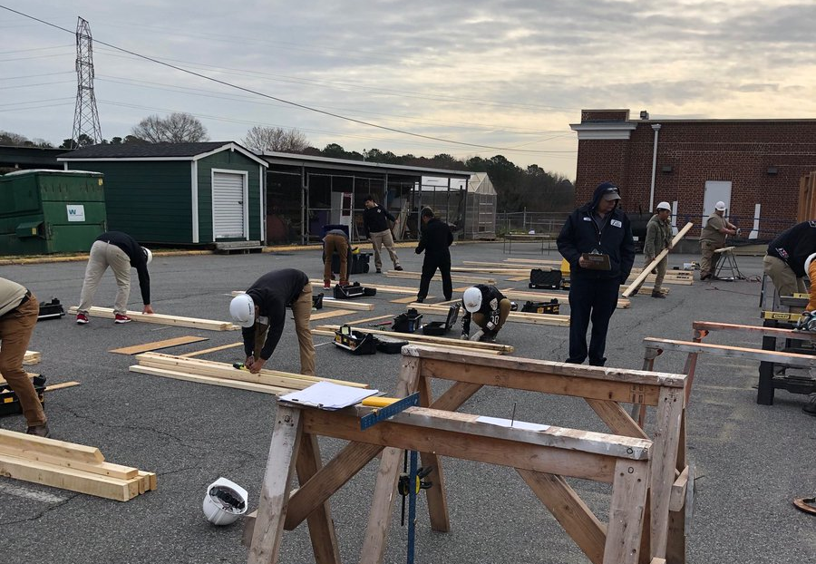

Slide 34
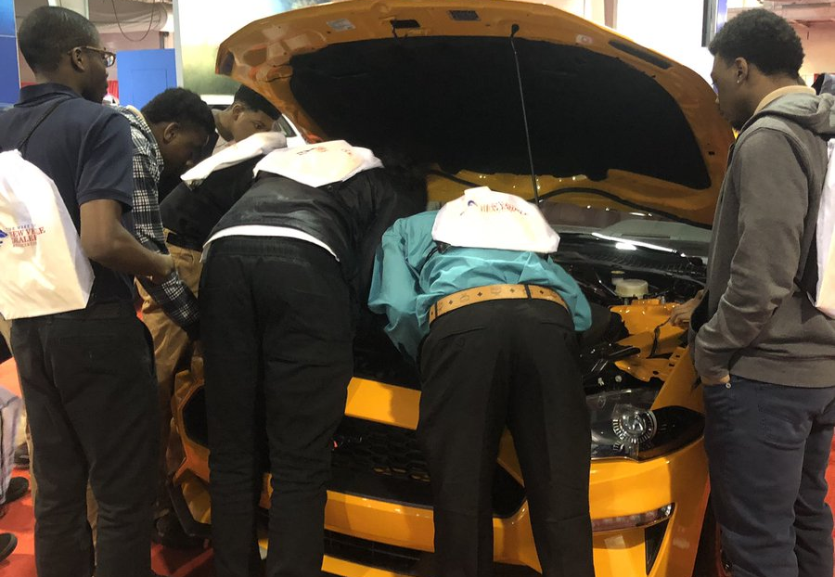

Slide 35
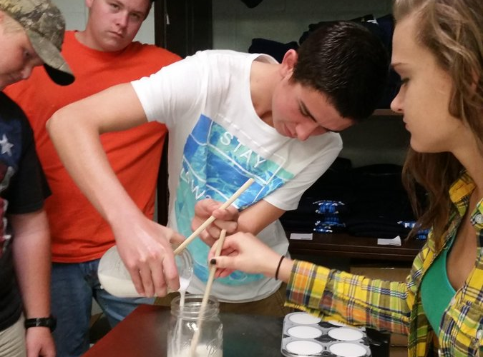

Slide 36


Slide 37


Slide 38
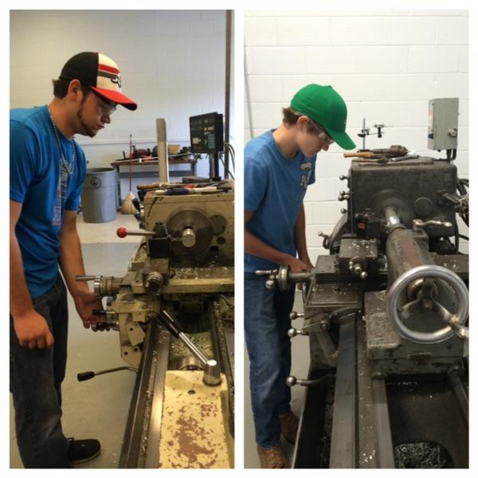

Slide 39
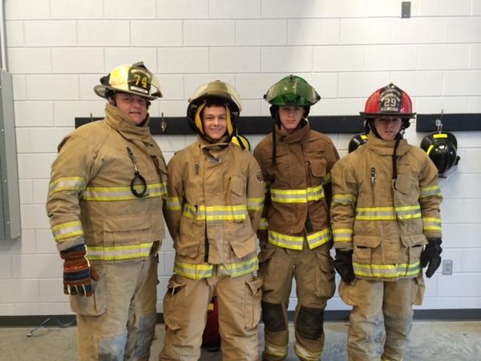

Slide 40


Slide 41
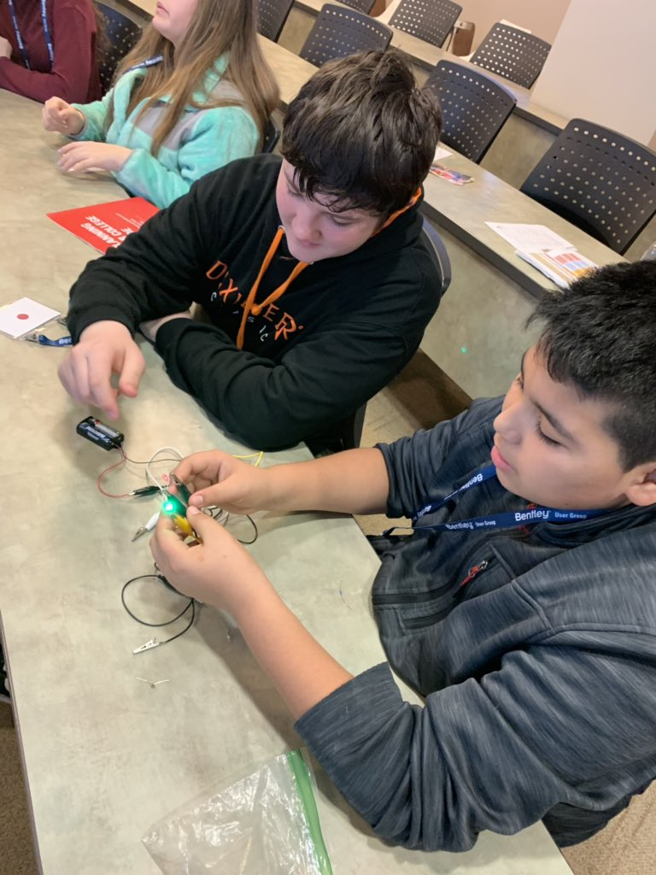

Slide 42
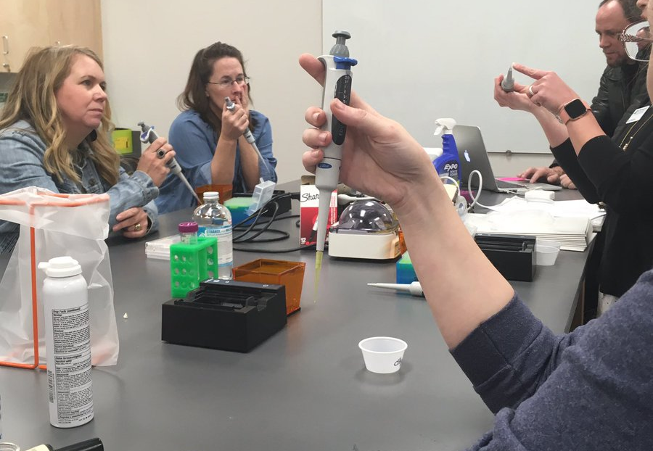

Slide 43
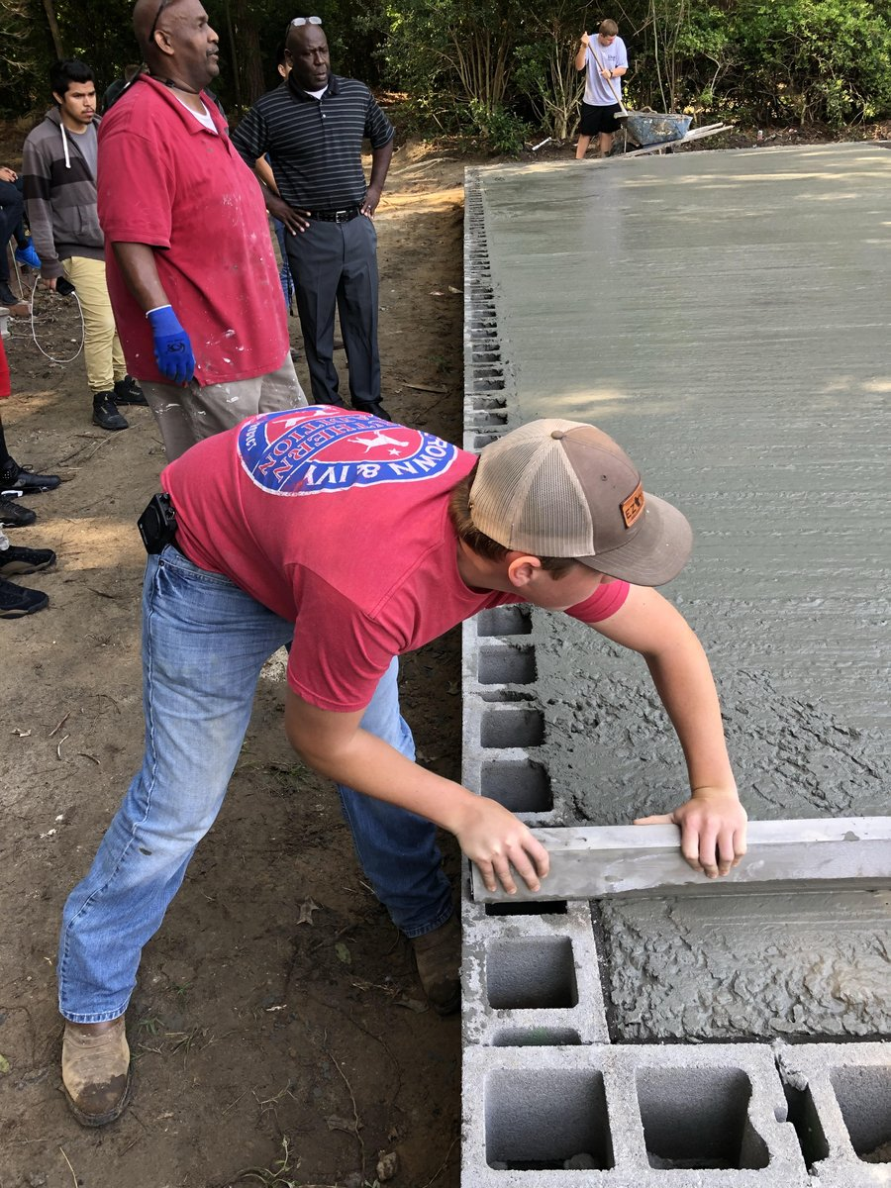

Slide 44
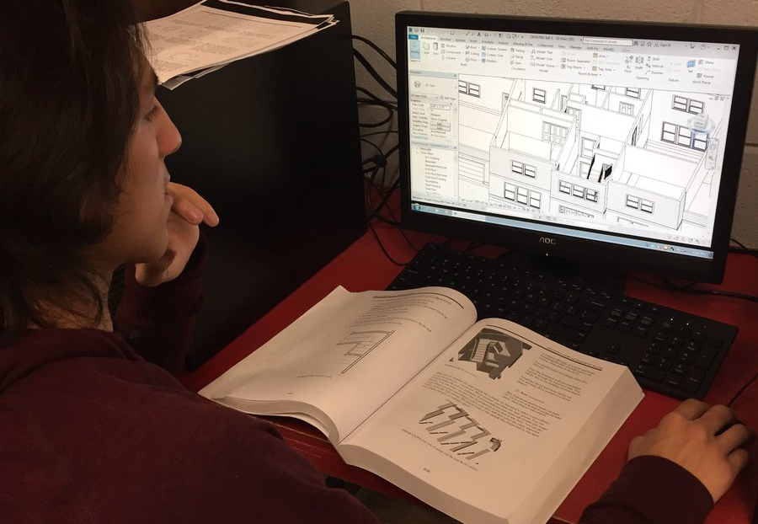

Slide 45
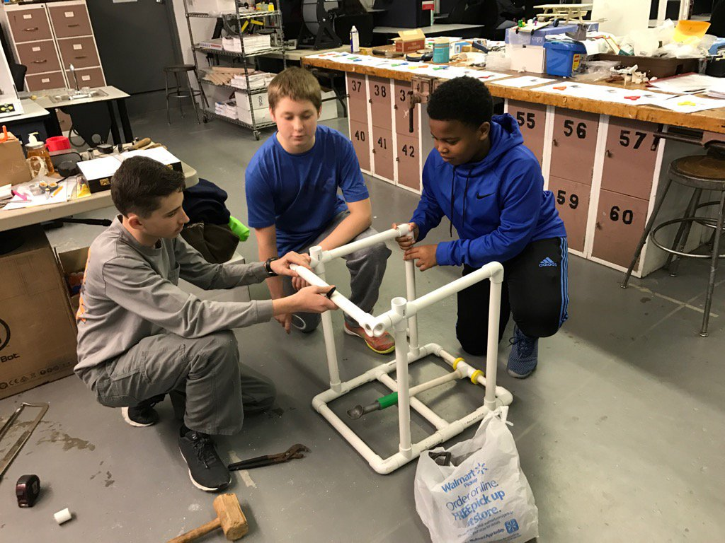

Slide 46
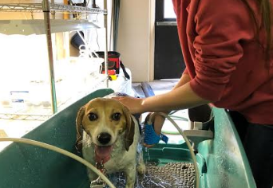

Slide 47


Slide 48
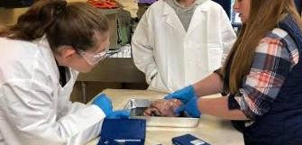

Slide 49


Slide 50
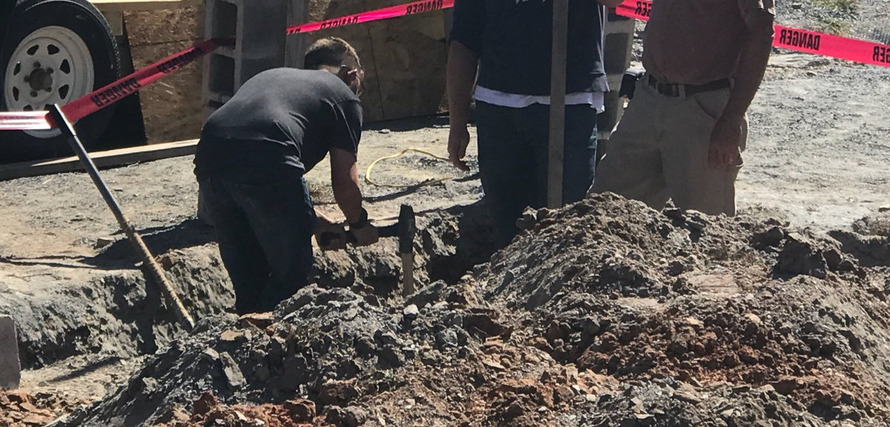

Slide 51
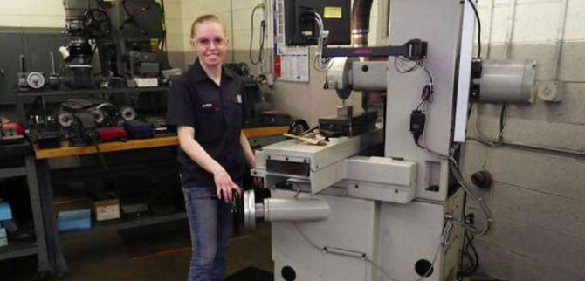

Slide 52
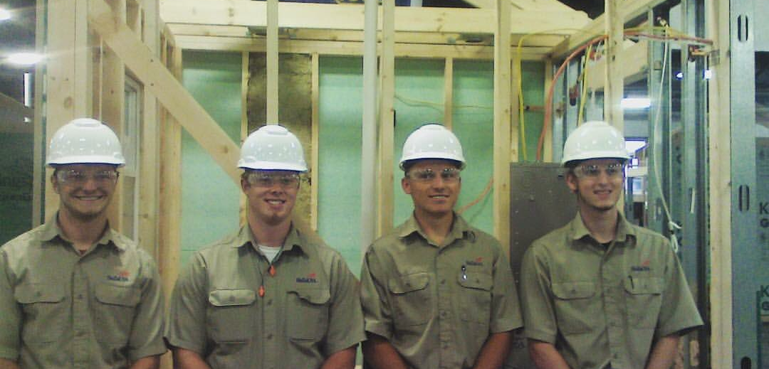

Slide 53
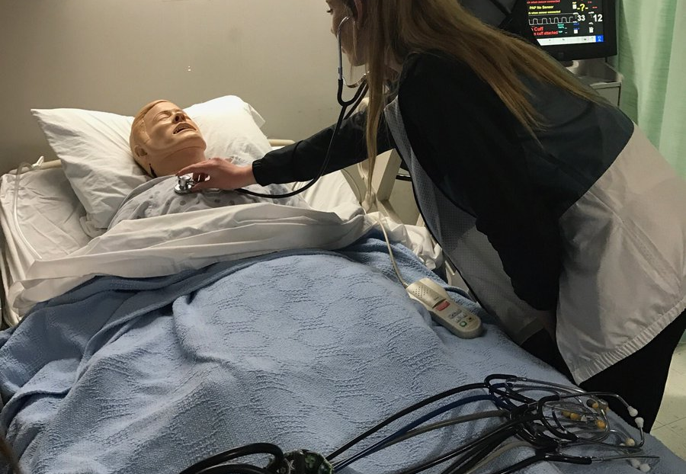

Slide 54
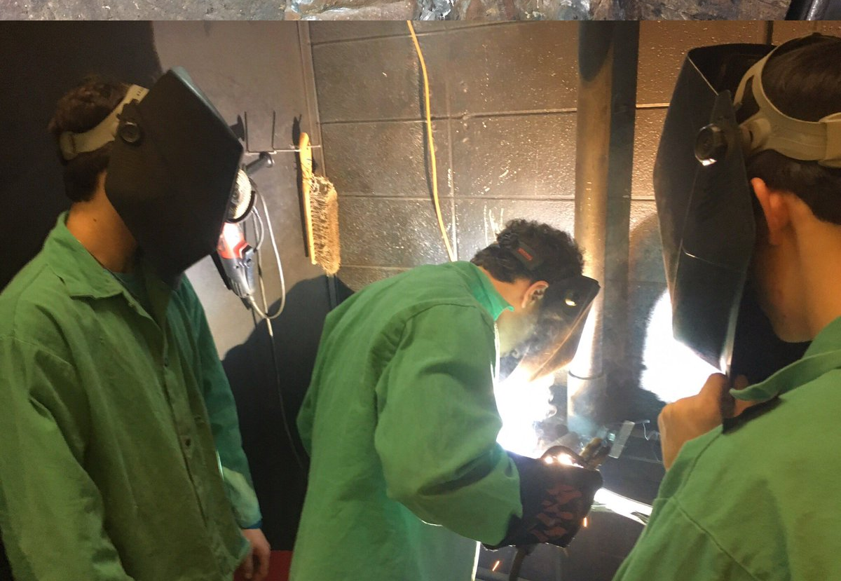

Slide 55


Slide 56
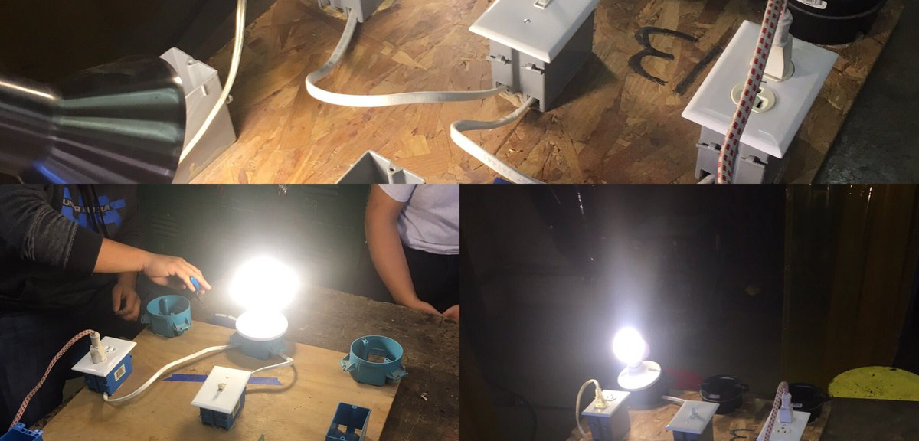

Slide 57
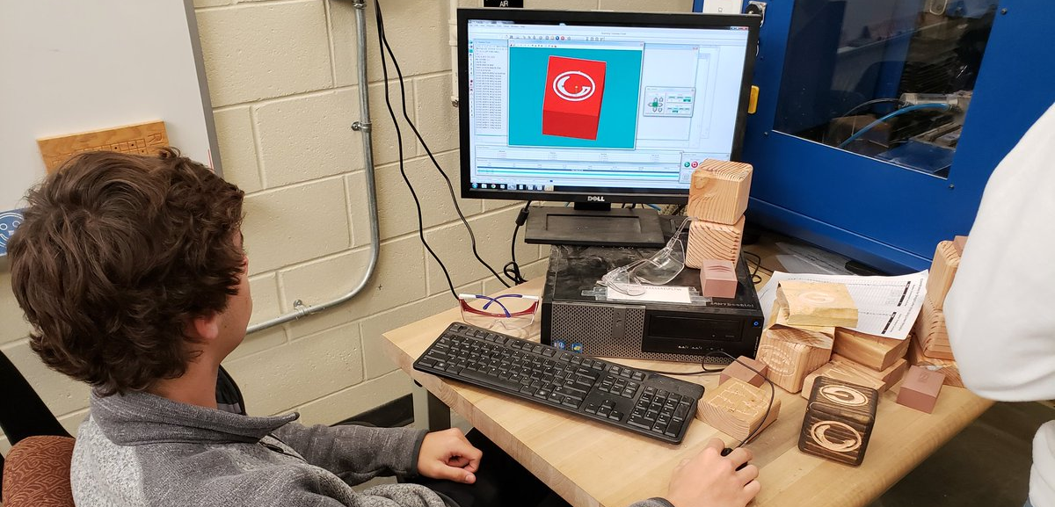

Slide 58
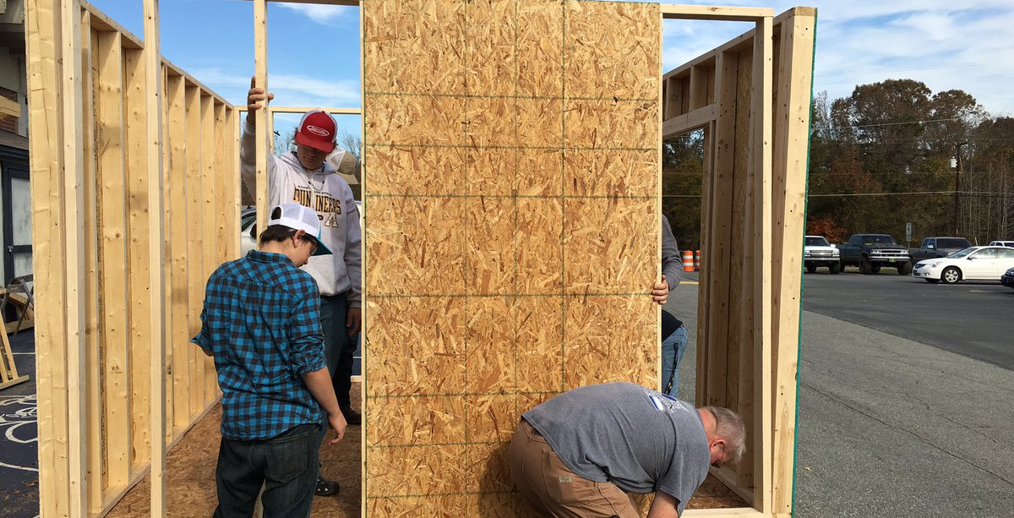

Slide 59


Slide 60


Slide 61


Slide 62
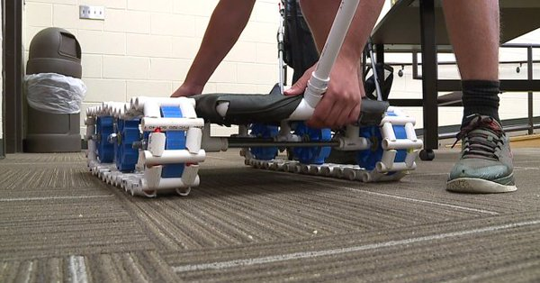

Slide 63
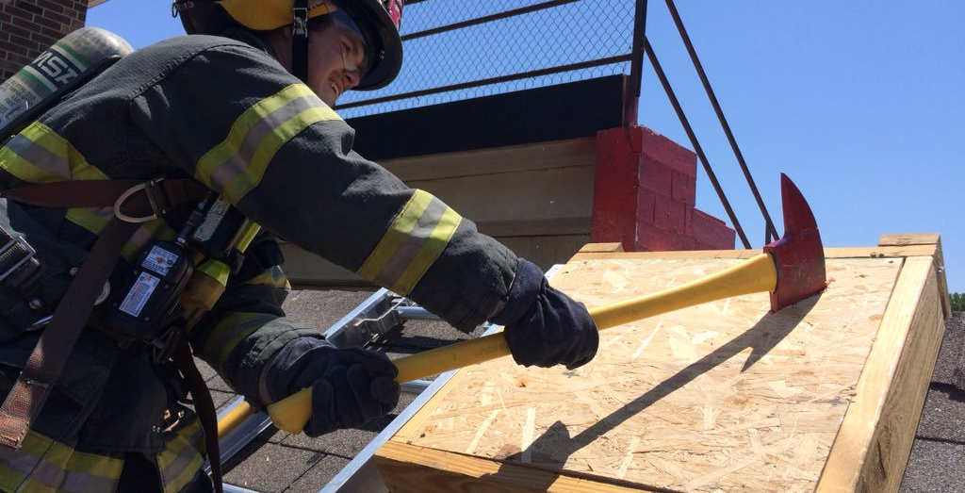

Slide 64


Questions

Slide 65

What starts here…. changes everything!
#ctefornc
#nencpathways

