Slide 1
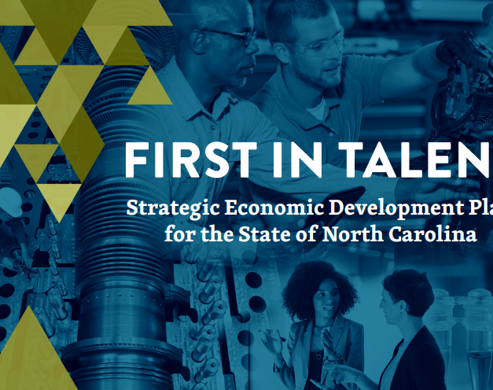
Sector strategy's role in the plan!
Scott Panagrosso – Sector Strategy Coordinator
Division of Workforce Solutions
NC Department of Commerce

Slide 2
Three primary goals
Prepare North Carolina’s Workforce for Career and Entrepreneurial Success
1
Prepare North Carolina’s Businesses for Success by Growing and Attracting Talent
2
Prepare Communities Across North Carolina to be more Competitive in Growing and Attracting a Talented Workforce and Businesses
3
Notes:
Released in July 2021 / Secretary Sanders and many others have been diligently educating and advocating on this plan across the state

Slide 3
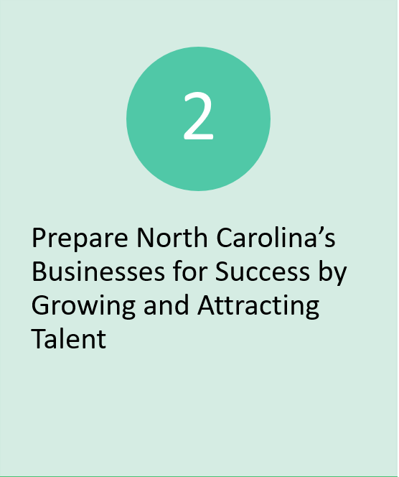
Goal 2
Tactic 5.5
Expand Sector Partnerships to more Regions and Industries in the state
Notes:
While the entire plan is awesome, our focus is on the second goal dealing with employers
Tactic 5.5 talks about the pilot work building sector partnerships using the Next Generation Sector Partnership model
It also talks about bringing together major state agencies to educate and advocate for this work within their organizations and across the state
Ultimately, the goal is to better engage business by:
Focusing on a sector
Putting employers in a leadership roll
Working together to help industry succeed so everyone can benefit from the applicant that walks in a career center / community college admissions office to the small business owner

Slide 4
What are sector partnerships?
“…is a regional, industry-focused approach… partnership of employers…in a critical industry…brings together education, economic development, workforce and community organizations to identify and collaboratively meet the…needs of that industry…”
They are the key component of sector strategies
Notes:
I have given sector strategies / sector partnership presentations before
Nice 3 + minute video on the Next Generation Sector Partnership model (not today)

Slide 5
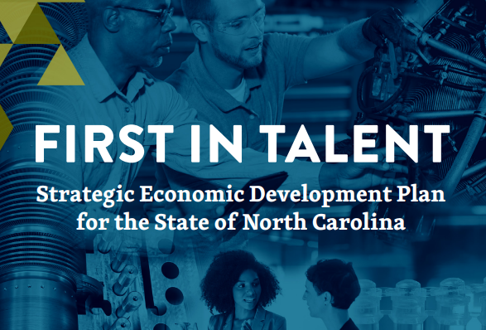
Why sector partnerships?
State Unified Plan 2020
NC Works Commission Strategic Action Plan 2021 – 2023
Workforce Development Board’s Annual Local Area Plan
Notes:
Not another new thing….. Not really
Since 2015, WIOA has identified sector strategies (and career pathways) as two key tools to effectively implement the new law.
WDBs are postured to be a great neutral convener
NC Job Ready / Recent economic development plan all stress employer engagement and leadership – pandemic has only magnified this need
State unified plan – promotes the use sector strategies
NCWorks Commission Strategic Action Plan Goal 2 / bullet 4 – prioritize and acknowledge sector partnerships
Employer leadership sub-committee currently looking at ways to energize the work
WDB local area plans – address their work in sector strategies

Slide 6
State Sector Strategy Council
OFFICE OF THE GOVERNOR
EDPNC
NCCCS
Industry led sector partnerships
NC CHAMBER
NC DPI
NC DEPT OF COMMERCE
Notes:
Council launched summer of 2019
Mission is to encourage and support the growth of sector strategies across the state
Share the best practices
Connect with other partnerships both in state and out of state

Slide 7
What’s happening locally
Healthcare employer initiative
Multiple employers
Four priorities
Early wins
Tradesformers
Biopharma

Slide 8
What’s happening across the state?
Next Generation Sector Partnerships
Foothills Manufacturing Alliance
Cape Fear Manufacturing Partnership
Talent Pipeline Management
Cape Fear Collective (construction)
Charlotte Works (construction – planning)
Business & Industry Leadership Team
NCCCS (Forsyth CC – Manufacturing)
Other
STEP (multi-sector)
McDowell Pipeline (manufacturing)
Central Carolina Manufacturing Institute (manufacturing)
Notes:
Many more examples going on
Are they all perfect examples of Next Gen / TPM / BILT or something else? NO WAY!
Are they all truly employer led? Probably not but do they have great employer involvement? They probably do if they are successful!!!!

Slide 9
Is there a sector partnership model…?
Notes:
Next Generation Sector Partnerships – whatever is a priority to industry is a priority for community partners
Talent Pipeline management – addressing industries workforce needs
BILT

Slide 10
So what do we do?
You already engage industry, just focus on the following
For industry
Let industry lead the conversation
Empower them to set the agenda and drive the conversation
For Public partners
Focus on a single sector / which industry is most impactful in your region
Do more listening
Align your efforts with partners
Expand the tent
How North Carolina does business with business

Slide 11
Wrapping it up
Sector Strategies are effective

