Slide 1
Advanced Manufacturing career pathway http://nencpathways.org /advanced-manufacturing/
Erica, Cortney and Diane

Slide 2
NCWorks Job Posting:
Air-O-Smith
(Point Harbor) Kitty Hawk, NC
HVAC Heating, Air Conditioning, and Refrigeration Mechanics and Installers
O*NET OnLine: 49-9021.00
https://www.onetonline.org/link/summary/49-9021.00?redir=49-9021.01

Slide 3
Advanced Manufacturing
$16.04
$20.42
$24.32

Slide 4
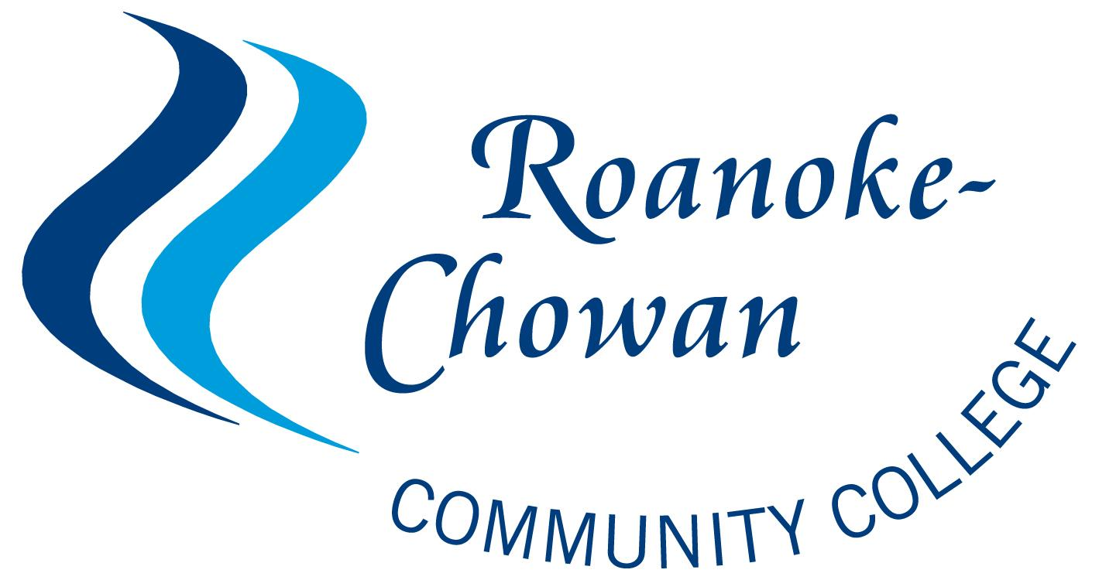
Education:
Post-Secondary Options:
1 semesters: HVAC Certificate 1
(16 credit hours)
2 semesters: HVAC Certificate 2
(12 credit hours)
Post-Secondary Diploma Program: Full-Time
(2 semesters)
*ALL offered on the NWDB Approved Training List*

Slide 5
Traits: Troubleshoot, Repairing, Equipment Maintenance
Abilities: Problem Solving, Visualization
Transferrable Skills: Customer Service, Working independently, Attention to detail

Slide 6
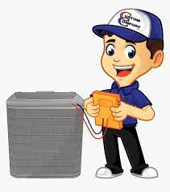
Labor Market Information:
In Northeast Coastal North Carolina nonmetropolitan area:
Workers on average earn $21.23 per hour.
10% of workers earn $15.62 or less per hour.
10% of workers earn $28.93 or more per hour.
** Job posting states a salary of between $20-$30 per hour

