Slide 1
What to Wear to the Job Interview
Let’s REVIEW!
Notes:
We are going to review by looking at 5 outfits. Please be ready to share what is appropriate and what might not be appropriate for each outfit.

Slide 2
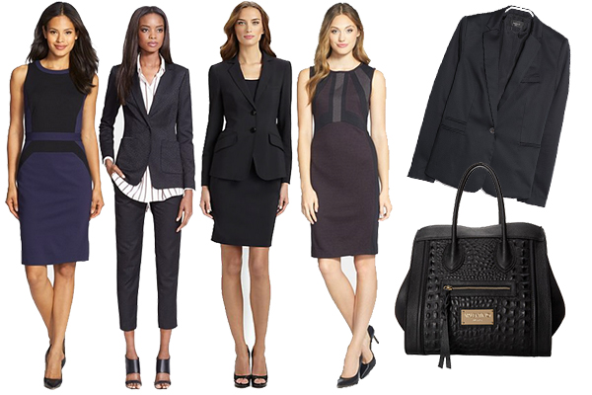
Appropriate
Not Appropriate
Notes:
Ideas to discuss: Should shoulders be covered? Will the third outfit’s skirt ride up when sitting? Can you walk quickly in the shoes? Should the shirt be tucked in?

Slide 3
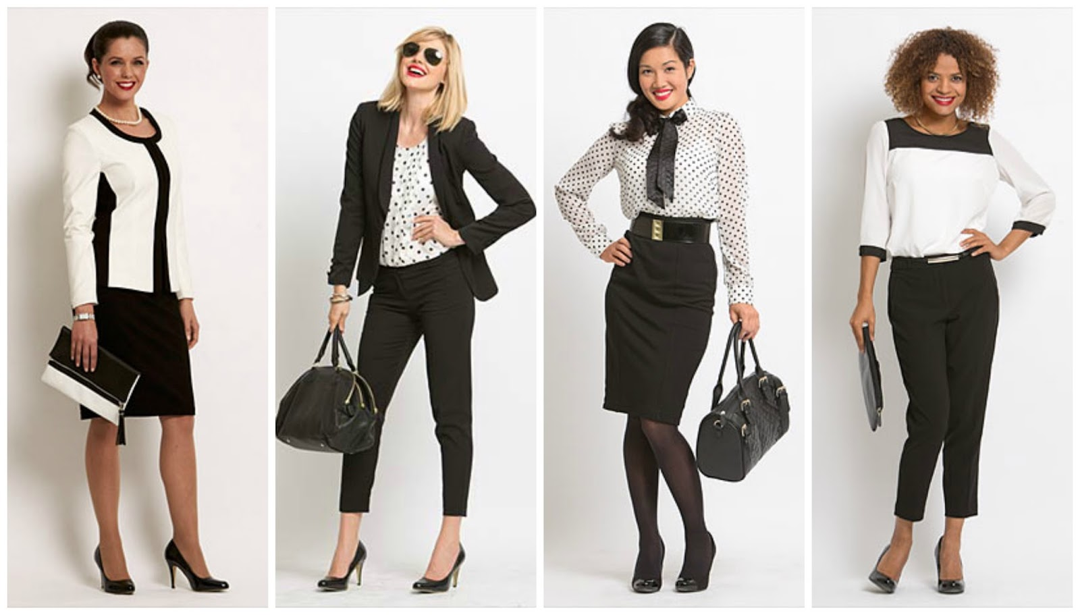
APPROPRIATE
NOT APPROPRIATE
Notes:
No sunglasses (even on top of head)
Don’t bring in big handbags.
Again, can you walk in shoes?

Slide 4
Appropriate Not Appropriate
Notes:
No jeans.

Slide 5
Appropriate Not Appropriate
Notes:
Keep sleeves down

Slide 6
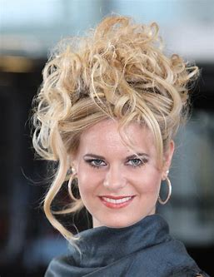
Appropriate
Not Appropriate
Notes:
Messy and too attention grabbing
Avoid big hoop earrings and heavy makeup

