Slide 1
myFUTURE NC
Northeast NC Career Pathways
Jeni Corn & Melissa Caperton, myFutureNC
JENI@MYFUTURENC.ORG  MELISSA@MYFUTURENC.ORG

Slide 2
North Carolina’s Skills Gap Problem
Projected growth in NC occupations requiring a postsecondary credential or above is expected to outpace growth in occupations requiring only a High School degree by 2x between 2018 and 2028.
67%
of jobs in NC require a high-quality credential or postsecondary degree
49%
of North Carolinians [ages 25-44] have completed that level of education.
1/2
of NC Employers need more hire-able workers, citing lack of skills & overall education

Slide 3
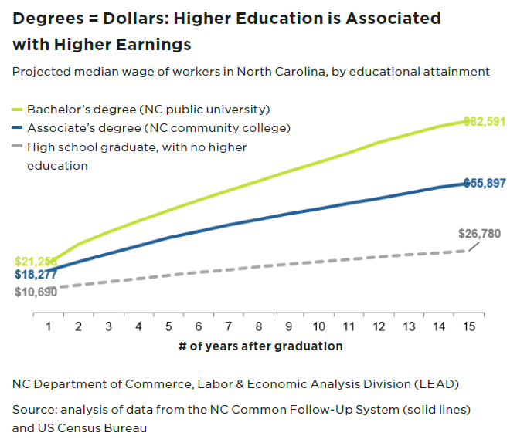
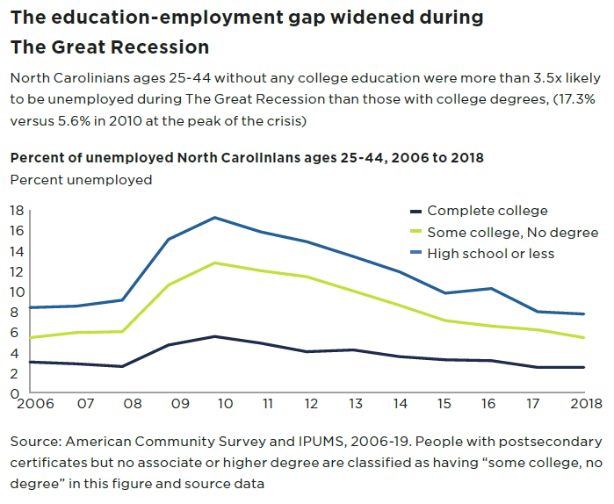
The Value of Postsecondary Education
NC Department of Commerce, Labor & Economic Analysis Division (LEAD)
Source: analysis of data from the NC Common Follow-UP System (solid lines) and US Census Bureau
Source: American Community Survey and IPUMS, 2006-19. People with postsecondary certificates but no associate or higher degree are classified as having “some college, no degree” in this figure and source data.

Slide 4
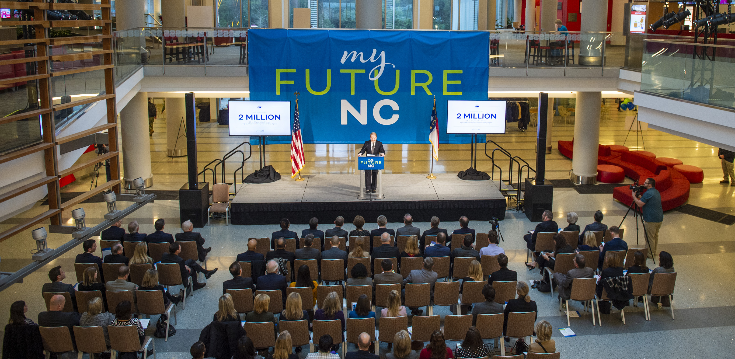

myFUTURE NC
A statewide nonprofit organization focused on educational attainment and the result of cross-sector collaboration between North Carolina leaders in education, business, and government.

Slide 5
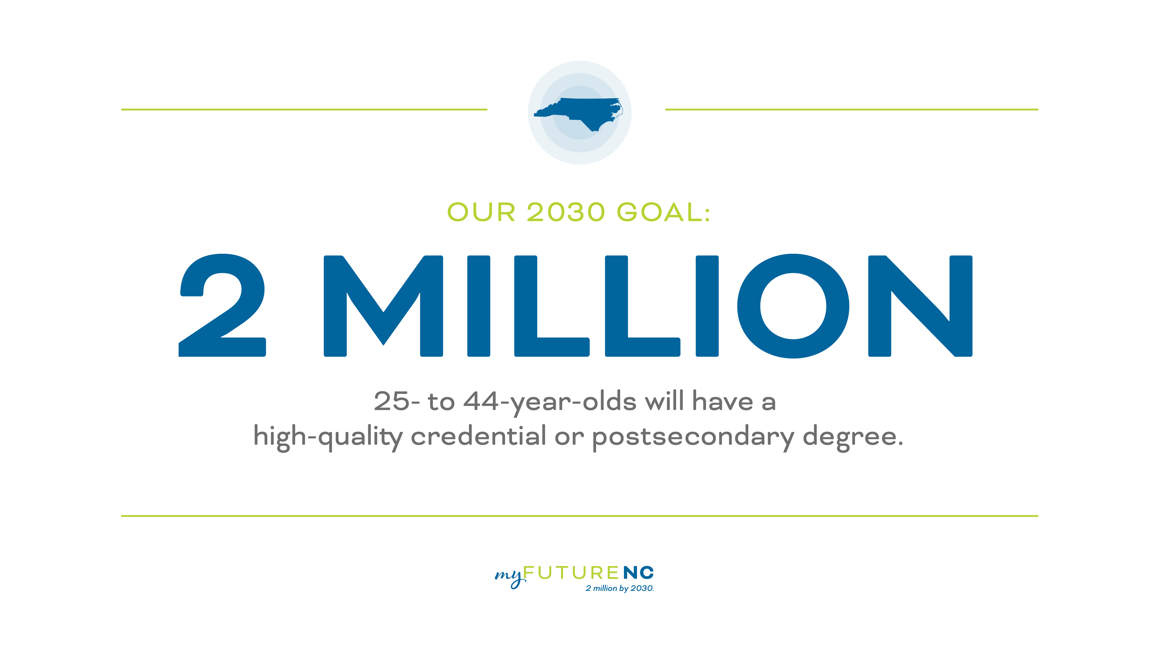

Slide 6
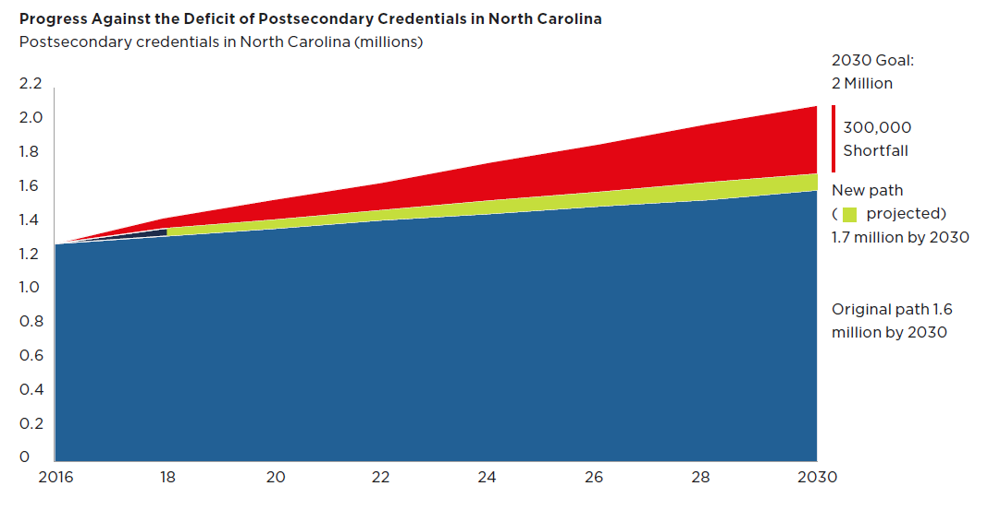
MyFutureNC Goal
2M North Carolinians with high quality credential or post-secondary degree
Determining what counts
associate/bachelor degrees and non-degree credentials valued by NC employers that support North Carolinians in obtaining in-demand living wage jobs

Slide 7
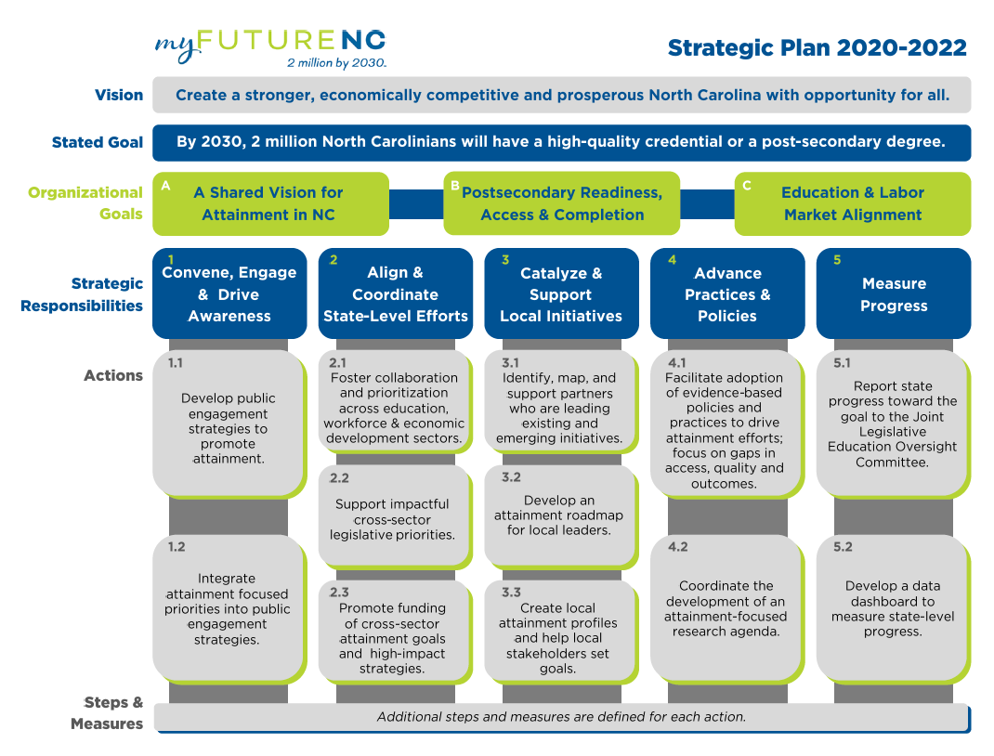
County Attainment Profiles support efforts to “Catalyze & Support Local Initiatives”

Slide 8
DATA-FOCUSED WORK
myFutureNC in partnership with Carolina Demography developed:
myFutureNC Attainment Dashboard using the state-level benchmark indicators and outcome measures.
Local Attainment Profiles as a resource for communities to assess key metrics across the local education continuum.

Slide 9
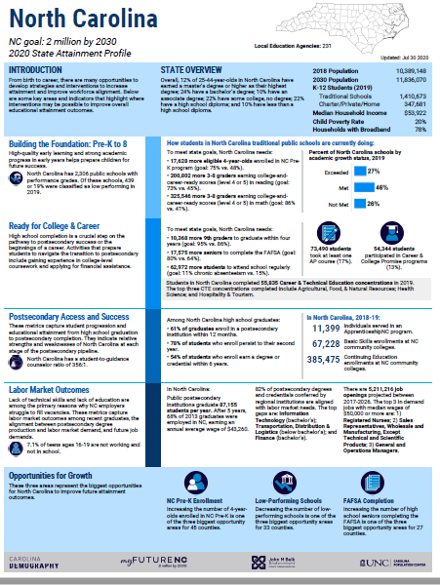
NC PROFILE OVERVIEW
Purpose:
To facilitate decision-making on STATE-LEVEL priorities by highlighting NC’s performance and specific opportunities for improvement that will ultimately lead to increased attainment.

Slide 10
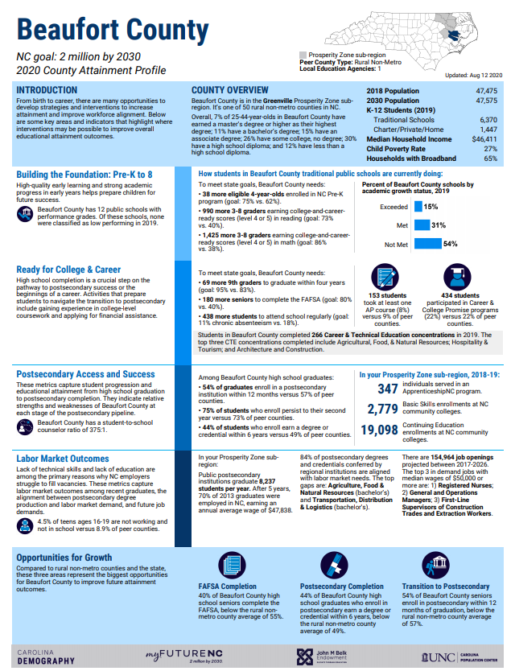
COUNTY PROFILE OVERVIEW
Purpose:
To facilitate decision-making on LOCAL priorities by highlighting county and regional performance and specific opportunities for improvement that will ultimately lead to increased attainment.

Slide 11
OPPORTUNITIES FOR GROWTH
AP Participation
Adult Learners
Career & College Promise Enrollment
Chronic Absenteeism
College & Career-Ready in Math
College & Career-Ready in Reading
Disconnected Youth
FAFSA Completion
First-Year Persistence
School Counselors
High School Graduation
Low-Performing Schools
NC Pre-K
Postsecondary Completion
Transition to Postsecondary

Slide 12
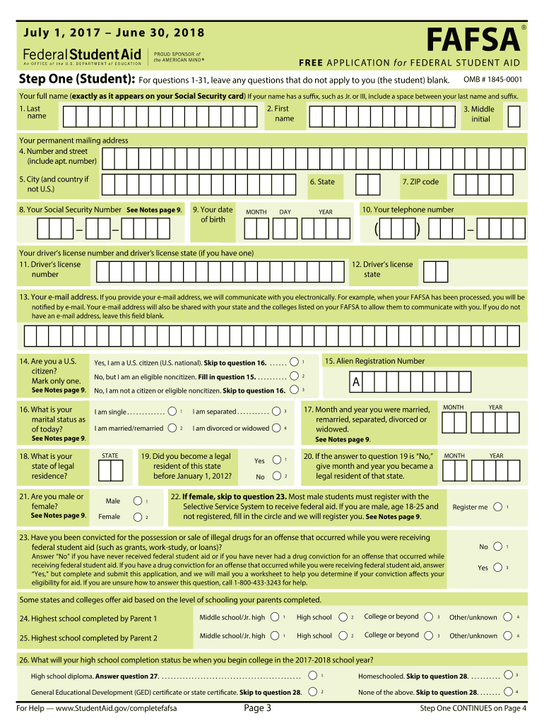
WHAT IS FAFSA?
Free Application for Federal Student Aid
FAFSA completion is necessary for students to receive federal student aid; it is also used by many states (including NC) and colleges to determine student eligibility for state and school aid
Completing the FAFSA is strongly and positively associated with postsecondary enrollment.

Slide 13
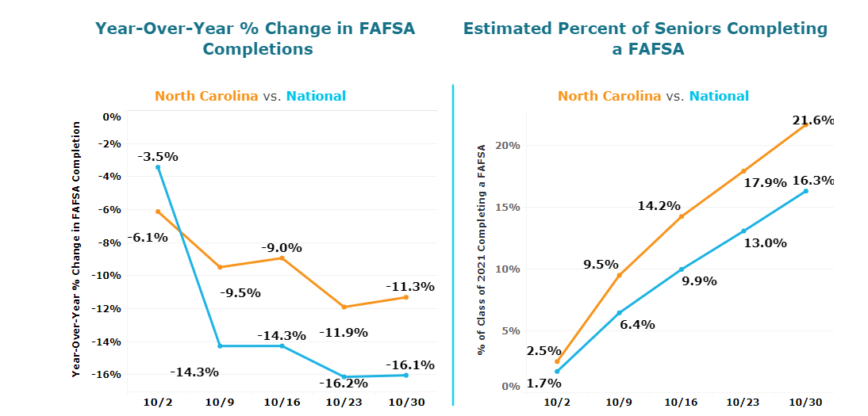
CURRENT NC FAFSA DATA

Slide 14
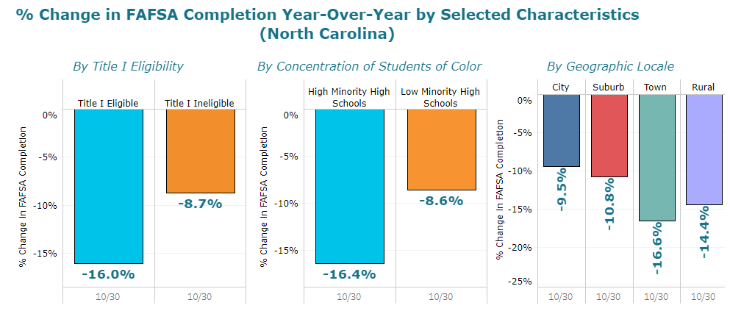
CURRENT NC FAFSA DATA

Slide 15



Tools to Support FAFSA Completion
First in FAFSA Tracker
First in FAFSA Challenge
Finish
the FAFSA
Raise awareness, shine a light on the data and help to close the gap between submissions and completions.

Slide 16
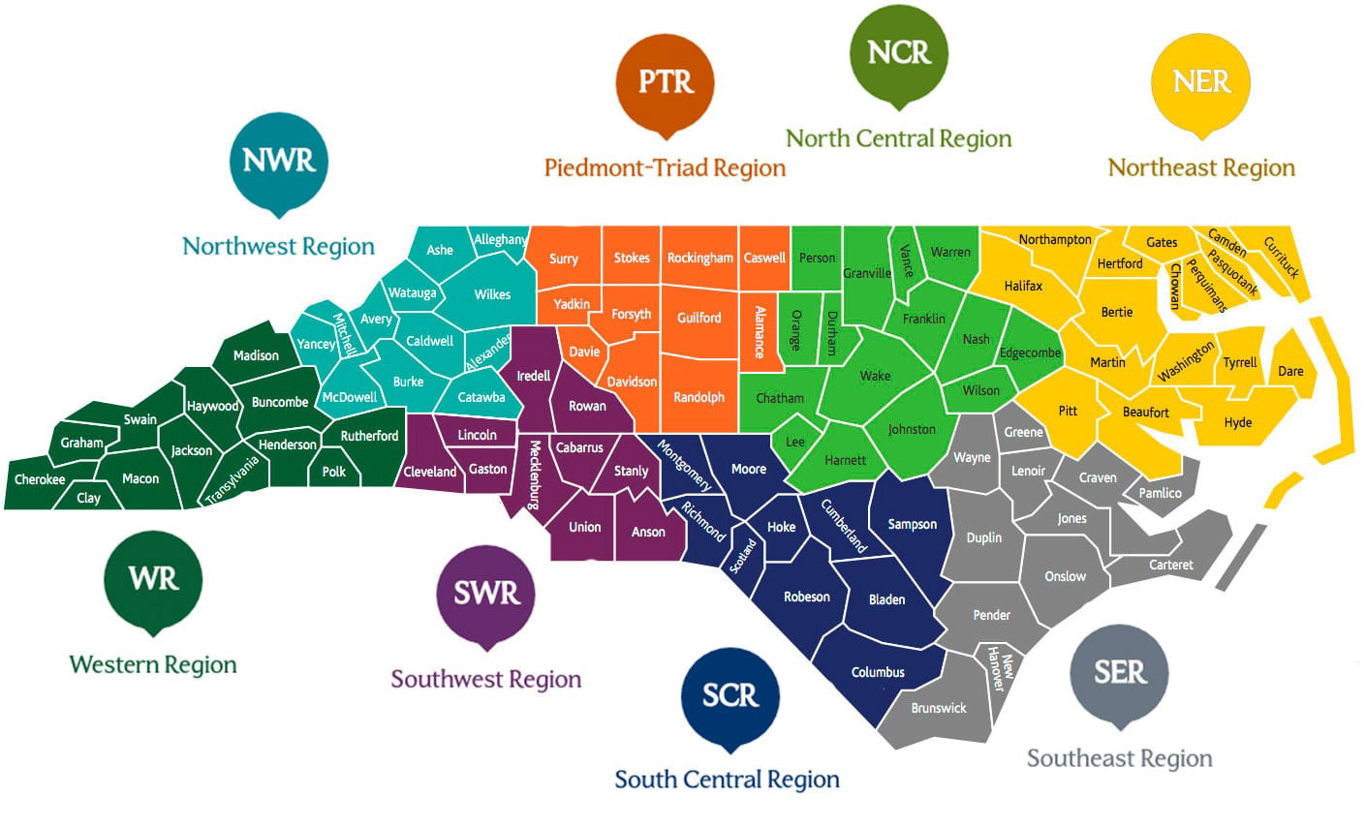
FAFSA Target Districts
Mooresville Graded School District
Kannapolis City Schools
Whiteville City Schools

Slide 17
DISCUSSION
Q&A

Slide 18
JENI@MYFUTURENC.ORG  MELISSA@MYFUTURENC.ORG
Thank you

