Slide 1
DAVID MEADS
Governor's NCWorks Award of Distinction for 2020 in the category of Outstanding Young Adult
Northeastern Workforce Development Board’s NextGen Participant

Slide 2
David’s Journey
High school dropout
Enrolled at College of the Albemarle (COA) for his GED.
Referred to an NWDB NextGen Career Advisor.
Oriented to what the NCWorks NextGen Youth Program
Navigated the Traitify Assessment tool where he was able to see if his personality would match his career interests
His personality matched extremely with with his career interest to become a Welder, which is a very promising career field in the NWDB region.

Slide 3
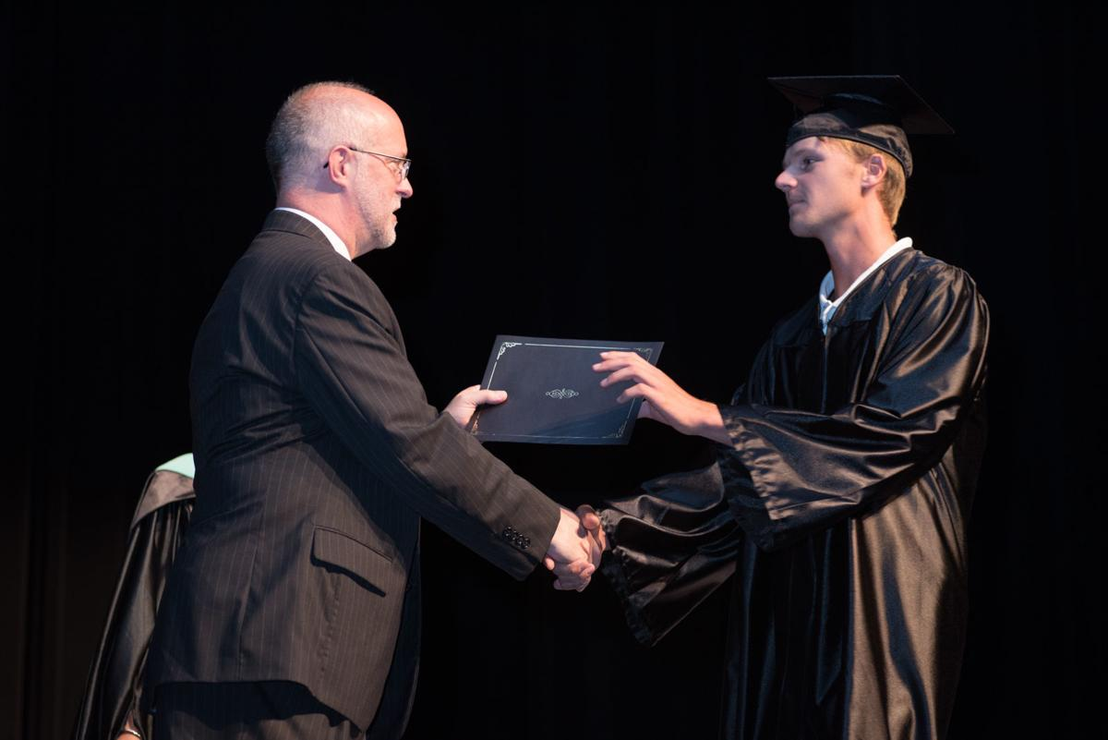
David’s original challenge was accomplished:
GED
C
O
A

Slide 4
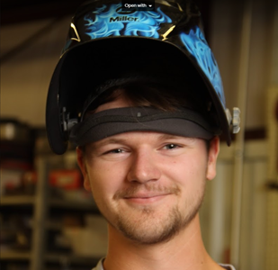
David’s Method
What methods did David use to become an Outstanding Young Adult?
Enrolled at College of the Albemarle for Post-Secondary Education in the Welding Program
Earned a 4.0 GPA and was on the Dean’s List
Earned a Basic Welding Certificate
[Each participant uses different methods of Successful Completion]

Slide 5
This is the most important takeaway that everyone has to remember.

Slide 6
The
data
Comprehensive guidance and counseling
NENC Career Pathways - Traitify
Dropout recovery services
Occupational Skills Training
Supportive Services
Financial literacy & LMI - O*Net Online
Postsecondary preparation and transition service
Paid Work Experience
On The Job Training
35
Services David was able to utilize during his NextGen Participation
22

Slide 7
Why I chose this Outstanding Young Adult
David Meads is a very humble and enthusiastic young adult and...
Has always gone above and beyond to meet the NextGen expectations
Consistently participated in his one-on-one meetings with myself
Followed his Individual Employment Plan (IEP), making it his own by strategizing on specific goals and keeping it current
Engaged himself in the NCWorks Career Center services (NCWorks Online, Resume Builder and Labor Market Information tools)
Attended Career Cafés offered by NCWorks NextGen Staff alongside his peers

Slide 8
Governor’s Award

Slide 9
Aha! David’s Accomplishments
Governors Award of Distinction
Employment with Hoffer Flow Controls Inc.

Slide 10
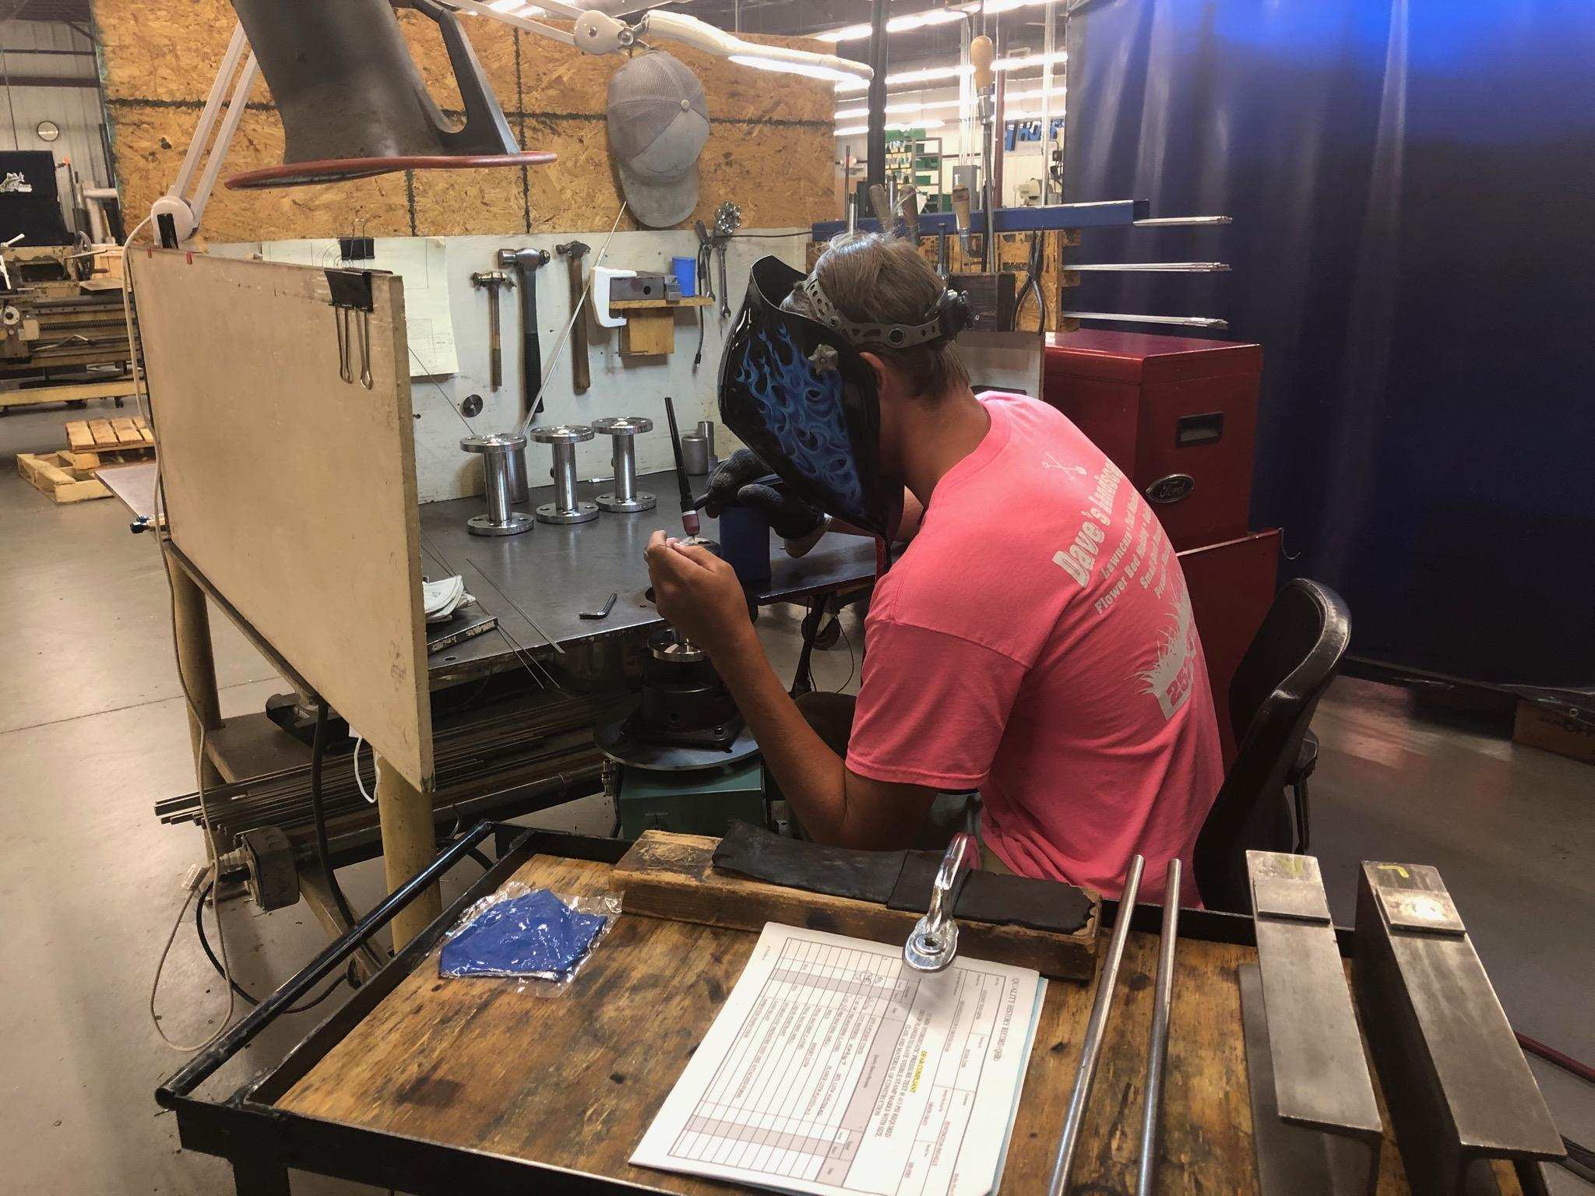
David’s Outcome
After 6 months of OJT with Hoffer Flow Controls Inc., David will continue on with Hoffer Flow Controls Inc. as a Welder and develop his Occupational Skills

