Slide 1




administrator training
Notes:
In NENC, we utilize Traitify with students beginning in middle school through high school and into community colleges. We also use Traitify with adults who are looking for a career change or who just want more information about how their personality and career goals match. Many of our partners in the literacy and language communities use this platform with ease. We are excited that you are taking the time to learn more about administering this great visual personality assessment. While this training was built for partners in the NENC Career Pathways region, people from other parts of the state who have access to Traitify accounts may find some of this information useful as well.

Slide 2

OBJECTIVES
Understanding the science behind Traitify
Learning the personality types
Knowing how Traitify works from a user perspective
Reviewing tips for analyzing career matches
Learning about customized information for our region
Understanding administrator actions
Recognizing learning resources available via Traitify
This Photo by Unknown Author is licensed under CC BY-NC-ND
Notes:
First, please note our objectives for this training. Hopefully by the end, you will understand and recognize each of these objectives. Even if you have been administering Traitify for a while already, we hope that you will still find some new insights and information through this training. Let’s begin…

Slide 3
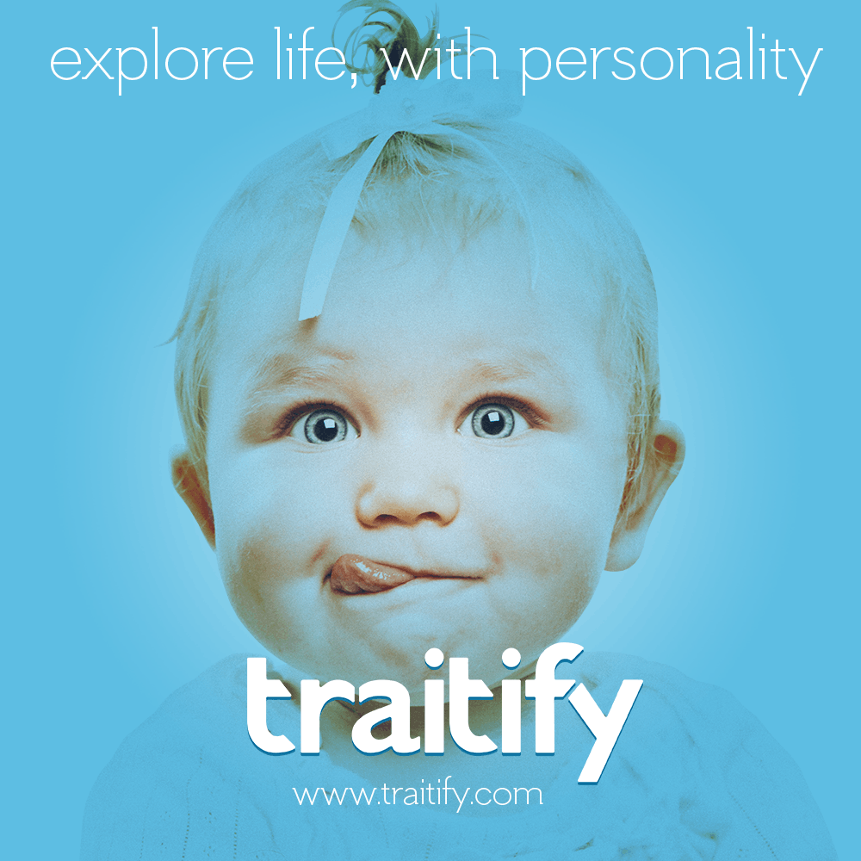
What is Traitify?
Traitify unlocks the potential of psychology and big data through a visual personality assessment that is quick, accurate, and accessible to businesses and entrepreneurial developers.
Built for the modern attention span
Designed for everyone
Backed by rigorous science
Notes:
What is Traitify? Where did it come from? Is it scientifically backed?
I’m so glad you asked!
Traitify's patented assessments collect personality data using human interaction with images. They validate against the Big Five and Holland Interest models and candidates can complete these tests 30x faster than traditional assessments.
Traitify is…
Built for the modern attention span:
90 second test = 96% completion rate. Test-takers answer quickly by simply responding to a series of images making a "me" / "not me" choice.
Designed for everyone:
Images make Traitify mobile friendly for those who don’t have access to large screen devices, more accessible to imperfect readers, and easier to translate. They are EEOC compliant and are available in over 10 languages and counting.
Backed by rigorous science:
They've run dozens of multi-month studies with 10,000s of participants so far. And we’ll do so continuously to ensure reliability and validity that stands up to the scrutiny of our scientific peers. The science is well-documented.

Slide 4
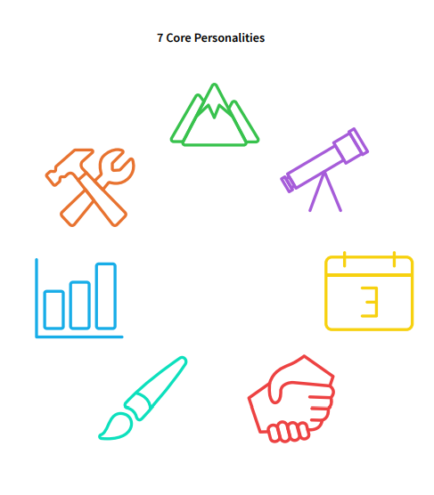
CATEGORIES
The Traitify Psychology Team identified the seven major personality categories that compose human personalities.
By combining these personality categories at different levels, a full picture of a person’s overall personality structure can be observed.
Notes:
The results of this quick visual personality and career assessment result in personality blends, which help us to see a fuller picture of an individual's personality. Blends are the two most dominant personality categories for each individual. This is determined by identifying the highest match percentage of each category by measuring the traits and preferences indicated by the individual’s selections. Each combination of two personality categories describes a general set of personality characteristics held by individuals that fit within that blend.
Now, we will go through the seven personality categories one by one. While doing this, take a few minutes to think of someone you know personally who embodies that personality category. You don’t have to know their actual Traitify blend, but by looking at the attributes of that personality, you can likely imagine someone you know who has those traits. Connecting the category to someone you know can help you to better understand the characteristics of the different personality types.
For example, when I think of a naturalist, I think of my cousin who is a trained herpetologist (meaning he plays with snakes for a living) and a botanist. Even as a kid, he was always outside and loved hunting and fishing. Even though he has never taken a Traitify assessment (to my knowledge) I am 99% percent sure he would be a naturalist. Speaking of naturalists, let’s move on.

Slide 5

NATURALISTS
are drawn to preserve, conserve and protect the natural environment, often working with plants and animals to complete tasks
nature lovers, they like to experience the world outdoors
orderly, functional, efficient, constructive and solid
excel at working as one with the natural environment
Notes:
Naturalists...are attached to the natural world, frequently working with plants and animals in their environment. Often nature lovers, they like to experience the world outdoors. They are committed to preserving and protecting the planet and its natural resources. Serene, earthy, efficient and solid, they excel at working as one with the natural environment.

Slide 6

ACTION-TAKERS
• are goal-oriented
• use manual and physical skills, working with technology or machinery to complete tasks
• drawn to work that involves a specific skill-set and a concrete task
• athletic, handy, practical, systematic, applied, and “down-to-earth”
• excel at solitary, goal-oriented work and “getting the job done”
Notes:
Action-Takers...are hands-on doers. They use manual and physical skills, working with technology or machinery to complete tasks. Often there is an athletic aspect to their work. They are handy, practical, systematic, applied, and 'down-to-earth.' They are drawn to jobs that involve a specific skill-set and a concrete task. They excel at solitary, goal-oriented work and 'getting the job done.'

Slide 7

PLANNERS
• create systems to follow, and enjoy working with data, detail, words and numbers
• great at manipulating data and love procedure and routine
• methodical, precise, and detail-oriented
• often found in office settings and excel at completing detailed work in an organized manner
Notes:
Planners...are the detail people. They are methodical, precise, and detail-oriented. Planners create systems to follow, and enjoy working with data, detail, words and numbers. Great at manipulating data, they love procedure and routine. Often found in office settings, they excel at completing detailed work in an organized manner.

Slide 8

VISIONARIES
• are charismatic, innovative and like to work with others in a “take charge” capacity
• love to take risks, make changes and set trends
• ambitious and energetic
• often in positions of prominence in business and the public eye and excel at taking charge and gaining the confidence of others
Notes:
Visionaries...are pioneers. They are great convincers and like to work with others in a 'take charge' capacity. They love to take risks, make changes and set trends. They tend to be ambitious and energetic. Visionaries are often in positions of prominence in business and the public eye and excel at taking charge and gaining the confidence of others.

Slide 9

MENTORS
• are caring and people-oriented
• have excellent communication skills and are most fulfilled when assisting or working directly with others to improve a personal or societal situation
• patient and compassionate and work best in a group or on a team toward a common goal
• excel at working with others to help them learn and grow
Notes:
Mentors...are people-oriented. They have great communication skills and are most fulfilled when assisting or working directly with others to improve a personal or societal situation. Mentors are patient and compassionate and work best in a group or on a team with a common goal. Mentors excel at working with others to help them learn and grow.

Slide 10

INVENTORS
• are creative, contemporary, and “out of the box”
• use themselves and other medium, often various forms of the arts, to communicate and interact with the world
• eclectic, expressive, introspective
• excel when they are “lost in their work,” completely engrossed in a creative project
Notes:
Inventors...are creative. They take a contemporary, 'out of the box' approach to work and life. Inventors use themselves and other medium, often various forms of the arts, to communicate and interact with the world. Inventors excel when they are 'lost' in their work, completely engrossed in a project.

Slide 11

ANALYZERS
• are inquisitive, have a keen eye and an experimental nature • delve, study and look deeply for information
• figure out problems and search for the facts, often in a laboratory environment
• excel at going beyond the surface toward uncovering information and discovery
Notes:
Analyzers...are inquisitive. They delve, study and look deeply for information. They have a keen eye and an experimental nature. Analyzers use these capacities to figure out problems and search for the facts, often in a laboratory environment. They excel at going beyond the surface toward uncovering information and discovery.

Slide 12
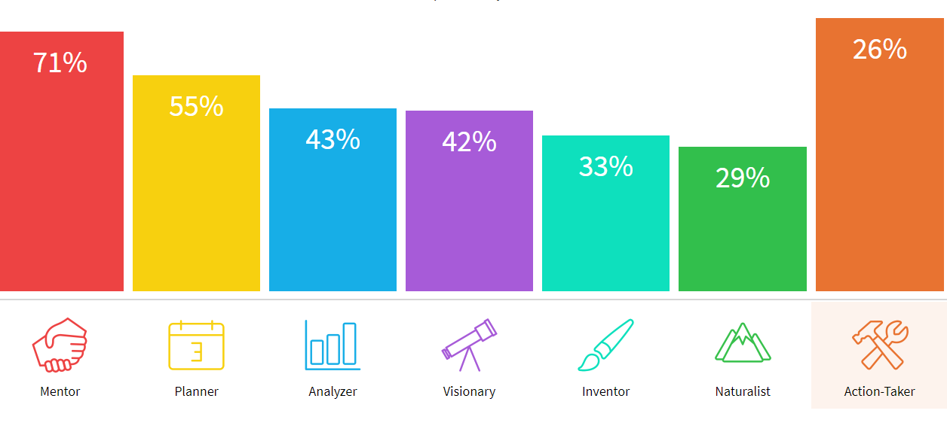
Notes:
Learning as much as we can about personality traits helps not only the students or job seekers we work with, but it helps in our personal lives and with colleagues also. Take some time to review the personality manual found in the resources section (we’ll go over where to find that later) and learn more about the personality blends and which work best together, as well as information about the best work environment for each blend.
When discussing the career personality results with an assessment participant, one should make a point to have the individual understand that the description given for the personality blend is intended to describe general personality characteristics that are intended to be an accurate representation of all individuals within that personality set. As the Traitify program considers the full breakdown of all personality characteristics, it is important to encourage them to think beyond the basic description and understand the fact that the assessment takes full conceptual consideration. When explaining the individual’s breakdown of results, it is also important to observe the proportionate breakdown of their personality categories.
Remember that like all assessments, Traitify is just one piece of data you are gathering to create a more holistic view of the person you are working with. There are many free personality and career assessments on the internet and through websites like NCCareers.org and CFNC.org. Having a student or job seeker complete multiple assessments and synthesizing information and recommendations from all sources can be very helpful while they are in the phase of assessing themselves.

Slide 13
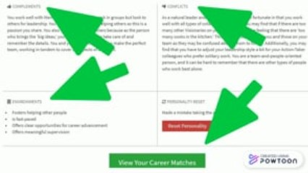
Notes:
Have you completed the Traitify assessment already? If not, please take the 90 seconds to complete it as soon as you’re done with this training. Remember that you can complete the assessment from your mobile phone, tablet or computer. Make sure to jot down your password somewhere, as you will need it to login as an administrator also.
Our friends at Turning Point Workforce Development Board created a great set of powtoon videos to provide information and instructions that can be used by students or job seekers who are planning to take Traitify. Let’s watch the first one now…
https://vimeo.com/447880231

Slide 14
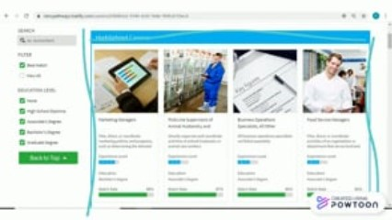
Notes:
Now that you’ve got the basics of a user experience in Traitify, check out a deeper dive into the information that is available.
https://vimeo.com/447882616

Slide 15
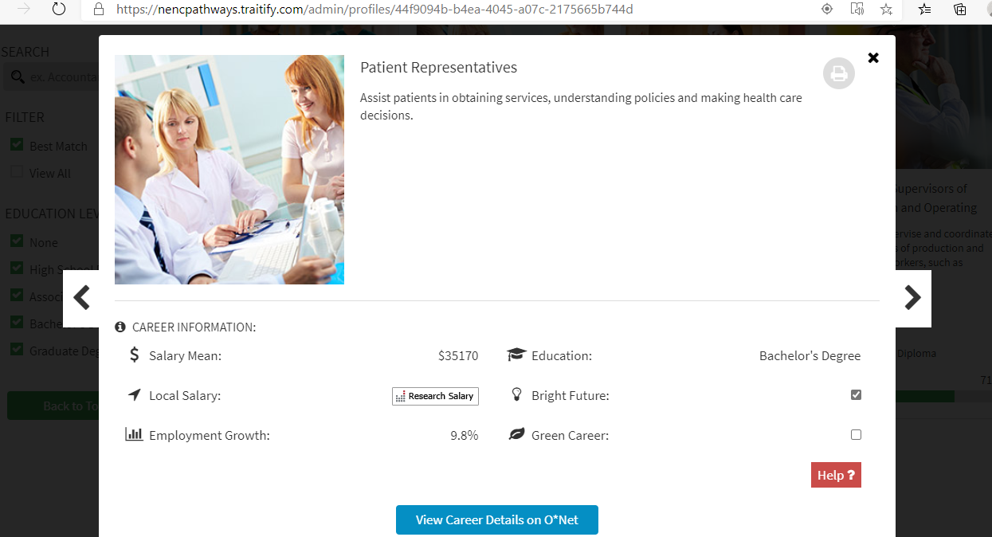
Notes:
Let’s go a little deeper into the career matches and talk about some of the things you just saw in that video. This screenshot should be what you see when you first click on a specific career. In this case, I chose Patient Representative as the career. Note that you can print information on this career by clicking the printer icon in the top right corner. Under career information you will see the national average for salary and a link to research local wages.
I love to point out the employment growth because it’s really important to know whether the career you are interested in is expected to continue growing. If the number is negative, you may want to steer your student or job seeker in a different direction, or at least do a little more research before they decide to go into that field. The Bright Futures and Green Careers checkboxes let you know if this career falls in those categories. Click the red help button to learn more about what they mean.
Clicking the blue button will take you directly to information about that career in O*Net. This is a great place for users to find information to complete the profiling one career handout (which I’ll show you how to get to later) and really for getting all the dirty details about a specific career.

Slide 16
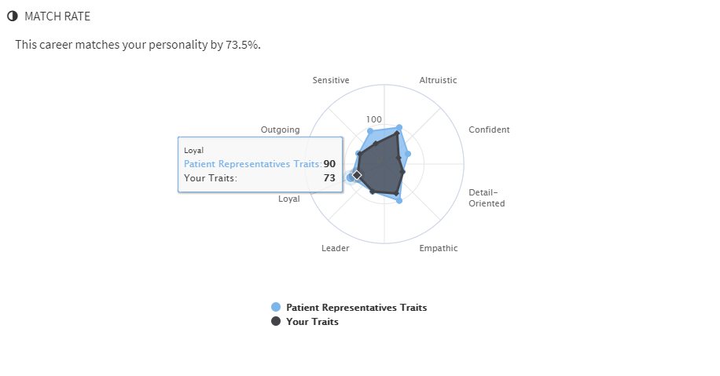
Notes:
I also like to point out the match rate for specific careers. This tool takes your traits and overlays them on the top traits for that career according to O*Net. By hovering over each trait, you can see how closely matched you are. For example, a patient representative should be at about a 90% rate for loyalty where I am at a 73%. That doesn’t mean that I wouldn’t make a good patient representative but it does show area for improvement if I choose to follow that career path.

Slide 17



Notes:
One of the coolest things about Traitify is the ability to customize it. The videos pointed out our “highlighted careers” blue box section on the careers page. This section allows us to highlight all of the careers that a person is matched with which fall under one of our four career path. Any careers falling outside of those pathways can be found under the blue box.
Also, we have the ability to include information and links to local employers. As an administrator, one the things we ask of you is to let us know if there is an employer you work with who hires for a career that we have not yet linked in Traitify. This information will help us stay up to date and keep our careers relevant for Traitify users.
The links to O*Net are essential for truly understanding what you need to know about each career. Each of the careers listed on the Occupational Information Network (O*NET) database was categorized by assigning a number of traits and preferences that correlate to the traits and preferences assigned to the personality categories and slides in the assessment process. Using the Traiify matching algorithm, a correlation is made between the career traits and preferences, and the personality traits and preferences which determine the order of the recommended careers.
Finally, the link to NCWorks allows for real-time employment information specific to your local area. This link is great for current job seekers and students alike. For students, seeing that some of the careers they are interested in are available locally can help them think more thoroughly about their options.

Slide 18
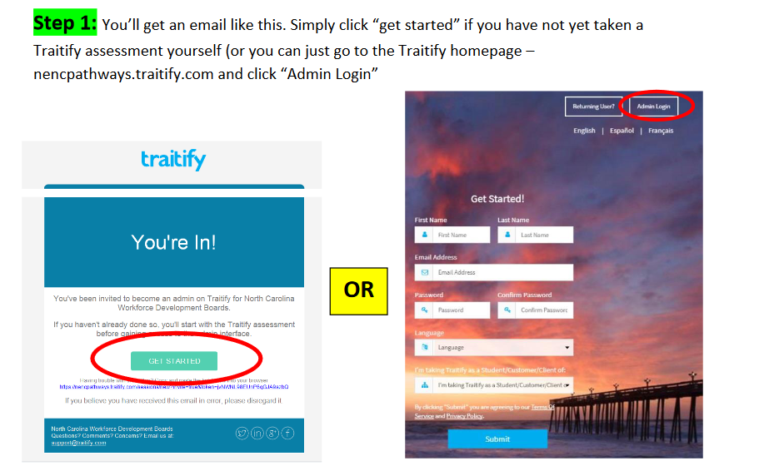
Notes:
Now, let’s go over some of the tasks you will need to know about in order to administer this platform. When you visit the NENC Career Pathways Traitify website, always make sure to look for our logos to be certain you are in the right place. If your student or job seeker goes to a different Traitify site, you won’t be able to see their results.
If you have not already accepted your invitation to become an administrator, this is a screen shot of the email you will receive. You must click “Get Started” and then you should be redirected to the website where you can choose “admin login.” You will use the same email and password you originally signed up with.

Slide 19
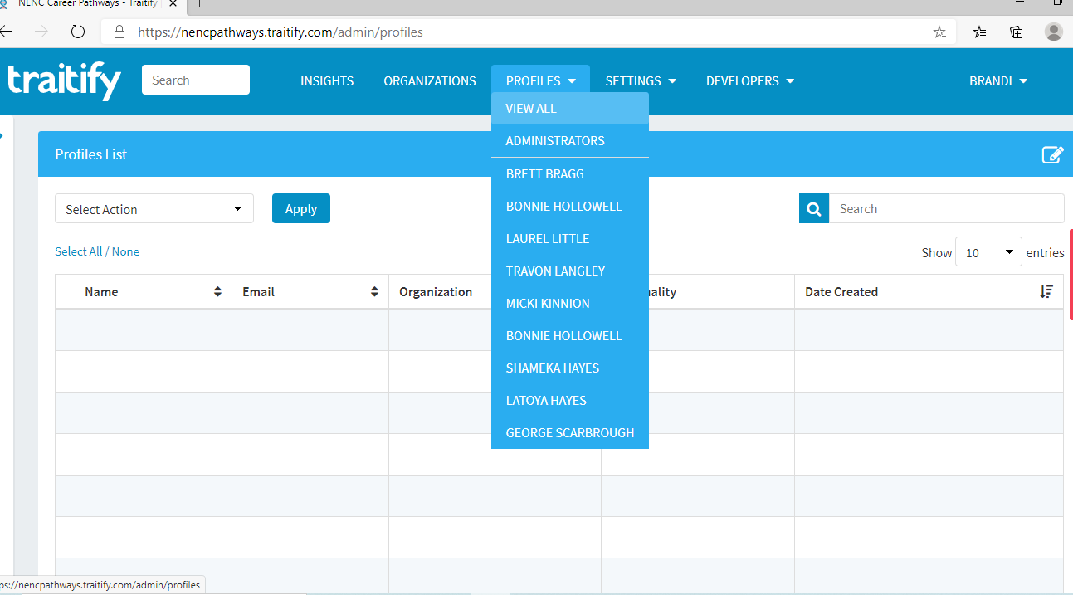
Step 2:
Click “Profiles” then “View All”, then you can search by first or last name, or email address, in the search box on the right.
Notes:
Next, you will want to learn how to look up the students and/or job seekers you are working with. Remember that if someone completed Traitify through a different partner you, as an administrator, can still access their information.

Slide 20
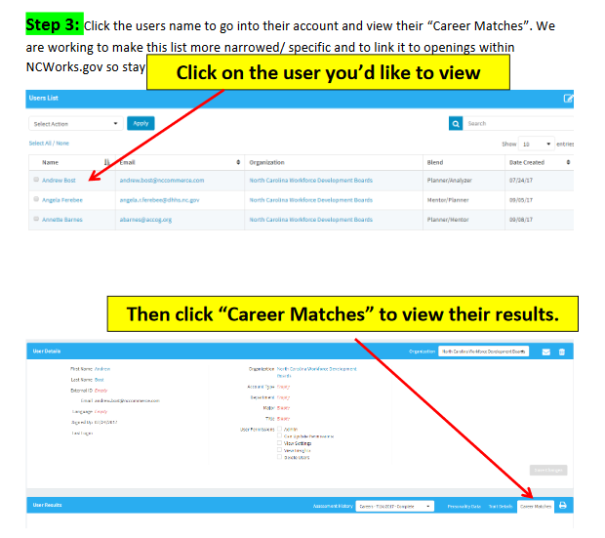
Notes:
Once you have found the person whose information you want to view, you can look at their personality traits or view their career matches. Also, you can email results to them, or to you, by clicking on the envelope icon and you can print results by clicking the printer icon.

Slide 21
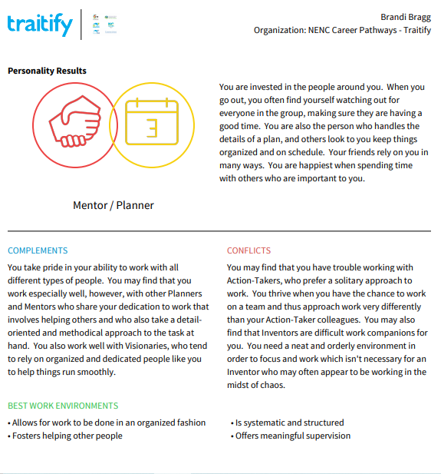
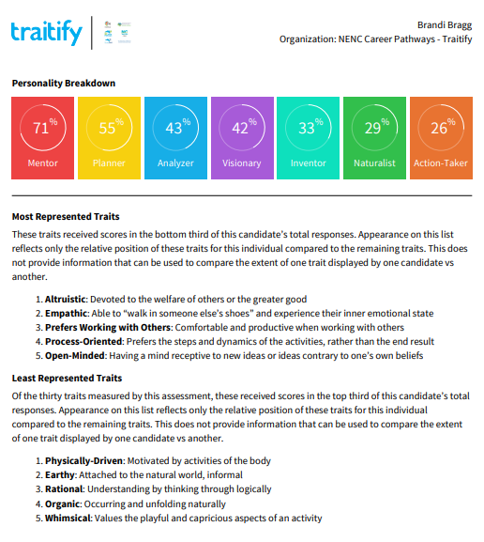
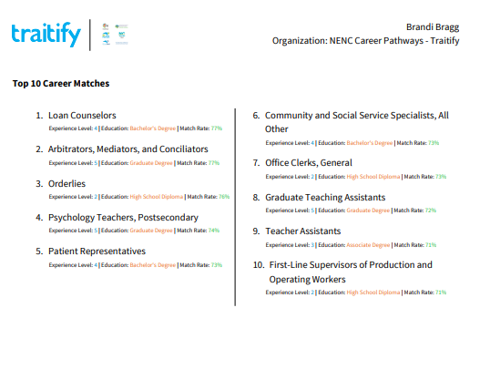
Notes:
One of the improvements Traitify has made over the years is the ability to print a 3 page summary for each user. Notice that the summary includes information on personality types the user works well with, best work environments, personality breakdown, a synopsis of most and least represented traits as well as the top 10 career matches. This is what you will get when you click the printer icon. Remember that you can also save it as a PDF to include in a customer or student digital file. I highly suggest printing this for the user so that they have something tangible to review and reflect on.

Slide 22
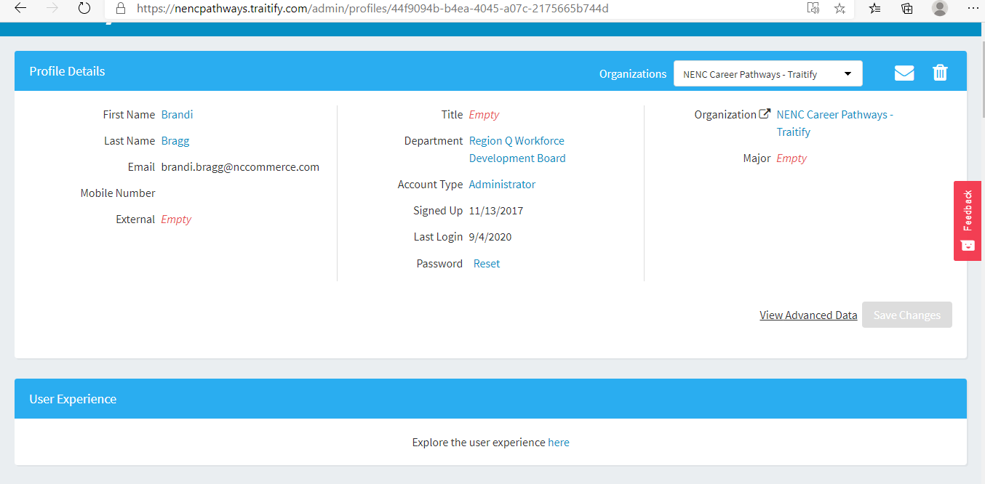
Notes:
One of the functions you will probably use the most is resetting the password for users who have forgotten theirs. Just visit their profile and click “password reset” which the purple arrow is pointing to. Traitify will then email the user to have them reset the password. Note that you can also see the last time someone logged in to their account from this screen. A word of caution, PLEASE DO NOT ADD ANY INFORMATION THAT IS NOT ALREADY IN THE PROFILE DUE TO PRIVACY LAWS.
Also, note the “Explore the user experience here” button at the bottom of this screen. When you are looking at Tratify through the Admin portal, you can see more information than a user would. If you want to know what the user is seeing, this is where you can go. This can be helpful if you are troubleshooting an issue with a student or job seeker, or if you are asking them to do something and want to make sure they can see the same information that you can.

Slide 23
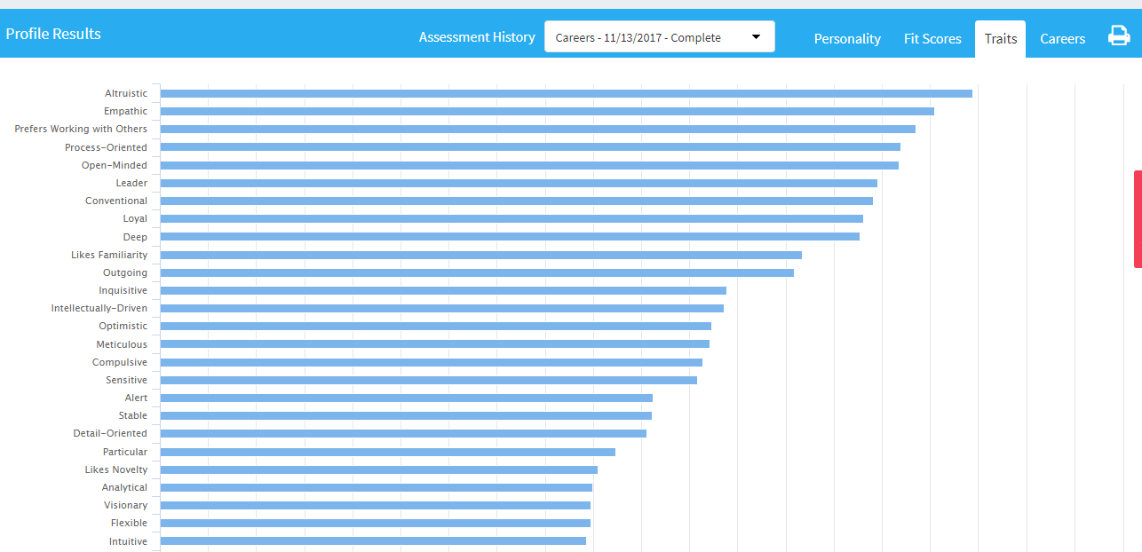
Notes:
Another great feature under profile is the “Traits” tab (see the arrow). This gives you a breakdown of which traits the user is most aligned with. If you hover over each trait, it will provide a definition and the percentage the user matched with the trait. These terms can be especially helpful when developing a resume, and when working with students and job seekers on recognizing their strengths and weaknesses.

Slide 24
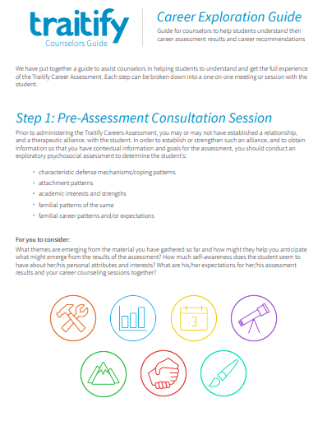
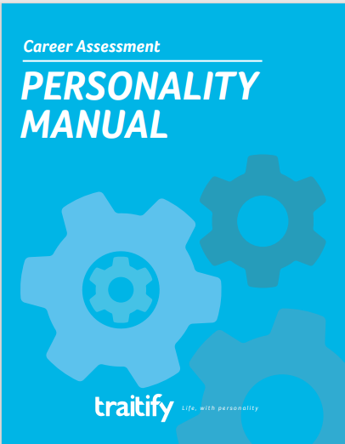
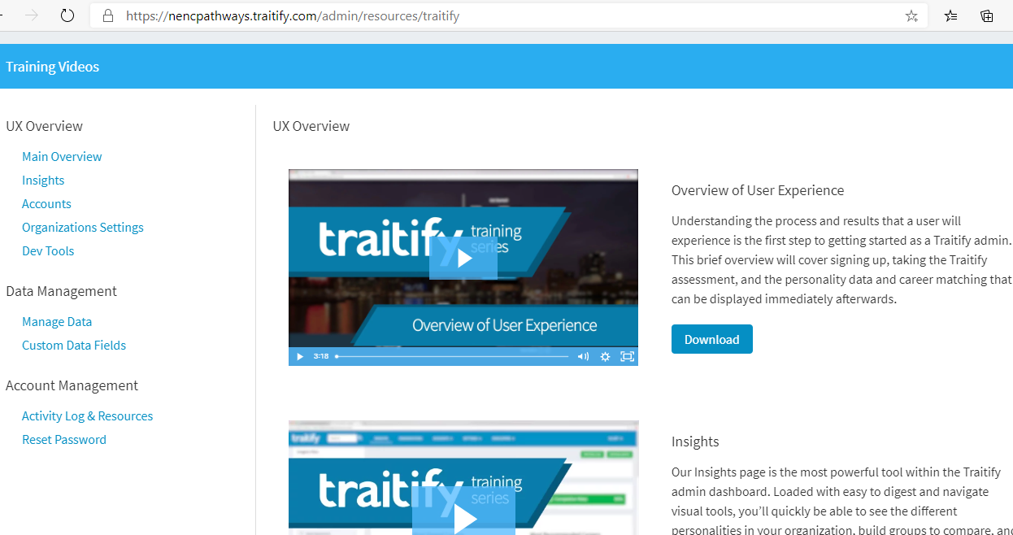
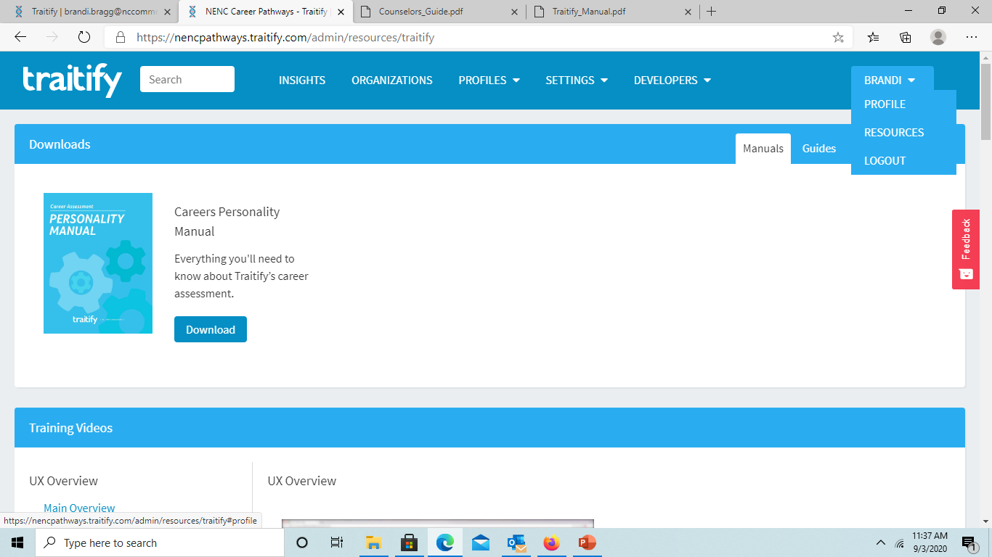
RESOURCES
Notes:
Finally, let’s talk about the resources available through the platform. If you are logged in as an administrator and you hover over your name, you should see an option to click “resources” as in the screenshot on the bottom of this page. This will take you to a section where you can access videos, manuals, guides and handouts.

Slide 25
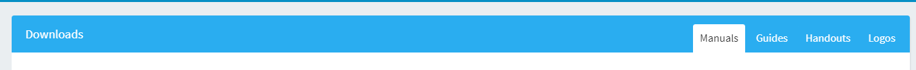
RESOURCES
Notes:
When you click on resources, you will see tabs like those at the bottom of this screen. The personality manual and the interview and communication guides are great, I highly recommend that you review them. But for me, the two handouts on the screen are among the best resources Traitify has to offer. The first handout is a self-discovery guide which helps users to think though their personality traits and begin to think about careers. The second handout is for in-depth career exploration. My suggestion is to have users who are unsure about their career path trajectory complete multiple profiling one career handouts, looking at a variety of careers. Most of the information requested on this worksheet can be found on Traitify or O*Net. The information it covers can be very helpful when considering which career might be the best fit for someone.
Feel free to look through all of the available resources and find the ones that will work best for those you are helping.

Slide 26

Notes:
Thank you for your time and attention during this training. We hope that this will information will help you to utilize this resource to the fullest. If you have any questions, please don’t hesitate to contact Brandi Bragg.

