Slide 1
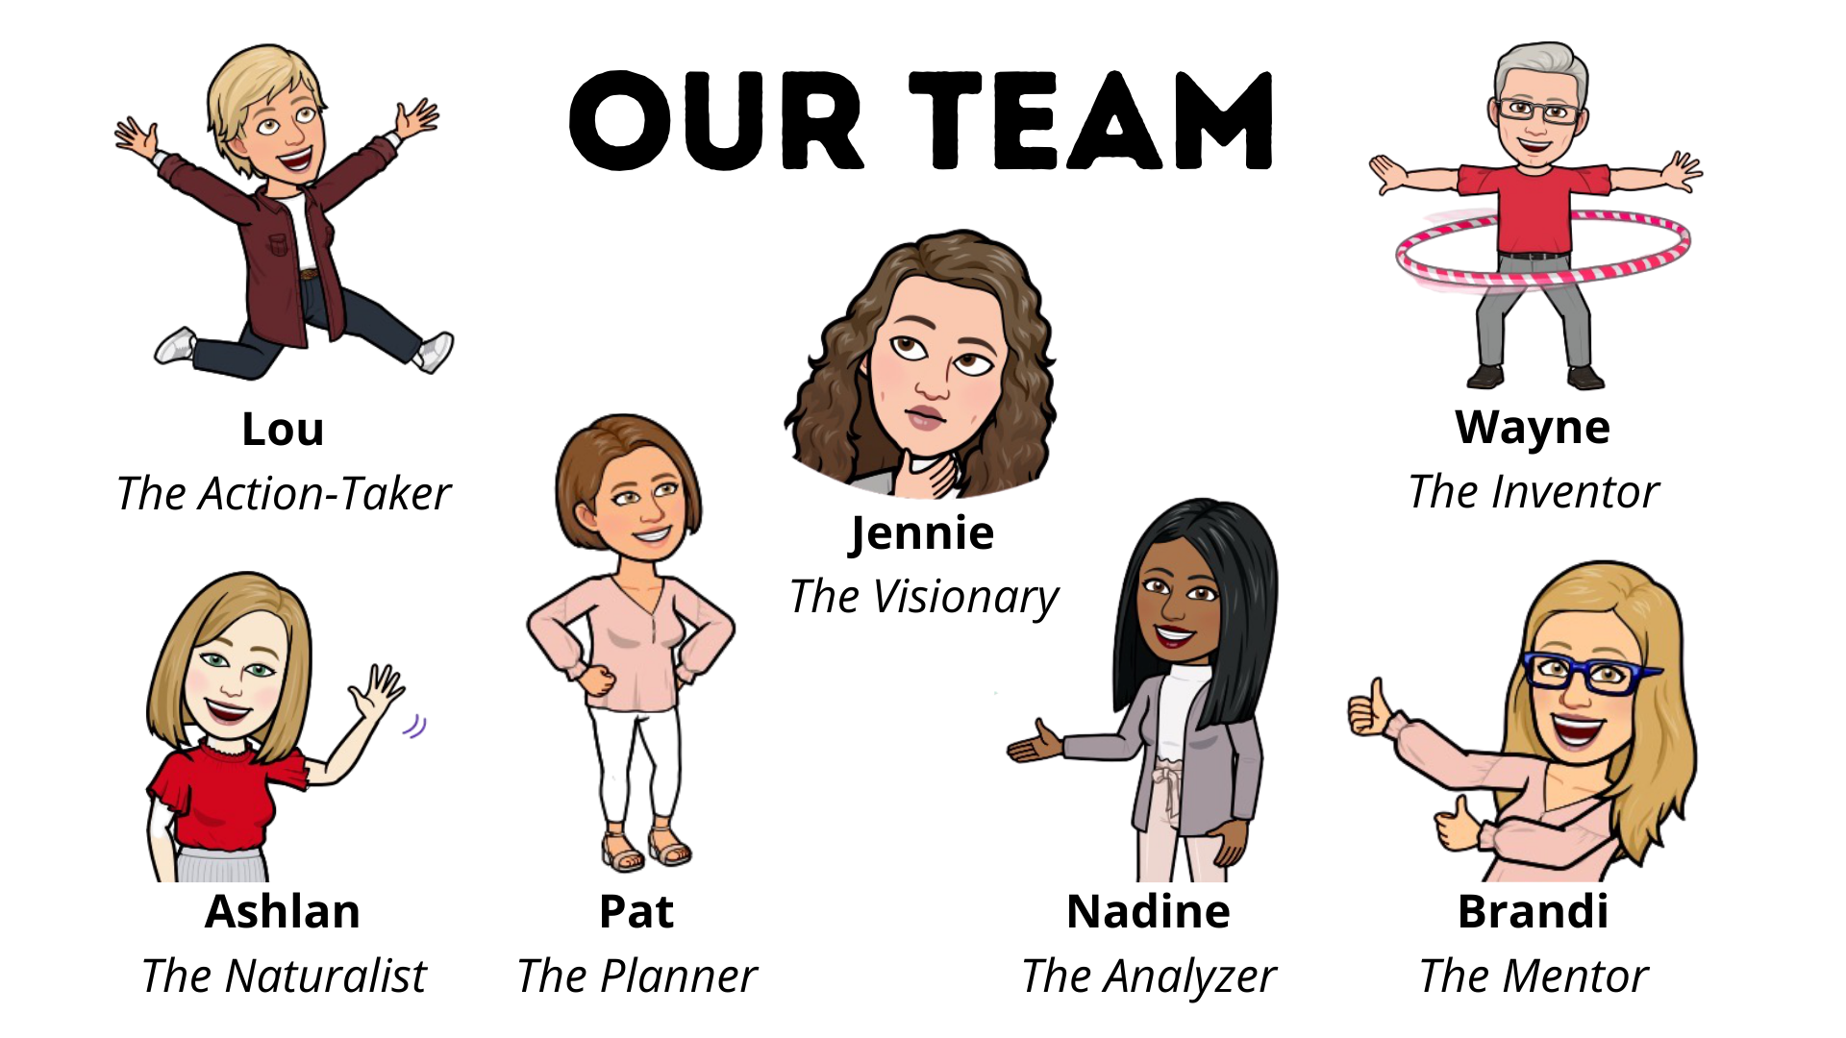
TEAM COLLABORATION AT ITS BEST!
The Rivers East Workforce Development Board Staff

Slide 2
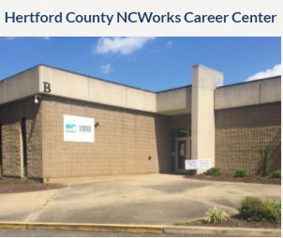
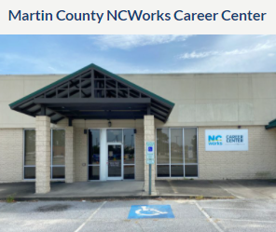
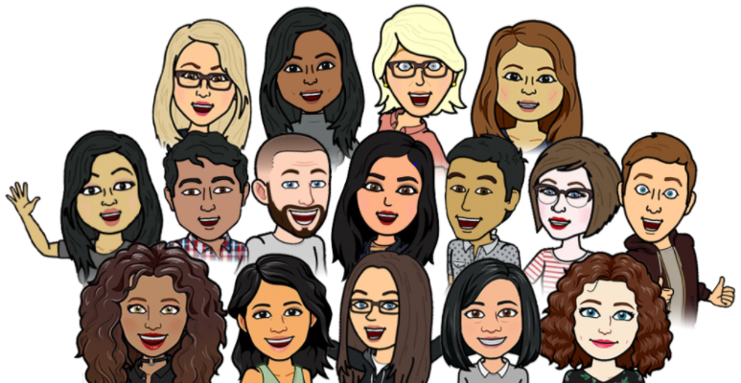
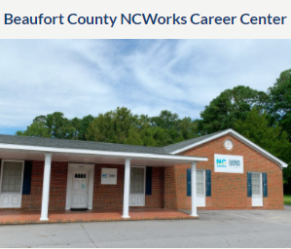
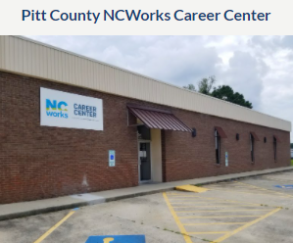

Our Awesome Frontline Staff
NCWorks Career Centers

Slide 3
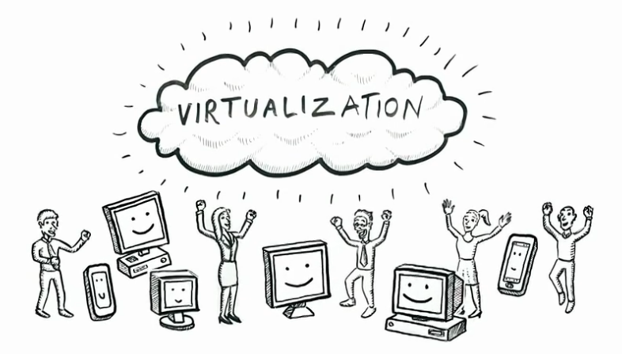
THE BASICS
VTC Software
Canva
Social Media
Other Considerations
Evaluation
Notes:
The Basics - tools needed to stage virtual programs (Brandi & Pat)
VTC software (Zoom)
Canva (free versus Pro)
Social Media (outreach)
Other Considerations
email alias to set up other programs (@gmail.com account)
usernames and passwords on file
Always evaluate; data sources; want to know if we’re reaching our goal(s)

Slide 4
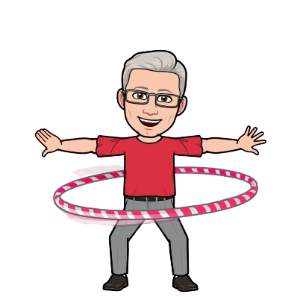
Audience Question #1
What kind of video-teleconferencing (VTC) software do you use?
  Webex
  Microsoft Teams
  Go To Meeting
  Zoom
  Other
Wayne
The Inventor

Slide 5

Audience Question #2
Which software are you using to design your outreach materials?
  MS Word and/or Publisher
  Canva or Canva Pro
  Google Draw
  Adobe Photoshop, Illustrator and/or InDesign
  Other
Lou
The Action Taker

Slide 6

Notes:
Constant Contact (Brandi)
What are people using for communications; Poll Question - how are you staying connected? (Survey Monkey, Doodle)
Newsletters
Surveys
Distribution Lists (staff, partner lists)
Events

Slide 7
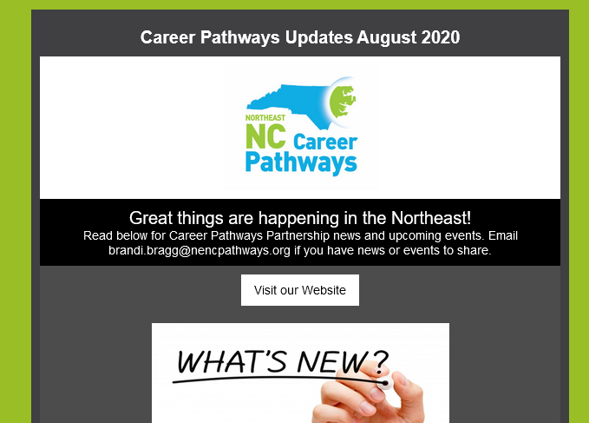
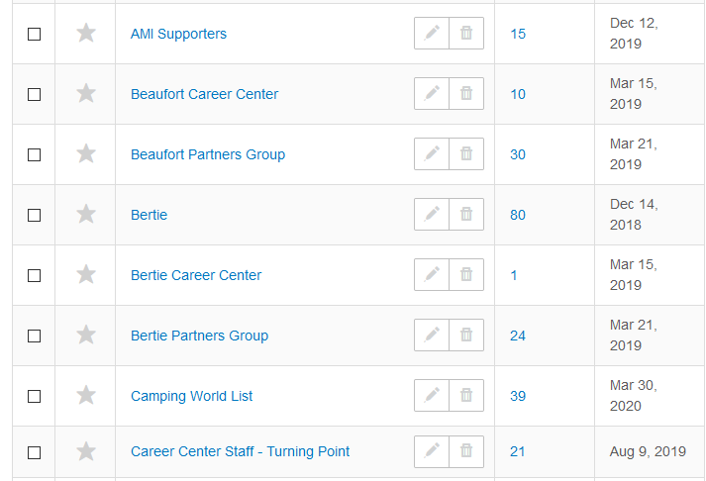

Slide 8

Audience Question #3
How are you surveying your internal and external audiences?
  Emails & distribution lists
  Constant Contact
  SurveyMonkey
  Google Forms
  Other
Nadine
The Analyzer

Slide 9


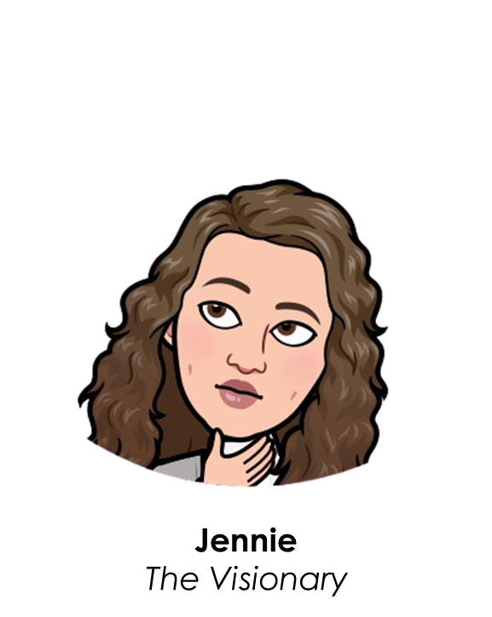
Goals
Improve internal & external communications
Utilize new technologies & equipment for placement into employment & post-secondary education
Skill up career advisors to better meet client needs & expectations
Equip career centers to become “Centers of Excellence”
Continue & expand outreach efforts to underserved clients
Establish & maintain partnerships

Slide 10
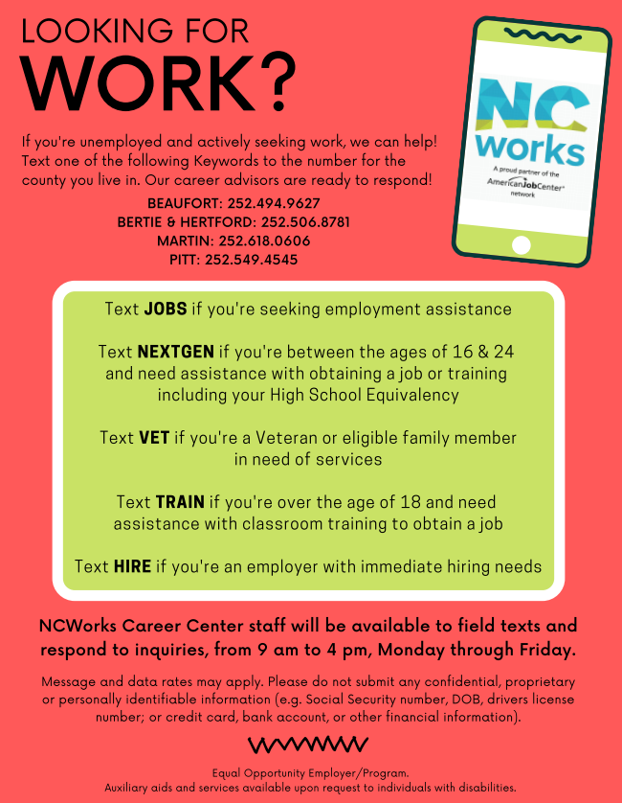

Text Request
Ashlan
The Naturalist
Notes:
Text Request (Pat)
funding

Slide 11

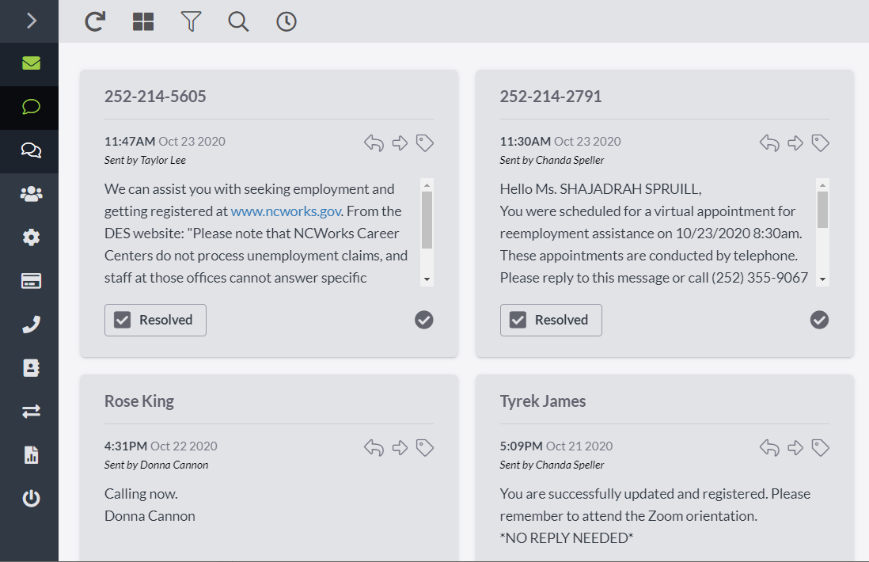

Slide 12
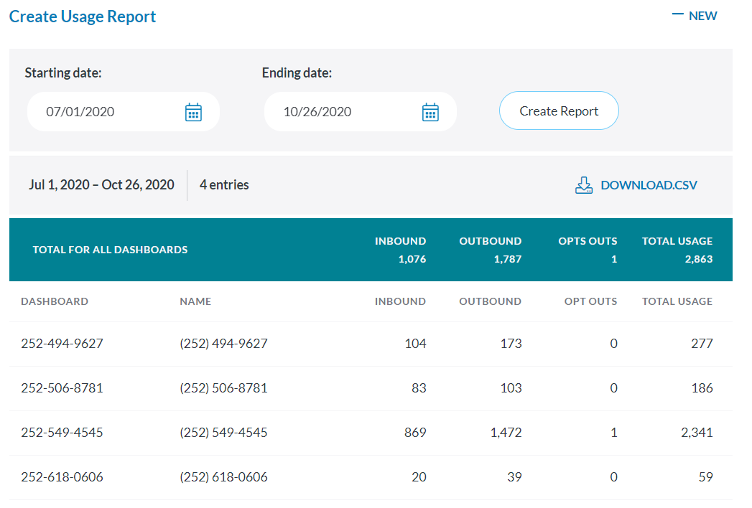
Text Request
Usage Report

Slide 13
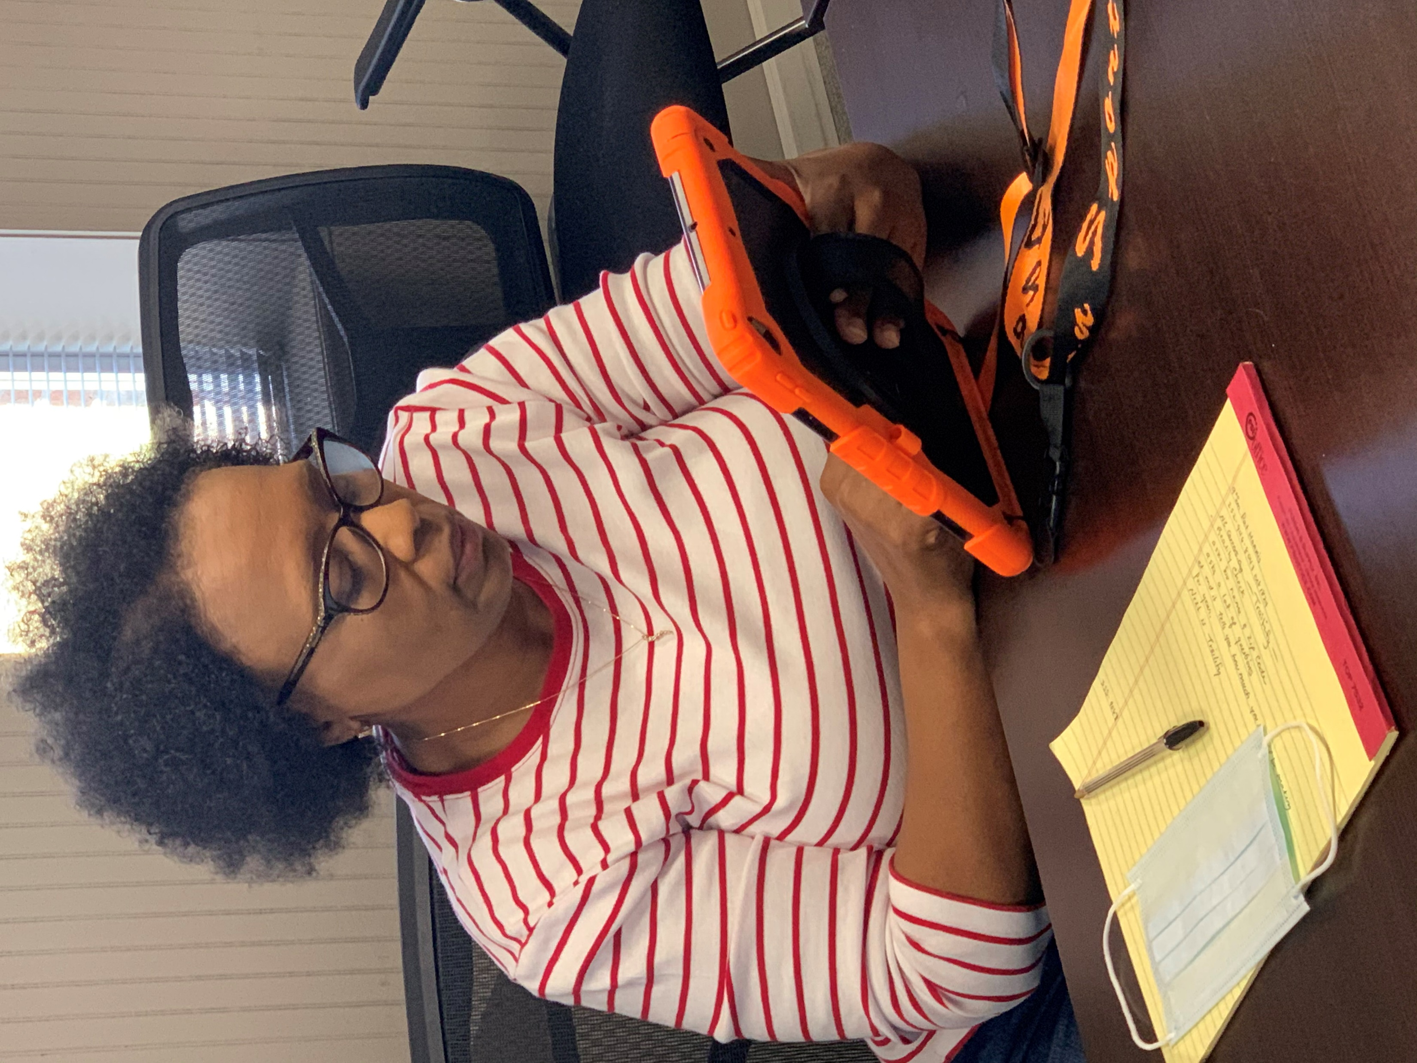

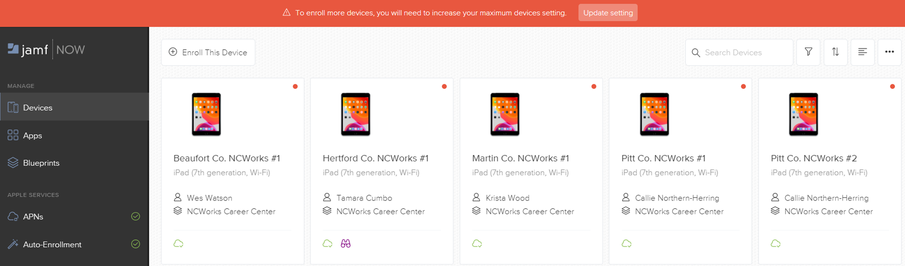
Rivers East Curbside Services
Implement when centers open by appointment only
Mobile Device Manager
Text Request w/new keywords
  Appt
  Here
  Ring

Slide 14
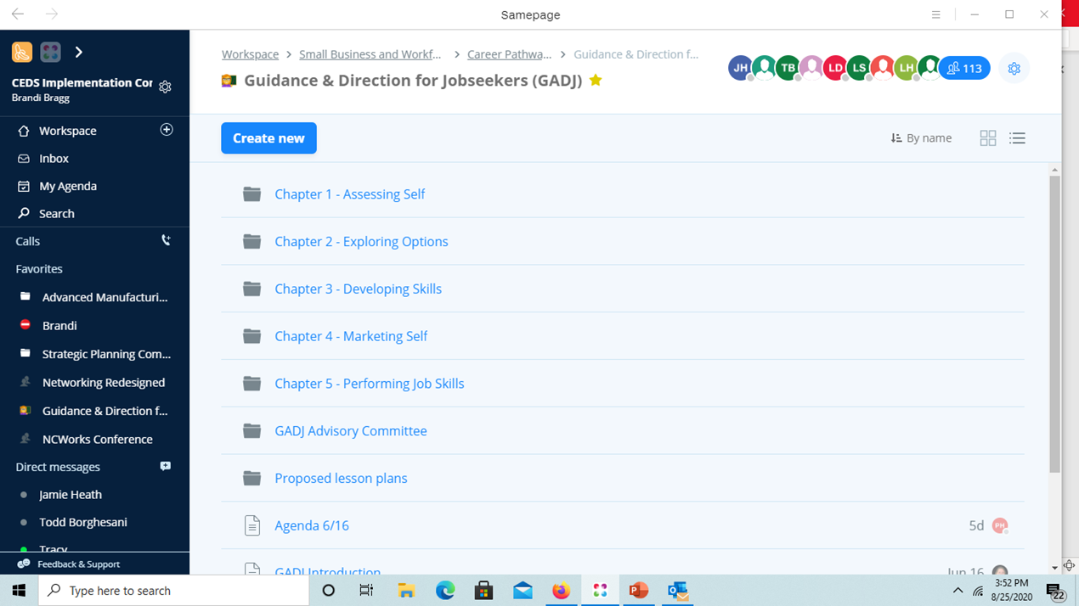
Notes:
Samepage (Brandi)
2-way communication for collaboration
Work with Jamie; idea of how it should work
Screen shots
GADJ

Slide 15
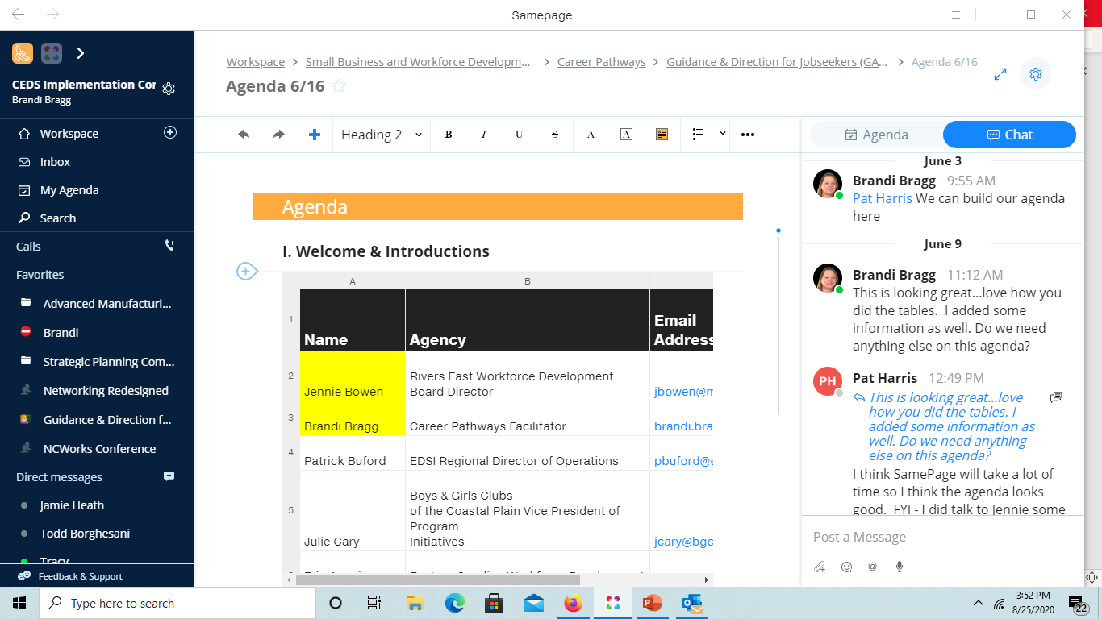
Notes:
Samepage (Brandi)
2-way communication for collaboration
Work with Jamie; idea of how it should work
Screen shots
GADJ

Slide 16

Virtual Career Fairs & Events
Easy Virtual Fair
Hosted 4 events to date
  Healthcare Career Fair, April 7-8
  Advanced Manufacturing Career Fair, May 19-20
  Networking Redesigned (Agency Event), July 16
  Career & Community Resources Fair, Sep. 1-2
Advantages:
  Transportation barriers
  Mobile device friendly
  Reaching new populations (May Fair @ 48% and Sep. Fair @ 42% not registered in NCWorks)
  Exhibitors and participants communicate through live chat feature
Disadvantages:
  Those dependent on public computer and internet access (e.g. public library) cannot utilize
  Intimidating to those new to virtual events

Slide 17
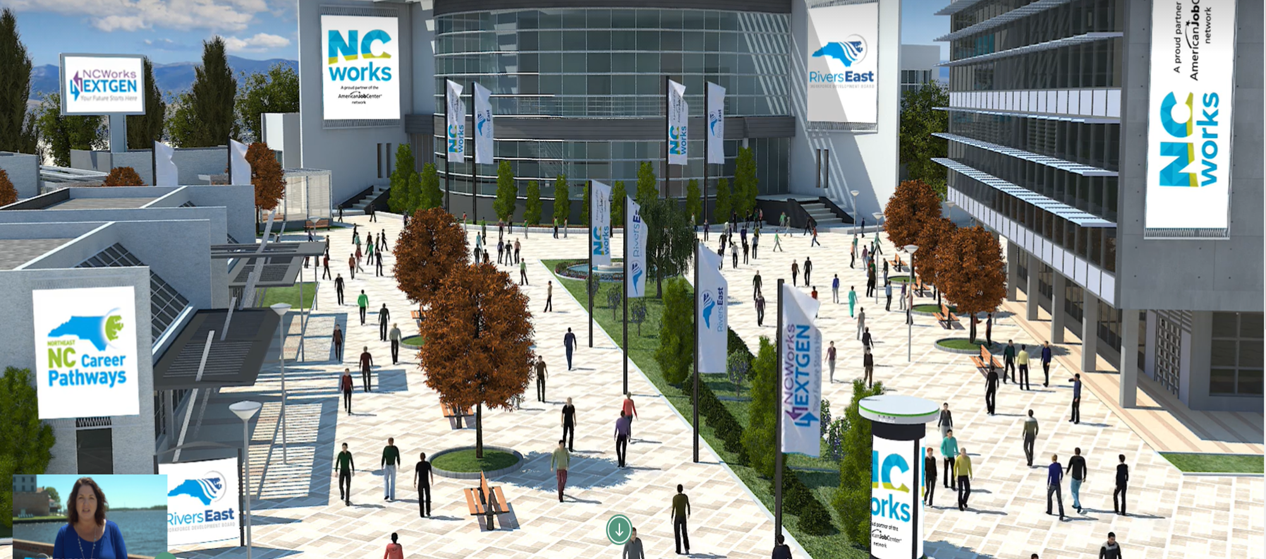
Rivers East Virtual Career & Community Resources Fair

Slide 18
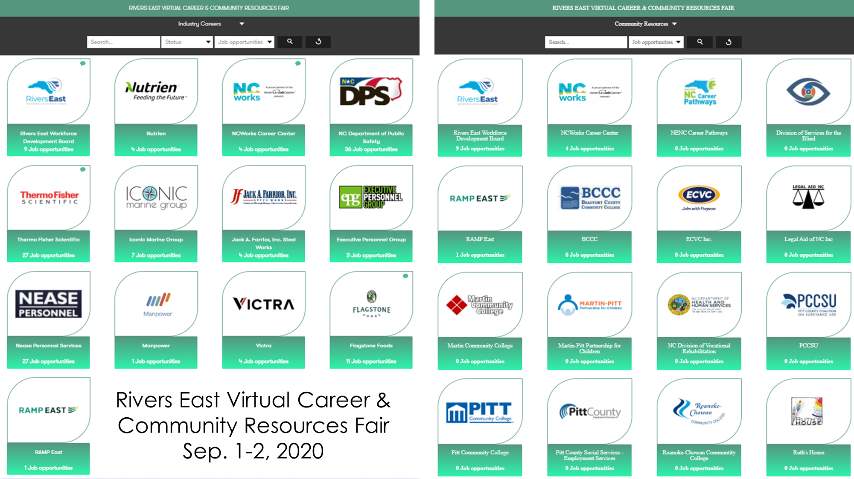

Slide 19
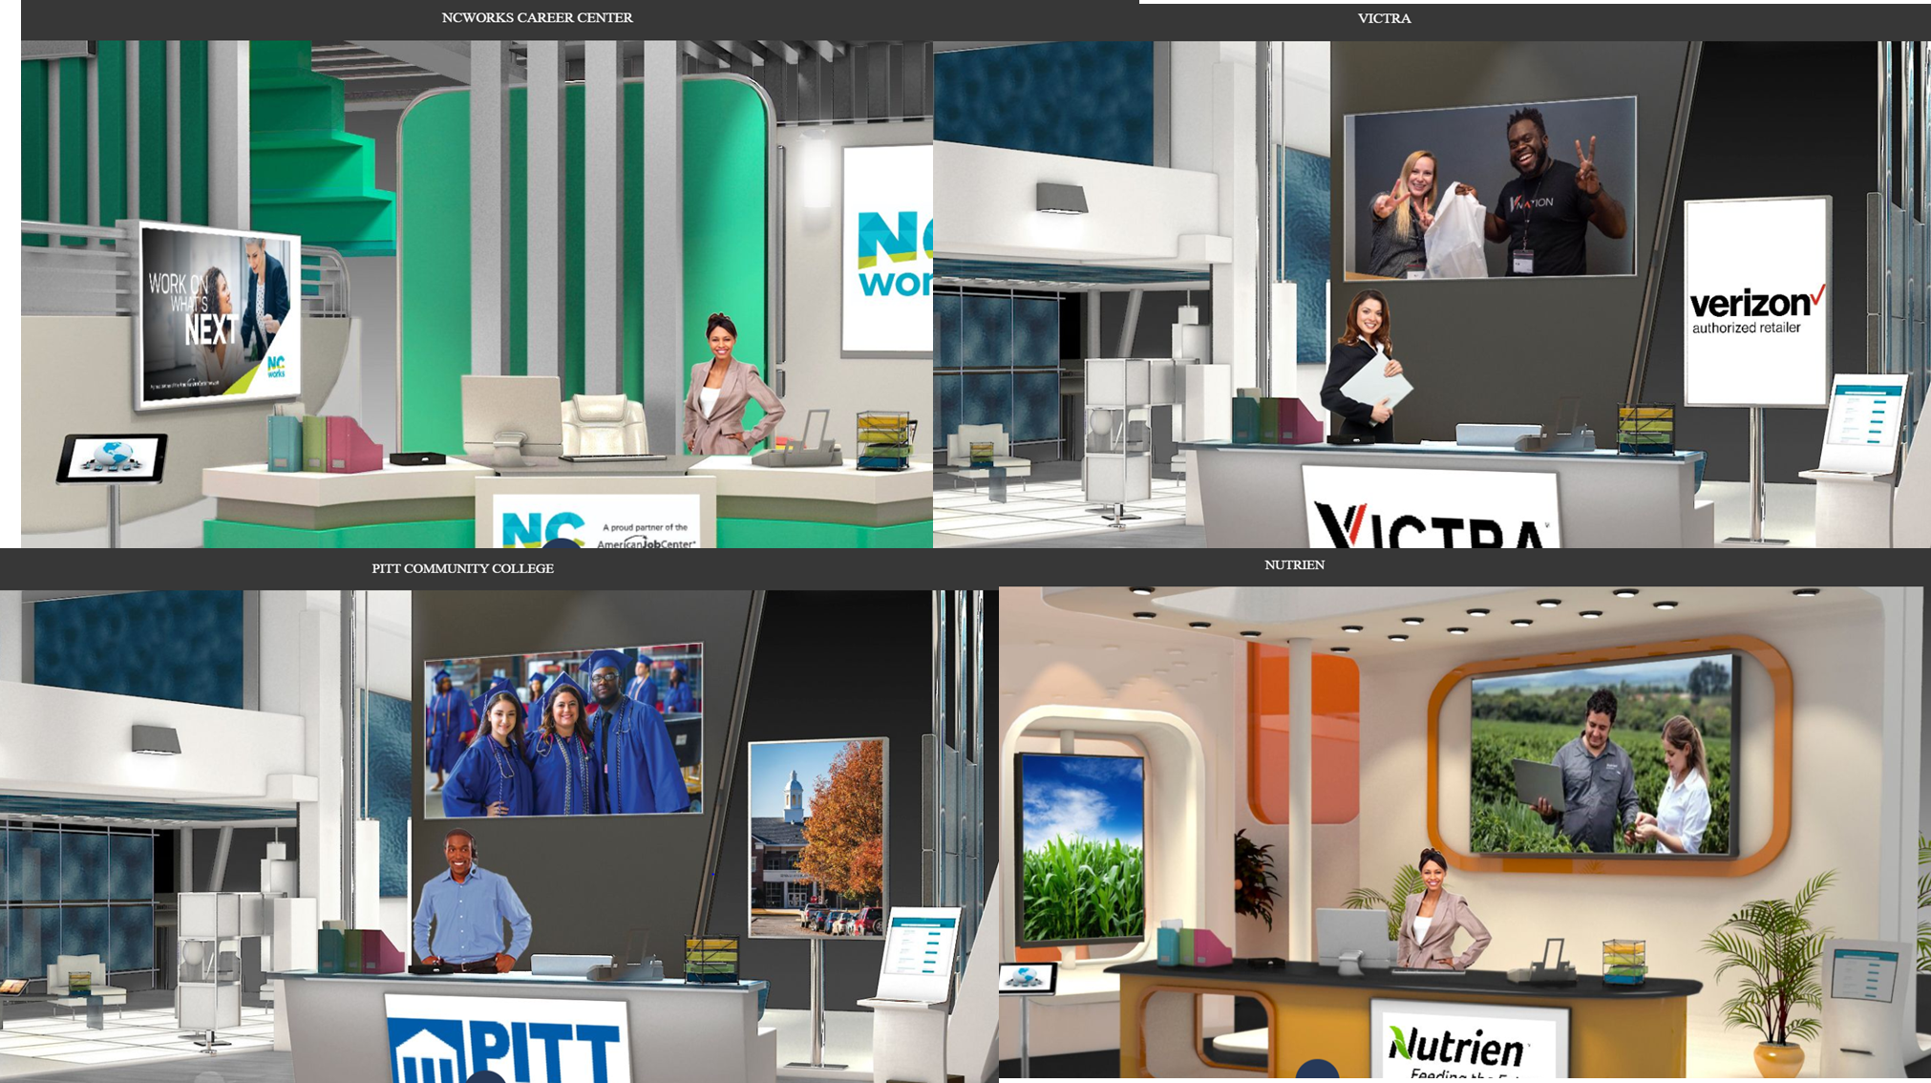

Slide 20



Slide 21


Considerations
Successes & failures (a.k.a. Lessons Learned)
  Learn and improve upon on failures
  Goal → Plan → Implement → Evaluate
  Customer learning curves
Team Effort! Team Effort! Team Effort!
Communications
Challenges → Pandemic
Funding
  Centers of Excellence Performance Enhancement Grant
  Staffing time costs
Brandi
The Mentor
Pat
The Planner
Notes:
focus on funding (lead to next presentation)
Success & Failures (aka Lessons Learned)
Communications

