Slide 1
NCWorks NextGen Real World Simulation
Northeastern Workforce Development Board

Slide 2
What is Real World?
A one-day simulation event that offers teens and young adults hands-on practice learning around areas of fiscal decision-making pertaining to education, careers, and lifestyle choices in the adult world….before it counts!
An opportunity for the business community to provide real life costs to teens for their particular industry BEFORE IT COUNTS.
An opportunity for teens and young adults to create a monthly budget based on real life costs and practice face-to-face social skills with people and businesses.
An opportunity for teens and young adults to see how their educational plans match up to potential entry level career earnings.
An opportunity for the business community to expand their customer base and meet potential employees.
REAL WORLD
NORTHEASTERN

Slide 3
Real World History
In 2000, Independent Living Resources (ILR), Inc. piloted the “Real World Raleigh” as a one day event. Three organizations were asked to work with ILR and promise to bring their teenagers and young adults to the event. ILR hoped to have 50 participants. The event made more of an impact than initially imagined. As the event became more popular, adults brought their teens from as far as five hours away to attend.
ILR decided that the focus should now be on teaching people how to coordinate the event so they could have it in their own community. In 2005, Nancy Carter began developing the curriculum that exists today on this website. Year after year, Nancy refined and adjusted the curriculum and teaching activities to best transfer knowledge to those in her trainings. Nancy’s enthusiasm for the Real World also transferred to her trainees and Real World events started to “pop up” throughout North Carolina and other states that attended the training.

Slide 4
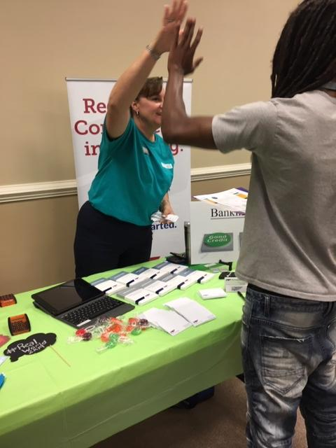
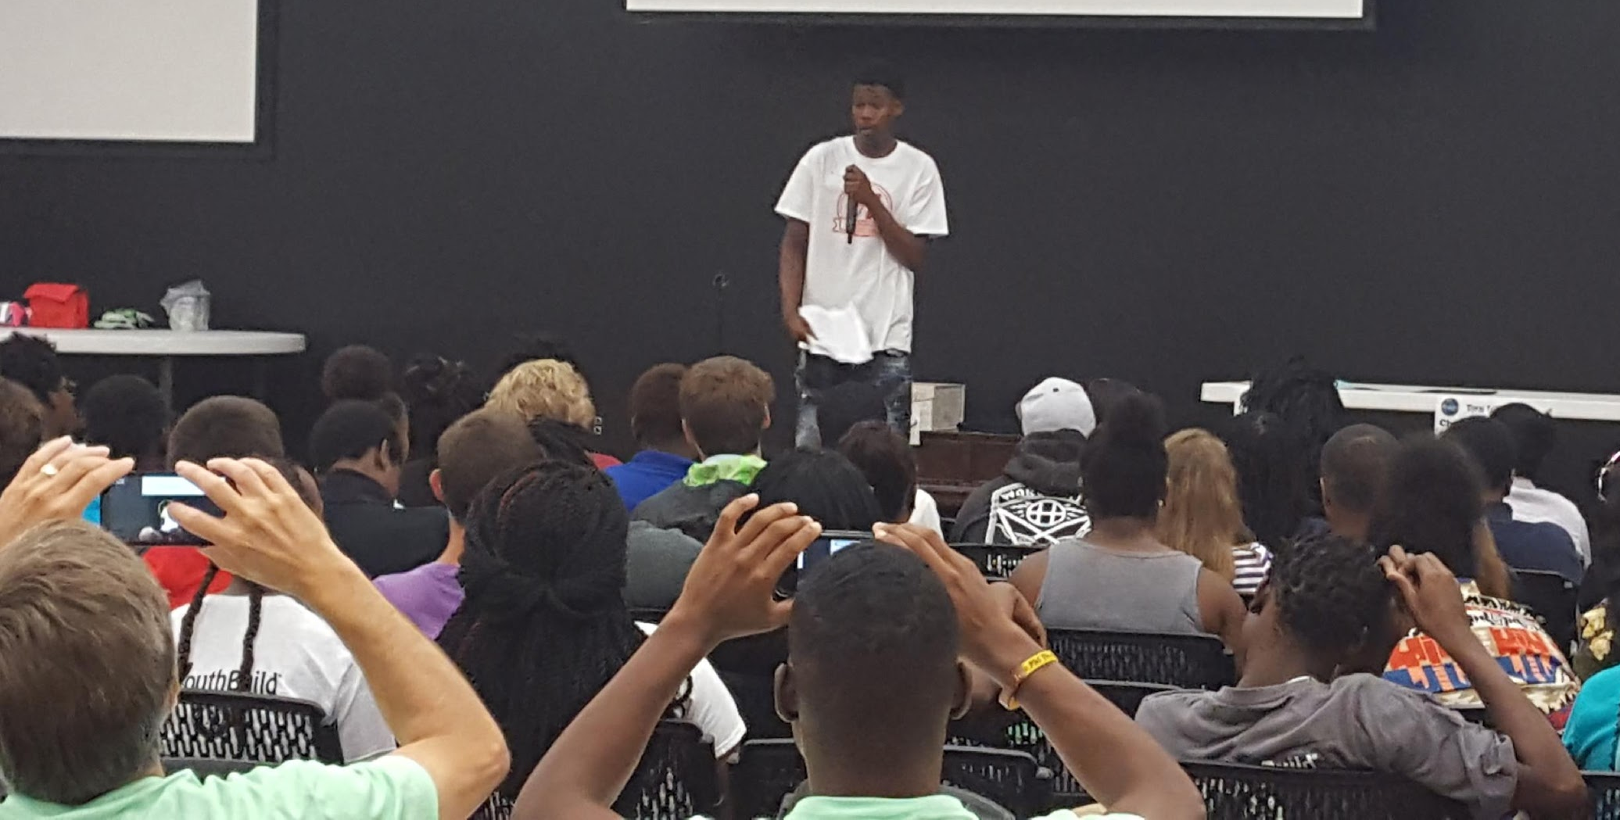
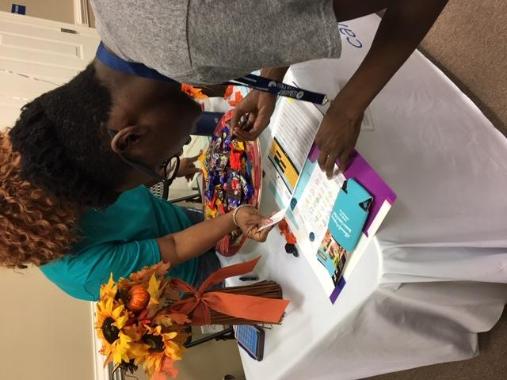
Why Host a Real World
Brings youth from similar situations together to share their future dreams/goals and identify potential challenges for when they transition to the adult world
Teaches youth the life skills necessary to meet their goals as productive adult citizens
Provides a one-day simulation based on how to make daily responsible, financial decisions necessary for adult life
Community businesses interact positively with young adults in their community.
Young adults want to attend this event (year after year) to practice their skills.
Teachers and youth workers feel they have made a difference towards preparing youths to navigate the adult world upon graduation.
Notes:
Talk about job cards, career choices, marital status, children, student loan, education level

Slide 5
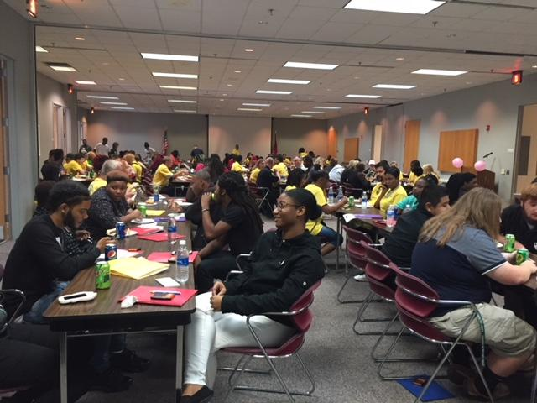
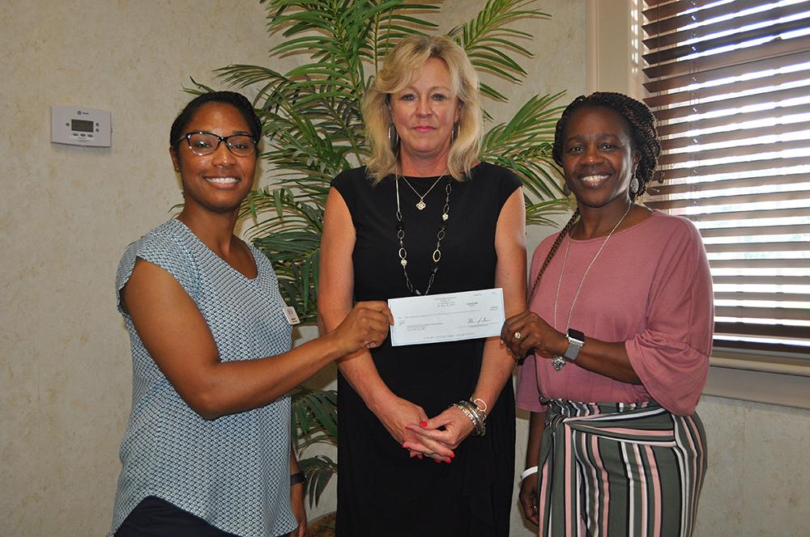
Getting Started
Select a target group (16-24 y/o)
Form a planning team with committees
Select coordinators for each committee
Core Committee
Youth Committee
Resource Committee
Materials Committee
Start planning process
Funding
5

Slide 6
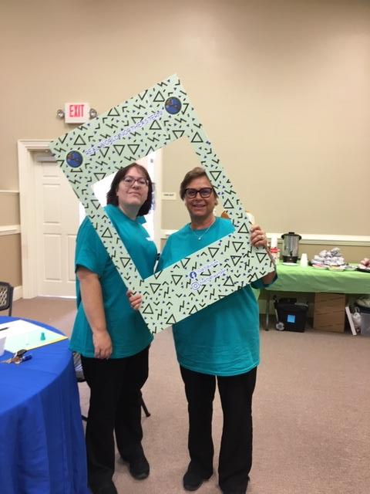
Volunteers
Community and business volunteers are critical for Real World success. Volunteers are needed for every aspect of the event. They fill positions like registration, booths, workshops, and serving on the planning committee.
We host a volunteer luncheon prior to each Real World to review volunteer duties and what to expect during the Real World. The luncheon also serves as a way to say “Thank You” to the
volunteers.

Slide 7
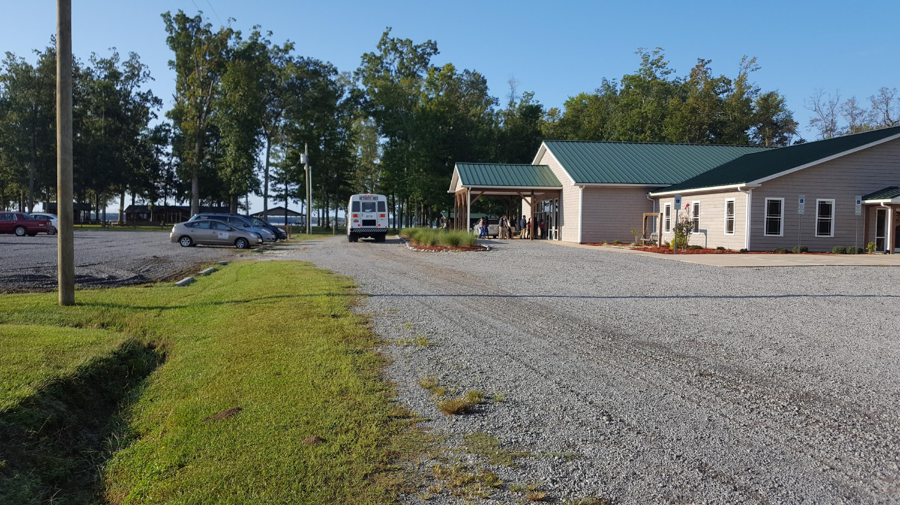
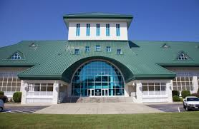
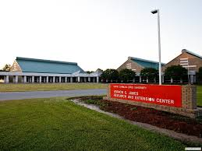
The Venue
The location must be one that appeals to the specific age-group targeted. It should also accommodate the Exhibit Set-up, space for the Mini-workshops, the Used Car Lot, and refreshment needs, while also providing ample parking for sponsors, volunteers, and staff. It is preferable to have the event outside of the targeted age groups' routine locations.
Camp Cale
Vernon James Research Center
NCWORKS CREATIVE MATERIALS MOCKUP
7
Museum of the Albemarle

Slide 8
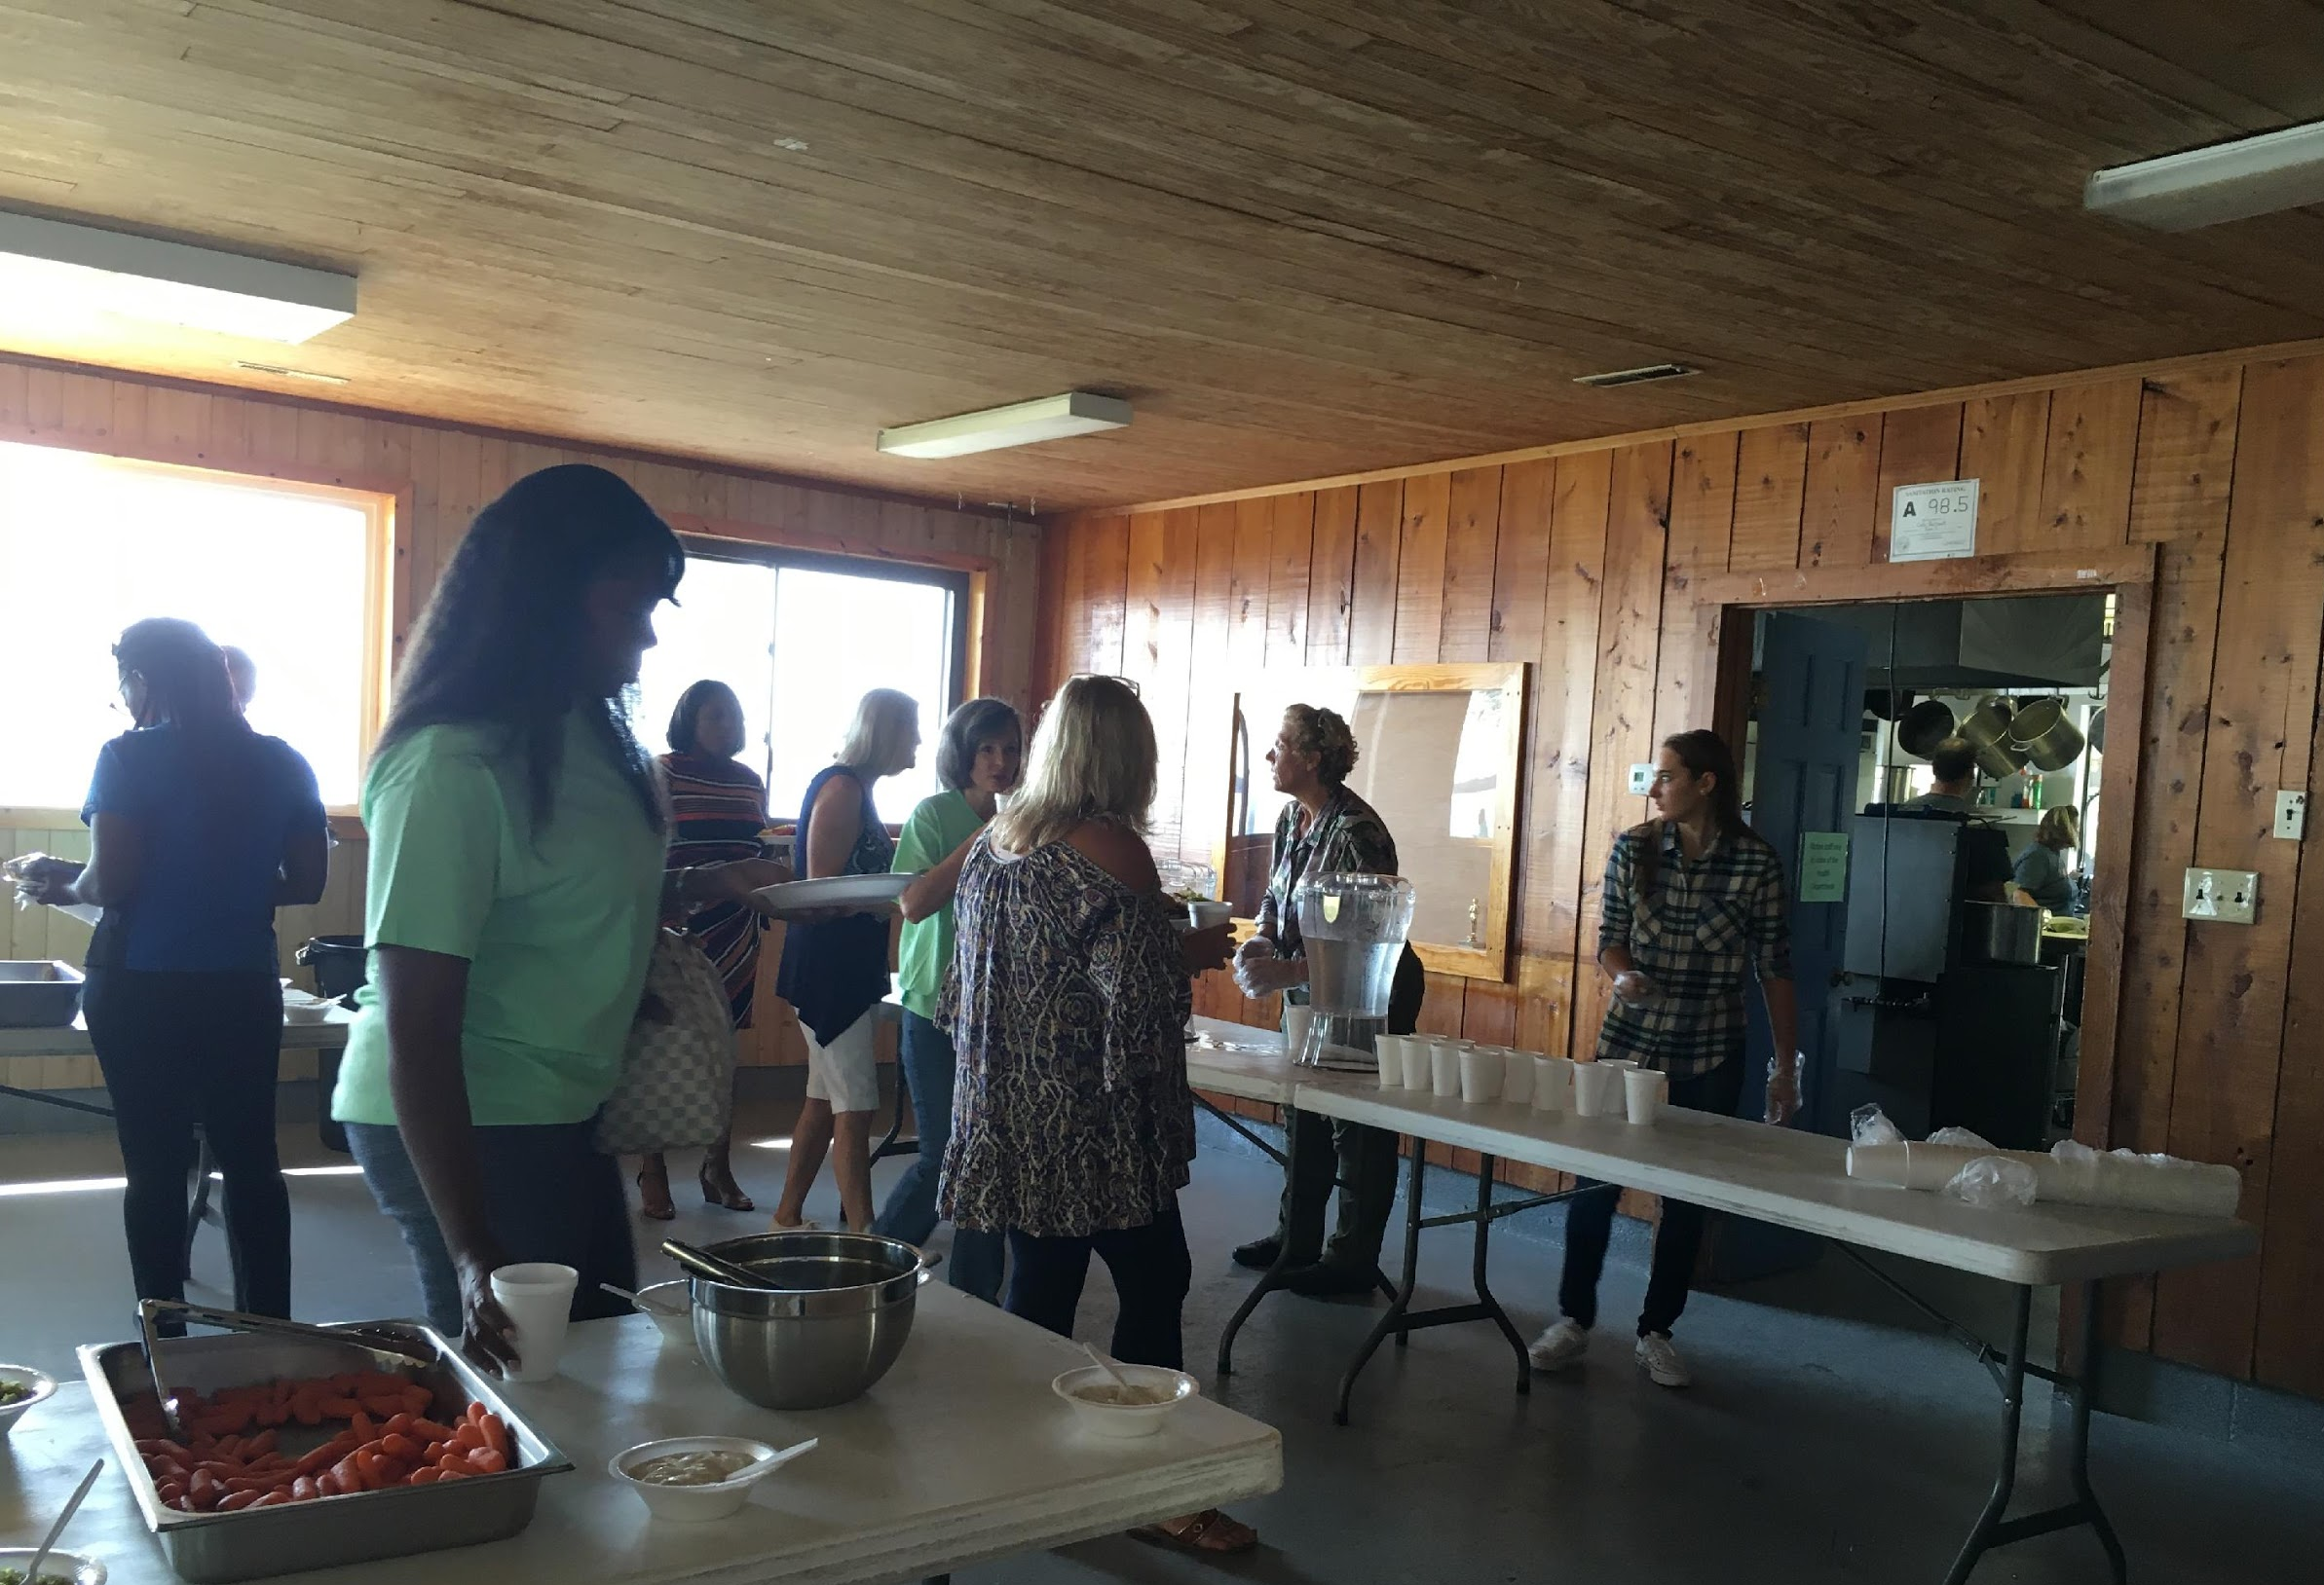
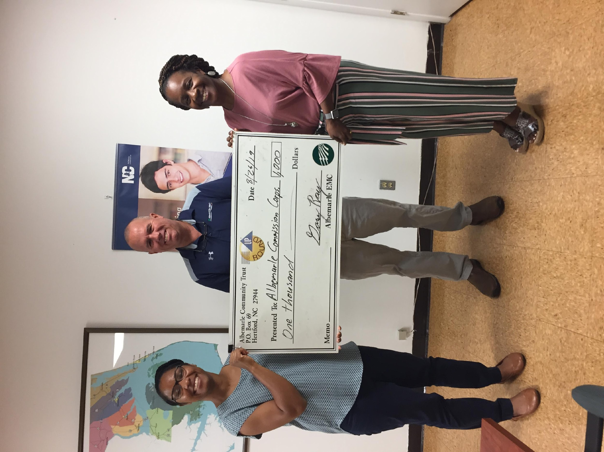
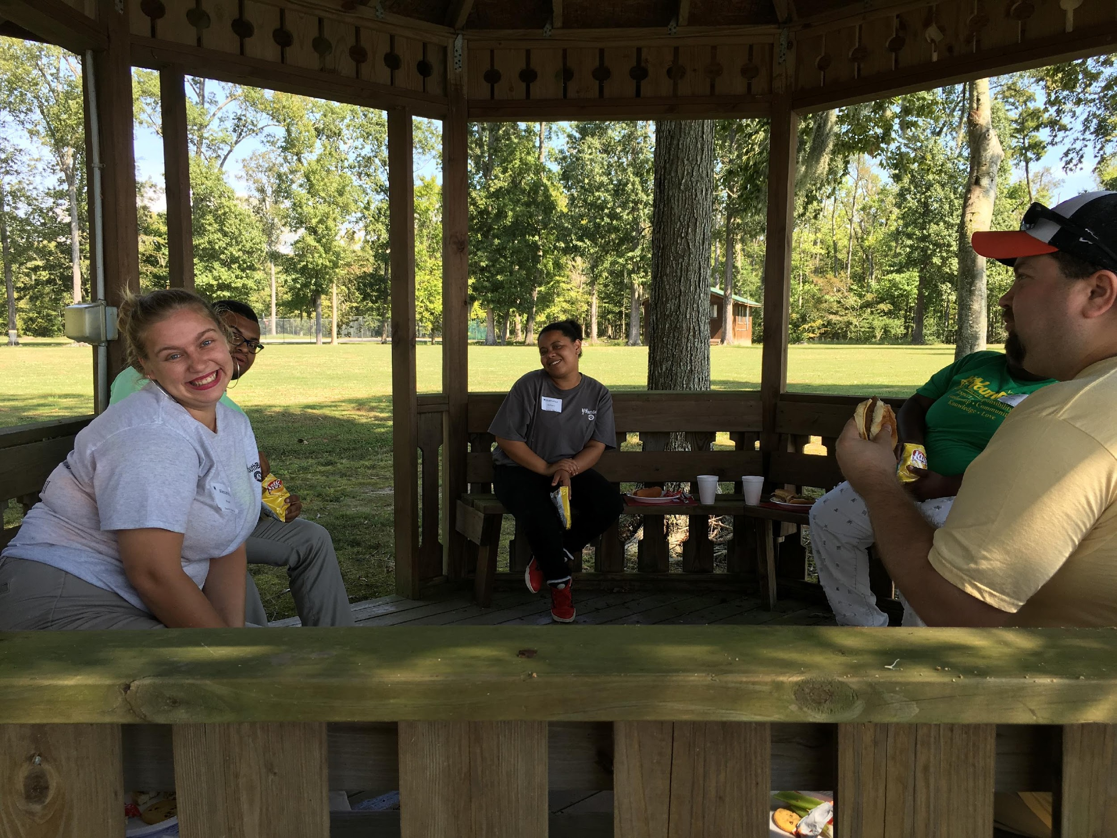
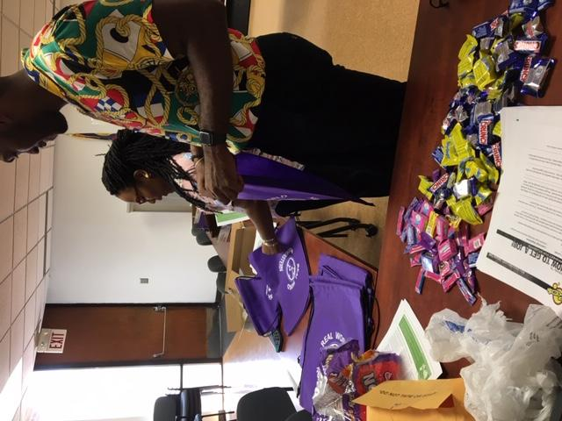
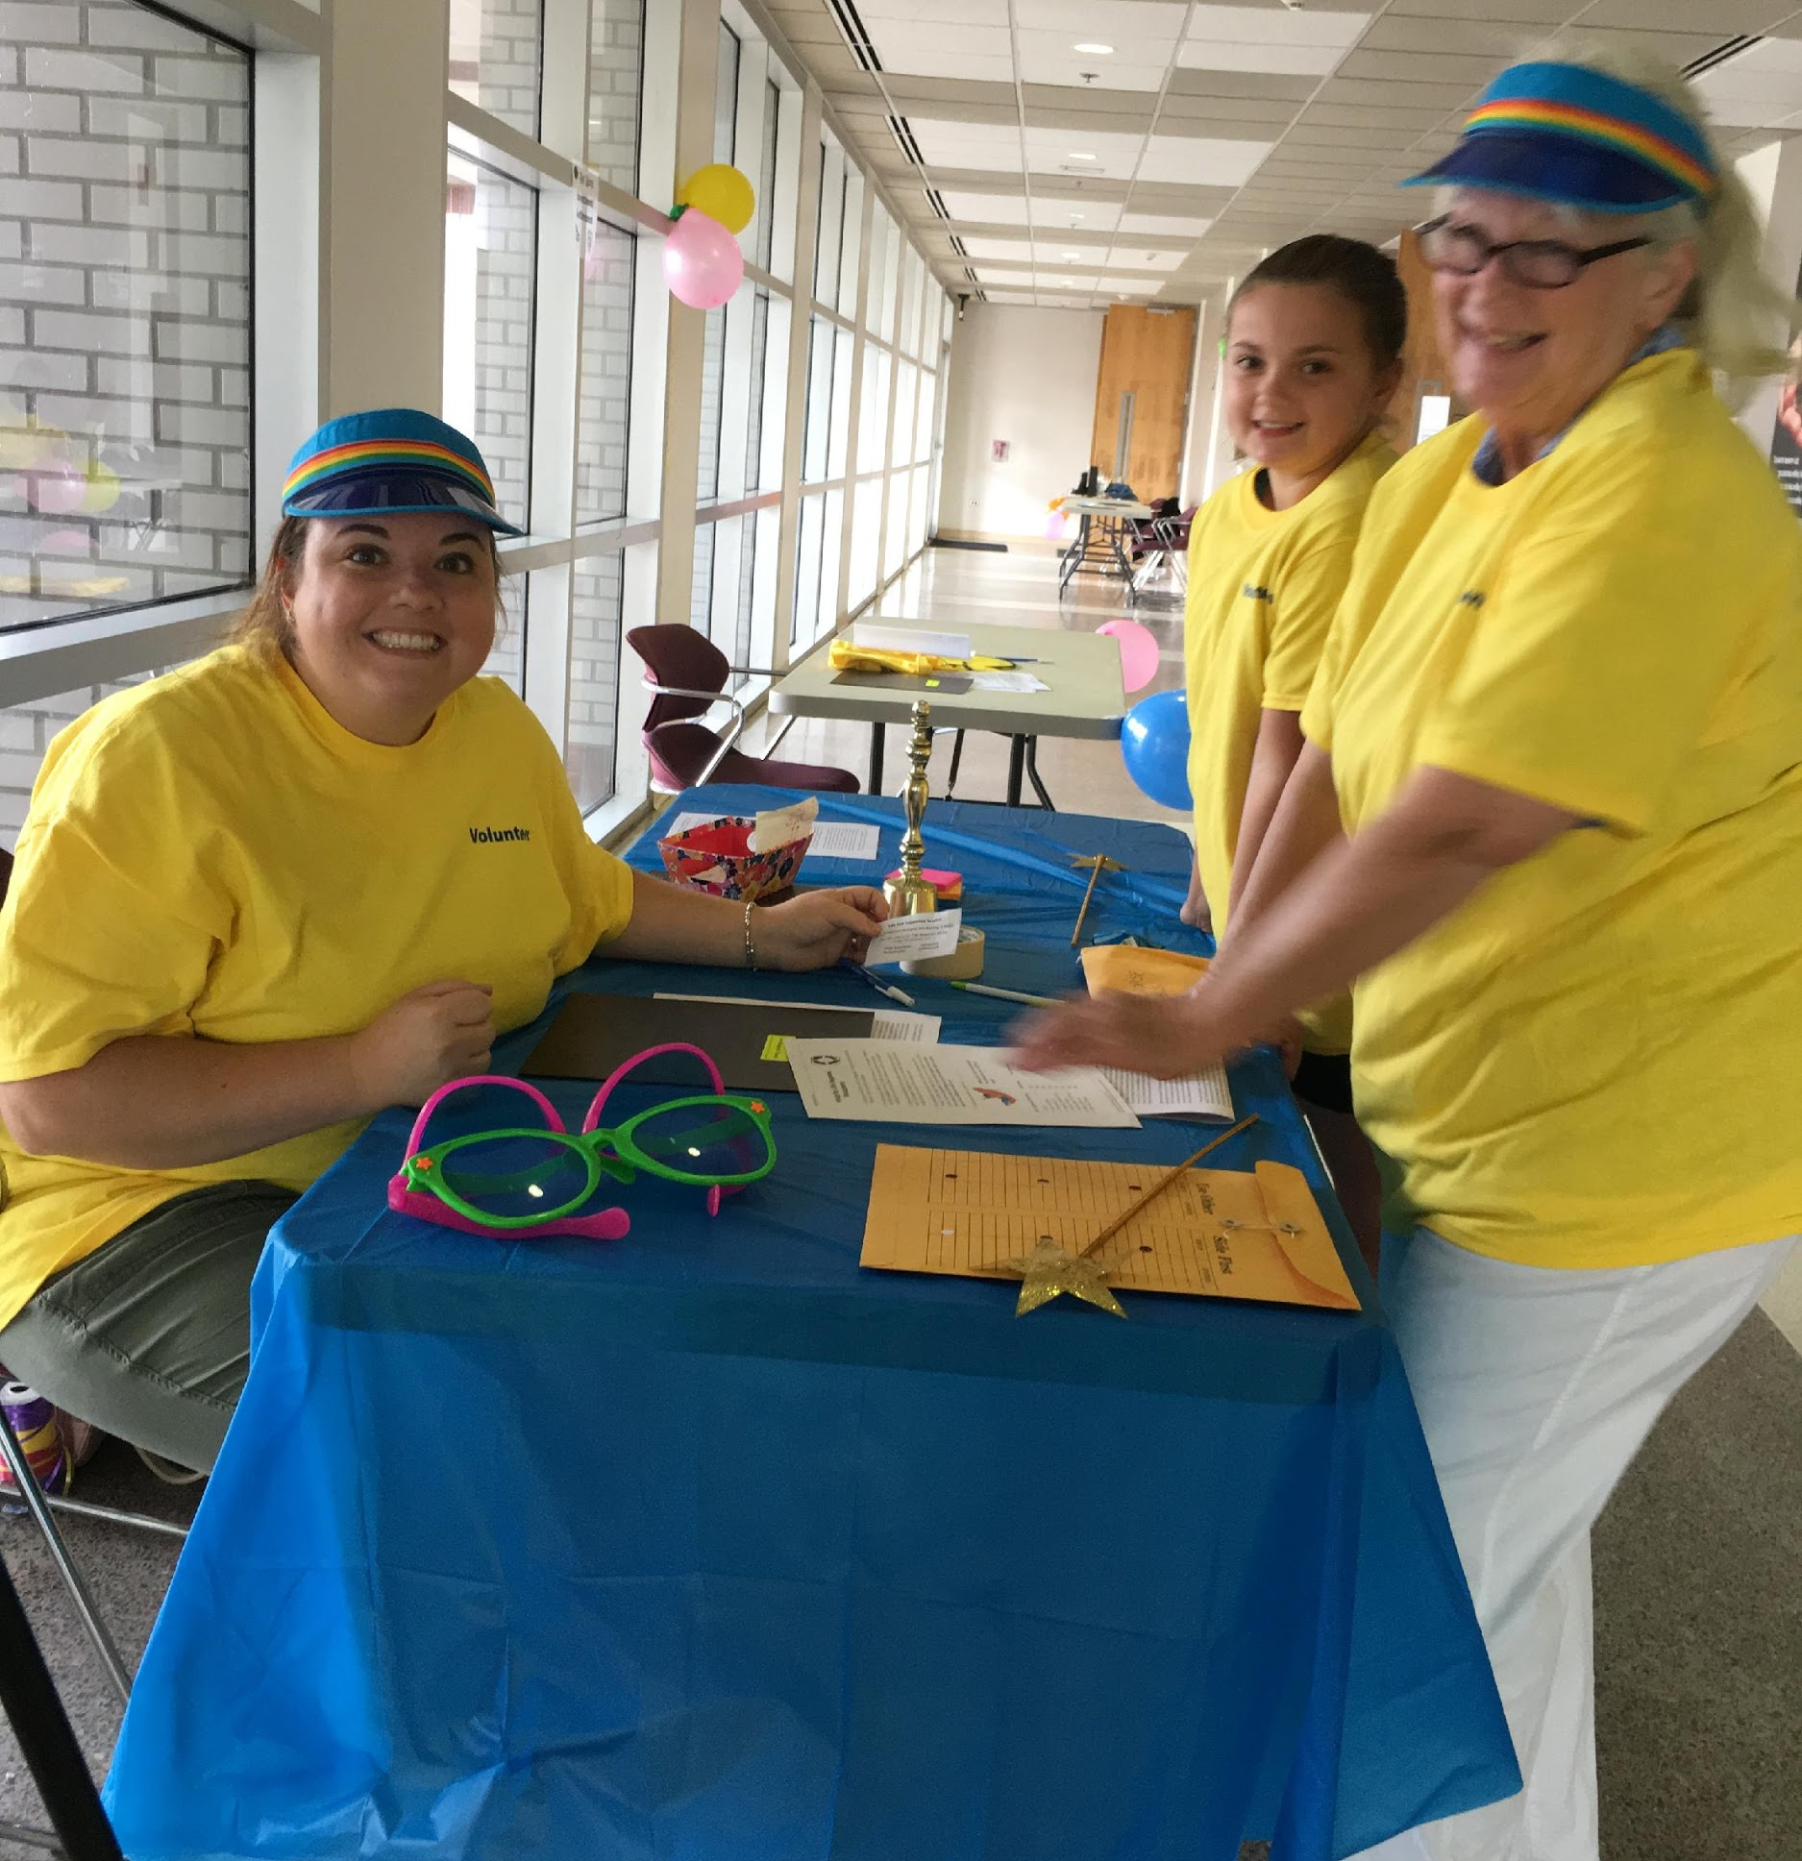
Support Materials
Lunch & Snacks
Name Badges
Check Register
Pencils
Calculators
Door Prizes
Volunteer Folders w/ Instructions
Volunteer T-shirts
Booth Props (by volunteers)
Booth Signs & Cost Listings
Decorations
Swag
8

Slide 9
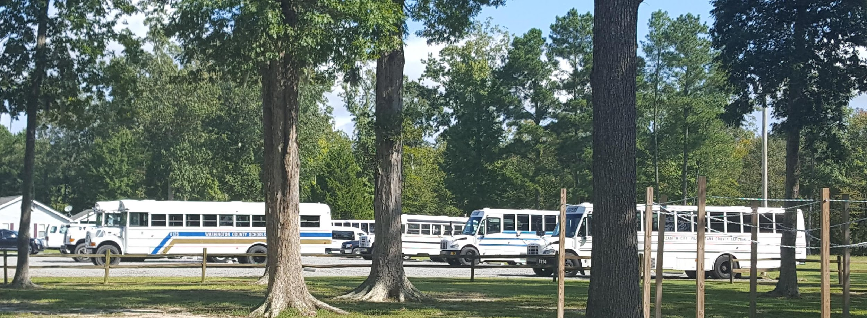
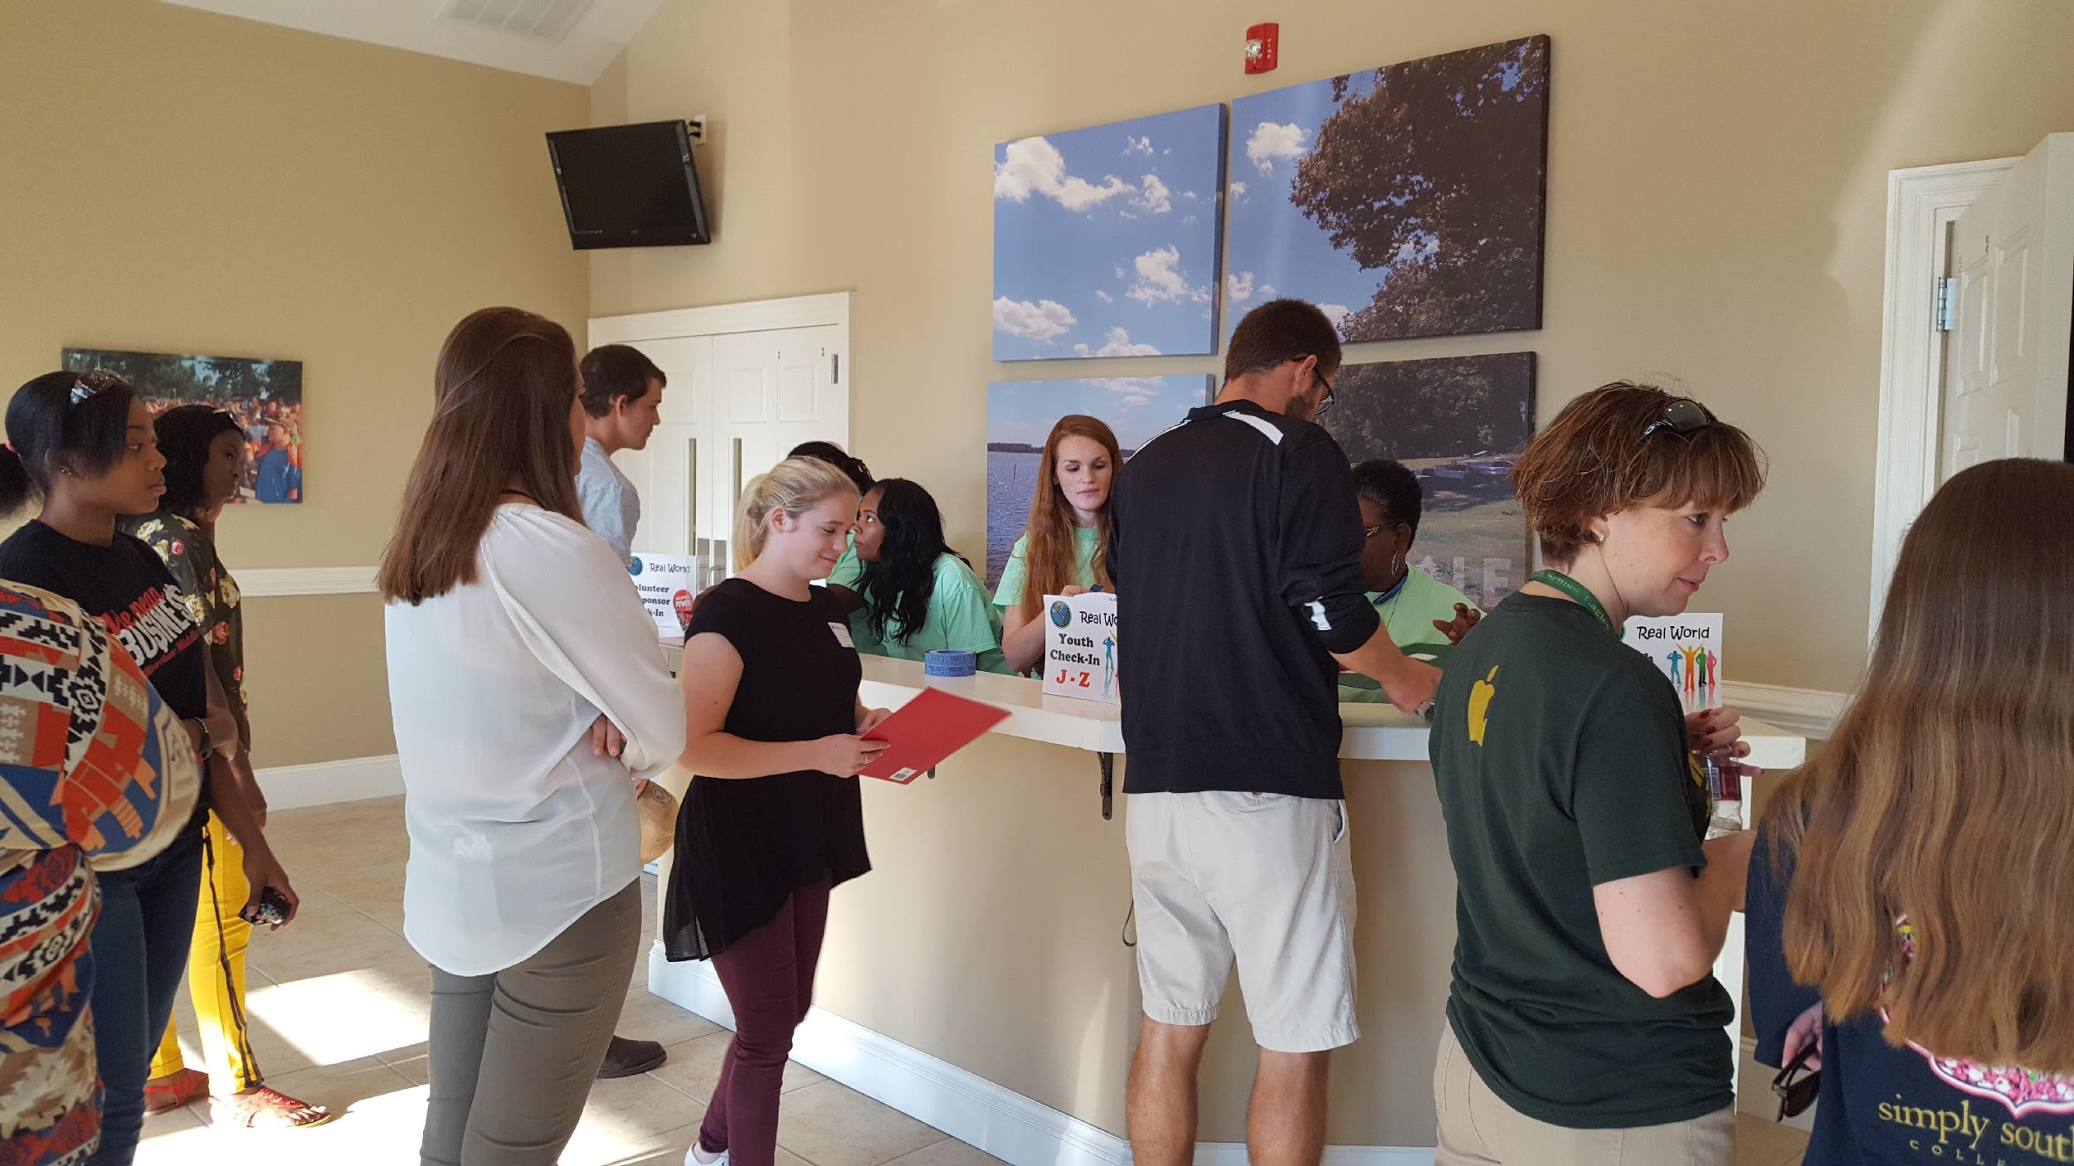
Attendees
A Real World Simulation should:
Have at least 50 youths in attendance to make the day worthwhile to your sponsors and to provide enough participants to make the event exciting to other youths
Recruit at least one-third more youths than you hope will attend
Register youth for the event
Can be completed electronically
Coordinate with school representatives
Stress the deadline for registering
(about 2 weeks before event)
Participating schools provide transportation to the event
Notes:
Talk about job cards, career choices, marital status, children, student loan, education level

Slide 10
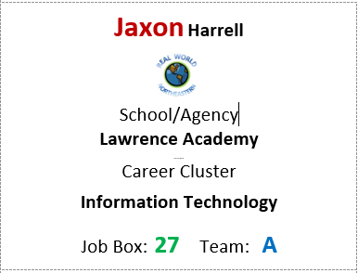
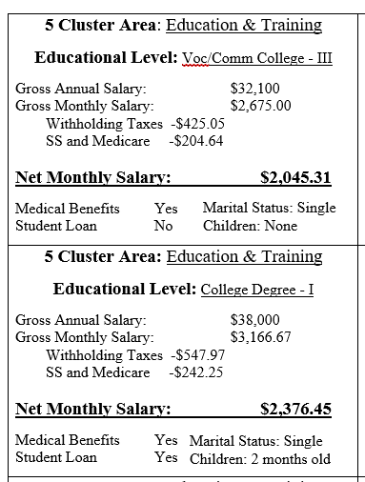
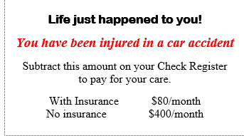
Starting Documents

Slide 11
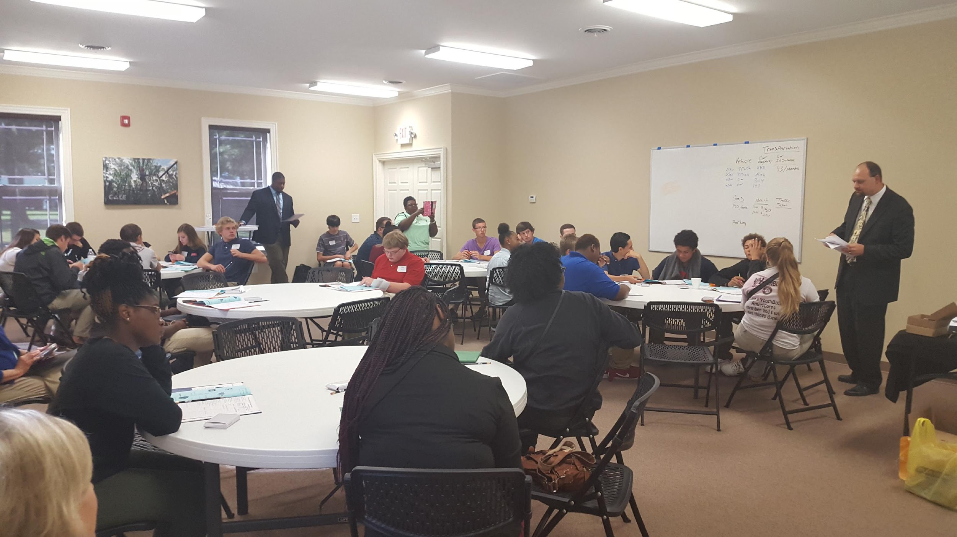
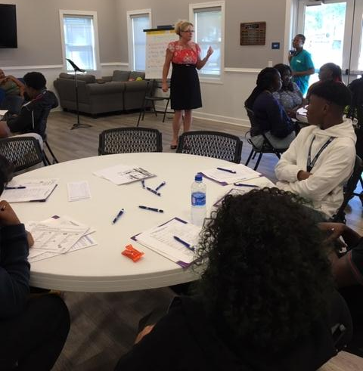
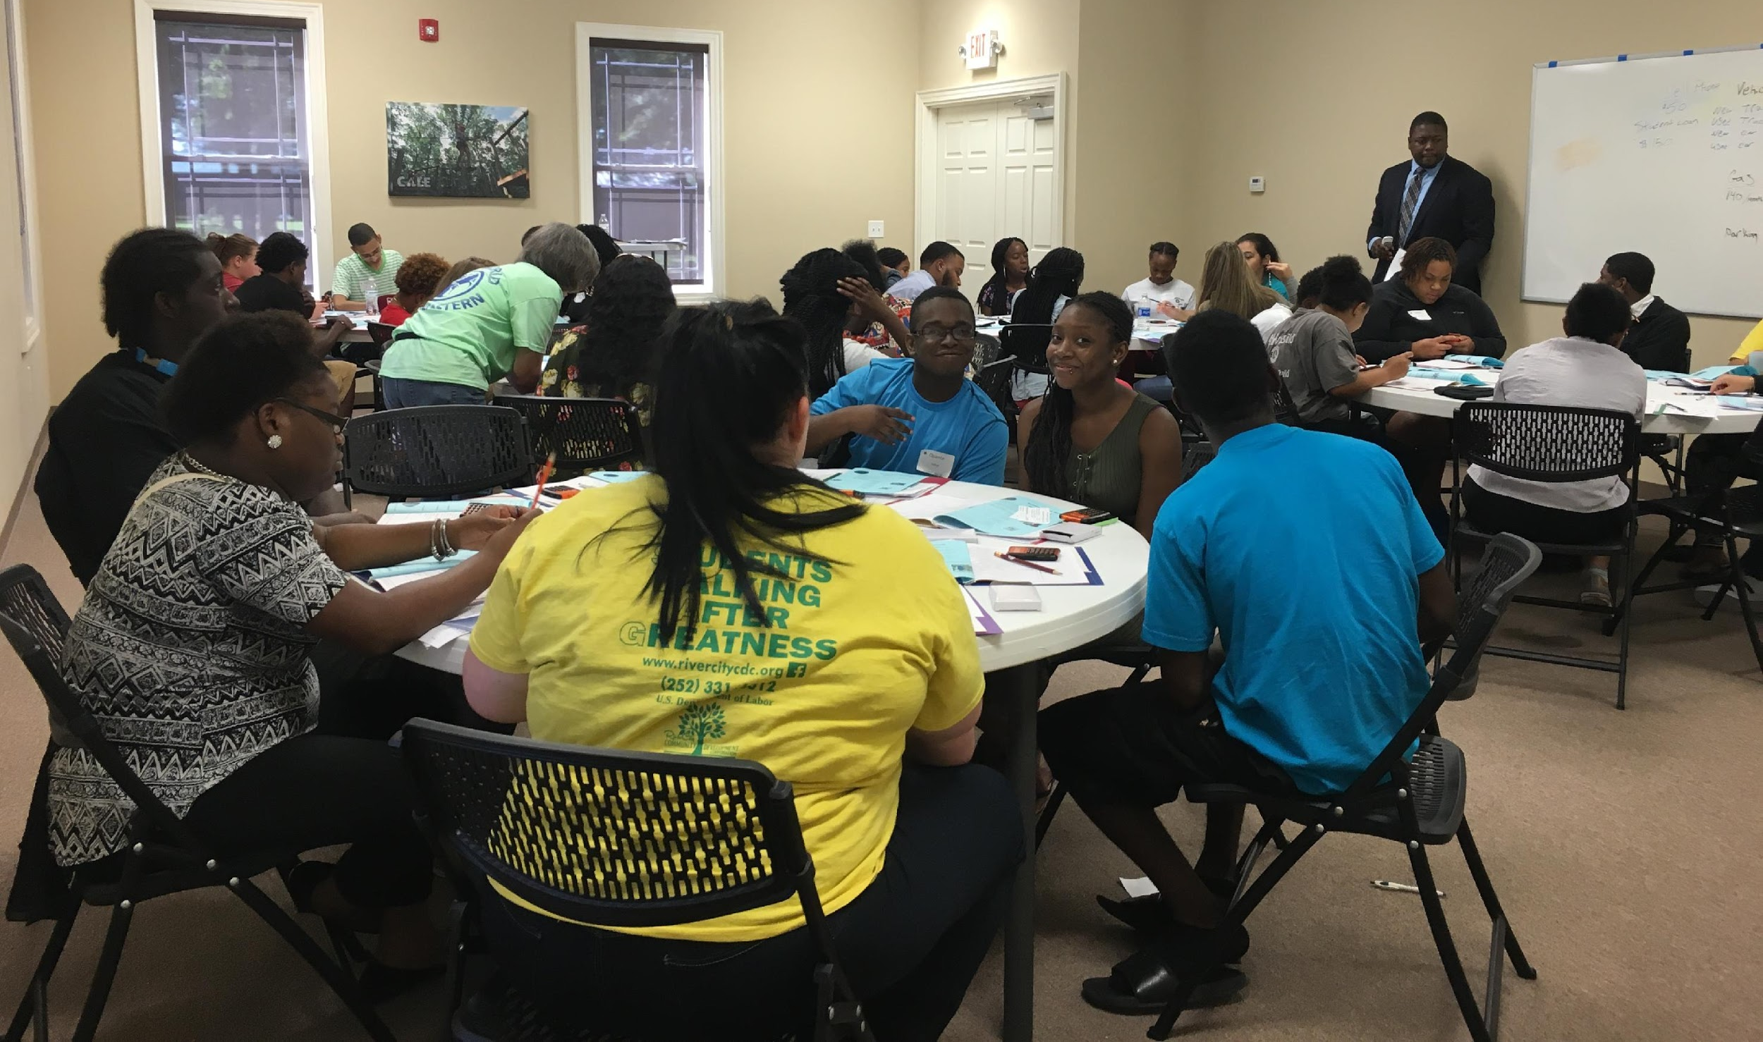
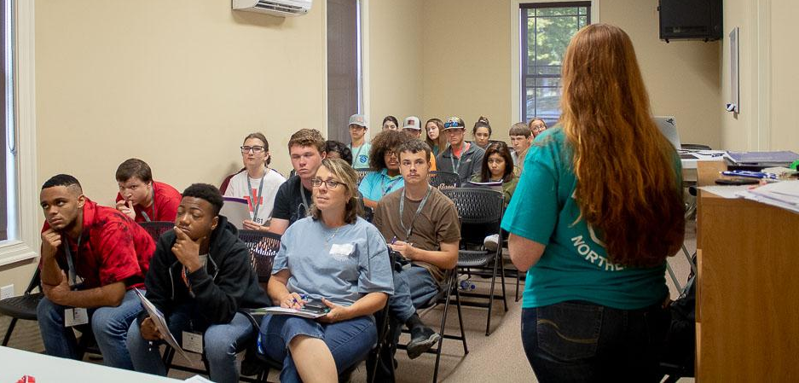
Workshops
Insurance
Budgeting
Banking

Slide 12
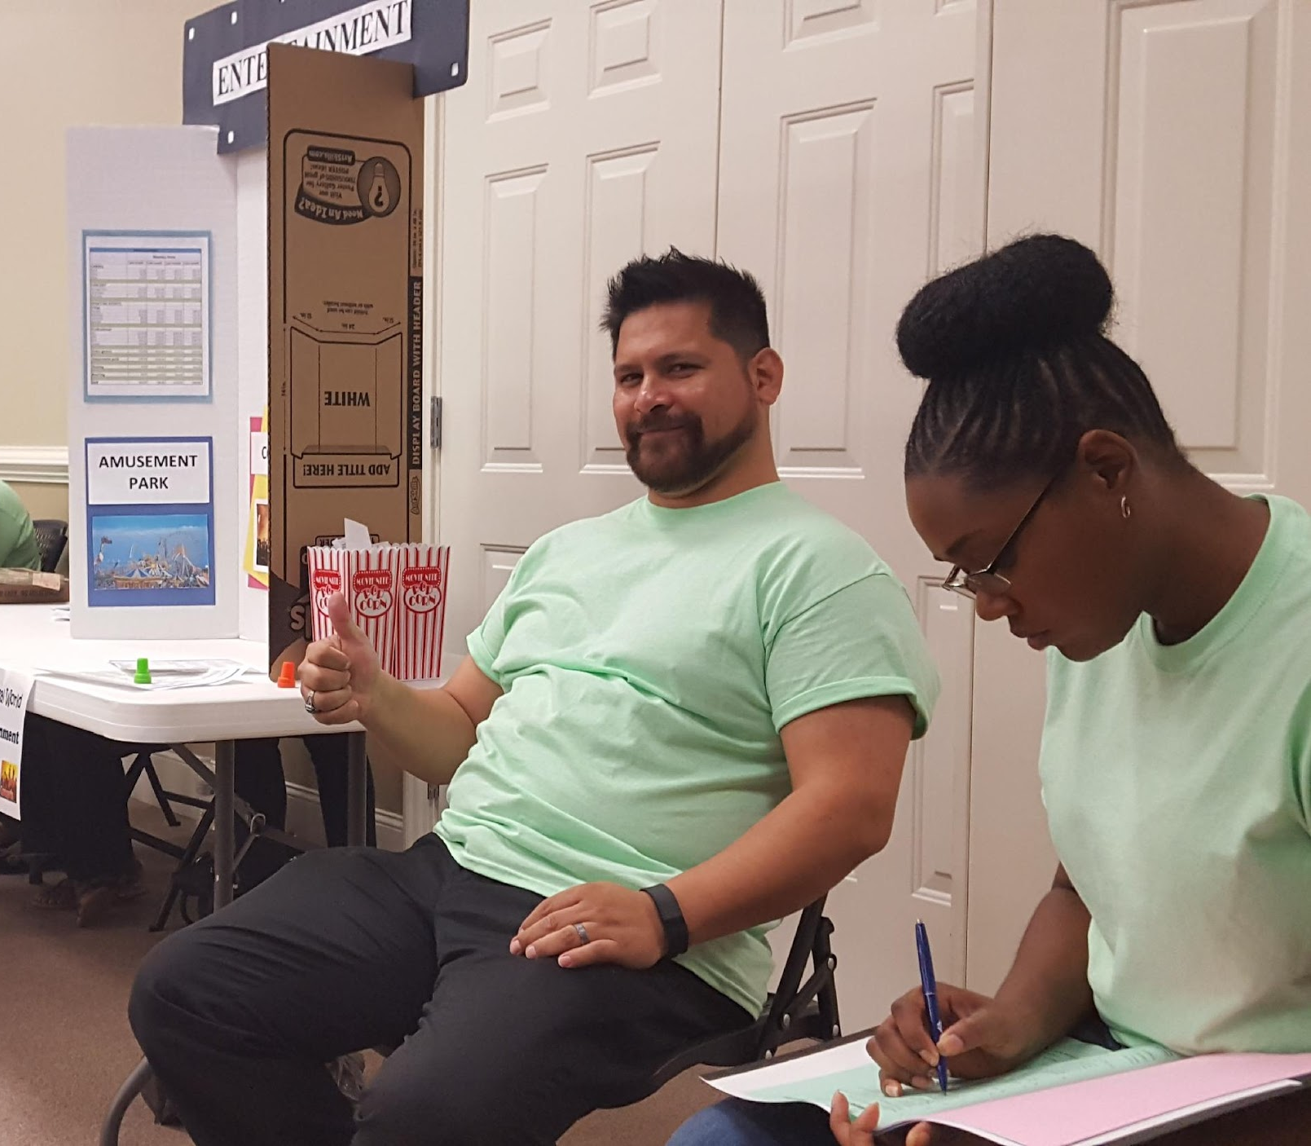
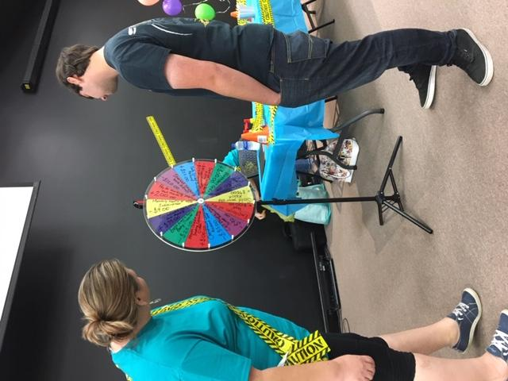
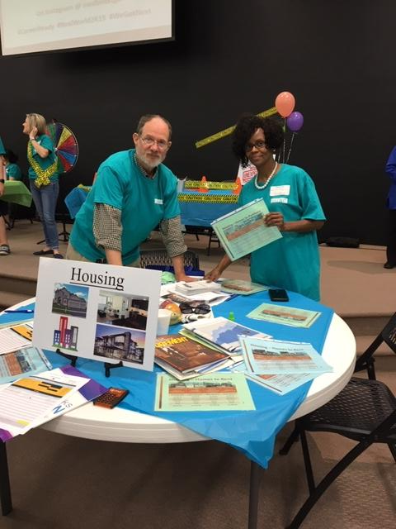
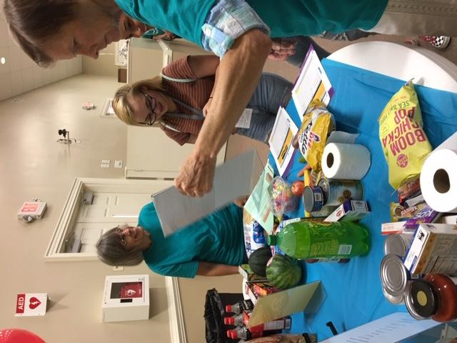
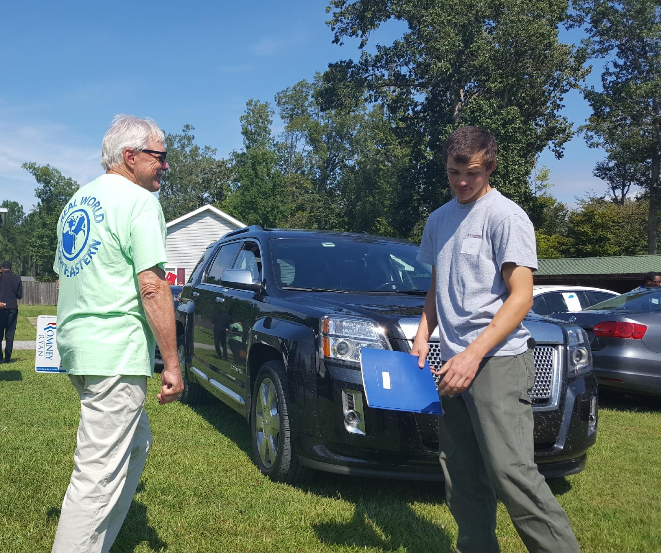
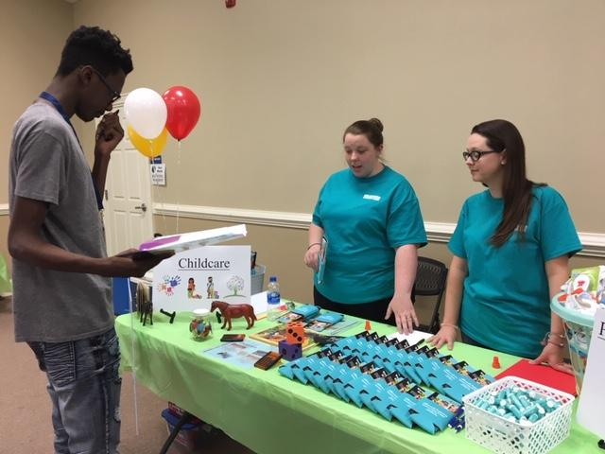
Booths
Housing
Entertainment
Career Center
Life Happens!
Groceries
Car Sales
Childcare
And More!!
12

Slide 13
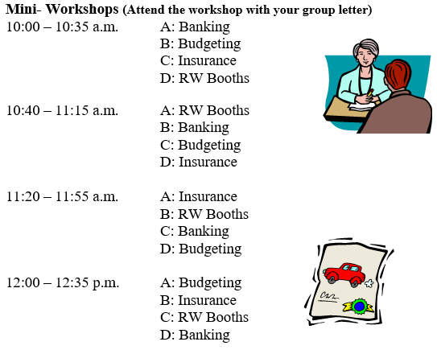
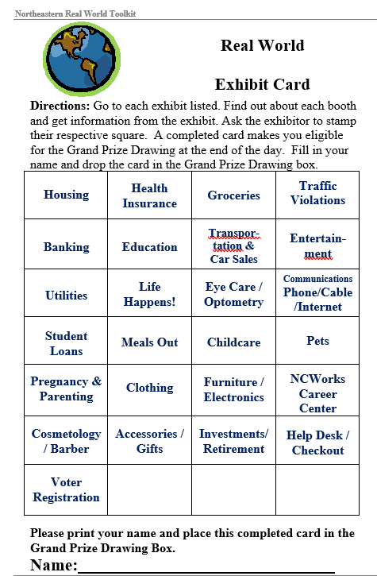

Slide 14
Real World & the Community
The Real World Simulation is an innovative program proven through research to assist adult professionals to motivate and stimulate youths’ knowledge of real world concept.
The Real World Simulation is intended to be a community-wide event utilizing community businesses, schools, youth organizations, and resources.
By connecting with those community businesses required to navigate the adult real world, youths will experience how those pieces contribute to a productive, healthy life.
Community business people and resources have the skills that youths need to be successful in the real world.
The Real World brings those people and skills together for one day of experiential learning.
REAL WORLD
NORTHEASTERN

Slide 15
Contact Info Janaye Clark jclark@accog.org (252) 333-5656 Lora Aples laples@accog.org (252) 312-5792
Northeastern Workforce Development Board

