Slide 1
Northeastern WDB Meeting
November 19, 2019
Notes:
Thank you for your work in sustaining my role and this partnership
Share Workplan

Slide 2
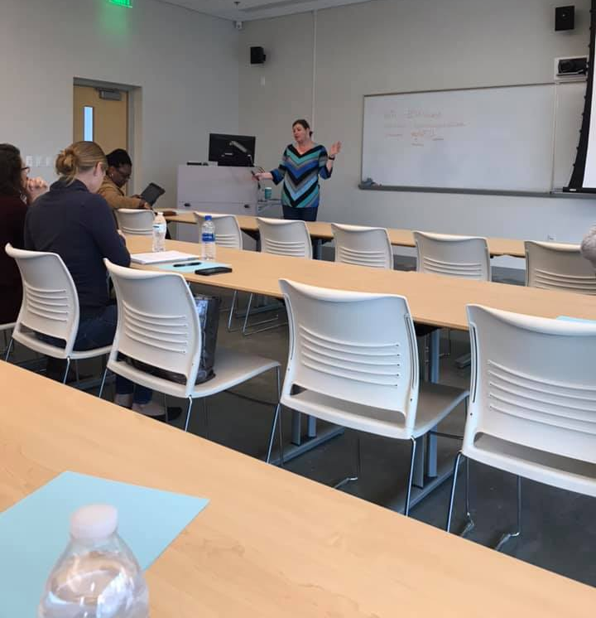
Training and Professional Development

Slide 3
Local Implementation

Slide 5
Impact on the Future Workforce
Research shows that effective teachers are the most important factor contributing to student achievement
Source: Teachers Matter: Understanding Teachers’ Impact on Student Achievement. Santa Monica, CA, RAND Corporation, 2012.
Notes:
Teachers matter more to student achievement than any other aspect of schooling. Many factors impact student achievement including family and neighborhood experiences. But research suggest that teachers matter most. When it comes to student performance on reading and mathematics tests, a teacher is estimated to have two to three times the impact of any other school factor.

