Slide 1

Dr. John Pickard

Slide 2

USDA RUS/DLT
3yr grant
Purpose – Telecommunications equipment directly supporting distance learning/Telemedicine
ECU received $346,423 from USDA (2018 RFP) for Cisco Webex boards deployed to rural eastern NC community colleges and high schools
Matching funds grant – high leverage (7x)

Slide 3











2018 USDA RUS Grant Award Partners

Slide 4
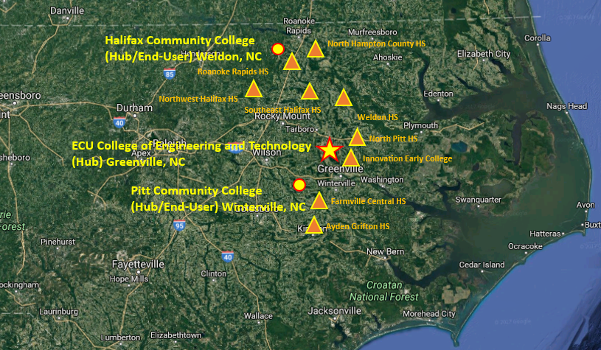
Current Site Map

Slide 5
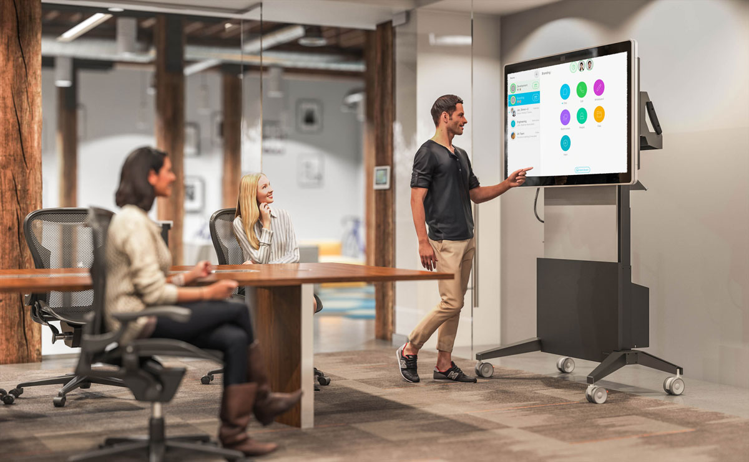
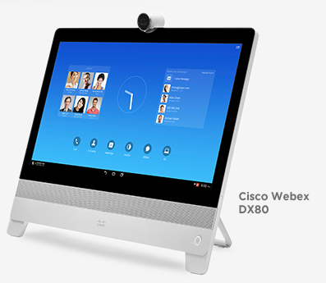
Cisco Webex Boards
55” all-in-one device:
  Mobile
  Wireless presentation
  Digital whiteboard
  Video conferencing
  Connects via Webex
23” desktop collaboration device

Slide 6



Endless Possibilities
Remote students/faculty
Universities
On campus students/faculty
High Schools
Internet
(Webex cloud)
Other Community Colleges
Govt. /public institutions
Industry engagement

Slide 7
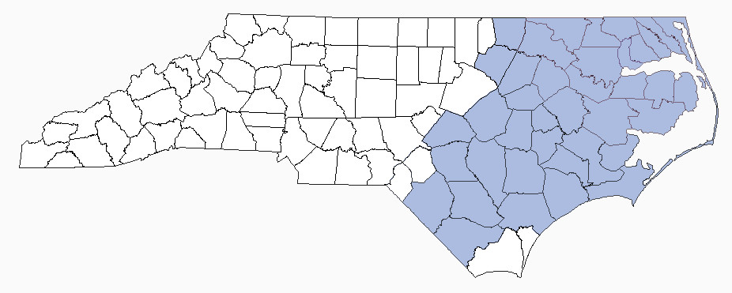

What Next?
Expand project throughout Eastern NC
  2020 proposal due ~ May 2020
    (Roanoke-Chowan, Bladen, Pamlico, James Sprunt, Others??)

