Slide 1
EASE Programs
Will Prettyman
11/13/19

Slide 2
What is the EASE Program?
One-day outreach program
Middle school students on college campus
Hands-on science activities to “solve” a mystery
Encourage STEM careers to students
CC staff/faculty volunteer to run activities
BioNetwork trains all volunteers

Slide 3
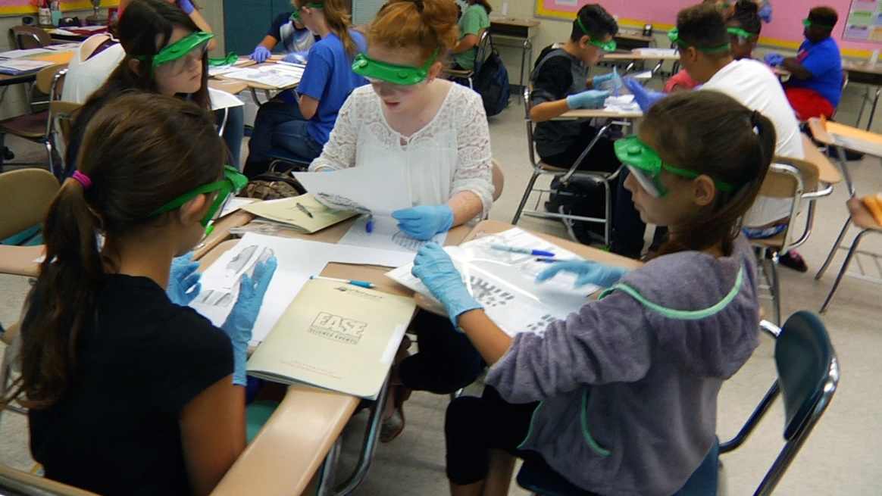
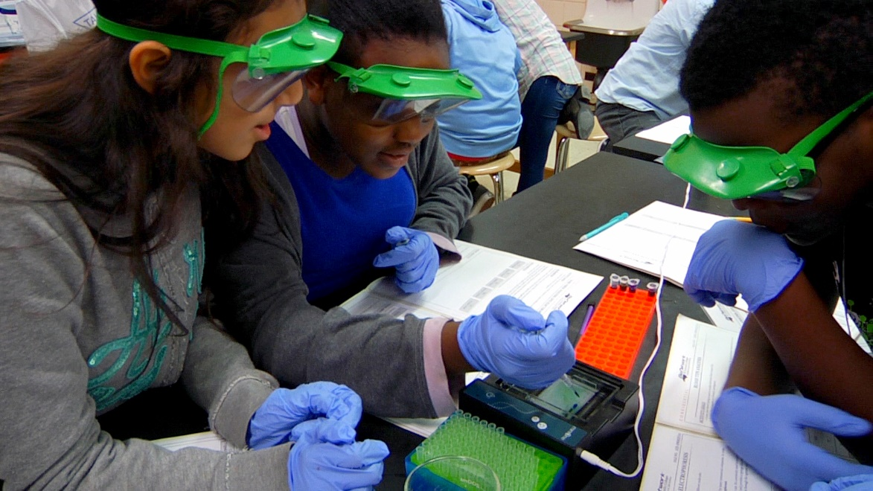
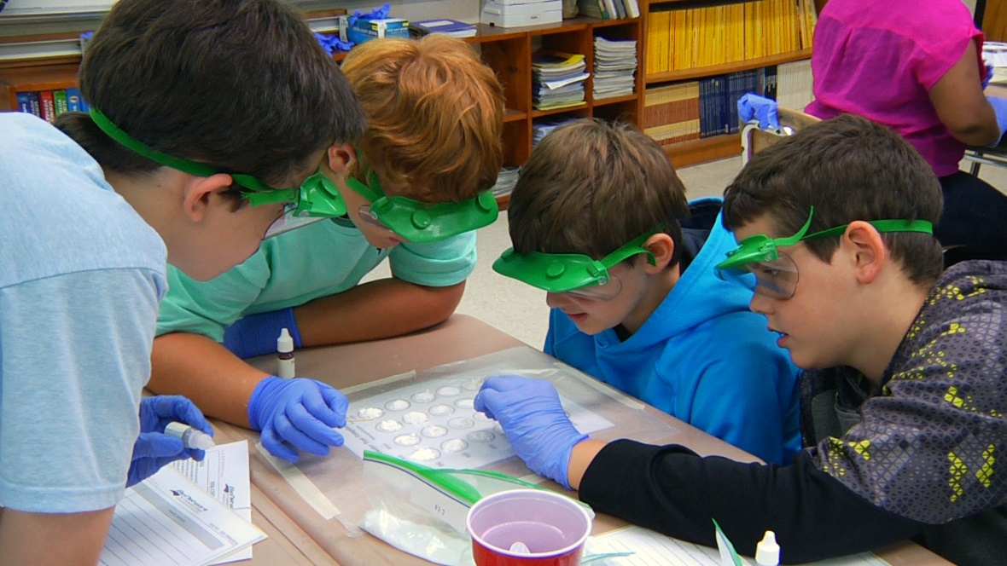
What does it look like?

Slide 4
Two Different Programs Available
Forensic Science
Outbreak

Slide 5
Benefits
Engages college with local middle schools
Encourages students in STEM fields that are offered by college
Makes parents/adults more aware of what the college has to offer
Minimal investment
Great publicity opportunity
Program is free!

Slide 6
Next Steps and Questions
Questions?
Contact Info:
Will Prettyman(wprettyman@ncbionetwork.org)
(252)757-3759
Erin Bingham(ebingham@ncbionetwork.org)
(252)916-4580

