Slide 1


College Partnership Meeting
11.13.19

Slide 2
2019-2020 Projects and Activities
Pathways
Training
Collaboration
Marketing

Slide 3




Slide 4

Impact on the Future Workforce
Research shows that effective teachers are the most important factor contributing to student achievement
Source: Teachers Matter: Understanding Teachers’ Impact on Student Achievement. Santa Monica, CA, RAND Corporation, 2012.
Notes:
Teachers matter more to student achievement than any other aspect of schooling. Many factors impact student achievement including family and neighborhood experiences. But research suggest that teachers matter most. When it comes to student performance on reading and mathematics tests, a teacher is estimated to have two to three times the impact of any other school factor.

Slide 5


Will Prettyman
Engagement Specialist

Slide 6

CISCO WebEx Board Project
Dr. John Pickard
East Carolina University

Slide 7


Slide 8
The SBTDC is a business and technology development extension service of the North Carolina University System operated in partnership with the US Small Business Administration.
sbtdc.org | info@sbtdc.org
Updated:
September 17, 2019

Slide 9
About the Small Business and Technology Development Center (SBTDC)
Unique Multi-Campus Center of The University of North Carolina System
Established in 1984 and subject to periodic oversight reviews by The University’s Board of Governors
Serves as the State of North Carolina’s host for the US Small Business Administration’s Small Business Development Center Program
Expected to serve as a vehicle for managing other Federal and State funded programs which serve small to mid-sized companies
Required to achieve and sustain national accreditation

Slide 10
SBTDC Mission & Vision
Mission:
Positively impact North Carolina’s economy by helping to grow small and midsize businesses and launch promising startups.
Vision:
The SBTDC is a primary contributing partner in North Carolina’s overall economic development infrastructure and the effective bridge between the state’s small businesses and the UNC System. SBTDC client businesses consistently achieve their objectives, outgrow and outperform their peers.

Slide 11
Fit with University Mission
Education/Teaching
  Enhance lifetime skills of business owners
  Engage students in internships and practicum course work
Research
  Apply business theory to real-world problems
  Conduct needs assessments, industry studies, marketing and
  research studies
Outreach and Engagement
  NC’s leading business assistance and support resource for existing businesses.
  Provide university interface with economic development organizations
  NC’s “first responder” for business-related disaster recovery

Slide 12
SBTDC Funding Sources
Total funding =
$7.2M year
Private/other 2%
Federal (SBA/DLA) 49%
University 49%
Notes:
I requested this information (on 2/5) from Larry for most recent year .

Slide 13
Current Operations
North Carolina

Slide 14
Results / Impact (most recent year)
Clients 4,611
Counseling Hours 61,381
Capital Formation $105,229,414
Jobs Created 1,806
Sales Increased $ 67,472,848
Contracts Awarded $229,486,643
North Carolina

Slide 15
Core SBTDC Services
In-depth, confidential, one-on-one business counseling focused on business foundations (money, markets and management)
Workshops, seminars and short-term management education programs
Web-based resources and publications
Applied research and advocacy, policy and program development

Slide 16
Counseling Relationships
Focus on in-depth, long-term client relationships
Average hours/case = 11-20 hours
76% existing businesses
40% women-owned businesses
35% minority-owned businesses
28% rural businesses
Notes:
This is another slide that I am not sure what he used to define a “long-term client relationship…
Is this the 1,672 long-term clients from the 2017(2015) Chrisman survey or some other defined group?
Once I know, I either have or can calculate the number of counseling hours (including initial and follow-ons) Should this include prep time?
I assume this would include PTAC and SBA. That is all we usually count.
I can determine the other data points.

Slide 17
Specialized SBTDC Programs & Services
Technology Development & Commercialization
Government Procurement
International Business Development
Access to Capital including Equity
Marketing & Research Services
Strategy, Growth & Sustainability
Business Launch
Publications and Web Resources
Business Disaster Recovery

Slide 18
Business Counseling
Addressing such issues as:
  Strategic positioning / performance
  Access to debt & equity capital
  Market growth / development
  Human resource management
  Operations
  Business planning
Providing expert referrals

Slide 19
SBTDC Client Counseling
By business type - existing businesses
Agriculture, Forestry,
Fishing - 1.7%
Construction – 8.2%
Other – 17.7%
Other Services 12.9%
Manufacturing - 18.6%
Accommodation
and Food
Services 3.6%
Wholesale Trade –
5.7%
Professional, Scientific and Technical Services – 17.7%
Retail Trade –
8.3%
Health Care
and Social Assistance
- 5.2%
Arts, Entertainment, and Recreation – 2.9%
Notes:
I was able to revise by pulling new report of businesses. I was able to determine what Bion used for each segment last year and replicate each grouping.

Slide 20
Business Disaster Recovery
The SBTDC is the designated lead responder to facilitate business recovery following disasters
  Serves on NC Emergency Management’s Disaster Recovery Advisory Team
  Establishes systematic response to business disaster losses
  Facilitates access to federal and state disaster loan programs and other recovery related resources

Slide 21
Training and Workshops
Marketing & sales
Financial management
International trade opportunities
Access to debt and equity financing
Government procurement opportunities (PTAC)
Client-specific trainings & events
Selected co-sponsored events

Slide 22

NEW Client Opinions of SBTDC Counseling
98%
of clients rate SBTDC counseling as good to excellent

Slide 23
Jobs Created and Sales Growth
Cost per job generated = $1,415
Source: 2019 SBTDC Impact Assessment Study
Notes:
I had this data and was able to update.

Slide 24
Return on Investment
$4.05* in tax revenues for every $1.00 spent on the SBTDC
* Impact from Counseling Services Only
Source: 2019 SBTDC Impact Assessment Study
Notes:
I do not know how the figure for taxes leveraged was found. I did locate the other two data points.

Slide 25
National Accreditation
“The NC SBTDC has a strong consistent identity
and is well recognized in the state’s economic infrastructure… It is highly introspective with
many examples of innovative thinking and action.
They are strongly committed to measurement,
evaluation of quality, and impact of its services.”
ASBDC Accreditation Report

Slide 26
Questions / Discussion

Slide 27

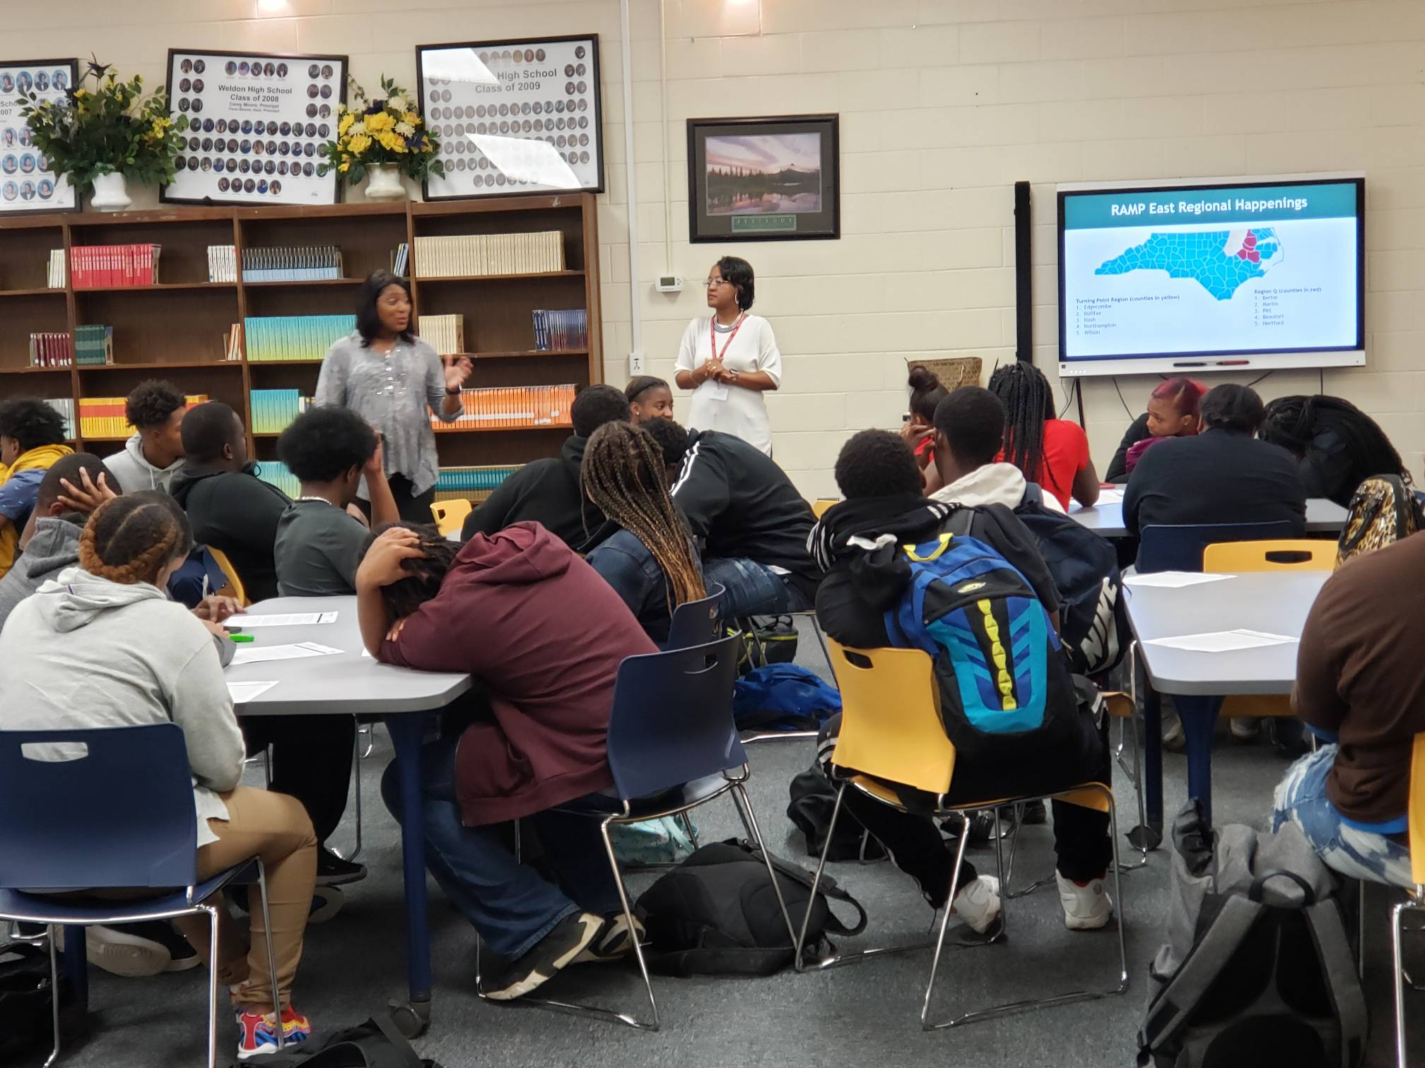
Angie Jenkins
RAMP East Recruiter
Turning Point

Slide 28


