Slide 1
TELAMON CORPORATION
Empowering Individuals,
Improving Communities

Slide 2
Ahoskie/NC02 Field Office
422 West Main Street
Ahoskie, NC 27910
252-332-1910
nc02@telamon.org

Slide 3
Our Service Area…

Slide 4
Who Are We…
"Empowering Individuals and Improving Communities" since 1965
Telamon-TRC* is a private, nonprofit organization which seeks to improve the lives of those in need.
Our mission is to provide educational services that lead to better jobs, better lives, and better communities.

Slide 5
What We Do…
"We are committed to our work to provide educational services that empower thousands of people each year to build better lives for themselves and their families."
As an organization, we provide educational services through three lines of businesses: Workforce & Career Services, Early Childhood & Family Support, and Housing & Financial Empowerment.
The Ahoskie/NC02 Office operates within the Workforce & Career Services line of business.

Slide 6
Ahoskie/NC02 Office Services…
Workforce and Career Services range from information about local job listings to financially supported occupational training:
Job Referrals Job Placement Assistance Career Counseling & Exploration Supportive Services Paid Work Experience Classroom Training | Education & Skill Level Assessments Assistance with Obtaining Occupational Certificates and Educational Credentials Paid On-the-Job Training Youth and Adult Activities
Services are tailored to meet the abilities and needs of individual customers, and supported by professionals in the workforce development field.

Slide 7
NATIONAL FARM WORKER JOBS PROGRAM YOUTH ACTIVITY
The activity serves youths between the ages of 16 – 24.
That have done farm work in the last 24 months.
Or has a parent/guardian that has done farm work in the last 24 months
They may qualify for our program!

Slide 8
NFJP Eligibility Requirements
We assist farm workers, their spouses, and dependents.
The farm worker must have done farm work within the last two years from the date of the initial NFJP Application for Services.
In determining eligibility, we pick the best 12 months out of the 24 months.
The farm worker must have done mostly farm work and/or earned most of his/her earnings from farm work during the chosen 12 month period.

Slide 9
Remember…
The applicant does NOT necessarily have to be the farm worker.
Applicants can be the spouse or dependent of the farmworker.
The farm work must have been paid and verifiable (we will need signed employment confirmation).
Farming must be hands-on/handling the product (driving/transport of product or sanitation of equipment will not qualify)

Slide 10
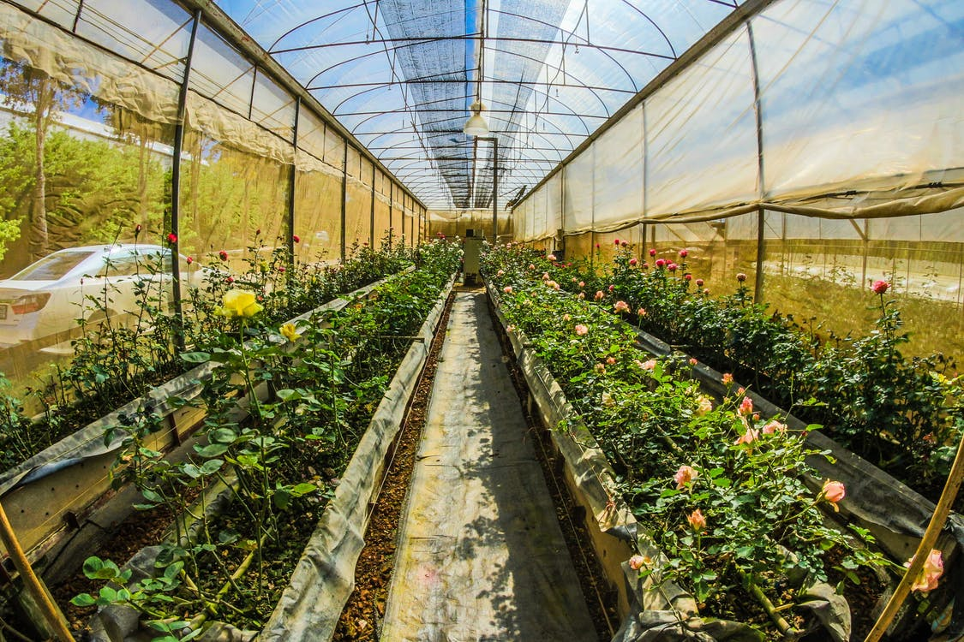
What Is Considered Farm Work?
Chicken Hatcheries
Field Work
Tending Livestock
Plant Nurseries
And more!

Slide 11
What is Considered Farm Work?
Egg Hatcheries
Chicken and Poultry Farms
Plant Nurseries
Hog Farms
Taking care of Live Stock

Slide 12
Employment and Training Services
Work Experience – Participants will acquire basic workplace skills and develop good work habits while working in public agencies or non-profit settings. Their full salary will be paid by Telamon while they are trained by an employer for 89 days.
On-The-Job-Training – Participants will gain valuable occupational skills while learning a new trade in a private or public sector job. They are hired by the employer and Telamon will reimburse up to 75% of the participant’s salary for the duration of their OJT contract.

Slide 13
Employment and Training Services
Occupational Skills Training
We can pay tuition, books and fees for short-term/2-year programs
Clients in the classroom training program are eligible for Needs Related Assistance and supportive services.
The Needs Related Payment can range from the minimum $75.00 to the maximize of $150.00 a week.
Client must complete 12 hours a week of classroom training.

Slide 14
Success Story
When George White was 12 years old he realized he wanted to cut hair. He lacked transportation, had limited work experience and had difficulty finding sustainable employment. George was not about to give up his dream of becoming a barber and opening his own barbershop. The NFJP program assisted George with relocation to Greenville, tuition at the Barber School Program at Pitt Community College, books, and other supportive services. George completed his barber training in November of 2016. In December 2017, George started working at Premier Vision Barber Studios in Elizabeth City.

Slide 16
A Moment of
Thank you all for attending and for your support as we strive to make an impact in the community!!!
To contact the Ahoskie/NC02 Office:
Roxana White - 252-370-6044
Aleta Tootle - 252-339-0267
Charity Davenport – 252-917-2512

