Slide 1
Partners in Opportunity:
Processes and strategies for engaging partners, the associated networking, outcomes and benefits, and lessons learned
Laurie Weston, Director, Transitional Studies, Pitt Community College
Brandi Bragg, Career Pathways Facilitator, NENC Career Pathways
Notes:
I cannot put my hands on the copy of the group photo, but I was thinking it would look great at the top of this slide?

Slide 2
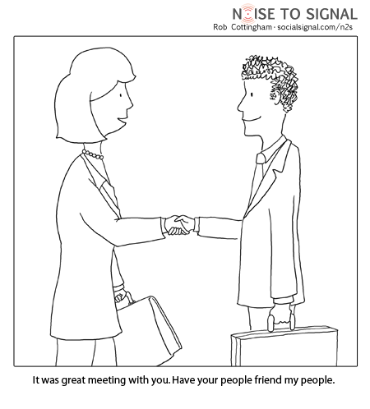
History of starting WIOA
Partnerships at Pitt CC
Outreach
Join in
Put your face in that place
Present to other community groups, agencies, organizations
WIOA 13 Considerations: 4, 10, and 11 Call for Title II programs to establish partnerships, collaborate and coordinate with these partners to provide support services and additional resources to clients, and align goals and objectives with partners and workforce development boards.

Slide 3
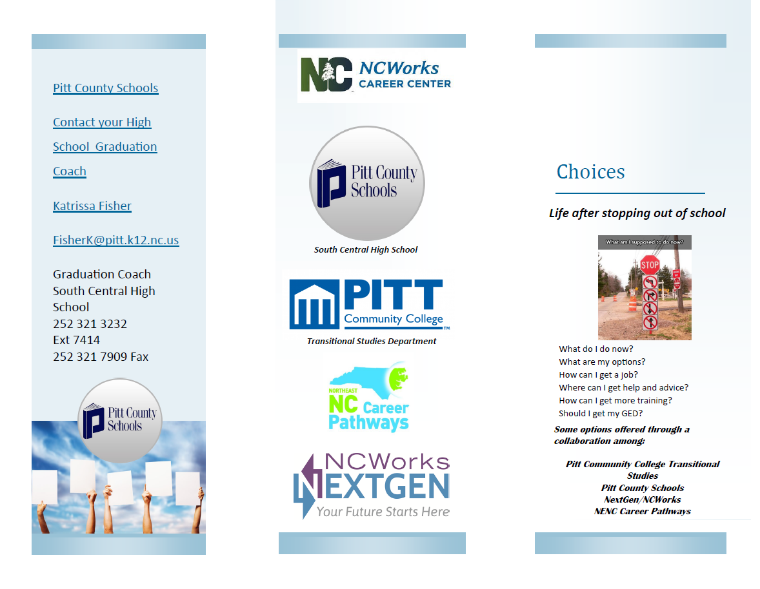
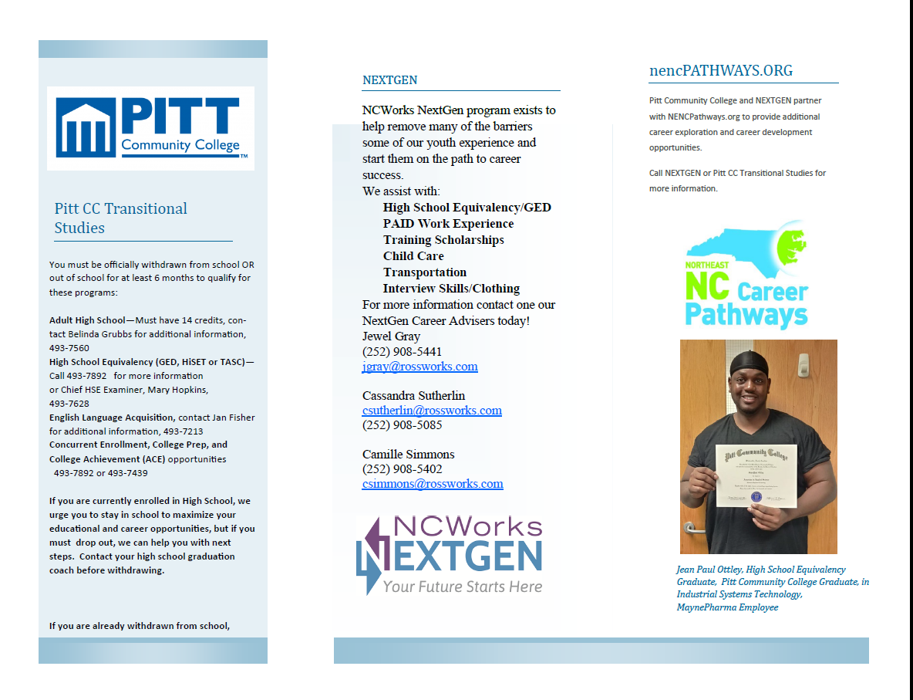
Successes and Initiatives:
CHOICES

Slide 4
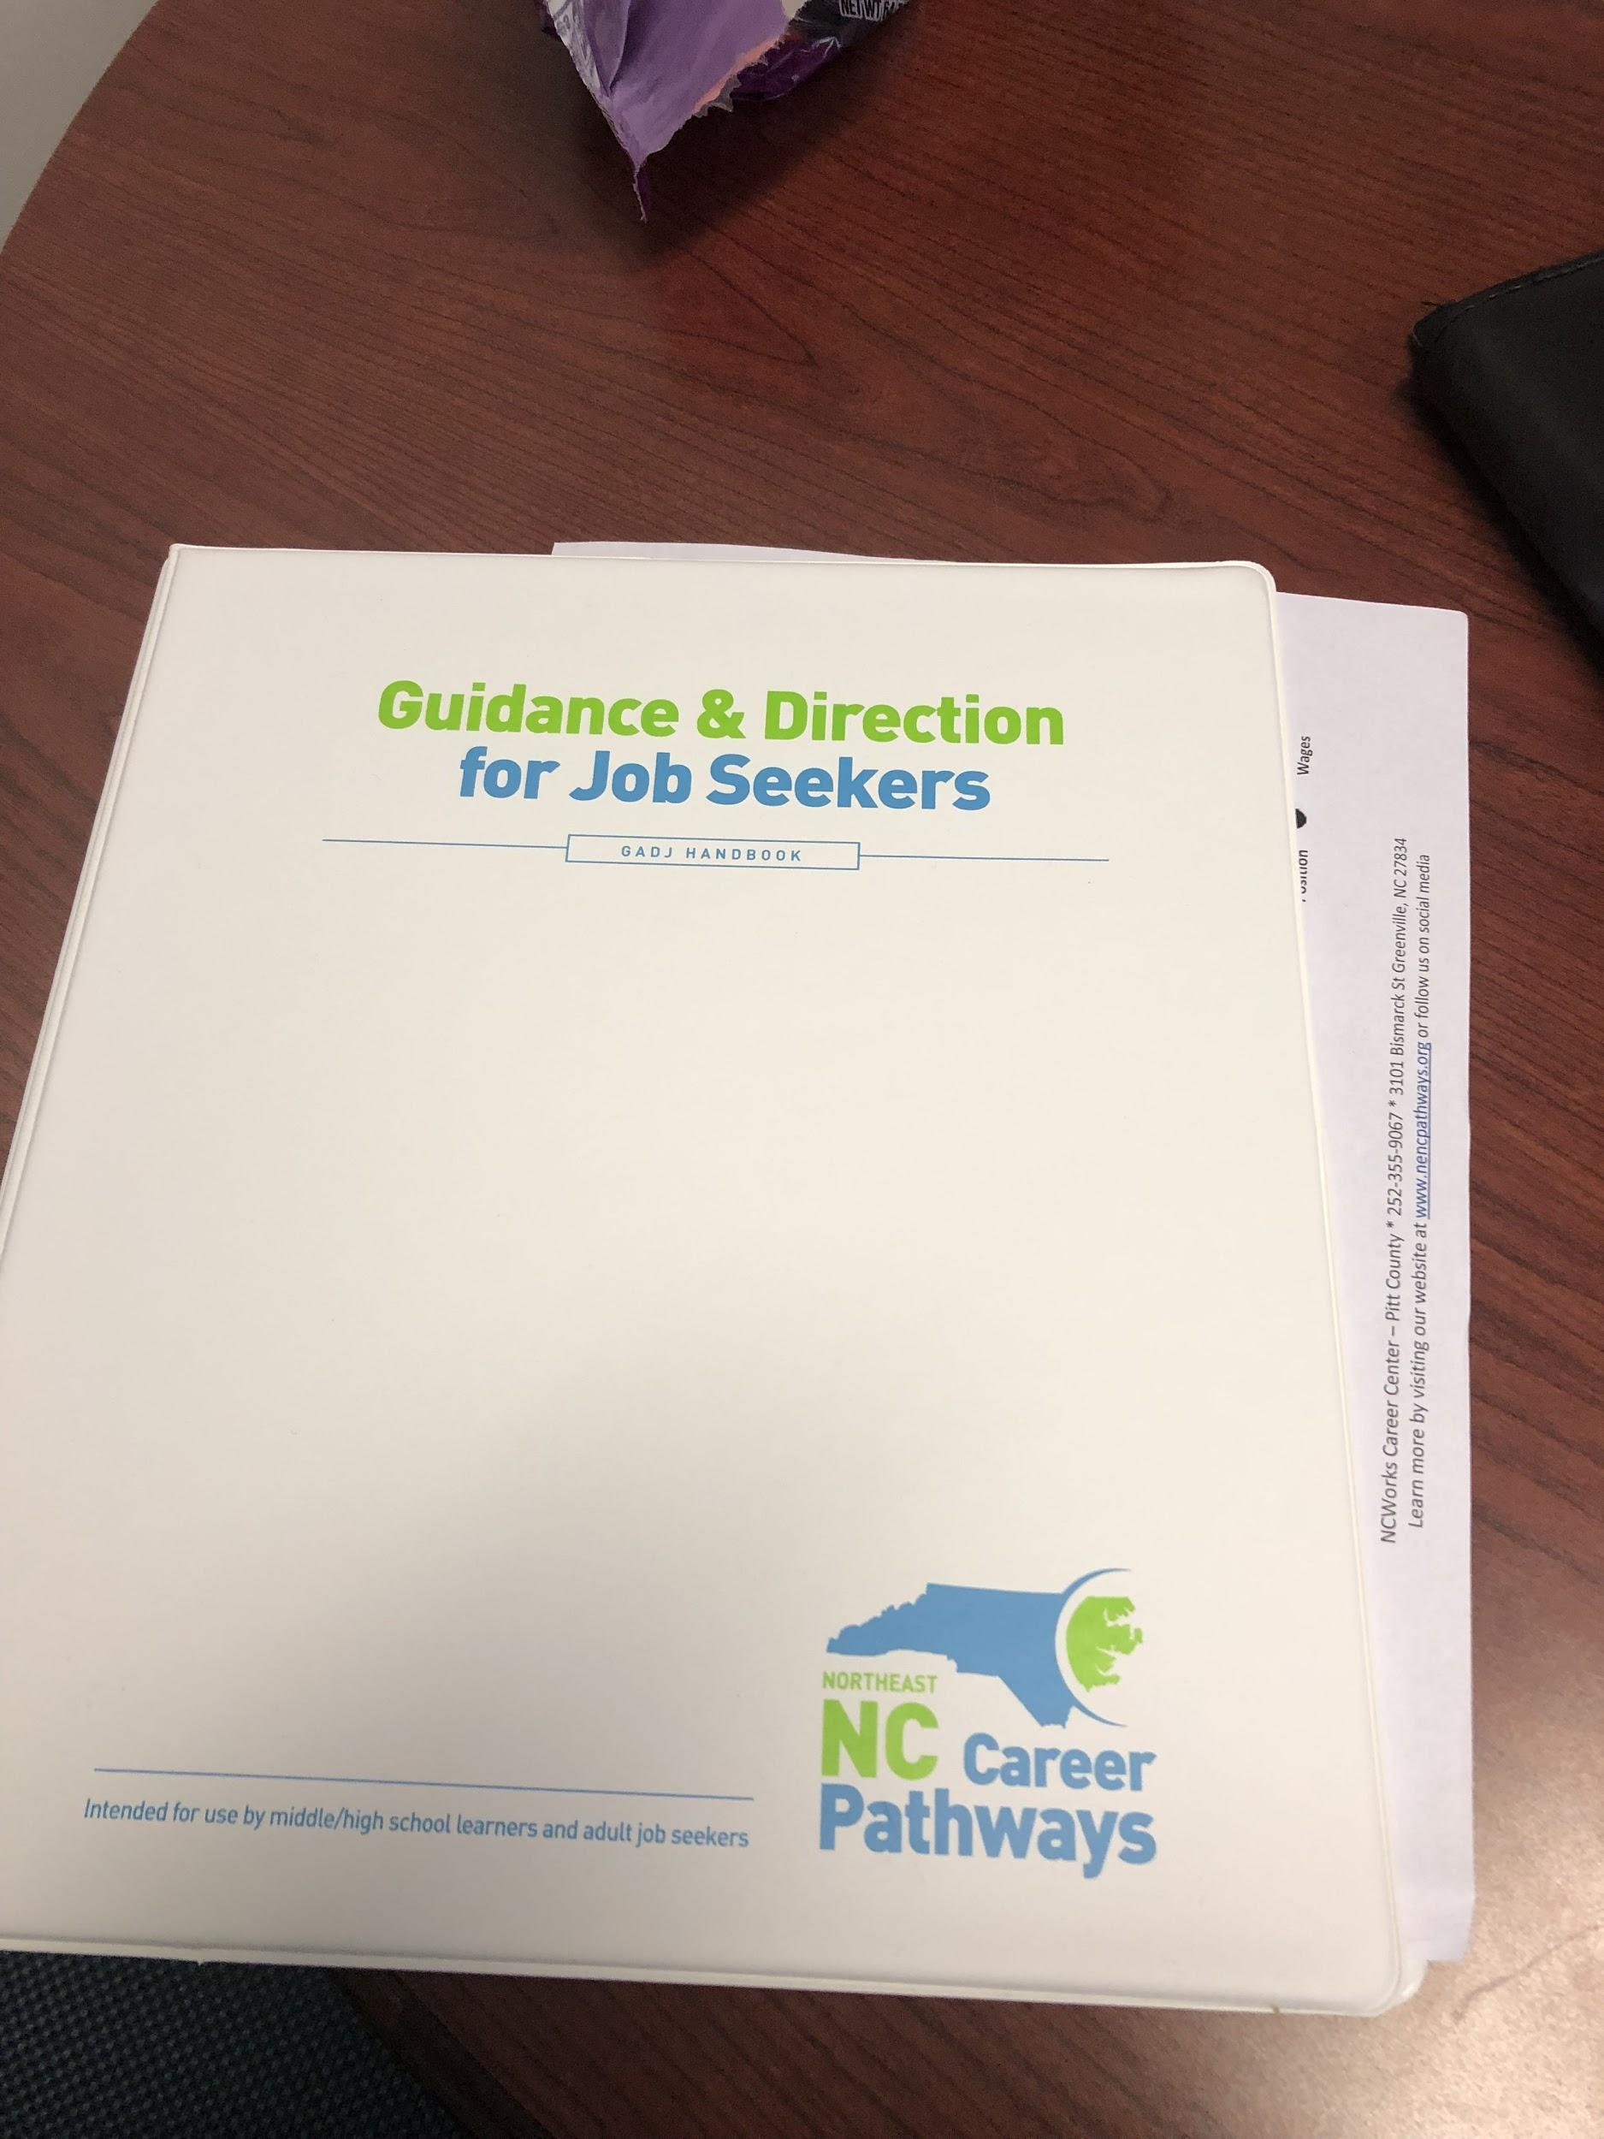
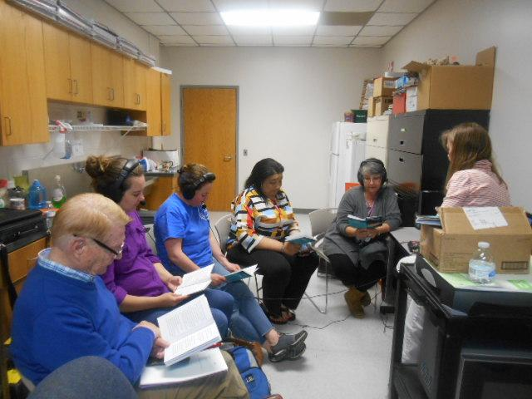
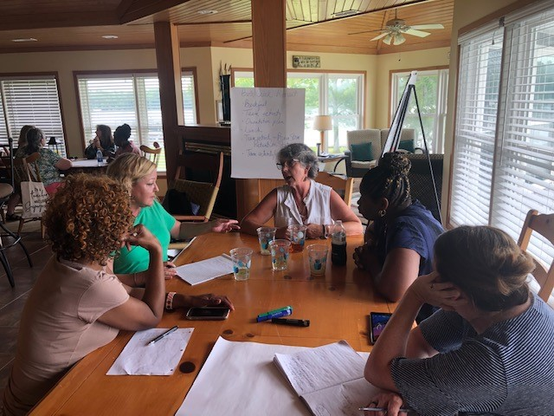
GADJ: GUIDANCE AND DIRECTION FOR
JOB SEEKERS

Slide 5

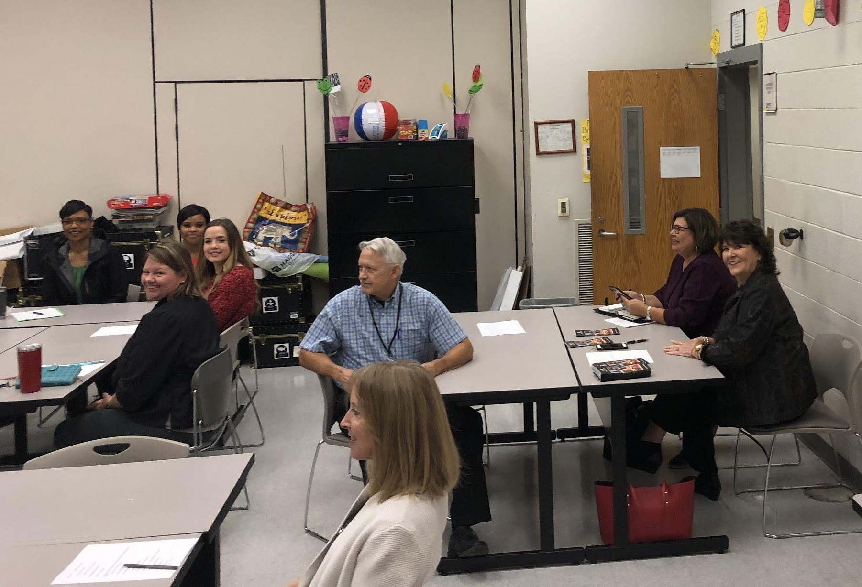

RESOURCE SHARING
Monthly Meetings with Featured Partners
NCCOMMUNITYCOLLEGES.AUNTBERTHA.COM
WIOA/TRANSITIONAL STUDIES GOOGLE
RESOURCE PAGES

Slide 6
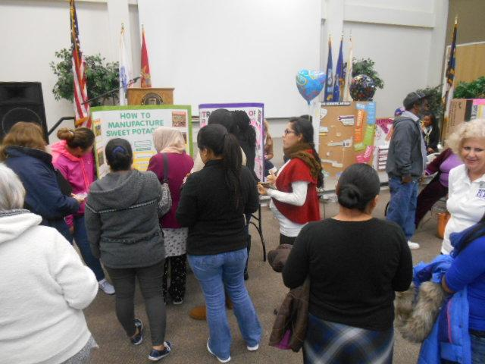
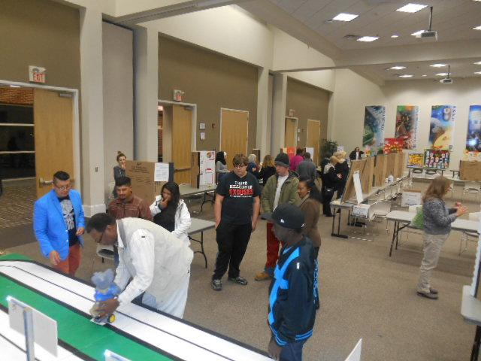
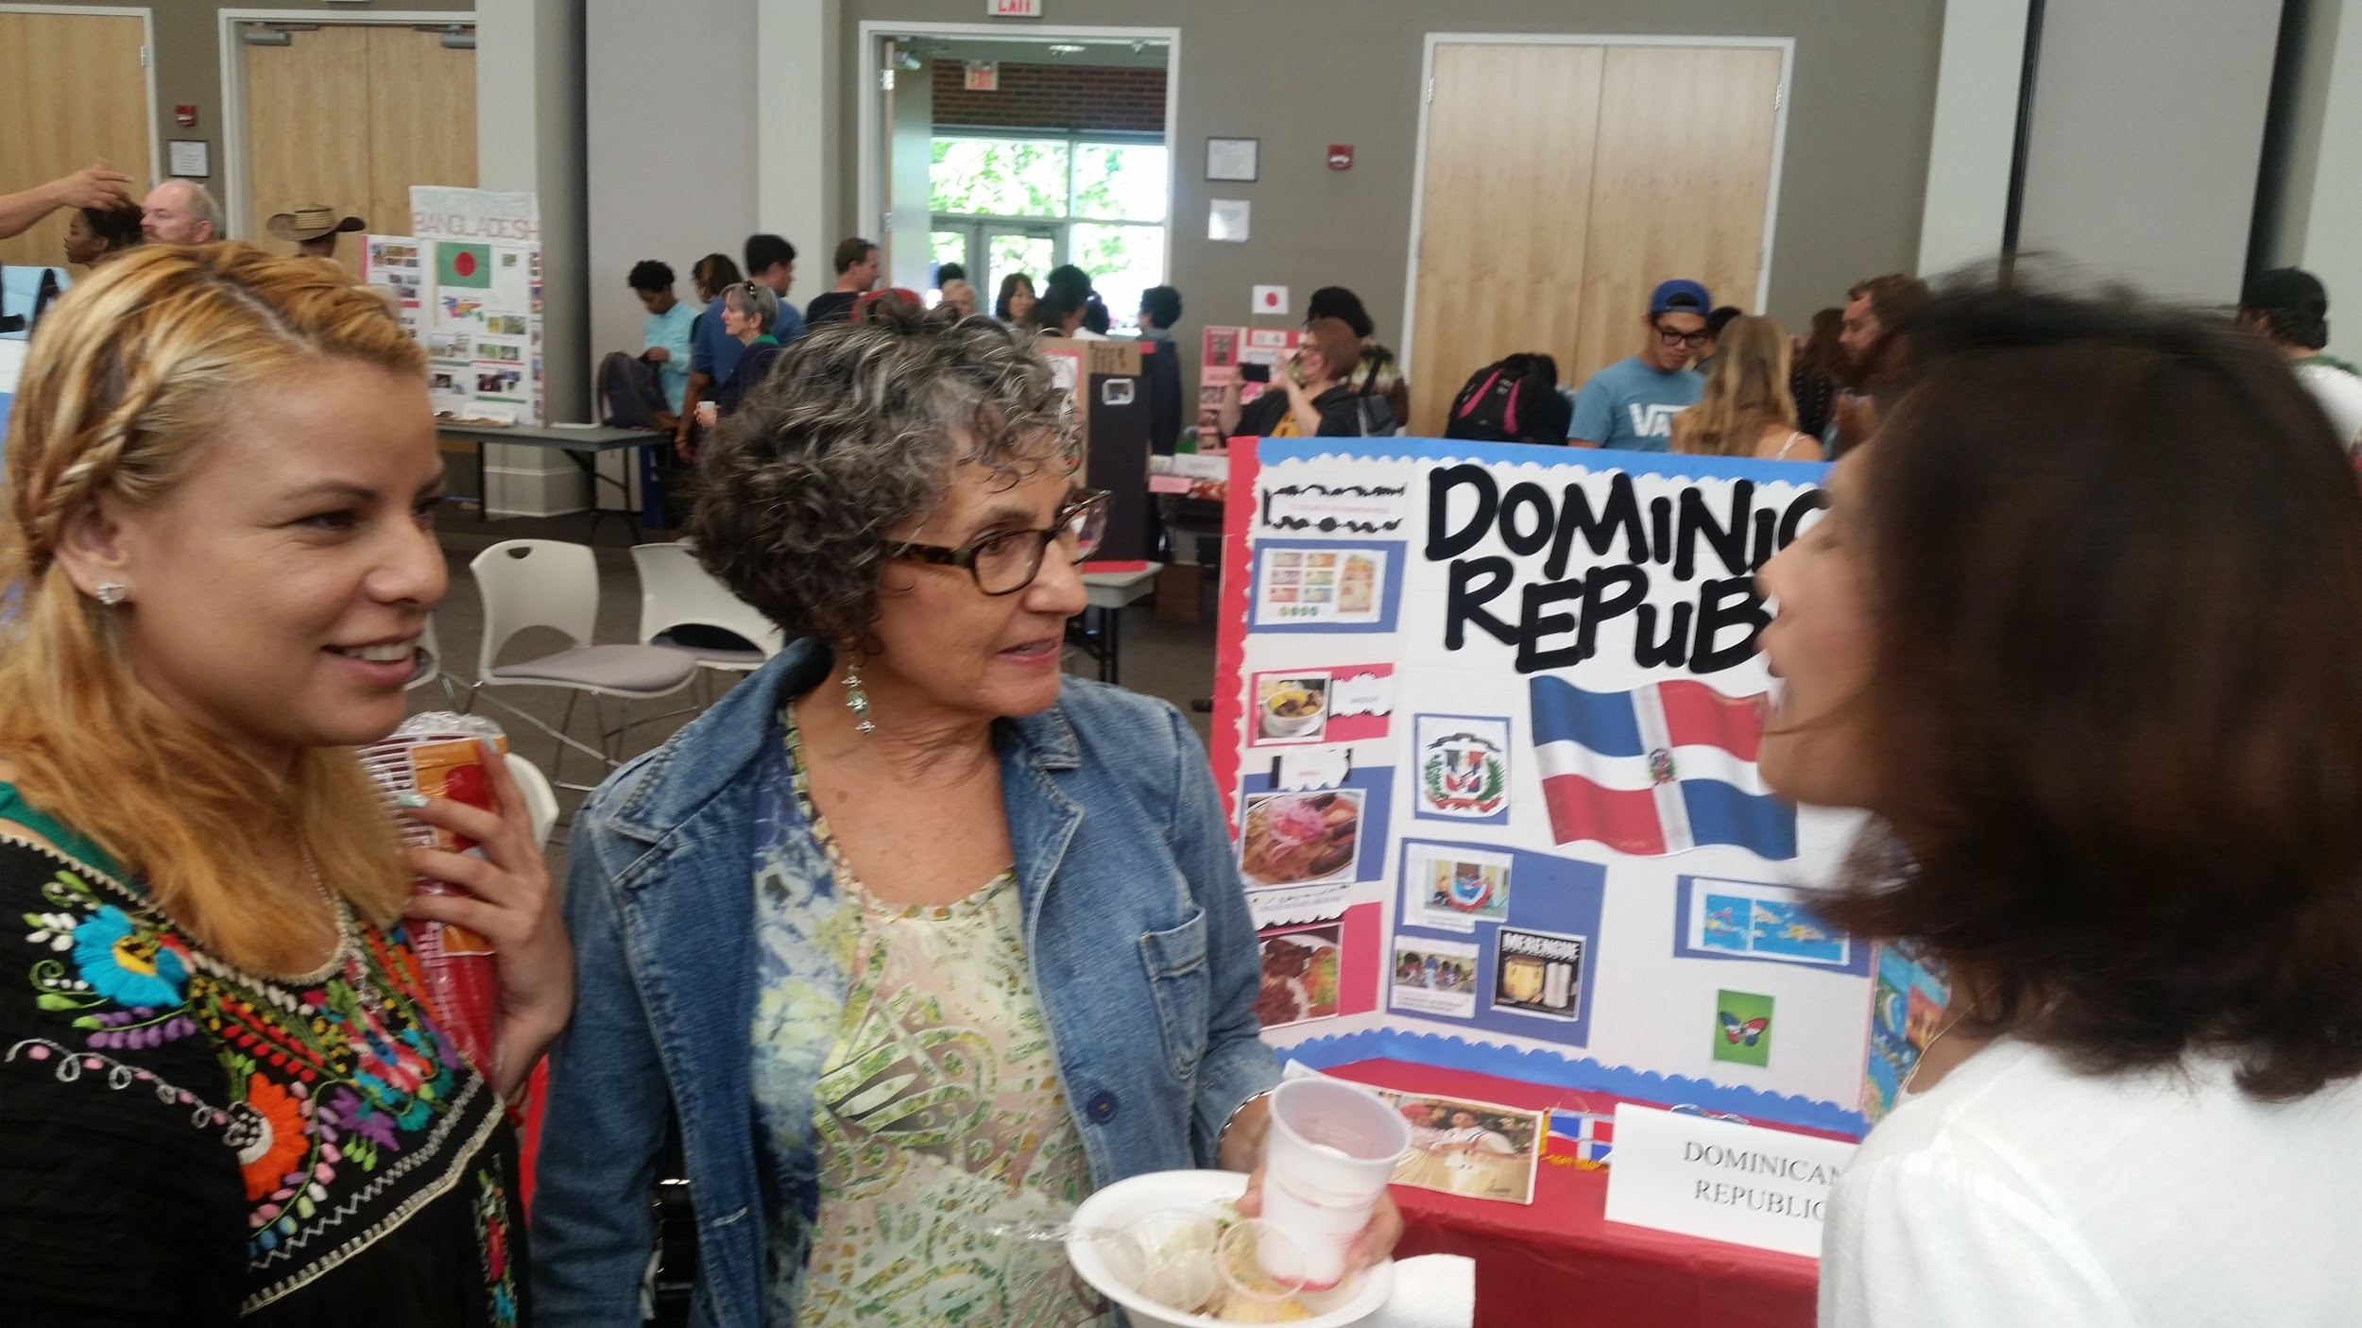
Project-Based Partnerships
Annual Project Fairs
International Day

Slide 7
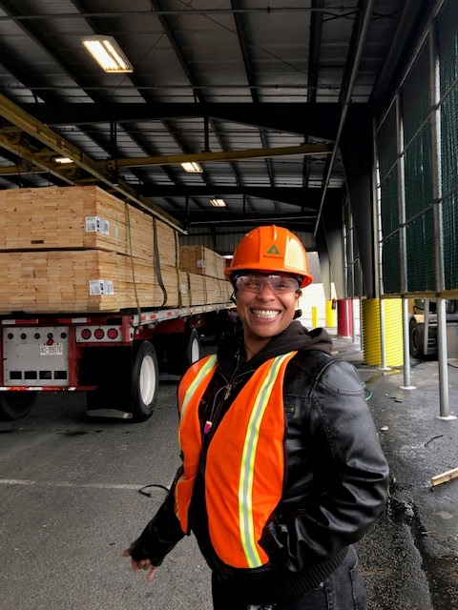
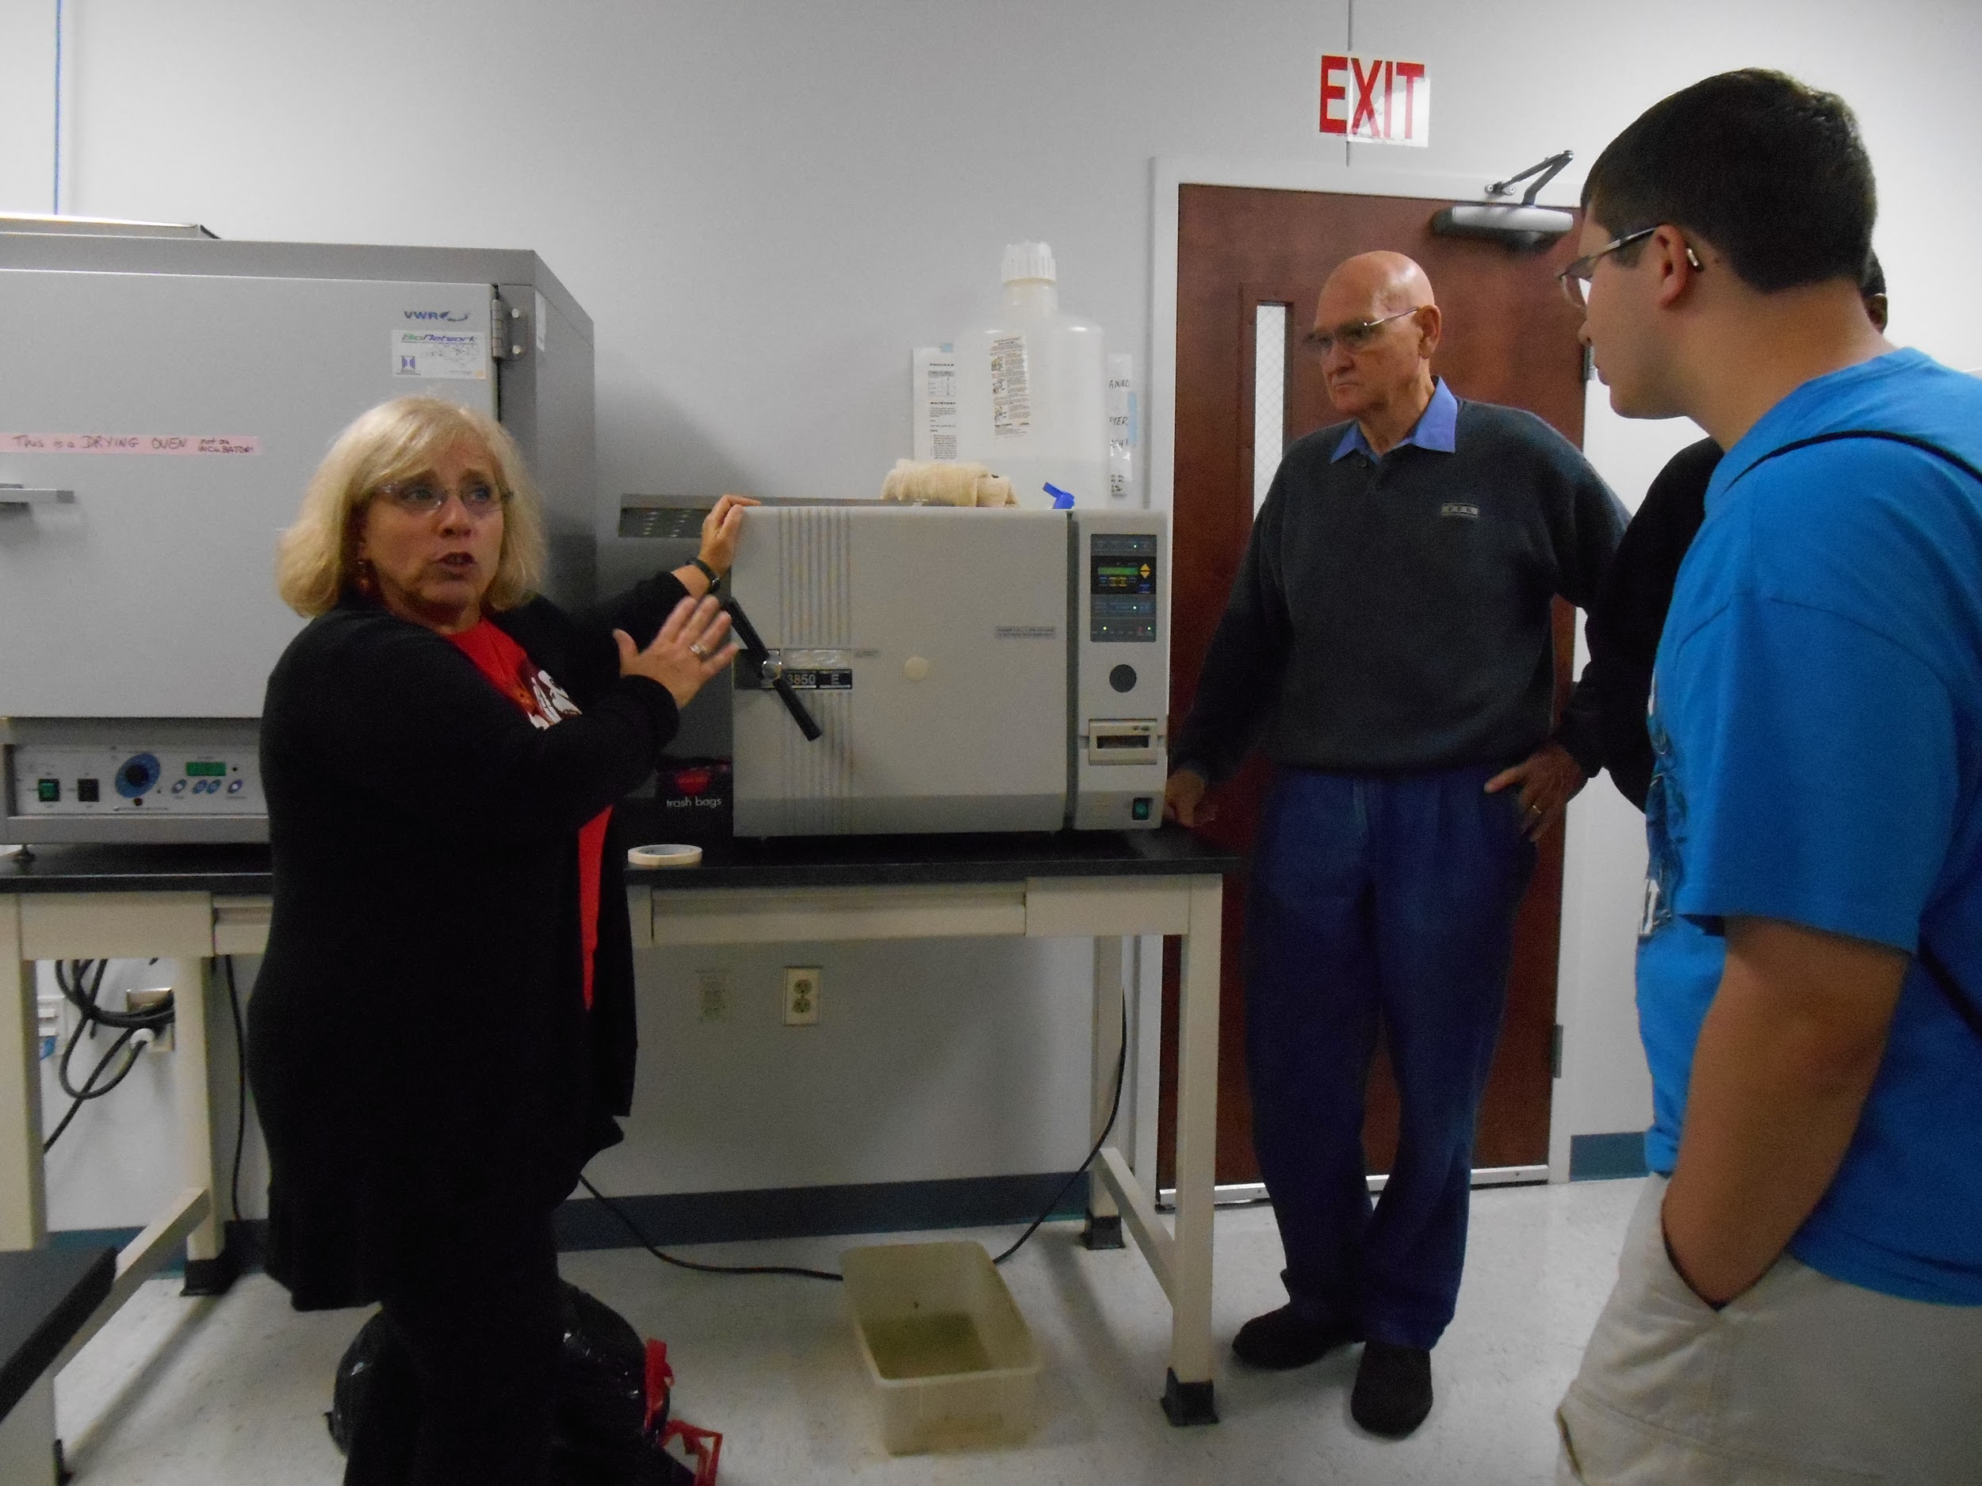
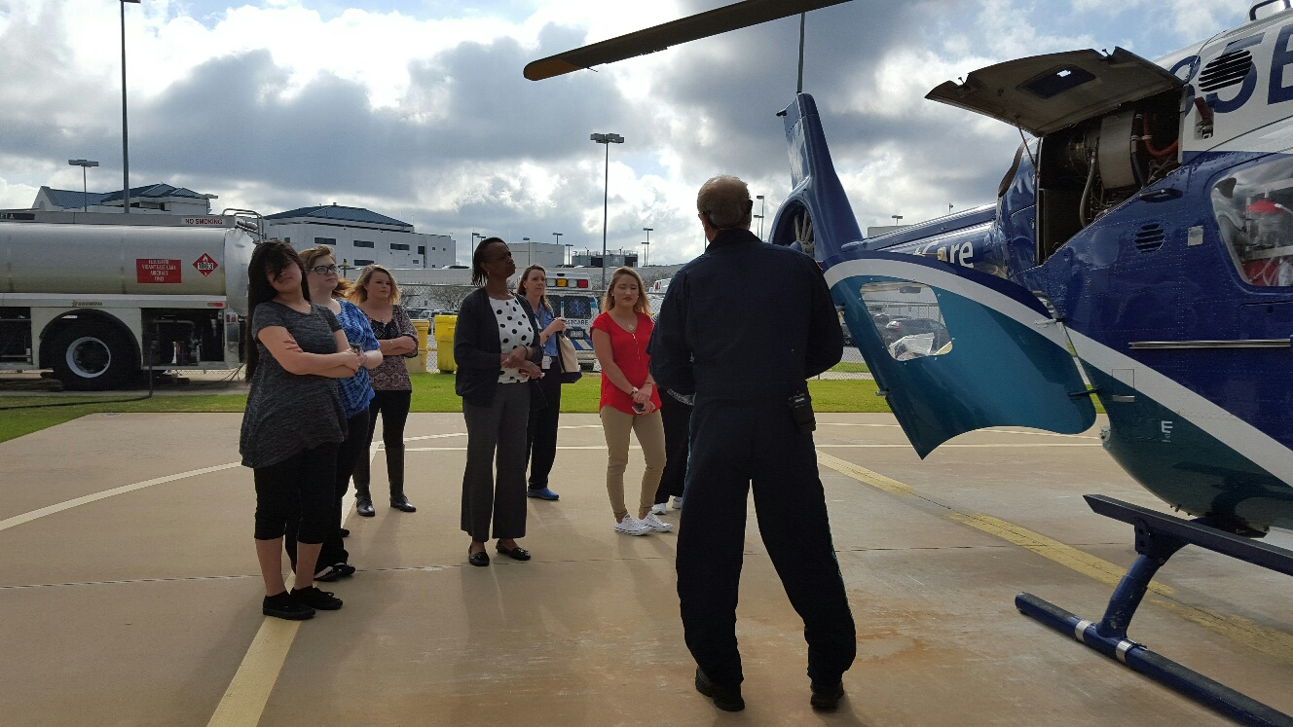
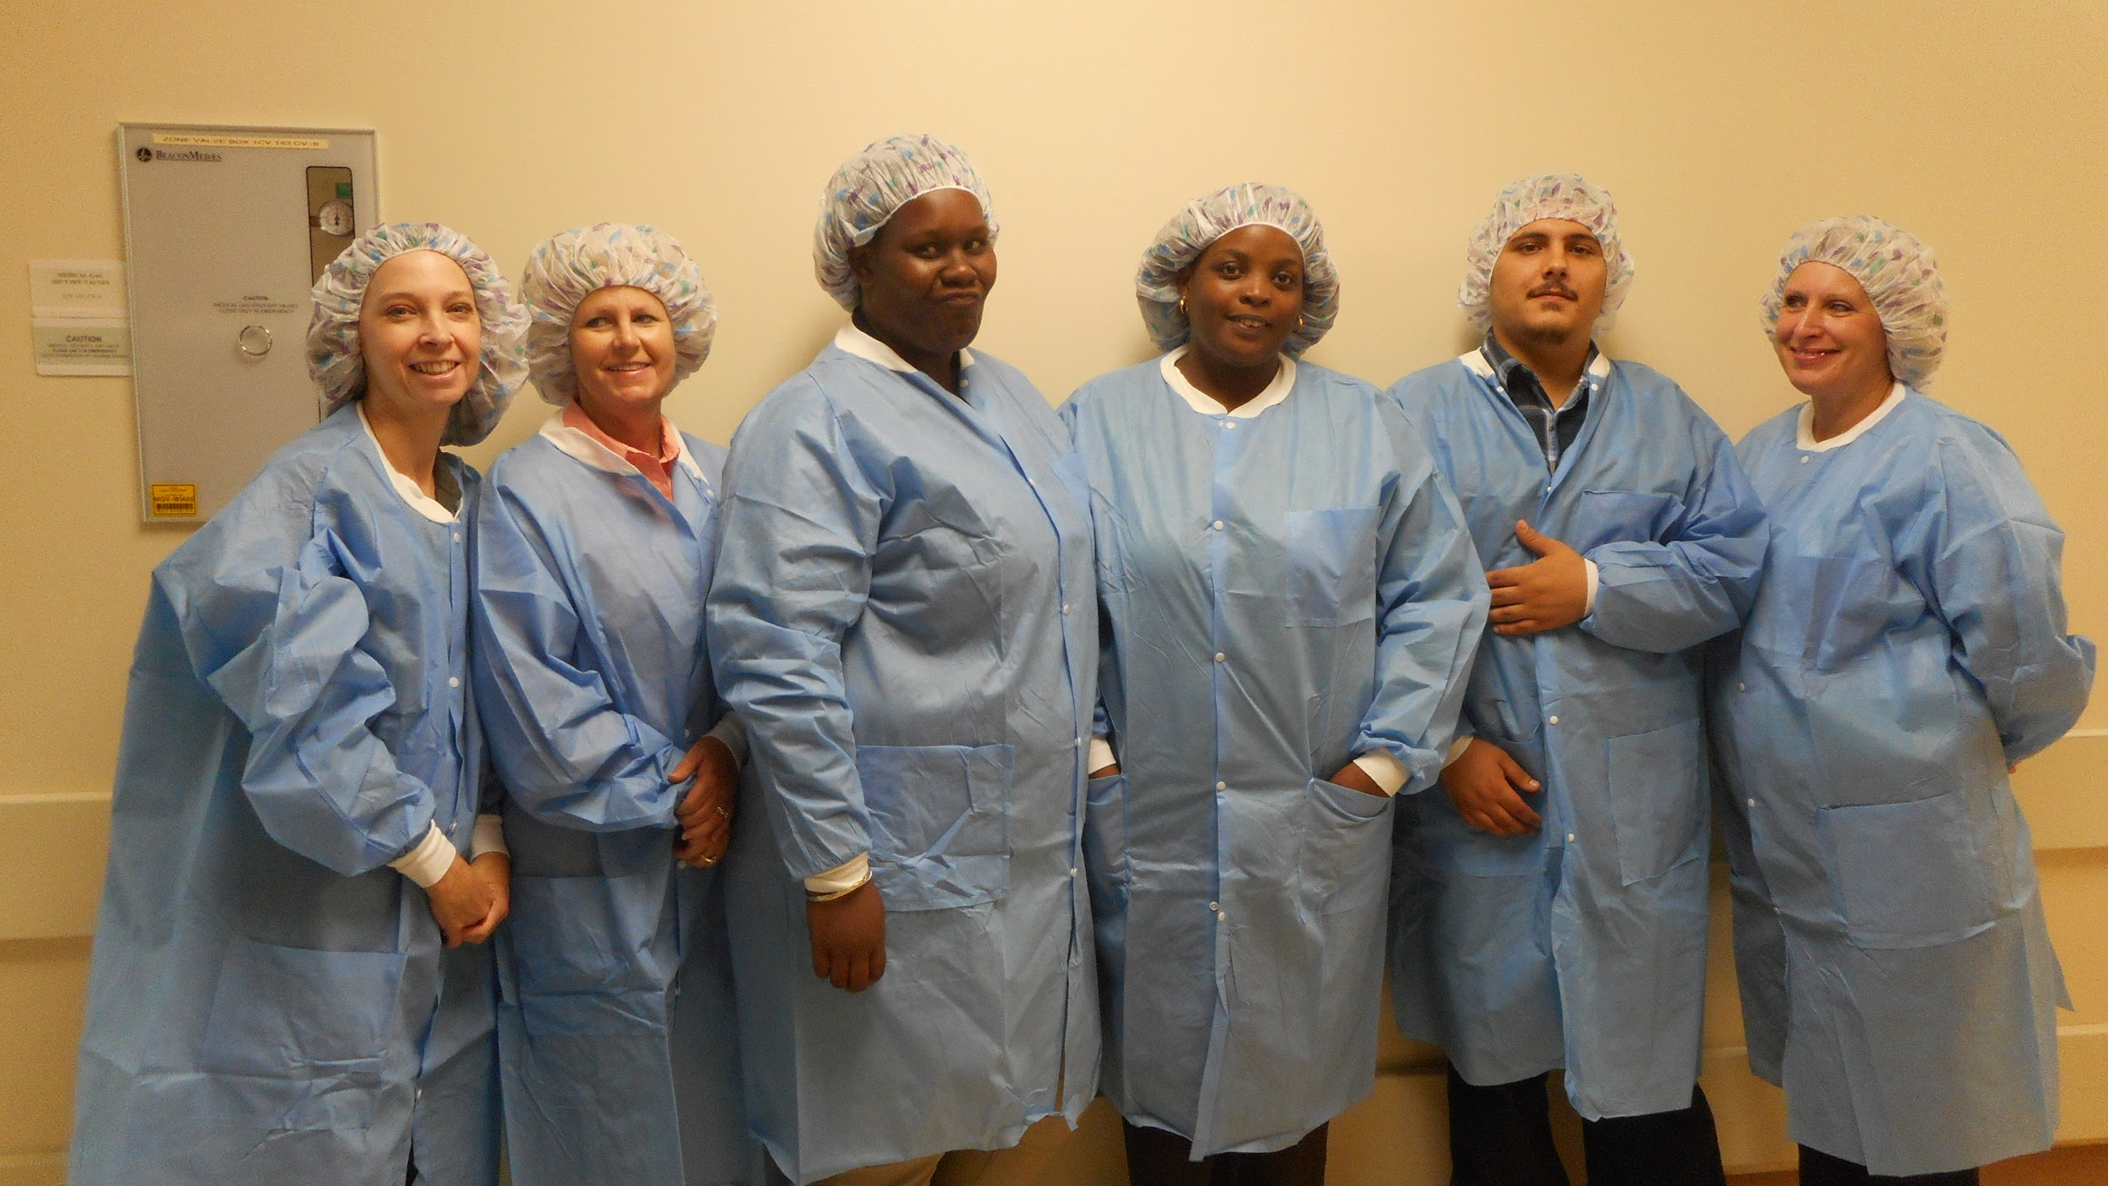
Field Trips
Weyerhaeuser
Vidant Medical Center
Biotech Center

Slide 8
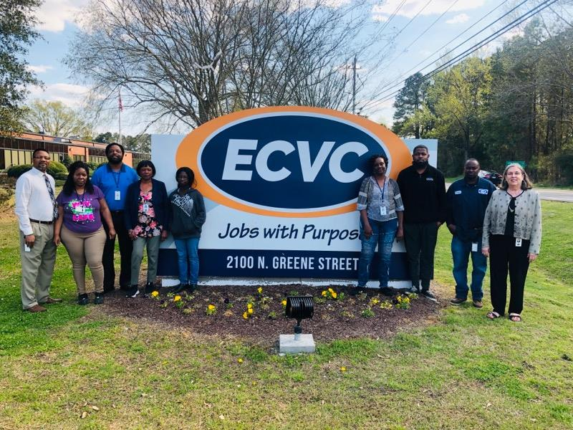
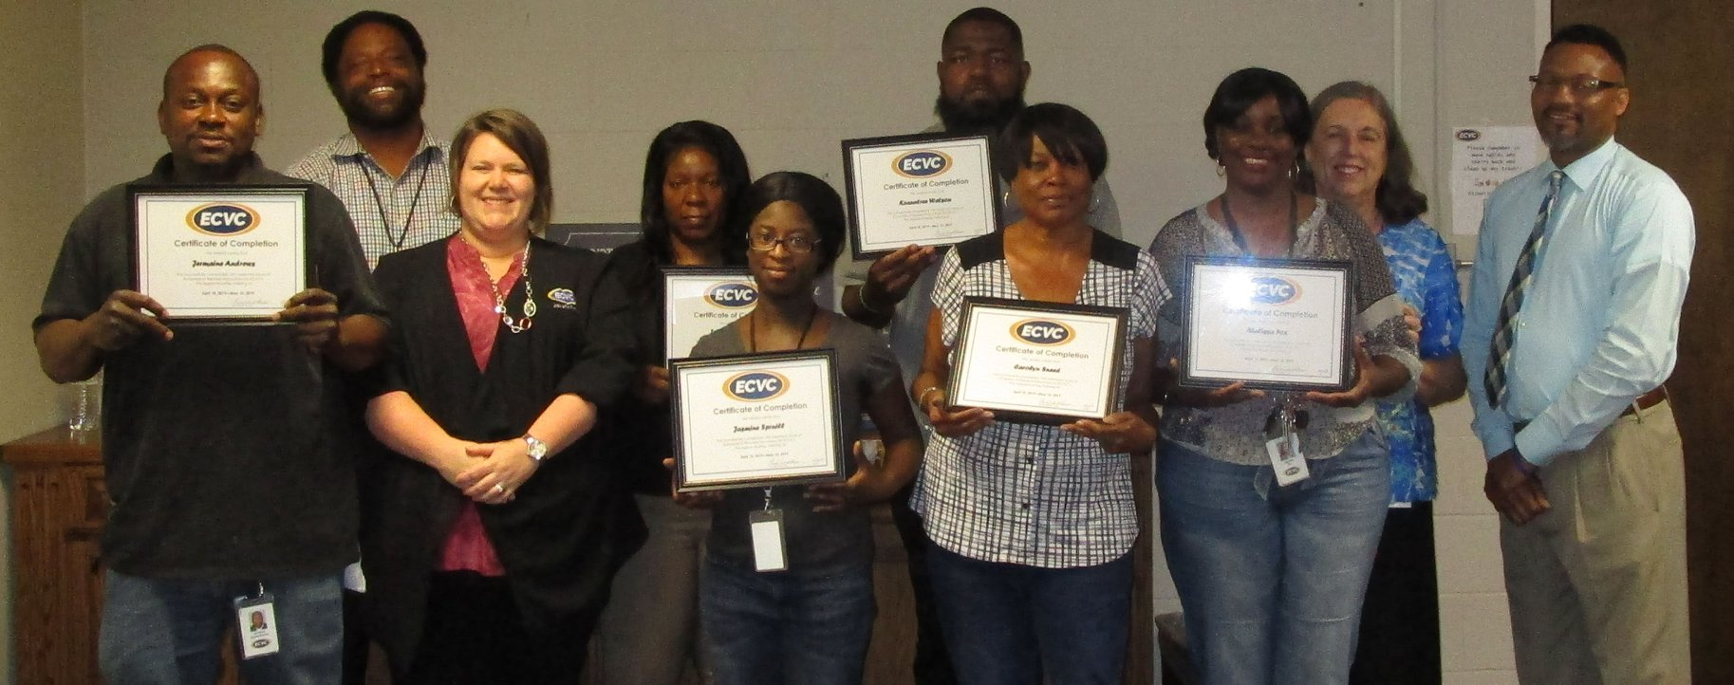
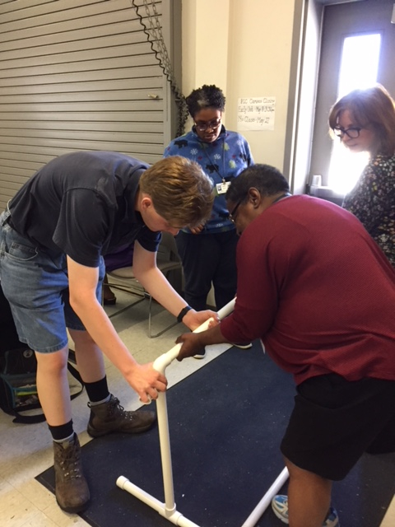
Apprenticeships

Slide 9
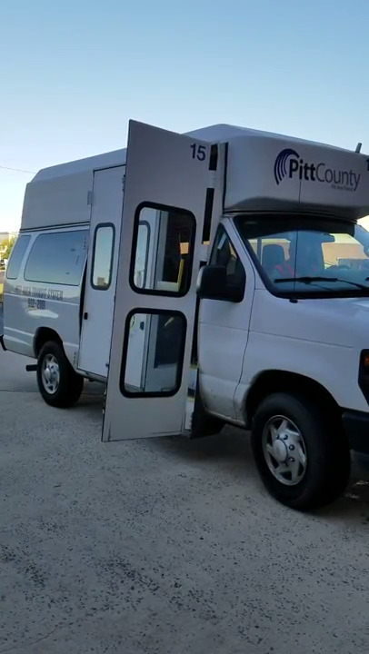
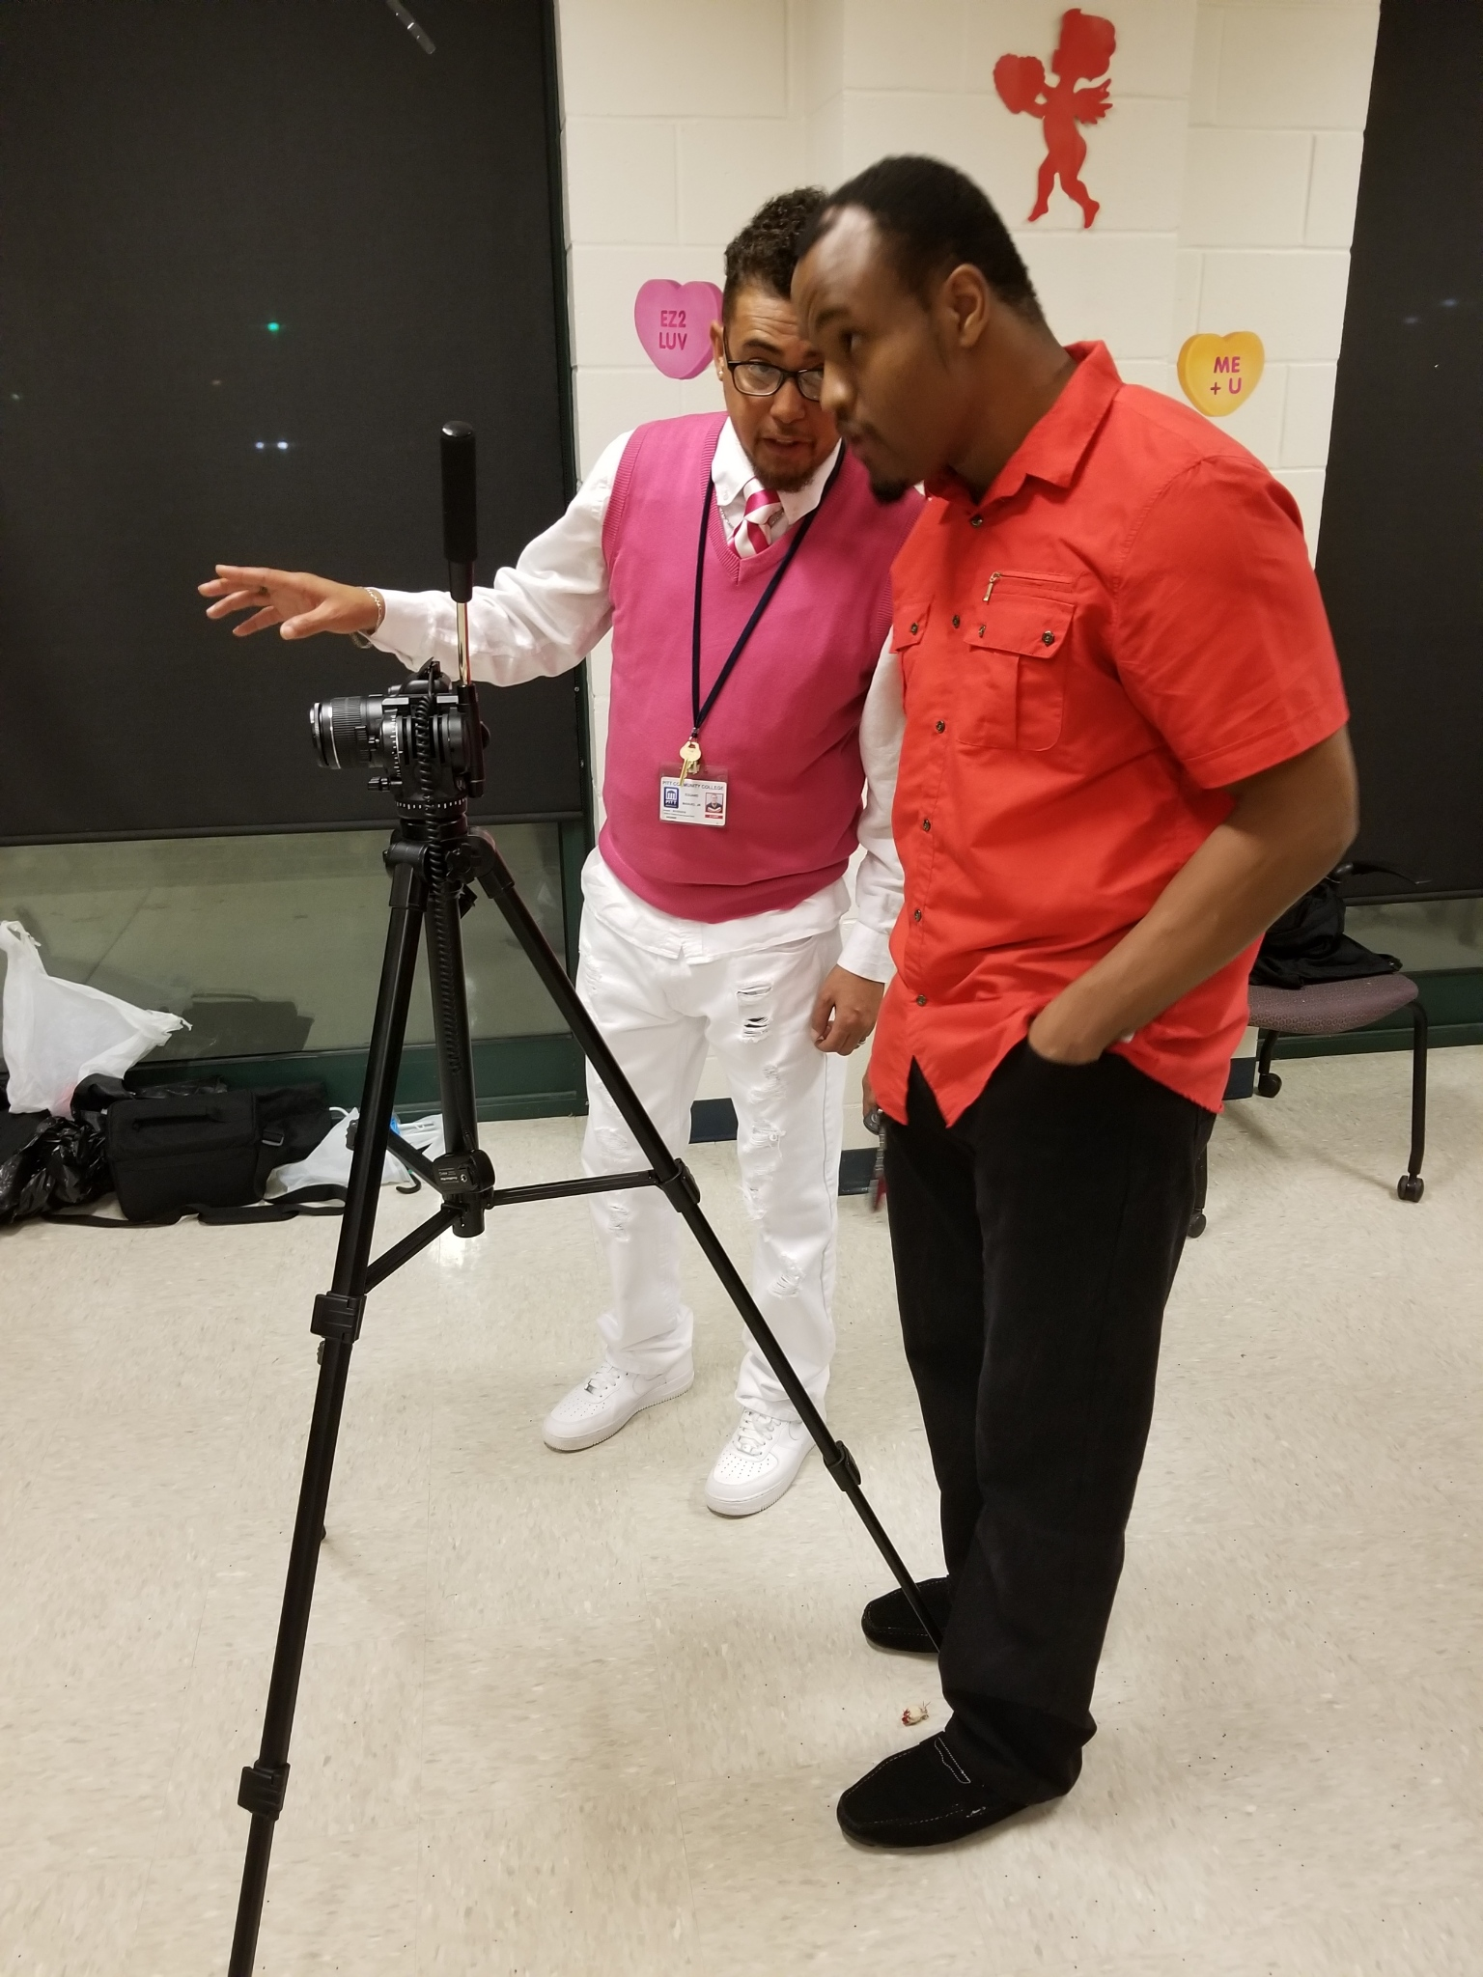
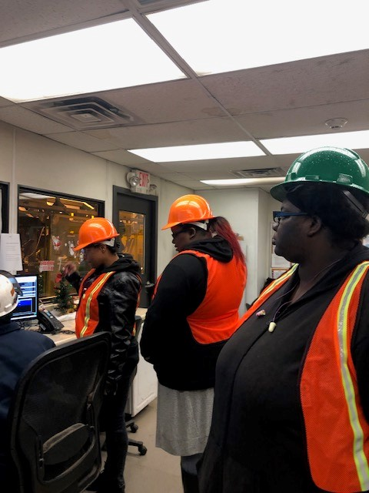
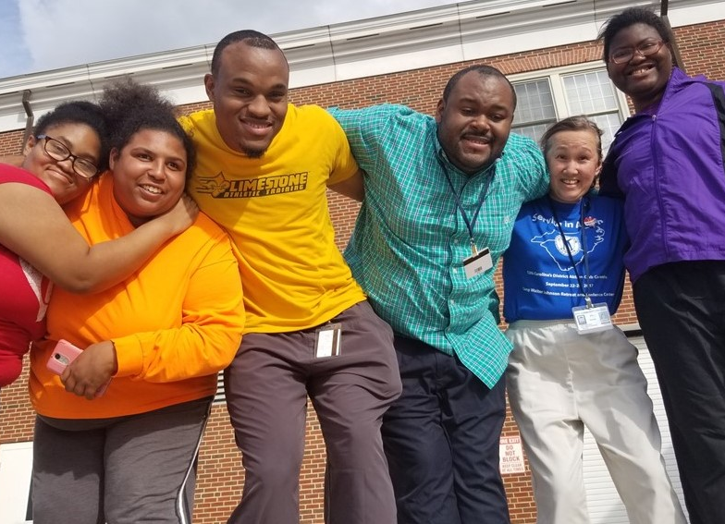
Grants
PATS EDTAP
ROTARY
WEYERHAEUSER

Slide 10


Interactive Networking
Notes:
Props (with instructions) will be passed around in two baskets, one for each side of the room. Attendees will be instructed to:
Find someone with the same prop (different colors ok).
Learn their name, title, organization and ask the question directed on the attached card.
Spend a couple of minutes chatting with your new connection.
If you want, take a snapshot with your prop partner and post on social media with the #NCWorksConference hastag. We might use your photo in future presentations.

Slide 11
Networking ReDesigned
Small but resourceful planning team
Secure sponsors
Invite partners
Introductions
Agenda
Welcome
Scavenger Hunt
Case Studies
Follow-up
Visit http://nencpathways.org/2019/10/10/diy-networking-redesigned/ for DIY instructions and samples to start planning your event!

Slide 12
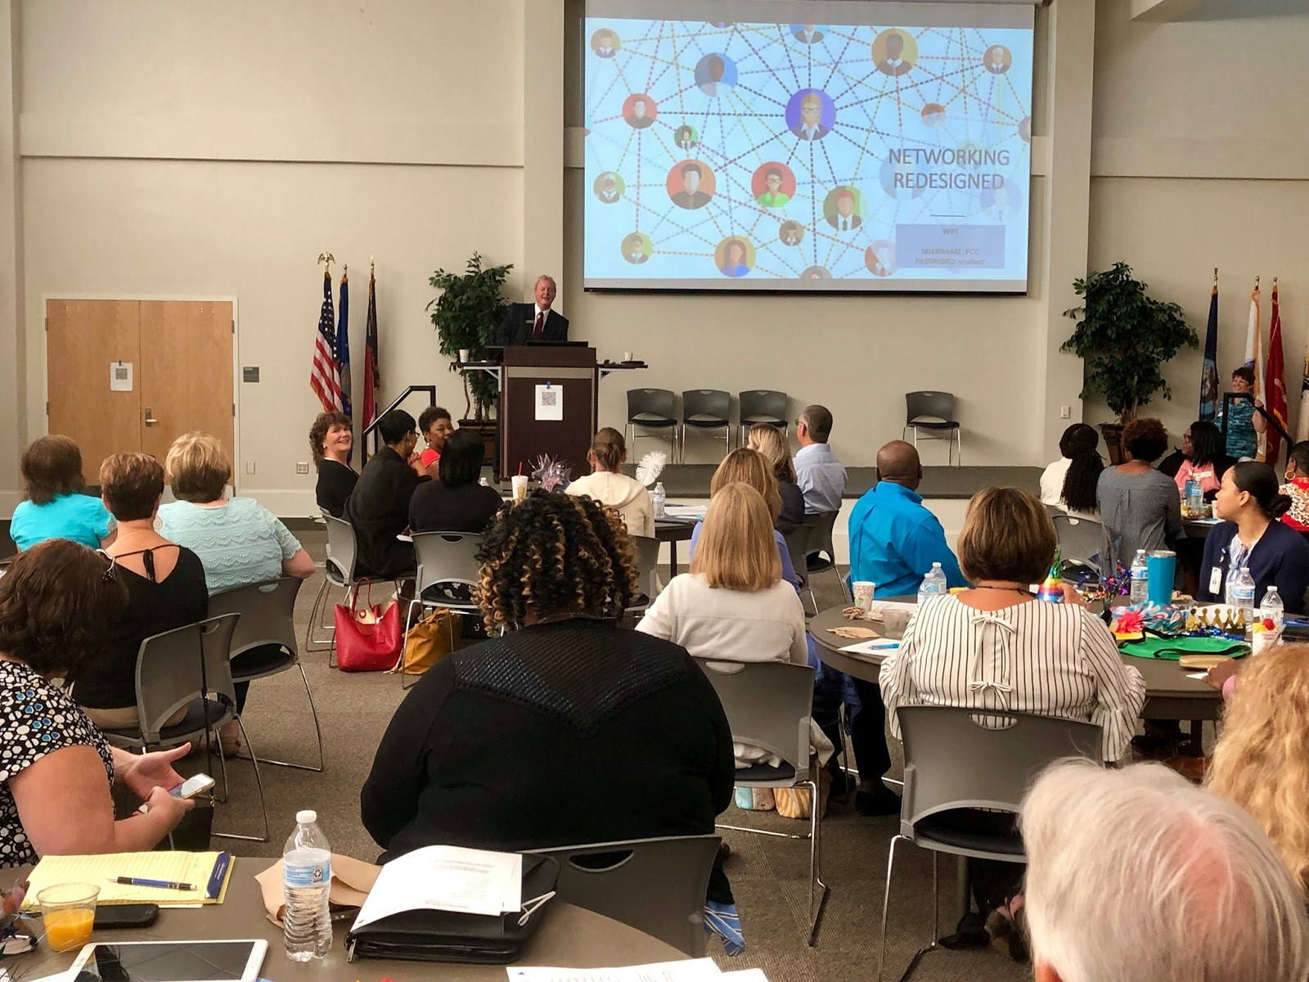
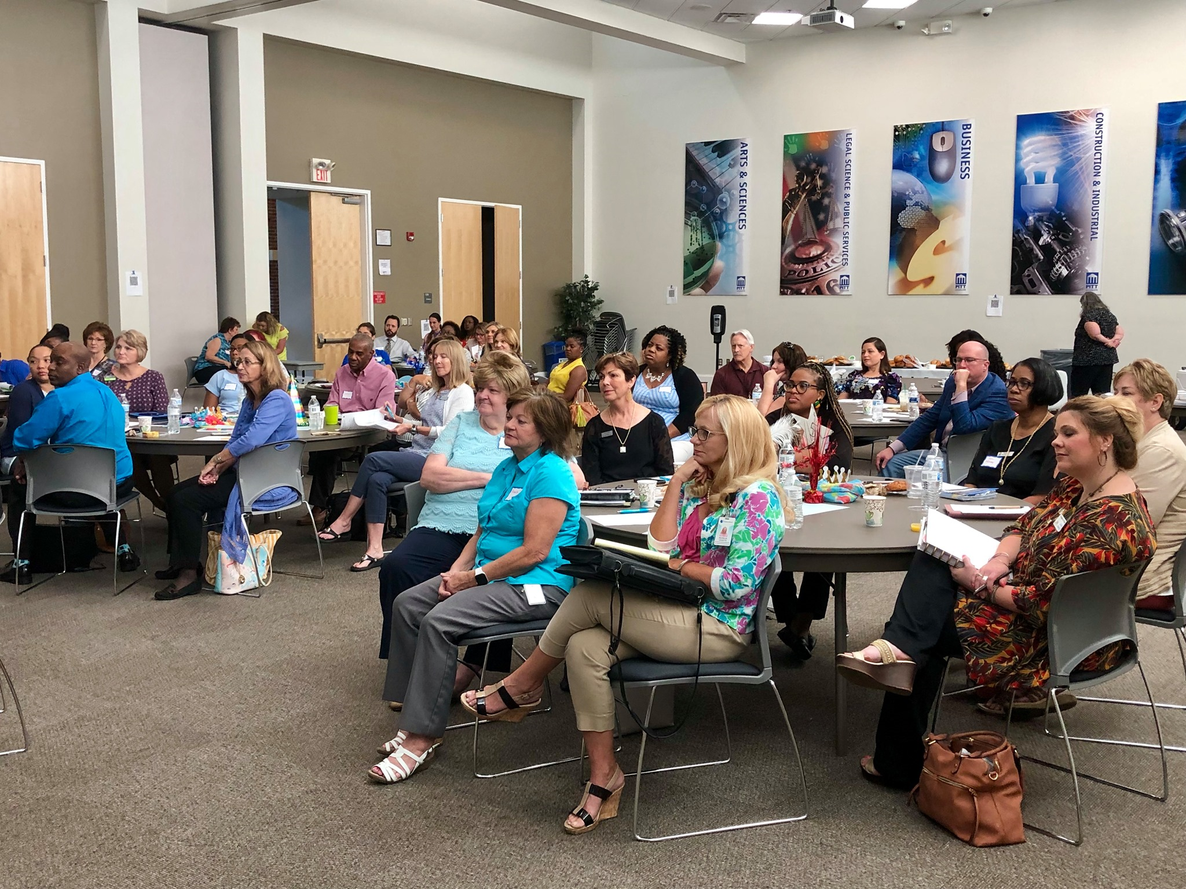
Networking ReDesigned - Pitt County

Slide 13
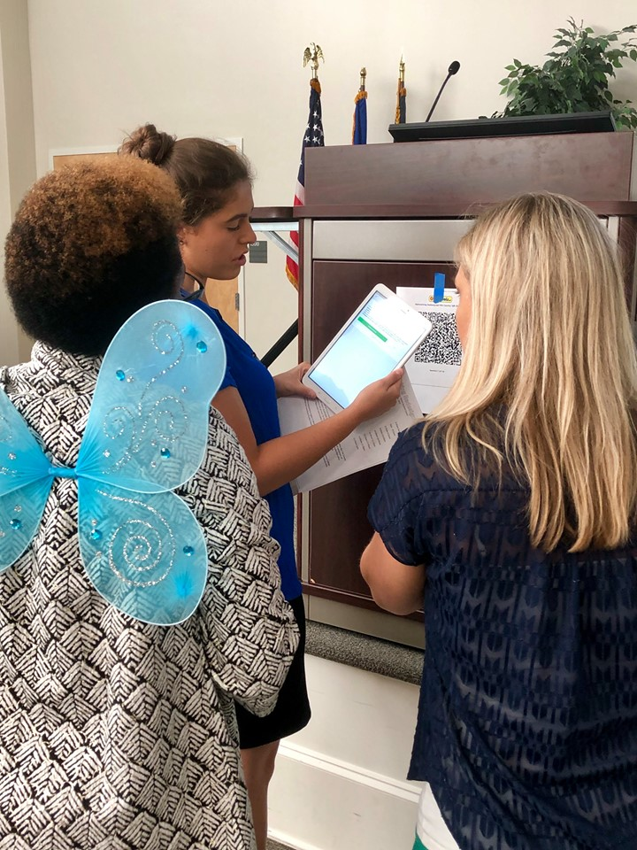
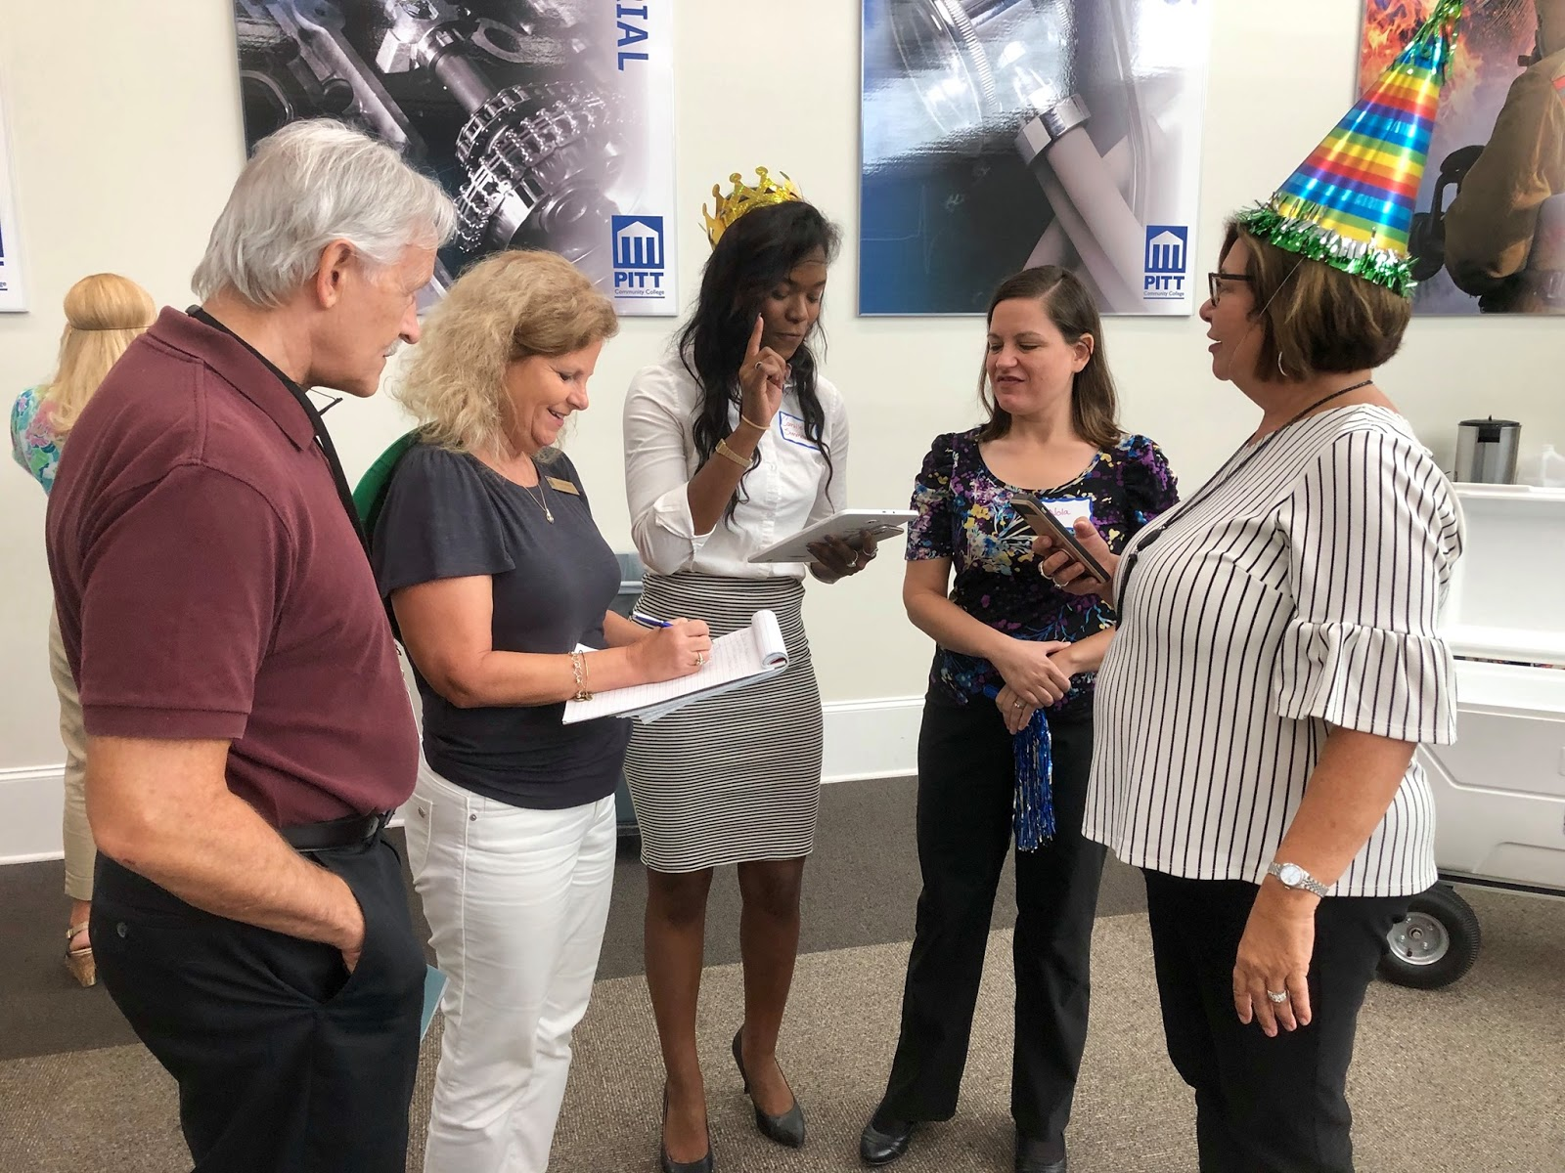
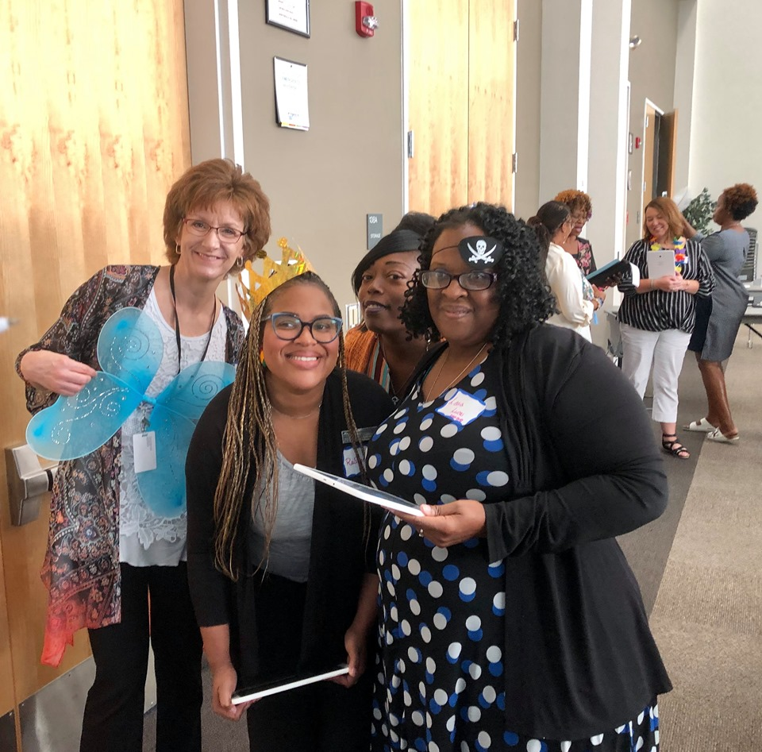
Networking ReDesigned - Pitt County

Slide 14
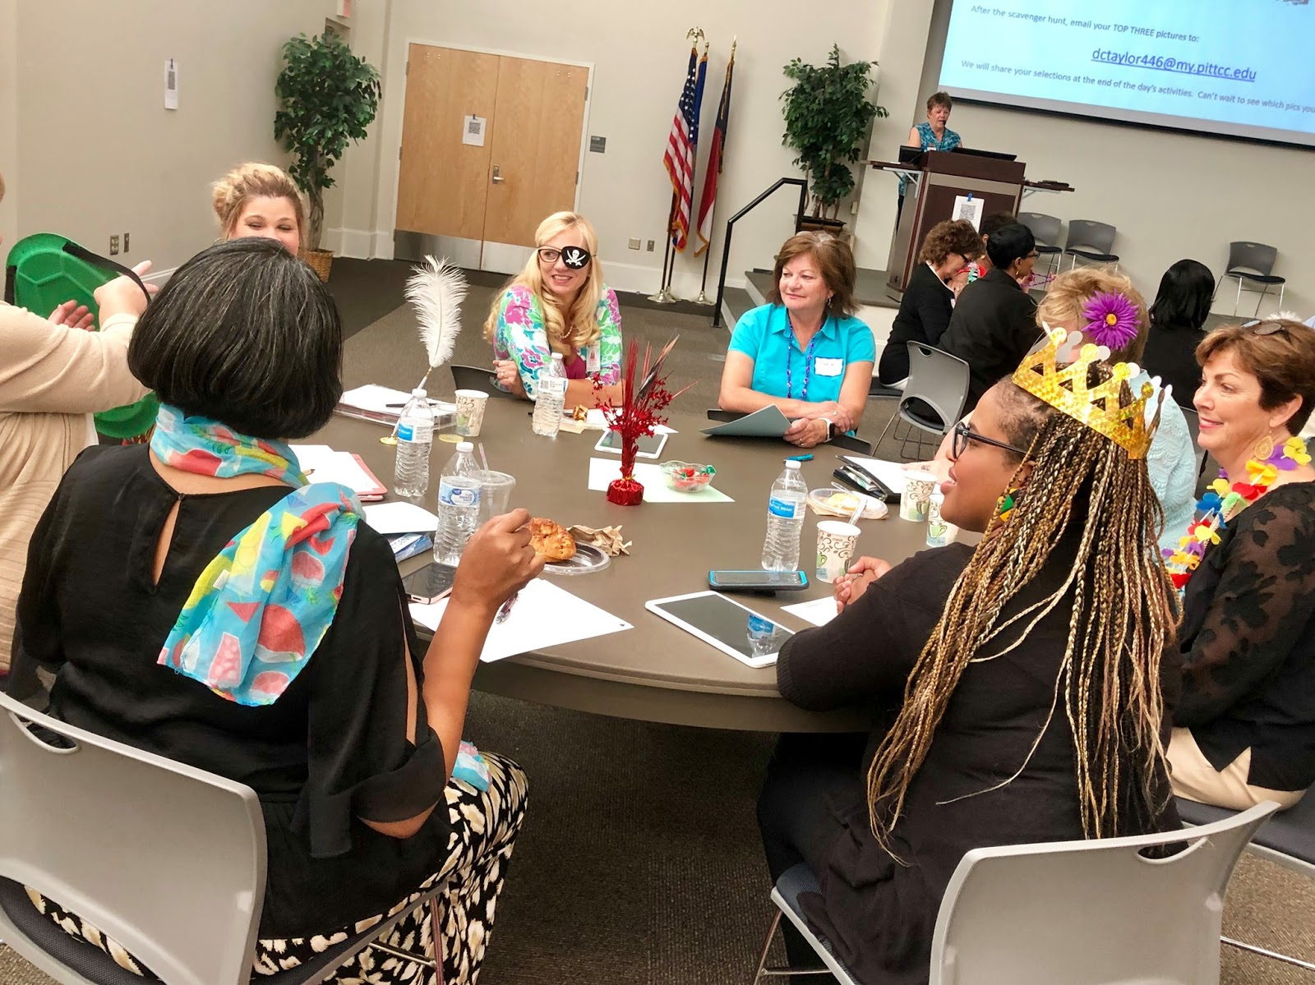
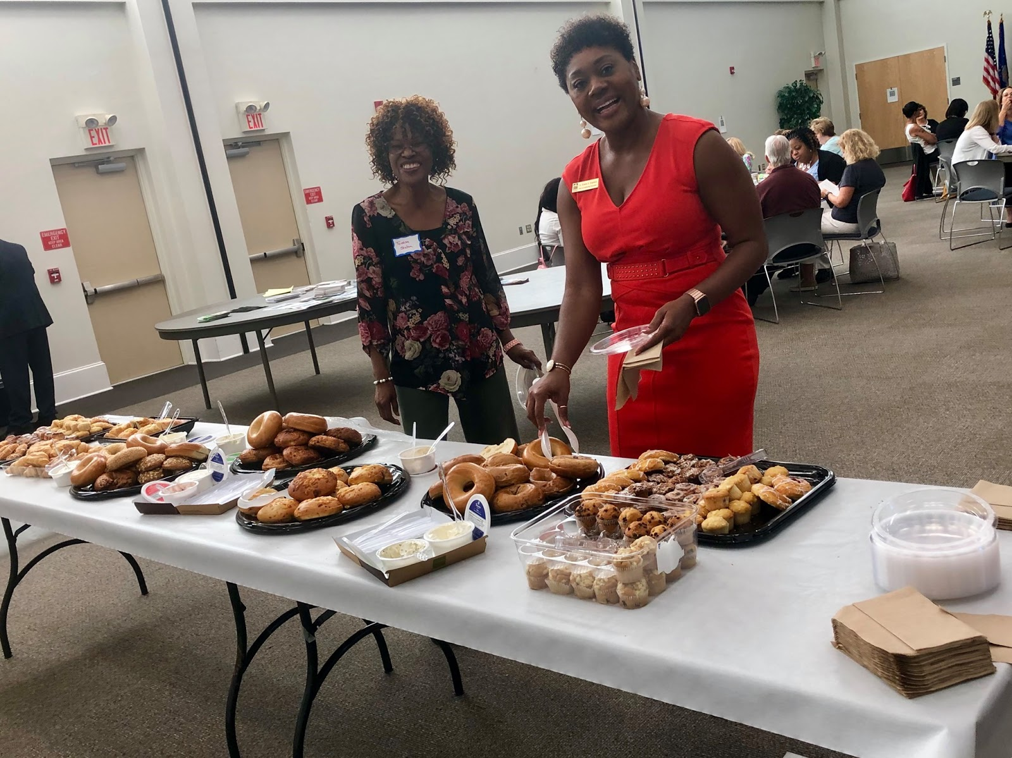
Networking ReDesigned - Pitt County

Slide 15
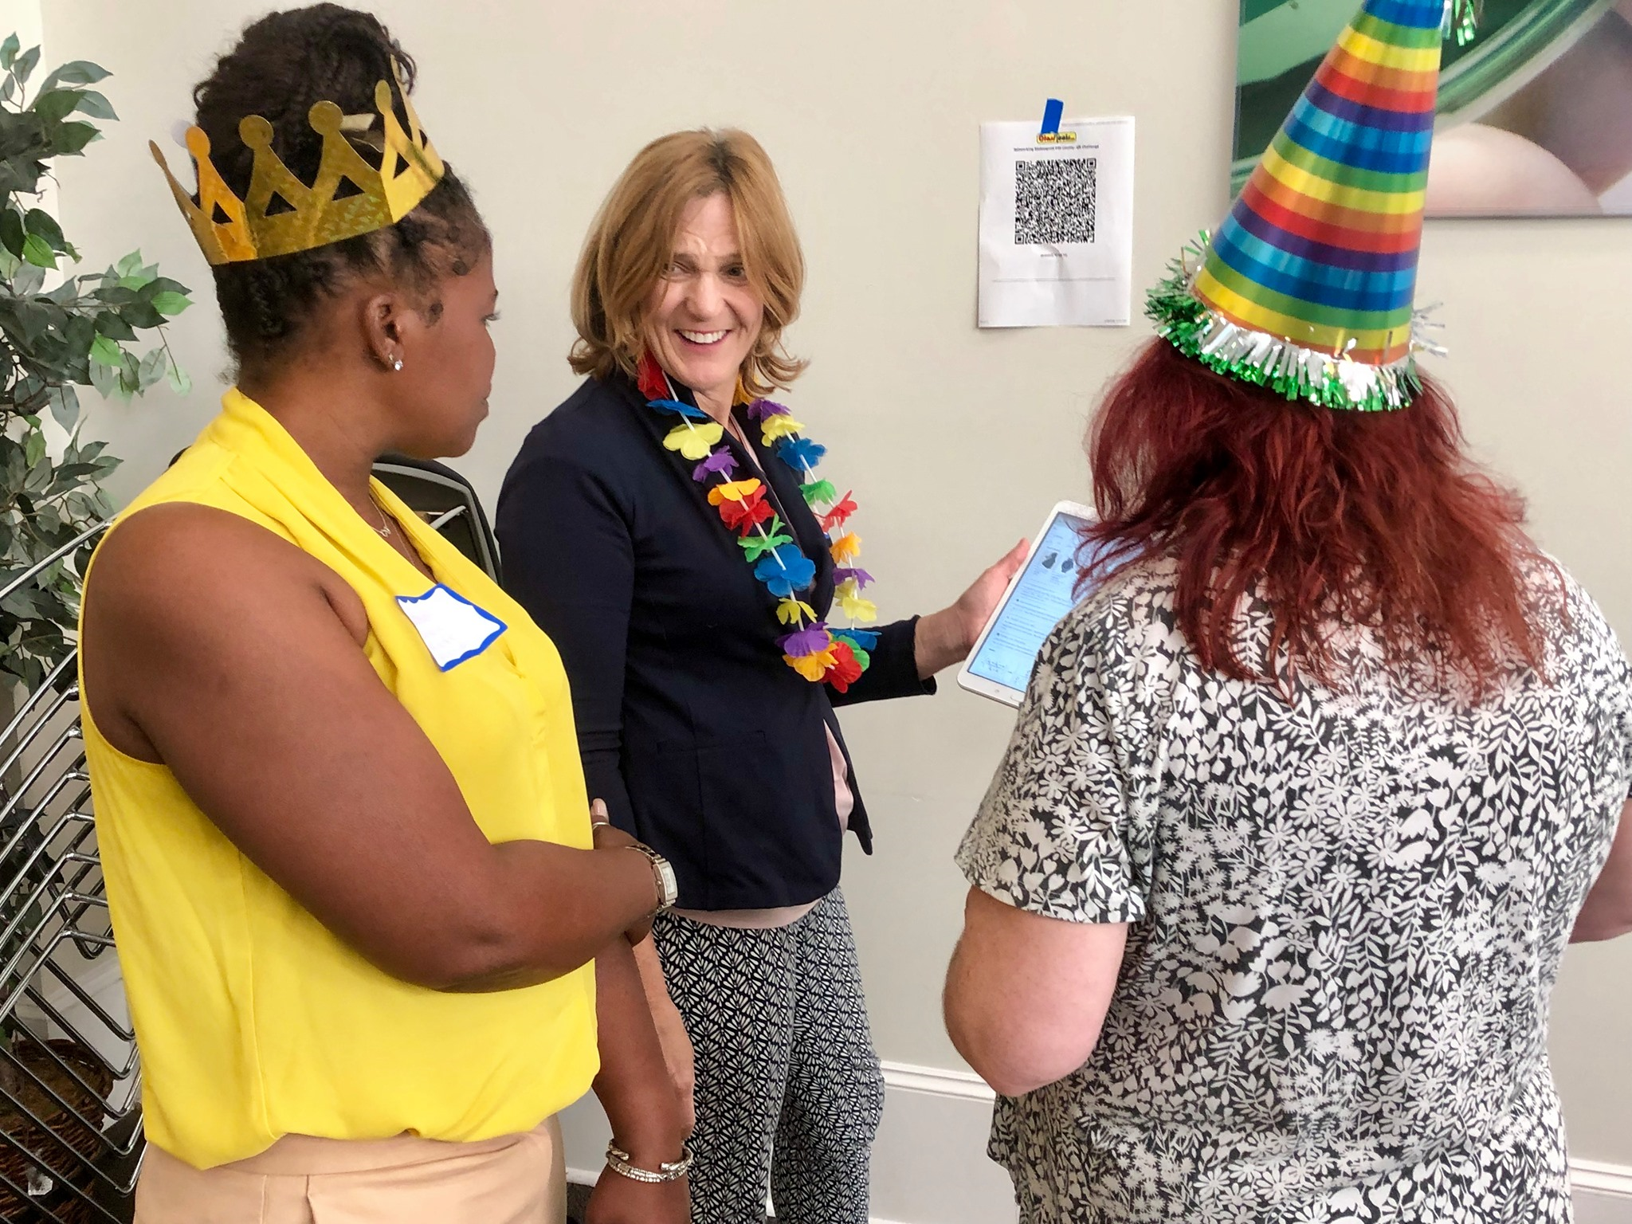
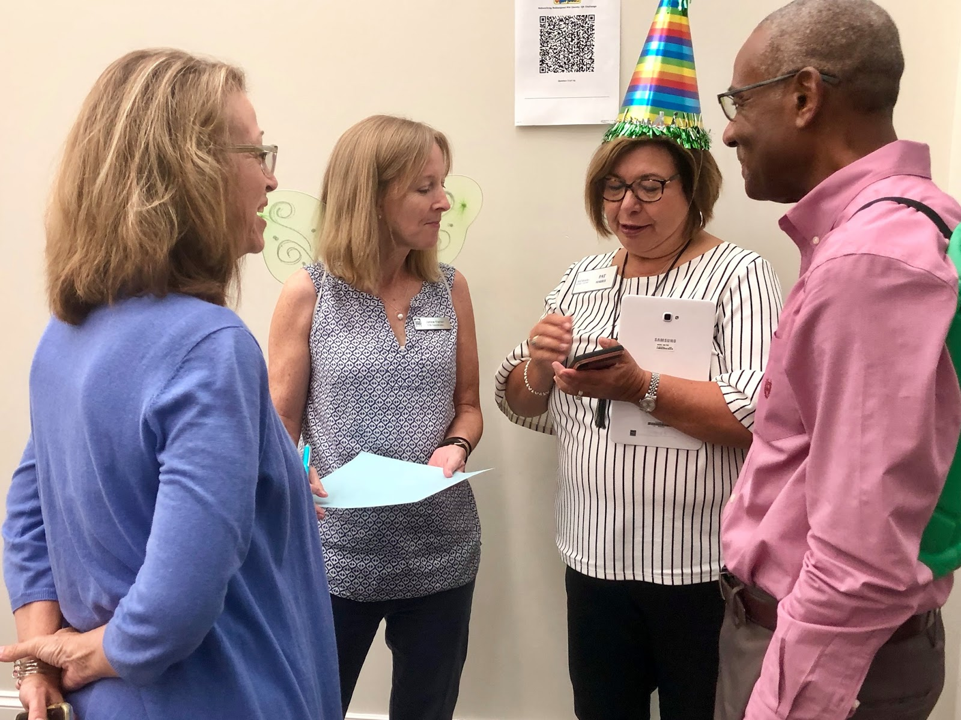
Outcomes and Feedback
Poll Everywhere
Emails
Requests
New outreach
Next Steps
Lessons Learned
Notes:
Lessons learned: add employers, more time for agency intros, scavenger hunt was faster
Requests: Dean Braswell

Slide 16
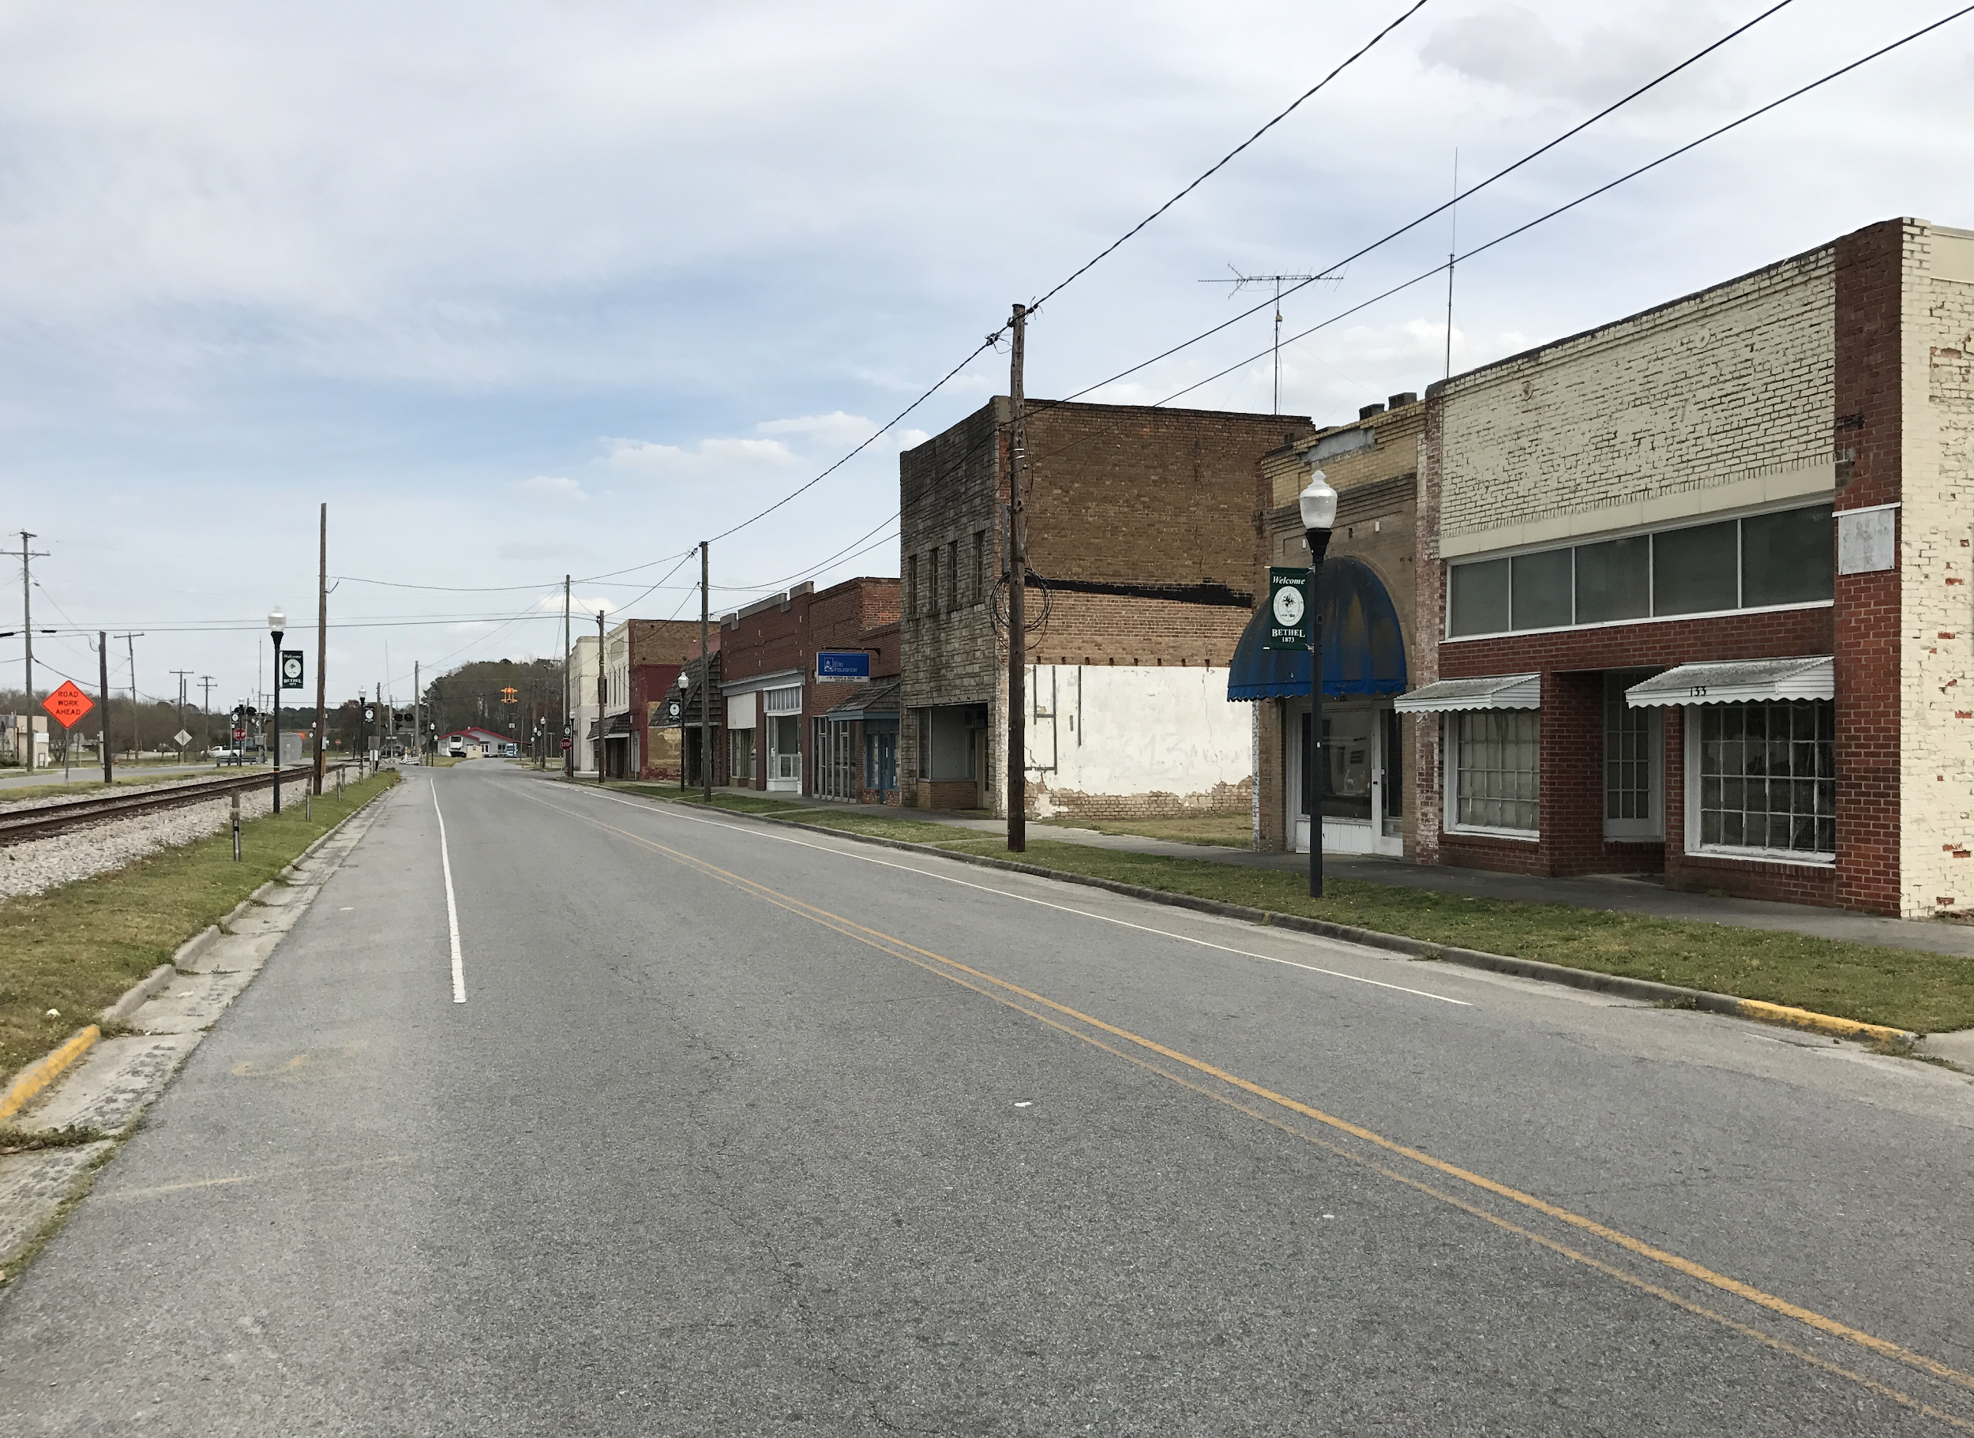
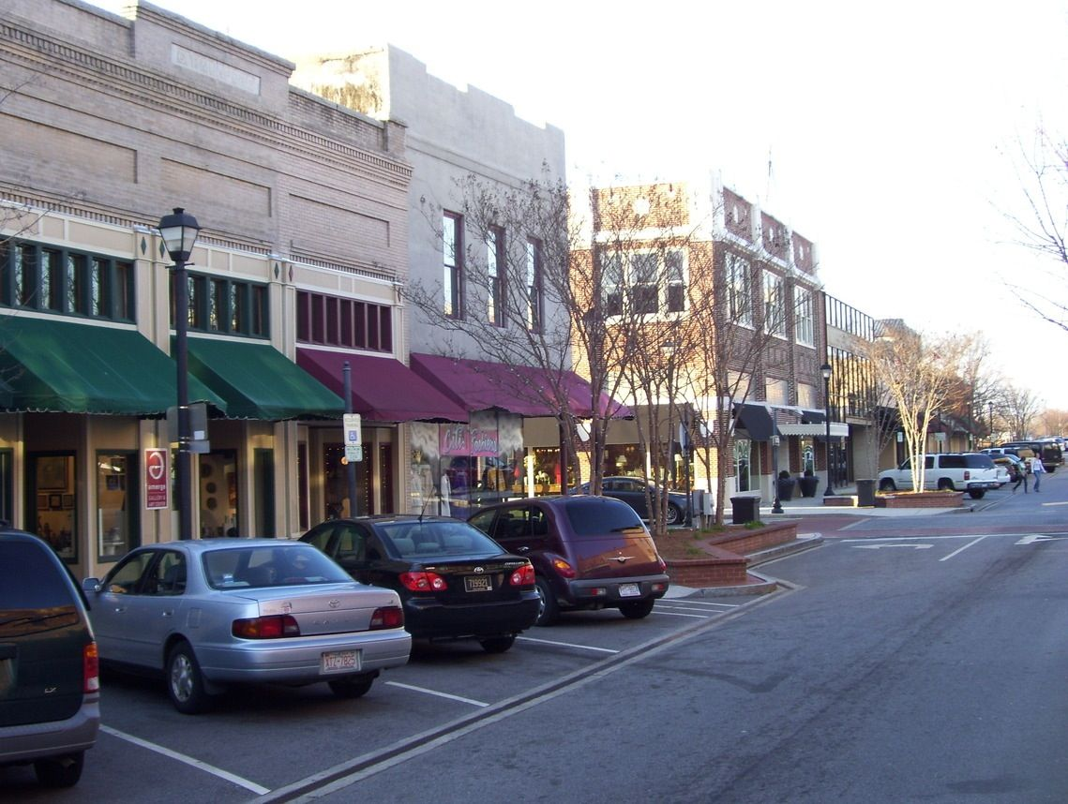
Make it your own!
How do you modify for rural regions?
How do you modify for urban regions?
Notes:
rural: expand the reach outside of one county
urban: Charlotte initiative, limit participants to space, resources and time

Slide 17
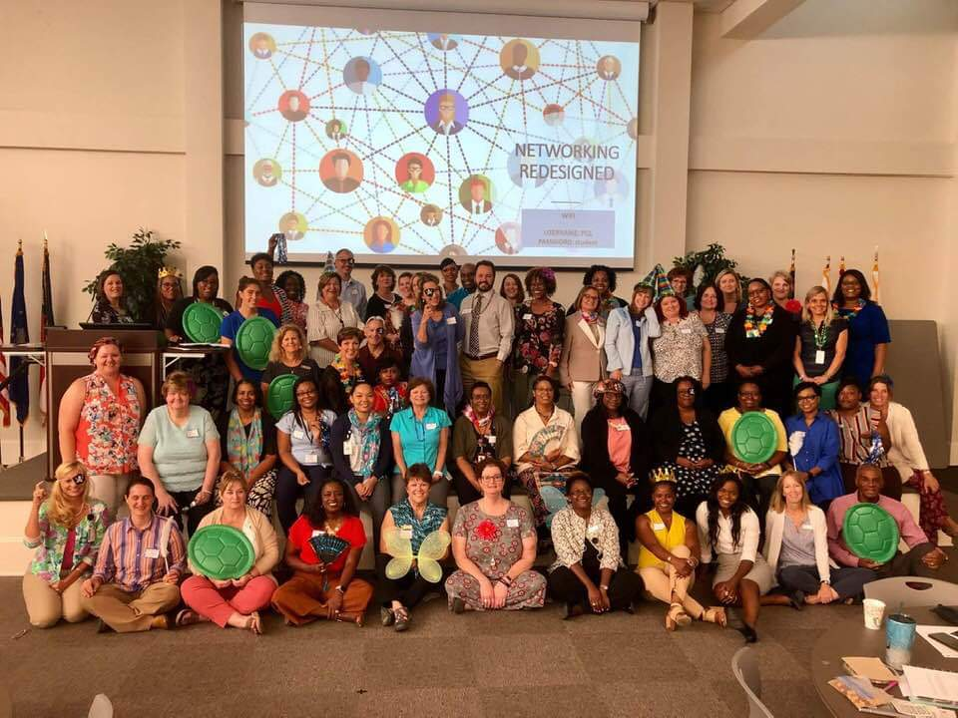
Laurie Weston: lweston@email.pittcc.edu
Brandi Bragg: brandi.bragg@nencpathways.org

Slide 18
PROVISIONS OF WIOA
Title I, Workforce Development Activities, is comprised of three core programs: the Adult, Youth, and Dislocated Worker programs, and is administered by the NC Department of Commerce, Division of Workforce Solutions;
Title II is Adult Education and Literacy and is administered by the North Carolina Community College System;
Title III is the Wagner-Peyser Act and is administered by the NC Department of Commerce, Division of Workforce Solutions; and,
Title IV, Vocational Rehabilitation, or the Rehabilitation Act of 1973, is administered by the NC Department of Health and Human Services, Division of Vocational Rehabilitation Services.
Notes:
For Reference

Slide 19
WHY BUILD PARTNERSHIPS?
The 21st century public workforce system created through WIOA builds closer ties between business leaders, State and Local Workforce Development Boards, labor unions, community colleges, nonprofit organizations, youth-serving organizations, and State and local officials.
FROM THE THIRTEEN CONSIDERATIONS OF TITLE II (ADULT LITERACY):
  4. Whether the eligible provider's activities coordinate with other available education, training, and social service resources in the community, such as by establishing strong links with elementary schools and secondary schools, postsecondary educational institutions, institutions of higher education, local workforce investment boards, American Job Centers, job training programs, and social service agencies, business, industry, labor organizations, community-based organizations, nonprofit organizations, and intermediaries, for the development of career pathways
  11. Whether the eligible provider's activities coordinate with other available education, training, and social service resources in the community, such as by establishing strong links with elementary schools and secondary schools, postsecondary educational institutions, institutions of higher education, local workforce investment boards, American Job Centers, job training programs, and social service agencies, business, industry, labor organizations, community-based organizations, nonprofit organizations, and intermediaries, for the development of career pathways
Notes:
For Reference

