Slide 1

NETWORKING REDESIGNED
WIFI
USERNAME: PCC
PASSWORD: student

Slide 2

Literacy Volunteers – Pitt County is an organization whose mission is to improve the literacy skills of adults in our community. This is accomplished through trained volunteer tutors who provide one-on-one and small group tutoring.
The future of our community
is at stake!
  Pitt County’s poverty rate is 22%
  Our unemployment rate is 10.2%
  Our four-year graduation rate is 57%.
  20% of adults do not have high school diplomas.
252.353.6578
www.pittliteracy.org
Sarah Gust
Board President/Director
Brenda Steigerwald
Education Coordinator

Slide 3

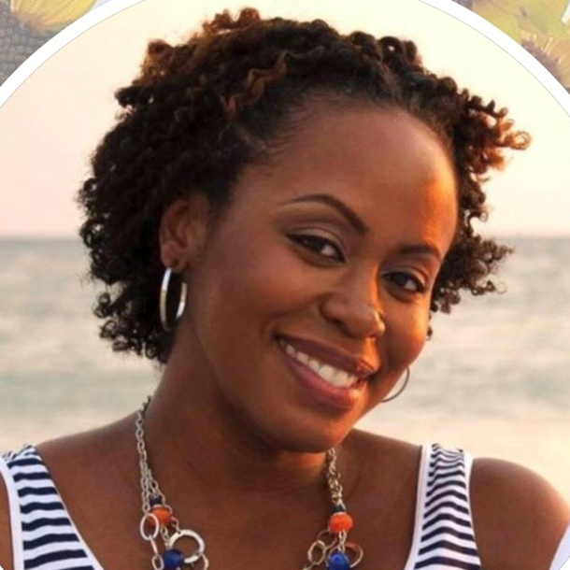
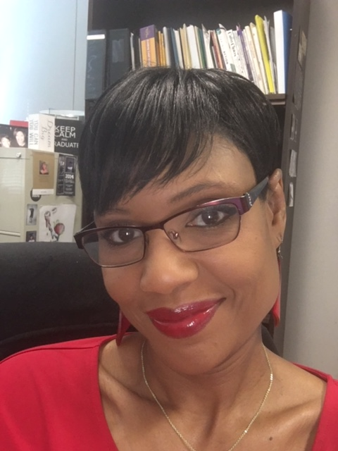
South Central High School
Every student achieves the skills and knowledge to be competitive in today’s world.
(252)321-3232
Katrissa Fisher
Graduation Coach
Kim Anderson
School Social Worker

Slide 4

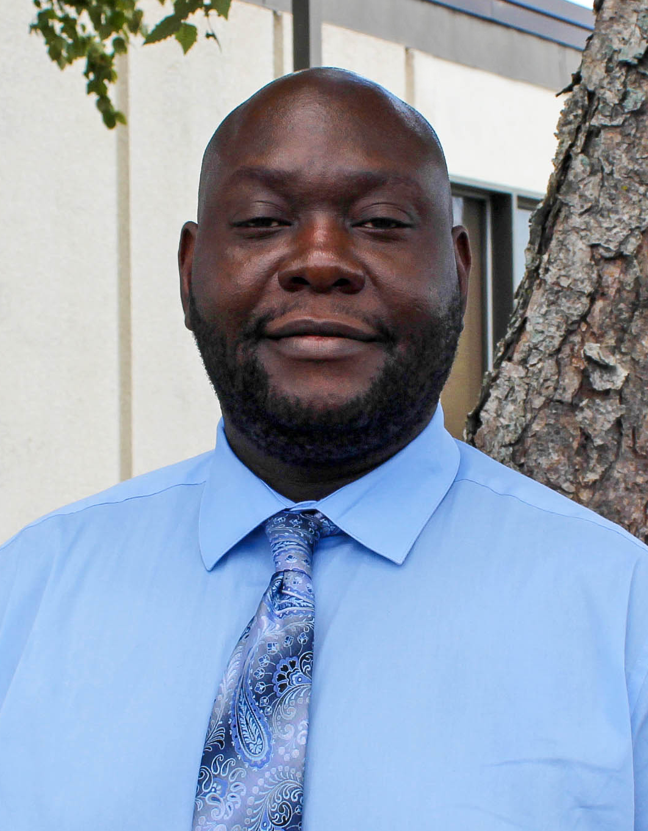
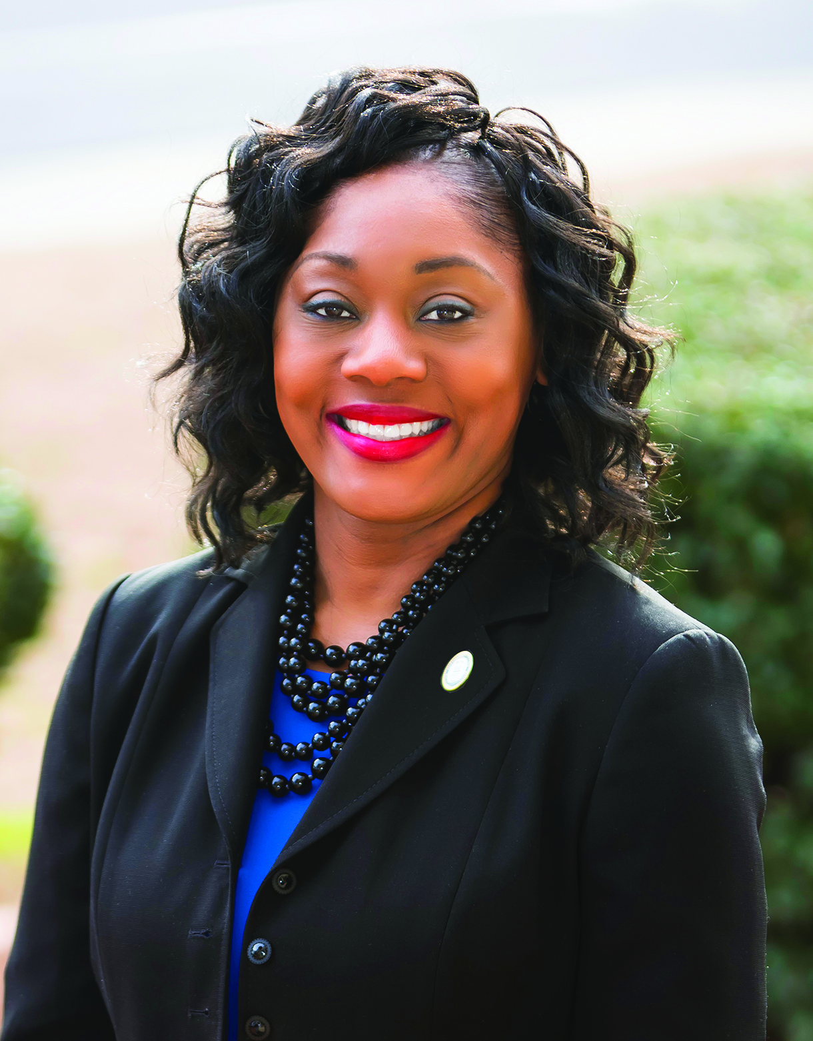
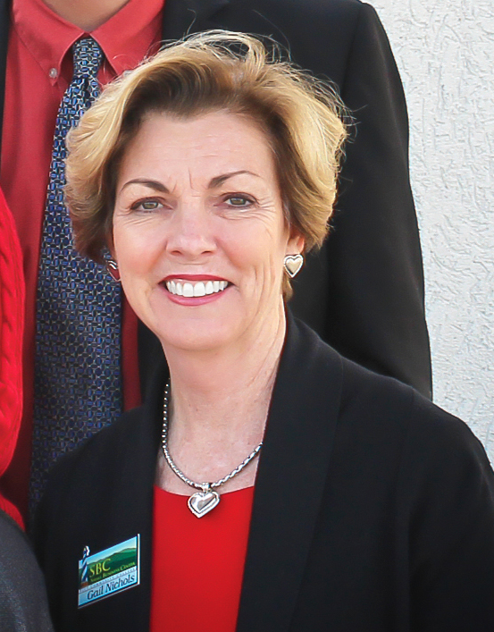
PITT COMMUNITY COLLEGE
CONTINUING EDUCATION & WORKFORCE DEVELOPMENT
Reginald Baker
Coordinator of
Workforce Development Special Projects
Dr. Kristin S. Braswell
Dean of Continuing Education & Workforce Development
Gail Nichols
Coordinator of Occupational Extension
252.493.7388

Slide 5
PITT COMMUNITY COLLEGE
CONTINUING EDUCATION & WORKFORCE DEVELOPMENT
SHORT TERM TRAINING PROGRAMS
Health Care
Business & Industry Services (Customized Training)
Human Resources Development (HRD)
Emergency Services Training
Law Enforcement Training
National Career Readiness Certificate (NCRC)
Small Business Center
Occupational Training
Personal Enrichment
Online Classes
Summer Camps
252.493.7388

Slide 6

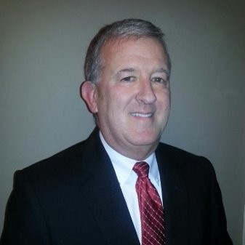
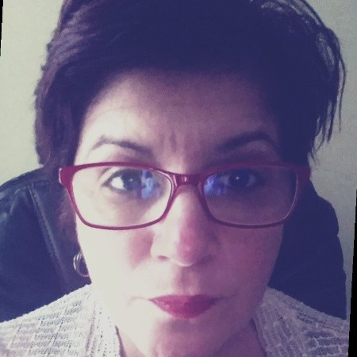
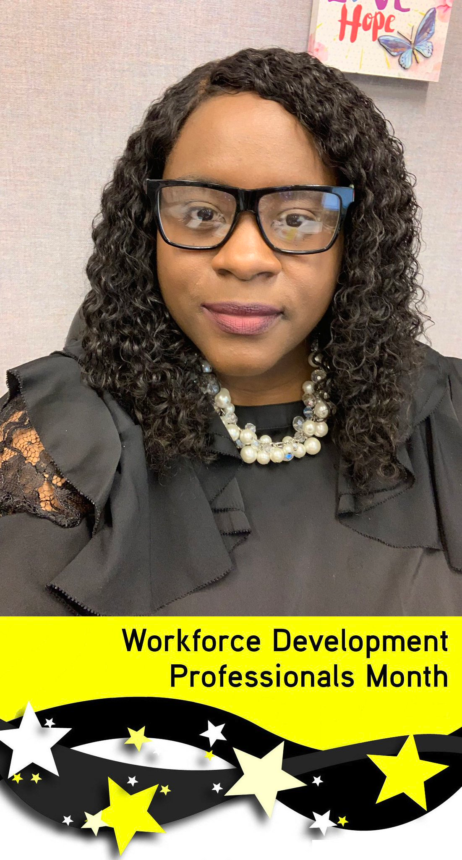
www.ncworks.gov
(252) 355-9067
We’re helping North Carolina’s job seekers find employment and businesses find workers.
Neal Anderson
Center Manager
Gabi Gonzalez
DVOP/LVER
(Disabled Veterans Outreach Program/Local Veterans Employment Representative)
Chanda Speller
Career Advisor

Slide 7
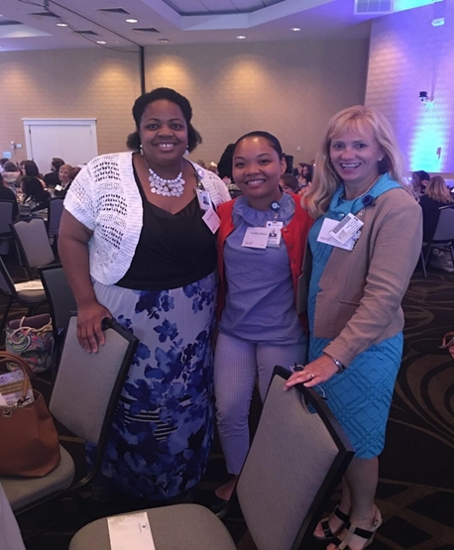

The social work team:
Terrani Moore, Christina Moore, Patricia Cromptom
Vidant Health Heart Failure Program/clinics
We believe in working from a strengths perspective with our patients, and we assist them in navigating through their social problems, which may include:
  Difficulty obtaining medications
  Transportation issues
  Lack of insurance
  Financial crisis
  Lack of support
  And much more…..

Slide 8
Clinic Locations
We believe in trying to help the person as a whole. Our team includes Physicians, NPs, PAs, Nurses, Psychologist, Social workers, Pharmacists and many more!
Some services offered:
101 Clinic Drive, Tarboro, NC , 27886
  For info/appts call 252-824-5150
500 S. Academy St, Ahoskie, NC, 27910
  For info/appts call 252-209-3260
115 Heart Dr., Greenville, NC 27834
  For info/appts call 252-847-1703
850 W. H. Blvd, Greenville, NC, 27834
  For info/appts call 252-758-3211
Medication initiation and titration
Focused patient education
Heart failure self-management tools that emphasize daily weights, low sodium diets and medication adherence
Laboratory monitoring as needed
Echocardiography
Cardiopulmonary exercise testing
Evaluation for device therapies
Bi-ventricular pacemaker optimization

Slide 9

Career Development Resources
Traitify - 90 second visual personality and career assessment tool, appropriate for middle school to adult, ESL, ABE)
GADJ (Guidance and Direction for Jobseekers) – Lesson plans based on career development for use by teachers, counselors and career advisors, middle school through adult
Career Ladders (and posters) – provide a visual for local careers in pathway areas, provides education level needed, wages earned and positions open
Brandi Bragg
Career Pathways Facilitator
Brandi.bragg@nencpathways.org
(252)974-1809
www.nencpathways.org

Slide 10

PITT COMMUNITY COLLEGE

Slide 11
Services Provided
Laurel Little
Soft Skills Coach
Teaching and Learning
Pitt Community College
llittle@email.pittcc.edu
252-493-7703
Instruct, train and advise students in developing Soft Skills for the classroom and career success.
Provide support for students who struggle or lack interpersonal skills.
Provide various role- playing activities that allow students to critique and strengthen core Soft Skills.

Slide 12
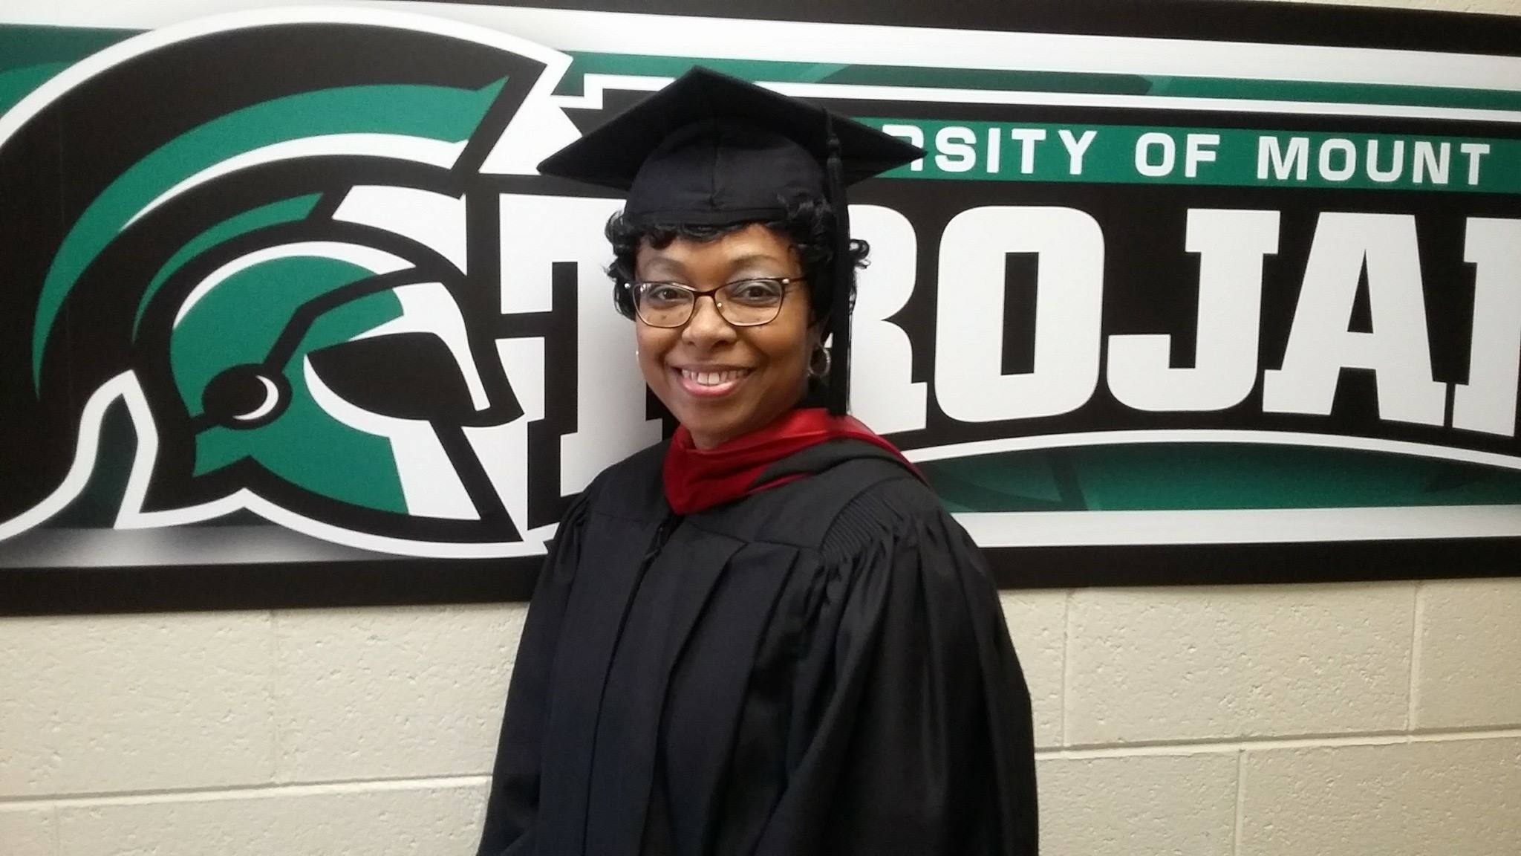
Education for Working Adults
Strategic Partner of PCC Tuition Scholarship Program: Offering 10-30% scholarships (Application Fee Waived)
Contact Lita Ward, Regional Director for more information @ (252) 940-4784!

Slide 13
UMO STATS
18,586 Degrees Granted
15:1 Student to Faculty Ratio
38 Countries Represented
2019/2020 Academic Year
UMO Named a “College of Distinction,” including additional distinctions in Business and Education
Top 20 Ranking in 2019 Best Value Schools for Colleges
and Universities in NC
Ranked in Best College’s Top 20 Best Online Bachelor Degrees in Criminology
*New Bachelor & Master Degree Programs*

Slide 14
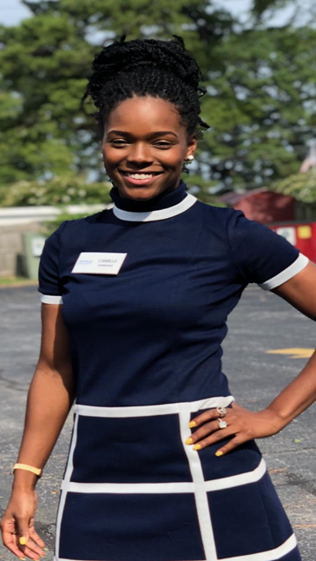
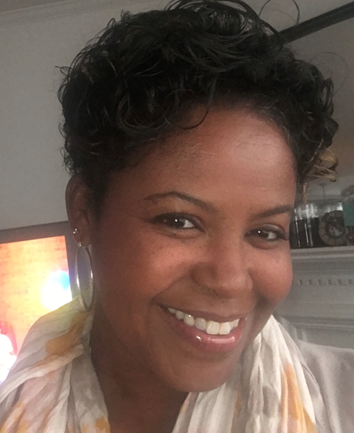




Camille Simmons
Pitt County Youth
Career Adviser
(252) 908-5402
csimmons@rossworks.com
Cassandra Sutherlin
Pitt County Youth
Career Adviser
(252) 508-5085
csutherlin@rossworks.com

Slide 15
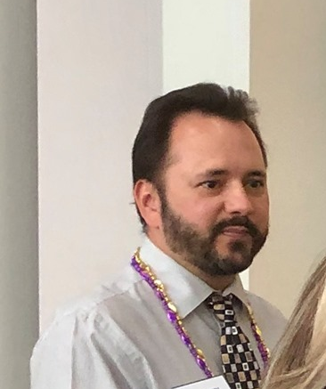
How do we assist?
Career Exploration
Job Search/Job Referral
Resume Development
Interview Skills
Paid Work Experience
Labor Market Information
Links to Community Resources
Informational and Skill Development Workshops
Training Scholarships
Supportive Services
Career Guidance
Individual Employment Plan Development (IEP)
John Powell
One-Stop Coordinator
Region Q
Ross IES
Stop by the NC Works Career Center at
3101 Bismarck St Greenville NC 27834

Slide 16

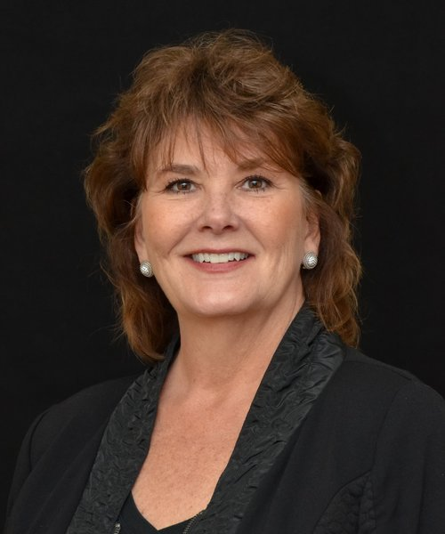
The Clubs offer members daily access to a broad range of programs that include:
Character & Leadership Development
Education & Career Development
Health & Life Skills
Arts & Culture
Sports, Fitness & Recreation
Julie Cary, EdS
Director of Strategic Partnerships
Boys & Girls Clubs of the Coastal Plain
 | 1-844-440-2717 Ex 301
 | 621 West Fire Tower Rd
 | Winterville, NC, 28590
 | www.bgccp.com e: jcary@bgccp.com

Slide 17
Vocational Rehabilitation Services
Samantha O. Johnson, Counselor-in-Charge
Gloria Leak, Counselor-in-Charge
Leora Lucas, Rehabilitation Counselor
Alexis Everette, Rehabilitation Counselor
August 2019

Slide 18
About Vocational Rehabilitation (VR):
VR is a state agency that assists people with disabilities with achieving their employment goals. VR is an eligibility-based program. Each case is individualized to meet the needs of the individual.
The following are examples of some of the services offered, at no cost to the individual, if needed to reach their goals:
Testing, evaluations and assessments
Guidance and counseling
Work-adjustment job-coaching
Work-adjustment training
Rehabilitation engineering services
Interpreter services
Supported-employment services
Job-seeking skills training
Job placement and follow-up
SOURCE: VR Policy Manual

Slide 19

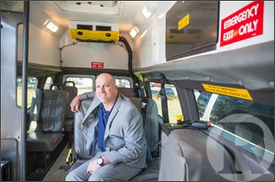
Pitt Area Transit
What is PATS?
A community transport system in Pitt County, NC
Open to all General Public
We are a “Demand Response Directly Operated” (DRDO) coordinated transportation system.
Serves as a “para transit” unit for the GREAT Bus system
*Not a charter system*
C. Cameron Coburn
Director of Transportation
“The mission of the Pitt Area Transit System is to provide safe, reliable, cost effective transportation that enables eligible individuals to access necessary medical care and other essential resources that improves and enhances their quality of life.”

Slide 20

NORTH CAROLINA DIVISION OF
SERVICES FOR THE BLIND
Enabling people who are visually impaired, blind and deaf-blind to reach their goals of independence and employment.

Slide 21
SERVICES
Transition Services
Community Employment Specialist
Vocational Rehabilitation Services
Supported Employment Services
Deaf-Blind Services- Donna Rhodes
Career and Training Center for the Blind
Independent Living Services- Lylaya Lennon
Business Enterprise
Agency Contacts for Pitt County:
Steven Alexander, VRCII
  252-355-9016 ext. 208
  steve.alexander@dhhs.nc.gov
Kathy Little, Social Worker for the Blind
  252-355-9016 ext. 214
  kathy.little@dhhs.nc.gov
Additional Services:
Career and Guidance Counseling
Vocational Assessments
Orientation and Mobility
Assistive Technology
Job Development (including limited physical restoration services related to employment)
Low Vision Services– Cheryl Franklin
Medical Eye Care- Cheryl Franklin

Slide 22


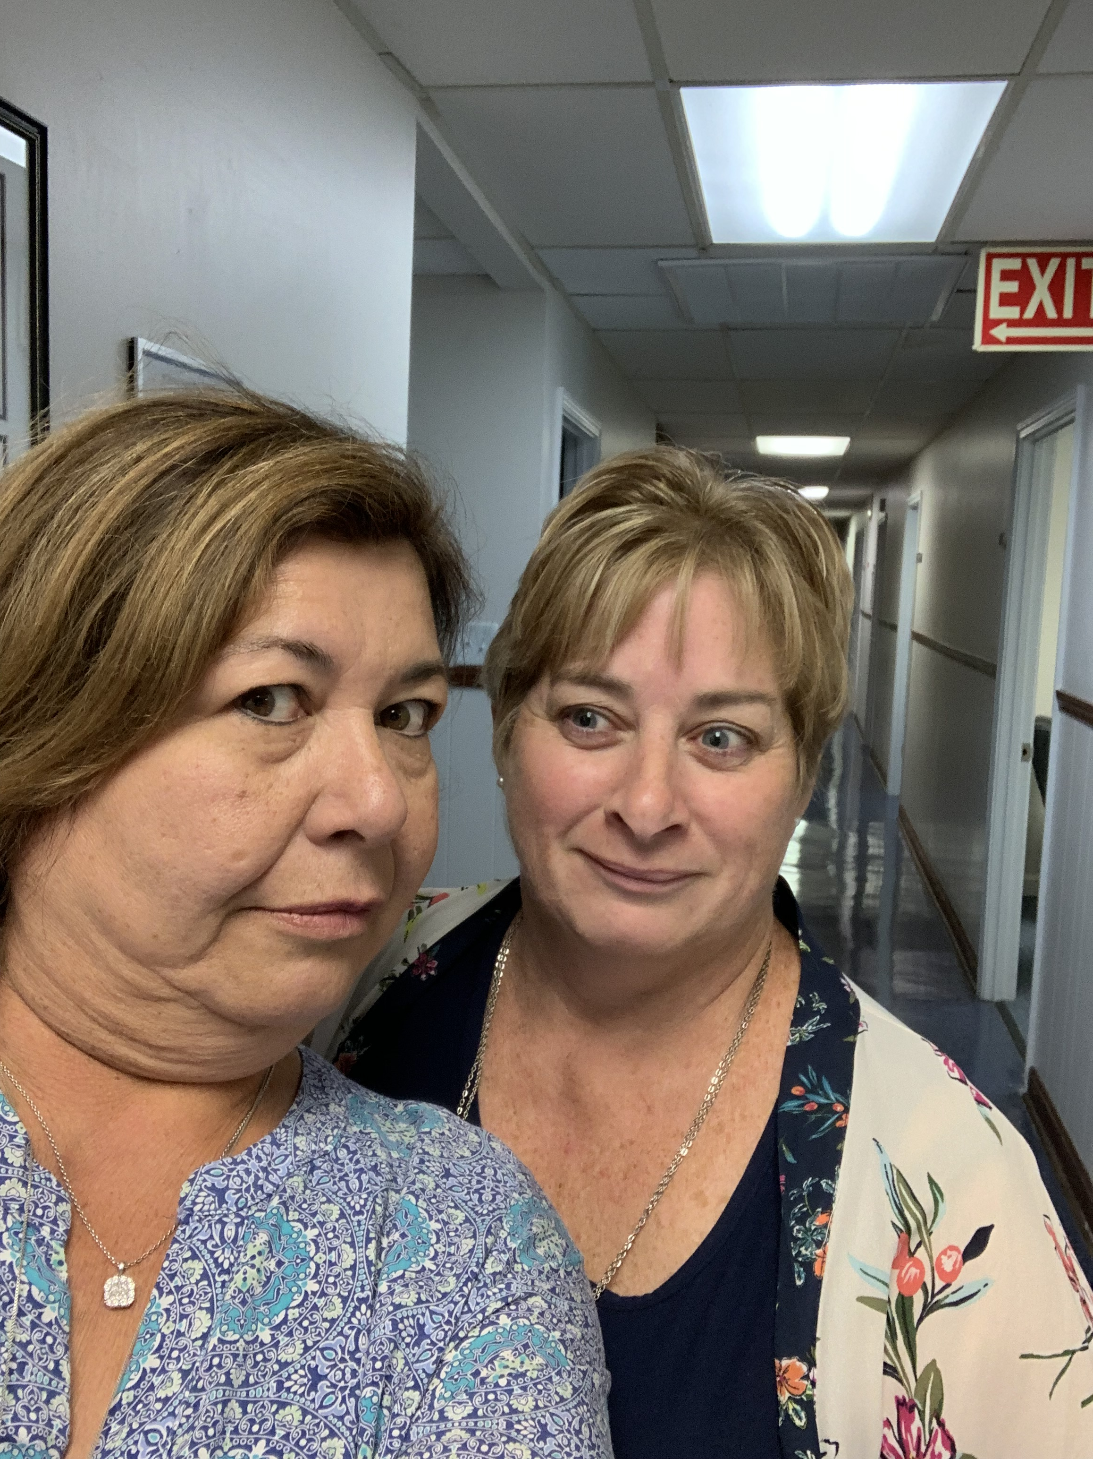
Providing Job Seeker and Business Services for Beaufort, Bertie, Hertford, Martin & Pitt Counties
Lou Stout Pat Harris
Business Engagement Coordinator NCWorks Outreach Coordinator
lstout@mideastcom.org pharris@mideastcom.org
(252) 974-2446 (252) 946-8043 ext. 1824

Slide 23

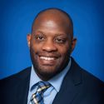
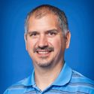
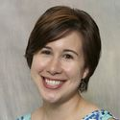

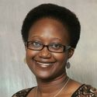
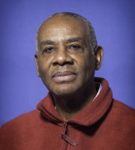
Career & Academic Advising
Pitt Community College
252-493-7322
Career Counseling/Exploration
Job Search Assistance
Employer Relations
Gregg Massenburg
Lead Navigator
Kurt Simmons
Career Outreach Specialist
Arwen Parris
Career Services Coordinator
Career & Academic Advising
Support/Intervention
Resource Referrals
Apprenticeship and Engineering Scholarship Information
$75,000 available
(252) 493-7335
Dr. Shakeena White
Director
Jerome Shepard
Regional Apprenticeship Coordinator

Slide 24

Pitt County Health Department
Mission:
to protect, promote, and assure the health of all people in Pitt County.
  Dr. John Silvernail, Director
Staff attending today:
  Jennifer Hardee- Coordinator, Women’s & Children’s Health Education Programs
  Kristey Coulter- Child Care Health Consultant
  Terry Quinn- Child Care Health Consultant

Slide 25

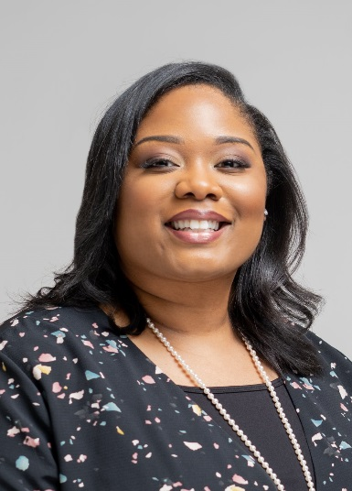
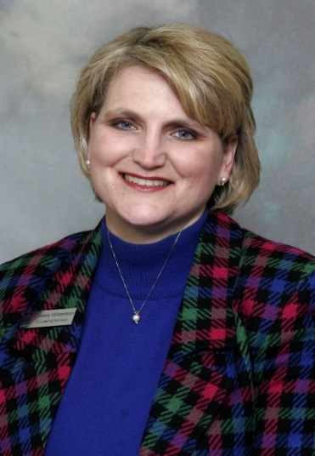
Phylicia Bridgers, MS,NCC,LPCA
Counselor
Counseling Services
Pitt Community College
pbridgers@email.pittcc.edu
252-493-7820
Kimberly Williamson, EdD
Assistant Dean, Counseling & Student Services
Counseling & Student Services
Pitt Community College
kwilliamson@email.pittcc.edu
252-493-7217

Slide 26
Services Provided by PCC Counselors
Admissions Counseling
Career Counseling
Academic Counseling
Personal Counseling
  Student Assistance Program (SAP)
    One-on-one counseling
    Crisis management
    Food pantry
    Referrals to community agencies
MISSION STATEMENT:
Counseling Services strives to educate and empower students to make realistic and attainable decisions as they pursue their academic, career, personal, and social goals.
Located in the Craig F. Goess Student Center, Suite 120
Normal Operating Hours:
  Monday: 8:00am-7:00pm
  Tuesday-Friday: 8:00am-5:00pm
  Phone: 252-493-7245
  Email: pcccounseling@email.pittcc.edu
  https://pittcc.edu/academics/student-development-services/counseling/

Slide 27

“People Working Together”
Area Agency on Aging
Planning, Economic Development & Community Services
Region Q Workforce Development Board
Working for
Eastern North
Carolina
Regional Council of Governments (COG)
The State of North Carolina established Regional COGs in 1972. The sixteen regional councils in North Carolina serve their member governments through a broad range of services.
The Mid-East Commission serves Beaufort, Bertie, Hertford, Martin and Pitt Counties, and their municipalities.
Planning, Economic Development & Community Services Department
Economic Development
Grant Administration
Grant Application Assistance
Mid-East Rural Planning Organization (RPO)
Transportation planning services for Beaufort County, Martin County, and the portion of Pitt County which is outside of Greenville MPO
Planning Services
Geographic Information Systems
Land Use Administration
Long-Range Planning
Ordinance Development
Special Projects
Mid-East Commission
1502 N Market Street, Suite A
Washington, NC 27889
(252)946-8043
Fax: (252)946-5489

Slide 28
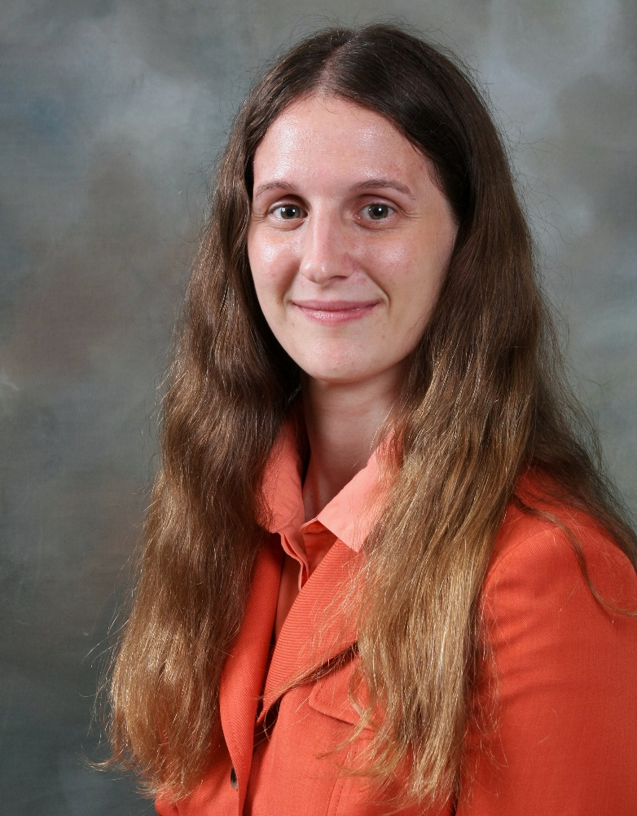
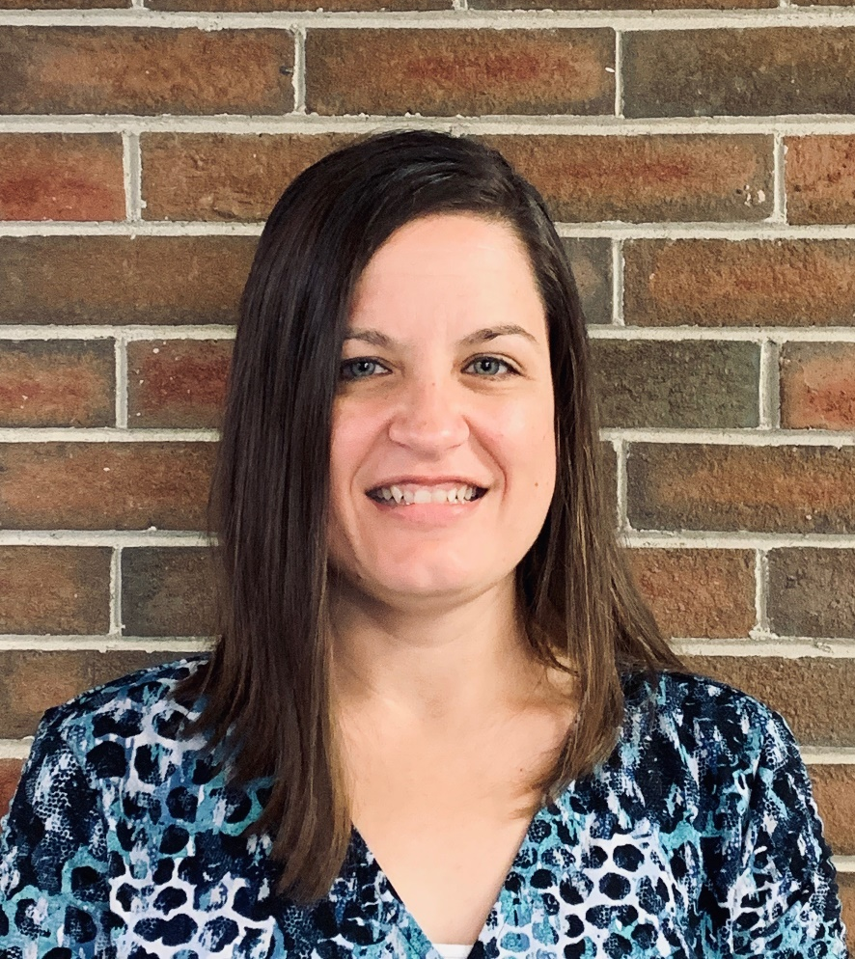
Mid-East Commission Planning Department
Jamie Heath
Planner
jheath@mideastcom.org
(252)296-1656
Nola Roberts
Planning Technician
nroberts@mideastcom.org
(252)974-1829

Slide 29
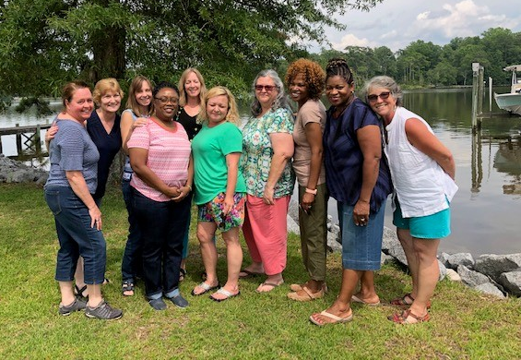

Pitt Community College Transitional Studies 493-7396
Laurie Weston, Director
Jan Fisher, English Language
Acquisition Coordinator
Sissy Grubbs, On-Campus and Adult High School Coordinator
Tereasa Staton, Off-Campus Coordinator
High School Equivalency (GED), College and Career Readiness, English Language Acquisition, Adult High School, Career Development and Exploration, Transition English and Math, Career Academy, Co-enrollment

Slide 30

Pitt Community College
Susan Marsh
Senior Student Success Navigator
Academic Advising – First Year Experience
Pitt Community College
smarsh@email.pittcc.edu
252-493-7514
RaSheeda Waddell
Student Success Navigator
Pitt Community College
rwaddell@email.pittcc.edu
252-493-7844
Orientation and Registration
Provide first-year students with a strong support system.
Track classroom performance and intervene when needed.
Teach ACA 111 and 122 courses that are division specific.

Slide 31

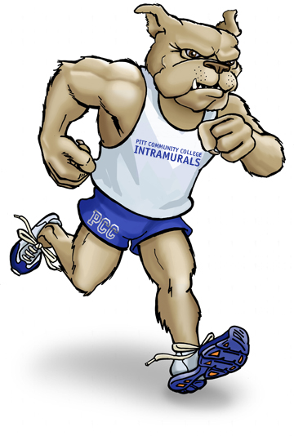

Connection to Support Resources…….
Success Navigators connect first-year students to resources that support student success
    Counseling Services
    Career Services
    TASC Services
    Student Activities
    TRIO Services
    Financial Aid
    Continuing Education
    Office of Accessibility

Slide 33
Kimberly P. Moody
Outreach Specialist
252.493.7689
Jessica Simms
Administrative Assistant
252.493.7556

Slide 34


Cindy Asbell
Crisis Counselor & Office Manager
call Cindy to tape PRC TV interviews to promote your organization on GPAT 23 and YouTube
We provide:
Counseling
Information & Referral
Sexual Assault Services
Advocacy
Suicide Intervention/Prevention
Pitt Resource Connection
Dial-A-Teen
Community Resource Connection
Outreach/Education
PRC is a program of the REAL Crisis center and was created in an effort to help our community during times of need, to rise above the hardships and make our community stronger.
https://pittresource.org/

Slide 35

EMPLOYMENT SERVICES
The Employment Services Program (Food & Nutrition Employment & Training and Work First) at Dept. of Social Services equips participants with employability skills to assist them in becoming self-sufficient through obtaining sustainable wages.

Slide 36
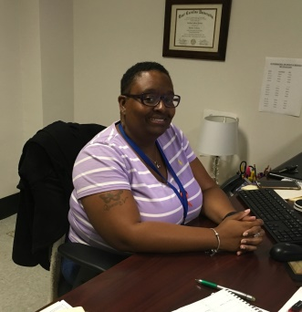
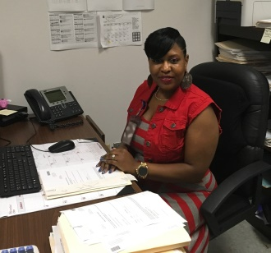
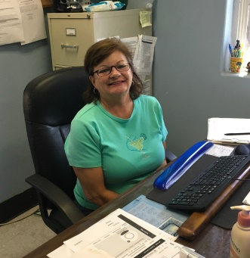
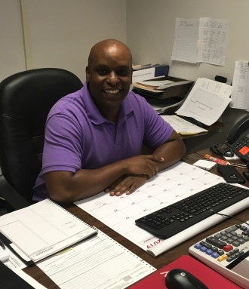
EMPLOYMENT SERVICES
Job Readiness
Job Search
Career Planning/Education Assistance
Work Experience
Job Retention
Supportive Services
ChaVonda Perkins-Ormond
Human Service Coordinator III
Lakisha Mills
Social Worker Work First
Angella May
Income Maintenance Worker
Victor Banfield
Social Worker
Employment & Training

Slide 37

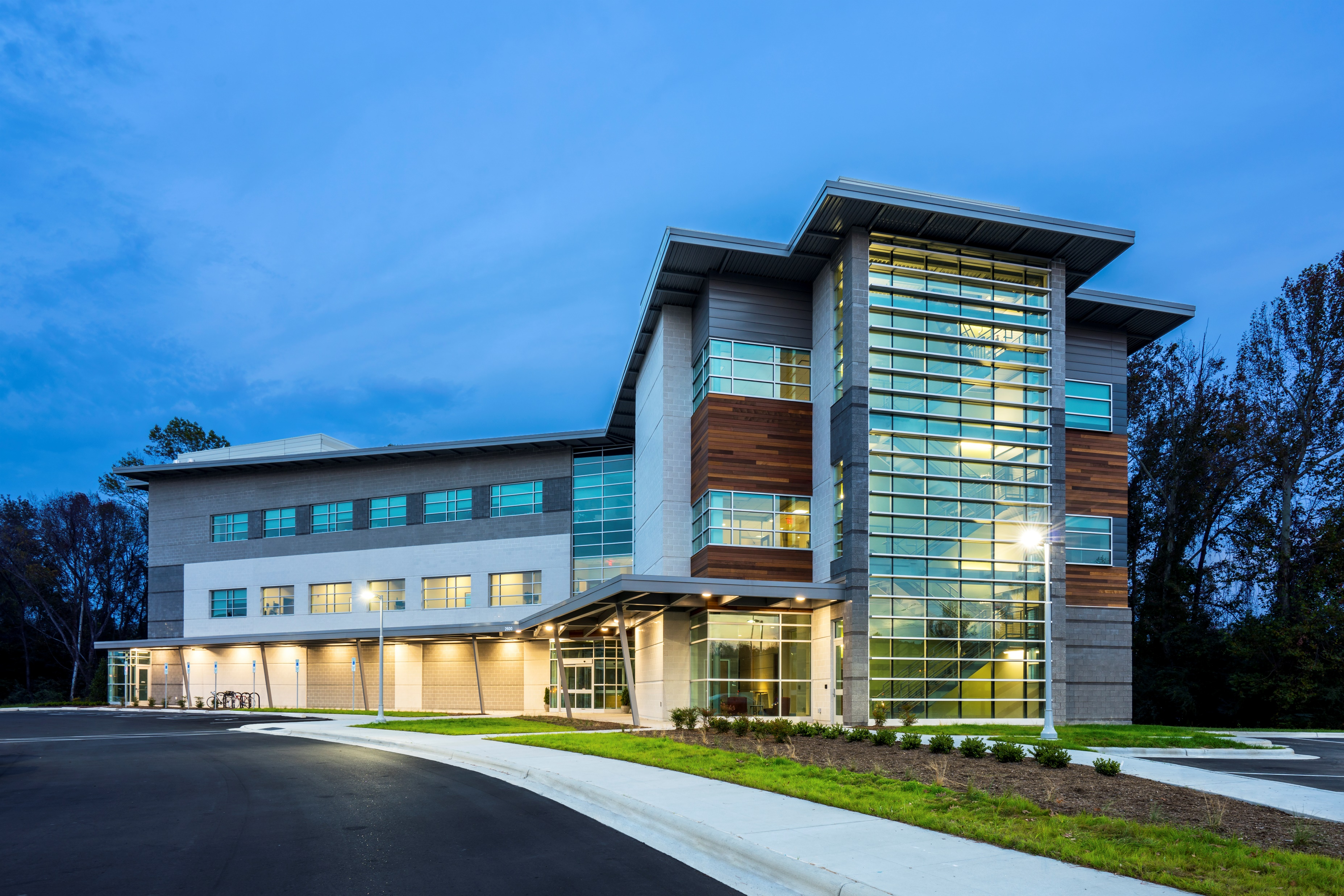
Millie House, DNP, MAEd, RN, CNE
Assistant Director
Nursing & Allied Health Education
P: 252-744-5224 ● F: 252-744-5229
WWW.EASTERNAHEC.NET
Recruit, Train, Retain: Creating and supporting the workforce to produce A BETTER STATE OF HEALTH!

Slide 38

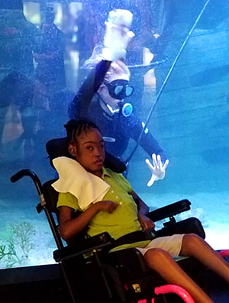
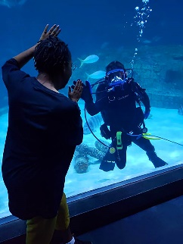
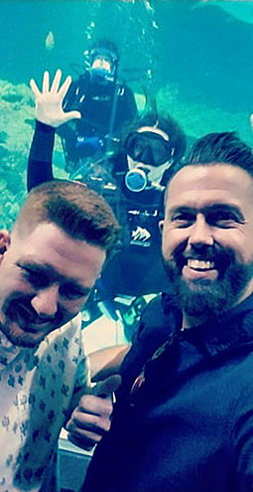
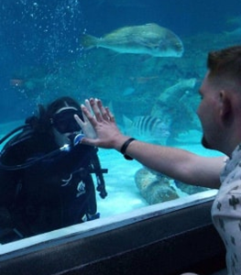
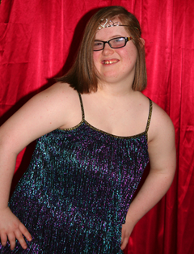
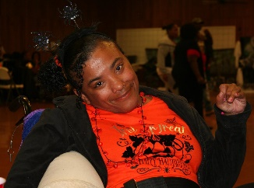
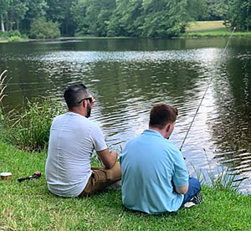
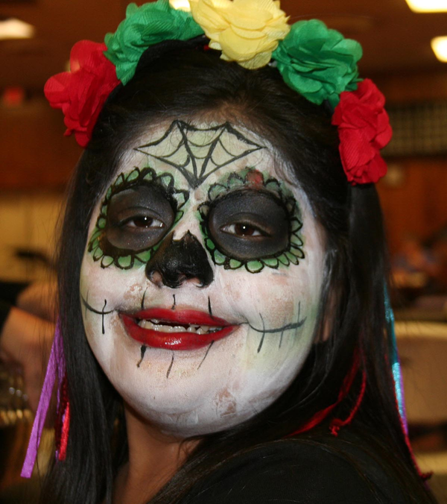
A CARING HEART
CASE MANAGEMENT, INC.
A Caring Heart provides the following NC Innovations Waiver Services in 40 eastern NC counties:
Community Living and Support (CLS)
Day Supports (Individual and Group)
Residential Supports (AFL)
Respite
Community Navigator
Supported Employment
Community Networking
Specialized Consultative Services
B3 Medicaid Services in the Wilmington, Rocky Mount, Greenville and Wilson areas:
Supported Employment
Individual Supports
Community Living and Facilities Services
Community Guide
Respite
PART ONE
State-funded (IPRS) services in Wilmington, Rocky Mount and Goldsboro:
Day Activity
Respite
Community Guide
Notes:
SCRIPT: A Caring Heart provides the following NC Innovations Waiver Services:
Community Living and Support (CLS) Supported Employment
Day Supports (Individual and Group) Specialized Consultative Services
Residential Supports (AFL) Community Networking
Respite Community Navigator

Slide 39


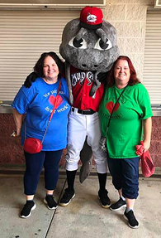
Team Members Attending:
Sandy Harris, Program Director for Wilson, Rocky Mount, Greenville
Luann Creech, Program Director for Goldsboro, Clinton, Kenansville
A Caring Heart’s Corporate Office:
1901 Tarboro Street, SW
Suite 201
Wilson, NC 27893
252-206-1266
www.acaringheartinc.com
Notes:
And…
State-funded (IPRS) services in Wilmington and Rocky Mount:
Day Activity
Respite
Community Guide

Slide 40

After the scavenger hunt, email your TOP THREE pictures to:
dctaylor446@my.pittcc.edu
We will share your selections at the end of the day’s activities. Can’t wait to see which pics you chose!!

Slide 41


Slide 42
Scenario #1
Felicia is a single mom who currently works at a grocery store as a cashier/stocker. She and her children are currently receiving Food and Nutrition Services (FNS-Food Stamps). Her Traitify (Career Assessment Tool) results show that she has aptitude and Interest in health care careers. She is also concerned about the cost of tuition and books. Felicia and her children have survived an abusive past, her children struggle with being left with childcare providers.

Slide 43
Scenario #2
Marcus recently separated from the military after 6 years of service. He operated heavy equipment in the military, and his Tratify (Career Assessment Tool) results show that he is a Naturalist, preferring the outdoors. Marcus also has PTSD, which means that some days are more difficult for him than others, and he has to be careful of triggers
like loud noises.

Slide 44
Scenario #3
Sue had worked at the local textile plant for the past 20 years, but last week they closed their doors. Sue is 58 and she has only worked in factories. There are no factories left within a 30 mile radius of her home. Her most recent position was production assistant, which required her to maintain records of daily production. Sue has no license and has been riding to and from work with co-workers. There are limited options for public transportation in her town. She currently receives Food and Nutrition Services (FNS-Food Stamps) Sue has her high school diploma and OSHA 10 certification.

Slide 45
Scenario #4
Joe has a recent conviction for possession of marijuana. While in jail, he worked on his GED but wasn’t able to complete it because he struggles with literacy. As a condition of his probation, Joe needs to work and pay fees. Joe currently receives Food and Nutrition Services (FNS-Food Stamps). Joe has a knack for technology, and his Traitify (Career Assessment Tool) results show that careers in Information Technology would be a good match. Joe is worried that his conviction and lack of education
will hold him back.

Slide 46
Scenario #5
Kim is 19, blind and a recent high school graduate. She has never held a job and is very shy and soft spoken. She’s not sure what she wants to do or what she would be good at, but she knows that she wants to earn a paycheck so she can move out of her parents’ house and become more independent.

Slide 47
Scenario #6
Isaiah is 25 and on the autism spectrum. He is really good at fixing things like small appliances, but his social skills are lacking (no eye contact, doesn’t greet people, etc). He completed his certificate (NOT A DIPLOMA) in high school a few years ago, and has been at home watching TV with his grandpa since then. He says that his parents don’t want him to work, but he is tired of watching TV and wants to make some money.

Slide 48
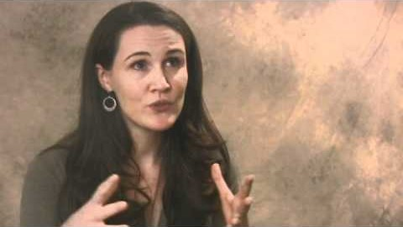
Liz Murray, Making Choices

Slide 49

VISIONS Voices 2016 – Pitt Community College

Slide 50
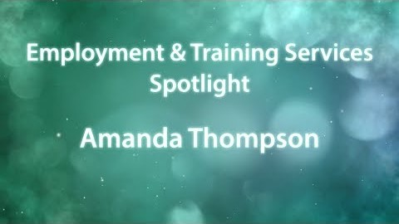
Employment & Training Services Spotlight: Amanda Thompson, Pitt County DSS

Slide 51

VISIONS Voices 2018 – Pitt Community College

Slide 52

Achieving the Dream: Pitt Community College

Slide 53


Slide 54

Website
Audience can respond at PollEv.com/laurieweston, as long as the poll is active.
Text messaging
Presenter session: Audience texts LAURIEWESTON to 37607 to join the session, then they text a response.

