Slide 1

Partnering with your local library
Pat Harris
NCWorks Outreach Coordinator
Region Q Workforce Development Board
Notes:
NOTE:
To change the image on this slide, select the picture and delete it. Then click the Pictures icon in the placeholder to insert your own image.

Slide 2
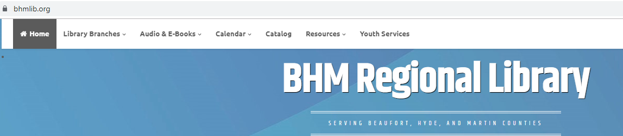
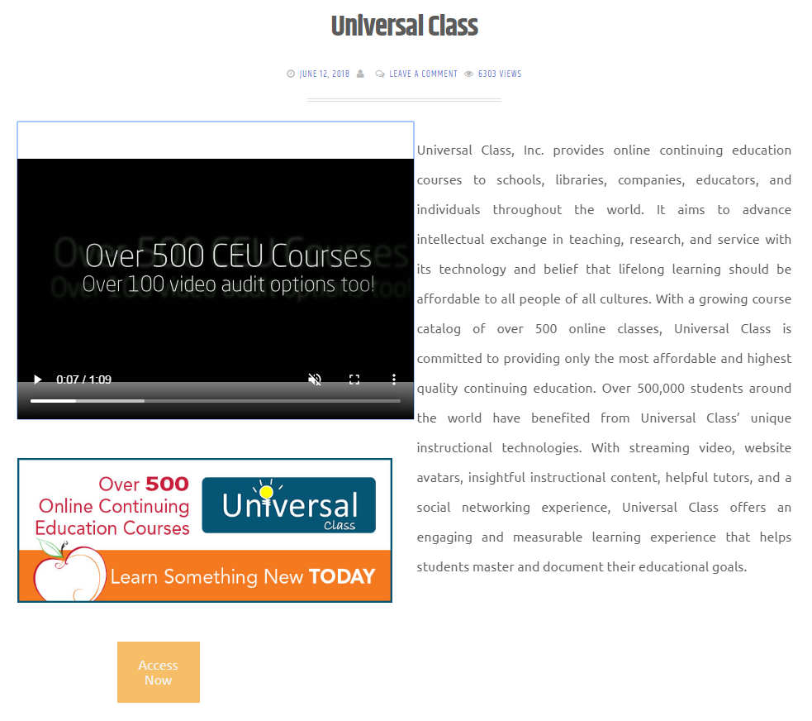
Thank You!
Martin Memorial Library
Ann Phelps, Librarian
Part of the BHM (Beaufort, Hyde and Martin) Regional Library
bhmlib.org
Branch Libraries located in Aurora, Bath, Belhaven, Ocracoke, Robersonville, Washington and Williamston

Slide 3
Why Target Libraries
Provide computers and allow the public free access to the internet
Gateway to underserved populations
Often serve as the networking hub particularly for small, rural communities
Provide an excellent marketing outlet
Provide excellent resources
Librarians and assistants often serve as career counselors and resource advisors for their local patrons

Slide 4
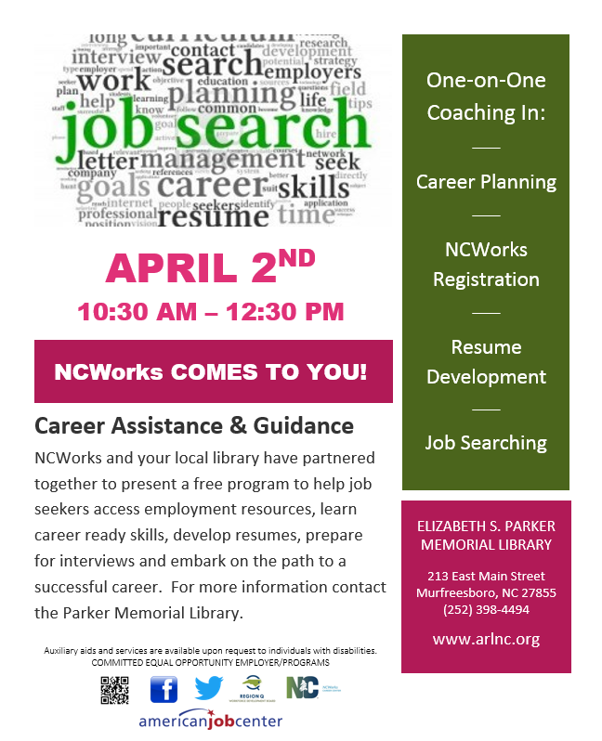

Slide 5
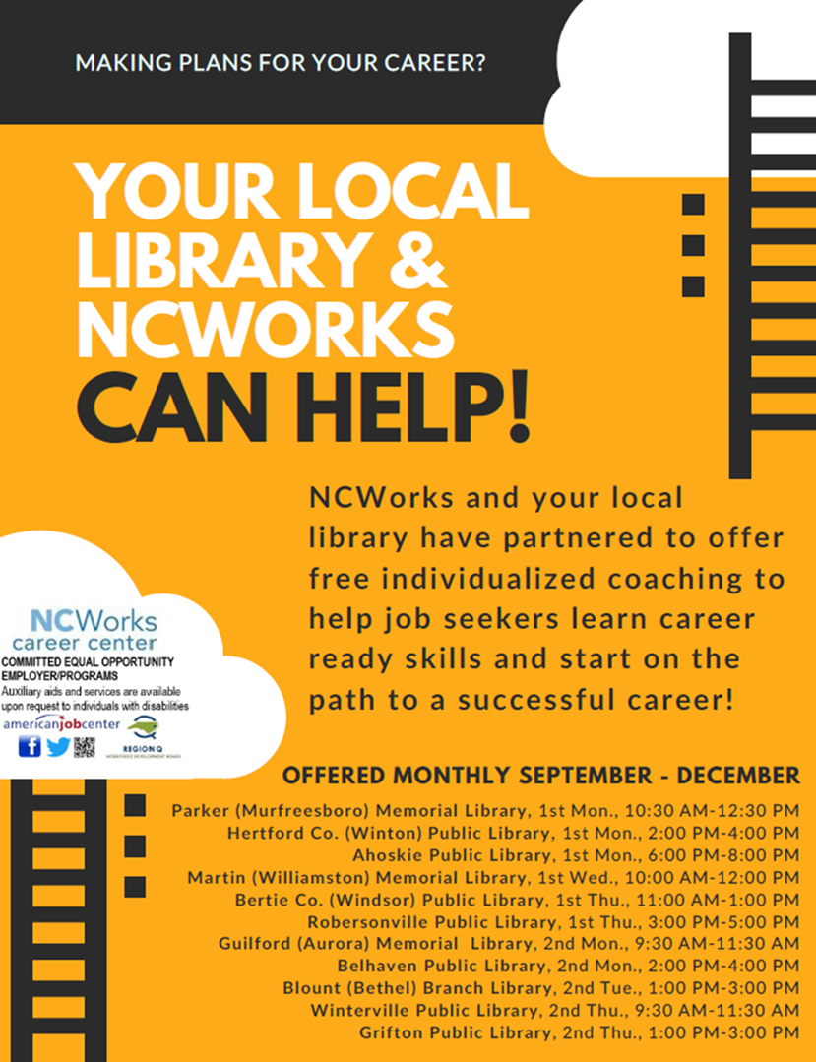

Slide 6
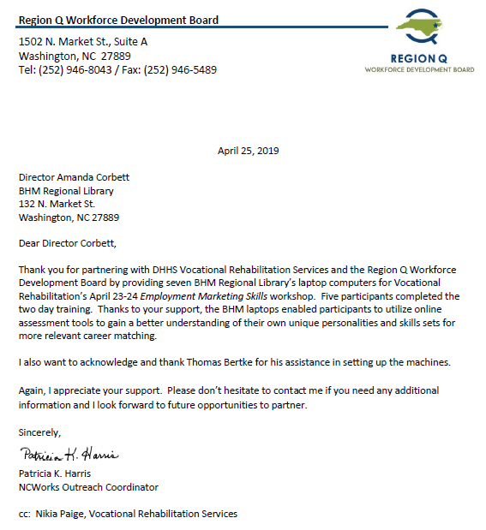

Acknowledgements
Caption

Slide 7
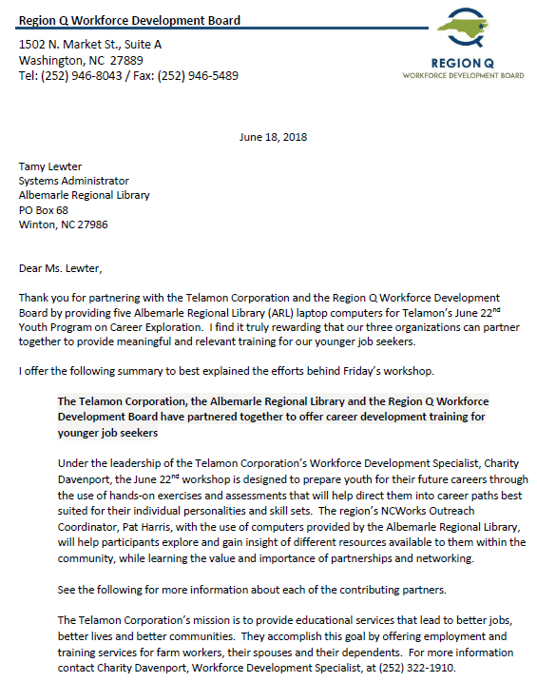
Acknowledgements
Caption

Slide 8
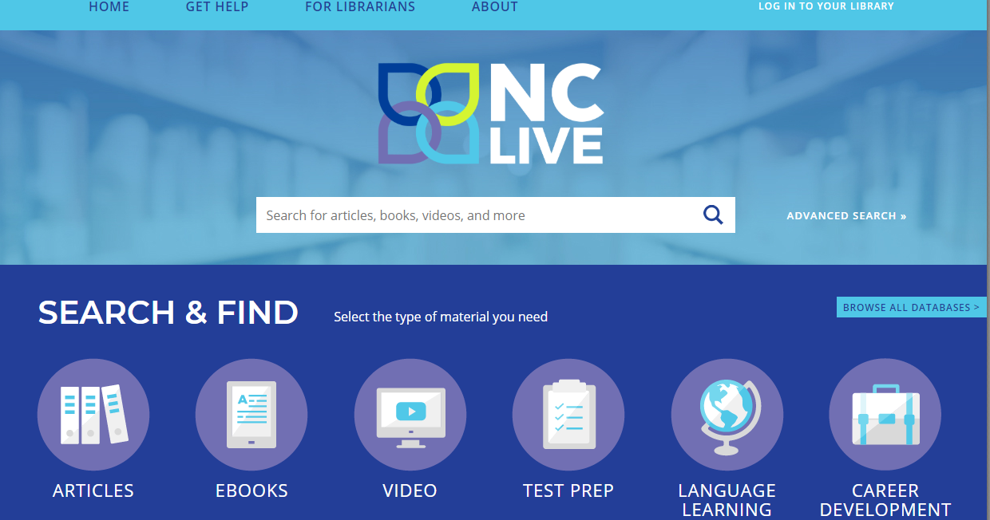

Slide 9
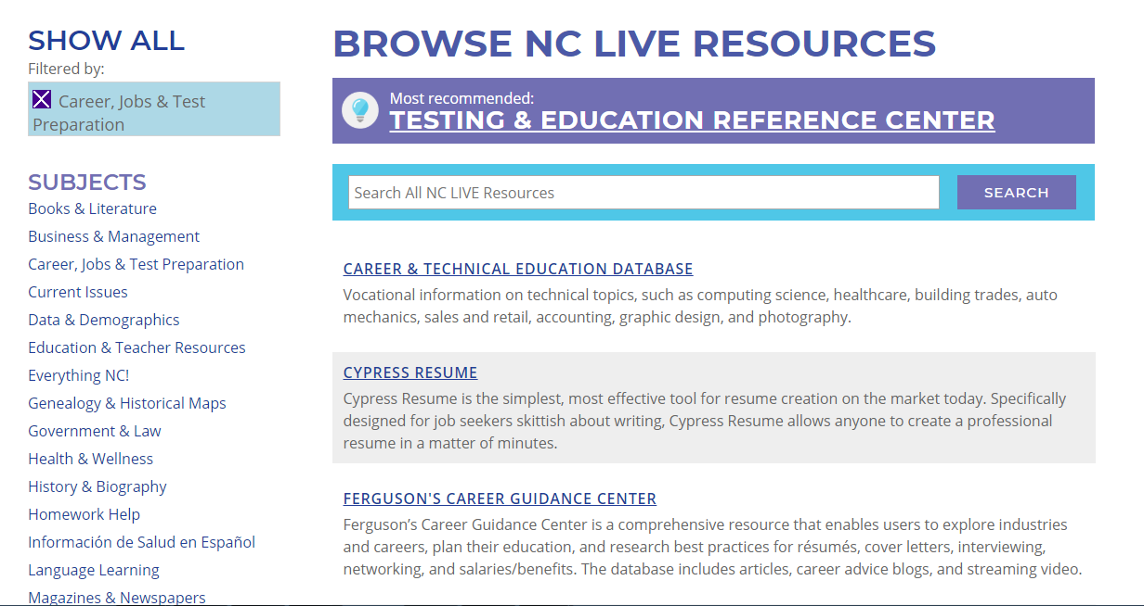

Slide 10
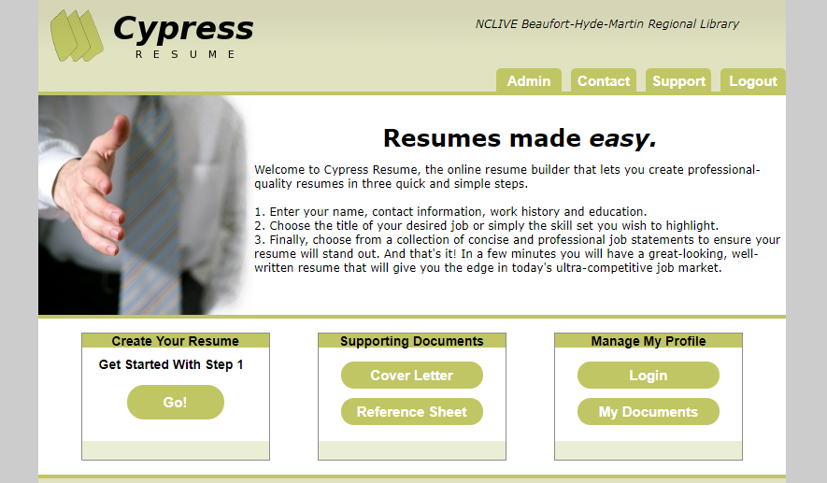

NC Live
https://www.nclive.org
Helps member libraries to better support education, enhance economic development, and improve the quality of life of all North Carolinians

Slide 11
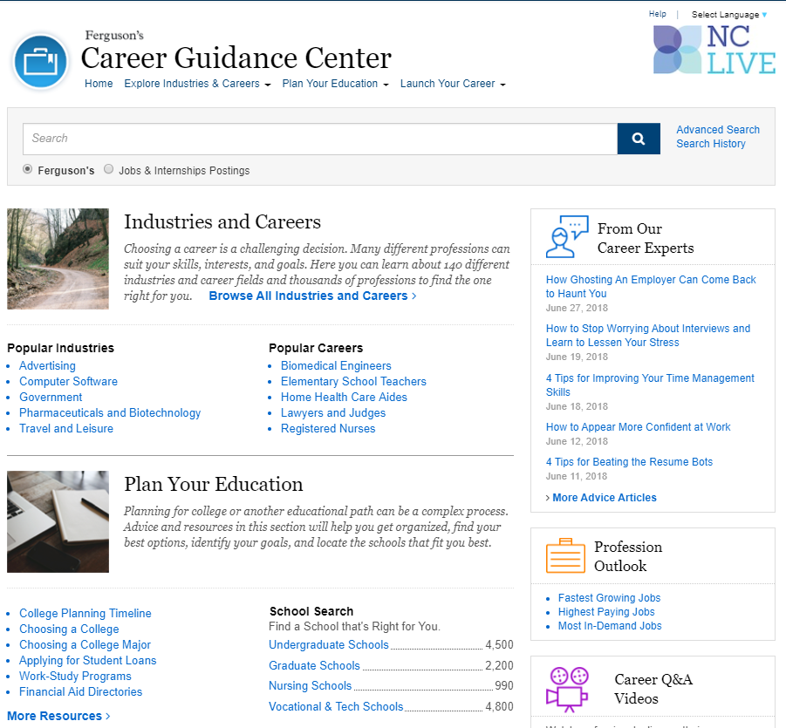

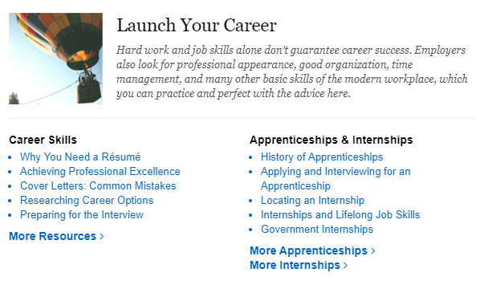
https://www.nclive.org

Slide 12
Continuing Outreach Efforts through Libraries (Region Q)
Continued work with job seekers by appointment
Established a Library Constant Contact distribution list for program marketing (RAMP East)
Encourage you to work with a library to reach under utilized populations and expand your outreach range; can provide introductions
Continue to use as marketing outlet (informational videos)
Continue to partner on initiatives and programs
Value libraries as contributing partners

