Slide 1
https://youtu.be/OyLlS_XF9to

Slide 2
ApprenticeshipNC: A Talent Driven Training Strategy

Slide 3
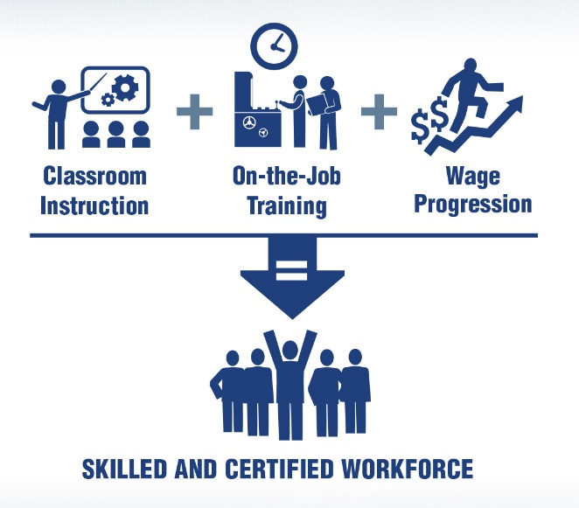
Today’s Discussion
Elements of Apprenticeship Programs and Standards
Apprenticeship Registration Process
Online Interest Profile
Youth/
Pre-Apprenticeship

Slide 4
Topic 1: Elements of Apprenticeship Programs & Standards

Slide 5
Why Registered Apprenticeship?
Build a Competitive Workforce
Employers Facing Complex Workforce Challenges in Competitive Domestic and Global Markets
Time-Tested Model
Proven Strategy for Recruiting, Training and Retaining World-Class Talent Used by Industry for Decades (and longer!)
Adaptable and Flexible
Registered Apprenticeship is a Solution and Can Be Integrated into existing Training and Human Resources Development Strategies!!!

Slide 6
What is Registered Apprenticeship?
Employer Involvement
Structured
On-the-Job Learning
Job Related Education/
Instruction
Rewards for Skill Gains
National Occupational Credential
Registered with the U.S. Department of Labor, Office of Apprenticeship and/or Federally Recognized State Apprenticeship Agencies
Five Core Components of
Registered Apprenticeship

Slide 7
Structured On-The-Job Learning (OJL)
Work-based Learning Developed with Industry/Employers
Minimum of 2,000 Hours = One Year of Training
Over 1,000 Apprenticeable Occupations
Credit awarded for previous training received

Slide 8
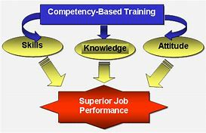
Structured On-the-Job Learning Model Types
Time – Sets a required number of hours of On-The-Job Learning and Related Education/Instruction
Competency – Progression is based on the apprentice’s pace and demonstrated competency in skills and knowledge through proficiency testing. No requirement to complete a specific number of hours.
Hybrid – Uses a minimum and maximum range of hours and the successful demonstration of identified and measured competencies.
Time-Based Model
Competency Based Model
Hybrid Model (Time and Competency)

Slide 9
Job Related Education/Instruction
Job Related Education/Instruction Training Providers
Vocational and/or Technical Schools
Community Colleges or Universities
Industry Associations
Labor Non-Union and Union Organizations
In-House or Sponsor
Job Related Education/Instruction Delivery Methods
Classroom
Correspondence
Electronic Media/Online
Minimum of 144 Contact Hours Per Year (No Maximum)

Slide 10
Progressive Wages for Skill Attainment
Incremental Wage Increases
Credit for Previous Experience
Documented Work Experience
Documented Educational Experience
Customized Training (Community College)
Pre-Apprenticeship Experience
Military Veterans
Federal Minimum Wage ($7.25 per hour)
Performance Based
Wage Progression = Skills Progression
Apprentice Wages % of Journeyworker Wage Rates

Slide 11
Registered Apprenticeship Credentials
Employer Credentials
Nationally Recognized Certificate of Registration
Apprenticeship Credentials
Nationally Recognized Certificate of Completion
Stackable Credentials
Opportunity to Earn College Credits, Certificates, Diplomas & Degrees

Slide 12
Basic Sponsor Responsibilities
Employ Apprentices Full Time
Program sponsor does not have to be the employer
Apprentices must train in all phases of the occupation
Coordinate On-the-Job Learning and Related Instruction to maximize
effectiveness of training

Slide 13
Basic Sponsor Responsibilities
Provide Job Related Education/Instruction for Apprentices
Apprentices do Not have to be paid for related education/instruction hours
Job Related Education/Instruction is conducted during or after work at the discretion of the employer
Partnerships can be made with high schools through college readiness curriculum, career academies, Career and Technical Education, and work-based learning programs

Slide 14
Basic Sponsor Responsibilities
Desire to Develop Skilled Workforce!
Registered Programs Require Minimal Sponsor Administrative Activities
Technical Assistance Services to Employers from ApprenticeshipNC Staff
Support from strategic partners

Slide 15
Apprentice Minimum Requirements
Minimum eligible age for an Apprentice is 16 years old
Apprentices 16 & 17 years of age must have parental consent
Apprentices must have: U.S. Citizenship, permanent residency status, or a Visa that permits employment in the U.S.
Ability to Satisfy Sponsor Additional Minimum Requirements:
Education, Physical Ability, Background Checks, Drug Testing, etc.
Ability to successfully complete their on-the-job learning and Job Related Education/Instruction
Desire to Earn – Learn – Succeed!

Slide 16
Questions and Discussion on Topic 1:
Elements of Apprenticeship Programs and Standards

Slide 17
Topic 2: Apprenticeship Registration

Slide 18
Registered Apprenticeship Program Development Process
Step 1 Contact
Us
Step 2
Build Program
Step 3 Program Check
Step 4 Program Registered
Step 5 Launch Program
Contact ApprenticeshipNC Representative Consultant
Collaboration with Sponsor to develop Training Program
Review and Approval of Customized Standards of Apprenticeship Developed Based on Sponsor’s Operational Input
Sponsor
Receives Finalized Standards of Apprenticeship and Certificate of Registration Documents
Employer Implements Registered Apprenticeship Program

Slide 19
ApprenticeshipNC Opportunities
US DOL Apprenticeship Expansion and Continuation Grants
Curriculum Classes
Continuing Education, Books, and Supplies
Identification of CC Regional Apprenticeship Coordinators
Workforce Innovation and Opportunity Act (WIOA)
On-the-Job Learning
Books, Tuition and Supplies
Supportive Services
Work Opportunity Tax Credit (WOTC)

Slide 20
USDOL Grants: Education Assistance
Funds available to reimburse education expenses for Curriculum or Continuing Education
Pre-Apprenticeship
Registered Apprenticeship
Industry Sectors:
Advanced Manufacturing
Construction
Energy
Healthcare
Hospitality
Information Technology
Logistics
Public Safety

Slide 21
Workforce Partnerships
Employers (Structured On the Job Learning)
Must have employer(s)
Must Drive Program Design and Related Education/Instruction
Provider of OJT/Work Based Learning
Sponsors (Administration)
Responsible for Administering the Program
Can be Employer, Consortia of Employers, Industry Association, Educational or Training Provider

Slide 22
Workforce Partnerships
Public Workforce System
Provide basic skills/pre-apprenticeship
Provide training funds (through WIOA OJT contracts, individual training agreements, Customized Training)
Provide support services
Educational (Job Related Education/Instruction) Provider
Can be the employer
Can be an Industry Associations
NC Community College System
Others

Slide 23
How to Utilize Funds
Apprenticeship Component Workforce Service (WIOA)
Prior to Entrance Assessment, case management
Pre-Apprenticeship Basic skills training, work experiences
Related Education/Instruction Individual training accounts
Cohort-funding a class
On-the-job Learning Reimbursement up to 75% of wage rate for jobseekers
Customized training funds
Min. of 20% of youth funds used for work experience

Slide 24
ApprenticeshipNC at Fort Bragg
Established January 1, 1993
890 Active duty soldiers enrolled from 07-01-2017 through 06-30-2018
80 Military Occupation Specialties (MOS) registered
Prior credit is granted for previous work experience and classroom hours upon review of Enlisted Record Briefs (ERB)
Soldiers receive State and Federal Certifications upon completion of On-the-Job Learning

Slide 26
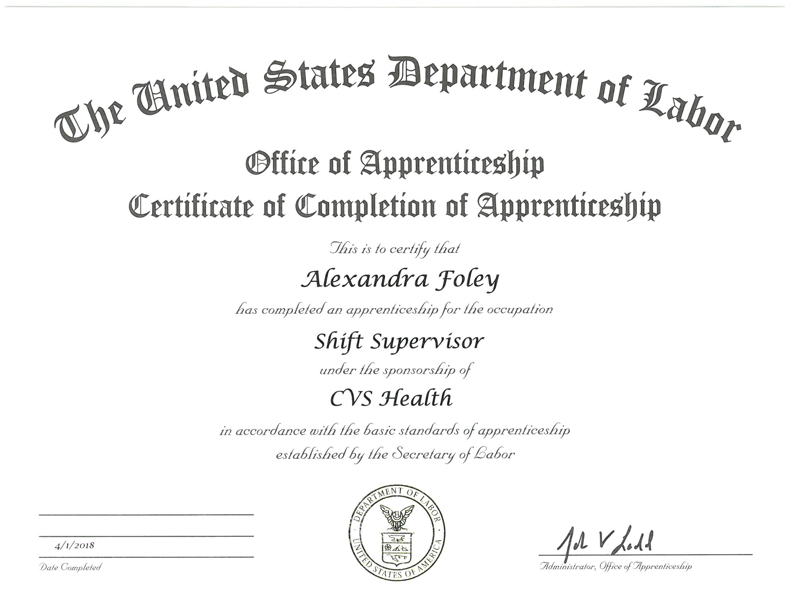

Slide 27
Registered Apprenticeship is a “Win-Win-Win-Win”
Apprentices Earn-and-Learn Incremental Pay Increases Earn college credit Training under qualified mentors Learn on-the-job with current technology and equipment Career development | Community Colleges Closer industry relationships Articulation between apprenticeship and college programs ensures relevance and rigor Increased enrollment in credit classes Increased program graduations
Businesses Effective recruitment tool Expand education and training options Increased employee retention Trained and educated workforce Address pipeline concerns Transfer knowledge, skills, and expertise Develop future leadership | North Carolina Aligns with key workforce system initiatives Learn and train locally Economic contributor Employed apprentices raise families, and purchase goods, services, and homes Future business leaders

Slide 28
Questions and Discussion on Topic 2:
Apprenticeship Registration

Slide 29
Topic 3: Online ApprenticeshipNC Interest Profile

Slide 30
ApprenticeshipNC Interest Profile
A paperless online tool that streamlines program registration information and design
Collects and stores pertinent information about the organization, their workforce, and the desired apprenticeable occupations
Creates program standards that connect directly with the Registered Apprenticeship system

Slide 31
ApprenticeshipNC Interest Profile
Comprised of helpful instructions that lead the user through a series of multiple choice questions about their program and training needs
Completed forms are used to generate a standards template.
Reduces the time to register a new program by simplifying the process for employers to develop program standards.

Slide 32
ApprenticeshipNC Interest Profile
An ApprenticeshipNC Consultant will make contact to finalize the process and register the sponsor’s Apprenticeship program
The following web link will guide you to the site to begin the process
https://apex.skillbuilders.com/ords/aprod/f?p=STB_PUBLIC

Slide 33
Questions and Discussion on Topic 3:
Online Interest Profile

Slide 34
Topic 4: Pre-Apprenticeship and Youth Apprenticeship

Slide 35
Pre-Apprenticeship Programs
Pre-apprenticeship programs are designed to prepare individuals to enter and succeed in Registered Apprenticeship programs
Pre-apprenticeship programs have a documented partnership with at least one Registered Apprenticeship program sponsor
Pre-apprenticeship programs expand the participant's career pathway opportunities with industry-based training coupled with classroom instruction

Slide 36
Benefits of Pre-Apprenticeship for Participants
Explore and learn about exciting careers
Qualify to meet the minimum standards for selection to a Registered Apprenticeship program
Benefit from classroom and technology-based training
Get a start on career-specific training with viable career pathway opportunities
Build Literacy, Math, English, and work-readiness skills employers desire
Advance into a Registered Apprenticeship program

Slide 37
Benefits of Pre-Apprenticeship for Employers
Streamlines the recruitment process
Pre-screens a qualified, job-ready apprentice pool
Recruits a diverse pool of prepared candidates
Aligns training with apprenticeship standards
Increases retention rates for registered apprenticeship participants
Improves quality control of preparatory training

Slide 38
Quality Pre-Apprenticeship Programs
Approved Training and Curriculum
Work Process and Related Instruction
Strategies for Long-Term Success
Strong recruitment strategies
Educational and pre-vocational services (career and industry awareness workshops, tutoring and job readiness courses)
Pathway to Registered Apprenticeship Programs
Access to Appropriate Support Services
Mentors, Career Counselors and Vocational Counselors
Promote Greater Use of Registered Apprenticeship to Increase Future Opportunities

Slide 39
Pre-Apprenticeship Program Standards
Program Sponsor and Partners will develop guidelines for:
Minimum Applicant Qualifications
Selection Process
Program Outline/Content
- Program length can range from a few weeks up to one year
- Program can include a combination of On-The-Job Learning and Related Instruction
Wages or optional if the pre-apprentice does not provide a service for the employer
Evaluation Criteria

Slide 40
Youth Apprenticeship Programs
Youth apprenticeship programs engage partners from industry, education, and community
ApprenticeshipNC helps to facilitate these partnerships in the local area
The ApprenticeshipNC Youth Coordinator and Regional Consultants work together with stakeholder groups to build programs
Apprenticeship Consultant

Slide 41
Youth Apprenticeship Models
Industry Sector Consortium: Local industry employers partner to meet a shared need for skilled employees in a particular industry
Determine the occupations they will register
Create a combined marketing strategy
Select the related education to leverage community college resources
Agree upon the wage scale
Build recruiting, screening and selection tools

Slide 42
Youth Apprenticeship Models
Workforce Development Consortium: form as an “umbrella” of interested employers, educators, and community partners who support and promote apprenticeship in their local area
Create a combined marketing strategy
Work with community college to develop pre-apprenticeship programs
Build recruiting, screening and selection tools
Register independent apprenticeship programs

Slide 43
Advantages of Youth Apprenticeship Programs
Youth Apprentices start at a lower wage and progress their wage as skills increase
Companies report productivity within 6 months to a year, making money for the company
Research has proven for every dollar spent on training, an employer receives a benefit of $1.47 up to $2.00
Youth have or can easily obtain the pre-requisite skills needed in the company through College and Career Promise or high school curriculum

Slide 44
Advantages of Youth Apprenticeship Programs
Partnerships with youth serving organizations can help off-set costs for on-the-job learning for eligible students
Increased retention (91%) and low turn over for the duration of the apprenticeship and beyond decreases company training costs
Student is eligible for a Community College Tuition Waiver when registered as a pre-apprentice or apprentice before their high school graduation

Slide 45
Youth Apprenticeship Partnerships: www.apprenticeshipnc.com

Slide 46
Youth Apprenticeship Guide

Slide 47
Questions and Discussion on Topic 4:
Pre-Apprenticeship and Youth Apprenticeship

Slide 48
Consultant Map Rev 7-17-2018
Kathryn Castelloes, Director
castelloesk@nccommunitycolleges.edu
Dale Yarborough, Field Supervisor
yarboroughd@nccommunitycolleges.edu
5001 Mail Service Center
200 West Jones St.
Raleigh, NC 27699
apprenticeshipNC@nccommunitycolleges.edu
Main 919-807-7100
Fax 919-807-7169
www.ApprenticeshipNC.com
Wanda Ramos-McPherson
984-365-3331
ramos-mcphersonw@nccommunitycolleges.edu
Shante Bell
919-219-1352
bells@nccommunitycolleges.edu
Tony McKnight
ACT Job Profiler
336-312-2282
mcknightt@nccommunitycolleges.edu
Shari Phelps
828-244-9279
phelpss@nccommunitycolleges.edu
Eric Tillmon
919-219-6258
tillmone@nccommunitycolleges.edu
Antwan Pippen
919-538-2185
pippena@nccommunitycolleges.edu
Danny Boykin
910-512-9989
boykind@nccommunitycolleges.edu
Elizabeth Standafer
State Wide Youth Coordinator
919-414-5948
standafere@nccommunitycolleges.edu
Charlene Sumlin Cross
Military Consultant
910-308-9413
crossc@nccommunitycolleges.edu

Slide 49
Partner with ApprenticeshipNC
Registered Apprenticeship is a flexible and proven workforce development strategy that can help grow talent at your company.

Slide 50
Open Discussion: Questions/Concerns/Opportunities

