Slide 1

College Partnership Meeting
February 2019

Slide 2
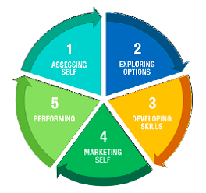
UPDATES
GADJ
Social Media Marketing
Partner Updates

Slide 3
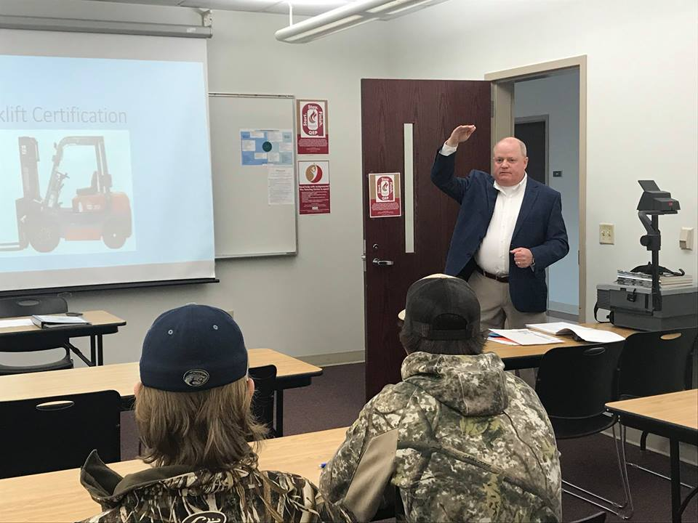
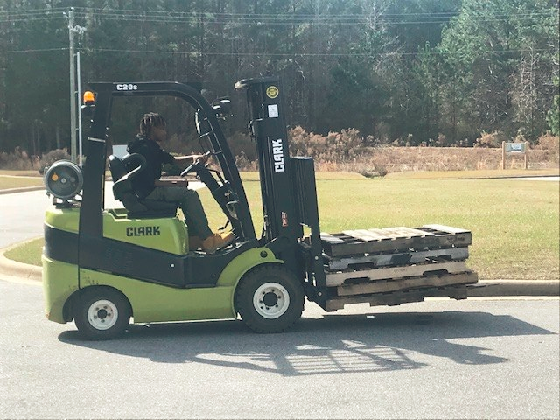
Edgecombe Community College
STEP was happy to partner with Edgecombe Community College for the first of three Forklift Training classes. Several high school seniors received their certification today and are on their way to a possible career in logistics/distribution. Thanks to our partner, Kanban & Harold Hobgood for speaking with the class about careers in our area.

Slide 4
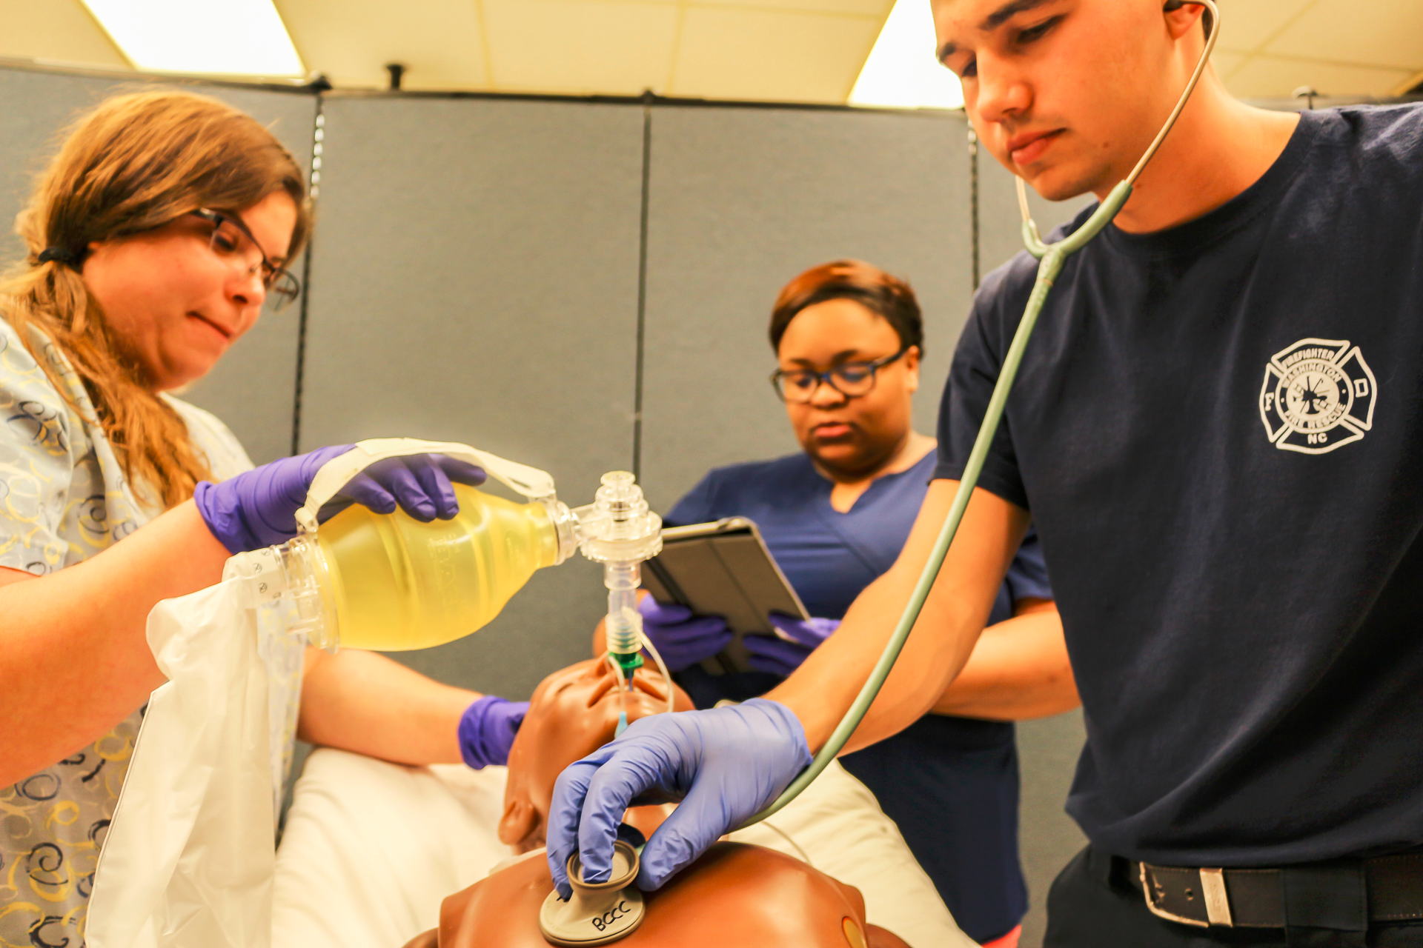
Beaufort Community College
Currently, BCCC has nine students already taking classes: four in EMT, three in pharmacy tech, one in nurse aide and one in HVAC. Braedon Burbage took the EMT pathway while still enrolled at Northside High School. He participated in the evening class with students of different ages and experiences. After taking the class last fall, Burbage passed his state certification exam, but had to wait until he turned 18 to start working in the profession. He plans to work at Washington Fire and Rescue after graduation.

Slide 5

Pitt Community College
Pitt Community College's mission is to educate and empower people for success. The College is a vital partner in the economic and workforce development of our community with a culture of excellence and innovation. Pitt Community College is surrounded by military bases. We strive to provide a welcoming environment for veterans and dependents and to ease the veteran's transition from active duty to civilian life. We have an active Student Veterans Association on campus to help veterans feel welcome and provide peer support.

Slide 6
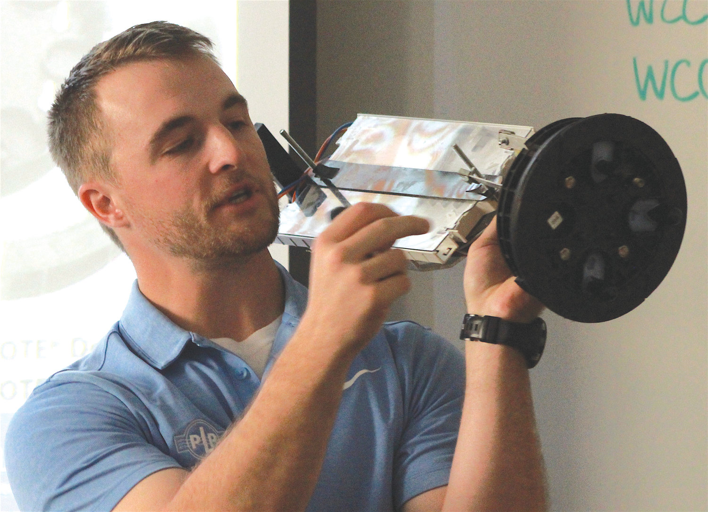
Wilson Community College
Greenlight is collaborating with Wilson Community College to provide a course in basic fiber optics hoping to attract people who can be trained in the emerging technology.

Slide 7

EMPLOYER PERSPECTIVE
Mary Paramore
Plant Learning & Development Specialist
Sarah Watson
Talent Acquisition Manager

Slide 8
RAMP-East
Jennie Bowen
Region Q WDB Director
Michael Williams
Turning Point WDB Director

Slide 9
Regional Advanced Manufacturing Pipeline-RAMP East
Area Served (Counties/Cities/Region): East of I95 Corridor – (Beaufort, Bertie, Edgecombe, Halifax, Hertford, Martin, Nash, Northampton, Pitt and Wilson Counties)
Requested Duration of the Grant: 24 months
Brief Description of the Project: Regional partnership between Region Q WDB, Turning Point WDB, regional community colleges and economic development partnerships to enhance recruitment efforts in the Advanced Manufacturing sector. The intent of the grant is to fund a proactive approach for recruiting under-served populations of the 10 counties building a pipeline of potential candidates for immediate and future advanced manufacturing jobs. Funding for outreach to individuals to inform them about the opportunities that exist and to point them in the right direction, whether that be to obtain a certain skill to meet the industry requirements or to provide soft skills training (i.e. resume clean-up, interview practice, etc.) to have them work ready for the interview process.

Slide 10

RAMP East (cont’d)
Funded by a $300,000 Enhancement Grant from Commerce/DWS
(2) Recruiters selected-
  Will work with Business Services, Community College, K-12, NCWorks Career Centers and Economic Development representatives.
  Will focus on outreach and recruitment of individuals of all ages to Advanced Manufacturing careers
In process:
  Logo
  Website
  Video

Slide 11

Golden Leaf Grant
Compliments RAMP East project
Focus on three major areas:
  Outreach to students, parents, teachers and job seekers utilizing multiple media outlets (print, radio, TV, social media)
  Student industry tours
  Teacher externships

Slide 12

More on RAMP-East
Christy Harris
RAMP-East Recruiter

Slide 13

NETWORKING BREAK

Slide 14

PARTNER SPOTLIGHT
Will Prettyman
Engagement Technician

Slide 15
BioNetwork Supports Colleges
Will Prettyman

Slide 16
Who we are
Part of Economic Development
3 Functions
  Industry Training
  Learning Solutions
  STEM Outreach

Slide 17



Industry Training
Courses
Certificates
Customized Training Projects
Natural Products Lab
Test Kitchen
BioWork

Slide 18

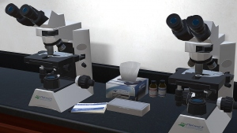
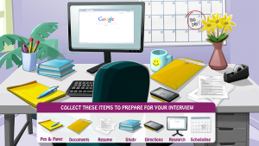
Learning Resources
Interactive eLearning Tools
Videos
Support media

Slide 19


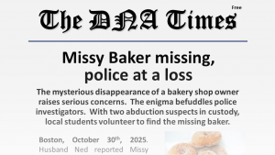
STEM Outreach
K-12 Outreach
Hands-on activities
Match K-12 standards
Please join us!
Professional Development
Teacher/Faculty workshops
Two upcoming in Wilson and Raleigh
Summer Workshops
NC³ABI Group and Biotech Group

Slide 20


College Specific Programs
EASE Programs
Effective and Authentic Science Events
Middle School students on campus
Whole day of activities driven by a story(New program coming this fall)
Community Science Nights
On campus or on K-12 campus
Materials and Training
Great community support
College Outreach
Activities for labs
PD for K-12 teachers on campus
Summer Camps
Supplied 3-5 day camp with materials and training
Each day has a different theme

Slide 21


Questions?
Will Prettyman
wprettyman@ncbionetwork.org
(252)757-3759
@bionetwork @NCBioNetwork

Slide 22

RESOURCE SHARING
Laurie Weston
PCC Transitional Studies Director

Slide 23
DISCUSSION TOPICS
Navigator WBL
Pathways: Agriscience/Biotechnology, Teacher pathway?
Finish Line Grants
Others?

Slide 24

Finish Line Grants
$2.6M awarded to local WDB’s and Community Colleges across the state (Total of $7M available)
To be eligible, students must:
  Enrolled in Community College
  Be 50% complete with their coursework
  Have a minimum GPA of 2.0
Eligible expenses include transportation, auto repairs, child care, dependent care, housing, accommodations for individuals with disabilities, utility bills, health care, assistance with tuition, books, fees & supplies

Slide 25
Finish Line Grants (cont’d)
Unallowable Expenditures include:
  Titled or deeded items (mortgage payments, property taxes, fines, late fees)
  Items where recovery of the expense is anticipated (rent or housing deposits)
  Purchase of vehicles
  Business start up costs
  Internet or phone service (including prepaid plans)
Students are served based on county/school attending

