Slide 1
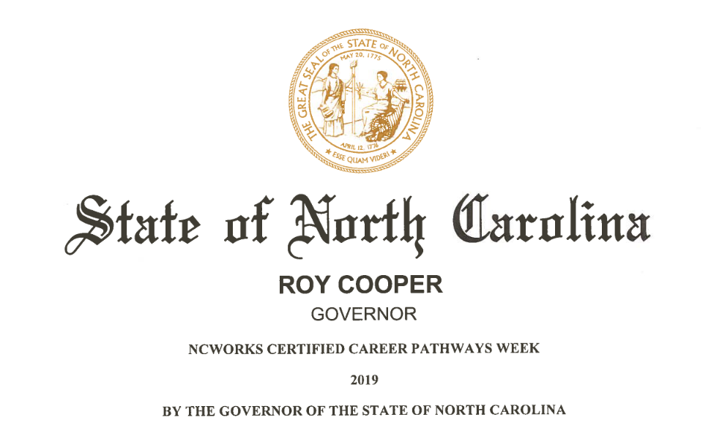

2019
Career Pathways Week
January 29, 2019
Martin Community College

Slide 2
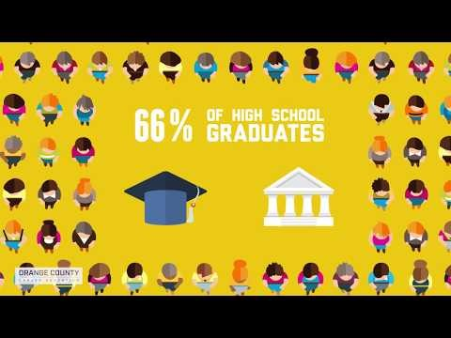
SUCCESS IN THE NEW ECONOMY

Slide 3
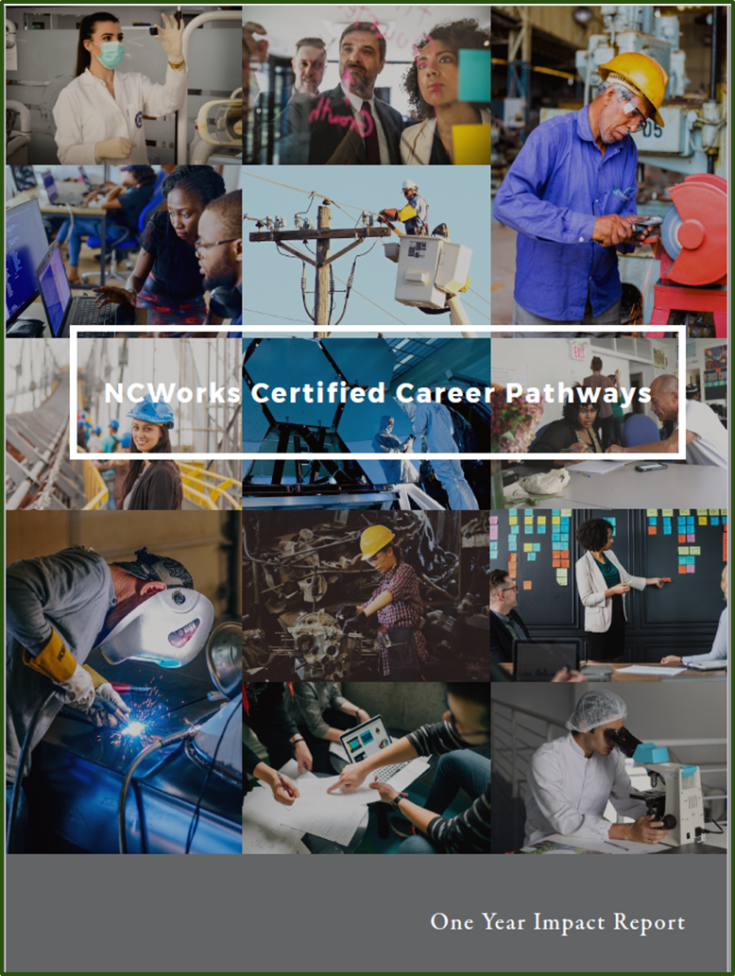
ONE-YEAR IMPACT REPORT
First Pathway Certified February 2016 – Northeast Region (Healthcare)
Thirty-five Pathways Certified Through 2018
Thirteen Pathways Reached One Year of Implementation by June 30, 2018 – Healthcare, Hospitality & Tourism, Advanced Manufacturing, Transportation, Information Technology
One Year Check-Ins Submitted by Each Team – Synthesized for Report
Captured Additional Data from Stakeholders
  Two Focus Groups
  Twenty-three Individual Interviews

Slide 4
Data indicate a continued need for Career Pathways
Ease the financial burden of education and training for career seekers
Upskill career seekers which makes them attractive candidates for gainful employment
Facilitate regional support, capacity building and collaboration for workforce partners
Cause a domino effect and inspire other success outside of their initial scope
College Partnership Survey-2018
-100% find Career Pathways professionally beneficial
-Partnership meetings help them to learn about pathways initiatives, networking, share best practices and discover local resources

Slide 5
Career Pathways have improved collaboration among partners and employers
Notes:
Local implementation
Adding new partners: Boys and Girls club, Roanoke Womens job corp, etc
programs like Biotechnology at ECC, 1 + 1 with PCC, Vet tech with NCC & MCC,

Slide 6
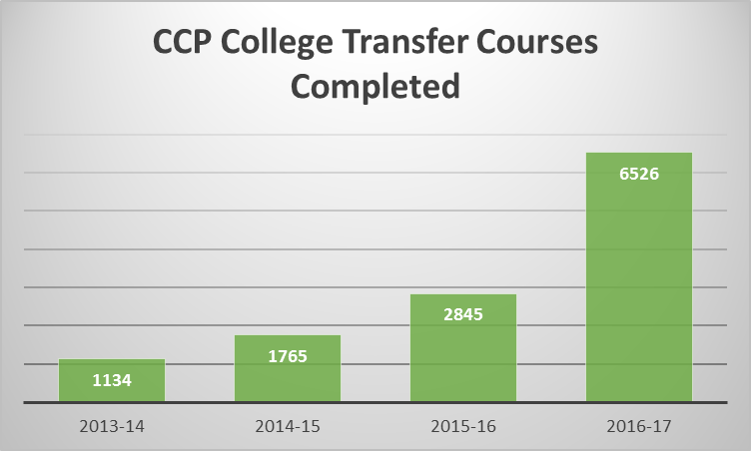
Educational institutions have streamlined course offerings
Notes:
better coordination between HS & College offerings, articulation agreements with local universities

Slide 7
Employers have provided larger numbers of Work-Based Learning opportunities
Notes:
All areas saw growth except Ag/Bio, due in part to educators allocating resources to other pathway areas.

Slide 8
Increased employer engagement has produced other, unintended benefits
Notes:
Employers offering WBL and other career awareness opportunities are able to see the “lightbulbs” come on with students who are learning about careers in their industry. Increased conversations about employer needs, including soft skills. Putting employers in the room with educators and career advisors spurs innovative ideas.

Slide 9
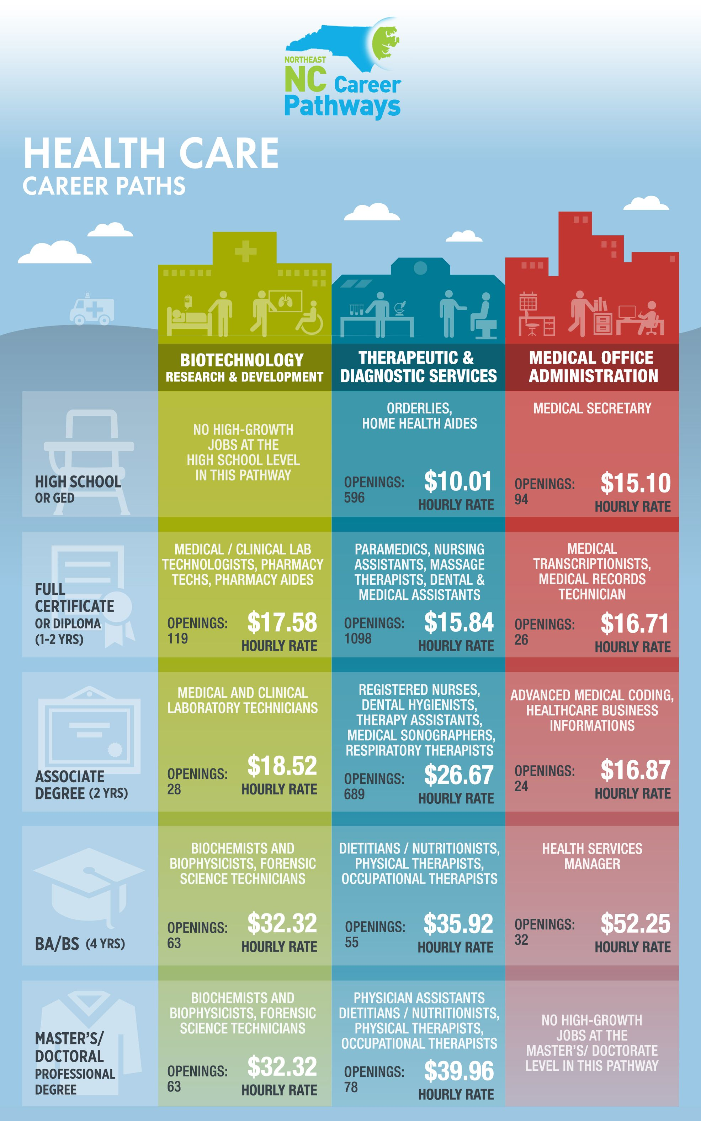

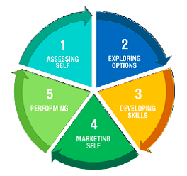
Career Pathways provide tools for smaller counties with fewer resources
www.nencpathways.org
Guidance and Direction for Jobseekers (GADJ)

Slide 10
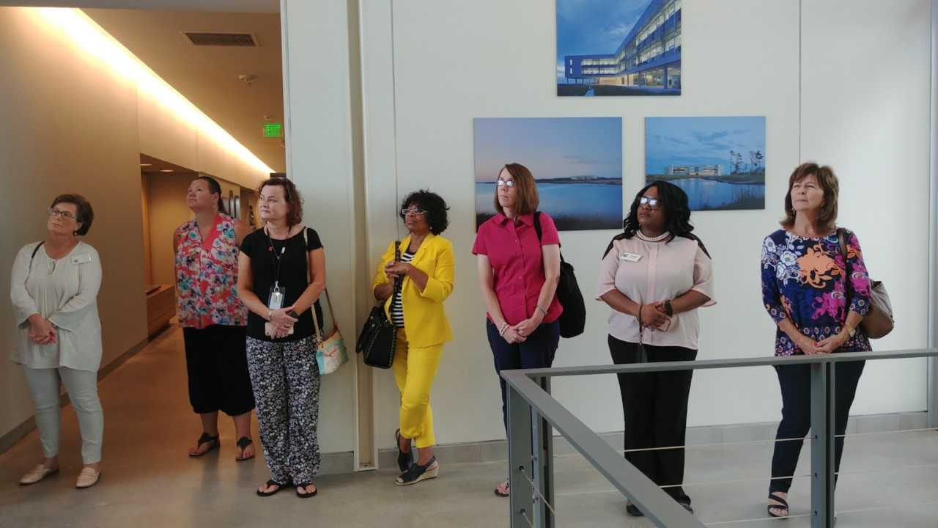
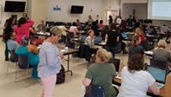
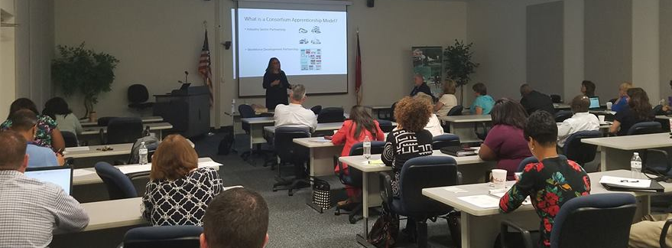
Front line staff feel invested in the Career Pathways process
Notes:
NCWorks Champions – also regional training on pathways toolkit, center training on career ladders
School Counselors/CTE – with CFNC at Halifax CC, also 2-3 CTE directors meetings each year, conferences
College Partnership

Slide 11

REFLECTION ON IMPACT OF CAREER PATHWAYS IN THE NORTHEAST
Larry Donley
Regional Operations Director
Northeast Prosperity Zone

Slide 12
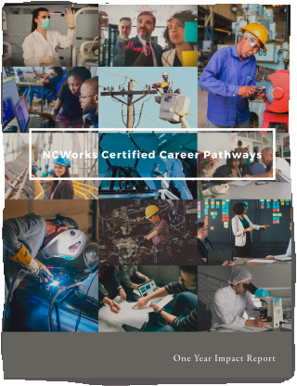


Impact of Certified Career Pathways in the Northeast

Slide 13


NORTHEAST LEADING THE WAY IN NC
Pathways to Prosperity – Harvard Pilot – 8 Best Practice Criteria (2012-2013)
1st Certified Career Pathway (Healthcare – 2016)
1st to have two Certified Career Pathways (Healthcare & Adv Manf - 2016)
1st to offer Local Implementation Certification (2017-Present)
1st to have Business Support Services CCP (2018)
(Will be) 1st to have Agriscience / Biotechnology CCP (2019)
Recognized for strong collaboration & partnership
Fortunate to have outstanding leadership

Slide 14

MAGNITUDE & SCALE
How many _________ have been involved in our CCP work?
How many _________ have been touched by our CCP work?
How many _________ have been impacted by our CCP work?
Fill in the blanks with:
  People / Staff / Players
  Agencies / Organizations / Administrations
  Partners / Employers
NCWorks Interagency Review Team
  important to maintain local representation

Slide 15
HOW RELEVANT ARE CCPs TODAY?
NC Job Ready Initiative
Skills & Education Attainment:
  Access to training – Finish Line Grants
  Skill requirements are increasing and rapidly changing
  Make NC Top Ten Educated State by 2025
  How increase local implementation certification?
Employer Leadership:
  Employer-led job training programs have best career outcomes
  Employers know what skills their workers need - employer involvement is key!
  Increase Work-Based Learning / Apprenticeship opportunities / NextGen Sector Partnerships
Local Innovation:
  How increase marketing & understanding of CCP’s among staff / students / parents / employers?
  How better integrate Economic Development & Workforce Development?
  How do we get Universities more involved with CCP’s?
  RAMP-East (CSX / Triangle Tyre / Corning)

Slide 16
PANEL ON SPECIAL POPULATIONS
Marcus Cutrell
Local Veterans Employment Representative
NC Department of Commerce
Beverly Davis
Senior Community Service Employment Program Coordinator
Upper Coastal Plain Council of Governments
Deidire Hill
Employment Services
Pitt County Department of Social Services
Victor Hinnant
Regional Reentry Specialist
Department of Commerce
Chloe Hudson
Manager, Greenville Unit Office
Department of Vocational Rehabilitation

Slide 17
SPECIAL RECOGNITION
Christina (Christy) Harris
Northeast Regional
CTE Coordinator
“Mother of Career Pathways in the Northeast”

Slide 18
FINAL THOUGHTS
Invite new partners
Share ideas and resources
Visit our website for information
Join our newsletter list for updates
www.nencpathways.org

