Slide 1

Health Care Pathway Review
January 22, 2019

Slide 2
Investing in Home Grown Nurses
Nash UNC Health Care Nurse Scholars Program
Katie Davison
HR Executive Director
January 22nd, 2019

Slide 3
Background – Nash UNC Health Care
Community, nonprofit 345 bed hospital in Rocky Mount
  Twin Counties: Edgecombe and Nash
  60,000 residents
Affiliate of University of North Carolina health care system
Focus on quality care, close to home
Registered Nurses
  Approximately 400 FT & PT bedside RNs
  Additional 100 PRN RNs
  Equates to 35% of our workforce

Slide 4
Nursing Shortage
Retirement is top driver for turnover
  As economy improves, American Nurses Association estimates 23% (187,200) RNs will continue to retire over the next 3 years
  Over 50% of RNs today are over age 50
  Physical demands of nursing contribute to reduction of hours (part-time, PRN) and/or outmigration from the bedside (schools, primary care offices, public health, etc.)
Turnover - National average for bedside RNs (2017) - 16.8%
  South East region (NC) slightly higher at 16.9%
Rising need for Advanced Practice Nurses will draw additional 198,000 RN’s from the bedside.
* Sources:
2018 Healthcare Staffing Survey Report, Nursing Solutions, Inc
2016 March Cost and Benefits of Nursing Turnover: A Business Case for Nurse Retention

Slide 5
Nurse Retention
Nursing shortage – Recruitment is only half the battle
Retention, retention, retention
Early Career RNs among most likely to leave
  Not just a “millennial thing”
    More opportunities in non-hospital environments, more appealing hours
    Social media and online networking increase exposure to hundreds of job opportunities in minutes
    Professional workplace culture has evolved – more common, and accepted, to change jobs at start of career
Nash Workforce Engagement Survey
  Lowest level of engagement: 6 months – 2 years, millennials
Sources:
HR Advancement Center, The Manager’s Guide to Engaging
Staff, Washington, DC: Advisory Board, 2017; Nursing Executive
Center research and analysis.
UNC Health Care 2018 Workforce Engagement Survey

Slide 6
Engagement by Length of Service
Line indicates your 2018 Engagement Score of 3.96

Slide 7
Engagement by Generation
Line indicates your 2018 NHC Engagement Score of 3.96

Slide 8


Our Challenge
How do we successfully prepare for nursing shortages with regards to recruitment and retention?
Nash UNC Health Care
Nurse Scholars Program

Slide 9
Scholarships - The Old Fashioned Way
Prior Scholarship practice at Nash UNC Health Care
  Scholarships ranging from $1,500 - $2,400 per semester
  Limited to internal candidates only, could attend any school
  After application & acceptance, passive process (money → student)
  Expectation to graduate, work at Nash
Challenges
  Internal pool limited (challenge to work & go to school)
  Some scholarship recipients changed their mind, went to work elsewhere
  Some scholarship recipients did not pass, dropped out of nursing program
  Very limited success rate

Slide 10
The Scholar Solution
Nash UNC Health Care Nurse Scholars Program
Partnership between Human Resources, Nursing, and our local community colleges
  Nash Community College (2017 – present)
  Edgecombe Community College (2018 – present)
We asked ourselves:
  Where do quality hires come from?
  And of these hires, who is looking for a career at Nash?
  Where can we invest resources financially for the best expected return?
  What barriers do NCC and ECC face to graduating additional RN students?
  How can we work together to ensure the success of these students?
SOLUTION → Create a fully funded, locally-focused, interactive scholars program invested in growing and nurturing our own nurses for success at Nash UNC Health Care.

Slide 11
The Scholar Solution – Community Partners
Why partner with Nash & Edgecombe Community Colleges?
Frequency of clinical rotations at Nash UNC Health Care
Pool of local candidates, many of whom desire to work in the area
Quality of nursing programs offered
  State of the art facilities
  Dedicated, strong faculty
  NCLEX pass rates
We are in this together! Win/Win approach

Slide 12

The Scholar Solution
Nurse Scholars Program:
Up to 15 nursing scholarships per year, per school
Financial Security
      Fully funds the cost of education (tuition, books, supplies)
      Additional $100/month monthly stipend
Invest in Success
      Participate in quarterly mentoring activities
      Free NCLEX review sessions
Retention From Day 1
      Scholars agree to a work commitment of up to 3 years post-graduation
      Participate in quarterly social activities
      Nash ID badge
      Interviewing preference – First choice of interviewing
      with desired department(s)

Slide 13
Scholar Selection Process
Requirements
Must be enrolled and accepted into an Associate Degree in Nursing (ADN) program
- Nash Community College
- Edgecombe Community College
Maintain a 3.0 GPA or higher
Two (2) letters of reference (must be from non-family members)
Application form outlining:
  Community or volunteer activities
  Personal statement
    Why do you want to be a nurse?
    Why do you want to be a nurse at Nash UNC Health Care

Slide 14

Scholar Selection Process
Selection Committee
  Nash UNC Nursing
      Chief Nursing Officer
      Associate Chief Nursing Officer
  Nash Human Resources
      HR Executive Director
      HR Manager
  Input sought from faculty
  Preference given to local students (Nash, Edgecombe county)
After selection →

Slide 15


Welcome to the Nash UNC Health Care Nurse Scholars Program!
Please join us as we celebrate your success and commitment to work at Nash
post-graduation.
Wednesday, October 17th
2:30pm – 4:30pm
Nash General Hospital
Auditorium
2460 Curtis Ellis Dr. Rocky Mount, NC

Slide 16

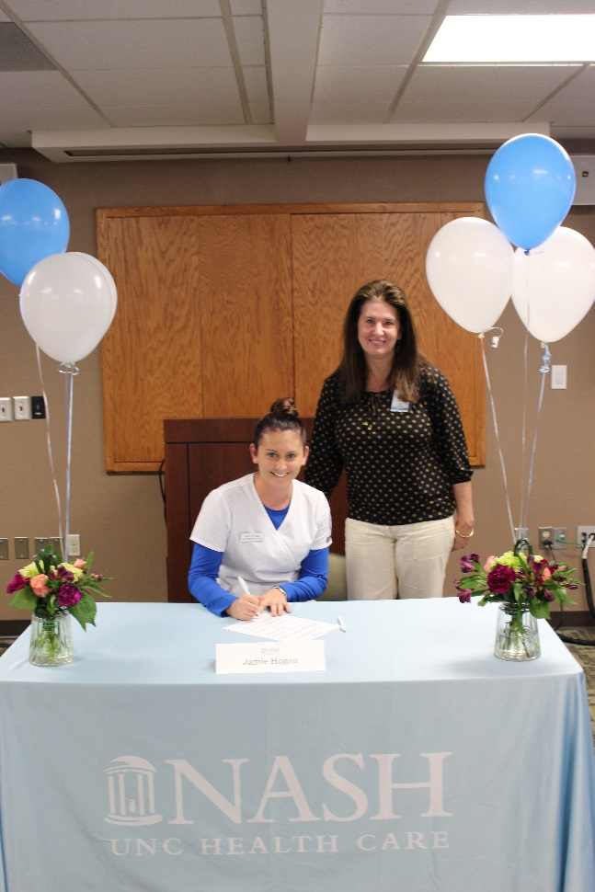

Signing Day

Slide 17


JAMIE HOGAN
School: Nash Community College
Hometown: Bailey, NC
Area of Nursing: CPSU or NICU
Favorite Food: Japanese/Sushi
Favorite Superhero: Wonder Woman
I am happiest when… I’m riding horses

Slide 18

MELISSA JOHNSON
NASH STATS
Position: LPN
Department: 3rd Floor Medicine
Number: #8
Nominated by: Dylan Johnson, Don Alston, Elbert Whitehead, & Gary McAninch
Melissa is a role model and leader in nursing who takes pride in caring for our patients. She shows compassion by reading and understanding the needs and concerns of others. Melissa is a nurse who always puts her patients and their needs first. She is a very caring person which shows in her care of those she is entrusted. Melissa makes a positive impact on her patients and her co-workers. Kind and selfless are two words that describe Melissa.

Slide 19

SHIRLEY SANDERS
NASH STATS
Position: Dietary Coordinator
Department: Food & Nutrition Services
Number: #32
Nominated by: The Food & Nutrition Services Leadership Team
Shirley Sanders (1958-2017) was our Dietary Coordinator at Coastal Plain Hospital. We mourn her loss and admire her optimistic spirit. Shirley’s nickname was Bee Bop because she was always bouncing around in high gear. She was quick with a smile and a kind word to brighten your day. Shirley loved life. Her main focus was on her patients and staff who took care of them.

Slide 20
Nash Scholars by the Numbers
2017 Pilot Year with Nash Community College
  12 total scholars
    5 first year students accepted (anticipated graduation May 2019)
    7 second year students accepted (graduated May 2018)
7 Scholars graduated May 2018
  Two year work-back commitment to Nash, full-time RN
  Many received their top choice department
# of Hires | Department
2 | Emergency Room
2 | Cardiac Pulmonary Support Unit
1 | Surgical Services (OR)
1 | Med/Surg
1 | Behavioral Health

Slide 21
Nash Scholars by the Numbers
2018 Pilot Year with Edgecombe Community College
  8 total scholars
    4 first year students accepted (anticipated graduation May 2019)
    4 second year students accepted (anticipated graduation May 2020)
2018 Nash Community College
  13 total scholars
    6 first year students accepted (anticipated graduation May 2020)
    3 returning second year Scholars (anticipated graduation May 2019, 3 year work-back)
    4 additional second year students accepted (anticipated graduation May 2019)

Slide 22
Nursing Workforce
Beside RN Workforce Projections for Nash UNC Health Care:
11 Scholars will graduate and begin work as full-time RNs Summer 2019
  3 Scholars have a three year work-back commitment
  8 Scholars have a two year work-back commitment
10 Scholars (possibly more!) to begin work as full-time RNs Summer 2020
Continue to promote Scholars program every year
Goal 30 Scholars/new employees every summer (15 Nash CC, 15 Edgecombe CC)

Slide 23
Looking Ahead
Lessons learned
  More focus on recruiting Year 1 students (application interest)
  Better ways to incorporate LPN → RN students into program
  Revised position recruitment to better align Scholars with top choice department
Goal – 30 Scholars every May (15 Nash CC, 15 Edgecombe CC)
Nursing program at both colleges is very competitive
  Goal – Increase the number of students that are accepted into nursing programs
  Need more graduates for expected RN shortages in near future
Elevate our partnership with Nash CC & Edgecombe CC regarding education
  Nash UNC Health Care has employees with MSNs, qualified clinical educators
  Envision job sharing partnership – assist with teaching 1-2 days/week
  Expand capacity of program

Slide 24



Thank you to our Community Partners!

Slide 25
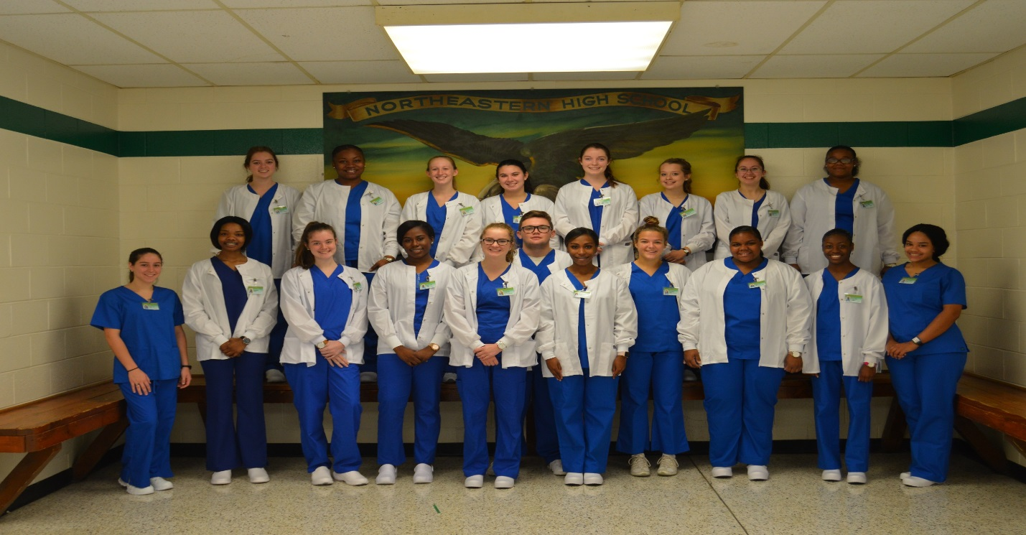
Spotlight on Success
Northeastern High School Health Science II students earn their certification in CPR/AED/First Aid for healthcare professionals. These students will experience clinical WBL opportunities from various healthcare professionals at Sentara Albemarle Medical Center.

Slide 26
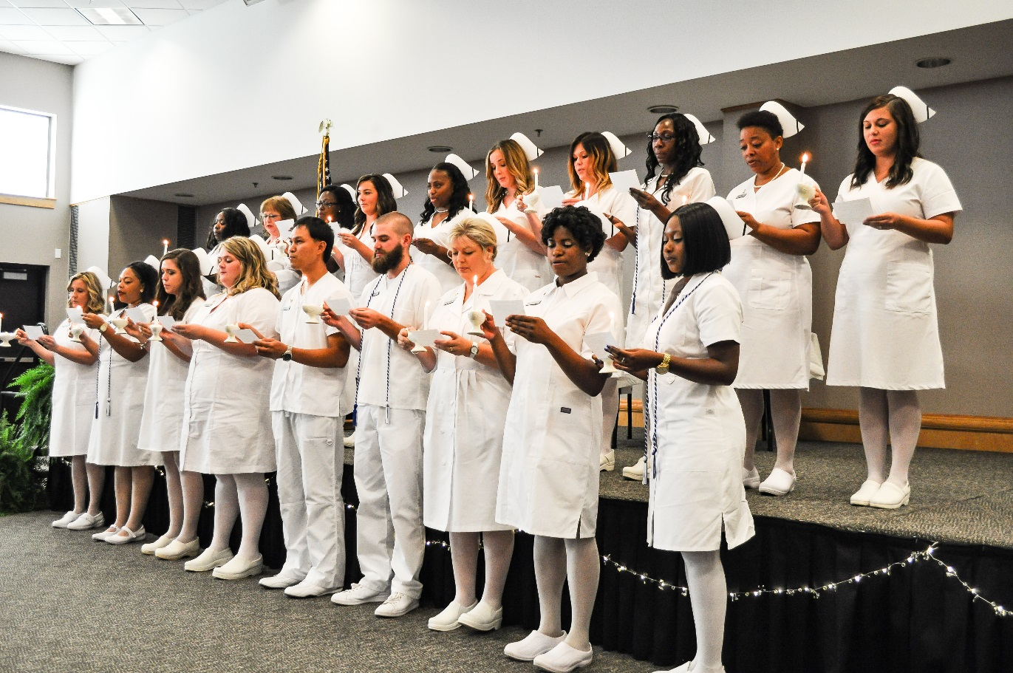
Spotlight on Success
Beaufort County Community College
Licensed Practical Nurse Pinning Ceremony 07/2018
*Sierra Hansley*
Notes:
Two years ago, Sierra Hansley was enrolled in the ADN Program at Beaufort County Community College. Right before her last semester she missed one class by 0.5 points and was not able to continue with the program. She had given up and wanted to quit. That is when Sierra visited her WIOA Career Advisor, Kimberly Laws. Sierra, Kim, and the BCCC Advisors devised a new game plan; transfer Sierra to the LPN Program. They were able to transfer her classes and all that hard work and with a couple of more classes, Sierra would be back on track! Encouraged and revived, Sierra stayed on course and was pinned on July 18! Congratulations!! and we wish you good luck on the State test.

Slide 27
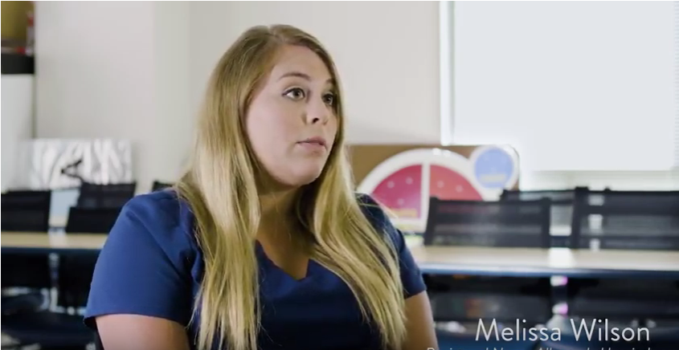

Spotlight on Success

Slide 28


Slide 29

Updates
Website Updates
Guidance and Direction for Jobseekers
Metrics collection/restructuring
Traitify personality/career assessment
Career Pathways Week – January 29th @ Martin Community College
Social Media Training with Martin Brossman
Raising awareness of Career Pathways webinar
Navigator WBL database
Conferences – NCETA/SETA, ApprenticeshipNC

Slide 30


Best Practices
Notes:
Social Media

Slide 31


Best Practices
Halifax Community College (HCC) will begin offering Certified Nursing Assistant (CNA) classes in Scotland Neck on Jan. 28.
Classes will be held at the Bryan Health and Rehab Center, with a maximum of 10 students per class. Upon completion of the program, students can go straight into the CNA II classes, which will offer even more professional opportunities.
Notes:
Local Implementation

Slide 32
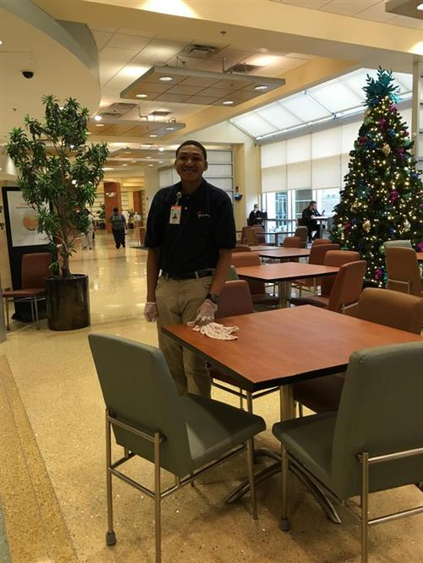

Best Practices
Through a collaboration between NC Council on Developmental Disabilities, Project SEARCH, Pitt County Schools, Vidant Medical Center, Vocational Rehabilitation, and RHA Health Services, Pitt County has it's first Project SEARCH site, which is the first of its kind in the East. Students with developmental disabilities in Pitt County now have the opportunity to learn transferable skills while working in Vidant Medical Center. Project SEARCH Vidant provides a supportive, welcoming work environment, daily individualized job coaching, daily classroom instruction on employability and life skills, and job placement assistance.
Notes:
RAMP

Slide 33

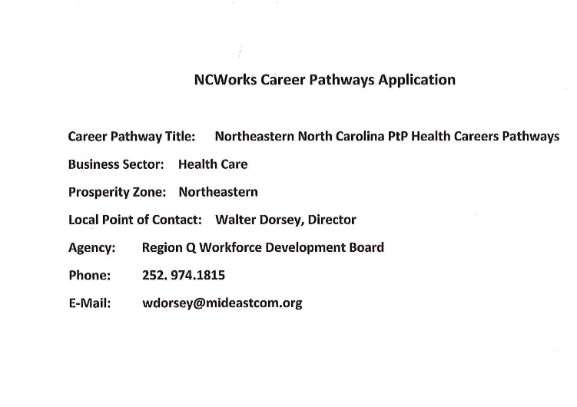
Recertification
FEBRUARY 2016

Slide 37
Evaluation

Slide 38
Community College

Slide 39
Workforce Development Boards

Slide 40
Local Education Agencies

Slide 41

BRUCE PANNETON
DEAN OF Health sciences & Public Safety

