Slide 1

Northeastern NC Career Pathways
College Partnership Meeting
November 26, 2018

Slide 2
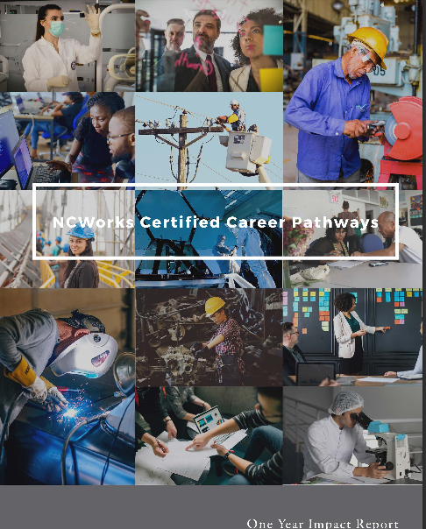

UPDATES
2018-2019 Projects/Calendar
Pathways Impact Report
Marketing Updates
Partner Updates

Slide 3
College Partnership Survey Results
Professionally beneficial
Providing and sharing information, discovering resources, networking, sharing best practices
Universities should contribute to metrics, networking, host events, participate in local implementations and provide representatives on leadership team
“We found that we needed 4 years universities to help ease parent concerns and wishes for a 4-year degree.”
Topics should include Employer perspectives, WBD and CTE updates, sharing of best practices
Most attend 4-6 Pathways meetings per year
Receive information from pathways via Meetings, Newsletters/Emails….some social media
Share pathways information via staff meetings & emails, some word of mouth
Most have received a local implementation certification or are working towards it
Supports needed for local implementation:
  “On-campus implementation process training.”
  “More employers saying they need pathways but also provide pathway elements of guest speakers, job shadowing internships, apprenticeships, tours etc.”
  “Collaboration with a community college that has implemented certification”
Future Metrics Questions
  “Is Industry Certificates the same as 3rd party credentials. IF not, a list of 3rd party credentials earned”
  “SkillsUSA Membership”
  “Industry specific needed courses”
Suggestions for the future
  “an industry certification database or something to track industry certs.”
  “Collaboration on regional specific Continuing Education class/ program offerings. (Needs from regional business and industry)”

Slide 4
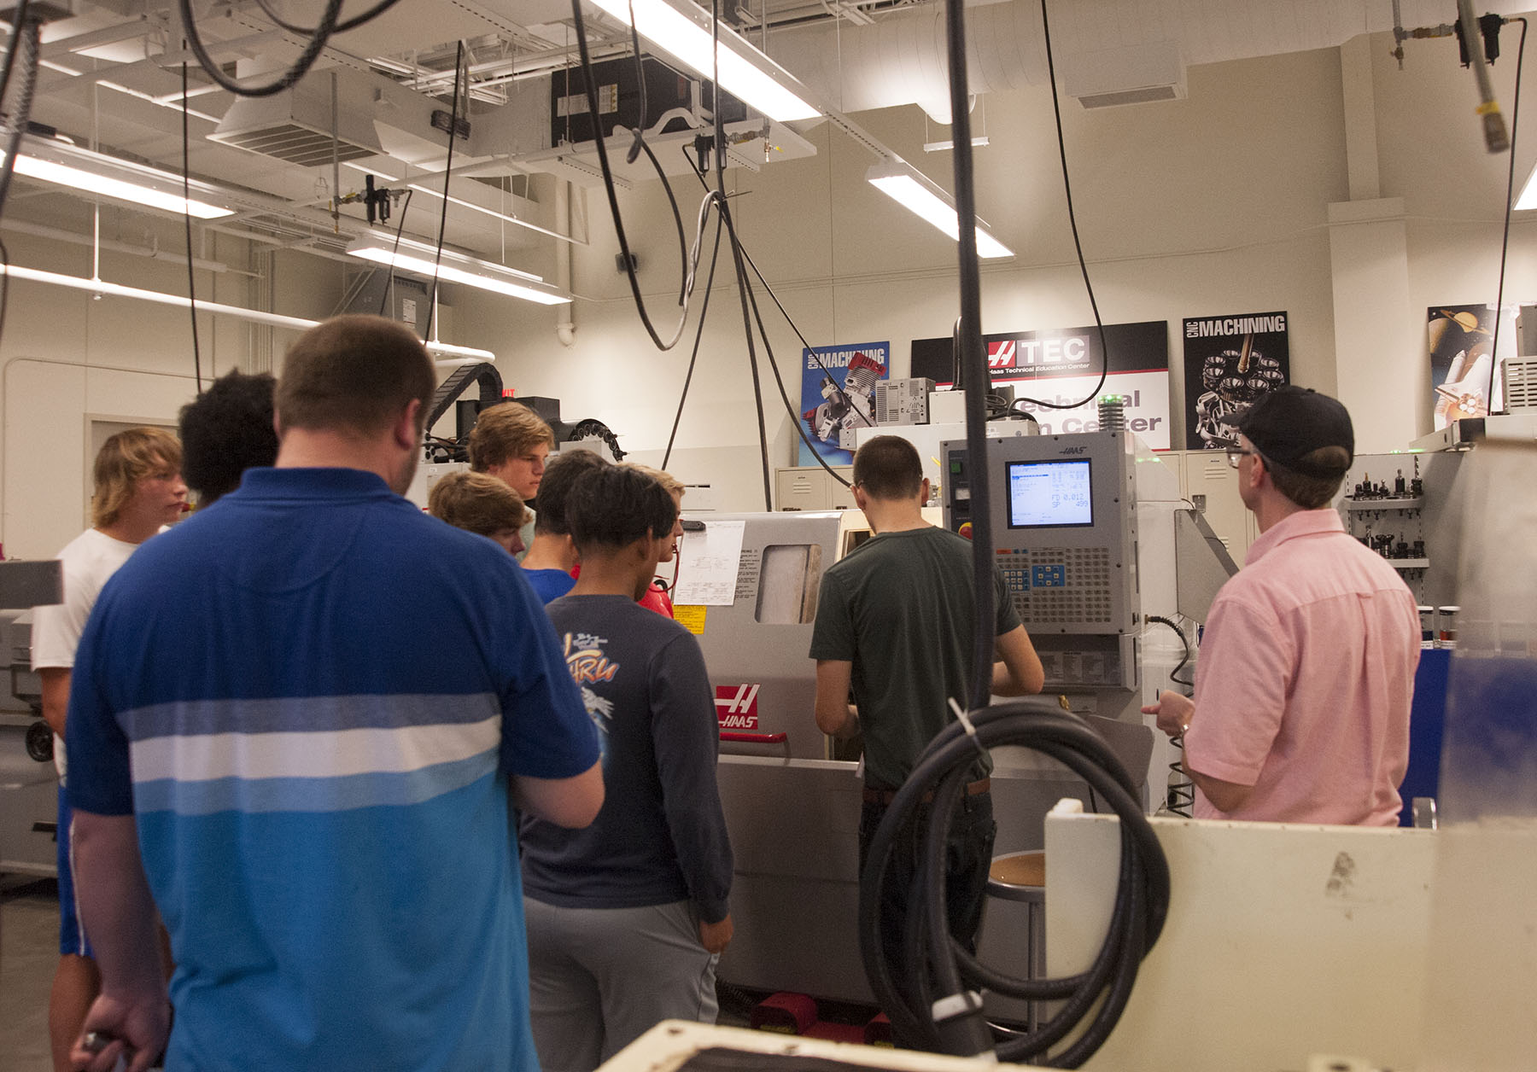
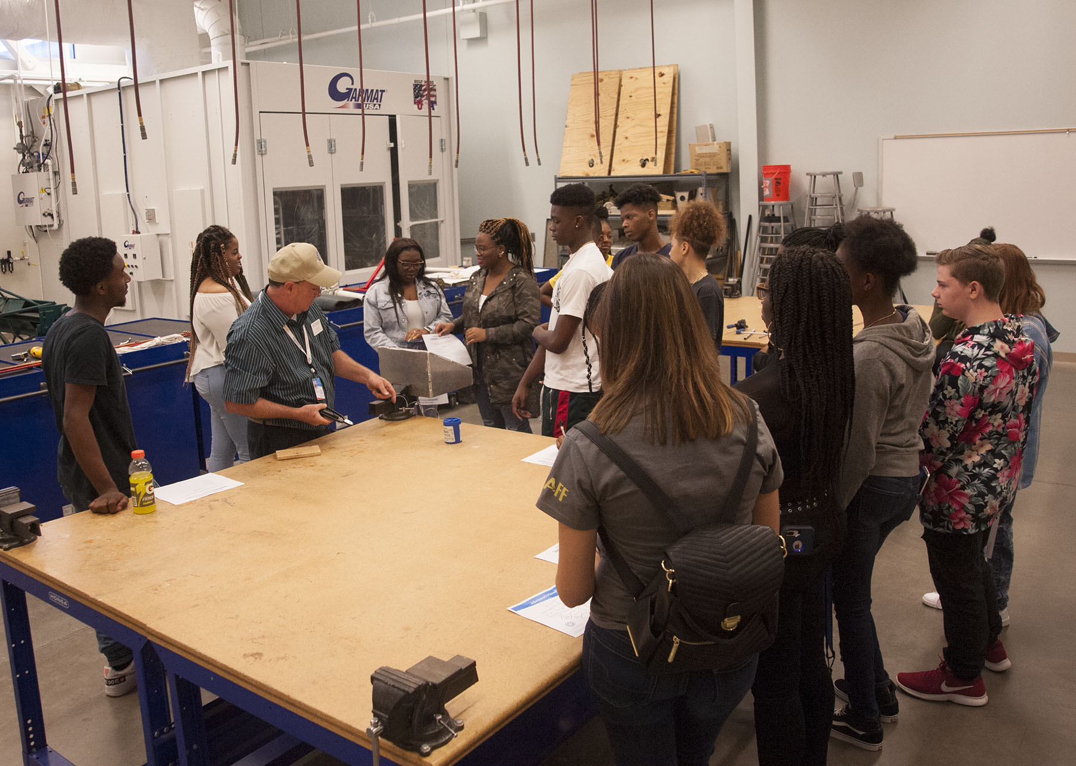
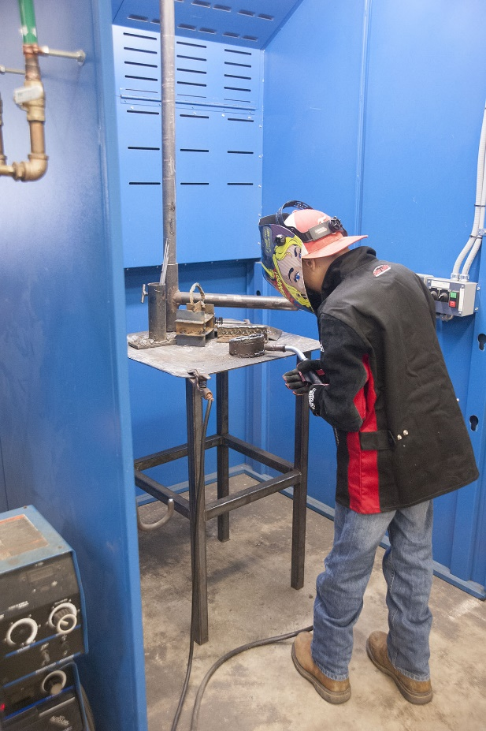
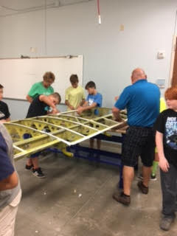
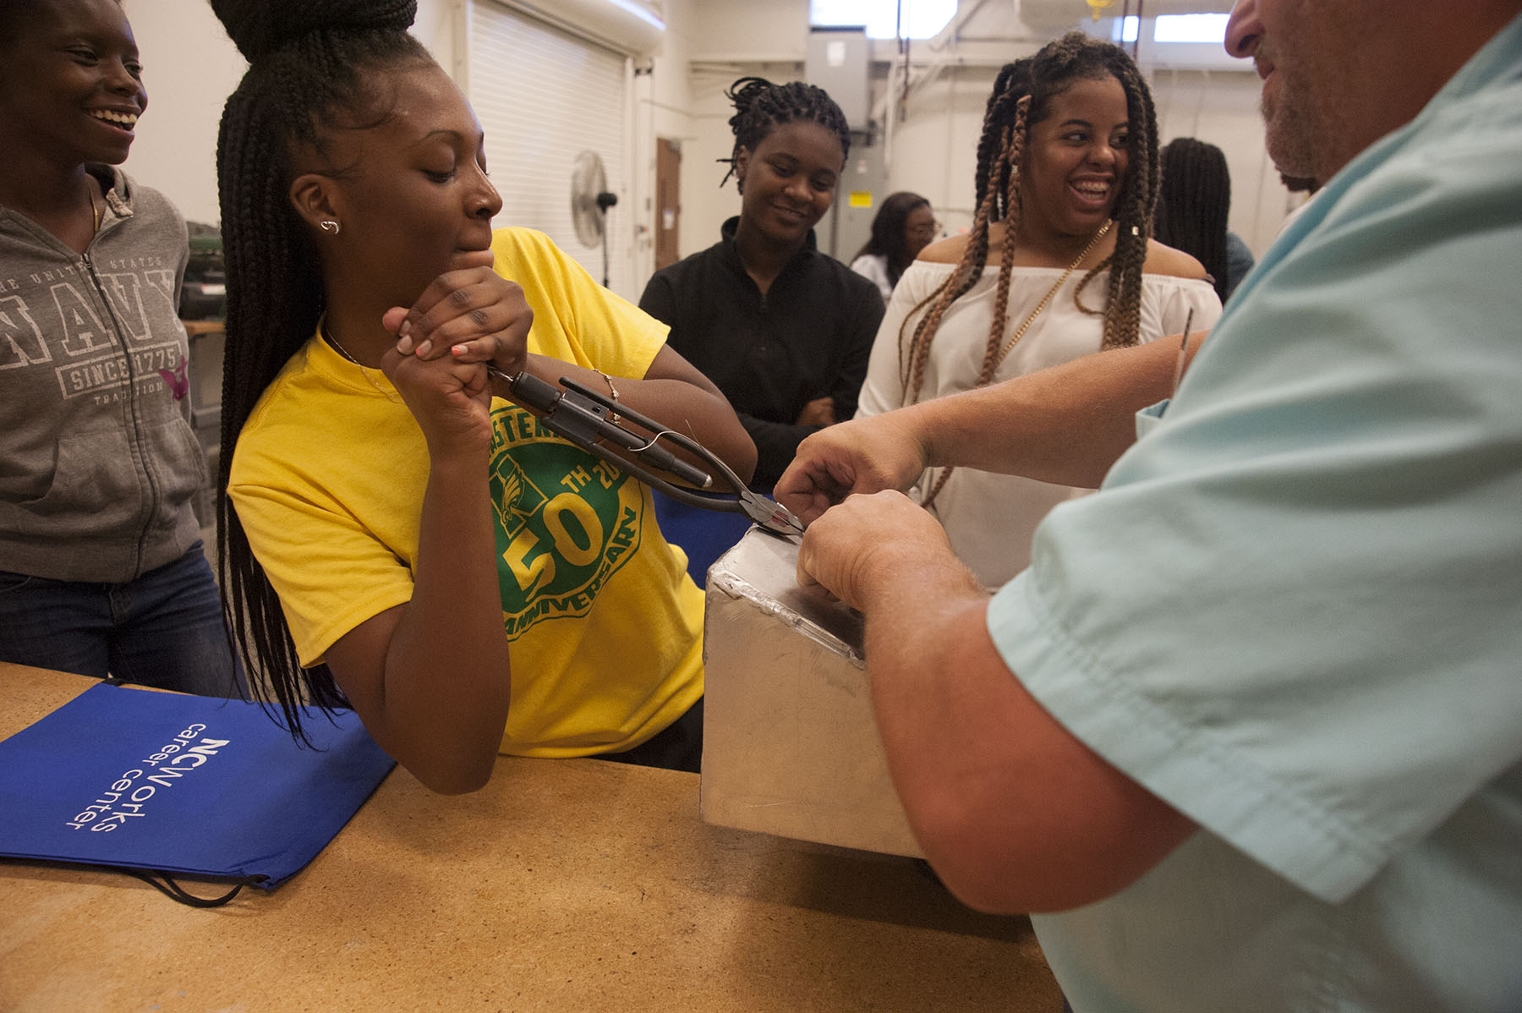
COA - Advanced Manufacturing Day in Currituck

Slide 5
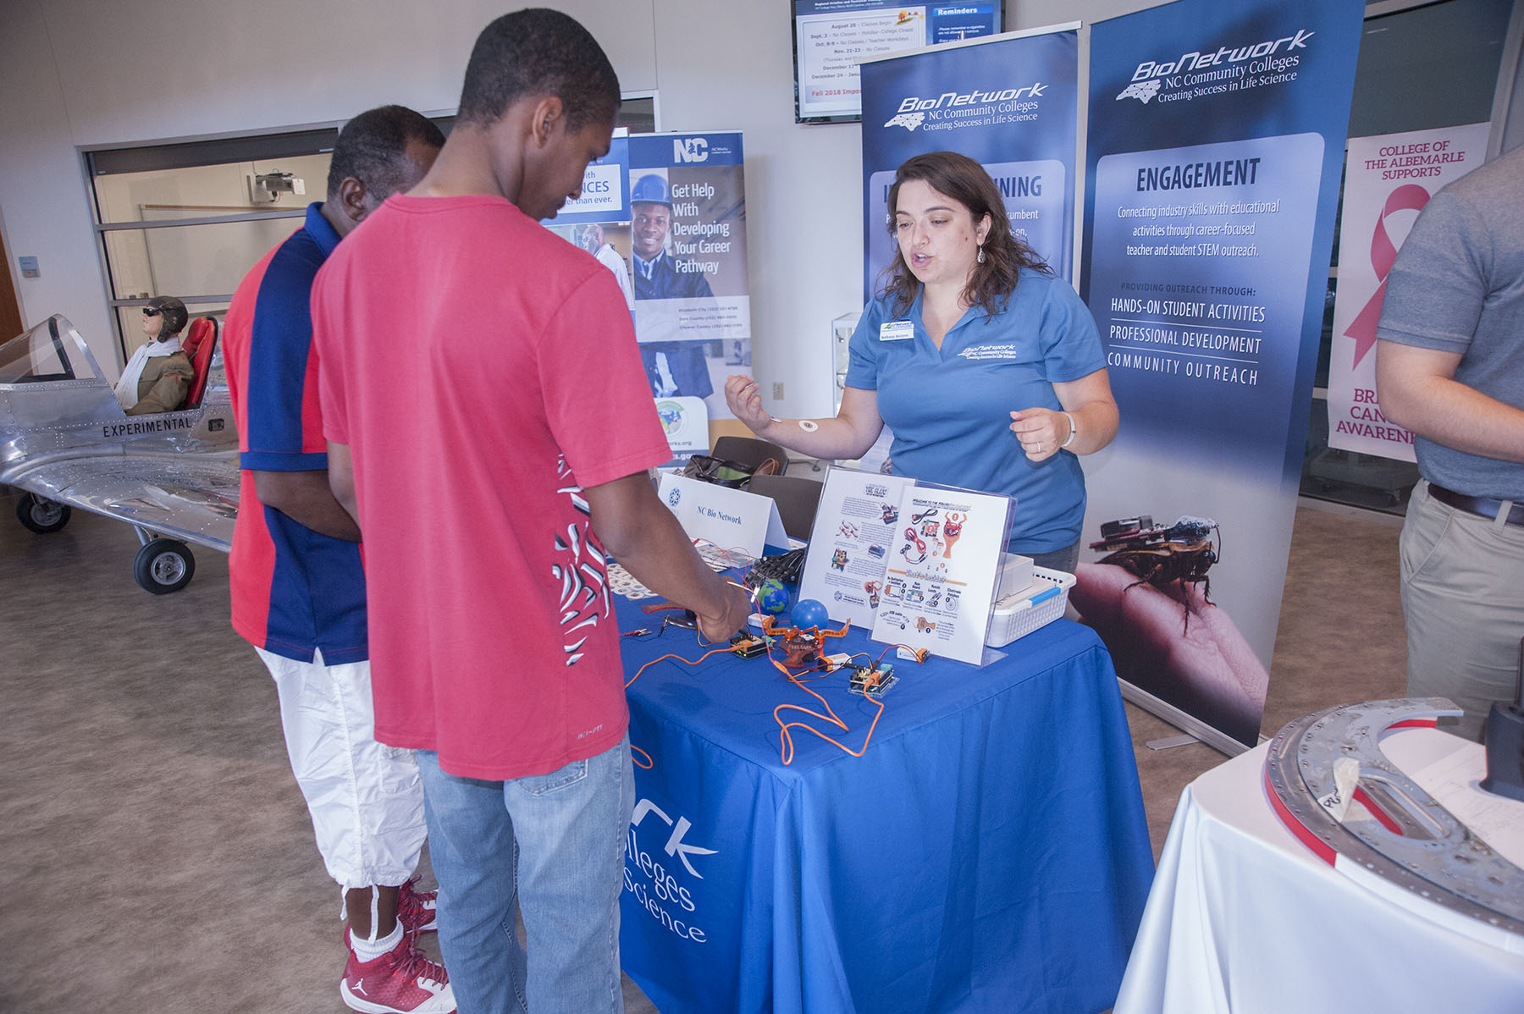
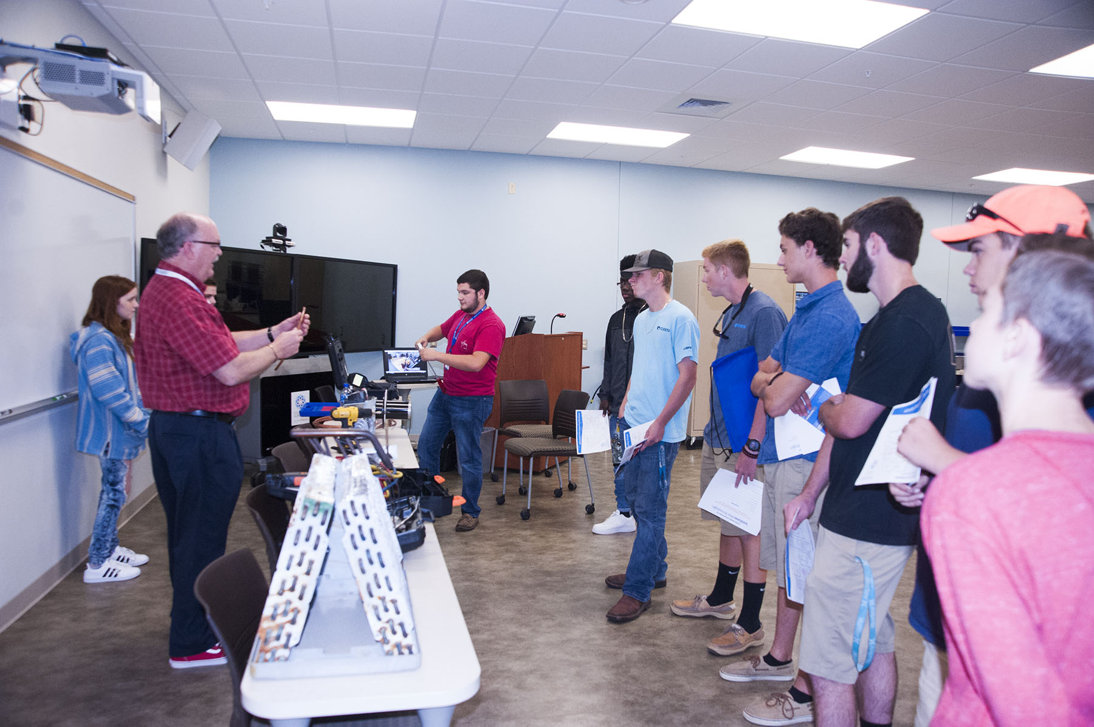
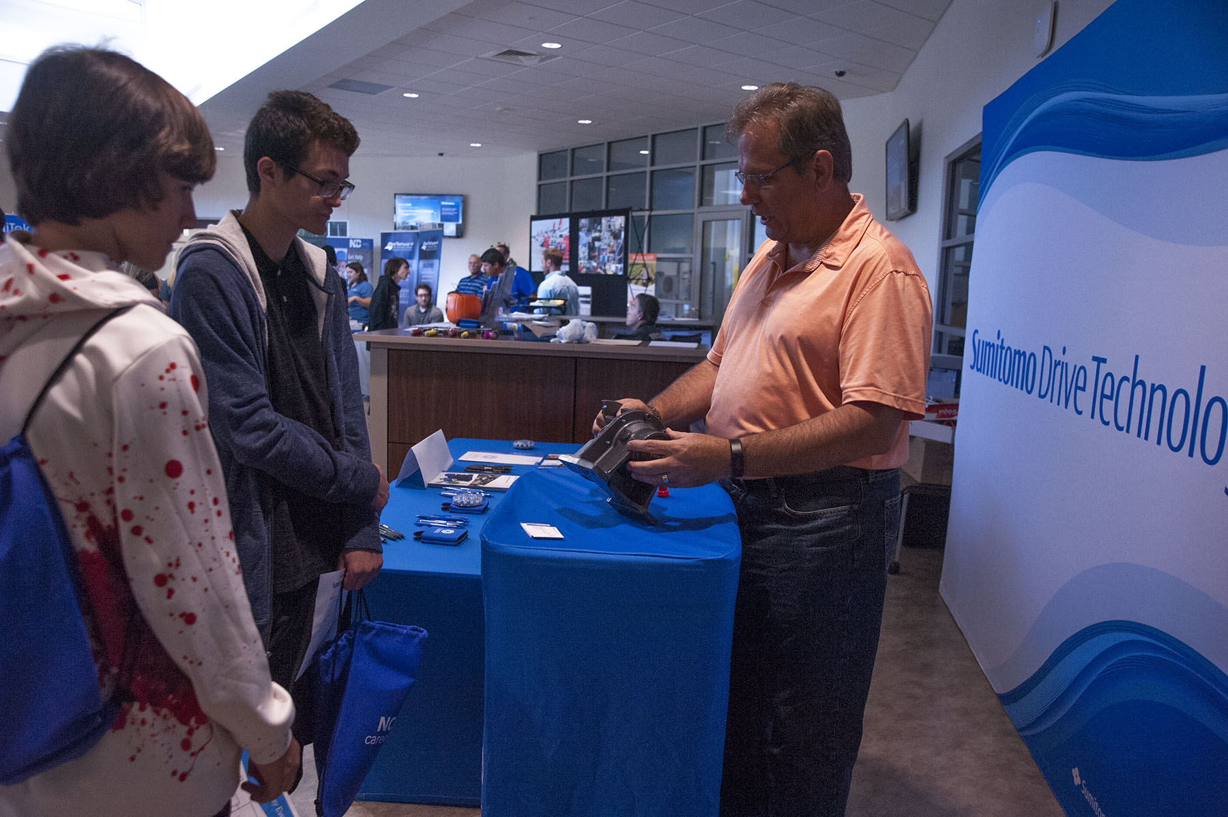
Advanced Manufacturing Day
in Currituck

Slide 6
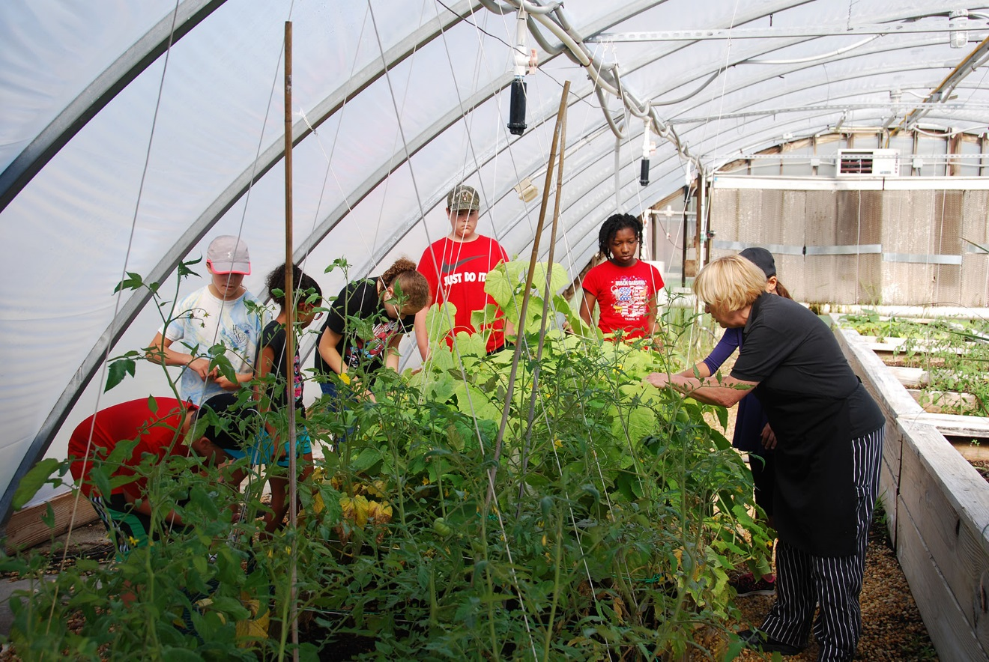
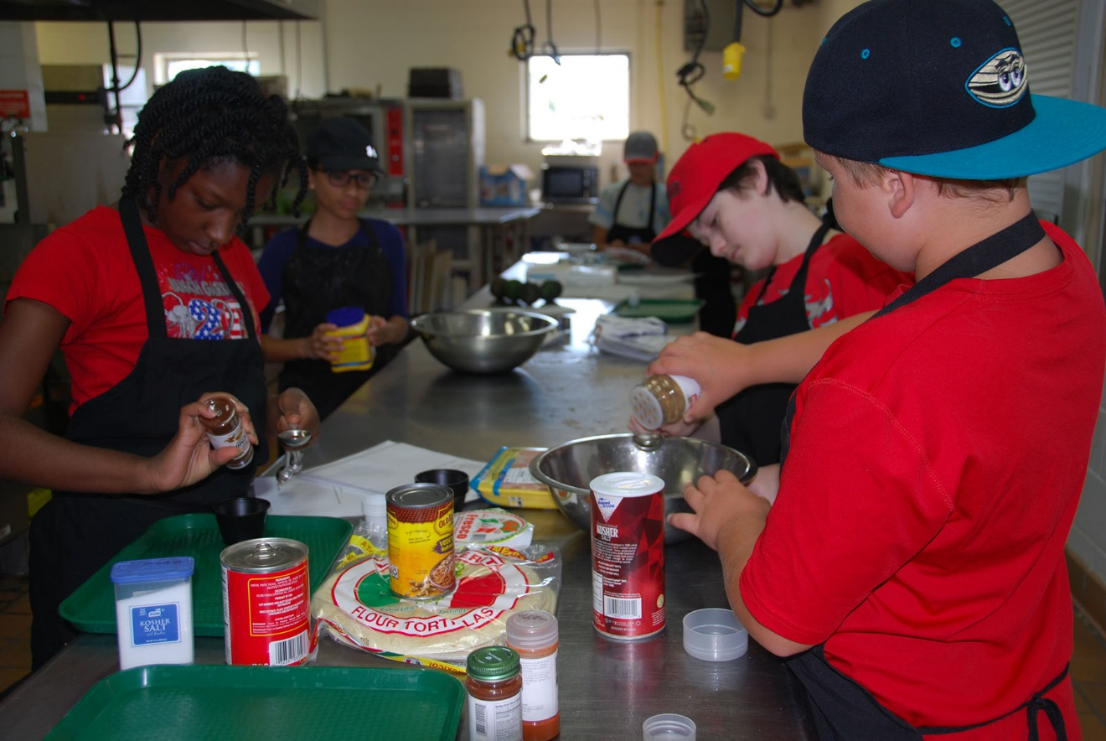
COA - Culinary Boot Camp in Chowan

Slide 7
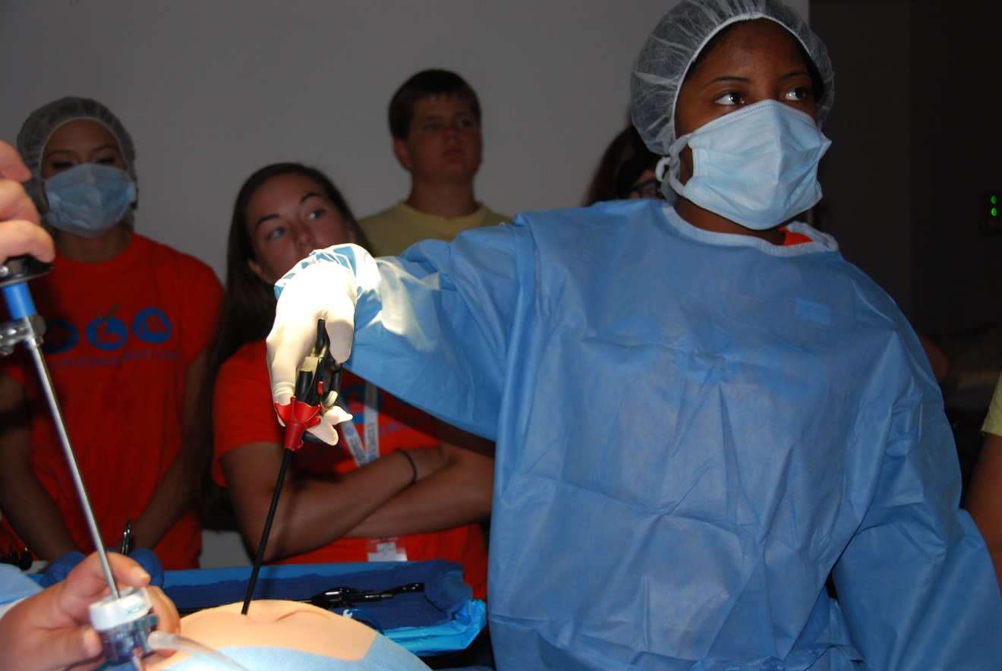
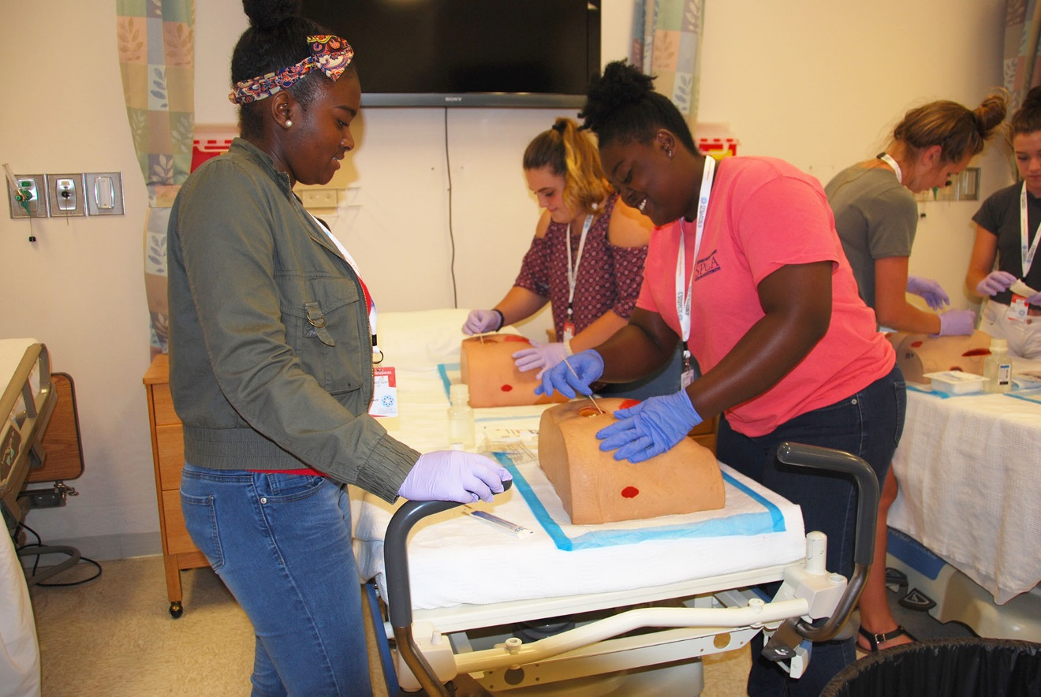
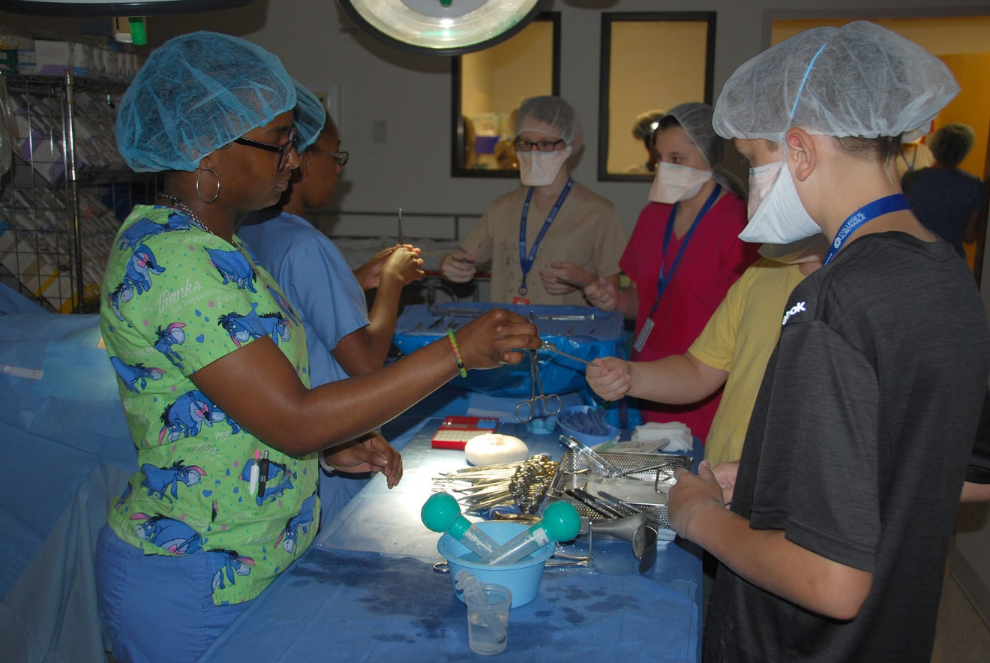
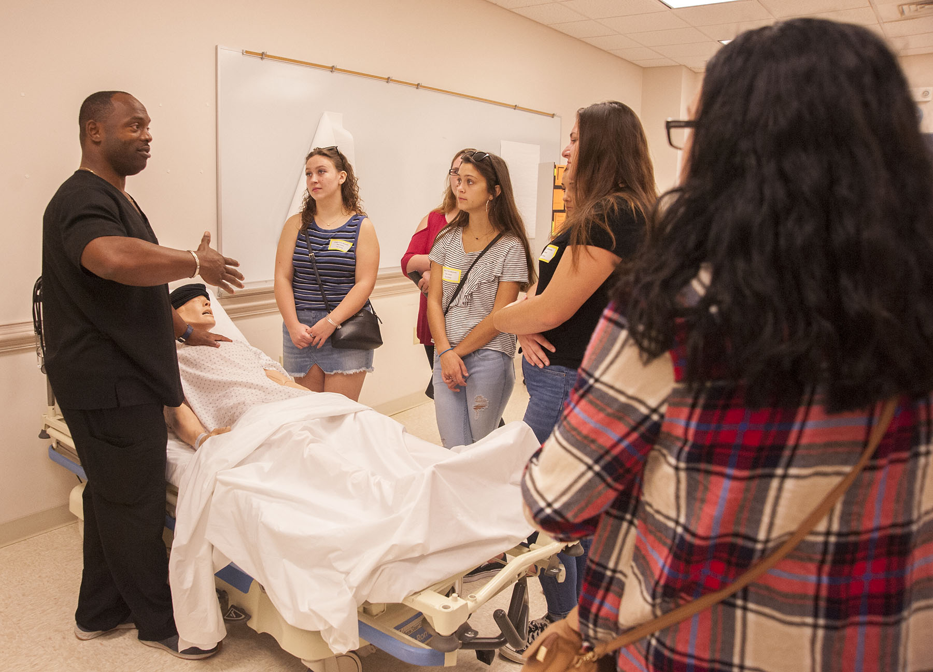
COA – Health Occupations Boot Camp – Eliz City

Slide 8
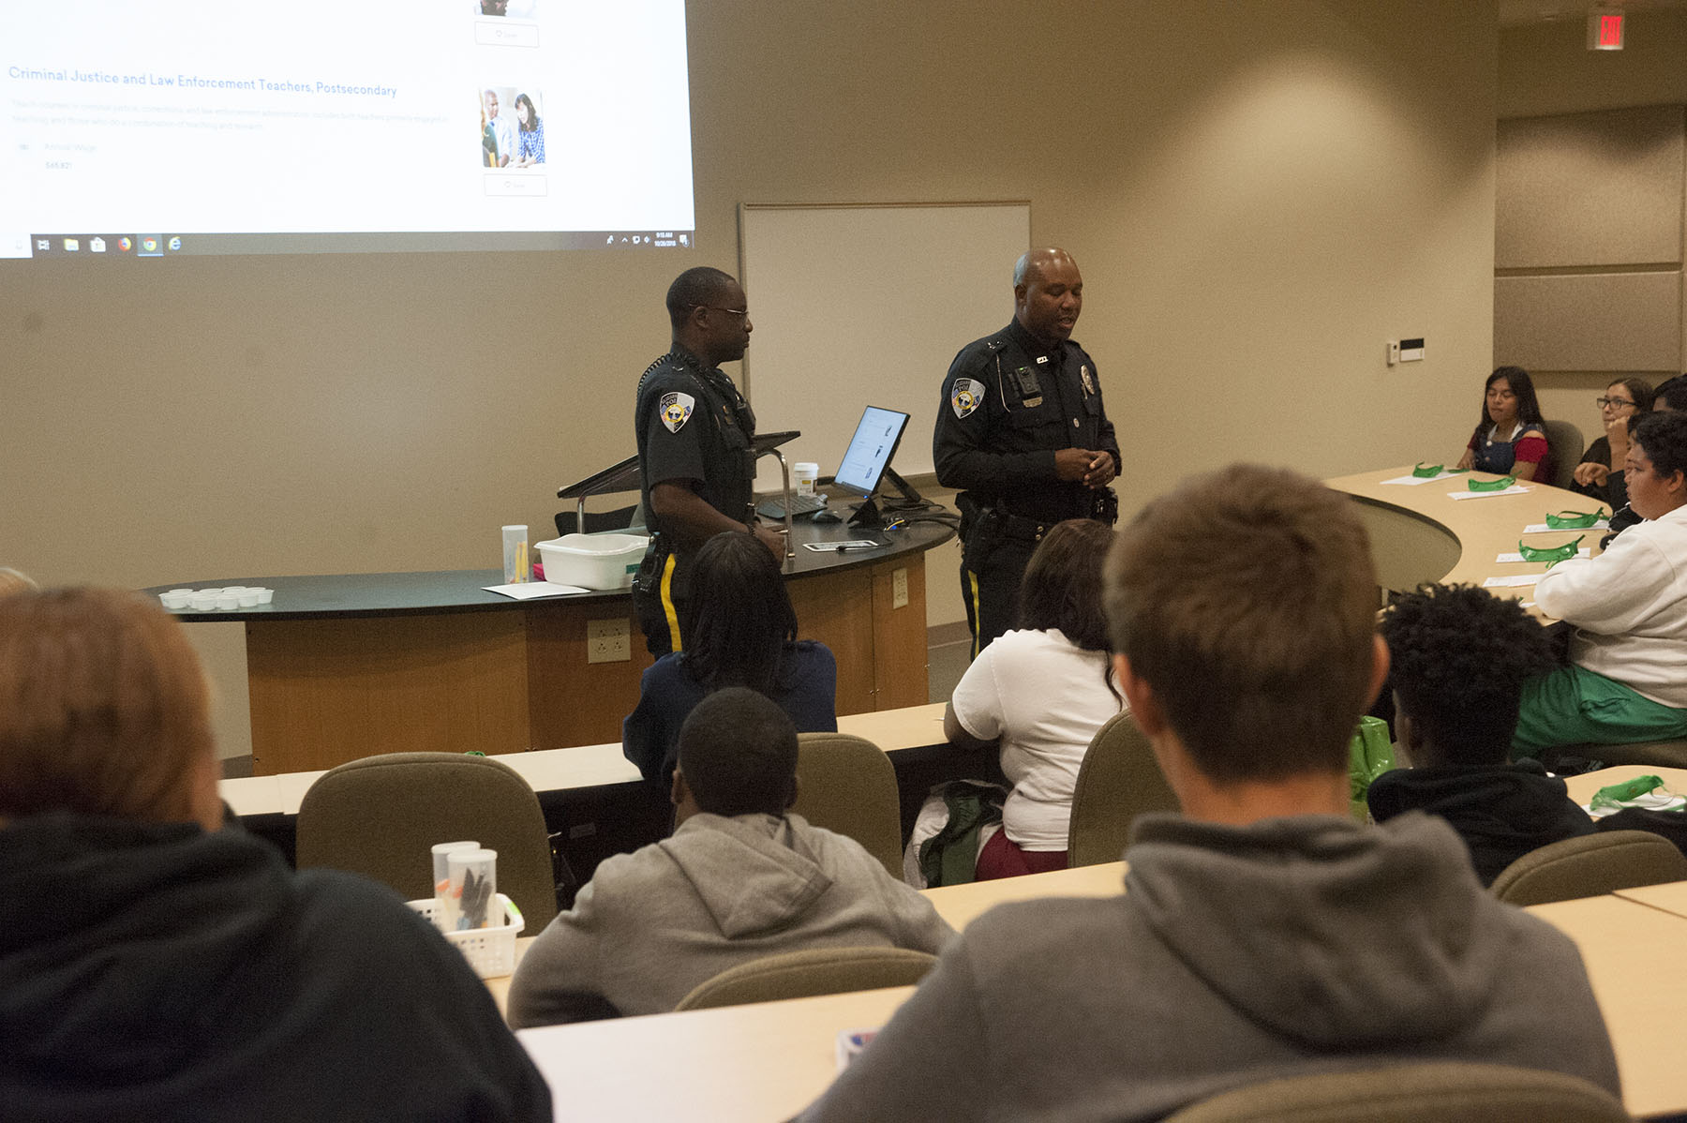
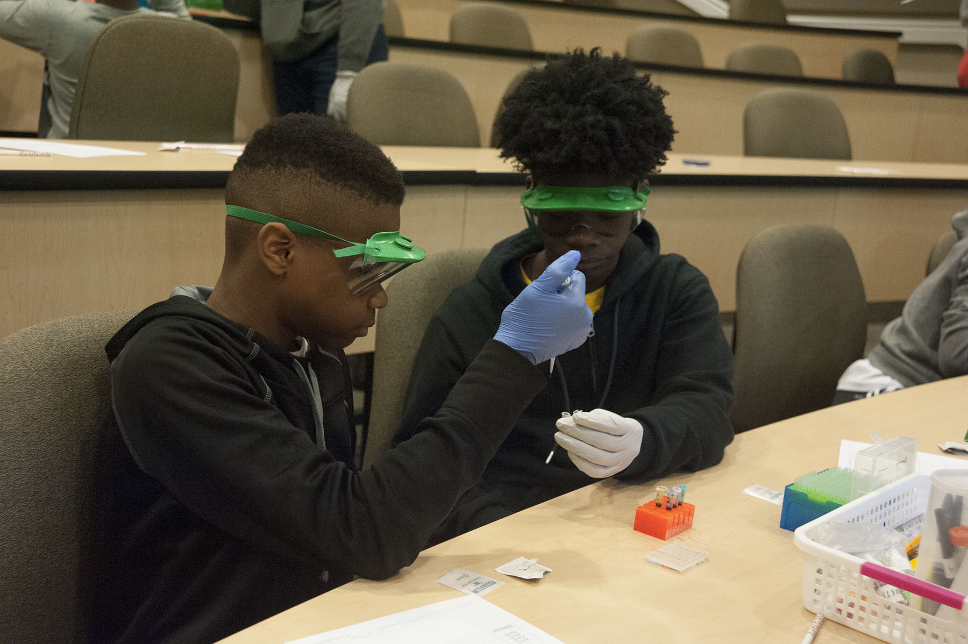
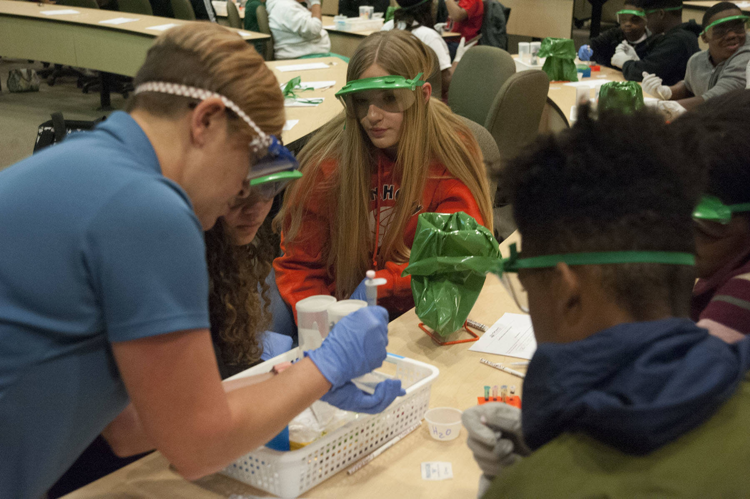
COA – Public Services Day– Eliz City

Slide 9


Regional Focus on Advanced Manufacturing
Jennie Bowen
Region Q Workforce Development Board Director
Michael Williams
Turning Point Workforce Development Board Director

Slide 10

Updates from CTE
Christina Harris
Northeastern Regional Coordinator

Slide 12
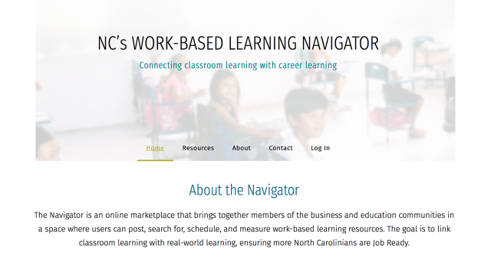
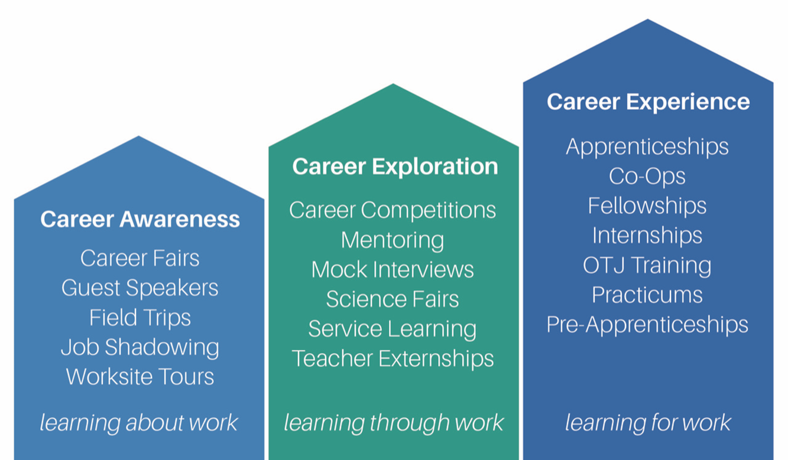

Experience More WBL Summit
www.ncbce.org
DECEMBER 7, 2018 9AM-12NOON
EDGECOMBE COMMUNITY COLLEGE – ROCKY MOUNT CAMPUS

Slide 13

Traitify training – November 27th @ BGCS
5th Annual Career Guidance Retreat – GADJ “Guidance and Direction for Jobseekers”
- December 4th 1pm-4pm (Turning Point)
- December 5th 1pm-4pm (Region Q)
- February 8th 9am-12pm (Northeastern)
Social Media Training – Dec. 10th

Slide 14

Future Metrics Questions from survey:
  “Is Industry Certificates the same as 3rd party credentials. IF not, a list of 3rd party credentials earned”
  “SkillsUSA Membership”
  “Industry specific needed courses”
QUESTION: For business support services and healthcare, there is some overlap. For example, the healthcare packet includes Healthcare Business Informatics, Healthcare Management Technology, Medical Office Administration, and Medical Billing and Coding. How do we structure this for metrics collection?
Packets due December 31st – Please take the survey once you turn it in!

Slide 15






2018-2019 Projects and Activities
Apply for Certification
3 year recertification
Periodic Review

Slide 16

Career Centers & Local Pathway Implementation Certification
NCWorks CCs are expected to be lead agency for promoting and delivering career awareness, career guidance, and employability skills to provide businesses with a skilled workforce.
Were not awarded local implementation status as part of the initial implementation process
To remedy that, NCWorks CCs in areas which have already received local implementation status are invited to apply for implementation.
Review team consults with WDB Director and NCWorks Regional Operations Director to determine readiness of NCWorks CCs in the local partnership to receive implementation certification.
The following information will be requested / provided:
  1. Provide documentation of local implementation meetings attended by Manager and/or Champion. Document
  input provided during the planning process and/or since the certification.
  2. Document meetings/training provided by manager and/or Champion to staff, specific to pathway.
  3. Provide documentation of collaboration with local implementation partners specific to the pathway.
http://nencpathways.org/2018/09/21/updated-local-implementation-applications/

Slide 17
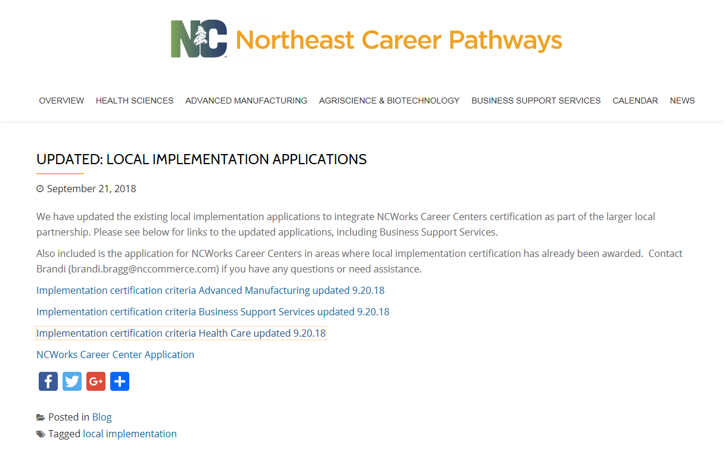

Slide 18
What will full implementation look like? How will we know it has been achieved?
2. What steps can we take to get to full implementation from where we are now?

