Slide 1
Northeastern NC
Career Pathways
(RAMP-East Pilot)
Region Q / Turning Point
Workforce Development Boards

Slide 2
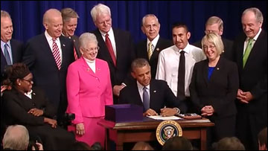
The Workforce Innovation and Opportunity Act Public Law 113-128
Notes:
Workforce Innovation and Opportunity Act of 2014. *Public Law 113-128 July 22, 2014* It became effective in PY2015 (July 1, 2015), with full implementation slated for July 1, 2016.

Slide 3

WIOA Overview – Core Programs
WIOA brings together federal investments in skill development
Employment and training services
  Title 1 - Adult, Dislocated Worker, Youth (Commerce)
  Title 3 - Wagner-Peyser (Commerce)
Adult education and literacy programs
  Title 2 - Adult Education and Literacy (Community Colleges)
Programs that assist persons with disabilities obtain employment
  Title 4 - Vocational Rehabilitation (Health &Human Services)

Slide 4
NCWorks System
Education & Training for adults (focus on 4-year degrees)
Assist individuals with disabilities obtain employment
Education & Training for K-12 students
Assist individuals obtain employment and businesses find qualified workforce
Education, training, retraining for workforce (focus on short-term and 2-year degrees)

Slide 5
NC Commerce Division of Workforce Solutions (DWS)
Enhancement Grant
The Division of Workforce Solutions (DWS) support system design and service delivery program initiatives that endeavor to address the workforce needs of businesses, to expand education and training opportunities for citizens, and assist disadvantaged, unemployed, and under-employed adults and youth make connections to employment in growth sectors of the economy.
The Enhancement Grant provides an opportunity for local Workforce Development Boards to apply for funding, build capacity, create systemic change within their workforce system, and improve career development access and workforce services to individuals and businesses.

Slide 6
Regional Advanced Manufacturing Pipeline-East (RAMP-East)
Area Served (Counties/Cities/Region): East of I95 Corridor – (Beaufort, Bertie, Edgecombe, Halifax, Hertford, Martin, Nash, Northampton, Pitt and Wilson Counties)
Requested Duration of the Grant: 24 months
Brief Description of the Project: Regional partnership between Region Q WDB, Turning Point WDB, regional community colleges and economic development partnerships to enhance recruitment efforts in the Advanced Manufacturing sector. The intent of the grant is to fund a proactive approach for recruiting under-served populations of the 10 counties building a pipeline of potential candidates for immediate and future advanced manufacturing jobs. Funding for outreach to individuals to inform them about the opportunities that exist and to point them in the right direction, whether that be to obtain a certain skill to meet the industry requirements or to provide soft skills training (i.e. resume clean-up, interview practice, etc.) to have them work ready for the interview process.

Slide 7
RAMP-East region data (10 County Make Up…..)
RAMP-East Region population – 594,930
Civilian Workforce – 281,313 / Labor participation rate 58.8% which is lower than the National average 62.70%.
Individuals ages 25-64 – 20.5% have a bachelor’s degree or higher which compares with 31.8% in the nation.
Unemployment rate for July 2018 was 4.9% in comparison to the national unemployment rate of 3.9%.
The poverty level for the RAMP-East region is 22.7% with 130,805 individuals living in poverty.
According to data provided by AccessNC 26.75% work outside their county or residence and 51.25% travel up to 19 minutes one-way to work.

Slide 8
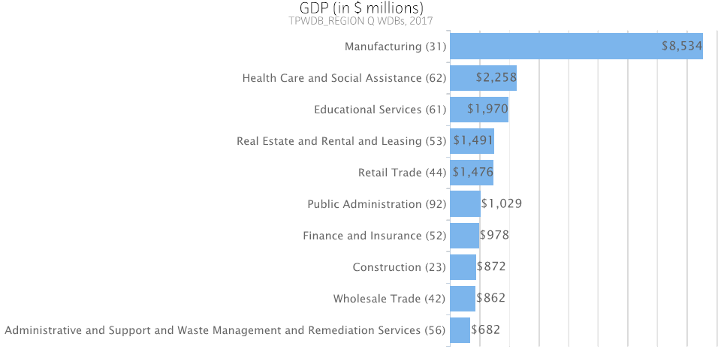
RAMP-East Economic Impact (GDP)

Slide 9
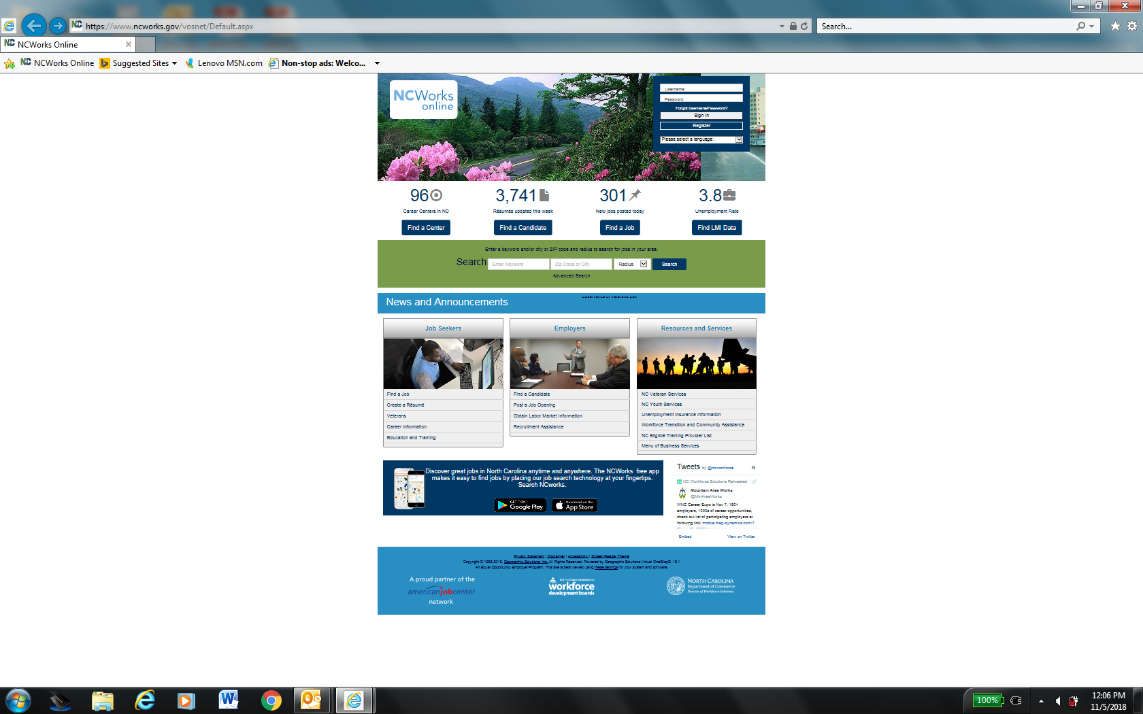
NCWorks.gov…
Notes:
NC Works is a one-stop online resource for job seekers and employers in North Carolina. Job seekers can search for jobs, create resumes, and find education and training.
Employers can find candidates, post jobs, and search labor market information.
Other Resources and Services:
1. Veterans- provides job seeker services for veterans, transitioning service members, and eligible spouses- can crosswalk service codes to civilian job codes – Vet receive priority of services – new job are placed on Vet hold.
2. Youth Services - information that is of interest to youth who are looking for a job, or interested in continuing their education after high school. If you are looking for a job, you can access a variety of websites that have job postings and helpful information specifically geared to people in your age group. You will also find information about career exploration, military service, financial aid for education, and other opportunities.
3. UI: Begin Filing a Claim, Successful Filing Tips, Report Fraud, FAQs, Additional Links, Hours. Employers can either speak with someone or expect to receive a call the same business day about the following topics:UI Laws, Applying for a New Tax Account Number
Questions about Rates, Liability Questions, Questions about Tax Bills
4. Workforce Transition and Community Assistance : This page contains links to resources to assist during your transition from employment to unemployment or retirement, or unemployment to re-employment. It includes other community or social service programs. Topics include health, families and children, temporary assistance programs, legal issues, government benefits, caregiver resources, and more.
5. Eligible Training Provider List
The Workforce Innovation and Opportunity Act (WIOA) requires training providers to apply to the State Workforce Agency (NC Division of Workforce Solutions) and to be approved by at least one Local Workforce Development Board for eligibility to receive WIOA funds. The publicly accessible Statewide List of Eligible Training Providers includes all training programs that are currently approved by one or more boards. Training Providers must complete initial or continuing eligibility requirements in order to be added to or maintain their status on the list.
6. Menu of Business Services to help businesses grow, via recruitment and scree
We provide training for new hires and existing employees through classroom, online, and on-the-job training solutions and support services:
On-the-job training resources to train qualifying employees using company instructors
Customized training for your growing business
Apprenticeships that combine on-the-job learning with related classroom instruction
Courses to upgrade employees’ job-related skills or provide a recognized industry or national credential (licensure, certification, renewal, registry listing)
ning - Job postings and applicant tracking on NCWorks.gov
Individualized screening by career professionals
Validated skill assessments, including the nationally-recognized ACT Career Readiness Certificate
Job profiling
Coordination of job fairs
Interview, meeting, and training space
Labor market information, including local wage data
Job accommodations to assist workers with disabilities including workplace modifications, assistive technology, and job coaches
Pipeline : We help you develop a sustainable pipeline of future talent by connecting you with the following opportunities:
Working collaboratively with regional education and workforce partners to develop NCWorks Certified Career
Pathways to prepare students for a career in your industry sector
Connecting with youth and adults through internships, pre-apprenticeships, co-ops, job shadowing, mentoring, and facility tours
Utilizing local funding opportunities to provide paid work experience to eligible candidates
Educating local teachers and career coaches on your industry’s workforce opportunities and needs
Transition Services: We provide on-site outplacement services to assist companies impacted by downsizing to find other employment for their workers:
Developing outplacement transition plans for companies
Analyzing regional career opportunities
Providing specialized assistance to employees, such as resume development, interview preparation, computer access, financial planning workshops, skill assessments, and connection to training opportunities
Designing comprehensive re-employment services for workers negatively impacted by foreign trade

Slide 10
Identified issues/opportunities…..
Employers have indicated a desire to engage with the NCWorks System, but have expressed frustration and concern when attempting to recruit candidates for entry and mid-level positions. The addition of this recruiter role will enhance existing services by focusing on real-time business needs to recruit, train and retain a skilled workforce. RAMP-East recruiters will review current resumes on www.NCWorks.gov online to identify skills of potential jobseekers for possible career matches in the advanced manufacturing sector. Recruiters will also review current and newly posted job descriptions to ensure appropriate information is provided to jobseekers. Due to the fact many postings are transferred from other online portals, there is often incorrect, misleading or outdated information which cause jobseekers to ignore certain postings. RAMP-East recruiters’ relationships with local businesses along with partner agencies such as community colleges, K-12, economic development representatives and career advisors will keep the talent pipeline active. One demonstration of appropriateness is the series of career fairs exposing the existing and emerging workforce to advanced manufacturing careers. During these events there are identified jobseekers being notified of career opportunities that align with their stated goals and objectives. Participating employers are able to be proactive in recruiting candidates while developing their connection to this valuable talent pipeline available through the NCWorks Career Center portal.

Slide 11
RAMP-East Recruiters solution(s)….
This grant will provide solutions by funding recruiters to strategically focus efforts to better connect with employers who have available and upcoming advanced manufacturing career opportunities. RAMP-East recruiters will work in conjunction with Business Services, Community College, K-12, NCWorks Career Centers and Economic Development representatives. The funding requested will be utilized for outreach and recruitment efforts, industry specific career fairs and tours, outreach materials and advertising. Our goal is to be at the forefront by combating the above problems and challenges through a regional collaborative recruitment effort that will show employers the creation of a talent pipeline of new and existing trained workers to meet their current and future hiring needs.

Slide 12
Category | Grant Funds Requested | Leveraged Resources⁺ (specify) | Other Resources: in-kind or cash (specify) | TOTAL
Contracted Services | (2) RAMP-East Recruiters $267,300 |  | Professional Development/ Training (details in narrative) | $267,300
Staff Salaries
Staff Fringe Benefits
Travel | $6,000 |  |  | $6,000
Materials, Supplies and Website | $12,700 |  |  | $12,700
Local Area Administrative Fee* | $14,000 |  |  | $14,000
Supportive Services
Training Components
Direct Participant Expenses
Other Expenses – please specify
TOTAL | $300,000 |  |  | $300,000
WIOA Program Enhancement Grant
Application Budget
WIOA Program Enhancement Grant
Application Budget

Slide 13

Questions?

