Slide 1

Annual Leadership Meeting
October 26, 2018

Slide 2


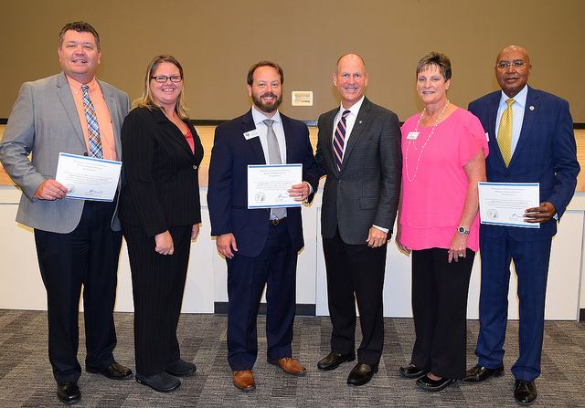
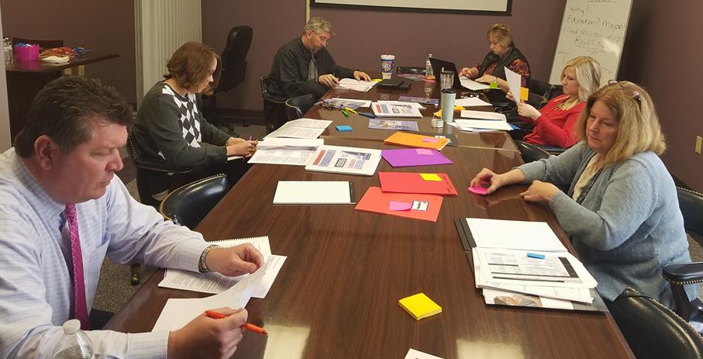
2017-2018 Projects & Activities
Business Administration & Support
Information Technology
Logistics & Supply Chain Management

Slide 3
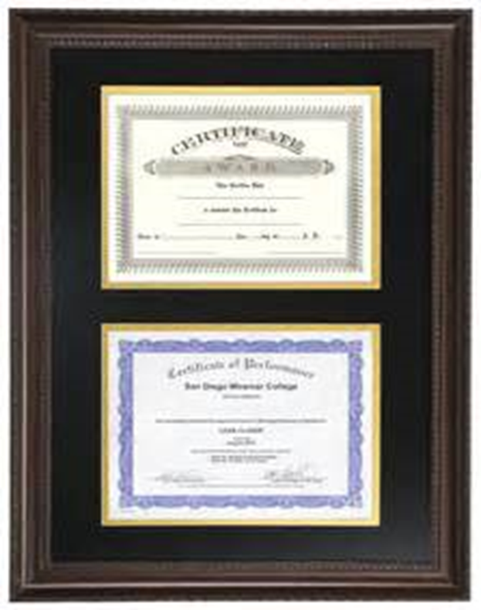
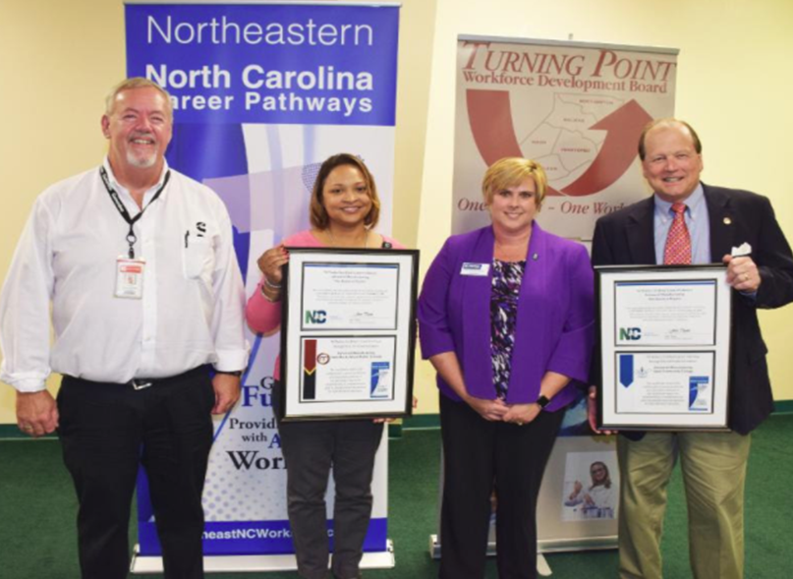
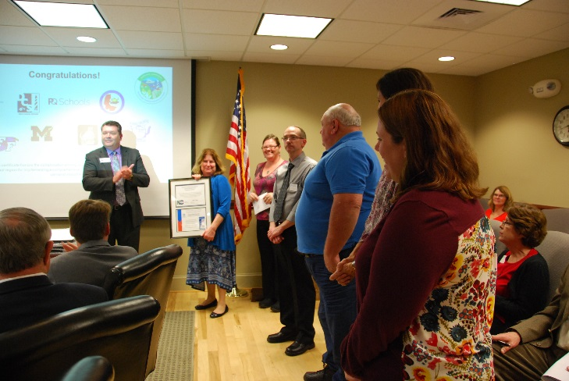
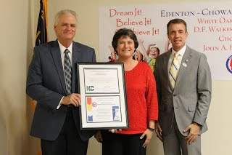
2017-2018 Projects & Activities
LOCAL IMPLEMENTATION
Advanced Manufacturing
College of the Albemarle
Nash Community College
Health Care
College of the Albemarle
Pitt Community College

Slide 4

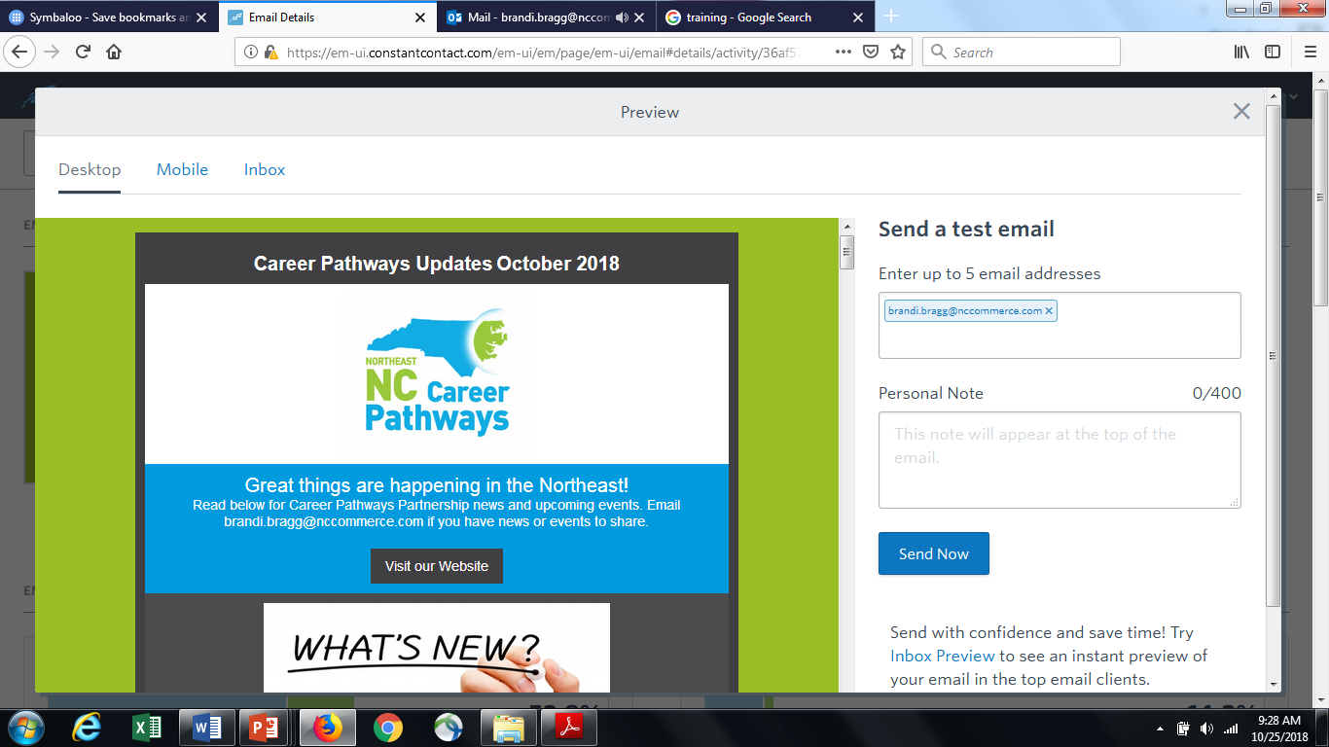
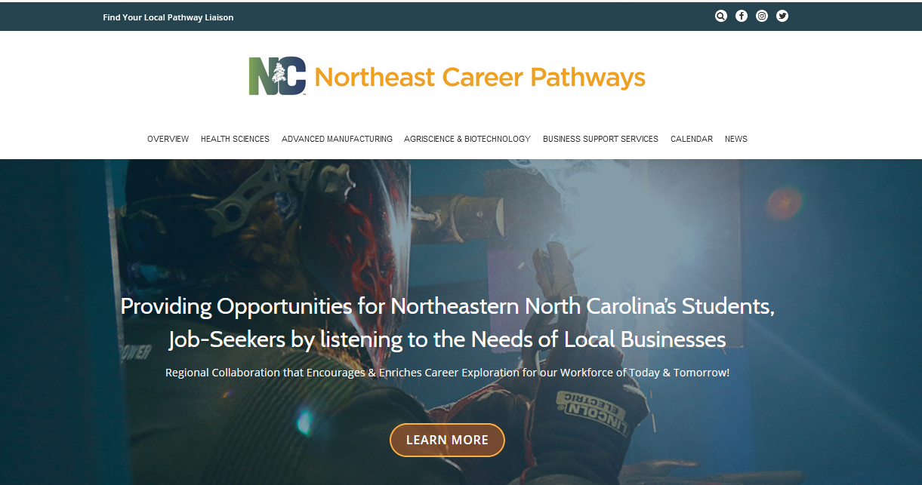

2017-2018 Projects & Activities

Slide 5
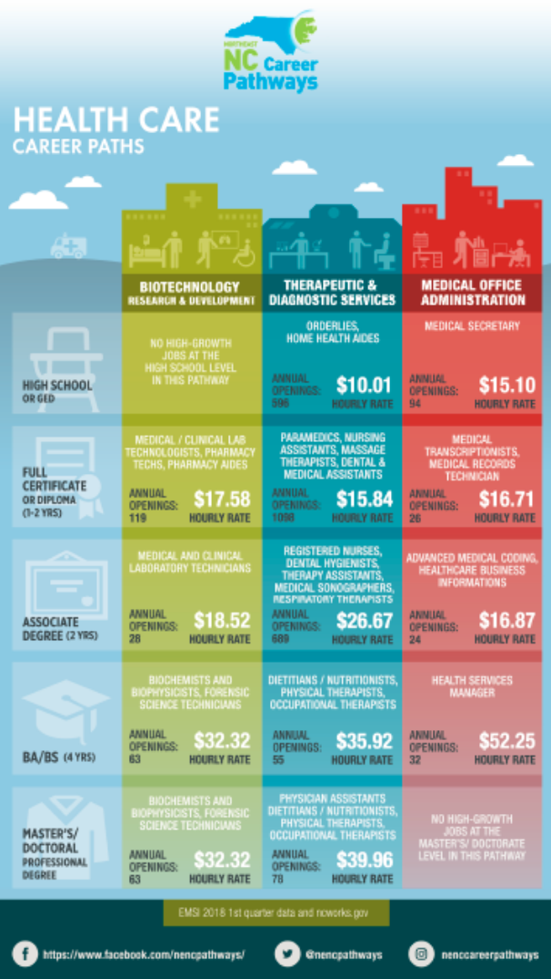

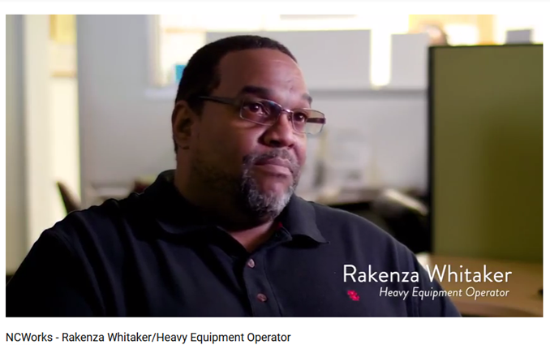
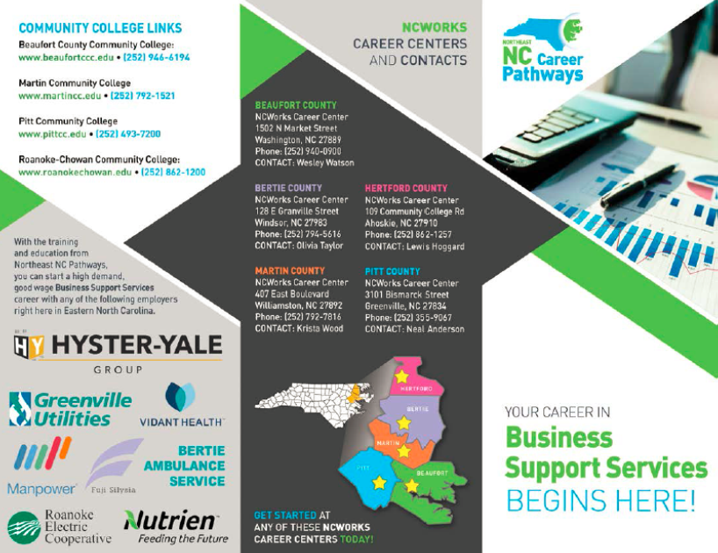
2017-2018 Projects & Activities

Slide 6

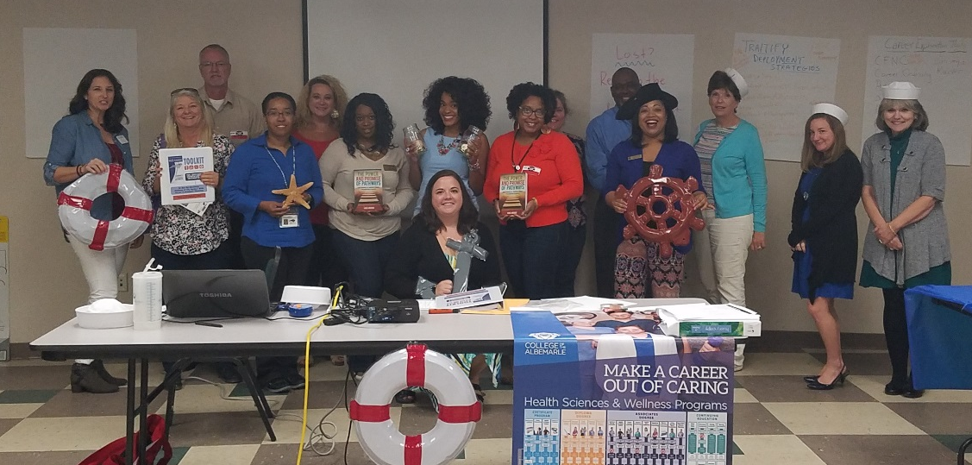
2017-2018 Projects & Activities

Slide 7
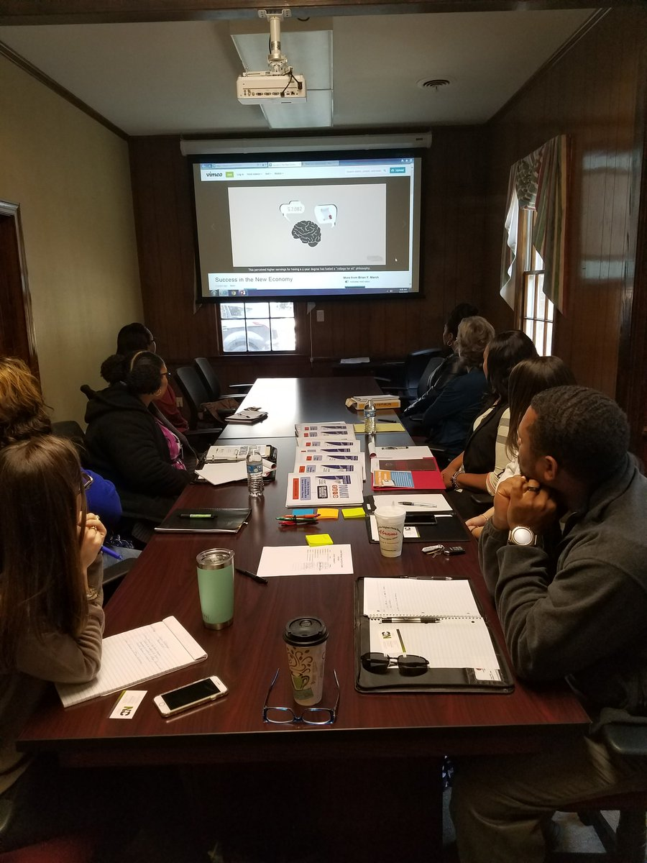
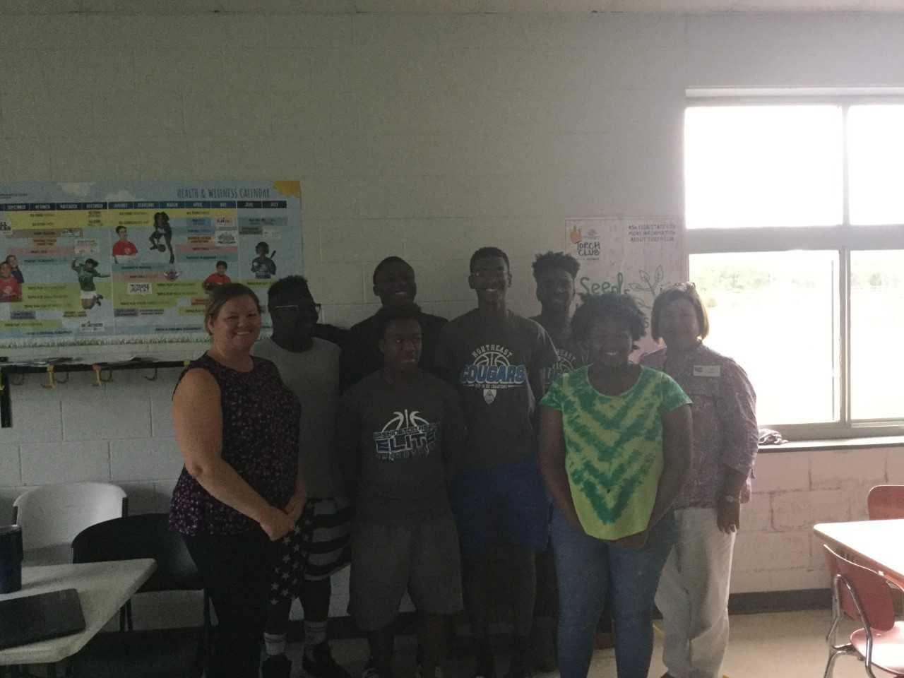
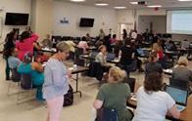
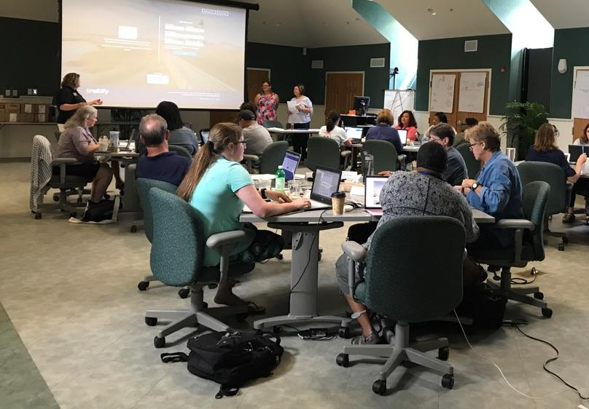
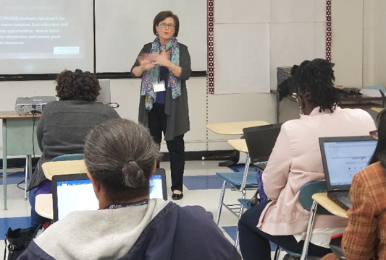

2017-2018 Projects & Activities

Slide 8
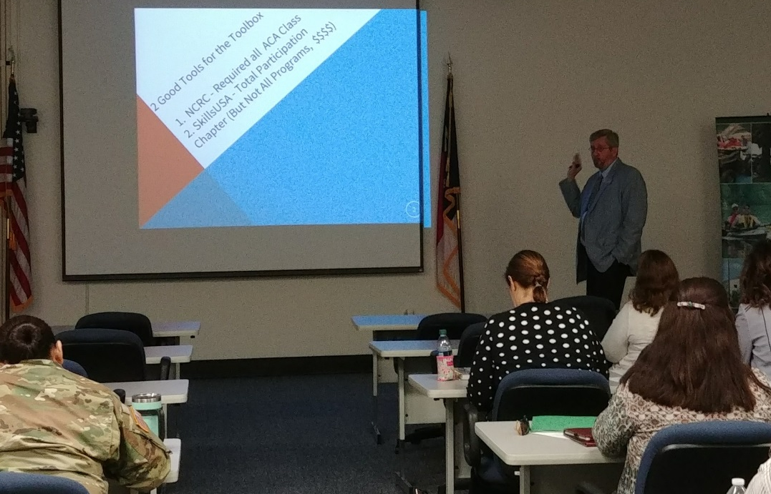
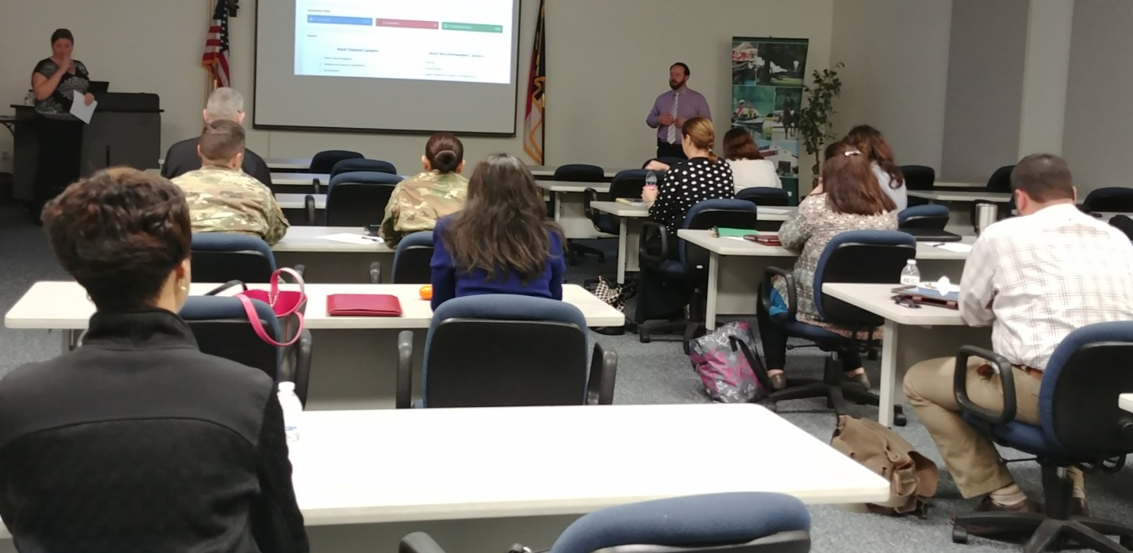
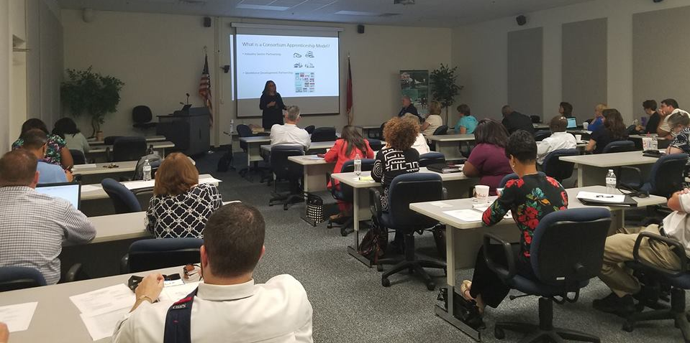
2017-2018 Projects & Activities
College
Partnership

Slide 9
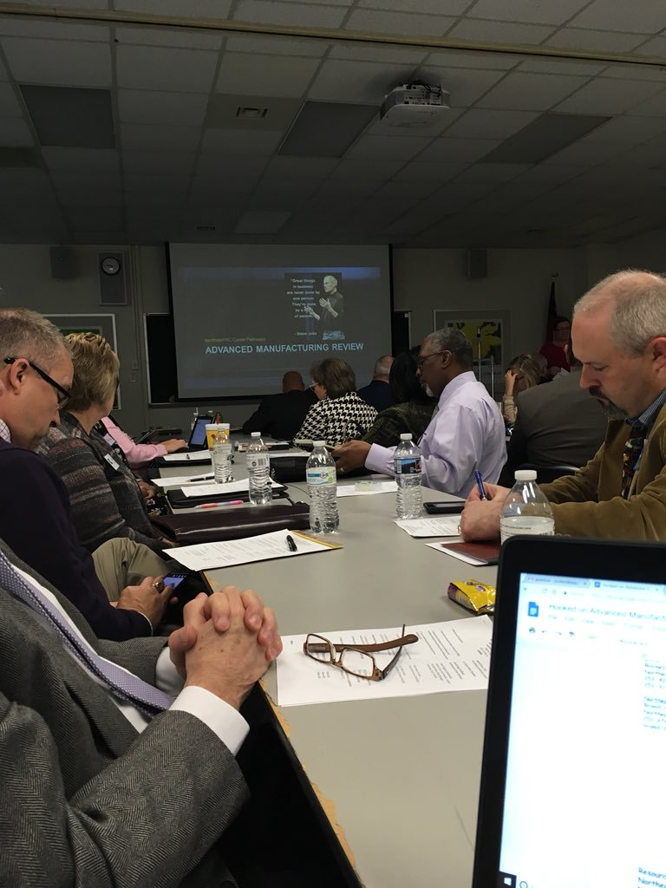
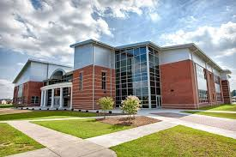
2017-2018 Projects & Activities
Advanced Manufacturing Pathway Review
Roanoke-Chowan Community College
March 8, 2018
Agriscience/Biotechnology Pathway Review
Pitt Community College
November 3, 2017

Slide 10
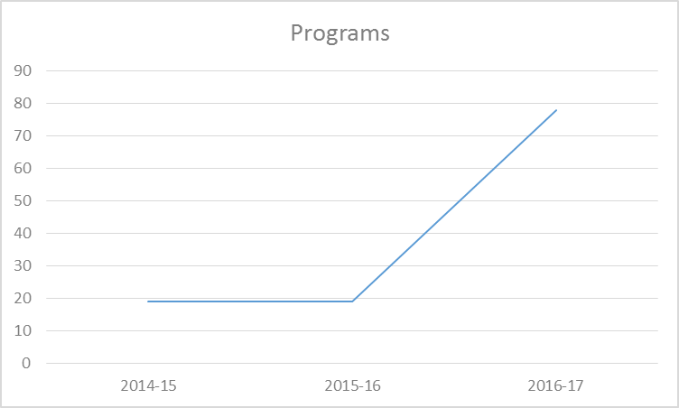
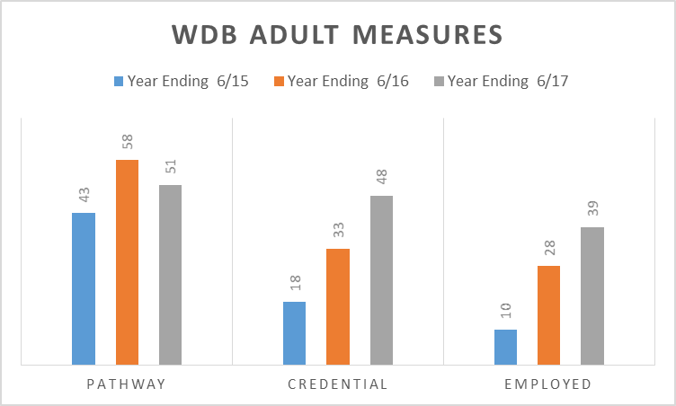
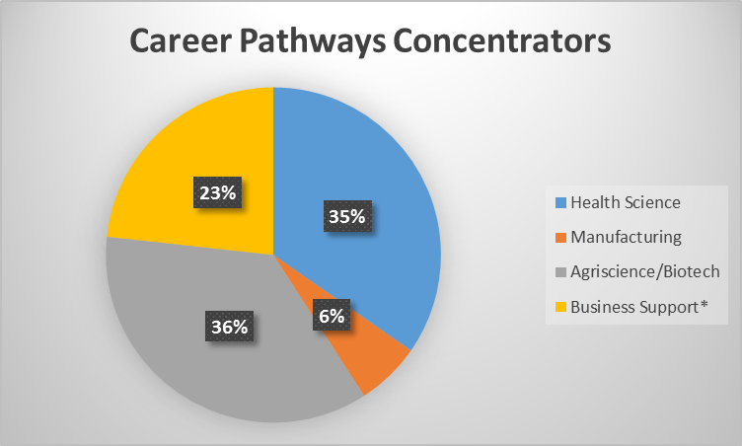
2017-2018 Projects & Activities
Find all of our metrics on our website:
www.nencpathways.org

Slide 11


Keynote
“Grow our world from the ground up”
Kim Toler
Training Manager - Nutrien, NCWorks Commissioner
Danielle Street
Employee Development Specialist - Nutrien

Slide 12

STAKEHOLDER PERSPECTIVE
Christina Harris
Northeast Regional CTE Coordinator
NC Department of Public Instruction

Slide 13

Maximizing Career Outreach through Effective Partnerships
Rachel Bridgers, PCC Career Outreach Specialist
Northeastern NC Career Pathways
Leadership Council Meeting
October 26, 2018

Slide 14






Career Outreach Activities
Connecting students of various majors and backgrounds with local employer partners
Federal Work Study
Earn while you learn. Eligible students are able to perform work related to their course of study through community service work or within a department on campus.
Cooperative Education
(aka Work-Based Learning)
Students can gain college credit and practical work experience in their program of study while learning valuable skills in local industry to help put theory into practice.
Field Trips/Tours
Students have the ability to participate in site visits to local employers to learn about the nature of their business, company culture, and more!
Employer Engagement
Apprenticeship
Students have the opportunity to engage with a variety of employers from multiple industries through Career Fairs, Coffee Friday events, classroom presentations, and more!
Students can engage in on-the-job-training and accompanied classroom work geared towards a profession or skilled trade.

Slide 15

Essential Partnerships
Providing Critical Support to Build a Skilled Workforce
Pitt Community College
Pitt County Schools
Local Business & Industry
External Stakeholders

Slide 16
Connecting the Dots
The Right Career!
Using our Partnerships & Resources
NETWORK OF PEERS
RELEVANT WORK EXPERIENCE
ESSENTIAL SKILLS

Slide 17


A Different Approach
Helping Transitional Studies Students Cross the Finish Line
Basic Skills Plus
Concurrent Curriculum Courses
Financial & Employer Support
Work-Based Learning
Fast Track to Industry
Students will have the opportunity to job shadow, complete coursework, and participate in work-based learning opportunities that will prepare them to pursue technical careers in skilled trades upon graduation.

Slide 18
New Initiative Fast Track to Industry
Program Objectives & Goals
To Increase & Improve…
Number of qualified potential employees who reflect the hiring needs of Pitt County employers
Employment rate and earning potential of students who complete High School Equivalency or Adult High School Diploma by providing concurrent enrollment opportunities in credential-bearing courses of study
Number of students who attain post-secondary credentials, stackable credentials, and additional 3rd-party certifications
Educational functioning level of students to improve opportunities for program completion and credential attainment
Benefits to Employer Partners
Increased number of skilled talent in the workforce
Support of PCC students completing high school equivalency and/or basic skills plus programs
Recognition as a “Fast Track to Industry” partner
Benefits to Students
Foundation of basic skills and knowledge required for employment in the skilled trades industry which includes technical skills learned in the classroom and through work-based learning, professional skills, as well as soft skills needed to be successful in the workplace

Slide 19

Pitt Community College’s Mission Statement:
“…PCC provides access to dynamic learning opportunities designed to foster successful career preparation, higher education transfer, community involvement, and global engagement.”

Slide 20

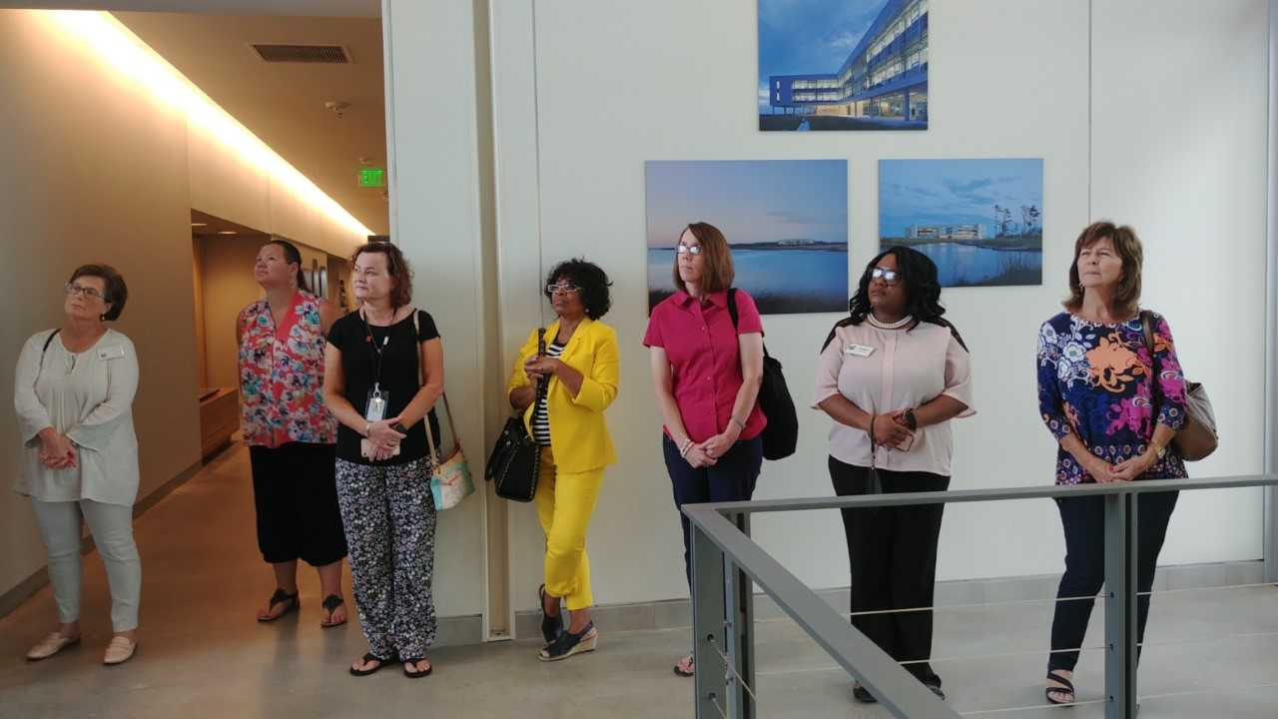

NCWorks Career Pathways “Champions”
Beaufort – Andrew Bost
Bertie & Hertford – Ron Lee new
Dare – Lucy Wallace
Halifax/Northampton – Taylor Hawkins & Linda Smith
Martin – Ann Williams
Nash/Edgecombe – Diane Thomas & Tracy Puddy new
Wilson – Cheryl Forbes
Pasquotank/Chowan – Latoria Roundtree
Pitt – Chanda Speller

Slide 21


Purpose
Lead/promote Career Pathways work in Centers/Local Area/NEPZ
Provide input to help develop trainings & tools utilized by front line staff
Foster good working relations locally (CTE/Community College/Partners/ Employers)
Attend Career Pathways meetings/conferences/trainings
Provide updates and disseminate information to center staff
Vision: NCWorks Career Centers are expected to be the lead agency for promoting and delivering career awareness, career guidance, and employability skills to provide businesses with a skilled workforce.

Slide 22
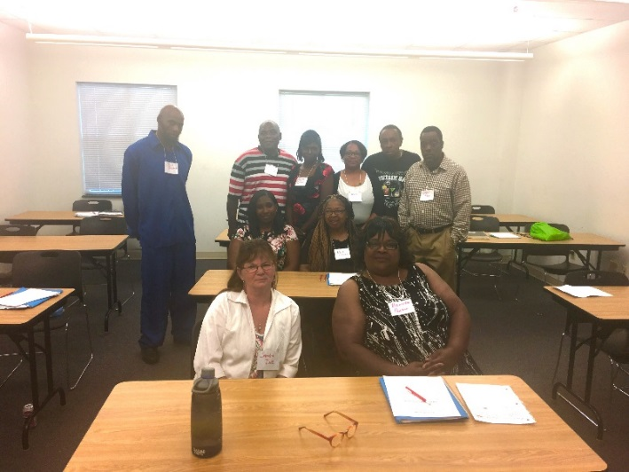
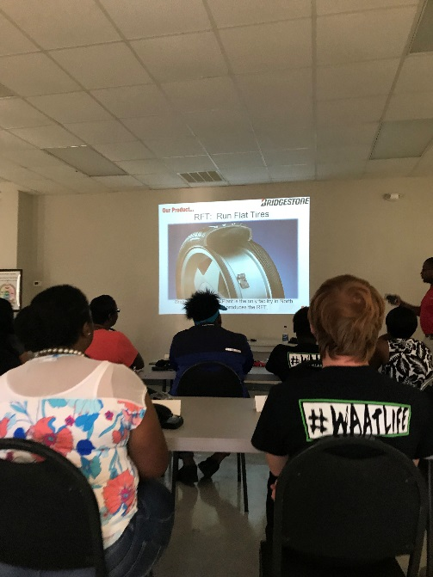
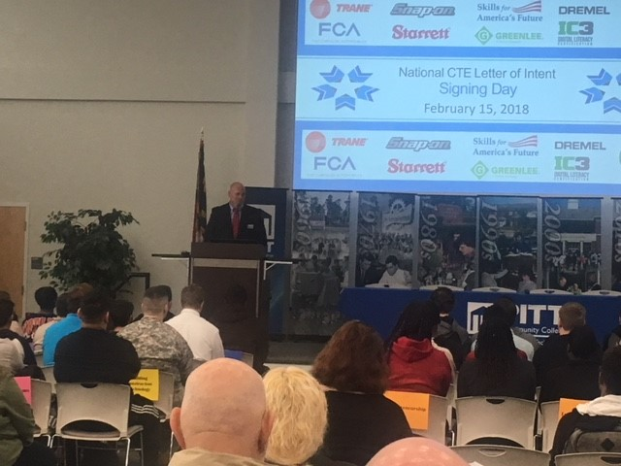
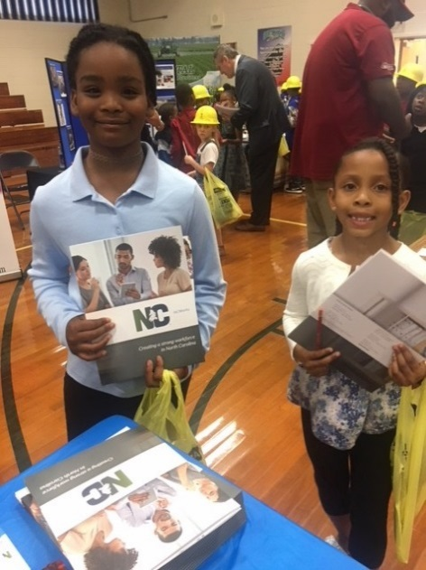
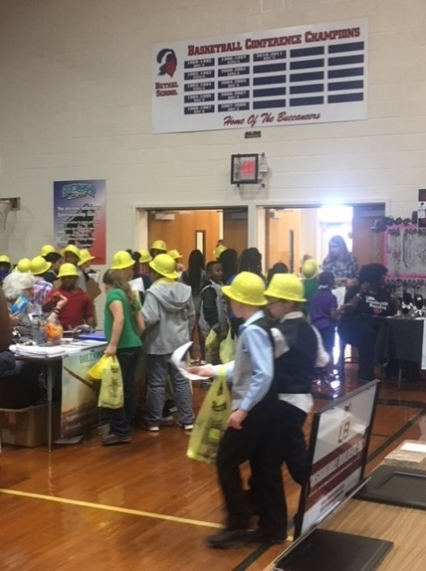
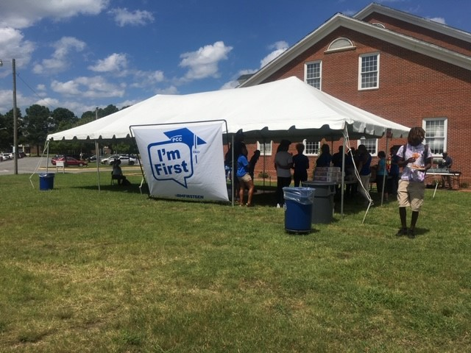

Edgecombe CC Working Smart Grads
CTE Signing Day
Pitt CC
Trio Event
Manufacturing Day - Wilson
Bethel School Career Fair

Slide 23
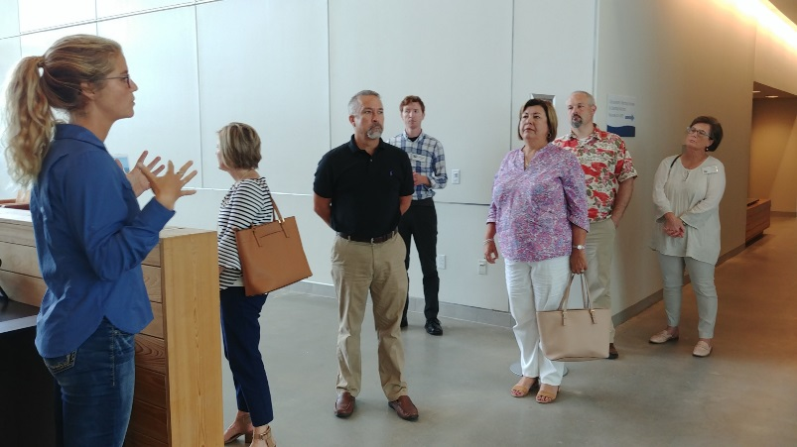

Goals 2018-19
Champions will:
Present Career Pathways info at staff/partner meetings at least quarterly
Attend at least 3 community events to promote & support Career Pathways
Identify at least 1 new partner
Participate in Career Pathways Trainings
Assist with developing marketing ideas/materials

Slide 24
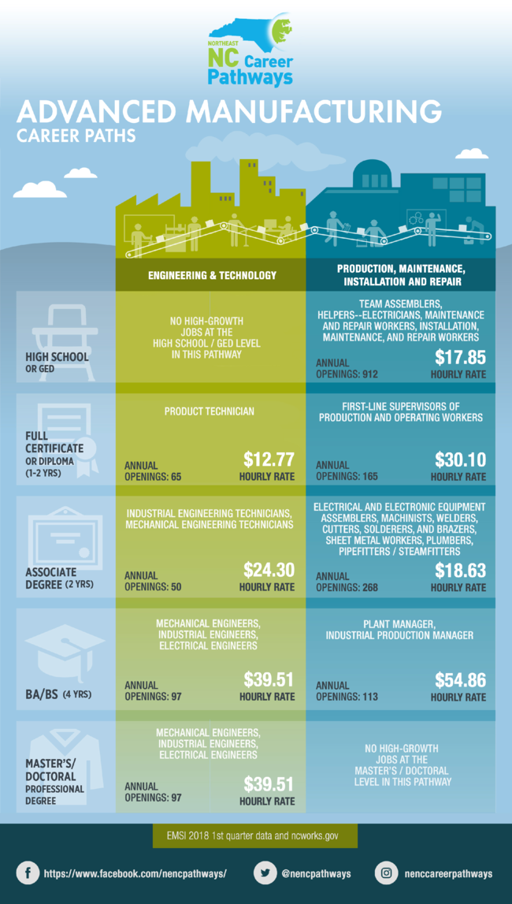
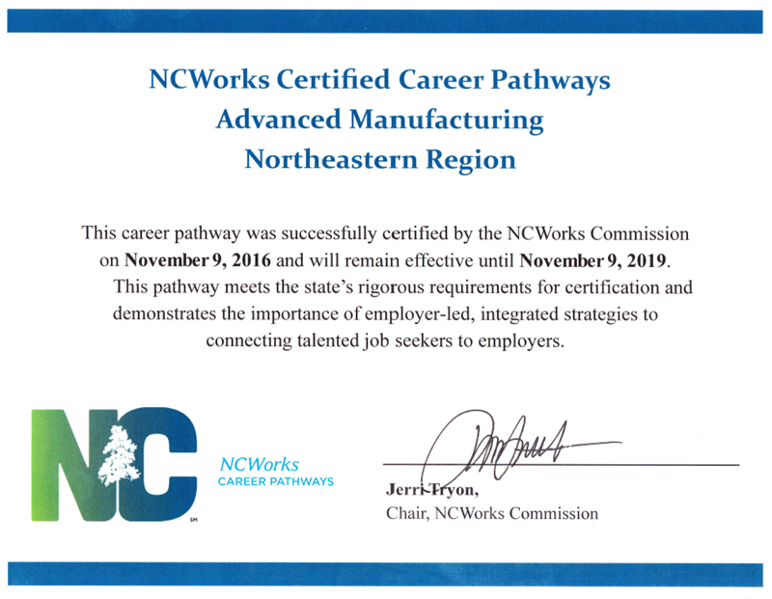
1st Certified Career Pathway in NC
1st to have Two Certified Career Pathways
1st to receive Certification in Business Support Services
Future Pathway: AgriScience & BioTechnology
http://nencpathways.org/

Slide 25
Career Centers & Local Pathway Implementation Certification
NCWorks CCs were not awarded local implementation status as part of the initial implementation process
To remedy that, NCWorks CCs in areas which have already received local implementation status are invited to apply for implementation.
Review team will consult with the WDB Director and NCWorks Regional Operations Director to determine readiness of NCWorks CCs in the local partnership to receive implementation certification.
The following information will be requested / provided:
  1. Provide documentation of local implementation meetings attended by Manager and/or Champion. Document
  input provided during the planning process and/or since the certification.
  2. Document meetings/training provided by manager and/or Champion to staff, specific to pathway.
  3. Provide documentation of collaboration with local implementation partners specific to the pathway.
http://nencpathways.org/2018/09/21/updated-local-implementation-applications/

Slide 26
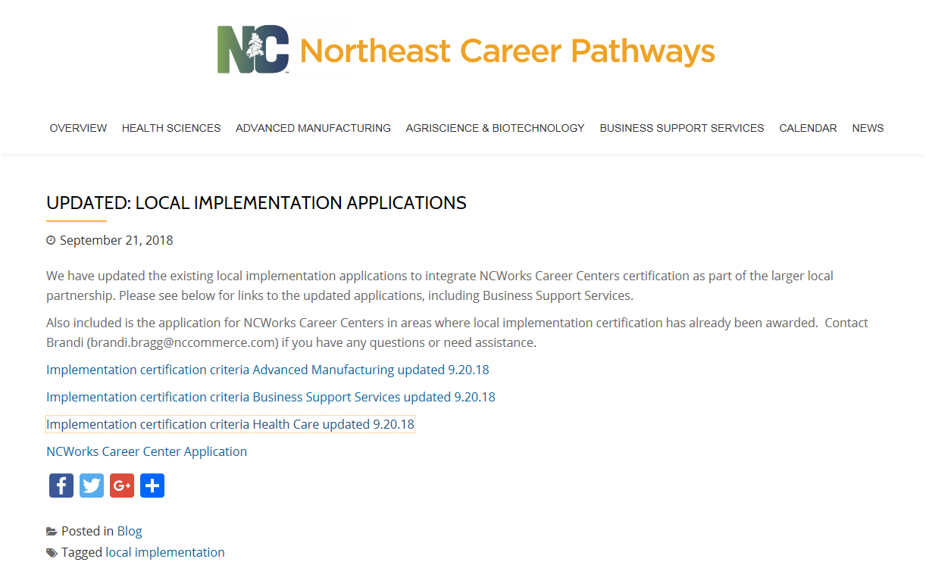

Slide 27

STAKEHOLDER PERSPECTIVE
Emily Nicholson
Assistant Director
Northeastern Workforce Development Board

Slide 28





2018-2019 Projects and Activities
Apply for Certification
3 year recertification
Periodic Review

Slide 29

2018-2019 Projects and Activities
5th Annual Career Guidance Retreat – GADJ “Guidance and Direction for Jobseekers”
Social Media Training – Dec. 10th
Traitify administrator training
Career Ladder Training
Career Pathways training (toolkit)

Slide 30


2018-2019 Projects and Activities

Slide 31
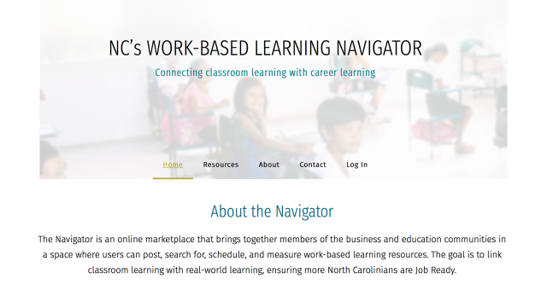
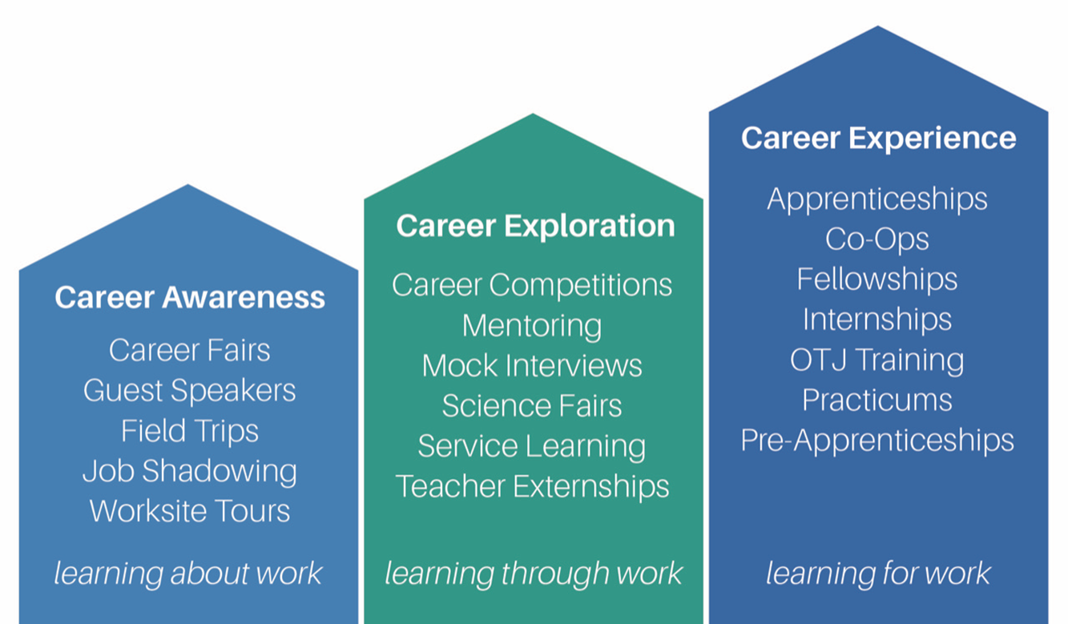
2018-2019 Projects and Activities
www.ncbce.org

Slide 32
Upcoming Events

Slide 33


