Slide 1
College Partnership
June 20, 2018

Slide 2
2017-18 Project Status
Support pathway professional development activities for frontline NCWorks staff and all high school and community college counselors and advisors (Publish Toolkit)
Rollout Traitify assessment and train counselors/career advisors
Develop, distribute and utilize pathway promotional and marketing materials
Collect and publish metrics for the four pathways from LEAs, Community Colleges and WDBs
Continue quarterly meetings with the Northeast Community College Career Pathway Partnership
Employ a full-time pathway facilitator for the Northeast
Submit NCWorks Certification application for Business Support Services Pathway
Support local partnerships in achieving local implementation certification for health care and advanced manufacturing
Support the “Working Smart” soft skills training in community colleges, NCWorks Centers and LEA pilots
Complete the development and activation of new pathway website
Conduct regional periodic review for Agriscience/Biotechnology (Nov. 3, 2017)
Conduct regional periodic review for Advanced Manufacturing (March 8, 2018)

Slide 3
2017-18 Project Status
Submit NCWorks Certification application for Agriscience/Biotechnology Pathway
Formalize a job-alike partnership for advisors/counselors/faculty working with adults and non-traditional students (Center Pathway Champions, Community College Adult/Non-Traditional Faculty and Voc. Rehab representatives) e.g. Northeast Non-traditional Career Pathways Collaborative (NTPathways Collaborative)
Develop local implementation certification for Business Support Services and Agriscience/Biotechnology once those pathways are NCWorks certified

Slide 4
M A R K E T I N G

Slide 5
NCETA 2018

Slide 6
Co-Admission Agreement with ECU
Beaufort CCC
College of the Albemarle
Halifax CC
Martin CC
Nash CC
Pitt CC
Roanoke-Chowan CC
Wilson CC

Slide 7
“Working Smart” graduates – partnership with Nash-Edgecombe NCWorks Center and Edgecombe Community College

Slide 8
Transportation Roundtable at Beaufort County Community College

Slide 9
Robotics
Foods
Cosmetology
Health Science
Criminal Justice
Entrepreneurship
Automotive

Slide 10
Luggage
Shampoo & Conditioner
Toothbrush/toothpaste
Bar soap/liquid soap
Disposable razors/shaving cream
Q-tips
Body Lotion
Band-Aids
Combs/hairbrushes
Sunscreen
Toiletry bags
Feminine hygiene products
Nail Clippers/Tweezers
Tissues/Kleenex
Small sewing kit
Makeup remover
Through
FRIDAY
JUNE 30

Slide 11
Add a Slide Title - 3

Slide 12
Dr. Elizabeth Standafer
Youth Apprenticeship Coordinator
ApprenticeshipNC
North Carolina Community College System

Slide 14
2018 North Carolina Employer Needs Study and other LEAD Products Northeast Career Pathways College Partnership Meeting June 20, 2018
Steven Pennington
Labor & Economic Analysis Division
NC Department of Commerce

Slide 15
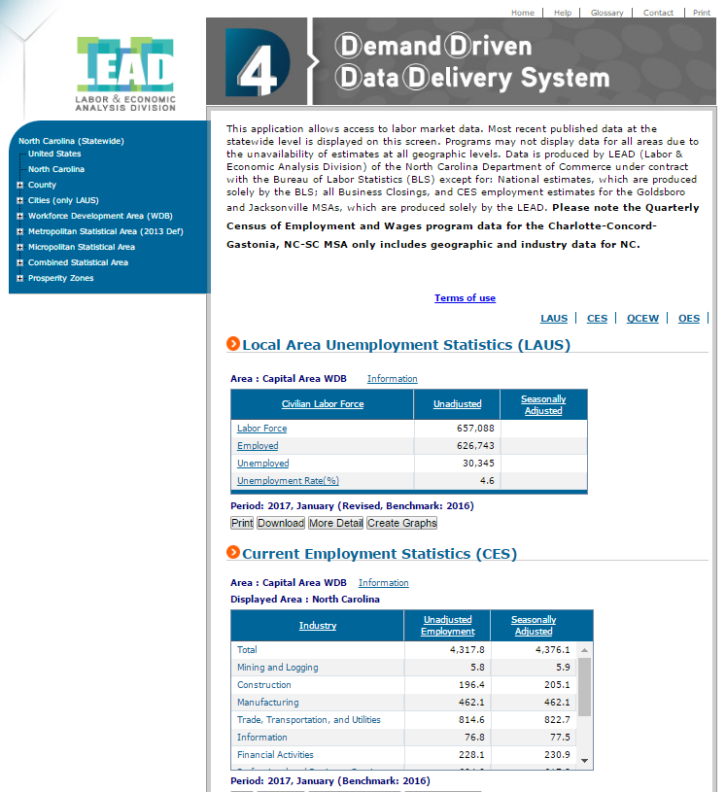
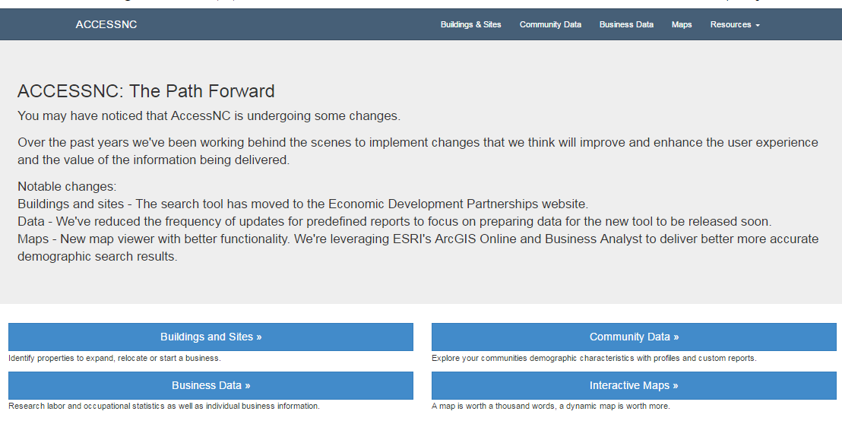
Current LEAD Data Tools
D4 originally designed for labor market customers (ESC)
AccessNC originally designed for economic developers (NC Commerce)

Slide 16
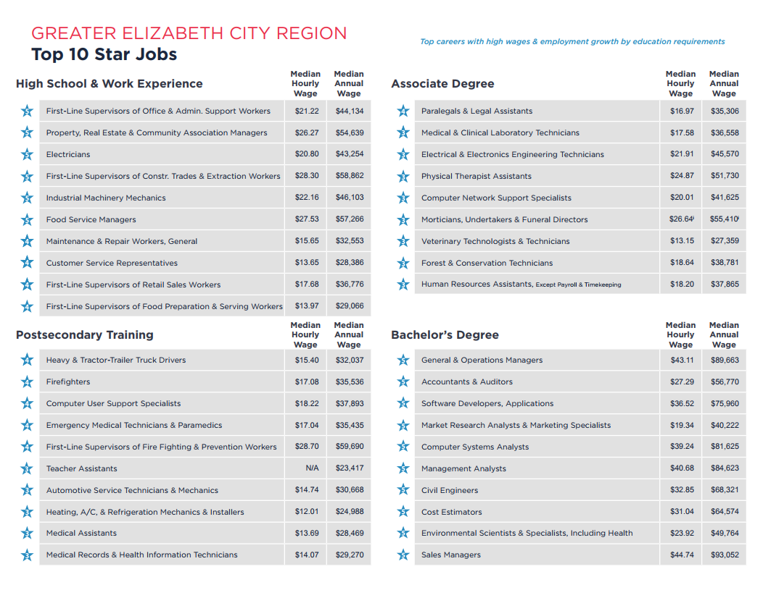
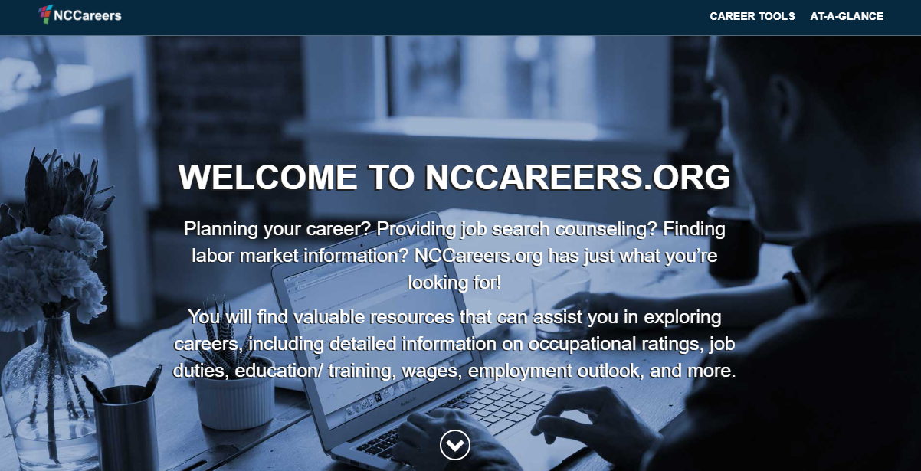
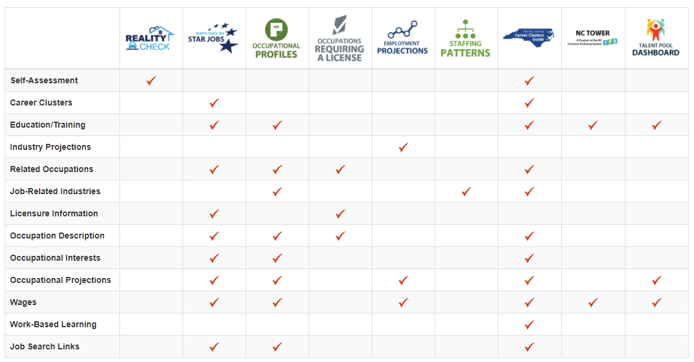
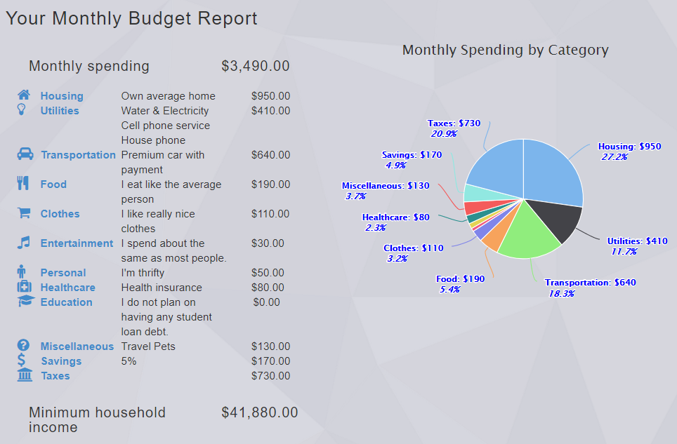
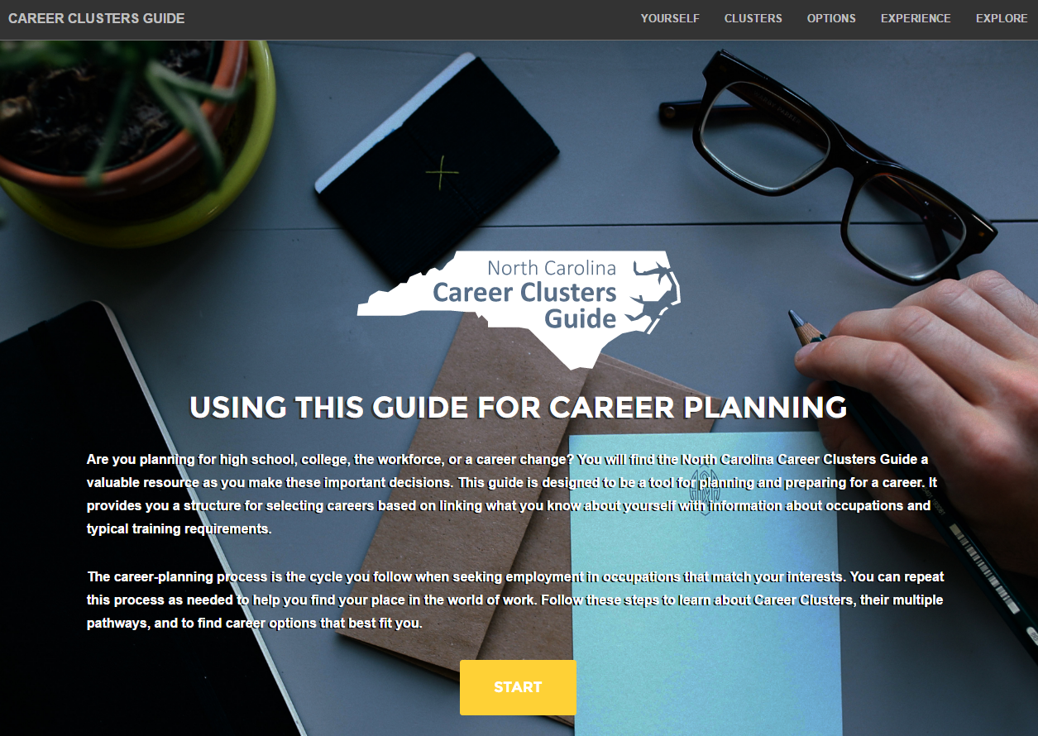
Data Tools
North Carolina Career Information Portal
Industry & Occupation Projections
2017 Star Jobs
Reality Check
Career Clusters Guide
Labor Supply-Demand Dashboard
coming soon…

Slide 17
New Data & Research
2018
Employer Needs Survey

Slide 18
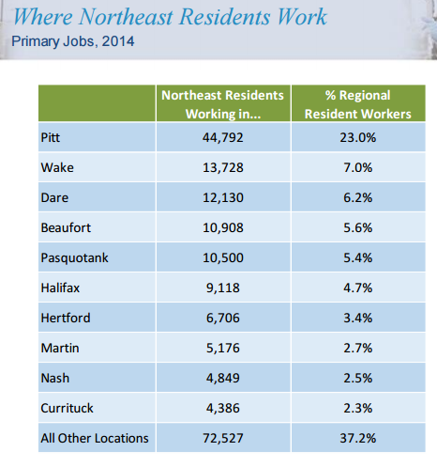
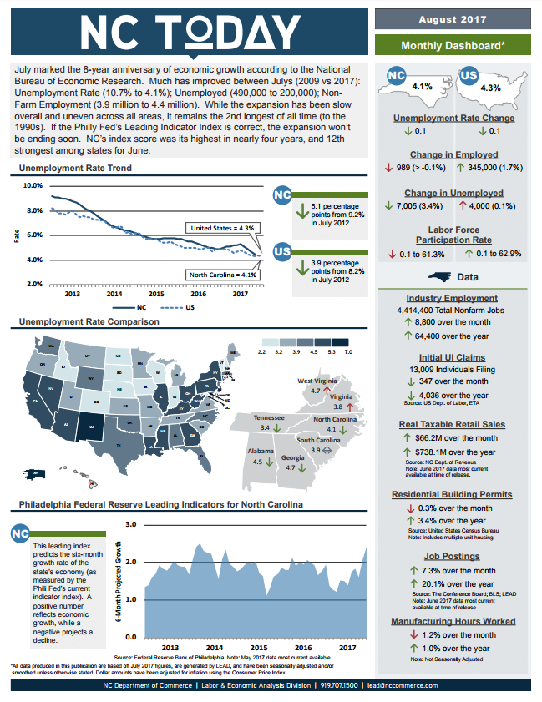
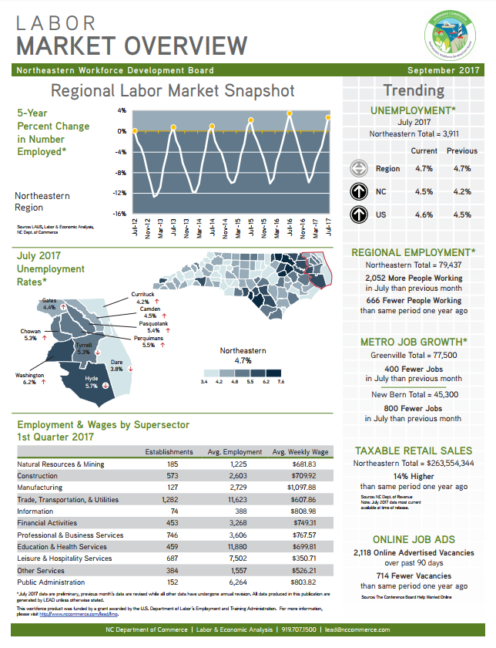
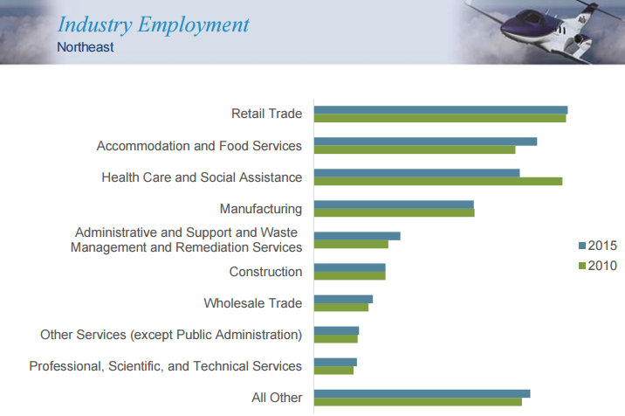
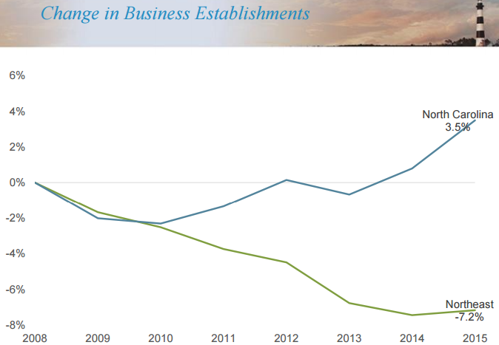
Publications

Slide 19
About the Employer Needs Survey
Sponsored by NCWorks Commission
Phone survey administered by NCSU’s Center for Urban Affairs & Community Services
3rd Biennial Survey since 2014
Representative sample of all NC employers with 10+ employees
Additional sample of businesses in Manufacturing & STEM
Nearly 2,000 completed surveys (Oct-Nov, 2017), responses from all 100 counties
New in 2018
Geographic analysis
Examination by position seniority
Adjusted questions on training needs / behavior

Slide 20
Needs In Context How has NC’s Economy Changed in 5 Years?
400,000 more Jobs, 200,000 fewer Unemployed Nov 2012 – Nov 2018
360,000+ Service Jobs, 64,000 Goods Producing Jobs
Nov 2012 – Nov 2017
Sources: NC Commerce, LEAD, LAUS (unemployed) & CES (jobs)

Slide 21
Employers with Hiring Difficulties
All Employers
Percent of Employers Attempting to Hire
In past 12 months
44.6%
More Difficulty in 2018 Study
38.5%
Half of NC Employers Who Attempted to Hire had Some Difficulty
49.6%

Slide 22
Manufacturers with Hiring Difficulties
All Manufacturers
Percent of Manufacturers Attempting to Hire
In past 12 months
45.3%
More Difficulty in 2018 Study
45.9%
Over Half of NC Manufacturers Who Attempted to Hire had Some Difficulty
57.6%

Slide 23
STEM Employers with Hiring Difficulties
All STEM Employers

Slide 24
STEM Employers with Hiring Difficulties
Percent of STEM Employers Attempting to Hire
in past 12 months

Slide 25
STEM Employers with Hiring Difficulties
Percent of STEM Employers Attempting to Hire
in past 12 months
45.3%
More Difficulty in 2018 Study
45.9%
Over Half of NC STEM Employers Who Attempted to Hire had Some Difficulty
57.6%

Slide 26
Difficulty by Geography

Slide 27
Difficulty by Geography
In 2018, Employer Needs Survey stratified by Metropolitan Statistical Area designations
Charlotte and Triangle Metropolitan Counties
All other Metropolitan Counties
Micropolitan Counties
Non-metro Counties
The Northeast Prosperity Zone includes:
Three metropolitan counties: Currituck, Gates, Pitt
Eight micropolitan counties: Beaufort, Camden, Dare, Halifax, Northampton, Pasquotank, Perquimans, Tyrrell
Six non-metro counties: Bertie, Chowan, Hertford, Hyde, Martin, Washington

Slide 28
Job Growth Since 2007 NC vs US
Statewide Total
4.8%
Source: NC Commerce, LEAD, QCEW

Slide 29
Large Metros
Job Growth Since 2007
Charlotte & Triangle MSAs vs
U.S. Large Metro Average (1+ million people)
6.6%
Source: NC Commerce, LEAD, QCEW

Slide 30
Small & Mid-Size Metros
(all other MSA counties)
Job Growth Since 2007
NC’s Other MSAs vs
U.S. Small/Mid-Size Metro Average (<1 million people)
2.8%
Source: NC Commerce, LEAD, QCEW

Slide 31
Micropolitan Counties
(small cities/large towns)
Job Growth Since 2007
NC’s Micropolitan Counties vs
U.S. Micropolitan Average
-1.7%
Source: NC Commerce, LEAD, QCEW

Slide 32
Non-Metro,
Rural Counties
Job Growth Since 2007
NC’s Non-Metro, Rural Counties vs
U.S. Non-Metro Average
-3.1%
Source: NC Commerce, LEAD, QCEW

Slide 33
Employer Difficulty by Region
North
Carolina
Charlotte & Triangle
Other MSAs
Micros
Rural

Slide 34
Difficulty by Experience Level
Entry-Level Positions = 1 year experience or less
Mid-Level = 2-4 years of experience
Senior = 5 years or more experience
Overall, all industries

Slide 35
Difficulty by Experience Level
Entry-Level Positions = 1 year experience or less
Mid-Level = 2-4 years of experience
Senior = 5 years or more experience
Overall, all industries
Manufacturers

Slide 36
Difficulty by Experience Level
Entry-Level Positions = 1 year experience or less
Mid-Level = 2-4 years of experience
Senior = 5 years or more experience
Overall, all industries
Manufacturers
STEM Employers

Slide 37
Reasons for Hiring Difficulty
Notes:
Work Experience and Technical Skills were more important for mid and senior-level positions. Employability is the biggest issue among hiring for entry-level positions. Talk about Criminal Records and Drug Screenings higher for entry and manufacturers. Manufacturing and STEM were similar to one another, but technical skills and education were more important for both compared to the overall population.

Slide 38
Reasons for Hiring Difficulty (Manufacturers)
Notes:
Work Experience and Technical Skills were more important for mid and senior-level positions. Employability is the biggest issue among hiring for entry-level positions. Talk about Criminal Records and Drug Screenings higher for entry and manufacturers. Manufacturing and STEM were similar to one another, but technical skills and education were more important for both compared to the overall population.

Slide 39
Reasons for Hiring Difficulty (STEM Employers)
Notes:
Work Experience and Technical Skills were more important for mid and senior-level positions. Employability is the biggest issue among hiring for entry-level positions. Talk about Criminal Records and Drug Screenings higher for entry and manufacturers. Manufacturing and STEM were similar to one another, but technical skills and education were more important for both compared to the overall population.

Slide 40
Employers’ Greatest Workforce Challenge
Overall, all industries:
Finding Job Candidates: 36%
Turnover: 36%
Staff Dvlpmnt/Training: 10%
Hiring: 6%
Promotion & Advancement: 3%

Slide 41
Employers’ Greatest Workforce Challenge
Overall, all industries:
Finding Job Candidates: 36%
Turnover: 36%
Staff Dvlpmnt/Training: 10%
Hiring: 6%
Promotion & Advancement: 3%
Manufacturers:
Finding Job Candidates: 55%
Turnover: 20%
Staff Dvlpmnt/Training: 9%
Hiring: 6%
Promotion & Advancement: 2%

Slide 42
Employers’ Greatest Workforce Challenge
Overall, all industries:
Finding Job Candidates: 36%
Turnover: 36%
Staff Dvlpmnt/Training: 10%
Hiring: 6%
Promotion & Advancement: 3%
Manufacturers:
Finding Job Candidates: 55%
Turnover: 20%
Staff Dvlpmnt/Training: 9%
Hiring: 6%
Promotion & Advancement: 2%
STEM Employers:
Finding Job Candidates: 56%
Turnover: 17%
Staff Dvlpmnt/Training: 10%
Hiring: 7%
Promotion & Advancement: 4%

Slide 43
Sources of Recruitment
All more frequently used than in ‘16 study

Slide 44
Sources of Recruitment
All more frequently used than in ‘16 study
Internet Job Sites, Company Job Boards, & Social Media up 20 pts or more from ‘16

Slide 45
Sources of Recruitment
All more frequently used than in ‘16 study
Internet Job Sites, Company Job Boards, & Social Media up 20 pts or more from ‘16
Greater use of NCWorks Online in Rural areas (38%), Lower use in Charlotte/Triangle (20%)
Higher for Manufacturers
43%

Slide 46
Sources of Recruitment
All more frequently used than in ‘16 study
Internet Job Sites, Company Job Boards, & Social Media up 20 pts or more from ‘16
Greater use of NCWorks Online in Rural areas (38%), Lower use in Charlotte/Triangle (20%)
Higher use of Newspapers in Rural areas (42%), Lower use in Charlotte/Triangle (15%)

Slide 47
Sources of Recruitment
All more frequently used than in ‘16 study
Internet Job Sites, Company Job Boards, & Social Media up 20 pts or more from ‘16
Greater use of NCWorks Online in Rural areas (38%), Lower use in Charlotte/Triangle (20%)
Higher use of Newspapers in Rural areas (42%), Lower use in Charlotte/Triangle (15%)
Agencies used more in Charlotte/Triangle (27%), Less in Rural (12%)
Higher for Manufacturers
53%

Slide 48
Sources of Recruitment
All more frequently used than in ‘16 study
Internet Job Sites, Company Job Boards, & Social Media up significantly from ‘16
Greater use of NCWorks Online in Rural areas (38%), Lower use in Charlotte/Triangle (20%)
Higher use of Newspapers in Rural areas (42%), Lower use in Charlotte/Triangle (15%)
Agencies used more in Charlotte/Triangle (27%), Less in Rural (12%)
Lower Career Center use in Charlotte/Triangle (10%), More in Micropolitans (24%) & Rural (23%)
Higher among Manufacturers
25%

Slide 49
Employers’ Responses to Challenges
Majority increase Trainings (60%), revise Pay Scales & Benefits (51% all, 59% manufacturers)
Majority increase Trainings (60%), revise Pay Scales & Benefits (51% all, 59% manufacturers)
Median 20 total hours per year
40% use private trainers/vendors
19% use NC Community Colleges
25% of Manufacturers
11% use Universities
6% use NCWorks Career Centers

Slide 50
Employers’ Responses to Challenges
Majority increase Trainings (60%), revise Pay Scales & Benefits (51% all, 59% manufacturers)
½ of Manufacturers use Temp Services vs ¼ of all employers
28% automate functions
39% of Manufacturers
A few turn down business as result of challenges (11%)
28% use workforce system resources (NCWorks, NCCCS, WDBs ,etc.)
41% of Manufacturers

Slide 51
Why Employers Don’t Use NC’s Workforce System Resources Career Centers, Workforce Boards, NCWorks Online, Community Colleges
Lower
Awareness
in
Rural Areas
60% unaware
Lower Service Mismatch
in
Rural
Areas
26% say don’t
mismatch

Slide 52
Employment Outlook for 2018
43% expect to Add Jobs at their site
Only 24% of Rural establishments expect to Add
74% expect to Remain the Same in Rural
53% of STEM Employers expect to hire

Slide 53
Takeaways
More employers claimed difficulty than 2016 study
Higher for Manufacturers
Tight labor market & structural economic changes are likely at least partially to blame
Some limit to job growth (outsourcing & automation substitution)
A few forego business opportunities due to hiring difficulties
Hiring Difficulties highest in mid-size Metro Areas (not Charlotte & Triangle)
Difference in reasons for difficulty vary by position seniority
Employability/Personal Issues high – particularly for Entry-level positions
Lack of Relevant Experience high for Mid- & Senior Positions
Employers are broadly expanding recruiting efforts to find talent
Opportunities exist for Workforce System to better market & match services
Employers bullish on adding jobs in 2018

Slide 54
Questions?
Steven Pennington
steven.pennington@nccommerce.com

Slide 55
DISCUSSION
Orienting faculty/staff (new and old) to Pathways
Input on projects being considered for 2018-19
Confirming 2018-2019 CC/University Contacts
Confirming College Training offerings
Dates for college partnership meetings for 2018-19
Discuss metrics collection processes for 2018-19
Discuss local implementation certification

Slide 56
2018-19 Potential Projects
Submit NCWorks Certification application for Agriscience/Biotechnology Pathway
Support local partnerships in achieving local implementation certification for health care, advanced manufacturing and business support services
Support the “Working Smart” soft skills training in community colleges, NCWorks Centers and LEA pilots
Maintain pathway website and social media
Conduct regional periodic review for Health Care (September 2018)
Conduct regional periodic review for Ag/Biotech (May 2019)
Develop plan for including non-traditional partners within pathways partnership
Support pathway professional development activities for frontline NCWorks staff and all high school and community college counselors and advisors

Slide 57
2018-19 Potential Projects
Support training and use of Traitify assessment for counselors/career advisors
Develop, distribute and utilize pathway promotional and marketing materials
Collect and publish metrics for the four pathways from LEAs, Community Colleges, WDBs and NCWorks Career Centers
Develop plan for local saturation of pathways work
Conduct annual training for counselors from K12, Colleges and NCWorks (include community partners)
Support NCWorks Centers Local Implementation Certification process
Continue NCWorks Champions meetings 3-4 times per year
Develop local implementation certification for Business Support Services and Agriscience/Biotechnology once those pathways are NCWorks certified
Continue quarterly meetings with the Northeast Community College Career Pathway Partnership

Slide 58
DISCUSSION
Orienting faculty/staff (new and old) to Pathways
Input on projects being considered for 2018-19
Confirming 2018-2019 CC/University Contacts
Confirming College Training offerings
Dates for college partnership meetings for 2018-19
Discuss metrics collection processes for 2018-19
Discuss local implementation certification

